Slide 1
SUBSTANCE USE DISORDERS
Shahed Alqatawneh
Abedalsalam Albshabsheh

Slide 2
Definition :
A chronic condition in which an uncontrolled pattern of substance use leads to significant physical , psychological, and social impairment or distress, with continued use despite substance-related problems.
Epidemiology :
Sex: ♂ > ♀
Alcohol and nicotine use are most common.
In Jordan : Nicotine is the MC type .
One-year prevalence of any substance use disorder in the United States is approximately 8%.

Slide 3
Characteristics :
Features that are typical for all substance use disorders (≥ 2 features must occur within 1 year to fulfill the DSM-V criteria)
Impaired control
1- Using a substance in larger amounts and/or for a longer time than originally intended.
2- Repeated failed attempts to cut down on use.
3- A great deal of time spent on substance-related activities (e.g., seeking out , buying, using , recovering from use)
4- Intense desire to obtain and use substance (craving).
Social impairment
١(Problems fulfilling work , school , family, or social obligations (e.g., not attending work or school, neglecting children or partner).
2) Problems with interpersonal relationships directly related to substance use (withdrawal from relationships, marital issues).
3) Reduced social, occupational, and recreational activities (e.g., less time socializing with friends, neglecting hobbies).

Slide 4
Risky use
***Use in physically hazardous situations (e.g., driving a car under the influence, operating heavy machinery).
***Continued use despite awareness of problems related to or exacerbated by substance use (e.g., continued alcohol use despite having cirrhosis).
Pharmacologic indicators
# Drug tolerance : the need to continuously increase the dose of a substance to achieve the same desired effect .
# Drug withdrawal : a substance-dependent collection of symptoms that appear after cessation of prolonged heavy drug use accompanied by a strong urge to readminister the substance.
NOTES :
Often , withdrawal symptoms are the opposite of intoxication effects , Ex:
Heroin intoxication causes sedation and constipation ,whereas heroin withdrawal causes anxiety , insomnia, and diarrhea .
Alcohol is sedating, but alcohol withdrawal can cause brain excitation and seizures.
Withdrawal from some substances, such as alcohol, benzodiazepines, and barbiturates can be fatal !

Slide 5
Important definitions :
Intoxication: a temporary condition caused by recent ingestion of a substance that alters a person's consciousness, cognition ,perception, judgment, affect, and/or behavior; commonly occurs in substance use disorders but also in one-off use
Withdrawal: a condition characterized by behavioral, physiological, and cognitive changes caused by a sudden reduction or cessation of substance intake after a prolonged period of heavy intake; usually occurs in association with substance use disorders
Tolerance : the need to continuously increase the dose of a substance to achieve the same desired effect
Addiction : the repeated and increased use of a substance, which gives rise to symptoms of distress and irresistible urge to use the agent again which leads to physical and mental deterioration (refers to the inability to control the use of drugs or alcohol )

Slide 6
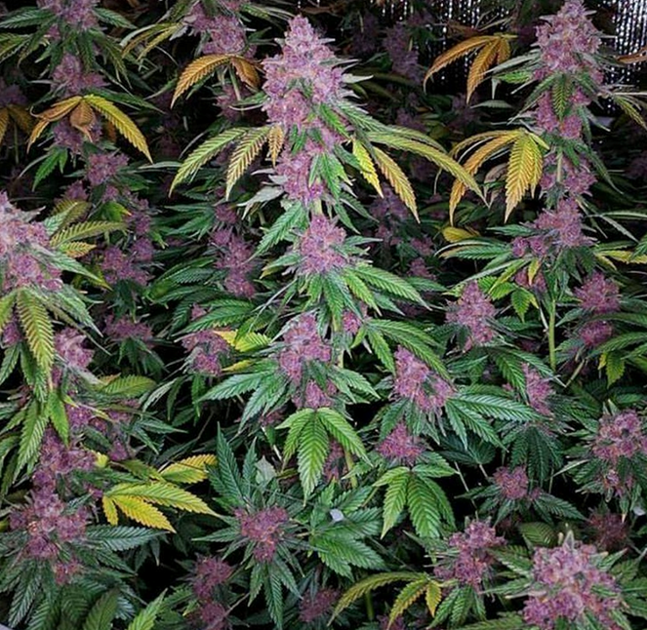
Types of substances
Depressants:
●Alcohol
● Barbiturates
● Benzodiazepines
● Opioids
●Inhalants
Stimulants:
●Amphetamines
●Caffeine
●Cocaine
●Nicotine
Hallucinogens:
Lysergic acid diethylamide
Cannabis
MDMA
Phencyclidine

Slide 7
ETIOLOGY
It is the result of multiple interacting factors influence drug-using behavior and the loss of judgment with respect to decisions about using a given drug.
Drug availability , social acceptability, and peer pressures may be the major determinants of initial experimentation with a drug , but other factors , such as personality and individual biology , probably are more important in how the effects of a given drug are perceived.
PSYCHIATRIC SYMPTOMS
Occurs in 40% of patients .
Mood symptoms:
are common among persons with substance use disorders.( e.g., major depression, anxiety disorders) .Psychotic symptoms may occur with some substances.
Personality disorders and psychiatric comorbidities.
It is often challenging to decide whether psychiatric symptoms are primary or substance-induced.

Slide 8
TOBACCO-RELATED DISORDERS
Substance : Nicotine from the tobacco plant (consumed in cigarettes, cigars, pipes, e-cigarettes)
Mechanism of action :
stimulates nicotinic receptors in autonomic ganglia → sympathetic and parasympathetic stimulation
Epidemiology:
Approx. 13% of adults in the US smoke cigarettes.
Most prevalent cause of preventable morbidity and mortality in the US.
Clinical features :
Tobacco intoxication
Euphoria
Tachycardia , mild HTN , weight loss
Restlessness , anxiety
Increased gastrointestinal motility
Insomnia

Slide 9
Tobacco Withdrawal
Dysphoria , depressed mood.
Irritability , frustration, anger , restlessness, anxiety.
Insomnia
Impaired concentration
Increased appetite, weight gain
Assessment:
Smoking history is measured in pack years, which is used to quantify a person's lifetime exposure to tobacco.
The number of cigarette packs (20 cigarettes) that a person smokes per day multiplied by the number of years of cigarette consumption, e.g., (1 pack/day) x (10 years smoking history) = 10 pack years.
Treatment :
Counseling and support
Varenicline (partial nicotine receptor agonist ) : reduces positive symptoms and prevents withdrawal.
Bupropion : reduces craving and withdrawal symptoms
Nicotine replacement therapy (inhaler, lozenges, transdermal patch, nasal spray, gum).
Complications :
COPD
Cardiovascular disease
Cancer (e.g., lung cancer)

Slide 10
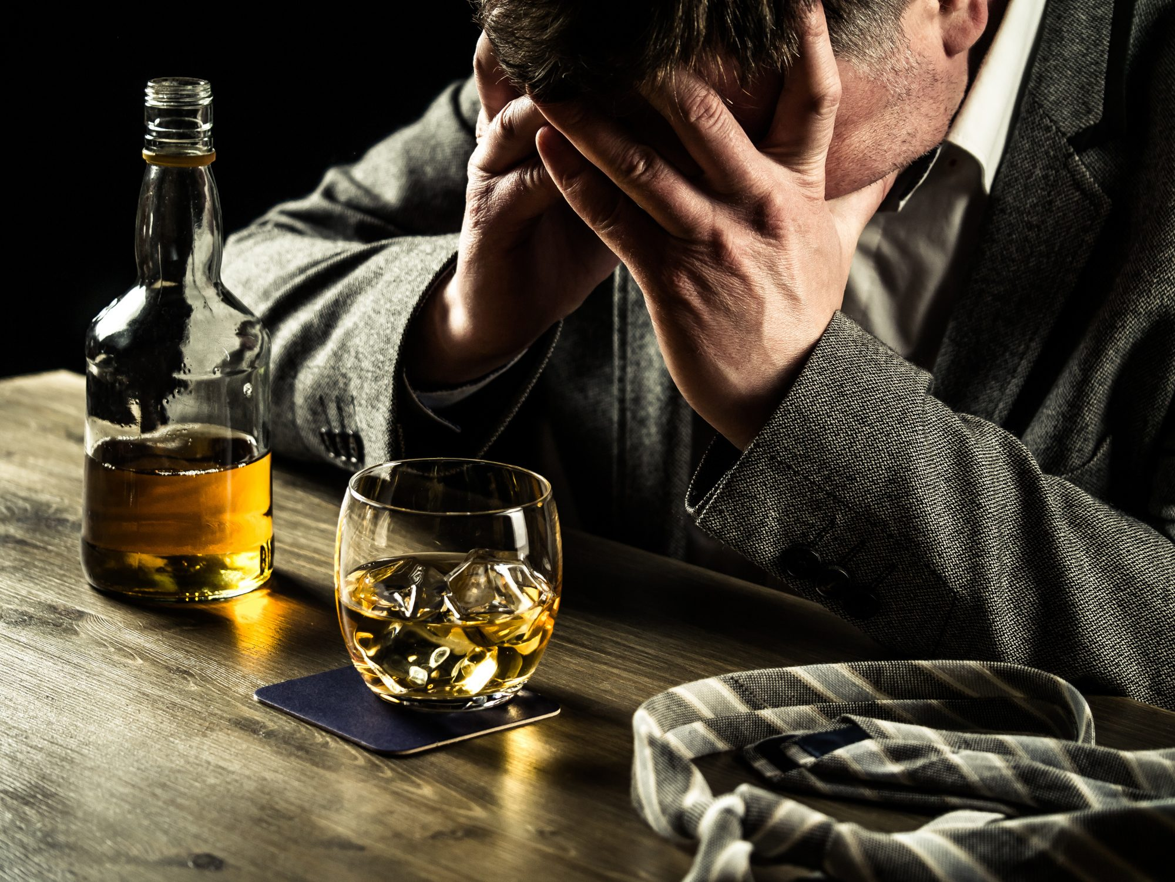
ALCOHOL
Alcohol is a central nervous system depressant. It can change your mood, behavior, and self-control. It can cause problems with memory and thinking clearly.
Alcohol can also affect your coordination and physical control.
Alcohol activates gamma-aminobutyric acid (GABA), dopamine, and serotonin receptors in the central nervous system (CNS).
Thus, alcohol abuse can produce serious temporary psychological symptoms including depression, anxiety, and psychoses.
On Long-term, escalating levels of alcohol consumption can produce tolerance as well as adaptation of the body that cessation of use can precipitate a withdrawal syndrome.

Slide 11
Alcohol Intoxication
Alcohol intoxication (also called simple drunkenness) according to DSM-5 diagnostic criteria are based on evidence of recent ingestion of ethanol, maladaptive behavior, and at least one of several possible physiological correlates of intoxication.
Signs of Alcohol Intoxication
1. Slurred speech
2. Dizziness
3. incoordination
4. Unsteady gait
5. Nystagmus
6. Impairment in attention or memory
7. Stupor or coma
8. Double vision
about 40% of those with alcohol abuse or alcohol dependence meet the criteria for major depressive disorder

Slide 12
Treatment:
Perform an ABCDE survey to assess hemodynamic and respiratory stability
Check vital signs and glucose ; treat hypoglycemia if present.
Administer naloxone for opioid overdose if co-ingestion is suspected.
Provide supporitive care when appropriate Ex:
Management of dehydration and hypovolemia .
Respiratory support.
Prophylactic dose of thiamine supplementation (for Wernicke’s encephalopathy ).
Electrolytes repletion .
Gastrointestinal evacuation (e.g., gastric lavage, induction of emesis, and charcoal) is not indicated in the treatment of EtOH overdose unless a significant amount of EtOH was ingested within the preceding 30–60 minutes ( rapid absorption of alcohol ).
A computed tomography (CT) scan of the head may be necessary to rule out subdural hematoma or other brain injury.
Severely intoxicated patients may require mechanical ventilation with attention to acid–base balance, temperature, and electrolytes while they are recovering

Slide 13
Long term complications of chronic alcohol use :
Wernicke’s encephalopathy ( acute , reversible )
Korsakoff syndrome ( chronic , irreversible )
Alcohol leads to decreased levels of thiamine levels in various ways :
1- alcohol interferes with conversion of thiamine to its active form .
2- prevents thiamine absorption .
3- chronic alcohol use can lead to fatty liver which interferes with the storage of thiamine within the liver .

Slide 14
Wernicke’s encephalopathy
It is an acute, reversible condition caused by severe thiamine (vit B1) deficiency , often due to chronic heavy alcohol use . Inadequate intake, impaired absorption, or increased excretion of thiamine can also cause Wernicke’s encephalopathy.
The classical triad of ( seen in about a third of patients) :
1- confusion
2- oculomotor dysfunction (vertical nystagmus is the most common), diplopia .
3- Gait ataxia
Other manifestations :
Autonomic dysfunction : hypotension, syncope, hypothermia .
peripheral neuropathy: parasthesia, foot drop, decreased DTR.
Cardiovascular dysfunction: tachycardia, exertional dyspnea.

Slide 15
Treatment:
Immediate IV administration of high-dose Vit B1 upon suspicion of Wernicke’s encephalopathy until symptoms recede , followed by a lower dose .
Thiamine must be administered before IV glucose infusions because glucose administration without thiamine can worsen encephalopathy ( thiamine is a necessary cofactor for glucose metabolism ).
Long-term oral replacement of Vit B1, Vit B6 , Vit B 12 , and folic acid (Vit B complex) .

Slide 16
Korsakoff syndrome
It is a late development in patients with persistent Vit B1 deficiency .
Chronic thiamine difeciency , especially in patients with alcohol use disorder, frequently progresses to Korsakoff syndrome , which is characterized by :
1- irreversible personality changes , apathy , indifference.
2- Anterograde and retrograde amnesia , (anterograde is more common than retrograde) .
3- Confabulation , Patients create fabricated memories to fill in the gaps of their memory.
Other manifestations :
Disorientation to time, place, and person.
Hallucination.
Treatment :
Oral thiamine supplementation to prevent further progression to irreversible complications.
Psychiatric and psychological therapy.
Memory strengthening exercises and aids.

Slide 17
Alcohol Withdrawal
The DSM-5 criteria for alcohol withdrawal require the cessation or reduction of alcohol use that was heavy and prolonged as well as the presence of specific physical or neuropsychiatric symptoms
The classic sign of alcohol withdrawal is :
Tremors , although the spectrum of symptoms can expand to include psychotic and perceptual symptoms (e.g., delusions and hallucinations), seizures, and the symptoms of delirium tremens

Slide 18
Clinical Presentation of alcohol withdrawal syndrome
Alcohol withdrawal symptoms usually begin in 6–24 hours after the last drink and last 2–7 days, in the following order
Mild : Irritability, tremor, insomnia
Moderate : autonomic hyperactivity (Diaphoresis, hypertension, tachycardia, fever, disorientation).
Severe : Tonic-clonic seizures, hallucinations, DTs

Slide 19
Delirium Tremens
It is the most severe form of ethanol withdrawal , and it is a medical emergency that can result in significant morbidity and mortality.
Occurs in 5% of patients .
Clinical features :
Altered mental status (confusion)
Autonomic hyperactivity (such as tachycardia, diaphoresis, fever, anxiety, insomnia, and hypertension )
Perceptual distortions, most frequently visual or tactile hallucinations , and fluctuating levels of psychomotor activity, ranging from hyper excitability to lethargy.
Onset : usually 72–96 hours after cessation of or reduction in alcohol consumption
Peak : 2-5 days .

Slide 20
Patients with delirium are a danger to themselves and to others, Because of the unpredictability of their behavior, patients may be assaultive or suicidal or may have hallucinations or delusional thoughts .
Untreated DTs has a mortality rate of 20%.

Slide 21
Treatment of alcohol withdrawal
Minor alcohol withdrawal syndrome may not need pharmacotherapy in all cases. The patient needs supportive care in a calm and quiet environment and low lighting . and observation for a period of up to 36 h, after which he is unlikely to develop withdrawal symptoms
Benzodiazepines are the mainstay of management of alcohol withdrawal states, followed by anticonvulsants, which may be considered in mild withdrawal states due to their advantages of lower sedation and lower chances of dependence .
Moderate to severe alcohol withdrawal syndrome Without seizures or DT , patients should be started immediately pharmacological therapy , while monitoring the clinical signs of tachycardia and hypertension

Slide 22
Severe alcohol withdrawal with seizures, the occurrence of seizures during the alcohol withdrawal period is indicative of severe alcohol withdrawal . Seizure prophylaxis with lorazepam intravenously must be given to all patients with seizures in the current withdrawal period at presentation
Severe alcohol withdrawal with DT , the Treatment is by achieving a calm, but awake state or defined as a sleep from which the patient is easily aroused . done by using intravenous diazepam while closely monitoring the patient during the procedure . Refractory DT can be managed with phenobarbital or adjuvant antipsychotics .
Detoxification is the process of weaning a person from a psychoactive substance by gradually tapering the substance or by substituting it with a cross-tolerant pharmacological agent and tapering it.
Rehabilitation for alcoholism is recommended.

Slide 23
Alcohol Withdrawal
First-line treatments
Naltrexone :
Opioid receptor antagonist
Reduces desire and the “high” associated with alcohol.
Will precipitate withdrawal in patients with physical opioid dependence.
Acamprosate :
Thought to modulate glutamate transmission.
Use for relapse prevention in patients who have stopped drinking (post-detoxification).
Major advantage is that it can be used in patients with liver disease.
Contraindicated in severe renal disease.
Side effect as diarrhea

Slide 24
Second-line treatments:
Disulfiram :
Blocks the enzyme aldehyde dehydrogenase in the liver, causing aversive reactions to alcohol (flushing, headache, nausea/vomiting, palpitations, shortness of breath) due to catecholamine release
Absolute Contraindication with severe cardiac disease, pregnancy, and psychosis.
Liver function should be monitored.
Best used in highly motivated patients, as medication adherence is an issue.
Topiramate :
Anticonvulsant that potentiates GABA and inhibits glutamate receptors.
Reduces desire for alcohol and decreases alcohol use.

Slide 25
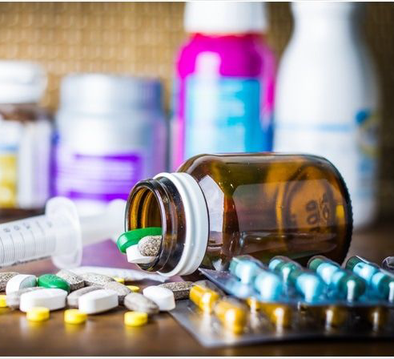
SEDATIVES
Barbiturates
Benzodiazepines
Opioids

Slide 26
Barbiturates
Phenobarbital, pentobarbital
Potentiate the effects of GABA by binding to the receptor and increasing duration of chloride channel opening.
Used in the treatment of epilepsy and as anesthetics
have a lower margin of safety relative to BZDs.
They are synergistic in combination with BZDs ,respiratory depression can occur.
they are physiologically addicting if taken in high doses over 1 month
Overdose: respiratory depression

Slide 27
Barbiturates
Abrupt abstinence after chronic use can be life threatening.
Clinical Presentation :
Signs and symptoms of withdrawal are the same as these of alcohol withdrawal.
Tonic-clonic seizures may occur and can be life threatening.
Treatment :
Benzodiazepines (stabilize patient, then taper gradually).

Slide 28
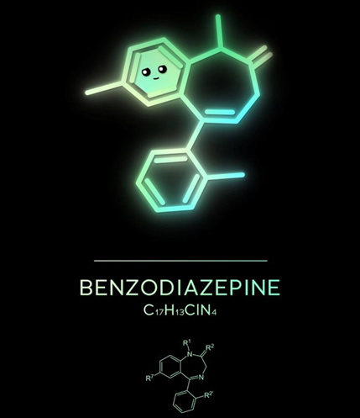
Benzodiazepines
Diazepam, oxazepam, lorazepam
Medical uses (anxiety, alcohol and barbiturates withdrawal)
Classic overdose presentation:
CNS depression with normal vitals
Altered mental status
Slurred speech
Ataxia
Rarely cause respiratory depression (safer drugs)

Slide 29
Benzodiazepine Withdrawal
Occurs with abrupt cessation in chronic user .
Timing depends on drug Long-acting BZD →longer washout
Presentation:
Tremors
Anxiety
Depressed mood (“dysphoria”)
Hypersensitivity to sensations (noise, touch)
Psychosis
Seizures

Slide 30
Flumazenil
Antagonist of benzodiazepine receptor .
FDA-approved clinical uses for flumazenil include reversal agents for benzodiazepine overdose.
Overdose has low mortality rate.
Flumazenil may cause withdrawal seizures in patients with a history of seizures.

Slide 31
OPIOIDS
Opioid overdose results from the toxic effects of exogenous opioid.
Deaths related to opioid overdose have been steadily increasing in the United States over the past two decades because of a sharp increase in the prescription of opioid for chronic pain and increasing amounts of illegally manufactured fentanyl.
Common clinical features of opioid overdose include :
respiratory depression , CNS depression, and miosis .
Treatment of suspected opioid overdose requires :
Airway management and prompt assessment of the need for naloxone to counter opioid induced respiratory depression, which can be fatal. Inpatient admission is indicated for patients with ongoing respiratory depression , overdose from long-acting opioid , or medical complications from an opioid overdose.
All patients with a noniatrogenic opioid overdose should undergo an assessment for substance use disorder and be discharged with take-home intranasal naloxone .

Slide 33
STIMULANTS
Amphetamines
Cocaine

Slide 34
Amphetamine
Potent stimulant by increasing synaptic levels of the biogenic amines, dopamine, norepinephrine and serotonin.
Amphetamine are FDA-approved for treatment of attention deficit-hyperactivity disorder (ADHD) and narcolepsy .
Symptoms of amphetamine intoxication include :
Euphoria
Dilated pupils
Tachycardia
Chest Pain
Amphetamine withdrawal can cause prolonged depression.
Complications of their long half-life can cause : ongoing psychosis, even during abstinence , so treatment is : sedation and observation with antipsychotics .

Slide 35
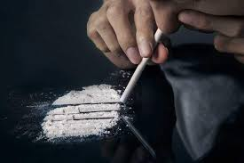
Cocaine
Cocaine blocks the reuptake of dopamine, epinephrine, and norepinephrine from the synaptic cleft, causing its stimulant effect
Overdose can cause : death secondary to cardiac arrhythmia, MI , seizure, or respiratory depression.
Treatment of cocaine use disorder :
There is no (FDA)-approved pharmacotherapy for cocaine use disorder.
Off-label medications are sometimes used as naltrexone .
Psychological interventions are the mainstay of treatment.

Slide 36
Cocaine Withdrawal
Abrupt abstinence is not life threatening.
causes post-intoxication depression .
Occasionally, these patients can become suicidal.
With mild-to-moderate cocaine use, withdrawal symptoms resolve within 72 hours; with heavy, chronic use, they may last for 1–2 weeks.
Treatment is supportive, but severe psychiatric symptoms may warrant hospitalization.

Slide 37
Thank you

