Slide 1
Anti-neoplastic Drugs I
Dr. Yousef Al-saraireh
Assistant Professor
Faculty of Medicine

Slide 2
Anti-neoplastic Drugs
1. Antimetabolites
2. Antibiotics
3. Alkylating agents
4. Microtubule inhibitors
5. Steroid hormones & their antagonists
6. Monoclonal antibodies
7. Others

Slide 3
1. Antimetabolites
Compounds bear structural similarity to a naturally occurring substance such as vitamins, nucleoside or amino acid.
They Interfere with availability of normal purine or pyrimidine nucleotide precursors either by inhibiting their synthesis or by competing with them in DNA or RNA synthesis
Phase specific and act during DNA synthesis (S phase)
There are three major classes:
A. Folic acid analogues
B. Purine analogues
C. Pyrimidine analogues

Slide 4
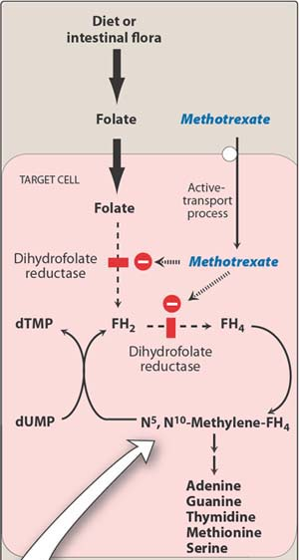
A. Folic acid analogues
Methotrexate:
Structurally related to folic acid
Competitively inhibits dihydrofolate reductase (DHFR), the enzyme that converts folic acid to its active tetrahydrofolic acid (FH4)
This results in decrease synthesis of DNA, RNA & protein and ultimately cell death
Depletion of thymidine is the most prominent effect.

Slide 5
Therapeutic uses
In combination with other drugs for:
- Acute lumphocytic leukemia
- Choriocarcinoma
- Burkitt lymphoma in children
- Breast cancer
- Head & neck carcinoma
Inflammatory diseases:
sever psoriasis and rheumatoid arthritis

Slide 6
B. Purine analogues
These drugs form nucleotides that mimic the natural nucleotide precursors of purines, and so incorporated into DNA instead of them leading to inhibition of normal DNA synthesis by DNA polymerase in proliferating cells
6- mercaptopurine (6-MP):
6-MP is converted to 6-thioinosinic acid mono phosphate (TIMP), which then inhibits purine synthesis
6-MP is used in maintenance of remission in acute lymphoblastic leukemia

Slide 7
2. 6-thioguanine (6-TG):
6-TG is converted intracellularly to 6-thioguanine monophosphate (TGMP), which then inhibit purine synthesis.
TGMP also undergoes phosphorylation forming deoxyribonucleotides that are readily incorporated into RNA and DNA leading to non-functional RNA and DNA.
It is primarily used in treatment of acute non lymphocytic leukemia

Slide 8
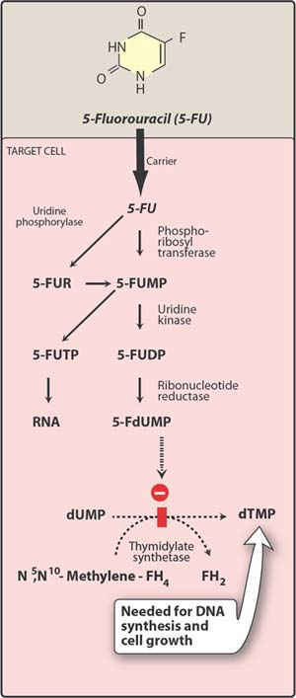
C. Pyrimidine analogues
1. 5-Fluorouracil (5-FU) :
5-FU is converted intra-cellularly into 5-FUTP (which inhibits RNA synthesis) and then 5-FdUTP which inhibits thymidylate synthase, and thus DNA synthesis.
5-FU is phase nonspecific, killing cells not only in S phase, but through out the cell cycle.
Treatment of slowly growing solid tumors (colorectal, breast, ovarian, pancreatic & gastric carcinomas)
.
5-FUR = 5-fluorouridine; 5-FUMP = 5-fluorouridine monophosphate; 5-FUDP = 5-fluorouridine diphosphate; 5-FUTP = 5-fluorouridine triphosphate; dUMP = deoxyuridine monophosphate; dTMP = deoxythymidine monophosphate. 5-FdUMP = 5-fluorodeoxyuridine monophosphate

Slide 9
Cytarabine (Ara-C; cytosine arabinoside):
Its is activated by intracellular kinases to Ara-CTP (cytosine arabinoside triphosphate) which inhibits DNA synthesis
Active nucleotide competitively inhibits DNA polymerase and thus blocks DNA synthesis leading to cell death
It is an S-phase-specific agent
Major clinical use is acute nonlymphocytic leukemia

Slide 10
main adverse effects of anti-metabolites
1. Myelosuppression :
peak toxicity on blood counts occurs in 1-2 weeks
2. Mucositis of GIT : causing usually stomatitis, but in high doses vomiting and diarrhea occur
3. Liver toxicity : hepatitis and jaundice may occur with 6-MP, and with large doses of methotrexate. Long-term use of methotrexate may cause hepatic fibrosis

Slide 11
2. Antibiotics
Antibiotics interact with DNA and therefore disrupt DNA function
Some inhibits topoisomerases and produce free radicals
They are cell cycle nonspecific agents
A. Dactinomycin:
It is obtained from streptomyces species.
It is a powerful protein synthesis inhibitor. It intercalates with DNA , and also inhibits DNA-dependent RNA polymerase and thus inhibits mRNA synthesis leading to marked inhibition of protein synthesis by cell.
It is used IV for Wilm”s tumour; also used for malignant melanoma, neuroblastoma, and for sarcomas(Ewing tumour , rhabdomyosarcoma).

Slide 12
B. Anthracyclines:
Doxorubicin and daunorubicin
These are obtained from streptomyces species
Mechanism of action
Intercalation of DNA: bind to the back bone of DNA leading to local uncoiling of DNA and thus blocks DNA and RNA synthesis.
Generation of oxygen radicals: Quinone metabolite reduce molecular oxygen, producing superoxide ions & hydrogen peroxide, which cause single-strand breaks in DNA
Uses:
Daunorubicin is used for acute leukemias

Slide 13
Doxorubicin has wide spectrum of activity in leukemia, lymphomas , myeloma, and also for carcinomas of breast, lung thyroid, stomach, ovary, and for sarcomas . It is used IV
Adverse effects:
Irreversible, dose-dependent cardiotoxicity (result of generation of free radical & lipid peroxidation)
Transient bone marrow suppression, stomatitis, increased skin pigmentation & alopecia

Slide 14
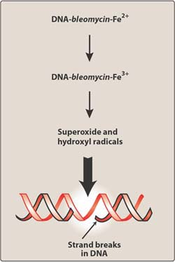
C. Bleomycin:
Mechanism of action
One end of Bleomycin molecule intercalates DNA while the other end binds to Fe⁺² , where it is oxidized to Fe⁺³ , thereby generating free radicals that cleave DNA.
Uses:
It is used in drug combinations in head & neck cancer, lymphoma, and testicular cancer.
Adverse effects:
- Pulmonary toxicity (most serious)
- Mucocutaneous reactions & alopecia
- Skin changes & hyperpigmentation of hands
- Fever & chills

Slide 15
3. Alkylating agents
Alkaylation of DNA (addition of alkyl groups to DNA) is responsible for cytotoxic activity of these drugs.
Most common binding site for alkylating agents is the 7-nitrogen group of guanine.
Alkylators exert their action by the following:
Cross-linking between two DNA strands leading to inhibition of DNA replication
Mispairing of bases leading to defective proteins
Deprurination of DNA: alkylation causes cleavage of purine ring leading to weak backbone of DNA and thus strand breakage
They are cell cycle nonspecific agents

Slide 16
A. Nitrogen mustards :
They are bifunctional Alkylators
General mechanism of action
These drugs form ethyleneimonium ion which reacts with DNA causing alkylation of purine or pyrimidine bases esp. N7-guanine forming cross links between DNA strands , and thus leads to inhibition of DNA replication which is lethal to cancer cells.

Slide 17
1. Cyclophosphamide :
This drug is activated in liver by cytochrome P450 enzyme system into phosphoramide mustard (which has the active anti-cancer alkylating effect) and acrolein (which is excreted into urine and may cause hemorrhagic cysteitis)
Uses:
It is used orally or IV for lymphomas, multiple myeloma, leukemias , and in drug combination for solid cancers e.g. breast and neuroblastoma.
It can also be used for immuno-suppression.
Adverse effects:
hemorrhagic cysteitis;

Slide 18
2. Melphalan
This is first choice drug for multiple myeloma;
Adverse effects include myelosuppression, nausea, vomiting and alopecia
3. Chlorambucil:
This is slowest acting.
It is first choice drug for CLL (chronic lymphocytic leukemia)
It can be given oral and also IV.
Adverse effects include mild myelosuppression, alopecia, and rarely vomiting

Slide 19
B. Nitrosoureas :
1. Carmustine: given IV
2. Lomustine: oral
Mechanism of action:
These drugs spontaneously form :
chloroethyl diazonium ion that alkylates DNA strands
b. isocyanates : that cause protein carbamoylation.
These drugs are highly lipid soluble , and easily enter CNS
Uses:
They are primarily used for brain tumours
Adverse effects
myelosuppression , vomiting, and liver toxicity

Slide 20
C. Triazenes
Dacarbazine
It is biotransformed in liver to active metabolite that can methylate DNA and RNA and thus inhibits DNA, RNA and protein synthesis
It is used IV mainly for the treatment of melanoma
Adverse effects include nausea, vomiting and myelosuppression
2. Temozolomide
It is biotransformed at physiological pH to active metabolite can methylate DNA and RNA and thus inhibits DNA, RNA and protein synthesis

Slide 21
Unlike dacarbazine, temozolamide can pentrate blood brain barrier
Temozolamide is used orally in treatment of resistant brain tumors (gliomas & anaplastic astrocytomas)
Adverse effects include nausea, vomiting and myelosuppression

