Slide 2
Somites.&.Folding

Slide 3
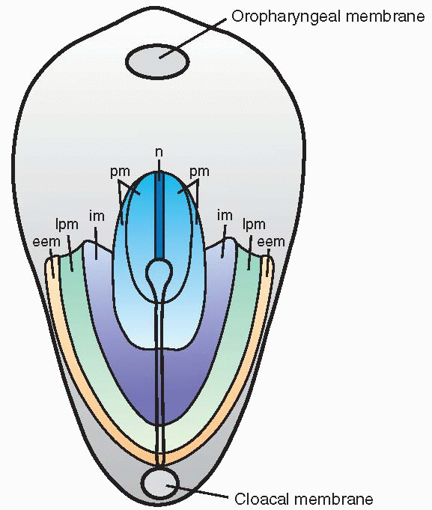
Early mesodermal patterning:
(buccopharyngeal membrane)
Specific regions of the epiblast migrate
through the streak at different levels
and assume different positions within
the embryo:
Cranial to caudal:
Notochord (n)
Paraxial mesoderm (pm)
Intermediate mesoderm (im)
*Lateral plate mesoderm (lpm)
Extraembryonic mesoderm (eem)
Langman’s fig 5-07

Slide 4
Mesodermal Regions

Slide 5
Development of Somites
As the notochord and neural tube forms
Embryonic mesoderm on each side of them proliferates
Form a thick longitudinal columns of paraxial mesoderm
Each column is continuous with intermediate mesoderm

Slide 6
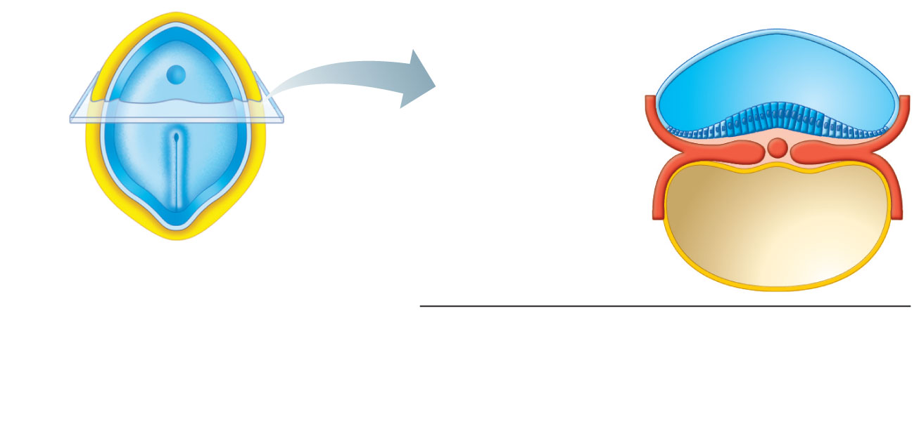
Head
Amnion
Amniotic cavity
Neural plate
Ectoderm
Left
Right
Mesoderm
Cut
edge of
amnion
Primitive
streak
Notochord
Endoderm
Tail
Yolk sac
(a) 17 days. The flat three-layered
embryo has completed
gastrulation. Notochord and
neural plate are present.
Figure 28.10a

Slide 7
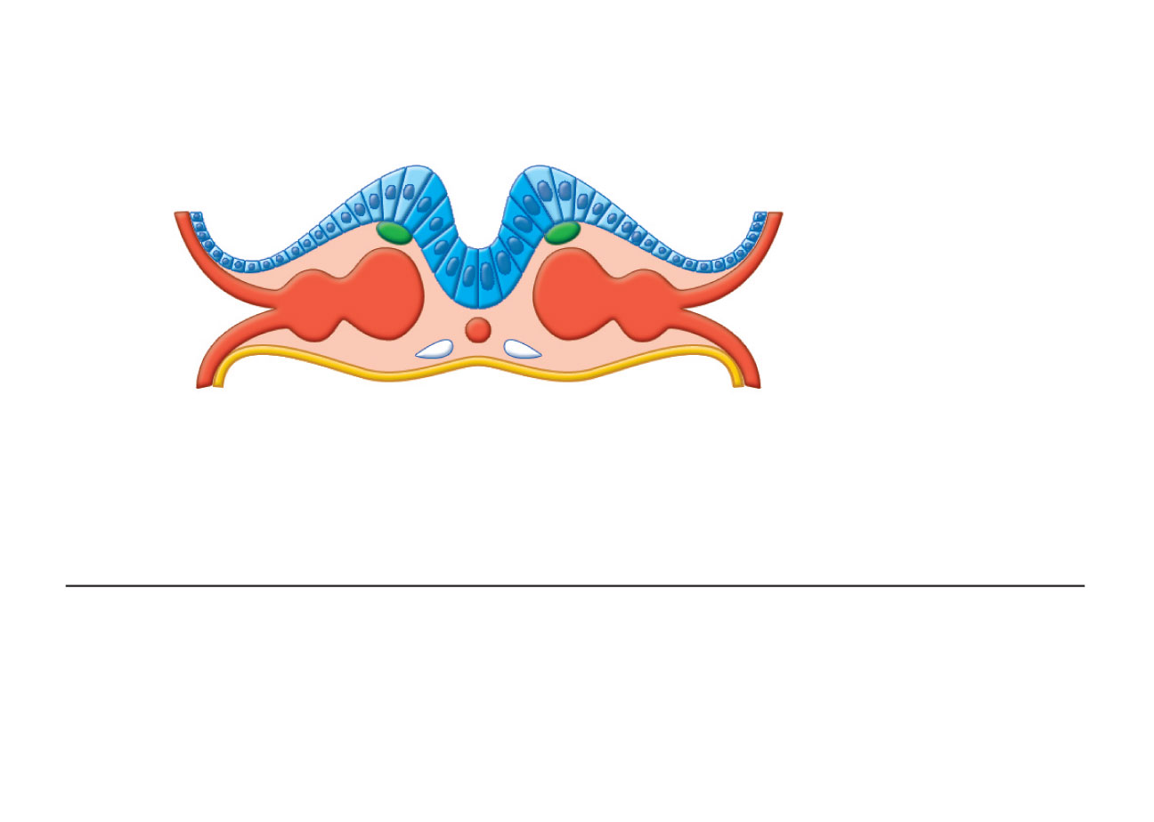
Neural groove
Somite
Neural
fold
Intermediate
mesoderm
Neural
crest
Lateral plate
mesoderm
• Somatic
mesoderm
Coelom
• Splanchnic
mesoderm
(b) 20 days. The neural folds form by folding of the
neural plate, which then deepens, producing the
neural groove. Three mesodermal aggregates form
on each side of the notochord (somite, intermediate
mesoderm, and lateral plate mesoderm).
Figure 28.10b

Slide 8
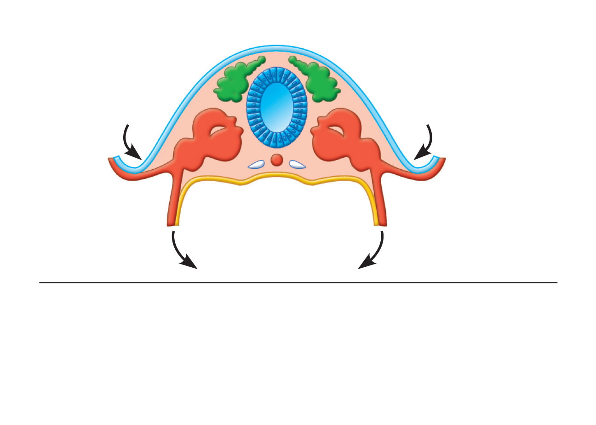
Surface ectoderm
Neural
crest
Neural
tube
Somite
Notochord
(c) 22 days. The neural folds have closed,
forming the neural tube which has detached
from the surface ectoderm and lies between
the surface ectoderm and the notochord.
Embryonic body is beginning to undercut.
Figure 28.10c

Slide 9
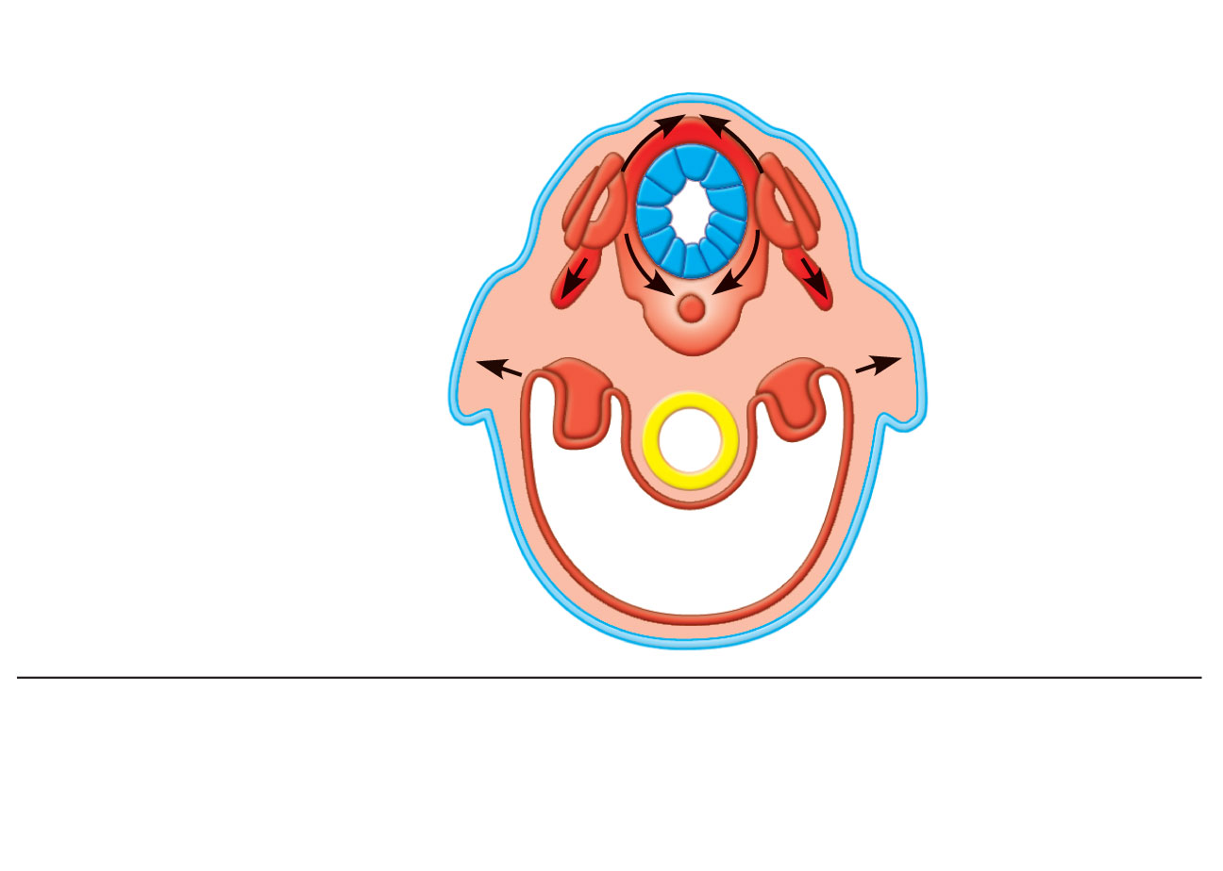
Dermatome
Neural tube
(ectoderm)
Somite
Myotome
Sclerotome
Epidermis
(ectoderm)
Kidney and gonads
(intermediate
mesoderm)
Gut lining
(endoderm)
Splanchnic
mesoderm
Somatic
mesoderm
• Visceral serosa
• Limb bud
• Smooth muscle of gut
• Parietal
serosa
• Dermis
Peritoneal cavity
(coelom)
(d) End of week 4. Embryo undercutting is complete. Somites
have subdivided into sclerotome, myotome, and dermatome,
which form the vertebrae, skeletal muscles, and dermis
respectively. Body coelom present.
Figure 28.10d

Slide 10
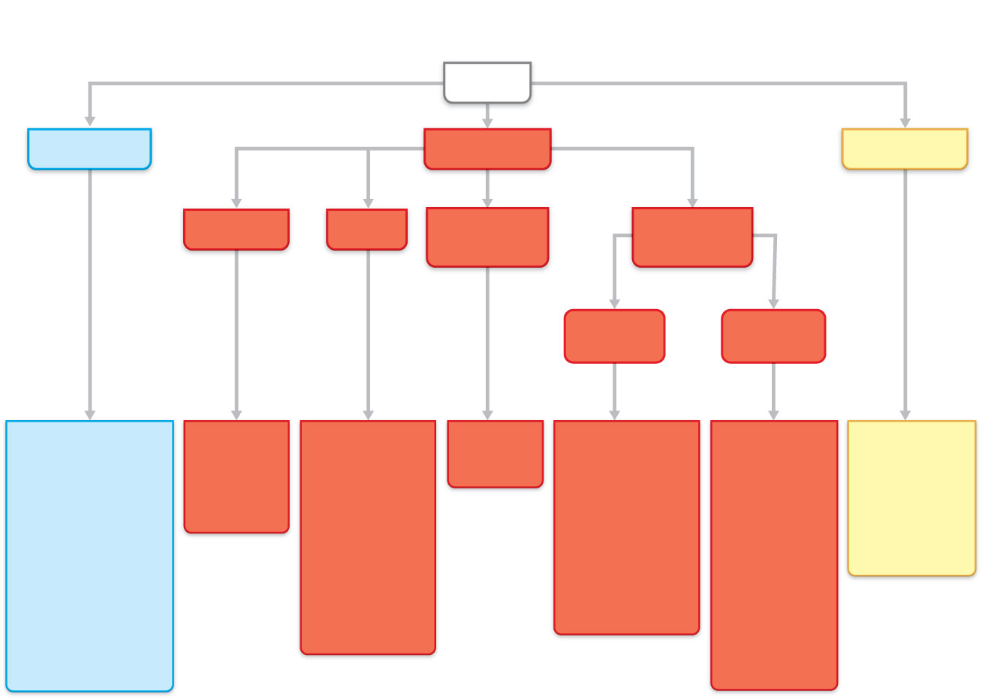
Epiblast
ECTODERM
MESODERM
ENDODERM
Notochord
Somite
Intermediate
mesoderm
Lateral plate
mesoderm
Somatic
mesoderm
Splanchnic
mesoderm
• Epidermis, hair,
nails, glands of
skin
• Brain and
spinal cord
• Neural crest
and derivatives
(sensory nerve
cells, pigment
cells, bones
and blood
vessels of the
head)
Nucleus
pulposus
of inter-
vertebral
discs
• Sclerotome:
vertebrae
and ribs
• Dermatome:
dermis of
dorsal body
region
• Myotome:
trunk and
limb
musculature
• Kidneys
• Gonads
• Parietal
serosa
• Dermis of
ventral body
region
• Connective
tissues of
limbs (bones,
joints, and
ligaments)
• Wall of
digestive
and
respiratory
tracts
(except
epithelial
lining)
• Visceral
serosa
• Heart
• Blood
vessels
Epithelial
lining and
glands of
digestive
and
respiratory
tracts
Figure 28.13

Slide 11
Development of Somites
Intermediate mesoderm gradually thins into a layer of lateral mesoderm
Lateral mesoderm is continuous with the extraembryonic mesoderm
Extraembryonic mesoderm covers the yolk sac and amnion

Slide 12
Somites
Paraxial mesoderm differentiates and begins to divide into cuboidal bodies called somites by the end of 3rd week
These blocks of mesoderm are located on each side of developing neural tube
About 35 pairs of somites form during the somite period of human development (20-30 days)

Slide 13
Somites
About 42-44 pairs of somites are present by the end of 5th week
Are triangular in transverse section
Form distinct surface elevations on the embryo
Are used as one of the criteria to know the age of the embryo at this stage

Slide 14
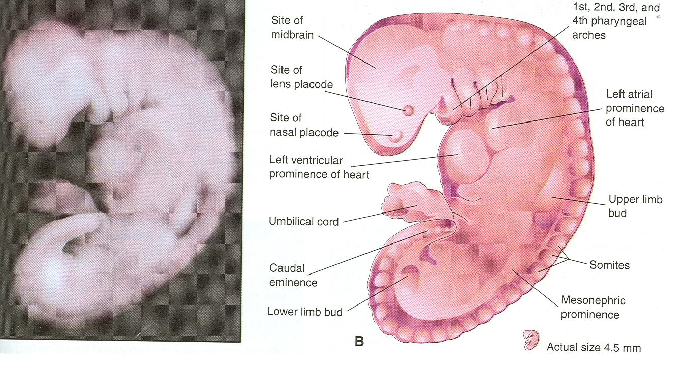

Slide 15
Somites
First appear in the future occipital region
Soon develop craniocaudally
Gives rise to the axial skeleton and associated musculature
Also forms adjacent dermis of the skin
The first pair of somites appear at the end of 3rd week

Slide 16
Somites
First appear at a short distance caudal to the cranial end of the notochord
Subsequent pairs form in a craniocaudal sequence

Slide 17
Intraembryonic Coelom
Also known as primordium of embryonic body cavity
Appears as isolated coelomic spaces in the lateral mesoderm and cardiogenic mesoderm
These spaces soon coalesce to form a single horseshoe shaped cavity called intraembryonic coelom

Slide 18
Parietal & Visceral Layers
Somatic or parietal layer continuous with the extraembryonic mesoderm covering the amnion
Splanchnic or visceral layer continuous with the extraembryonic mesoderm covering the yolk sac

Slide 19
Parietal & Visceral Layers
Somatic mesoderm with overlying embryonic ectoderm form the embryonic body wall or somatopleure
Splanchnic mesoderm with underlying embryonic endoderm form the embryonic gut or splanchnopleure

Slide 20
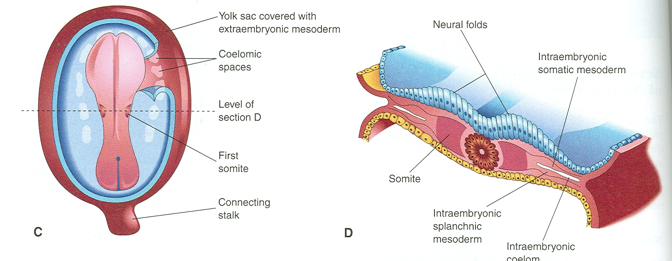

Slide 21
Fate of Intraembryonic Coelom
During the 2nd month, the intraembryonic coelom is divided into 3 body cavities:
Pericardial cavity
Pleural cavity
Peritoneal cavity

Slide 22
Folding

Slide 23
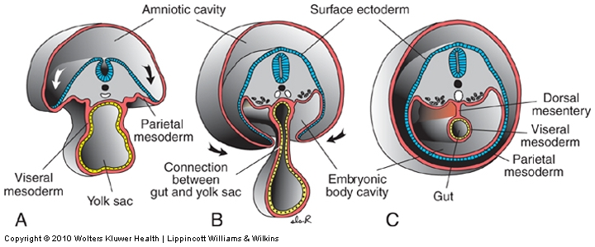
With lateral folding, mesoderm is recruited to gut wall
Carlson fig 6-20
Langman’s fig 6-18
Lateral folding of the embryo completes the gut tube
Mesodermal layer of the gut tube is called splanchnic (visceral) mesoderm - derived from lateral plate mesoderm
Somatic mesoderm lines body cavity
Notes:
Fig 13.3

Slide 24
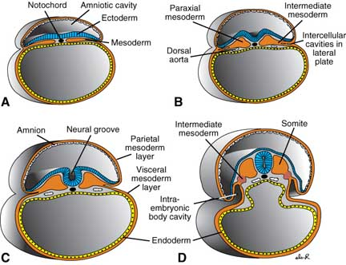

Slide 25
Specialization of Endoderm
Embryonic folding begins with lateral folds
Next, head and tail folds appear
Endoderm tube forms epithelial lining of the GI tract
Organs of the GI tract become apparent, and oral and anal openings perforate
Mucosal lining of respiratory tract forms from pharyngeal endoderm (foregut)

Slide 26
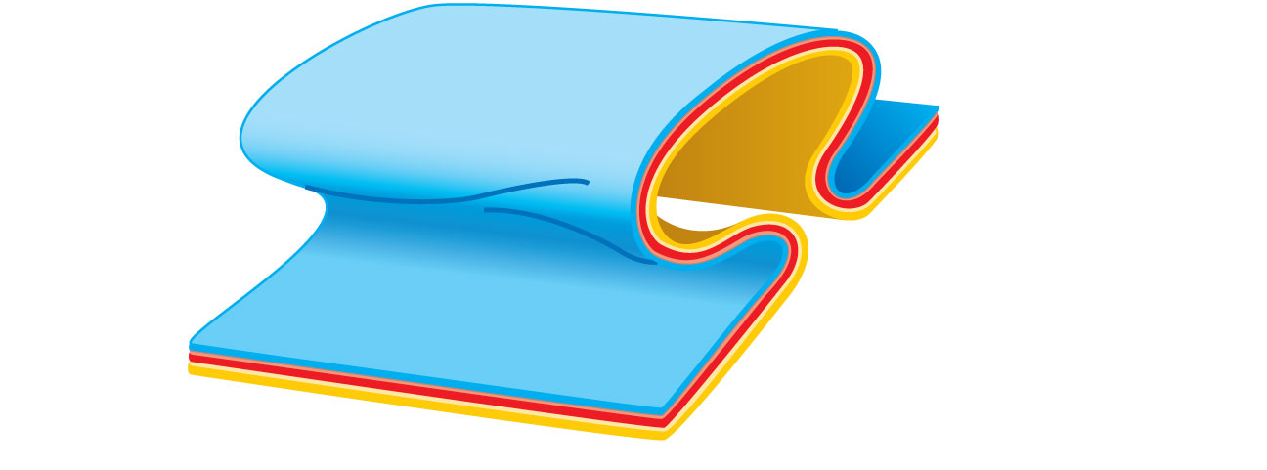
Future gut
(digestive
tube)
Lateral
fold
(b)
Figure 28.11b

Slide 27
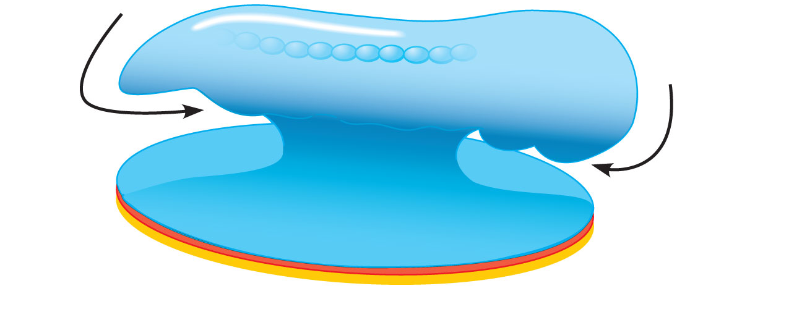
Somites (seen
through ectoderm)
Tail
fold
Head
fold
(c)
Yolk sac
Figure 28.11c

Slide 28
Neural tube
Notochord
Primitive
gut
Yolk
Foregut
Hindgut
sac
(d)
Figure 28.11d

Slide 29
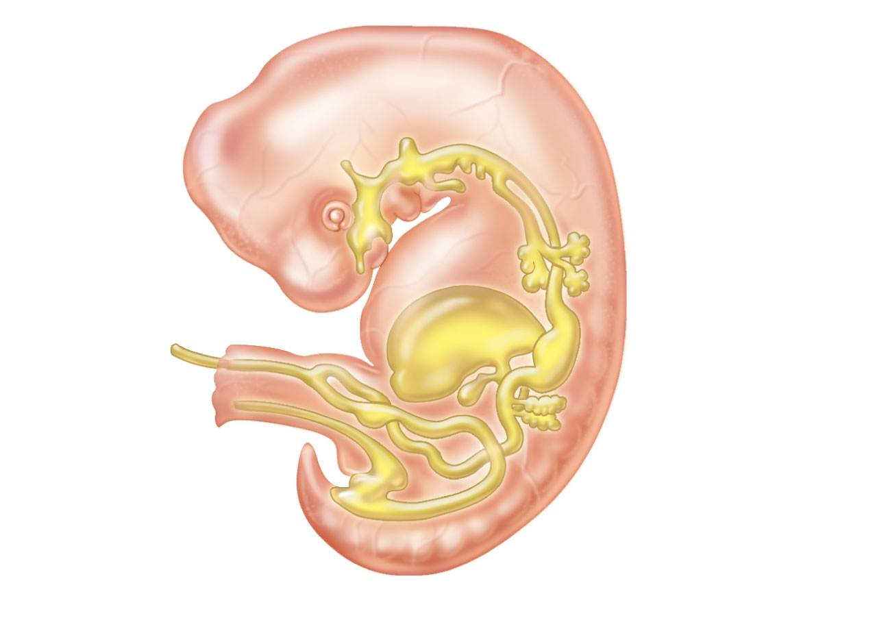
Pharynx
Parathyroid glands
and thymus
Thyroid gland
Esophagus
Trachea
Connection
to yolk sac
Right and
left lungs
Stomach
Liver
Umbilical
cord
Pancreas
Gallbladder
Small intestine
Allantois
5-week embryo
Large intestine
Figure 28.12

Slide 30
thank you

