Slide 1
Micronutrients (Vitamins)
Community Medicine
Subtitle

Slide 2
Introduction
Micronutrients: are chemical substances that, ingested in small quantities, are needed to regulate the metabolic and biochemical processes of the body.
Micronutrients are essential components of the diet.
Micronutrients have important influences on the health of the humans (esp. pregnant women and growing fetuses)
Deficiencies or imbalance → lead to growth deficiencies, problems in the development of cognitive and physiological functions, and immuno-deficiencies.
The term “hidden hunger” is used to refer to micronutrient deficiency.
Excess → will also negatively affect health (Vitamin toxicity)

Slide 3
Introduction:
Micronutrients are classically divided into four groups:
Water-soluble vitamins
(vitamin B group, and vitamin C)
Fat-soluble vitamins
(vitamins A, D, E, and K)
Macro minerals
(sodium, potassium, calcium, phosphorus, magnesium, chlorine, and sulfur).
(Grams)
Micro minerals
Trace: (iron, fluorine, iodine, manganese, cobalt, copper, and zinc.) (milligrams )
Ultra trace elements: (silicon, nickel, chromium, lithium, molybdenum, and selenium).
(micrograms)
Organic
Inorganic

Slide 4
Risk factors for micronutrient malnutrition:
Monotonous diet resulting in low micronutrient intake, and poor bioavailability, especially of minerals.
Low intake of animal source foods.
Increased physiological demands for growth during pregnancy and lactation.
Increased demand due to acute infection (especially if infection episodes are frequent), chronic infection (e.g. tuberculosis, malaria and HIV/AIDS) and disease (e.g. cancer).
Poor general nutritional status, in particular, protein–energy malnutrition (PEM).
Malabsorption due to diarrhoea or the presence of intestinal parasites (e.g. Giardia lamblia, hookworms).
Increased excretion (e.g. due to schistosomiasis).
Seasonal variations in food availability, food shortages.
Social deprivation, illiteracy, low education.
Poor economic status and poverty
Low prevalence of breastfeeding.
Notes:
Low- and middle-income counties

Slide 5
Micronutrients deficiencies
Many of these deficiencies are preventable through nutrition education and consumption of a healthy diet containing diverse foods, as well as food fortification and supplementation, where needed.

Slide 6
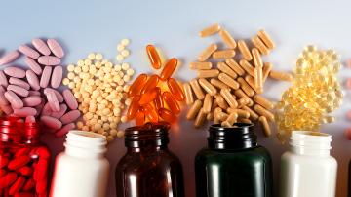
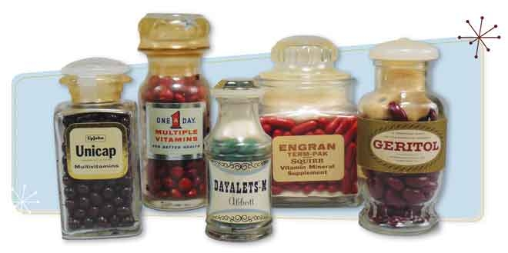
Vitamins:
In 1930s, commercially produced tablets of yeast-extract vitamin B complex and semi-synthetic vitamin C became available.
13 vitamins are known, 4 fat soluble (ADEK) & 9 water soluble (C, the B group)

Slide 7
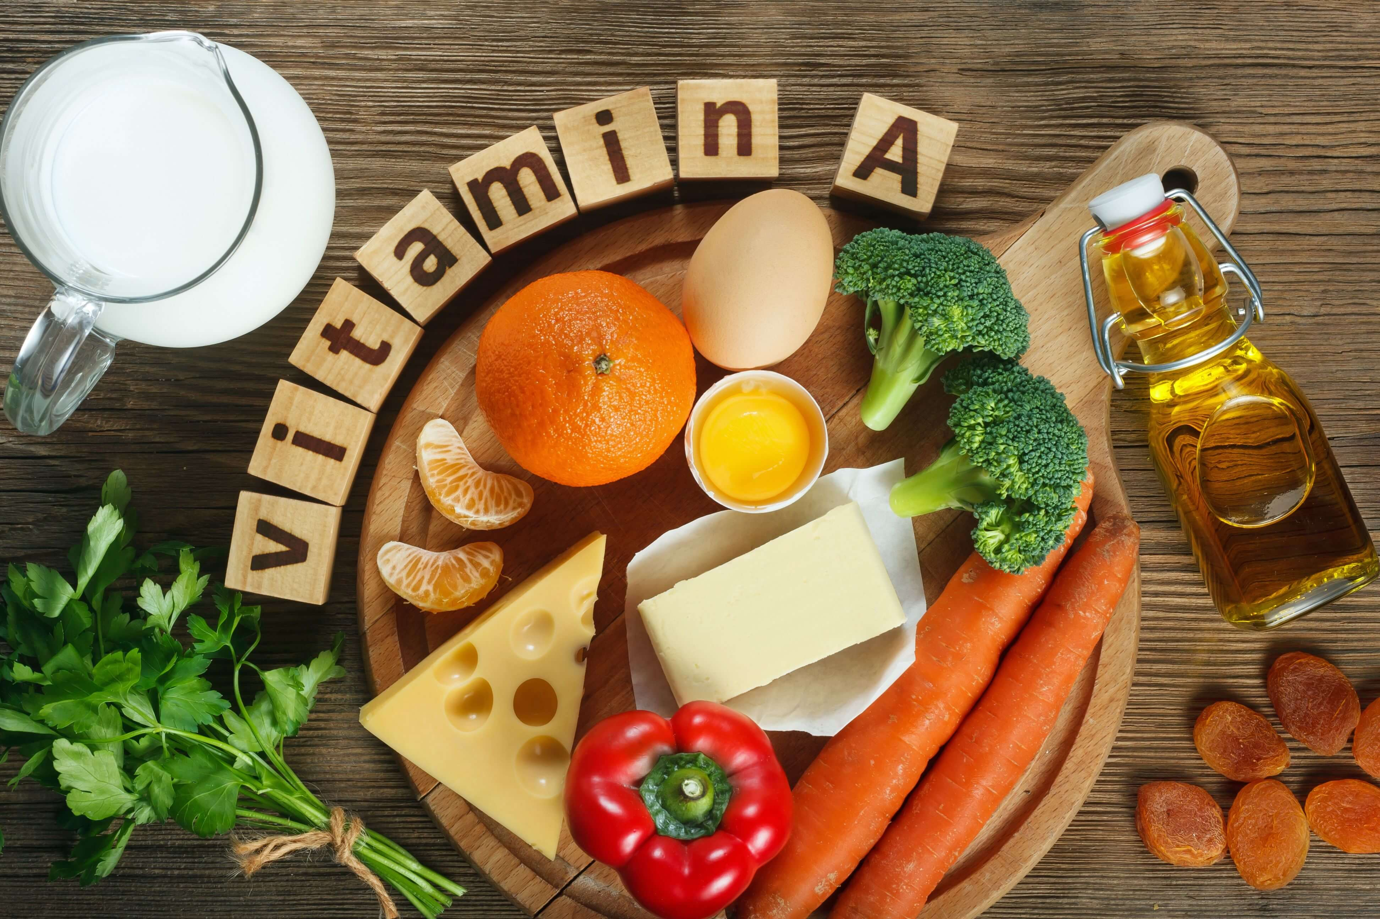
Vitamin A
Vitamin A is normally provided as a mixture of preformed vitamin A (retinol) (present in animal source foods) , and provitamin A (carotenoids) ( derived from foods of vegetable origin) which have to be converted into retinol by tissues such as the intestinal mucosa and the liver in order to be utilized by cells.

Slide 8
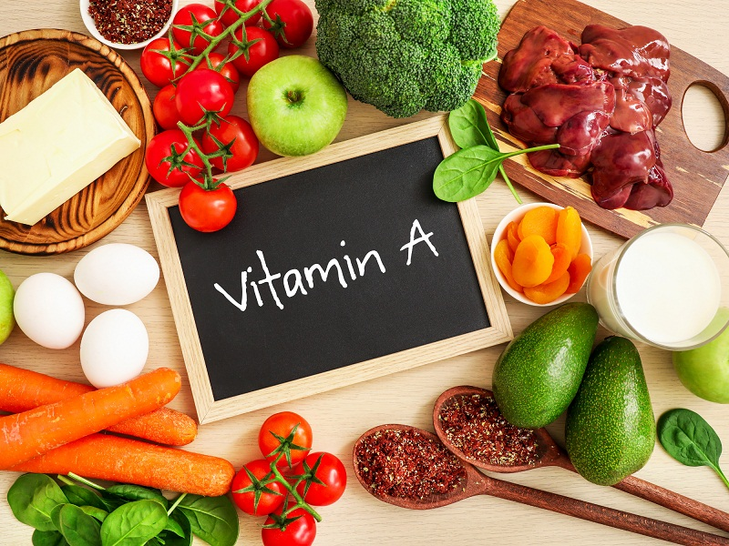
Sources of vitamin A
(retinol)
Cheese
Eggs
Liver
Sources of beta-carotene which the body can convert into retinol
Yellow, red and green (leafy) vegetables, such as spinach, carrots, sweet potatoes and red peppers
Yellow and orange fruits, such as mango, papaya and apricots

Slide 9
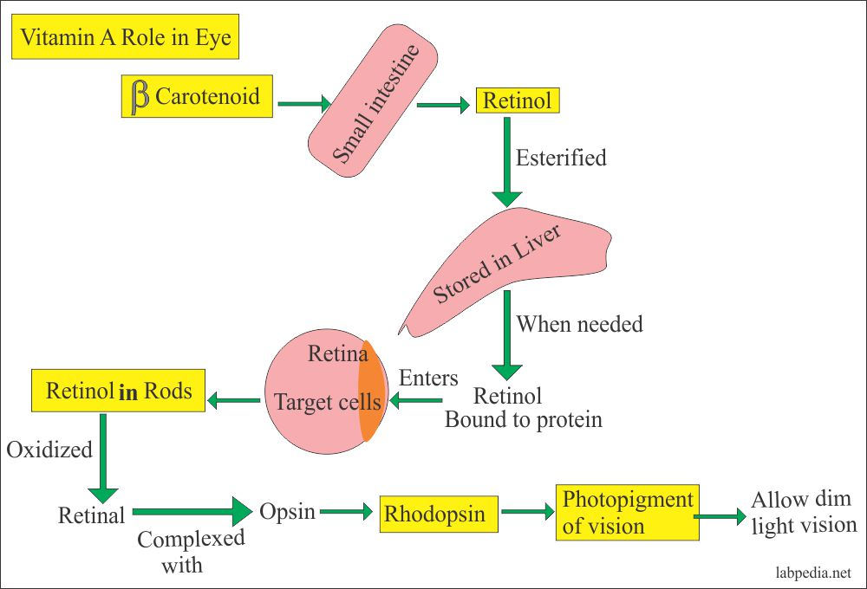
Functions
Immunity: Important for activation of T lymphocyte, maturation of WBC & integrity of physiological barrier.
Vision: integrity of eye & formation of rodopsin necessary for dark adaptation.
Regulation of gene expression: vital to cell differentiation & physiologic processes
Growth & development

Slide 10
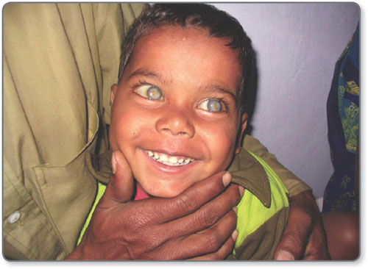
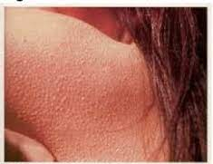
Vitamin A deficiency
Deficiency of vitamin A leads to:
Ocular change:
Night blindness & xerophthalmia
Vitamin A deficiency is the most common cause of childhood blindness.
2. Extra ocular changes:
Growth retardation
Acquired immune deficiency
Keritinization of epithelia in RT, GIT & UT with increased risk of RTI, malabsorption & UTI
Dry skin (follicular hyperkeratosis)
follicular hyperkeratosis, which manifests as small, rough, cone-shaped, raised papules on the posterior and lateral aspects of the arms and thighs.
Vitamin A deficiency is more commonly assessed using serum or plasma retinol levels.

Slide 11
Daily requirements
The total vitamin A content of a food is usually expressed as micrograms (µg) of Retinol Activity Equivalents (RAE).
The amount of vitamin A adults aged 19 to 64 need is:
Men: 900 mg RAE
Women: 700 mg RAE
Pregnancy: 770 mg RAE
Breast-feeding: 1,300 mg RAE
Any vitamin A the body does not need immediately is stored for future use. This means you do not need it every day.

Slide 12
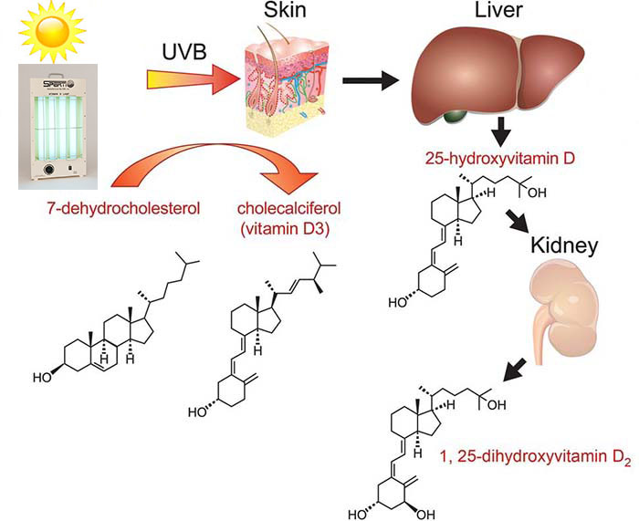
VITAMIN D
Vitamin D comprises a group of sterols; the most important of which are cholecalciferol (vitamin D3) & ergosterol (vitamin D2).
Humans & animal utilize only vitamin D3 & they can produce it inside their bodies from cholesterol. Cholesterol is converted to 7-dehydro- cholesterol (7DC), which is a precursor of vitamin D3.
Exposure to the ultraviolet rays in the sunlight convert 7DC to cholecalciferol.
Vitamin D3 is metabolically inactive until it is hydroxylated in the kidney & the liver to the active form 1,25 Dihydroxycholecalciferol.
1,25 DHC acts as a hormone rather than a vitamin with endocrine & paracrine properties.

Slide 13
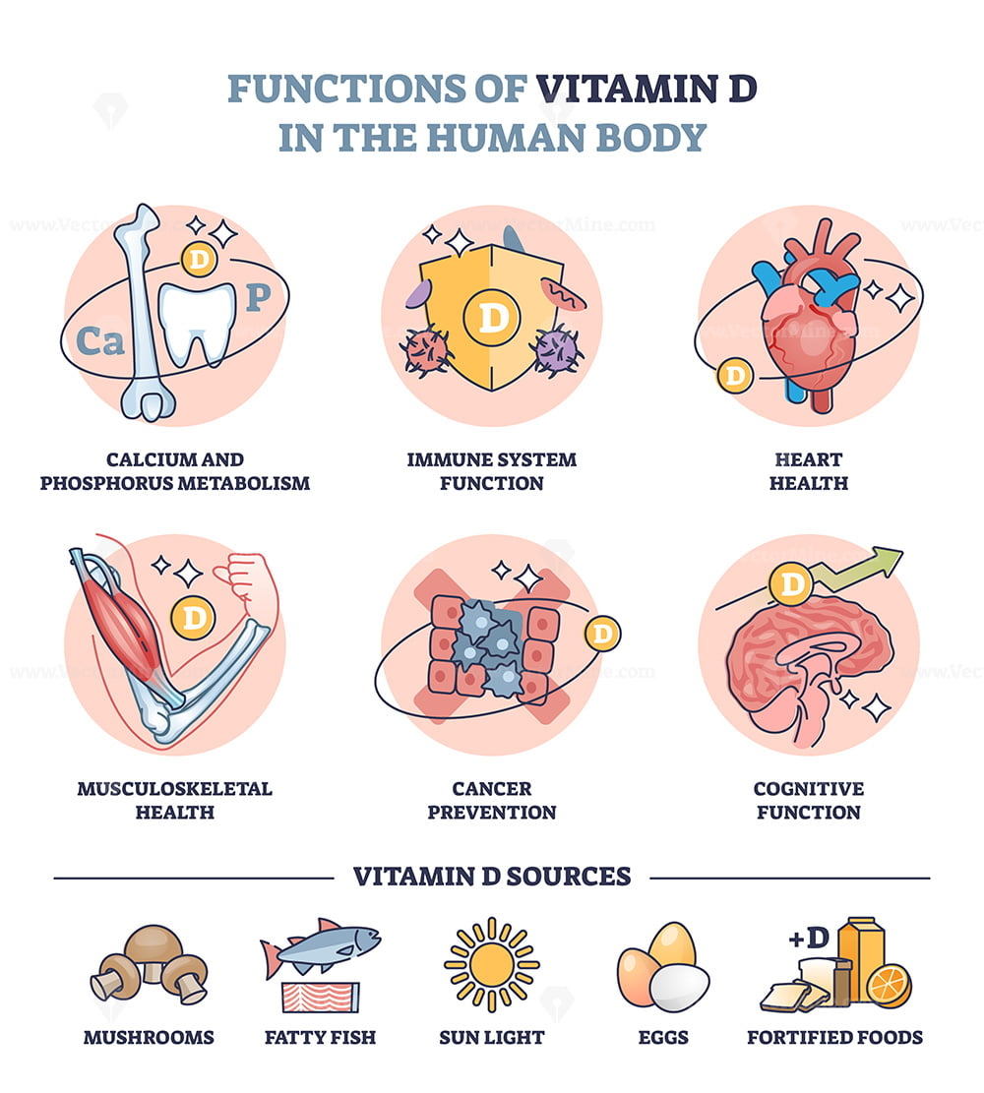
FUNCTIONS
Calcium metabolism: vitamin D enhances ca absorption in the gut & renal tubules.
Cell differentiation: particularly of collagen & skin epithelium
Immunity: important for Cell Mediated Immunity & coordination of the immune response.

Slide 14
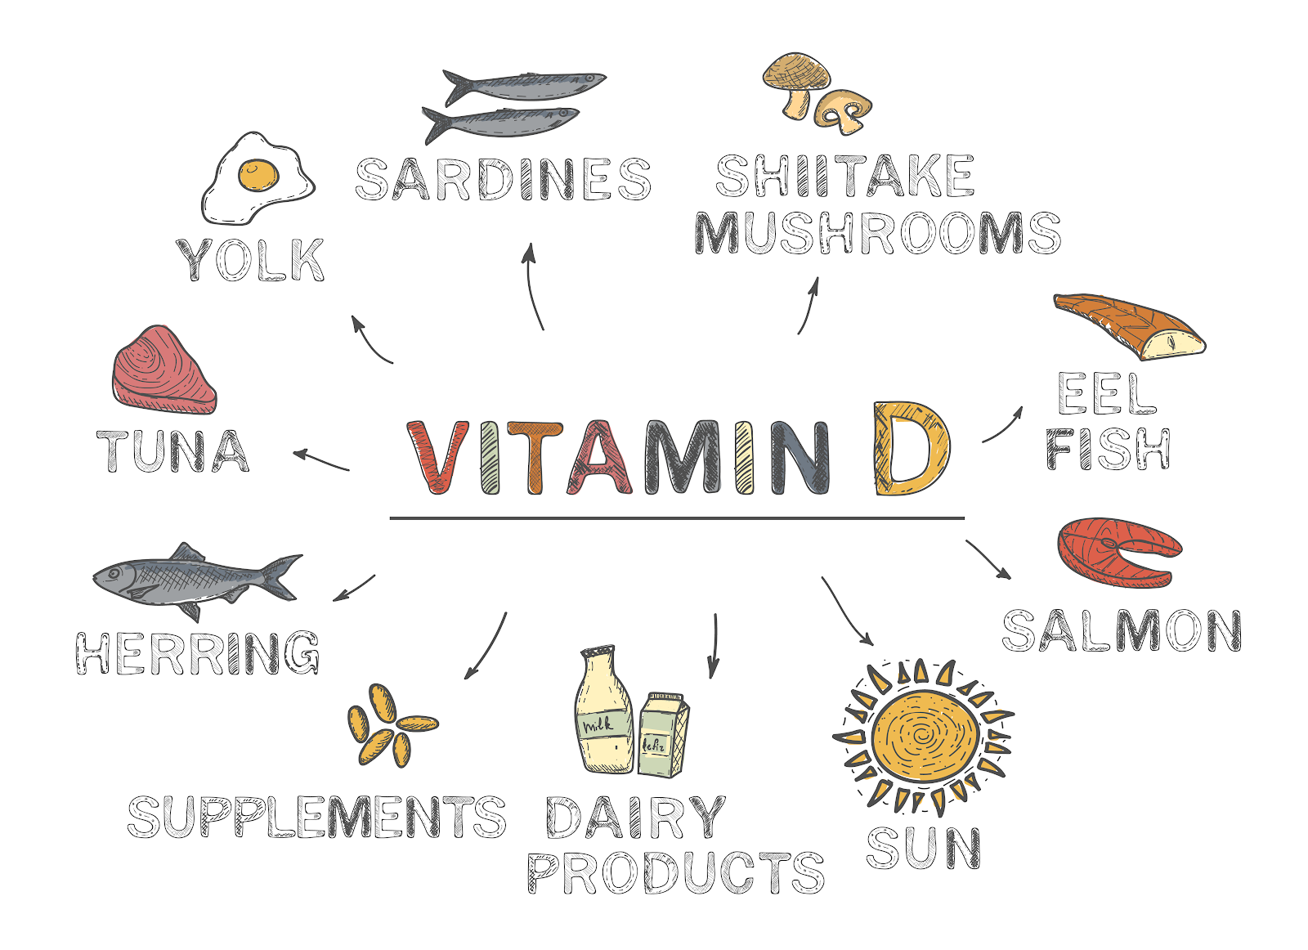
Sources of Vitamin D
Sunlight is the most important source (influenced by season, latitude, skin pigmentation, area of skin exposed, sunscreen use, and age)
Fish liver oil, Fish & sea food (herring & salmon)
Eggs
Plants do not contain vitamin D3
Human milk is deficient in vit. D

Slide 15
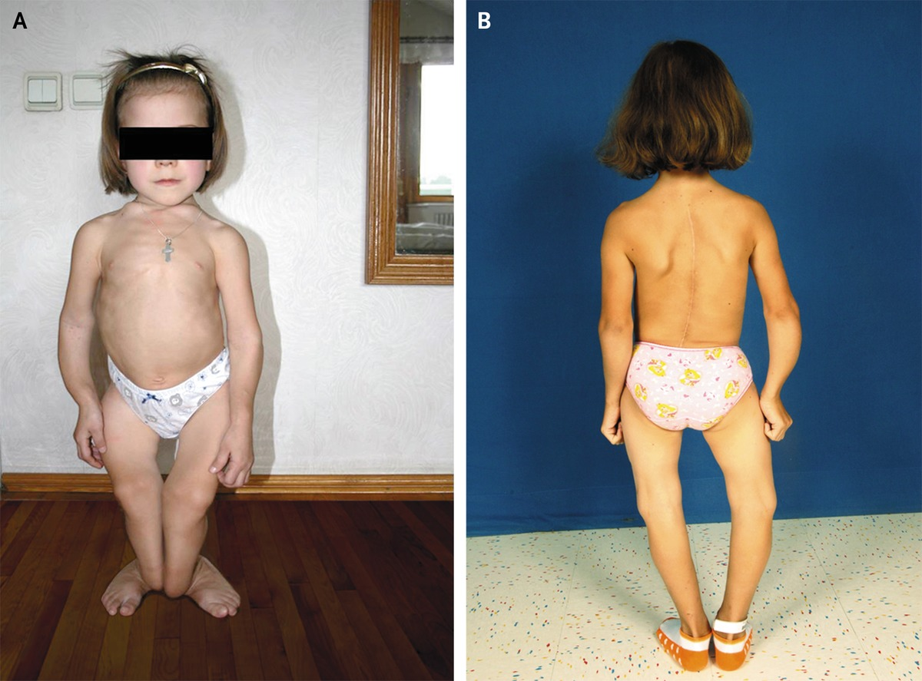
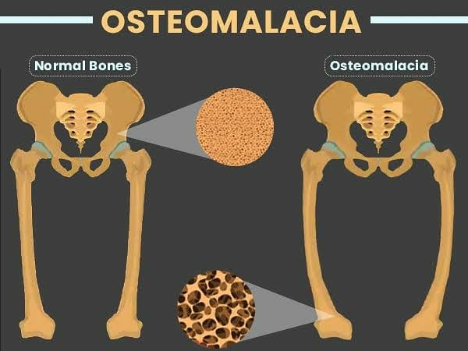
Vitamin D deficiency
Deficiency of vitamin D leads to:
Rickets in children. (Lack of adequate mineralisation of growing bone)
Osteomalacia
Osteoporosis

Slide 16
Vitamin E
Functions:
Antioxidant in cell membranes
Supports normal nerve function
Augments functional activity of immune cells
Sources:
Olive oil, safflower oil, sunflower oil, almonds, hazelnuts, peanuts, spinach, carrots, avocados
Vitamin E deficiency is genetic in origin and runs in families.

Slide 17
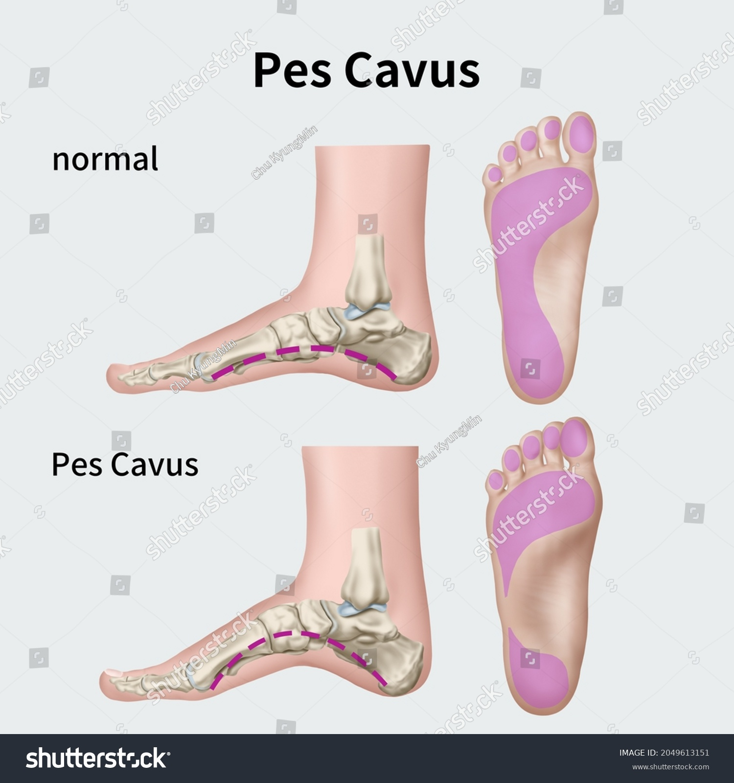
Vitamin E Deficiency:
Observed in low birth weight infants.
Anemia, reticulocytosis, thrombocytopenia, and abnormal erythrocyte metabolism.
Low levels of vitamin E in premature infants is associated with hemolytic anemia, hyperbilirubinemia and intraventricular hemorrhage.
Clinical manifestation: loss of reflexes, ataxia of trunks and limbs, diminished proprioception, muscle weakness, ptosis, pes cavus, scoliosis and dysarthria.

Slide 18
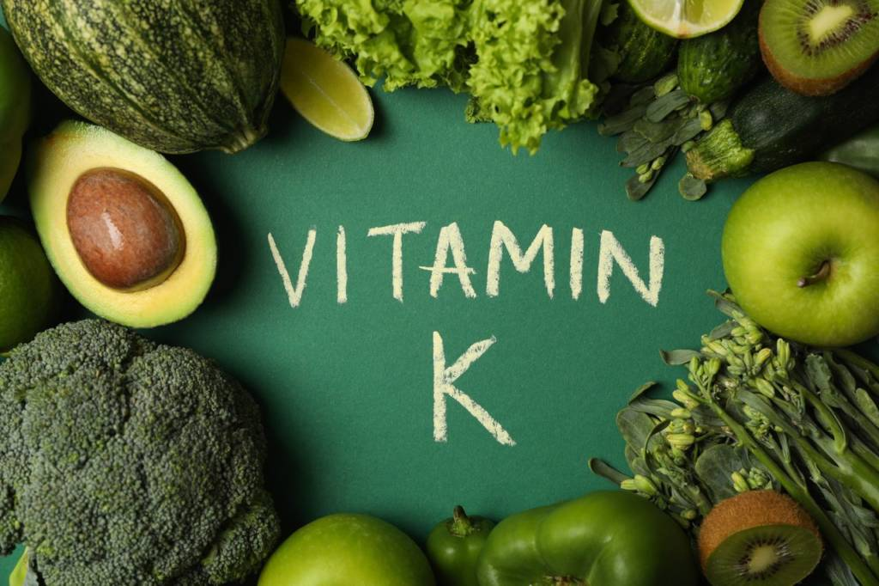
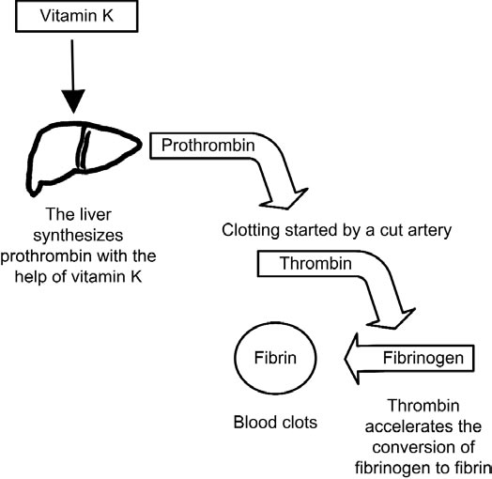
Vitamin K
It is a cofactor of the enzyme that catalyzes one step in the formation of prothrombin.
Needed for the generation of several clotting factors in the liver. (helping wounds to heal)
Source- green leafy vegetables.
Deficiency-coagulation defect due to hypoprothrombinemia and deficiency of factor VII resulting in hemorrhagic disease of the newborn.
1mg IM –newborn.
In severe deficiency-2.5 to 5 mg parenterally.

Slide 19
The B Vitamins

Slide 20
Vitamin B1
Biologically active form – thiamine pyrophosphate (TPP) (Other forms, Thiamine triphosphate, Thiamine mononitrate, Thiamine hydrochloride)
Function – Assists the release of energy from carbohydrates and protein. cofactor in oxidative decarboxylation of a- keto acids (TCA, AA degradation)
Sources – meats, whole grains, legumes, tuna, soy milk
RDA –1 mg/day
Deficiency – decreased ATP production – impaired cellular function – Beriberi
Two major types of Beriberi:
Wet Beriberi which affects the cardiovascular system
Dry Beriberi which affects the nervous system.

Slide 21
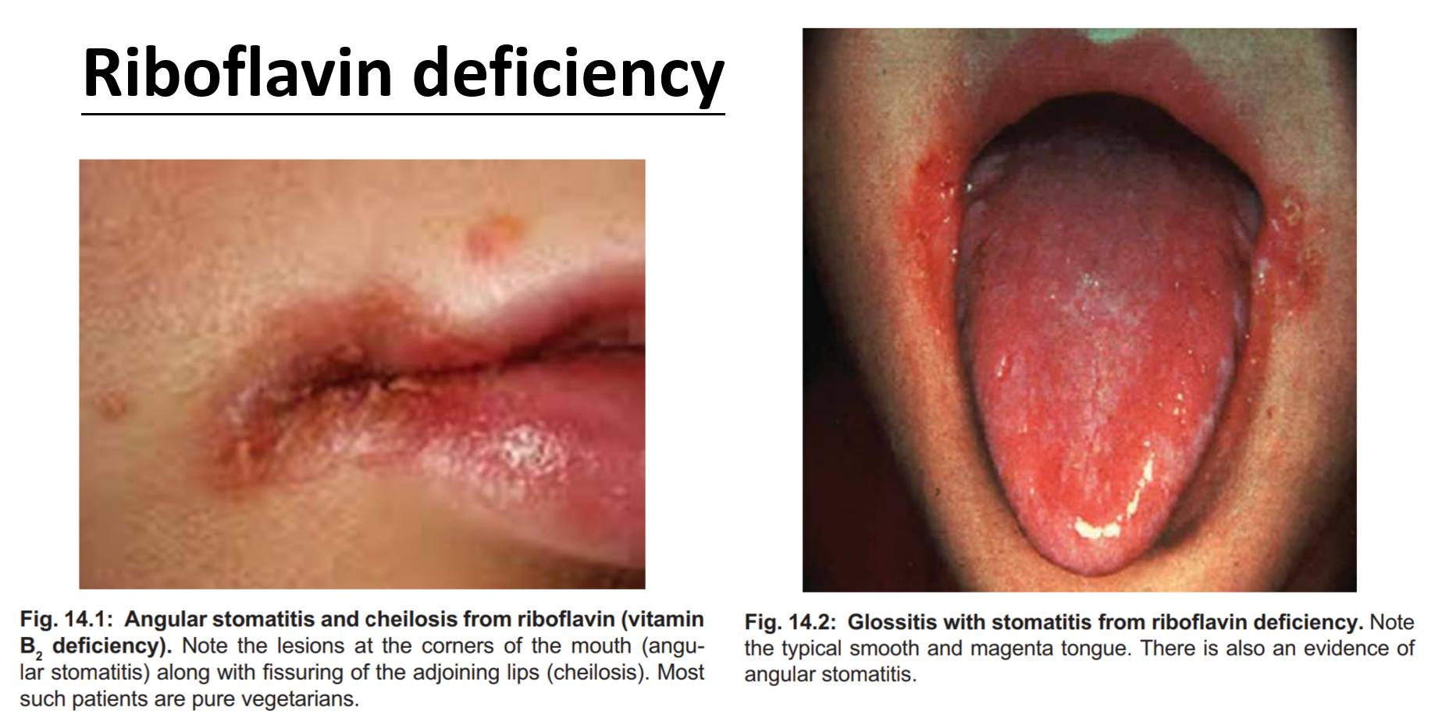
Riboflavin B2
Vitamin B2
Biologically active forms – Flavin mononucleotide (FMN) – Flavin adenine dinucleotide (FAD)
Function –involved in the conversion of nutrients into energy. It is also required in the conversion of vitamin B6 to its active form, and in the conversion of tryptophan to niacin (vitamin B3).
Sources – Milk, mushrooms, tomatoes, liver, green leafy vegetables
RDA – 1.1-1.3 mg/day
Deficiency – Growth retardation – Ariboflavinosis • Glossitis (soreness of the tongue). • Stomatitis (Stomatitis is inflammation of the mouth and lips)

Slide 22
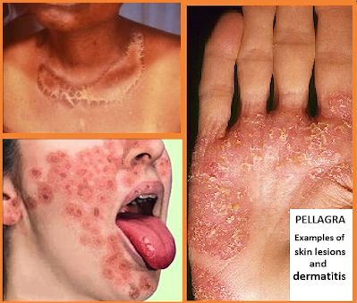
Niacin B3
Function – Niacin is metabolized from tryptophan and works as a precursor for nicotinamide adenine dinucleotide and nicotinamide adenine dinucleotide phosphate coenzymes. Both are needed for DNA repair and cholesterol synthesis.
Sources – Unrefined grains, fortified cereal, meat, fish, tomatoes, mushrooms, milk, liver, rice
• RDA – 14-16 NE/day (NE = niacin equivalents = 1 mg niacin or 60 mg tryptophan)
• Deficiency –Pellagra = “rough skin”
Pellagra is characterized by “the 3 Ds”: dementia, diarrhea, and dermatitis.
Casal necklace (collar)
Notes:
Other associated manifestations include memory loss, depression, disorientation, headaches, apathy, fatigue, vomit, a swollen mouth, and a scaly rash on sun-exposed skin.

Slide 23
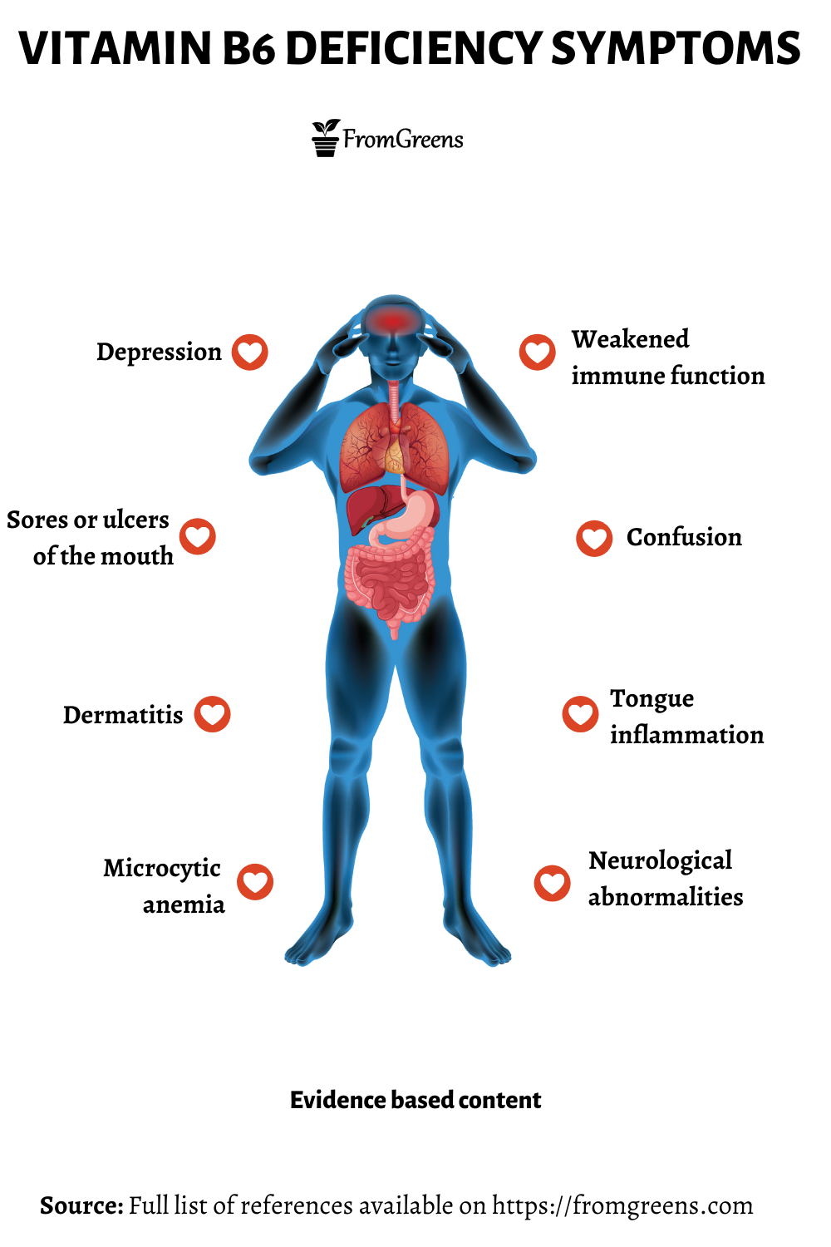
Pyridoxine B6
• Biologically active form – pyridoxal phosphate (PLP)
• Function – Coenzyme for transamination reactions, esp. AAs (neurotransmitters) – Decarboxylation of carboxylic acids
• Sources – Wheat, corn, egg yolk, liver, potato, banana, fish, chickpeas
• RDA – 1.3-1.7 mg
• Deficiency – Induced by TB drug isoniazid (supplement given)
Pyridoxine deficiency is commonly associated with other B vitamin deficiencies, such as folic acid and vitamin B12, and is rare in isolation.
– Microcytic hypochromic anemia
Deficiency of active pyridoxine is found in chronic alcohol dependence, chronic renal failure or autoimmune disorders, obesity, pregnancy, preeclampsia, eclampsia, and malabsorptive states such as celiac disease, inflammatory bowel disease, and bariatric surgery.

Slide 24
Biotin B7
• Biologically active form – Binds to lysine residue of enzyme
• Function – Cofactor in carboxylation reactions, carrier of CO2 (acetyl-CoA to malonyl-CoA, synthesis of fatty acids) – Regulation of gene expression
• Sources –milk, egg yolk, tomato, almond, peanuts, avocado, mushroom – Also synthesized by intestinal bacteria
• RDA – At least 30 mg/day
• Deficiency –Rare except in high-risk populations, such as those who experience biotinidase deficiency, alcoholism, chronic use of epileptic medications, and pregnant or breastfeeding women.
Biotin deficiency is associated with hair thinning, a scaly rash around the eyes, nose, mouth, and perineum, nail changes, skin infections
Excessive biotin levels have no known toxic effects

Slide 25
Vitamin B9 (Folate)
The dosage for women of childbearing age : 0.4–0.8 mg/d
Function: nucleic acid synthesis and red blood cell production. involved in converting homocysteine to methionine, which is essential for hematopoiesis and prevention of megaloblastic anemia
Sources: highest levels in dark green leafy vegetables, nuts, beans, dairy products, meat, poultry, grains, and brussels sprouts
Deficiency is associated with poor diet, alcoholism, and malabsorptive disorders.
Folate deficiency : megaloblastic anemia, characterized by large erythrocytes with abnormal nuclei. Patients may report weakness, fatigue, poor concentration, irritability, headaches, and palpitations. Deficiency can also cause oral ulcerations and changes in skin, hair, and fingernails.
Maternal low folate levels during pregnancy increase the chance of congenital birth defects, including fetal neural tube defects, and congenital heart defects, in addition to low birth weight, preterm labor, and delayed fetal growth

Slide 26
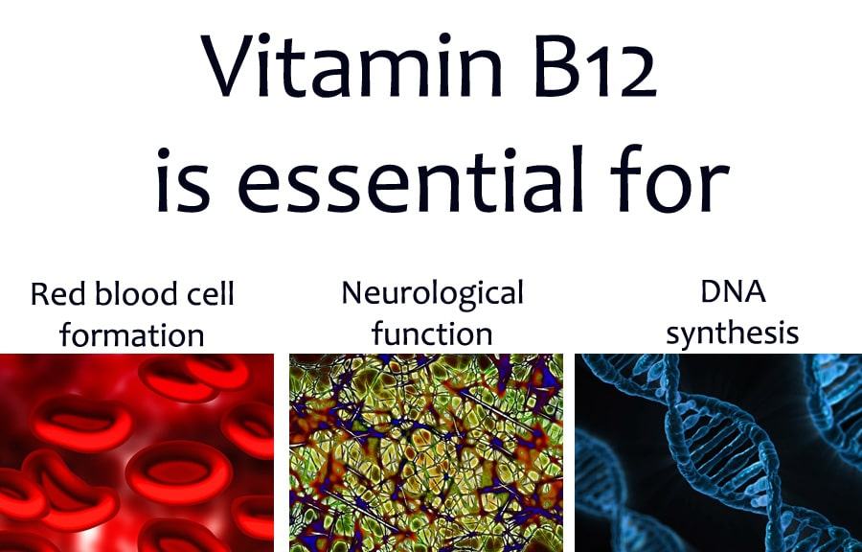
Vitamin B12 (Cobalamin, Cyanocobalamin, Methylcobalamin)
FOOD SOURCES: found in animal products and fortified foods.
BIOCHEMICAL FUNCTION: Gastric acid helps to release cobalamin from animal protein. Cobalamin combines with an intrinsic factor to absorb in the distal ileum.
Important for red blood cell production, neurologic function, and myelin synthesis. It serves as a cofactor in DNA and RNA synthesis as well as hormone, protein, and lipid synthesis and metabolism.
Deficiency: Patients using proton pump inhibitors, H2 receptor antagonists, colchicine, and metformin are more likely to have cobalamin malabsorption.
Megaloblastic anemia, fatigue, low appetite, and neuropsychiatric symptoms. If not treated, neuropsychiatric illness and irreversible neurologic damage occur.
Cobalamin deficiency is treated with IM injections of 1000 mcg 3 times weekly for 2 weeks followed by weekly injections for 1 month to replenish stores. Patients can then receive monthly cobalamin 1000 mcg injections or oral cobalamin 1000–2000 mcg daily for maintenance
one third of Jordanian adults have vitamin B12 deficiency with no gender differences.
https://doi.org/10.1159/000355440

Slide 27
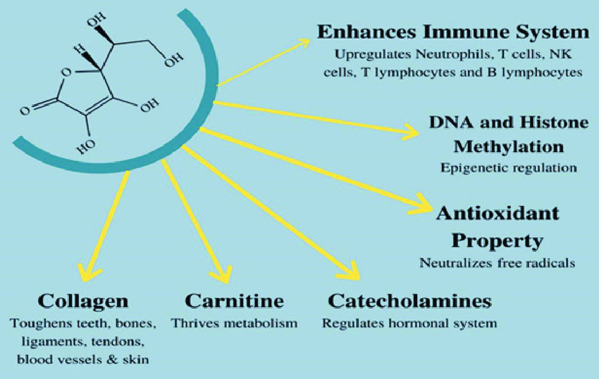
Vitamin C
BIOCHEMICAL FUNCTION: One of the main Antioxidant in blood and cells • Augments functional activity of immune cells • Assists collagen, carnitine, serotonin, and adrenaline production
As a result, deficiency affects the skin, tendons, ligaments and bones.
Immune function: Immune cells contain high levels of vitamin C. During an infection, its levels are quickly depleted.
The most common form is known as ascorbic acid.
Unlike the B vitamins, vitamin C doesn’t act as a coenzyme,
Source: Chili peppers, sweet peppers, guavas, kiwifruits, strawberries, oranges, kale, spinach, broccoli, grapefruit, potatoes, tomatoes
Supplement: Men: 90 mg (125 mg*) Women: 75 mg (110 mg*) * Smokers

Slide 28
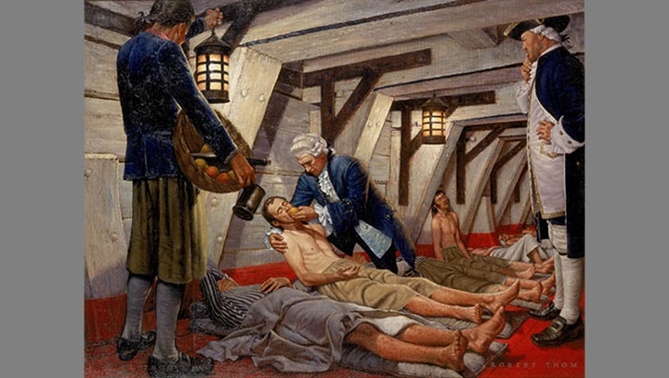
Vitamin C deficiency
SCURVY : Rare nowadays especially severe forms.
Characterized by the breakdown of connective tissue.
Deficiency is usually a result of:
low consumption of fresh fruits and vegetables
Displaced populations who rely on cooked, fortified rations and who do not have access to fresh fruits and vegetables are at a high risk for deficiency. Outbreaks have been repeatedly reported from refugee camps.
Chronic alcoholics, institutionalized elderly
vitamin C is low in cow’s milk, infants can be at high risk for vitamin C deficiency.

Slide 29
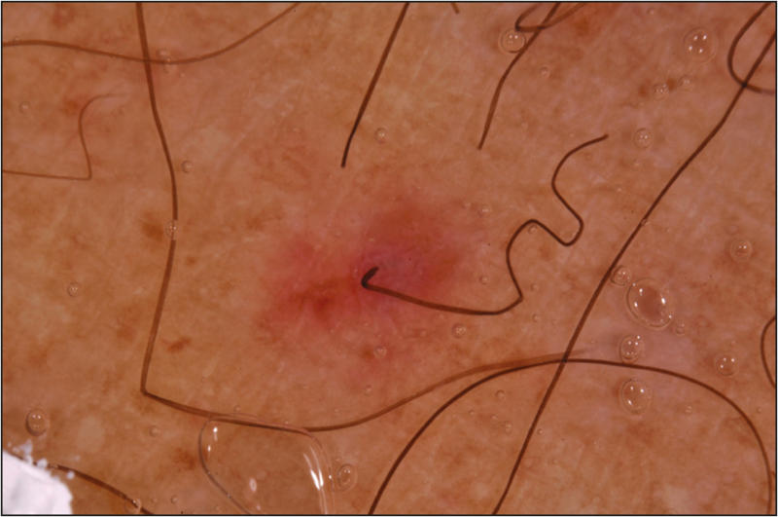
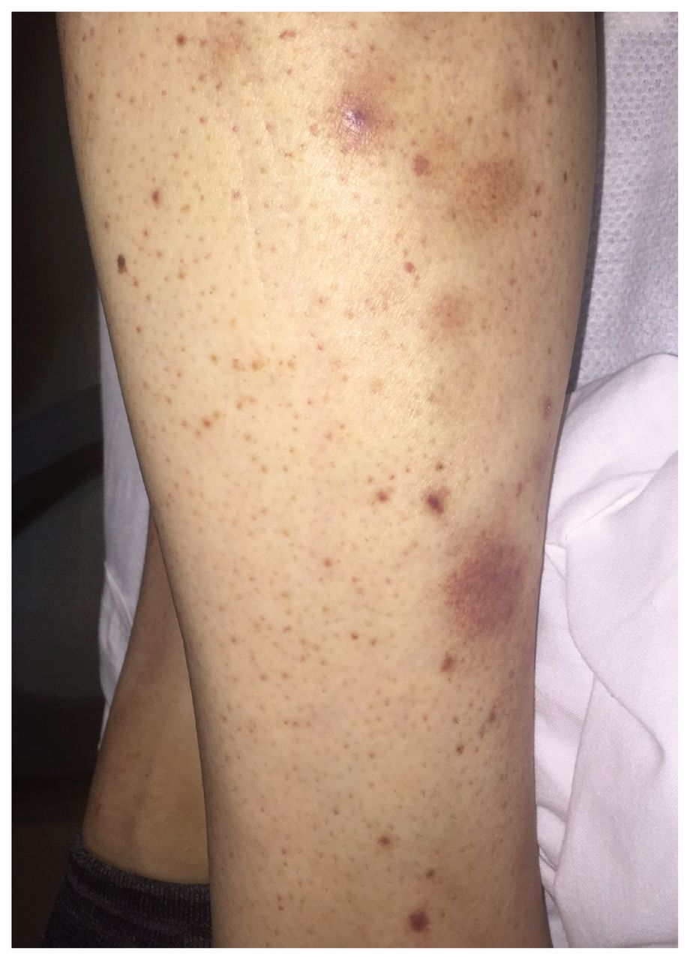
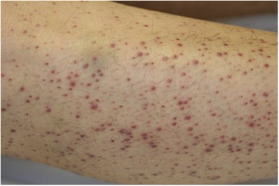
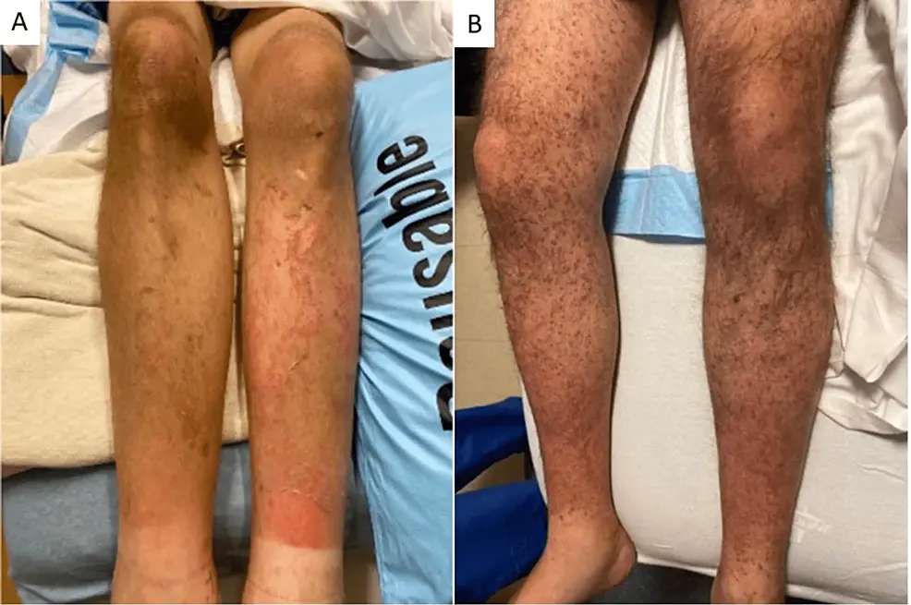
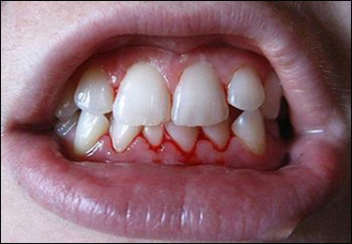
Perifollicular haemorrhage AND corkscrew hair

Slide 30
THANK YOU

