Slide 1
وسهلا
أهلا
الأستاذ الدكتور/ يوسف حسين
أستاذ التشريح وعلم الأجنة
كلية الطب – جامعة الزقازيق- مصر
دكتوراة من جامعة كولونيا المانيا
د. يوسف حسين (استاذ التشريح)

Slide 2
frontal process of the maxilla
1
Nasal bone
Infraorbital foramen
nasal cartilage
Greater alar cartilage
Boundaries External nose

Slide 3
2
infratrochlear nerve ophth N.
external nasal nerve ophth. N.
Infraorbital nerve
Max. N
Blood supply of external nose as the nerve supply
Nerve supply
of External nose

Slide 4
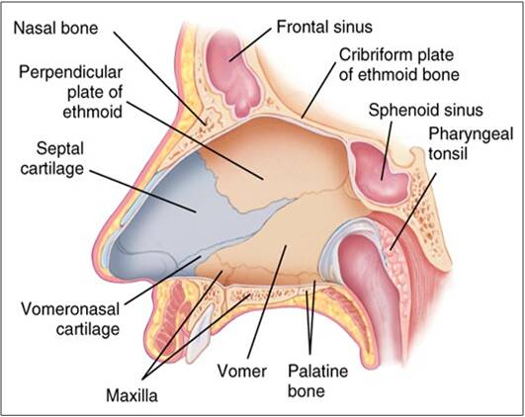
Roof
Frontal sinus and frontal bone
Body of sphenoid
Medial wall
5
Palatine process of
Floor
Horizontal plate

Slide 5
Lateral wall
Anterior
Posterior
Nasal bone
Ethmoid bone
Frontal process of of the maxilla
lacrimal bone
medial Pterygoid plate of the sphenoid bone
maxilla
Palatine bone
Inferior concha
7

Slide 6
Nasal conchae
Superior concha of the ethmoid bone
Frontal sinus
Sphenoid air sinus
inferior concha
middle concha
9

Slide 7
Lateral wall
Sphenoethmoidal recess
Frontal sinus
Superior concha
Superior meatus
Middle meatus
sphenoid air sinus
inferior concha
middle concha
Inferior meatus
11

Slide 8
13
Roof & upper part
Posterior superior alveolar N
Ophthalmic nerve
Anterior superior alveolar N
Pterygopalatine ganglia

Slide 9
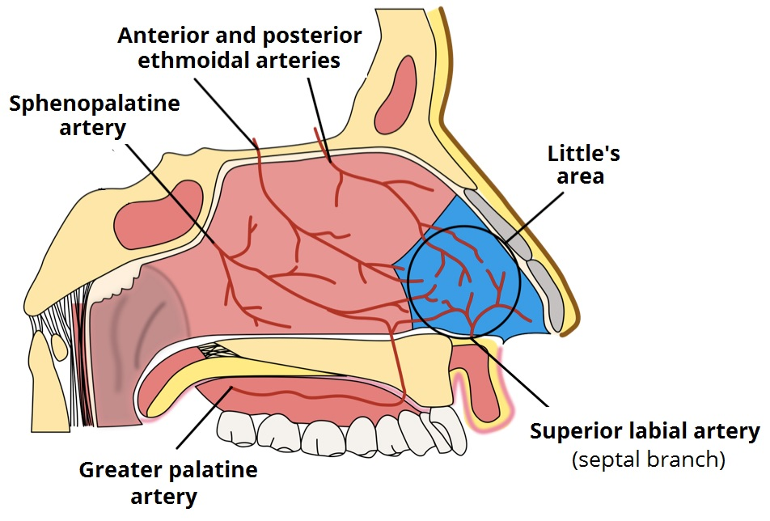
Arterial blood supply of the nose
14
2 ethmoidal ICA
2 palatine ECA
2 Superior ECA
Kieselbach’s plexus,- common site for epistaxis
Anterior superior alveolar artery

Slide 10
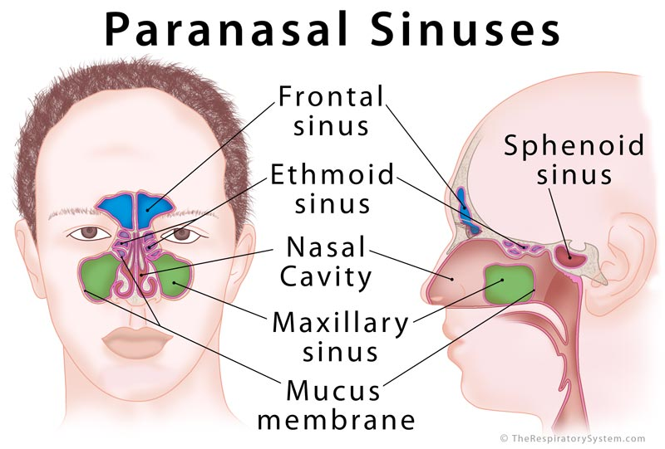
4
18

Slide 11
Paranasal sinuses
frontal sinus
20
Sphenoidal sinus
Ethmoidal air sinuses
Between nose & orbit
- Anterior
- Middle
- Posterior
Sphenoidal sinus is related to
- Pituitary gland (above)
- Cavernous sinus (on each side)

Slide 13
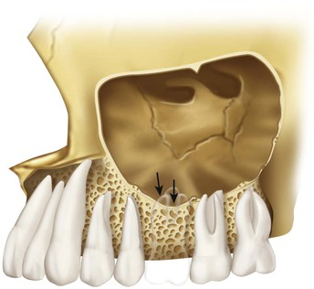
Maxillary sinus

Slide 14
Maxillary sinus
23
Base
Roof
The floor of the orbit
The lateral wall of the nasal cavity
Apex
Zygomatic process of maxilla
Roots of upper teeth
Alveolar process of maxilla
Floor

Slide 15
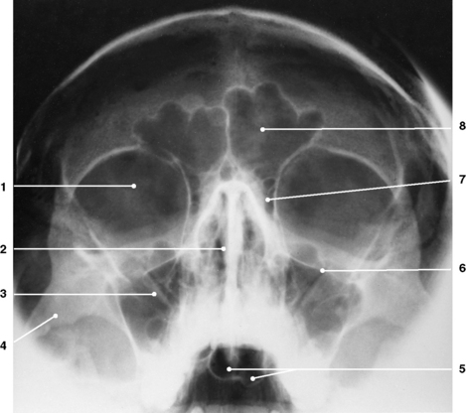
26
Frontal sinus
Ethmoid sinus
Nasal sputum
Maxillary sinus
Sphenoid
sinus

Slide 16
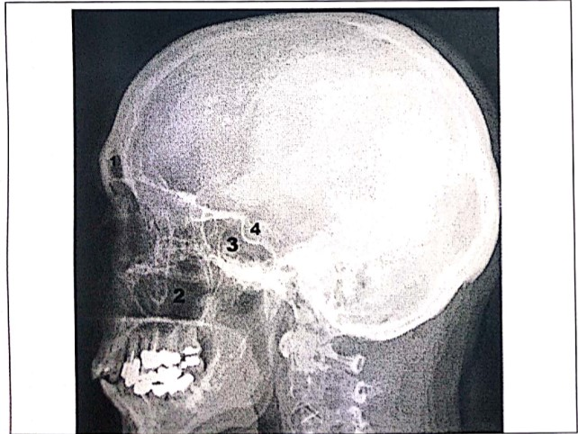
frontal sinus
Hypophyseal
fossa
Sphenoidal
sinus
Maxillary sinus

Slide 17
- extending from the root of the tongue to the trachea (from C3 to C6 vertebra)
C3 vertebra
extension
Larynx
C6 vertebra
Lower border of Cricoid cartilage
2

Slide 18
Cartilages
3 paired
3 single
Cuneiform cartilage
Epiglottis
Thyroid cartilage
(Adam's apple).
Corniculate cartilage
Arytenoid cartilage
Cricoid cartilage
3

Slide 19
Epiglottis is a leaf-shaped plate
C3 vertebra
Epiglottis
Free Upper margin
Epiglottis
Narrow Inferior end to the inner aspect of thyroid
Post. Surface of epiglottis
4

Slide 20
Epiglottis
Median Glosso-epiglottic fold
Lateral Glosso-epiglottic fold
Root of tongue
Ant. Surface of epiglottis
Valleculae
5

Slide 21
Thyroid notch
Superior horn
Thyroid lamina
Angle
Posterior margin
laryngeal prominence (Adam's apple).
Inferior horn
Thyroid Cartilage
7

Slide 22
signet-ring shaped
Cricoid cartilage
Arytenoid cartilage
Broad posterior lamina
Articular facet for Arytenoid cartilage
Narrow anterior arch
Cricoid cartilage
Is the only complete cartilaginous ring in the whole of air passage
9

Slide 23
Arytenoid cartilages (Key cartilage)
Medial surface
Corniculate cartilage
Apex
Arytenoid cartilage
Muscular process
Crico- Arytenoid joint
Base
Cricoid lamina
Vocal process
pyramidal in shape
11

Slide 24
Joints of larynx (Synovial)
Anterior
Posterior
Arytenoid
Inferior horn Thyroid
Cricoid
Cricoid
Forward and backward.
abduction and adduction.
13

Slide 25
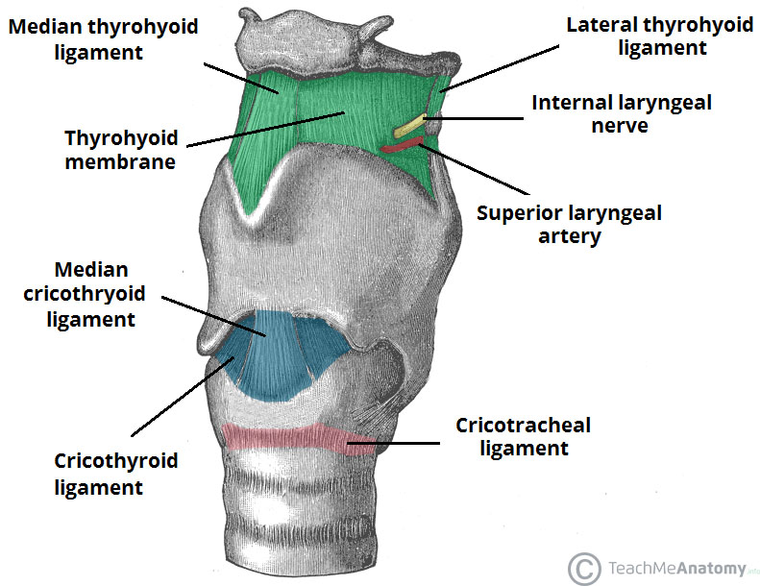
Membranes and ligaments of the larynx
H
Pierced by
T
C
Lateral
1st T ring
15

Slide 26
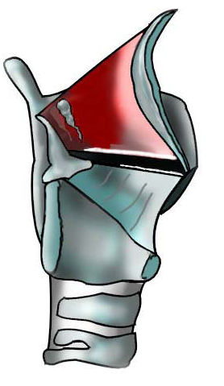
Conus elasticus
Cricothyroid membrane
Upper free margin
vocal ligament
Thyroid angle
Vocal process of Arytenoid cartilage
Cricothyroid membrane
lower margin
Cricoid arch
17

Slide 27
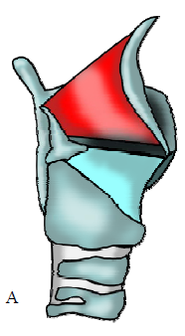
Upper free margin aryepiglotic fold
Quadrangular
Membrane
Epiglottis
Short posterior attachment
Longer anterior attachment
Arytenoid cartilage
Lower free margin
Vestibular ligament
False vocal cord
18

Slide 28
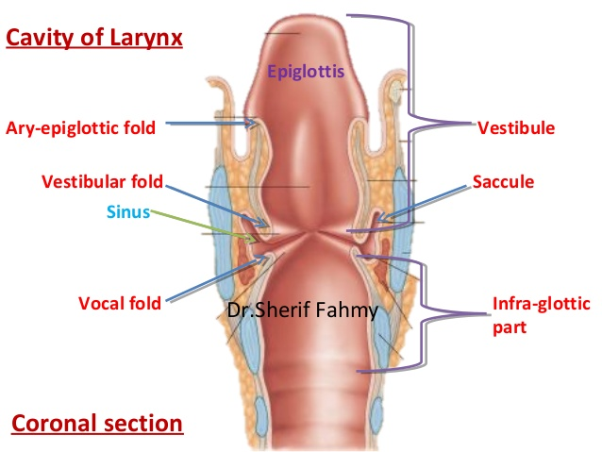
Rima vestibuli
Rima glottidis
Infraglottic part
20

Slide 29
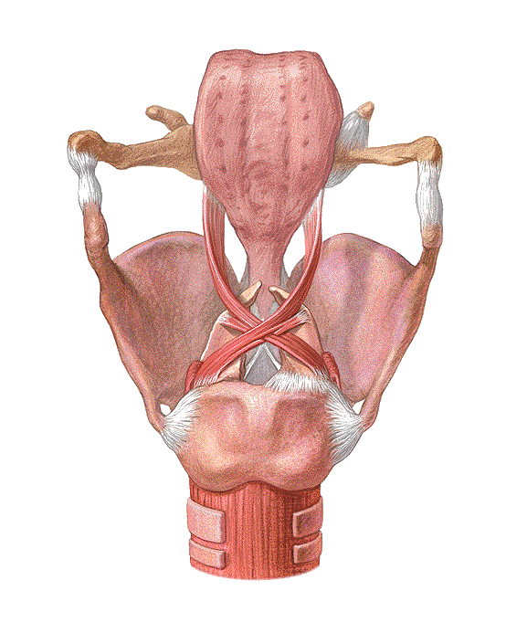
Muscles Controls the inlet of larynx
(act as sphincter of the inlet)
Oblique Arytenoid muscle
From muscular process of one arytenoids cartilage to apex of opposite one
Aryepiglottic muscle
From arytenoids cartilage to epiglottis
Aryepiglottic muscle
Oblique Arytenoid muscle
22

Slide 30
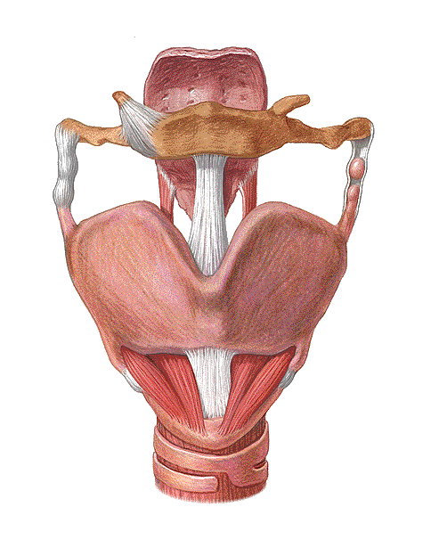
Muscles which stretch and relax the vocal cords
Cricothyroid muscle: From the arch of cricoid cartillage to the inferior horn and lamina of the thyroid cartilge
Thyro-arytenoid muscles relax vocal cords : from back of thyroid angle to arytenoids cartilage.
Cricothyroid stretch
only muscle lies outside
Lateral view
Front view
23

Slide 31
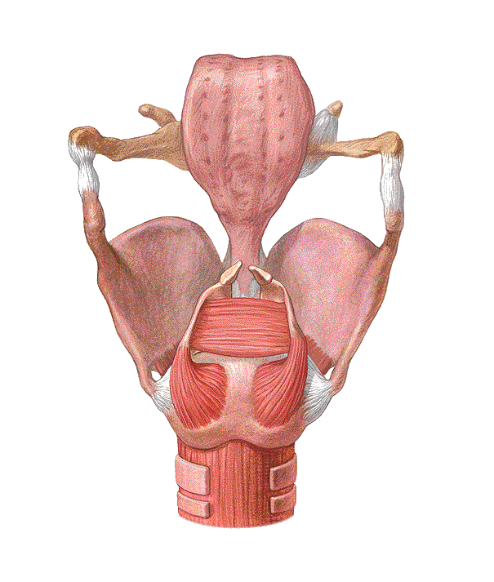
Muscles abduct and adduct the vocal cord
Adduction
Abduction
- Transverse Arytenoid (Only single)
Posterior cricoarytenoid
- Lateral cricoarytenoid
The most important muscle
24

Slide 32
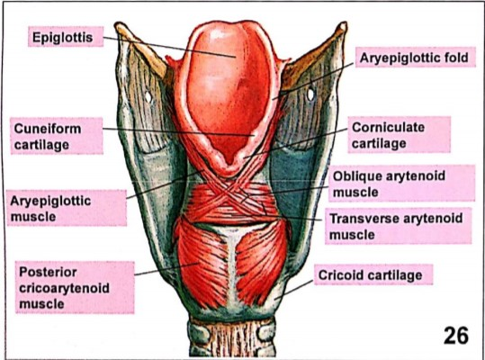

Slide 33
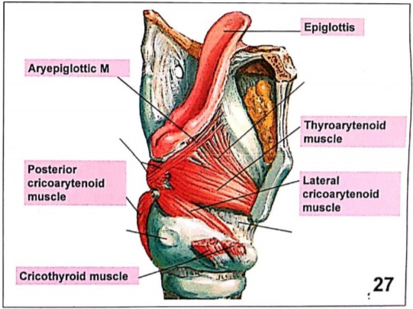

Slide 34
Nerve supply of larynx
1- Superior Laryngeal N
Internal Laryngeal N
External Laryngeal N
Cricothyroid M
2- Recurrent Laryngeal N
28

Slide 35
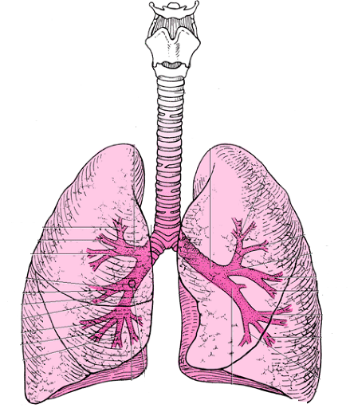
Trachea
Beginning
6th CV
Cervical part
Length
B
B
Thoracic part
10-15 cm
Lower border of T4, sternal angle
End
31

Slide 36
- It is formed of 18-20 C-shaped cartilaginous rings.
cartilaginous rings
Trachealis muscle allow dilatation of the esophagus during deglutition.
Esophagus
32

Slide 37
Trachea is slightly deviated to the right of the median plane
The lower tracheal ring has a keel like extension known as Carina.
Tracheostomy It is done between the 2nd and 3rd tracheal rings about 3 cm above the suprasternal notch (T2/T3) midway between cricoid and sternal notch
Last ring Carina
Apex
33

Slide 38
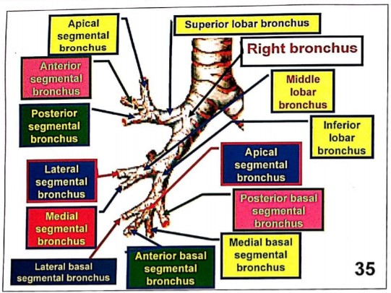

Slide 39
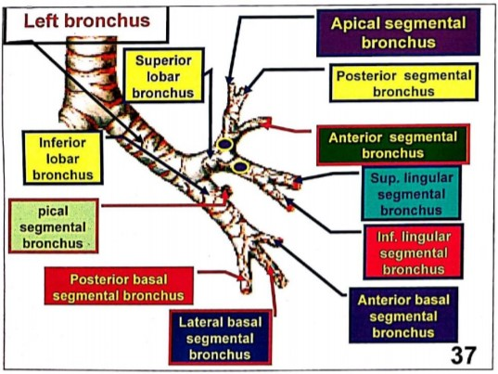

Slide 41
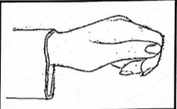
Hilum (root) of lung
Pulmonary ligament
It is the thickened part of the pleura below the root of the lung

Slide 42
Parts of the parietal pleura

Slide 43
pericardium
Cervical pleura
Costal pleura
C3,4,5
Phrenic nerve
mediastinal pleura
diaphragmatic pleura

Slide 44
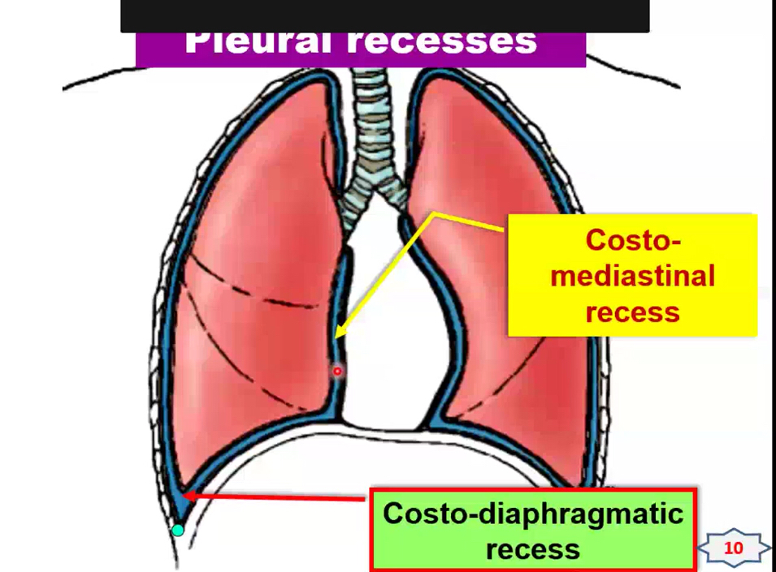
Pleural recesses

Slide 45
To avoid possible

Slide 46
Position
mediastinum
Pleura
Lungs

Slide 47
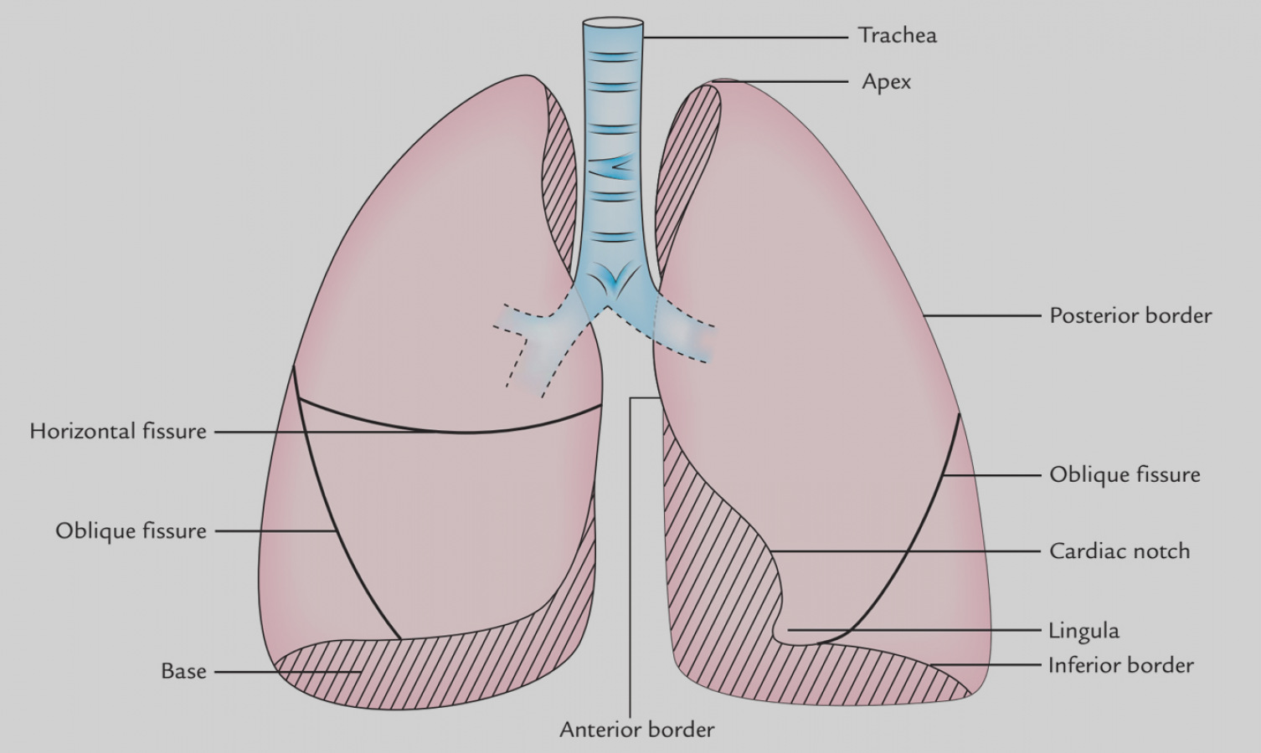
Lungs
Lobes and borders
Apex
Upper lobe
Post. border
Upper lobe
Horizontal fissure
Oblique fissure
Middle lobe
Oblique fissure
Cardiac notch
Lower lobe
Lower lobe
Lingula
Inferior border
Anterior border
Base

Slide 48
Surface anatomy of the pleura and lungs (ant.)

Slide 49
Surface anatomy of the pleura and lungs (post.)

Slide 50
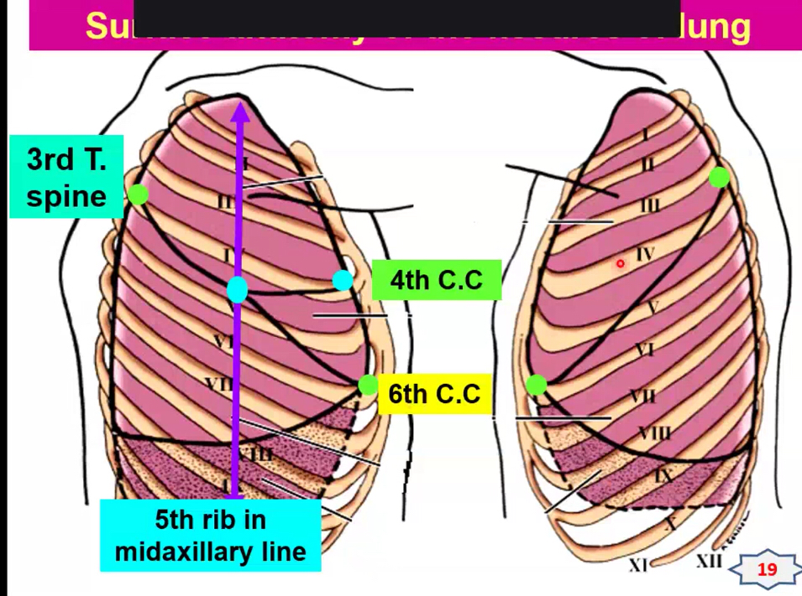
Surface anatomy of the fissures of the lungs

Slide 51
Medial surface
Apex
mediastinal surface
1
2
Anterior border
Vertebral surface
U
Posterior border
M
TF
L
Hilum of lung
Right lung
Base of lung
OF

Slide 52
Right Phrenic nerve
Groove for right

Slide 54
Left lung

Slide 55
common

Slide 56
Eparterial bronchus

Slide 57
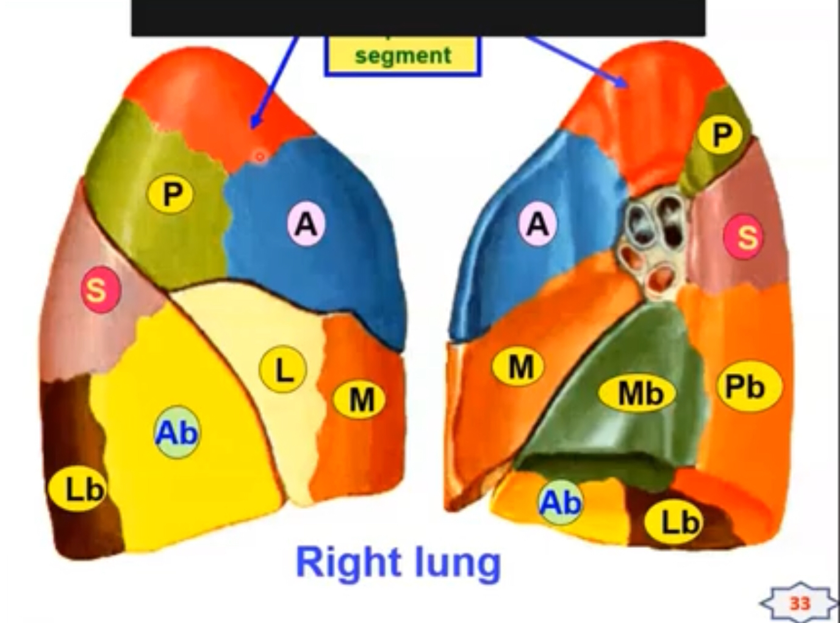
Apical

Slide 58
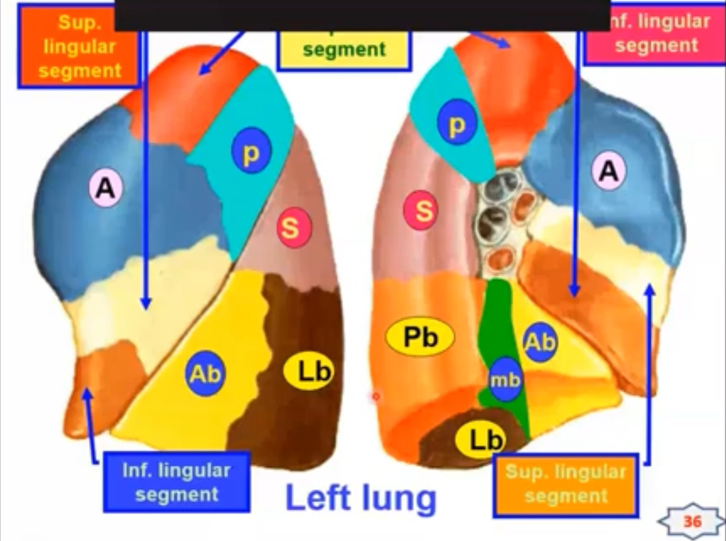
Apical
inferior

Slide 59
Lymphatic
5-Bronchomediastinal trunck

Slide 60
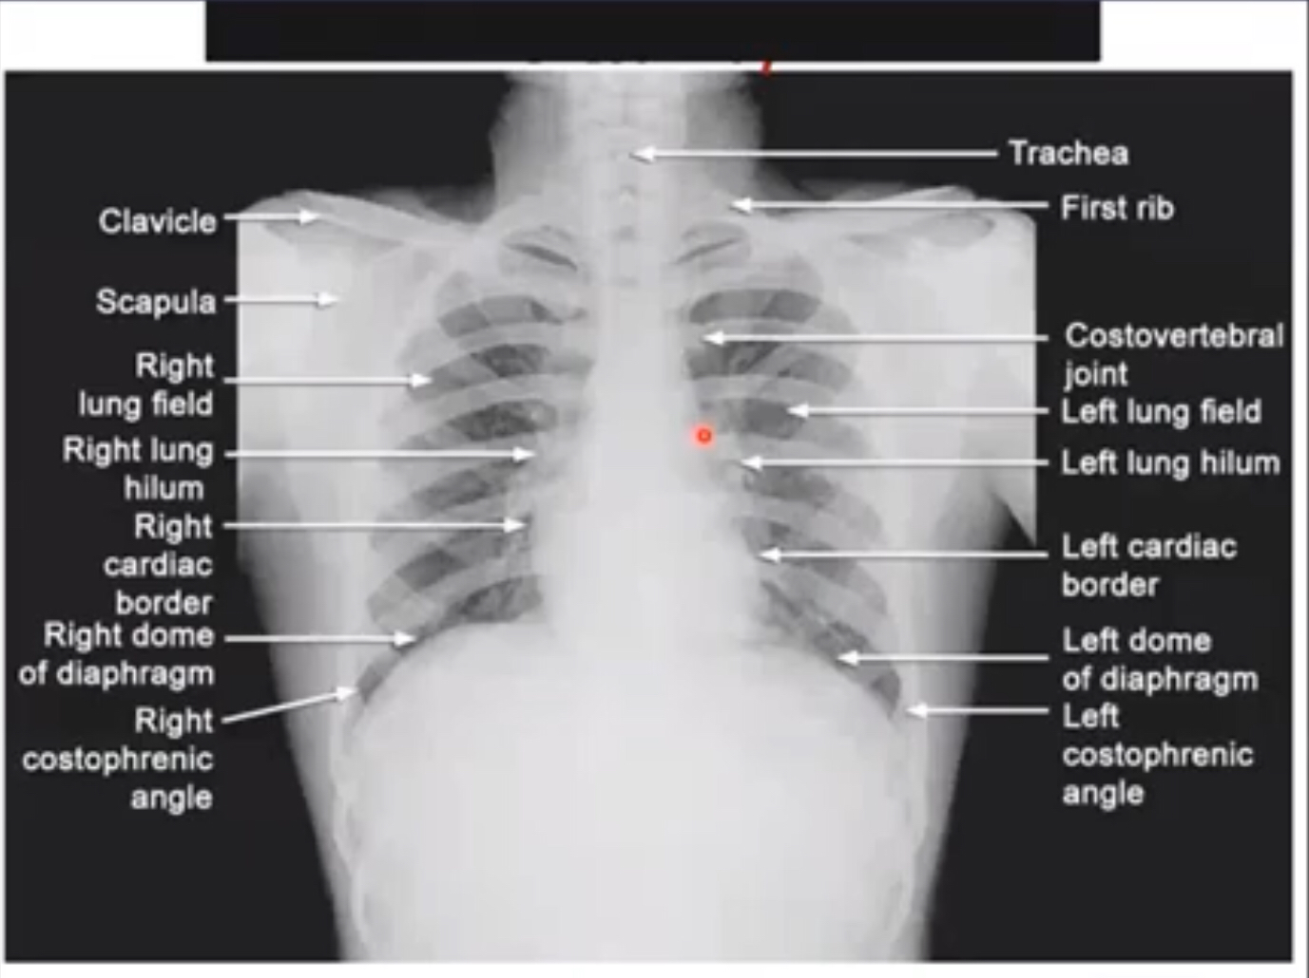
Chest x-ray

