Slide 1
GALL BLADDER &BILIARY PASSAGE
DR. DALIA M. BIRAM

Slide 2
GALL BLADDER
The gallbladder (gall-=bile) is a pear-shaped sac that is located on the inferior surface of the liver.
It is 7–10 cm (3–4 in.) long and part of it typically hangs below the anterior inferior margin of the liver

Slide 3
Gallbladder
The parts of the gallbladder are:
the broad fundus, which projects downward beyond the inferior border of the liver
the central portion, called the body
and a tapered portion called the neck.
The body and neck project superiorly

Slide 5
BLOOD SUPPLY&Lymphatic drainage
It is supplied by the cystic artery (from right branch of hepatic artery). Its venous drainage goes to the cystic vein which drains to the right branch of portal vein.
The gallbladder drains into nodes in the porta hepatis and to the cystic node in Calot’s triangle, which is found at the junction of the cystic duct with the common hepatic duct.

Slide 8
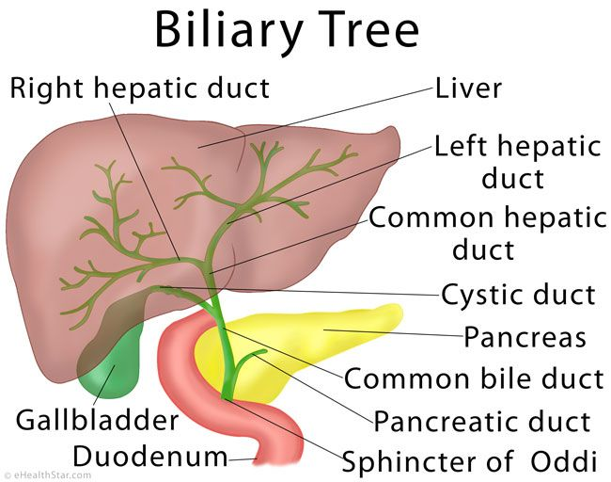
BILIARY DUCTs
The biliary ducts convey bile from the liver to the duodenum.
Bile is produced continuously by the liver and stored
and concentrated in the gallbladder, which releases it intermittently when fat enters the duodenum.
portal triads (terminal branches of the hepatic portal vein
and hepatic artery and initial branches of the biliary ducts).

Slide 9
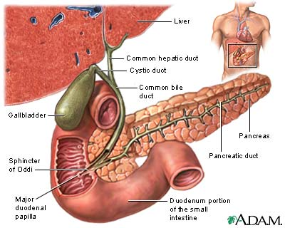
Biliary Tract
Part of the digestive system.
Made up of:
Intra hepatic ducts
Extra hepatic ducts
Gallbladder
Common Bile Duct
Notes:
9

Slide 10
BILIARY DUCT
The hepatocytes secrete bile into the bile canaliculi formed between them. The canaliculi drain into the small interlobular biliary ducts and then into large collecting bile ducts of the intrahepatic portal triad, which merges to form the hepatic ducts
The right and left hepatic ducts drain the right
and left (parts of the) liver, respectively.
Shortly after leaving the porta hepatis, these hepatic ducts unite to form the common hepatic duct,
common hepatic duct is joined on the right side by the cystic duct to form the bile duct (part of the extrahepatic portal triad of the lesser omentum), which conveys the bile to the duodenum

Slide 11
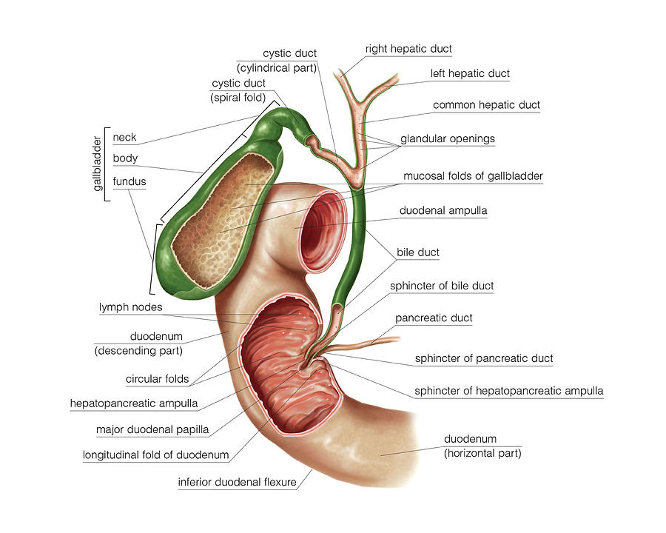

Slide 12
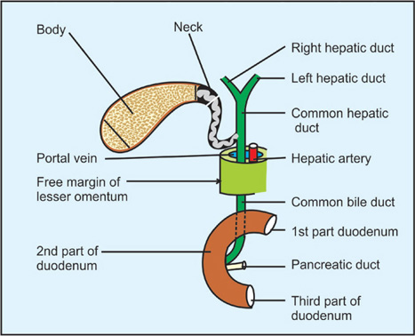
BILE DUCT
The bile duct (formerly called the common bile duct) forms in the free edge of the lesser omentum by the union of the cystic duct and common hepatic duct anterior to the portal vein.
The length of the bile duct is about 3 inches, depending on where the cystic duct joins the common hepatic duct.
The bile duct descends posterior to the superior part of the duodenum and lies in a groove on the posterior surface of the head of the pancreas.

Slide 13
On the left side of the descending part of the duodenum, the bile duct comes into contact with the main pancreatic duct.
These ducts run obliquely through the wall of this part of the duodenum, where they unite, forming a dilation, the hepatopancreatic ampulla The distal end of the ampulla opens into the duodenum through the major duodenal papilla
The circular muscle around the distal end of the bile duct is thickened to form the sphincter of ODDI

Slide 14
