Slide 1
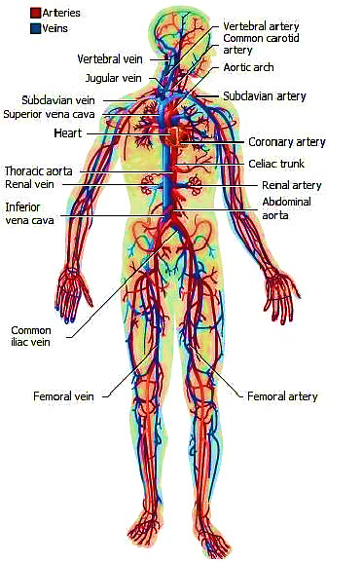
The vascular system Professor Dr. Hala El-mazar (Part 1)

Slide 2
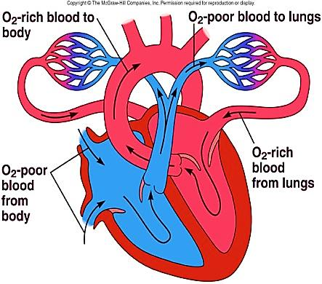
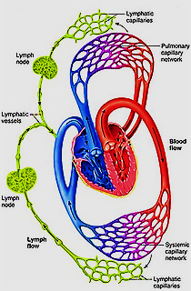
Circulatory system
I. Blood -vascular
II. Lymphatic vascular

Slide 3
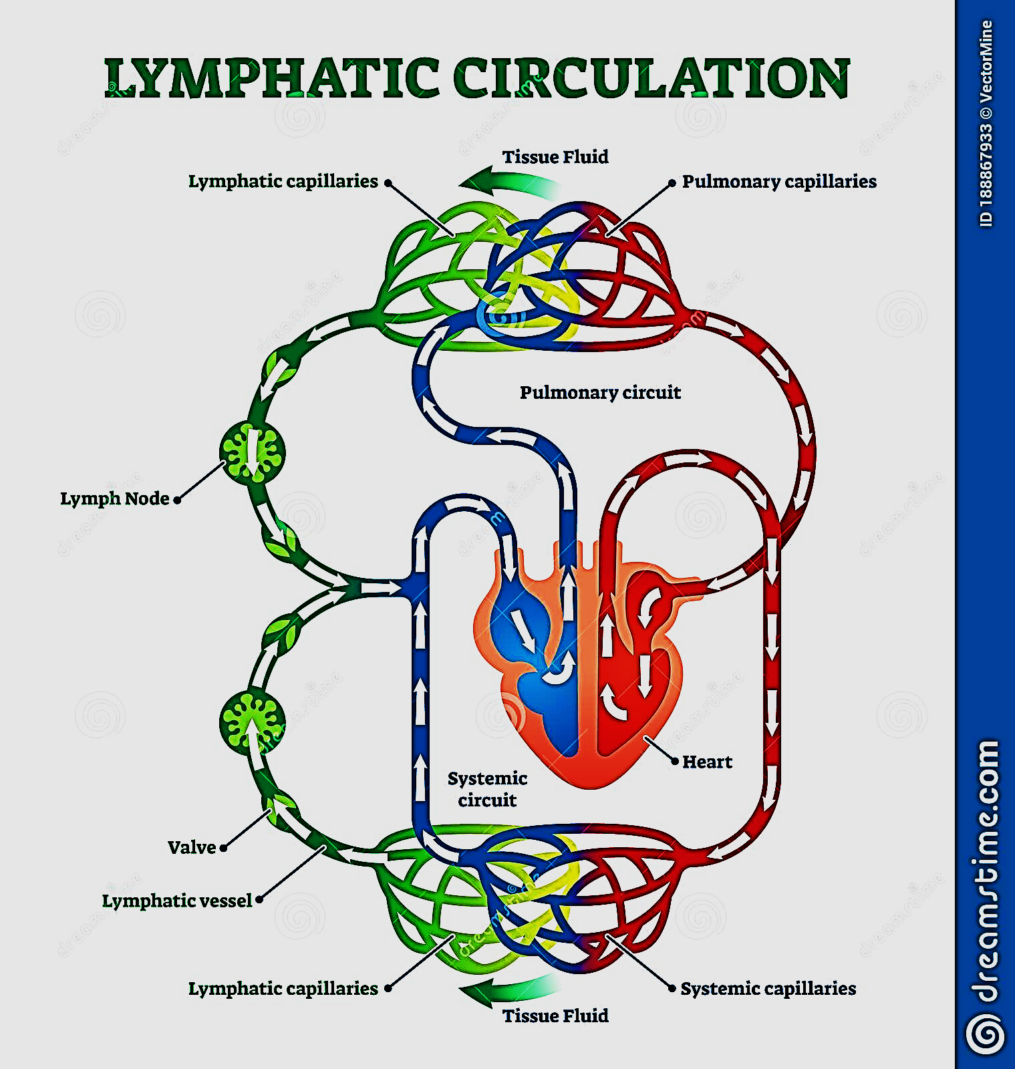

Slide 4
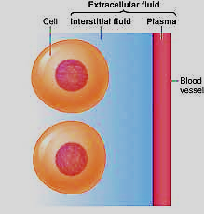
Cardio-vascular system
Includes: The heart + blood vessels + blood
Humans have a closed circulatory system
( blood circulates within vessels & is distinct from interstitial fluid)
The heart pumps blood into large vessels that branch into smaller ones ending in organs at what called capillaries
Materials are exchanged by diffusion between the blood and the interstitial fluid around the cells.

Slide 5
Main functions of the Vascular system
Transport of oxygen, carbon dioxide, nutrients, hormones, metabolic products, cells of immune defense system and many other essential products
Gaseous exchange: blood / air in lung
Temperature control

Slide 6
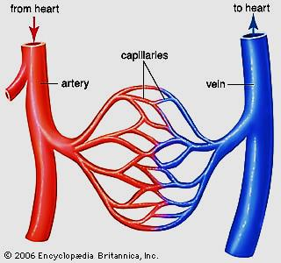
The blood vessels
Include:
Arteries: Large (elastic) arteries
Medium (muscular) arteries
Arterioles
Veins: Large veins
Medium sized veins
Venules
Microcirulation:
Capillaries
Arterio –venous anastomosis

Slide 7
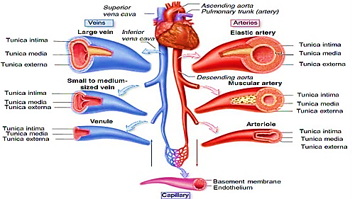
The vascular system
The transition from one type of vessels to another is gradual

Slide 8
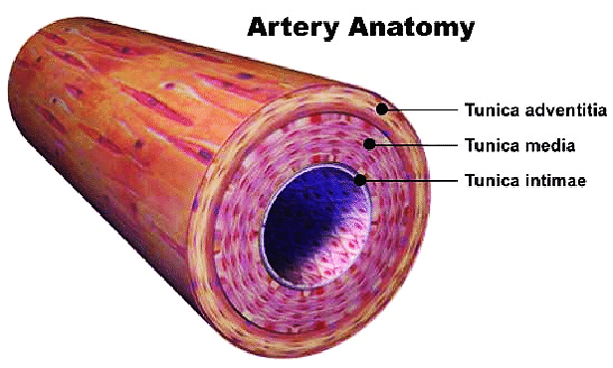
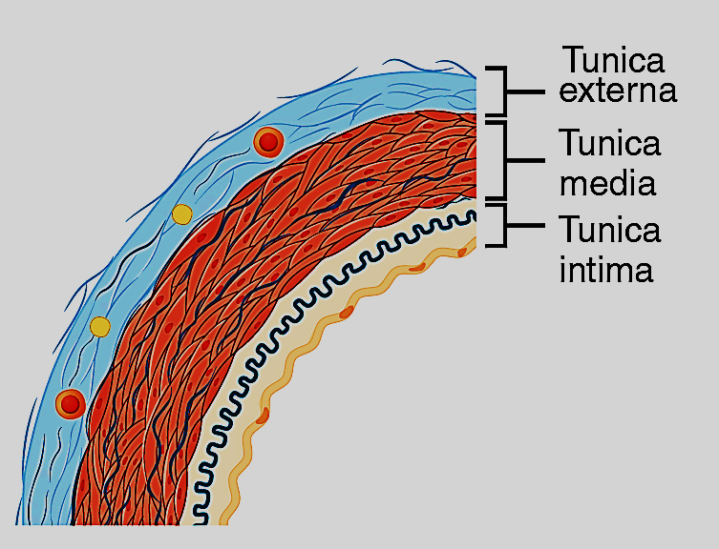
General structure of the wall of a blood vessel
Formed of 3 layers or tunics (Except for capillaries)
(inside → outside)
Tunica intima
Tunica media
Tunica adventitia

Slide 9
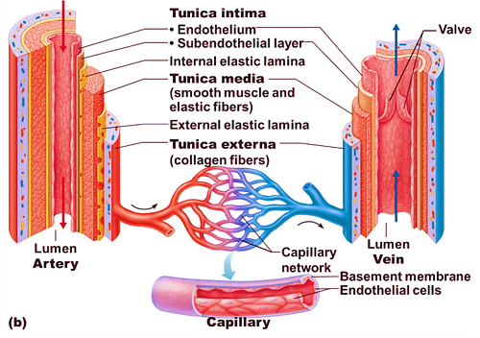
L.S showing the wall, of the Blood Vessel

Slide 10
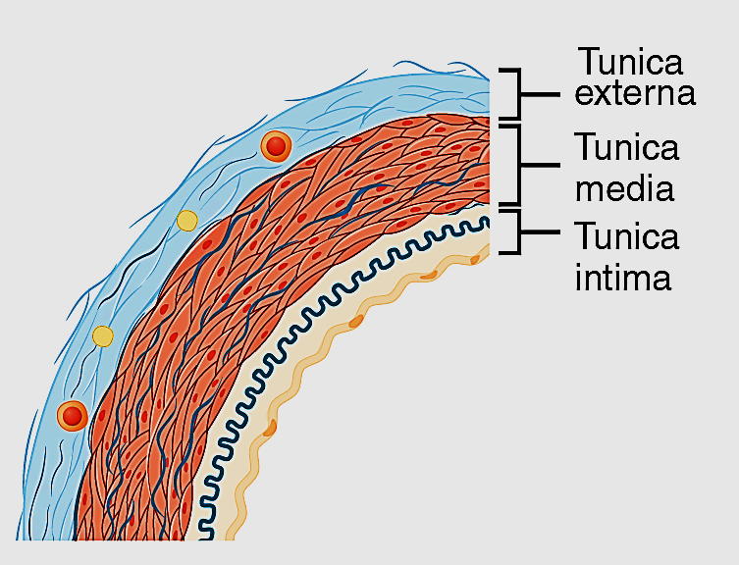
Tunica intima
1- Endothelium:
simple squamous epith - basal lamina
(smooth surface , easy diffusion /exchange)
2- Sub-endothelium:
contains fibrocytes, macrophages and
smooth muscle like-cells called Myointimal
Cells. The collagen and elastic fibers
are longitudinally arranged.
3- Internal elastic lamina (IEL):
Layer of elastic fibers separates intima from media
Present ONLY in arteries , very clear in muscular arteries,
absent in veins & small arterioles
(for elasticity & prevent complete occlusion of arteries)
The IEL composed of elastin , has holes that allow the diffusion of substances to nourish cells deep in the vessel wall
IEL

Slide 11
Structure of the wall of the bold vessel

Slide 12
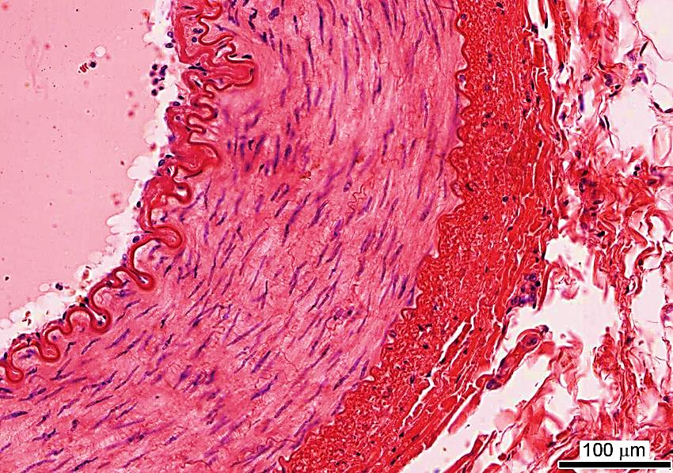
Tunica media
Middle layer of circularly arranged
smooth muscle cells
Contains collagen & elastic fibers
External elastic lamina (EEL)
separates The tunica media from
adventitia
Elastic fibers help expansion in systole & its recoil helps maintain blood flow in diastole
The activity of smooth ms. Fibers is regulated by vasomotor autonomic supply
Tunica media

Slide 14
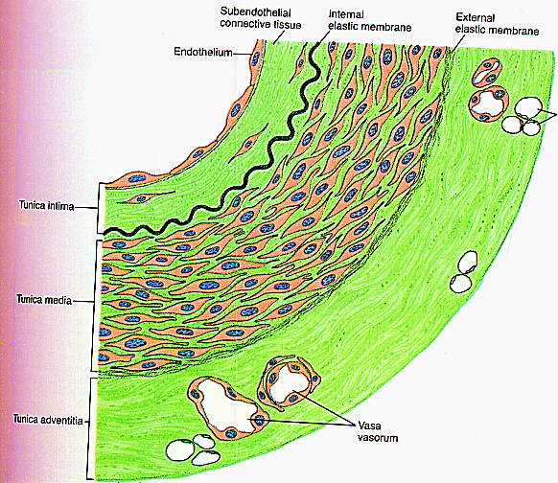
Tunica adventitia
Outermost C.T. layer, contains
collagen fibers more than elastic fibers
Contains nerves, lymphatics & vasa vasorum
( common in large vessels since
their wall is too thick to be nourished solely by
diffusion from blood in lumen)
It prevents over distension of vessel
Anchor the blood vessel to the surroundings
organs and tissues
Prevents shortening if vessel is cut
Since veins carry deoxygenated blood they
have vasa vasorum More than arteries
Vasa vasorum

Slide 15
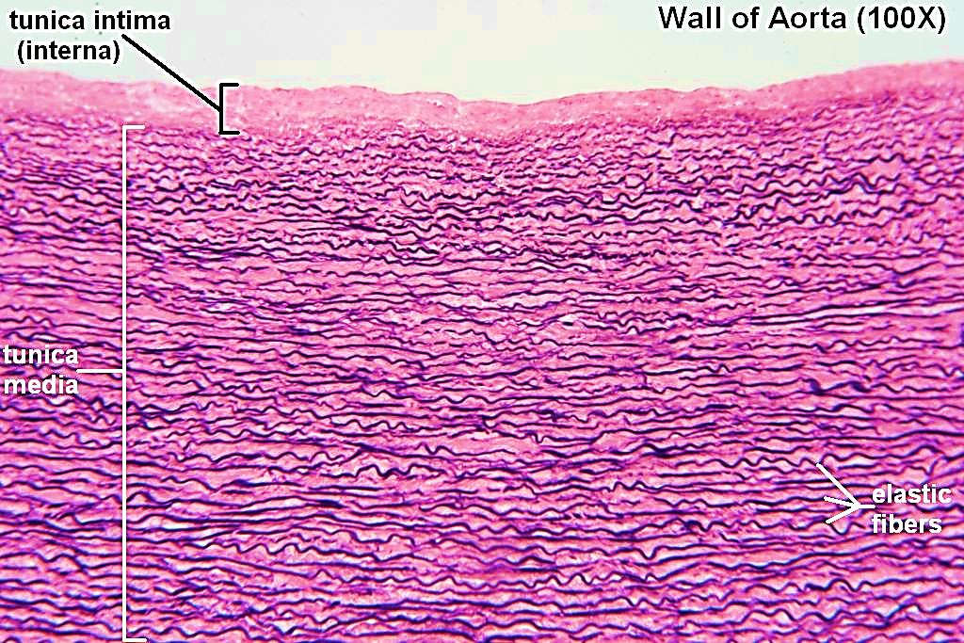
Large (Elastic) arteries/ Aorta
Large branches e.g. pulmonary, subclavian, innominate a.
Wide lumen + very thick wall ( mainly elastic fibers)
Tunica intima:
Thick sub-endothelium rich in elastic fibers, IEL not clear
Tunica media (70%):
- very thick mostly fenestrated
elastic membranes (elasticity)
+ smooth muscle cells
- EEL not clear
Tunica adventitia:
CT contains collagen +
elastic fibers +vasa vasorum

Slide 16
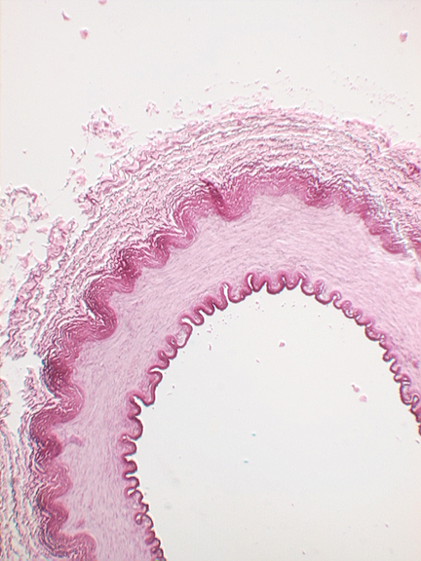
Medium sized (Muscular) arteries
They deliver blood to muscles & organs (renal , coronary)
Their wall is formed mainly of smooth muscles
The transition from elastic to muscular arteries is gradual
(Gradual ↓in elastic fibers & ↑in smooth ms cells )
Tunica Intima: thinner, No subendothelial layer + clear IEL
Tunica media: mainly smooth muscles
(40 layers) + EEL is clear
Tunica adventitia:
Thick CT layer contains collagen &
elastic fibers + V.V.
(Adventitia = Media 50/50 in thickness)
EEL
IEL

Slide 17
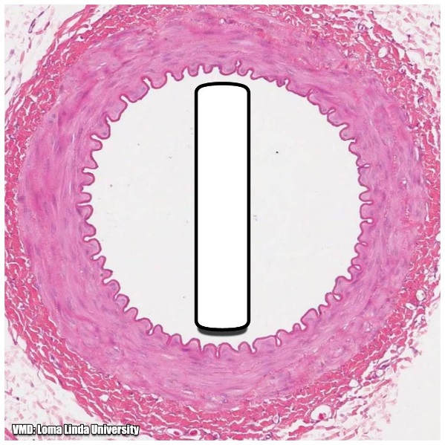
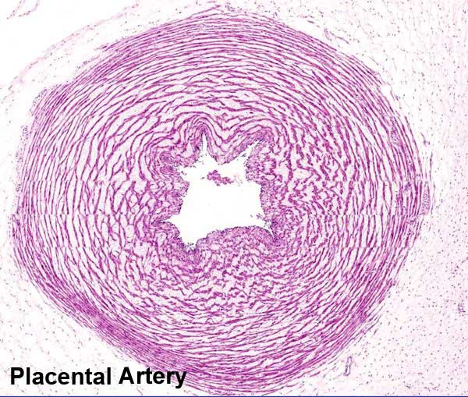
Special types of medium sized arteries
1- Basilar artery: protected by the skull.
Tunica intima : has prominent thick IEL
2- Umbilical artery: in the umbilical cord,
Tunica adventitia: made by Mucoid CT
Umbilical artery

Slide 18
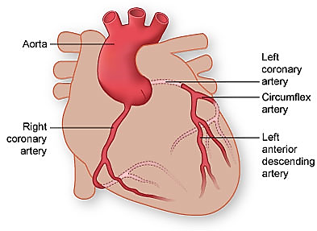
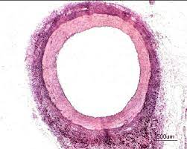
3- Coronary artery:
Tunica intima : shows musculo-elastic cushions that may contribute to development of atherosclerosis
Tunica media: thicker compare to other muscular arteries of same size
(helps with its bending course)
Tunica adventitia: high collagen to elastic ratio which reflects high tensile

Slide 19
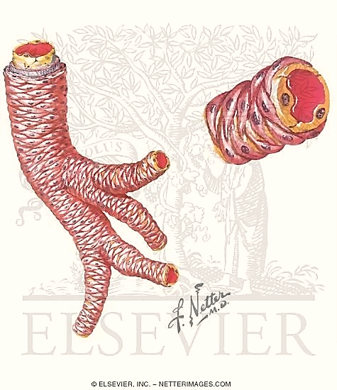
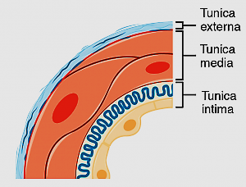
Arterioles (10- 100 µm)
Responsible for peripheral resistance of blood vessels
Control blood flow into capillaries
Tunica intima: thin with thin IEL
(IEL gradually disappear in small
arterioles)
Tunica media: 1 or 2 layers of smooth m.
(gradually disappear & replaced
by pericytes in capillaries
Tunica adventitia : very thin

Slide 20
Arterioles have muscular walls formed of only 1 or 2 layers of smooth muscle

Slide 21
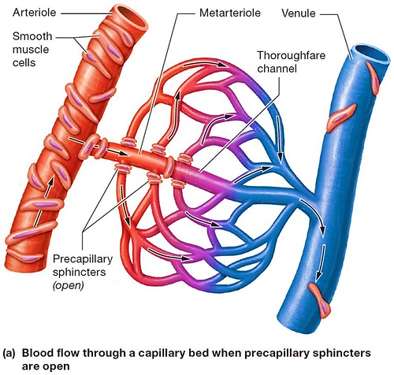
Metarterioles (arterial capillaries)
short micro vessels (8- 10 µm) that links terminal arterioles to capillaries
Instead of continues tunica media they have individual muscle cells placed short distance apart.
Form pre-capillary sphincters
rings of smooth ms fibers
at the entrance to capillaries,
act as a valve to regulate
blood flow into capillary

Slide 22
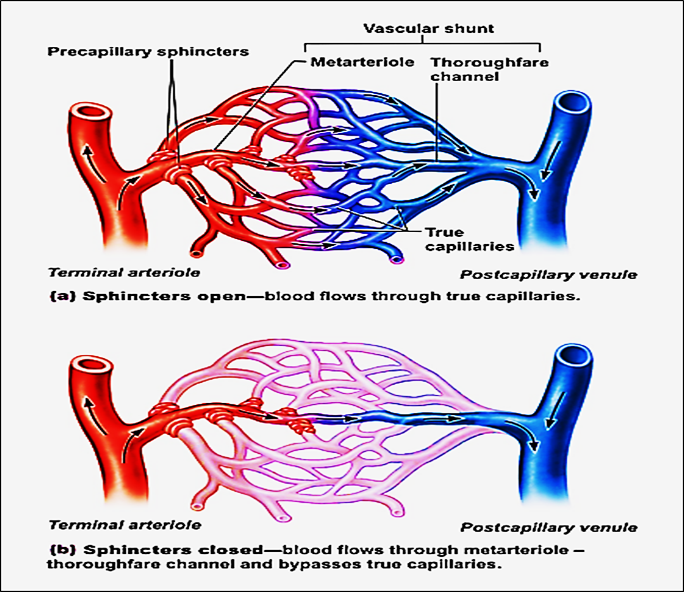
When pre- capillary sphincter relaxed →blood flow through true capillaries → exchange with tissue
When pre- capillary sphincter contracted blood flows through shunts and bypasses tissue cells

Slide 23
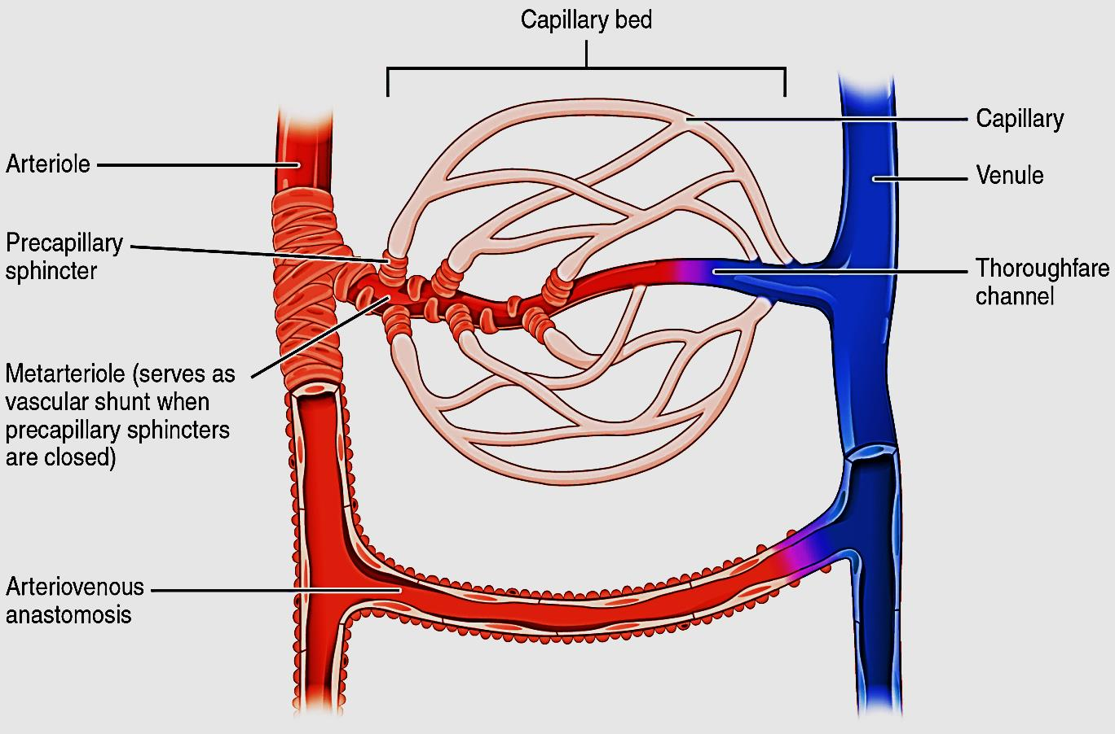
The smooth muscle of metarterioles and the precapillary sphincters contract and relax causing intermittent flow of blood in capillaries this is known as vasomotion.
The osmotic pressure (OP) of plasma proteins plays a role in that process
Thoroughfare channel = the distal half of the metarteriole is called thoroughfare Channel which has no sphincters ( No smooth muscles) and receives blood from the capillary bed , becoming more like a venule

Slide 24
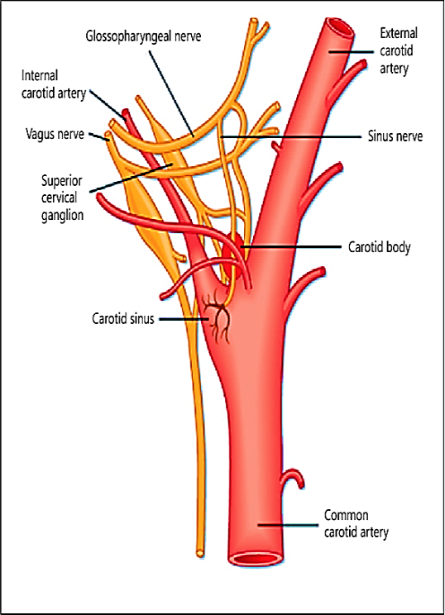
Arterial sensory structures
1- Carotid sinuses:
Dilatation in the wall internal carotid arteries
and in Aortic arch
Contains baroreceptors which monitor
Changes in blood pressure.
- The tunica media of each carotid sinus is
thinner allowing greater distension when
bl. pressure rises
Sensory nerve endings from cranial n. IX glossopharyngeal nerve are embedded in the wall of the artery
Afferent n impulse → brain → trigger adjustment in
vasoconstriction → blood pressure return to normal

Slide 25
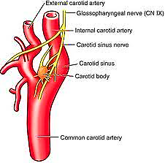
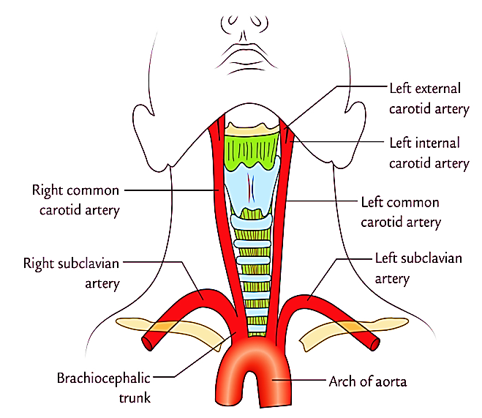
2- Carotid bodies:
- Small , ganglion like structures
Found in the adventitia near the
bifurcation of
common Carotid
arteries
Contain chemoreceptors sensitive to blood Co₂ & O₂
& H˖ concentrations
These structures contains sinusoidal capillaries that -
intermingled with clusters of cells called Glomus cells

Slide 26
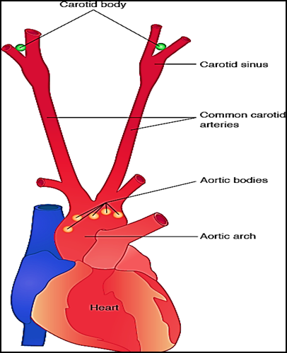
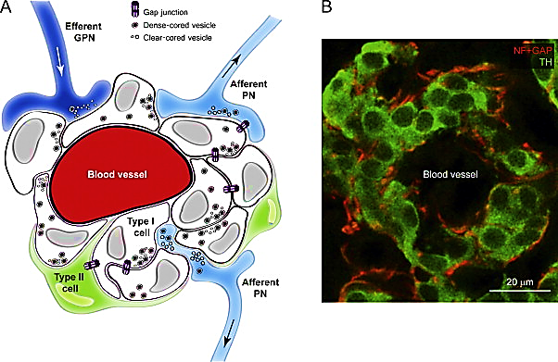
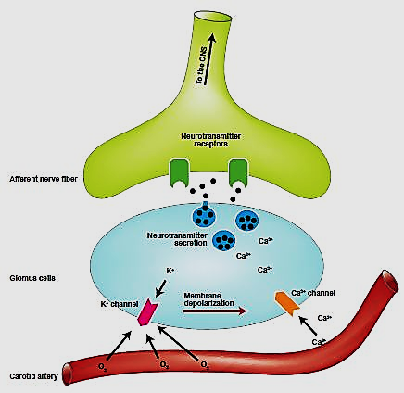
- Glomus cells cytoplasm contain neurotransmitters e.g. dopamine, serotonin , adrenaline,
- Glomus cells form synaptic connection with dendritic fibers of glossopharyngeal nerve. the sensory nerve is activated by neurotransmitters released from glomus cells in response to changes in the composition of the sinusoidal blood
3- Aortic bodies
Located on the arch of aorta similar to carotid bodies

Slide 27
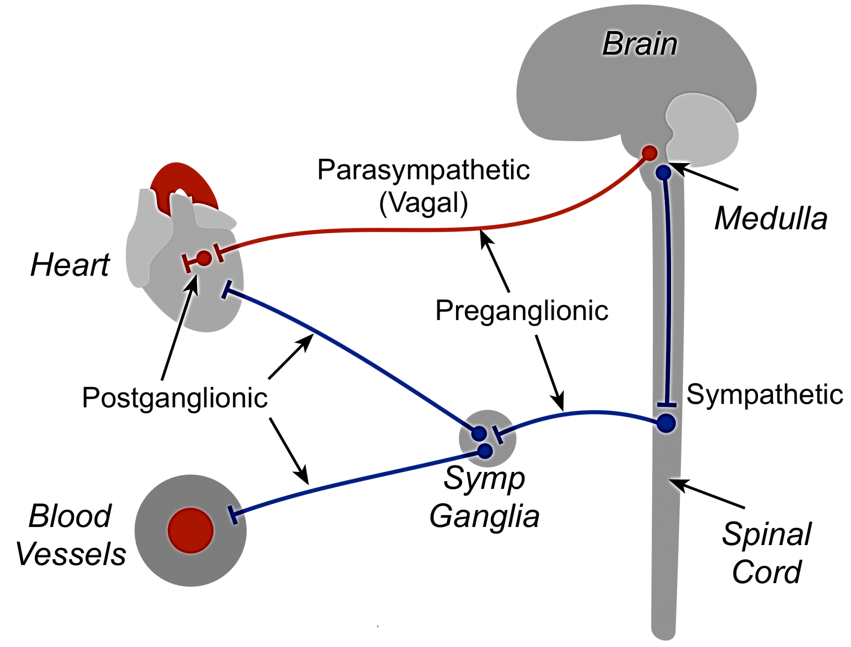
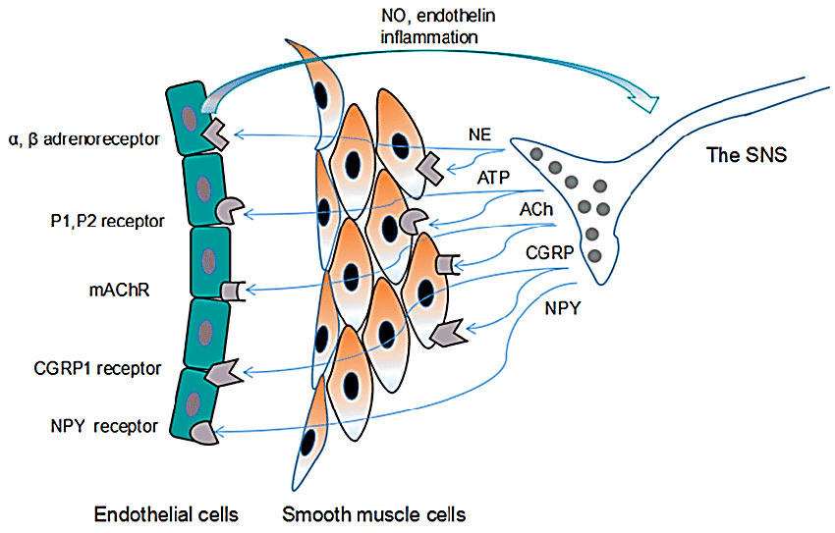
Innervation of blood vessels

Slide 28
Large vessels are supplied with network of sympathetic nerve fibers (vasomotor) whose neurotransmitter is norepinephrine .
Discharge of epinephrine produce vasoconstriction . These efferent nerve fibers generally do not enter the media of arteries, instead they discharge the neurotransmitters which diffuse through the wall to affect the smooth muscle cells of the media
the gap junction between the smooth muscle cells propagate the response

Slide 29
Sympathetic nerve fibers innervate all vessels EXCEPT capillaries ,precapillary sphincters & metarterioles
The density of innervation of veins is less than that of arteries
sympathetic Innervation of small arteries & arterioles → vasoconstriction → increase the peripheral resistance
Vascular smooth muscles are not innervated by parasympathetic nervous system
(except salivary glands, gastrointestinal glands, genital
erectile tissue in male penis)

Slide 30
Vasodilation: is caused through muscarinic receptors on endothelial cells → release endothelium derived relaxing factor nitric oxide → diffuse to muscle cells in media → activates cGMP→ relaxation
However smooth muscles in tunica media posses muscarinic receptors, which when activated cause vasodilation… ( medications can work on them)
Endothelial dysfunction and inflammation are associated with disturbed sympathetic nerve activity in many pathological conditions, such as hypertension, heart failure, and diabetes mellitus.

Slide 31
The arterioles including terminal are well innervated because they contain smooth muscle cells
The capillaries are not innervated cuz they don’t have smooth muscles
Hormones circulate in the blood ( catecholamine, renin-angiotensin, vasopressin, atrial natriuretic peptide can affect the microcirculation causing vasodilation or vasoconstriction
The Exchange of substances through capillaries occur through 3 different mechanisms: Diffusion, bulk flow, transcytosis

Slide 32
Thank you

