Slide 1
Acute Respiratory Distrss Syndrome (ARDS)
.MOHAMMAD HABASHNEH
.MARYAM ALDABABSEH
.MOAWIAH ABED QBELAT

Slide 2
CONTENT
1- Definition
2- Causes&Pathophysiology
3- Clinical manifestation
4-Diagnosis
5- T r e a t m e n t & pr ognosi s

Slide 3
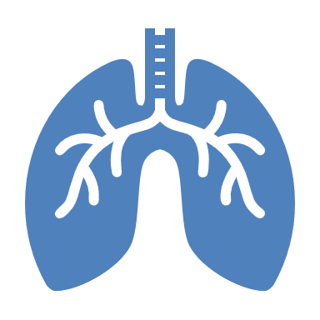
Definition
one of RESPIRATORY DISTRESS SYNDROMES
characterized by:
Acute and diffuse inflammatory damage into the alveolar-capillary barrier associated with a vascular permeability increase and reduced compliance, compromising gas exchange and causing hypoxemia: Po2 < 60mmH / ABG saturation <90%
Rapidly progressive non-cardiogenic pulmonary edema. (PCWP <18 )

Slide 4
Causes
direct lung injury:
Pneumonia
Aspiration (inhalation of stomach contents into the lungs)
Inhalation of toxic substances
Viral infection of the lungs, including by SARS-CoV-2, the coronavirus that causes COVID-19 infection.

Slide 5
indirect lung injury:
Sepsis (Most Common)
Severe trauma to the body (head trauma, burns, multiple bone fractures)
Massive blood transfusion
Pancreatitis (inflammation of the pancreas)
Cardiopulmonary bypass (heart-lung bypass surgery)
Drug overdose (…… Amiodarone)
Out of these possible causes of lung injury, two of them—sepsis and pneumonia—make up 40% to 60% of all ARDS cases.

Slide 6
Pathophysiolgy

Slide 7
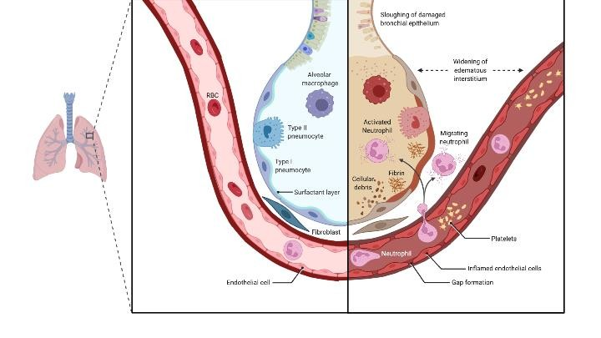
Widespread alveolar damage involving the alveolar epithelial and capillary endothelial cells .
Leak of protein rich fluid resulting in interstitial and alveolar edema causing ‘Hayaline membrane ‘.
Influx of inflammatory cells (neutrophilic alveolitis ).
Damage to surfactants causes alveolar collapse .

Slide 8
The inflammatory response can also activate the coagulation system, leading to the formation of microthrombi in the capillaries.
The microthrombi can further impair gas exchange by reducing the surface area available for gas exchange and increasing the diffusion distance

Slide 9
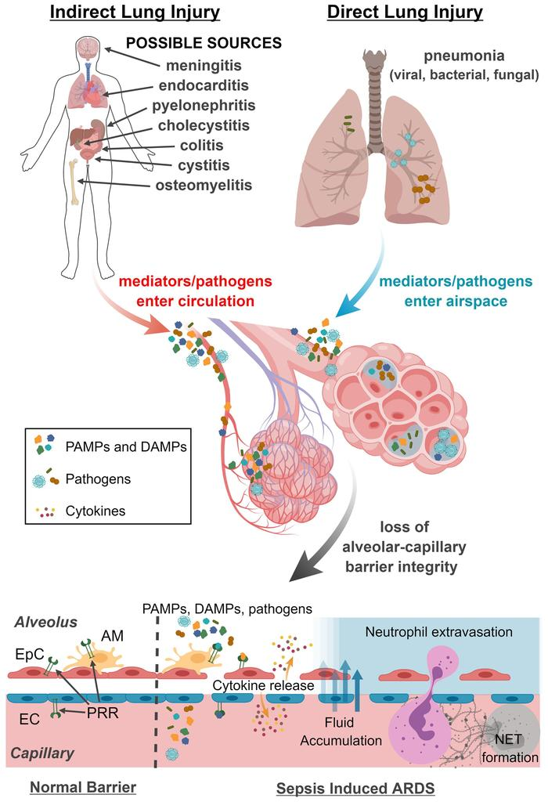

Slide 10
Amiodarone Pulmonary Toxicity:
Amiodarone is an iodine-containing compound like thyroxine and is an antiarrhythmic agent, commonly used to treat supraventricular and ventricular arrhythmias. It tends to accumulate in several organs, including the lungs.
It has got various adverse effects too. Of these events, the most serious is Amiodarone Pulmonary Toxicity (APT).
In patients in whom the dose of amiodarone exceeds 400 mg per day
Amiodarone and its metabolites can produce lung damage directly by a cytotoxic effect and indirectly by an immunological reaction

Slide 11
Clinical Features
Dyspnea,
tachypnea,
tachycardia .
Progressive hypoxemia—not responsive to supplemental oxygen.
Patients are difficult to ventilate and at high risk for barotrauma.

Slide 12
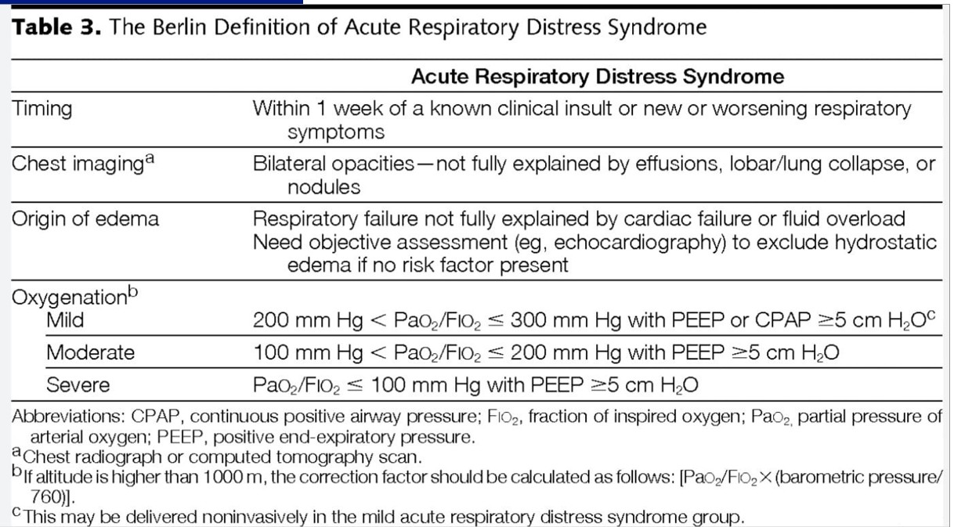
2012
Berlin definition for diagnosing ARDS:
Hypoxemia that is refractory to
oxygen therapy:
ratio of PaO2/FiO2 200 to 300 is mild, 100 to 200 is moderate,
and <100 is severe
Bilateral diffuse pulmonary infiltrates
on CXR
No evidence of CHF clinically or
PCWP ≤18 mm Hg
Respiratory symptomsthat develop
within 1 week of known insult

Slide 13
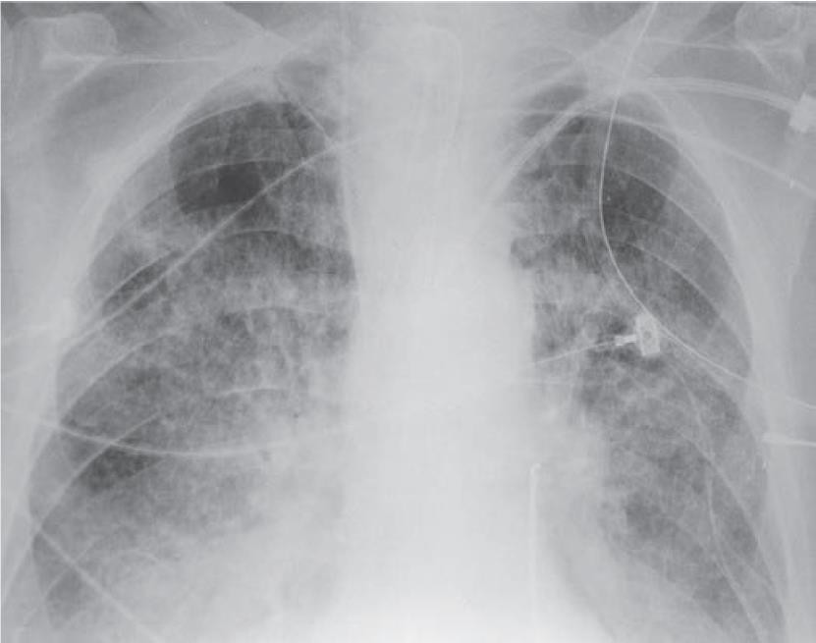
diagnosis
1. CXR: shows diffuse bilateral pulmonary infiltrates
Diuresis improves and volume overload worsens the infiltrates regardless of
CXR findings, the underlying
ARDS may or may not be improved.
CXR improvement follows clinical improvement after 1 to 2 weeks or more.

Slide 14
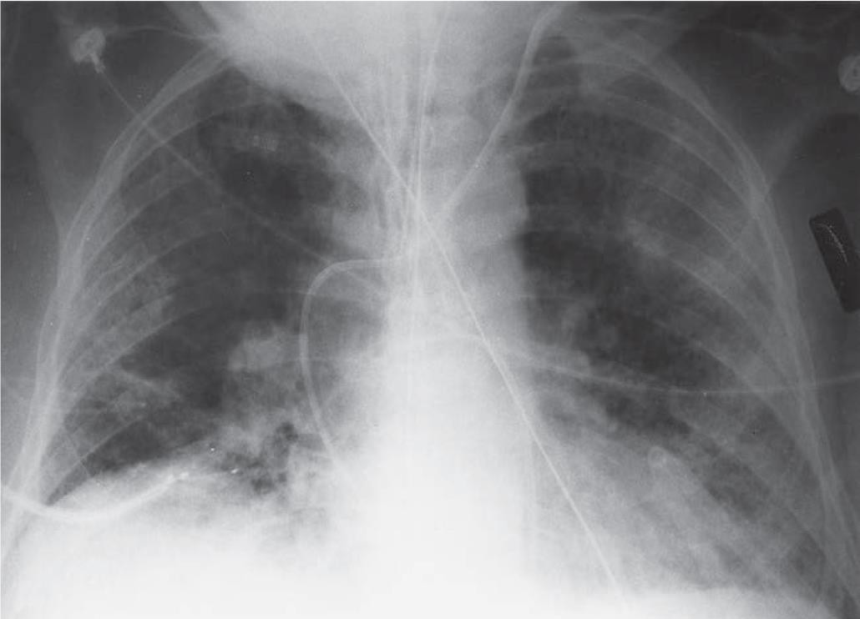

Slide 15
2. ABG
a. Hypoxemia (PaO2 <60).
b. Initially, respiratory alkalosis (PaCO2 <40) is present, which gives way to respiratory acidosis as the work of breathing increases and PaCO2 increases.
c. If the patient is septic, metabolic acidosis may be present,
with or without respiratory compensation.
3. Pulmonary artery catheter enables a determination of
PCWP.
PCWP reflects left heart filling pressures and is an indirect
marker of intravascular volume status
PCWP is the most useful parameter in differentiating ARDS
from cardiogenic pulmonary edema.

Slide 16
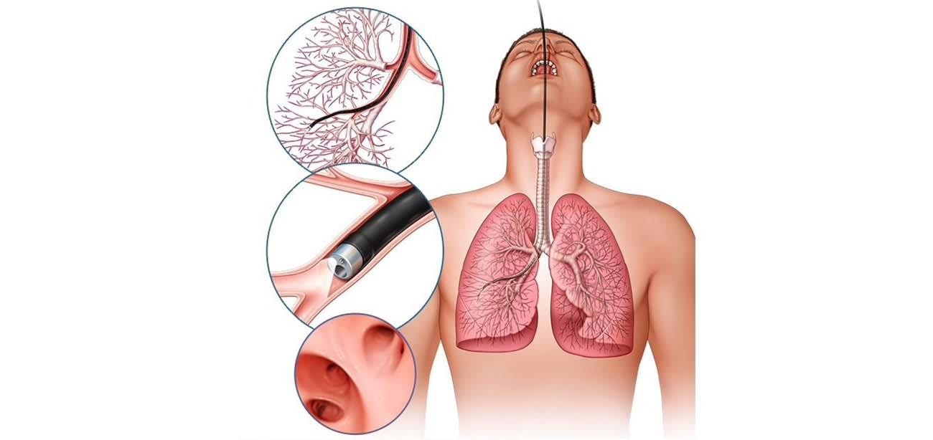
If PCWP is low (<18 mm Hg), ARDS is more likely, whereas if PCWP is high (>18 mm Hg), cardiogenic pulmonary edema is more likely.
4. Bronchoscopy with bronchoalveolar lavage
a. This may be considered if patient is acutely ill and infection is suspected.

Slide 17
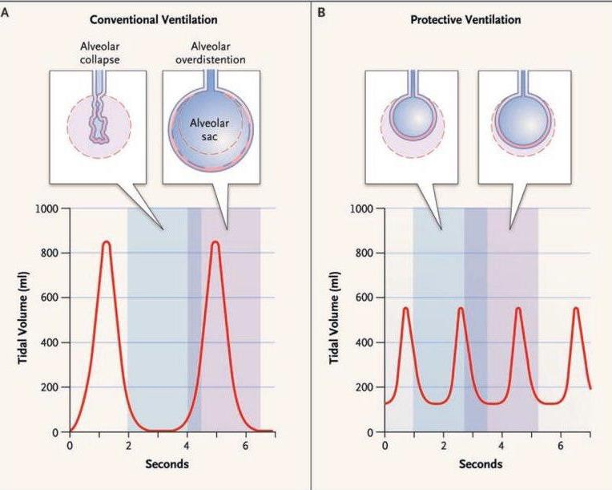
Treatment
1- Use lung-protective ventilatory strategy
Small tidal volumes (6 mL/kg) coupled with
low plateau pressures (less than
30 cm H2O):help to minimize ventilator-induced lung injury
This approach decreases mortality from ARDS,
reduces incidence of multiorgan system failure, and decreases measures of local and systemic Inflammation.
*Positive end-expiratory pressure (PEEP)
is important to prevent collapse of the alveoli.
2- Oxygenation—try to keep O2 saturation
>90%

Slide 18
3- Use of a conservative fluid management strategy
(limiting fluid balance after initial resuscitation has been accomplished) improves lung function and decreases the need for mechanical ventilation without increasing rates of cardiovascular or renal failure.
Prone positioning for at least 16 hours/day for patients with severe ARDS in conjunction with low tidal volumes may reduce mortality from ARDS
Cis-atracurium infusion in the first 48 hours of mechanical ventilation in patients with severe ARDS may also decrease mortality.
Treat the underlying disease
Corticosteroids to treat late-phase ARDS may be of benefit in carefully selected patients
Do not forget to address the patient’s nutritional needs Tube feedings are preferred over parenteral nutrition

Slide 19
complications
Permanent lung injury—resulting in lung scarring or honeycomb lung
Complications associated with mechanical ventilation :
Barotrauma secondary to high-pressure mechanical ventilation, possibly causing a pneumothorax or pneumomediastinum
Nosocomial pneumonia
Line-associated infections: central lines and pulmonary artery catheters (line infection sepsis), urinary catheters (UTI), and nasal tubes (sinus infection)
Renal failure—may be due to nephrotoxic medication, sepsis with hypotension, or underlying disease
Ileus, stress ulcers
Multiorgan failure
Critical illness myopathy and polyneuropathy

Slide 20
prognosis
Overall mortality related to number of organ system failures
Single-organ system failure mortality rate 25% to 40%
Three-organ system failure has up to 90% mortality rate
Note: Mortality rates increase with age
Sepsis and multiorgan system failure most common causes of death
Rare for patients to die solely from intractable hypoxemia

Slide 21
Survivors of ARDS may have long-term sequelae:
Two thirds of survivors have minimal to moderate respiratory impairment 1 year after event
Recent studies have reported muscle wasting, weakness, and posttraumatic stress disorder as late as 1 year after illness in survivors of ARDS. Only half of the survivors return to work 1 year after discharge.
Some neuromuscular and psychiatric sequelae persist 5 years after hospital discharge.

Slide 22
One of the following is not a feature of ARDS :
Bilateral diffuse pulmonary opacities on CXR
Respiratory symptoms that develop within 1 week of known insult
PCWP =< 18mmHg 4. Pao2\Fio2 = 400

