Slide 1
Urinary Tract infection VUR Enuresis in pediatrics
تبييض الطالبة : رؤى الزواهرة

Slide 2
Definition
An illness caused by infection of the lower urinary tract (cystitis), the upper urinary tract (pyelonephritis), or both
The presence of pyuria and symptoms distinguishes UTI from asymptomatic bacteriuria
We need a symptoms along with positive urine culture ± Pyuria
Negative culture with symptoms = not UTI
Positive culture without symptoms = asymptomatic bacteriuria (no need to treatment)
Positive culture with pyuria = UTI

Slide 3
Urinary tract infections
One of the most common bacterial infections in children
Occurs in 30 % of children with anomalies of urinary tract & can be the first sign
Classified according to site, symptoms or episode
E. coli is responsible for 80-90 % of acute pyelonephritis episodes
The incidence is estimated by 2-8%
5-10% of children with UTI and fever develop scarring

Slide 4
Urinary Tract Infections
Below one year , UTI more common in male baby
After one year , UTI more common in female baby
8% girls, 2% boys had UTI by age of 8
5% of febrile infants had UTI
Overall prevalence in infants with UTI was 7%.
Prevalence of UTI is decreasing with age
Among febrile male infants less than 3 months of age , 2.4% of circumcised males and 20.1% of uncircumcised males had a UTI
Highest incidence during first year
M >F as neonate, more in uncircumcised
Recurrence rate 12- 30% in first 6-12 m after UTI
Previous UTI is a risk factor for UTI

Slide 5
Risk Factors for Urinary Tract Infection
Female
Uncircumcised male
Vesicoureteral reflux
Toilet training
Voiding dysfunction
Obstructive uropathy
Urethral instrumentation
Wiping from back to front
Bubble bath
Tight clothing (underwear)
Pinworm infestation
Constipation
P fimbriated bacteria
Anatomic abnormality (e.g., labial adhesion) + urethral stenosis
Neuropathic bladder

Slide 6
Risk factor for UTI
8% girls, 2% boys had UTI by age of 8
5% of febrile infants had UTI
Overall prevalence in infants with UTI was 7%
Prevalence of UTI is decreasing with age
Among febrile male infants less than 3 months of age , 2.4% of circumcised males and 20.1% of uncircumcised males had a UTI
Highest incidence during first year
M >F as neonate, more in uncircumcised
Recurrence rate 12- 30% in first 6-12 m after UTI

Slide 7
Asymptomatic bacteriuria
Presence of bacteria in urine obtained in asymptomatic children on routine screening or incidentally during other investigations
The prevalence of asymptomatic bacteriuria is 0.37% in boys and 0.47% in girls
Highest rates in uncircumcised boys younger than 1 year old and girls older than 2 years of age
Asymptomatic bacteriuria does not require treatment
Except : 1) pregnancy
2)immunocmprimised
3)instrumentation

Slide 8
Uncomplicated UTI
UTI in a patient older than 2 months, who has a structurally and functionally normal urinary tract, normal renal function, and a competent immune system

Slide 9
Complicated UTI
Child who is: ≤ 2 months old;
or
has a structural or functional abnormality of the urinary tract; or has abnormal renal function; or is systemically unwell (toxic-looking, hemodynamically unstable, immunocompromised, unable to tolerate oral medication, or not responding to oral medication)

Slide 10
Atypical UTI
septicemia
Includes seriously ill
Poor urine flow,
Abdominal or bladder mass
Raised creatinine
Septicemia
Failure to respond to treatment with suitable antibiotics within 48 hours
Non-E. coli organisms
obstruction
Like Klebsiella &pseudomonas

Slide 11
Symptoms (heterogeneous)
Pyelonephritis: abdominal and loin pain, urgency during urination, dysuria, fever, anorexia, vomiting, lethargy, headache, sweaty
Cystitis: frequency, urgency, dysuria, hematuria, or suprapubic pain, new onset urinary incontinence, gross hematuria
In younger patients, especially in newborns and infants, these symptoms are atypical and rarely diagnose accurately
Bad smell
Atypical symptoms :
Septicemia
prolonged neonatal jaundice
Hypoglycemia

Slide 12
Physical Examination
Fever >39°C : Higher fever and fever duration >24 hours increase the likelihood of UTI in infants. (Absence of high fever does not preclude the presence of UTI). The overall prevalence of UTI in children <2 years of age with an undifferentiated febrile illness is approximately 5%
Irritability (neonates & infants)
Dehydration , ill looking
Suprapubic tenderness or costovertebral tenderness : In infant girls, may be the only helpful sign for making the diagnosis of UTI

Slide 13
Physical examination
Examine the external genitalia for signs of irritation, pinworms, vaginitis, trauma, or sexual abuse
For recurrent UTI: check BP, Growth parameters
Abdominal examination for fecal masses other masses as palpable kidneys, palpable bladder,
Don’t forget the back
Neurological examination of the lower limb
CKD cause short stature
palpable bladder and child doesn't feel it = neurogenic bladder
Innervation of bladder superior to innervation of lower limbs
Don’t forget examine the back :
1) Spinal cord 2) tough of hair 3) dumpling or bit on spinal 4) sacrum agenasis 5) menengiocele

Slide 14
Diagnosis
Clinical picture
Urine analysis (need ½ hour)
Urine culture (need 3 days)

Slide 15
Diagnosis
Diagnosis: urine culture and microscopy (standard, automated), CRP, ESR, WBC, Dipstick for LE, nitrite
Urine gram stain of bacteria is most sensitive and specific
Pyruia is more than 10 cells/mm³, 5 cells per HPF
Pyruia may be found in streptococcal infection, Kawasaki, vaginitis
Absence of pyurea in non Ecoli infection
Microscopic hematuria is common, gross hematuria seen in 25%
CRP increase with upper urinary tract inf.
Like Klebsiella &pseudomonas

Slide 16
Caveats for Urinalysis as a Screening tool
Negative in at least 10% of patients with positive urine cultures
Certain bacterial uropathogens are less likely to elicit pyuria
Pyuria reflects any local or systemic inflammatory process and is therefore not specific for UTI
Detection of nitrite is highly specific for UTI (98%) but depends on the type of bacterium and requires that urine remain in bladder for 4 hours
Nitrite = proteus

Slide 17
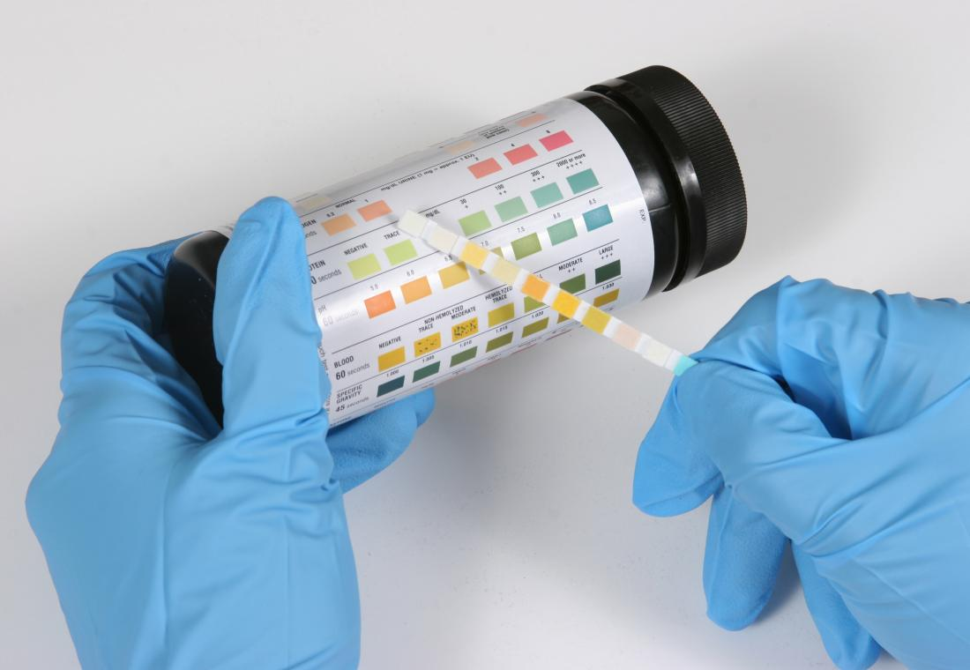
Dipstick testing
This is a positive urine analysis test indicating UTI :
Pyuria (wbc >5)
Hematuria (rbcs >3)
Turbid and cloudy
Color concentrated
Ph less acidic
Bad smell
Positive dipstick (leukocyte esterase and nitrite )

Slide 18
Causative microorganism
80% caused by E.coli
Other: Klebsiella, Enterobacter, enterococcus, Proteus, Pseudomonas
Pathogenesis: Ecoli has strong adhesive capacity
Bacteria usually comes from bowel, from under foreskin in boys
Methods of collection: SPA, Cath, clean catch, midstream
Bag not used has a high false positive result

Slide 19
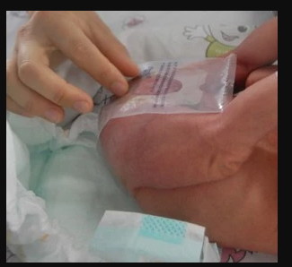
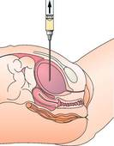
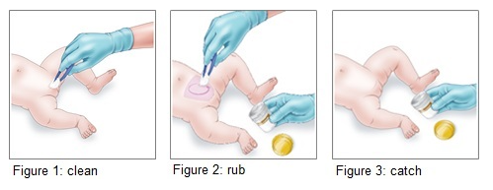
Bag sample
Cath
Suprapupic aspiration
(doing for baby <1 year )

Slide 20
Bag samples: has a false-positive rate so high that this method of urine collection is not suitable for diagnosing UTI
However, a culture of a urine specimen from a sterile bag that shows no growth is strong evidence that UTI is absent
Just For analysis

Slide 21
Treatment of UTI
Oral and parenteral antibiotics are equally effective
Infants up to 3 months, parenteral therapy is recommended
The base for initial antibiotic choice depends on the local antimicrobial sensitivity and adjust according to susceptibility test

Slide 22
Duration of treatment
Pyelonephritis: 7-10-14 day
Cystitis; 3-5 days

Slide 23
Further investigation
Urinary Ultrasound: hydronephrosis, confirm the presence of 2 kidneys other abnormalities as cystic kidney disease or masses, urteric dilatation , bladder abnormalities as Uretrocele
Micturition cystourythrogram ( MCUG): VUR, NB, PUV
Dimercapto-succinic acid (DMSA scan): Kidney scaring and split percentage of function for each kidney
Ureterocele
Contraindication for MCUG is UTI

Slide 24
RBUS findings suggestive of VUR

Slide 25
Renal Bladder Ultrasound(AAP)
Febrile infants aged 2-24 months with UTIs
Delayed or unsatisfactory response to treatment of a first febrile UTI
An abdominal mass or abnormal voiding (dribbling of urine)
Recurrence of febrile UTI after a satisfactory response to treatment
Any child with a first febrile UTI in whom good follow-up cannot be ensured

Slide 26
RBUS for first febrile UTI
UK ( NICE): first febrile UTI after 6 weeks unless Atypical UTI
– do it during acute illness
Seriously ill
Poor urine outflow
Abdominal or bladder mass
Raised creatinine
Septicemia
Poor response to treatment to suitable antibiotic after 48 hours of treatment
Non-EColi micro-organism infection
Italian society of pediatric Nephrology: 2-4 weeks after the first Febrile UTI in all children with first febrile UTI 2 months – 3 years

Slide 27
What is so special about Non-E. Coli UTI
In more than one study it was shown that it is associated with high grade VUR some studies Grade 4 VUR
Notes:
2 studies shown that non ecoli uti is associated with high grade vur

Slide 28
Factors that predicts Renal Scaring at first UTI
Renal Scaring cause HTN & CKD
Temperature > 39 C
Etiology other than non-E.Coli
Abnormal Us findings
PMN > 60%
CRP > 40 mg/L
Grade 4 or 5 VUR
Recurrent UTI
Delayed treatment more than 3 days

Slide 29
Vesicoureteral Reflux

Slide 30
Vesicoureteral reflux (VUR)
Retrograde passage of urine from the bladder into the upper urinary tract
It is the most common urologic diagnosis in children, occurring in approximately 1 % of newborns and in as many as 30 to 45 % of children with (UTI)
Vesicoureteral reflux (VUR) is divided into:
- Primary
- Secondary

Slide 31
Primary VUR
Most common form of reflux
Incompetent or inadequate closure of the ureterovesical junction which contains a segment of the ureter within the bladder wall (intravesical ureter)
Normally, reflux is prevented during bladder contraction by fully compressing the intravesical ureter and sealing it off with the surrounding bladder muscles
Failure of this anti-reflux mechanism is due to the shortening of the intravesical ureter. The intravesical ureter length may be genetically dictated, which may explain the increased incidence in family members of patients with VUR

Slide 32
Normal versus refluxing ureterovesical junctions

Slide 33
Secondary VUR
Abnormally high pressure in the bladder that results in failure of the closure of the UVJ during bladder contraction
Secondary VUR is often associated with anatomic (posterior urethral valves) or functional bladder obstruction (dysfunctional voiding and neurogenic bladder)
The degree and chronicity of obstruction can influence the severity of VUR. The management of secondary VUR is focused on treating the primary abnormality with the rare need for direct surgical correction of the VUR
And overacting bladder

Slide 34
Epidemiology
VUR is present in approximately 1 % of newborns
The risk of VUR is increased in children with febrile UTIs, with a reported incidence that ranges from 30 to 45 %
In neonates with prenatal hydronephrosis, the prevalence of VUR is about 15%
Ethnicity – White children were3 times more likely than black children. The maximal grade of reflux was significantly lower in black children.
Gender – Girls were twice as likely to have reflux as boys. However, this ratio is reversed in patients who present with antenatal hydronephrosis with a male predominance
Age – Young children and infants (younger than two years of age were more likely to have VUR than older children.
Genetic studies reported prevalence rates of 27.4 % for siblings of a patient with VUR, and 35.7 % for children of an affected parent
Both parents have VUR = prevalence 70%

Slide 35
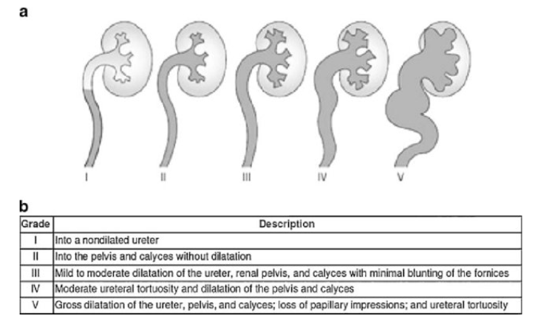
cupping

Slide 36
Grade 3

Slide 37
Presentation
ANHN ( antenatal hydronephrosis)
VUR does not cause any specific signs or symptoms ( silent) unless complicated by UTI

Slide 38
Theraputic intervention Management of vesicoureteral reflux (VUR) is principally based upon the following:
خلال اول سنة من عمر الطفل ما بنعمل عملية لانه بتروح لحالها
Identification of children with VUR
Prevention of pyelonephritis
Prevention of further renal damage resulting from infection and inflammation
Minimization of morbidity by treatment and follow-up
Identifying and managing children with bladder and bowel dysfunction – as constipation is a very important risk factor for all urinary pathologies
To prevent scaring (CKD)

Slide 39
Therapeutic intervention
medical therapy (ie, antibiotic prophylaxis)
Treating comorbid conditions (eg. voiding dysfunction)
surgical correction
Clinical trials demonstrate a decrease in the incidence of pyelonephritis with surgical intervention, but no significant difference in the risk of developing subsequent new renal scars, hypertension, or chronic kidney disease
reimplantation

Slide 40
Therapeutic intervention
When there is no ureteral dilation, there is an 85% chance of spontaneous resolution as the child grows. In the meantime, the urinary tract must be kept free of infection, and this is done by:
Regular voiding
High fluid intake
Avoiding constipation
Maintaining perineal hygiene
Prophylactic antibiotics (Trimethoprim-sulfamethoxazole)
Regular follow up, with charting of growth and development

Slide 41
Spontaneous Resolution after the age of 1 year
Grade 1 and 2: 80% resolution
Grade 3: 70% if young and unilater,20% if older and bilateral
Grade 4:60% unilateral,less than 10% bilateral
Grade 5:low resolution except in males in first year
Spontaneous resolution of primary VUR can occur with growth. As the bladder grows, the intravesical ureter increases in length, improving the function of the anti-reflux mechanism. This is especially true in infants
On one side

Slide 42
Correction of VUR
Specific indication but not all cases
Surgical reimplantation
Injection therapy

Slide 43
Enuresis (bed wetting)

Slide 44
Discrete episodes of urinary incontinence during sleep in children ≥5 years of age
Monosymptomatic enuresis – Enuresis in children without any other lower urinary tract symptoms (frequency, daytime incontinence, urgency, genital or lower urinary tract pain) and without a history of bladder. More common
Nonmonosymptomatic enuresis – Enuresis in children with other lower urinary tract symptoms
Primary enuresis: Enuresis in children who have never achieved a satisfactory period of dryness
Secondary enuresis – Enuresis that develops after a dry period of at least six months

Slide 45
Nocturnal enuresis
10% of 7 year old children wet bed
Prevalence :15-20 % in 5y
5 % in 10 y
1-2 % in 15 y
Boys are affected more than girls
15 % become dry each year without treatment

Slide 46
Non-monosymotomatic enuresis
Daytime wetting
Frequency; increased more than 8 times or decreased last than 3
urgency
Hesitancy
Straining
Weak stream
Intermittent stream
Holding maneuvers
Feeling of incomplete emptying
Genital or lower urinary tract pain

Slide 47
Causes of Primary bedwetting
1. Low capacity of bladder (Bladder over activity)
2. Night time urine production is high (Nucternal polyuria)
3. The child dose not wake up when the bladder is full (impaired arousal)
4. Runs in family, genetic background
5. Additional factors as Constipation
Small bladder
Because ADH hormone
Notes:
Bedwetting is medical problem and dose not associated with psychological cause
It has a huge effect on well being and self esteem

Slide 48
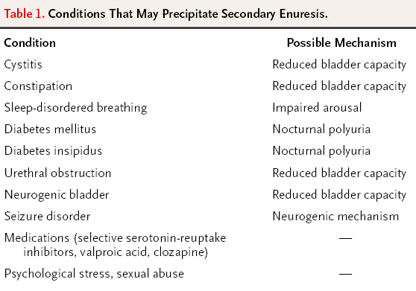

Slide 49
Risk Factors Nocturnal Enuresis
Younger age
Male sex
Constipation
OSA
Black race
History of urinary tract infection
Family history of enuresis
Obesity
Chronic illness
Low socioeconomic status is not consistently associated with enuresis
Sexual abuse
Stressful home condition
Notes:
Bedwetting is medical problem and dose not associated with psychological cause
It has a huge effect on well being and self esteem

Slide 50
Primary evaluation: examinations and tests
Physical examination: ( Free in pure MNE)
Height, weight, blood pressure, general neurological exam,back
Genital inspection. Consider rectal exam if constipation suspected
Urine tests
Dipstick test: glucose, leukocytes, protein, erythrocytes and bacteria
Blood tests, radiology, urodynamics
Not indicated in uncomplicated MNE
Bladder diary/voiding charts
Strongly recommended

Slide 51
Warning signs
Weight loss, growth retardation: creatinine, urine glucose, electrolytes & physical examination
Voiding difficulties, weak stream, need to strain to void: uroflow and residual urine, urine analysis & culture, Physical examination
Heavy snoring or sleep apneas, consult ENT
Secondary nocturnal enuresis with recent debut: Check urine glucose
Excessive thirst with a need to drink at night: urine glucose, complete a fluid intake list

Slide 52
Treatment / Pathophysiology
Minirin
( A heterogeneous disorder )
Nocturnal
Polyuria
(Lack of ADH Release)
Reduced nocturnal
functional bladder
capacity
Nocturnal enuresis
Anticholinergics
Impaired arousal response
to bladder fullness
from sleep
Genetics

Slide 53
Management
Behavioral therppy :needs to achieve good bowel and bladder habits requires a supportive parent, a motivated child, patience and time
Frequent regular voiding, fluid intake
Star charts
Avoid caffeinated drink
Treat constipation
Relief of constipation resulted in disappearance of daytime urinary incontinence in 89% and nighttime urinary incontinence in 63% of patients

Slide 54
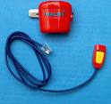
Selecting treatments for PNE categories
Insufficient nocturnal release of ADH and normal bladder capacity: use of Desmopressin is indicated First Line Treatment
Small bladder capacity: Anticholinergic
Difficult arousal : Enuresis alarm

Slide 55
Enuresis alarm
Assets: Curative potential. Cheap. Harmless
Drawbacks: Requires time, motivation and hard work
Prognostic indicators: best effect in motivated families
Practicalities
Information, motivation and early follow-up are essential!
The parents need to help the child to wake up
Use consistently every night without interruptions
Use until either 14 consecutive dry nights or 2-3 months without effect
Success rate 50-80%
Relpase 30%
*

Slide 56
desmopressin
30% full responder
40% partial response
Relapse rate 60%
Tapering the dose decrease relapse
For nocturnal polyuria

Slide 57
Anticholingerics
Oxybutinin , tolterodine
constipation as side effect

Slide 58
Tricyclic antidepressant
Imipramine , clomaprimine
60 % improve, 40 % become dry
high relapse rate
Has anticholinergic ,central effects on sleep and perception
Third line of treatment due to safety
Affect mood and cause sleep disturbances , constipation, cardiotoxic
Cause prolonged QT-interval = Heart Block

Slide 59
Bladder dysfunction
Prevalence of LUTD is 20% in children
Cause is neurologic (MMC), anatomic (puv),functional
Cause of recurrent UTI
Can be caused by constipation
Is the problem during filling or emptying

