Slide 1
HYPERTENSIVE HEART DISEASE
Dr. Bushra Al-Tararawneh

Slide 2
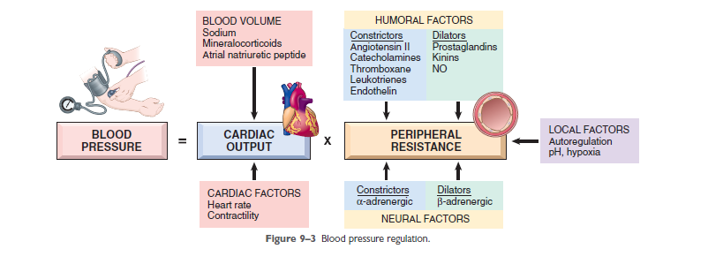
BLOOD PRESSURE REGULATION

Slide 3
Hypertension is a common disorder associated with considerable morbidity and affecting many organs.
Diastolic pressures greater than 90 mm Hg, or sustained systolic pressures in excess of 140 mm Hg, (cutoffs in diagnosing hypertension in clinical practice).
25% of persons in the general population are hypertensive.
The prevalence of pathologic effects of high blood pressure increases with age and is also higher in African Americans.
Without appropriate treatment, some 50% of hypertensive patients die of ischemic heart disease (IHD) or congestive heart failure.
The risk of hypertension can lead to stroke, atherosclerotic coronary heart disease, cardiac hypertrophy and heart failure (hypertensive heart disease), aortic dissection, multi-infarct dementia, and renal failure.

Slide 4
Malignant hypertension :
Usually is severe (i.e., systolic pressures over 200 mm Hg or diastolic pressures over 120 mmHg)
A small percentage of hypertensive patients (approximately 5%) present with a rapidly rising blood pressure that, if untreated, leads to death in within 1 to 2 years.
Associated with renal failure and retinal hemorrhages, with or without papilledema.
It can arise de novo but most commonly is superimposed on preexisting benign hypertension.

Slide 5
TYPES
1. (95%) are idiopathic (essential hypertension).
This form is compatible with long life unless a myocardial infarction, stroke, or another complication supervenes.
2.(5%) (secondary hypertension) .

Slide 6
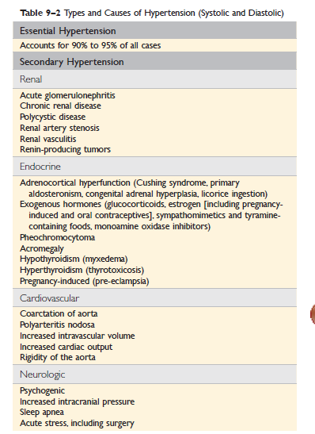

Slide 7
Mechanism
Essential Hypertension Although the specific triggers are unknown, it appears that both altered renal sodium handling and increased vascular resistance contribute to essential hypertension.
Reduced renal sodium excretion
Fluid volume
Cardiac output

Slide 8
• Genetic factors play an important role in determining blood pressure, as shown by familial clustering of hypertension.
Environmental factors, such as stress, obesity, smoking, physical inactivity, and high levels of salt consumption.
Evidence linking dietary sodium intake with the prevalence of hypertension in different population groups is particularly strong.

Slide 9
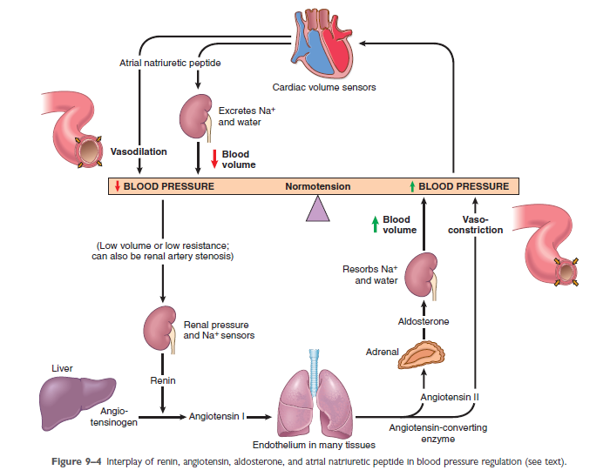

Slide 10
Two forms of small blood vessel disease are hypertension-related:
1- Hyperplastic arteriolosclerosis.
2- Hyaline arteriolosclerosis

Slide 11
1-Hyaline arteriolosclerosis
is associated with benign hypertension.
It is marked by homogeneous, pink hyaline thickening of the arteriolar walls, with loss of underlying structural detail, and luminal narrowing.

Slide 12
2- Hyperplastic arteriolosclerosis
Is more typical of severe hypertension.
Vessels exhibit “onionskin,” concentric, laminated thickening of arteriolar walls and luminal narrowing.
The laminations consist of smooth muscle cells and thickened, reduplicated basement membrane.

Slide 13
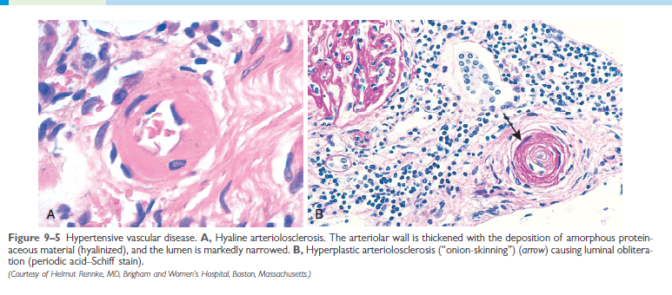

Slide 14
HYPERTENSIVE HEART DISEASE
Hypertension cardiac hypertrophy and heart failure (Hypertensive heart disease).
Systemic (Left-Sided) Hypertensive Heart Disease.
Pulmonary Hypertensive Heart Disease—Cor Pulmonale.

Slide 15
Systemic (Left-Sided) Hypertensive Heart Disease
*The criteria for the diagnosis of systemic hypertensive heart disease are:
(1) left ventricular hypertrophy in the absence of other cardiovascular pathology (e.g., valvular stenosis).
(2) A history or pathologic evidence of hypertension.
*It was established that even mild hypertension (above 140/90 mm Hg), if sufficiently prolonged, induces left ventricular hypertrophy.

Slide 16
The mechanisms
The mechanisms by which hypertension leads to heart failure are incompletely understood; presumably the hypertrophic myocytes fail to
contract efficiently, possibly due to :
1- Structural abnormalities in newly assembled sarcomeres.
2- The vascular supply is inadequate to meet the demands of the increased muscle mass.

Slide 17
MORPHOLOGY
The essential feature of systemic hypertensive heart disease is left ventricular hypertrophy, typically without ventricular dilation until very late in the process
The heart weight can exceed 500 g (normal, 320 to 360 g), and the left ventricular wall thickness can exceed 2.0 cm (normal, 1.2 to 1.4 cm).
With time, the increased left ventricular wall thickness imparts a stiffness that impairs diastolic filling and can result in left atrial dilation.
Microscopically, the transverse diameter of myocytes is
increased and there is prominent nuclear enlargement and
hyperchromasia (“boxcar nuclei”), as well as intercellular
Fibrosis.

Slide 18
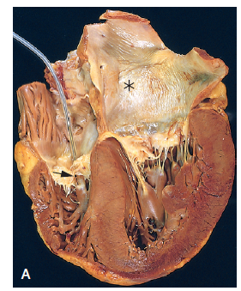
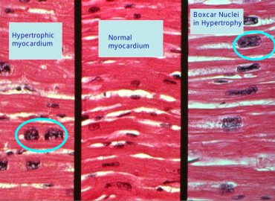
Systemic (left-sided) hypertensive heart disease. There is marked concentric thickening of the left ventricular wall causing reduction in lumen size. The left ventricle and left atrium are on the right in this four-chamber view of the heart. A pacemaker is present incidentally in the right ventricle (arrow). Note also the left atrial dilation (asterisk) due to stiffening of the left ventricle and impaired diastolic relaxation, leading to atrial volume overload.

Slide 19
Clinical Features
Compensated hypertensive heart disease typically is asymptomatic and is suspected only from discovery of elevated blood pressure on routine physical exams, or from ECG or echocardiographic findings of left ventricular hypertrophy.
The disease comes to attention with the onset of atrial fibrillation (secondary to left atrial enlargement) and/or CHF.
Depending on the severity and duration of the condition, the underlying cause of hypertension, and the adequacy of therapeutic control, patients Can :
(1) Enjoy normal longevity and die of unrelated causes,
(2) Develop progressive IHD owing to the effects of hypertension
in potentiating coronary atherosclerosis,
(3) Suffer progressive renal damage or cerebrovascular stroke.
(4) Experience progressive heart failure.
(5) The risk of sudden cardiac death also is increased.

Slide 20
Pulmonary Hypertensive Heart Disease—Cor Pulmonale
Cor pulmonale consists of right ventricular hypertrophy and
dilation—frequently accompanied by right heart failure—
caused by pulmonary hypertension attributable to primary disorders of the lung parenchyma or pulmonary vasculature.
Right ventricular dilation and hypertrophy caused by left ventricular failure (or by congenital heart disease) is substantially more common but is excluded by this
definition.
Cor pulmonale can be acute in onset, as with pulmonary
embolism, or can have a slow and insidious onset when
due to prolonged pressure overloads in the setting of
chronic lung and pulmonary vascular disease

Slide 21
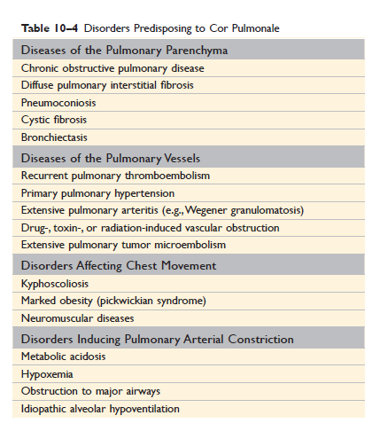

Slide 22
MORPHOLOGY
In acute cor pulmonale, the right ventricle usually shows only dilation; if an embolism causes sudden death, the heart may even be of normal size.
Chronic cor pulmonale is characterized by right ventricular (and often right atrial) hypertrophy.
When ventricular failure develops, the right ventricle and atrium often are dilated.
Because chronic cor pulmonale occurs in the setting of pulmonary hypertension, the pulmonary arteries often contain atheromatous plaques and other lesions, reflecting longstanding pressure elevations.

Slide 23
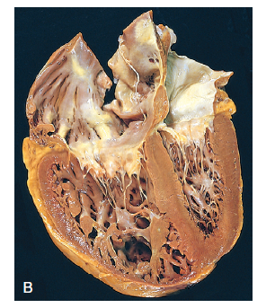
Chronic cor pulmonale. The right ventricle (shown on the left side of this picture) is markedly dilated and hypertrophied with a thickened free wall and hypertrophied trabeculae. The shape and volume of the left ventricle have been distorted by the
enlarged right ventricle.

Slide 24
GOOD LUCK

