Slide 1
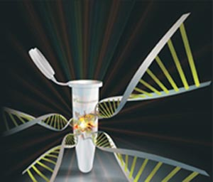
Genomic DNA Extraction
Dr. Nesrin Mwafi
Biochemistry & Molecular Biology Department
Faculty of Medicine, Mutah University

Slide 2
Part I
Introduction

Slide 3
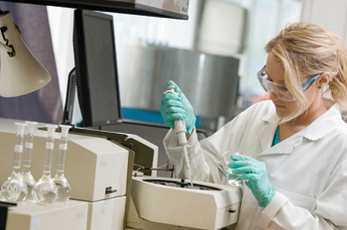
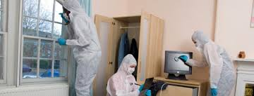
Extraction of DNA
DNA Extraction: is a process of isolation and purification of DNA from a sample using a combination of physical and chemical methods
Routine procedure widely used in:
Molecular biology labs
3. Forensic analyses (e.g. DNA fingerprinting)
2. Genetic testing

Slide 4
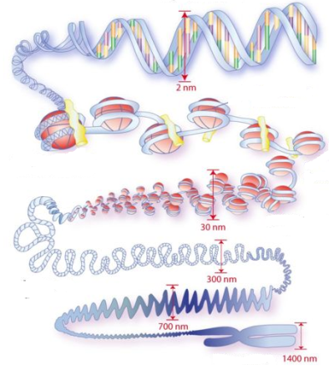
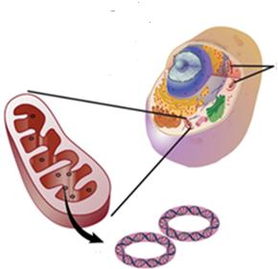
Types of DNA
We need cells to isolate DNA. In human (Homo sapiens), genomic DNA is found inside the nucleus of every cell (exceptions like the anucleated RBCs ). Also, DNA is found within mitochondria, the energy producing organelles.
Chromosomal DNA
Mitochondrial DNA

Slide 5
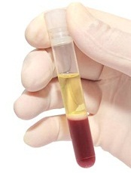
Blood Sample
Plasma (55% of total blood)
Proteins, electrolytes, clotting factors, hormones , etc…
centrifugation
Buffy coat (<1% of total blood)
WBC’s and platelets
RBC’s (45% of total blood)

Slide 6
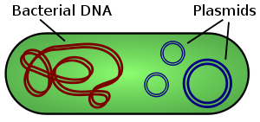
Types of DNA
We need cells to isolate DNA. In human (Homo sapiens), genomic DNA is found inside the nucleus of every cell (exceptions like the anucleated RBCs ). Also, DNA is found within mitochondria, the energy producing organelles.
Chromosomal DNA
Mitochondrial DNA
In bacterial cells, extrachromosomal DNA called plasmid can be extracted too.

Slide 7
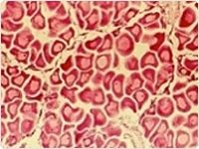
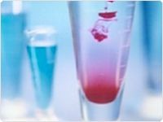
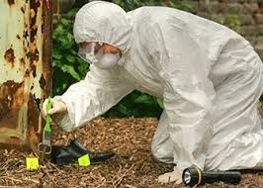
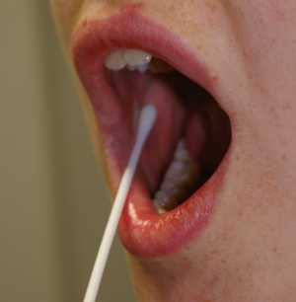
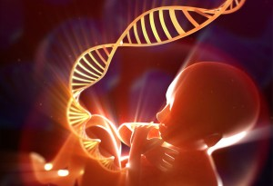
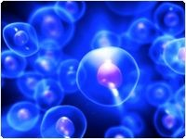
DNA Isolation from Various Samples
DNA can be extracted from variety of samples:
Human Samples
Tissues
Blood
Forensic Sample
Prenatal genetic testing
Cells
Buccal swab

Slide 8
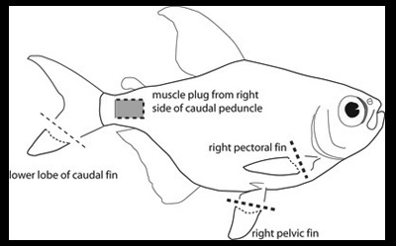
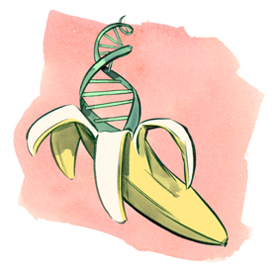
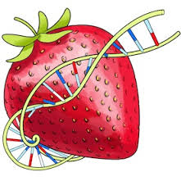
DNA Isolation from Various Samples
Animal cells/tissues (e.g. zebrafish fins)
Plant material (e.g. banana and strawberry)

Slide 9
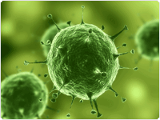
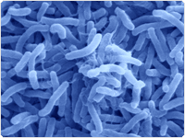
DNA Isolation from Various Samples
Viral and Bacterial cells
Viral cells
Bacterial cells

Slide 10
DNA Isolation from Various Samples
Plasmid DNA (containing the interested gene)
After transformation of bacterial cells (competent cells), the amplified plasmid is extracted using:
Miniprep (50-100 µg) kits
Midiprep (100-350 µg) kits
Maxiprep (500-850 µg) kits
depending on the required amount of plasmid to be stored as stock at -20 ̊C

Slide 11
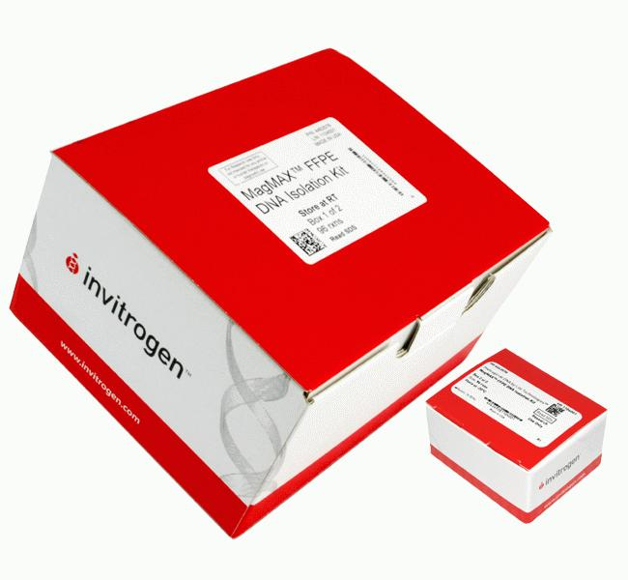
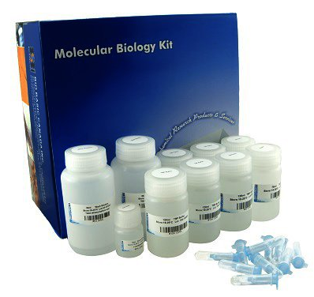
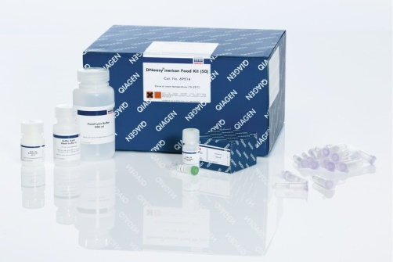
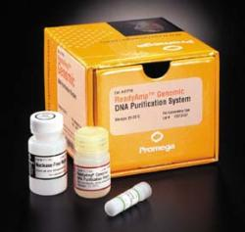
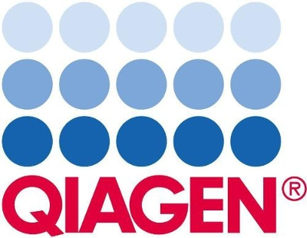
DNA Extraction Kits
Obtaining high-quality, intact DNA is often the first and most critical step in many fundamental molecular biology applications, such as DNA cloning, sequencing, PCR and electrophoresis
Different kinds of kits are available from different companies: Qiagen, Invitrogen, Promega and Bio Basic Inc.

Slide 12
Part II
The Principle of DNA Extraction

Slide 13
The principle of DNA Extraction
There are three basic steps in DNA extraction:
Cell lysis with digestive solution to expose the DNA. Lysis buffer contains detergents/surfactants such as SDS (sodium dodecyl sulphate) to disrupt both cellular and nuclear membranes.
Inactivate endogenous nucleases like DNases. Actually, this is can be done by adding proteases like proteinase K as well as chelating agents (e.g. EDTA) which sequester Ca⁺² and Mg⁺² required for nuclease activity. On the other hand, RNases are usually added to the sample to get rid of RNA.

Slide 14
The principle of DNA Extraction
Purification of DNA from proteins, RNA, detergents, salts and reagents found in cell lysate:
Ethanol precipitation using ice-cold ethanol or isopropanol
Phenol/chloroform extraction
Minicolumn purification

Slide 15
The principle of DNA Extraction
Ethanol precipitation:
DNA is insoluble in ethanol or isopropanol (anti-solvent)
To enhance precipitation of DNA in presence of 95-100% ethanol, the solution should contain positive ions such as sodium acetate

Slide 16
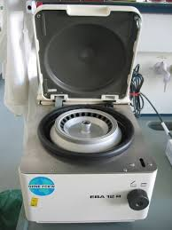
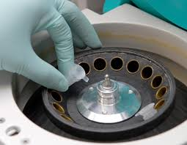
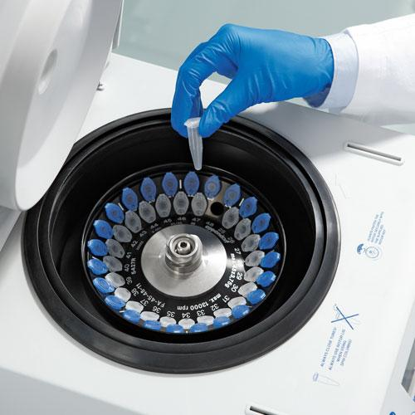
Centrifuge
Centrifuge

Slide 17
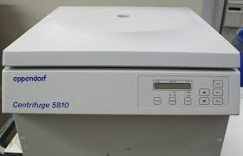
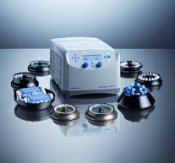
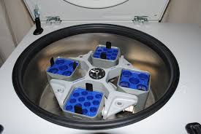
Centrifuge

Slide 18
The principle of DNA Extraction
Ethanol precipitation:
DNA is insoluble in ethanol or isopropanol (anti-solvent)
To enhance precipitation of DNA in presence of 95-100% ethanol, the solution should contain positive ions such as sodium acetate (use the right concentration !!!!)
After centrifugation, a pellet of crude DNA is formed

Slide 19
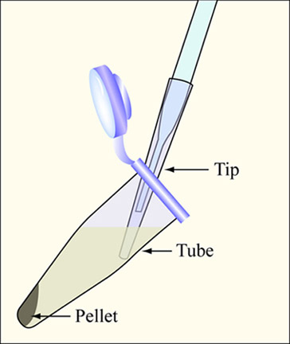
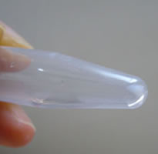
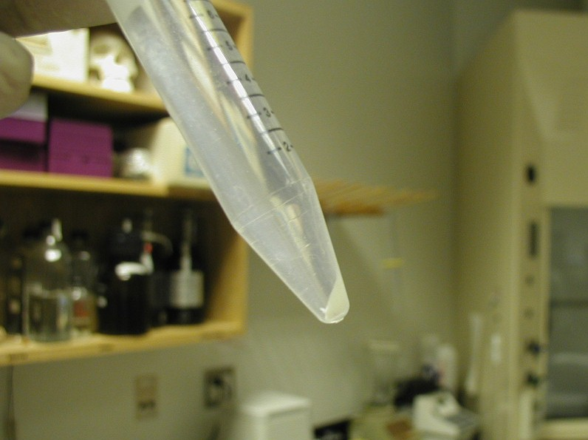
The principle of DNA Extraction
Ethanol precipitation: formation of DNA pellet

Slide 20
The principle of DNA Extraction
Ethanol precipitation:
DNA is insoluble in ethanol or isopropanol (anti-solvent)
To enhance precipitation of DNA in presence of 95-100% ethanol, the solution should contain positive ions such as sodium acetate
After centrifugation, a pellet of crude DNA is formed
The pellet is washed with 70% ethanol to remove some salts present in the left over supernatant and bound to DNA
Air dry the pellet then redissolve in ultrapure or Milli-Q water

Slide 21
The principle of DNA Extraction
Phenol/ chloroform extraction:
Equal volume of phenol/chloroform added to an aqueous solution of lysed cells or homogenized tissue
Centrifugation yields two phases: the upper aqueous phase (containing the nucleic acids DNA and RNA) and the lower organic phase (containing the lipids and denatured proteins)
Add phenol/chloroform
and centrifuge

Slide 22
The principle of DNA Extraction
Phenol/ chloroform extraction:
Equal volume of phenol/chloroform added to an aqueous solution of lysed cells or homogenized tissue
Centrifugation yields two phases: the upper aqueous phase (containing the nucleic acids DNA and RNA) and the lower organic phase (containing the lipids and denatured proteins)
pH of phenol determines the partitioning of DNA and RNA between the organic and the aqueous phases

Slide 23
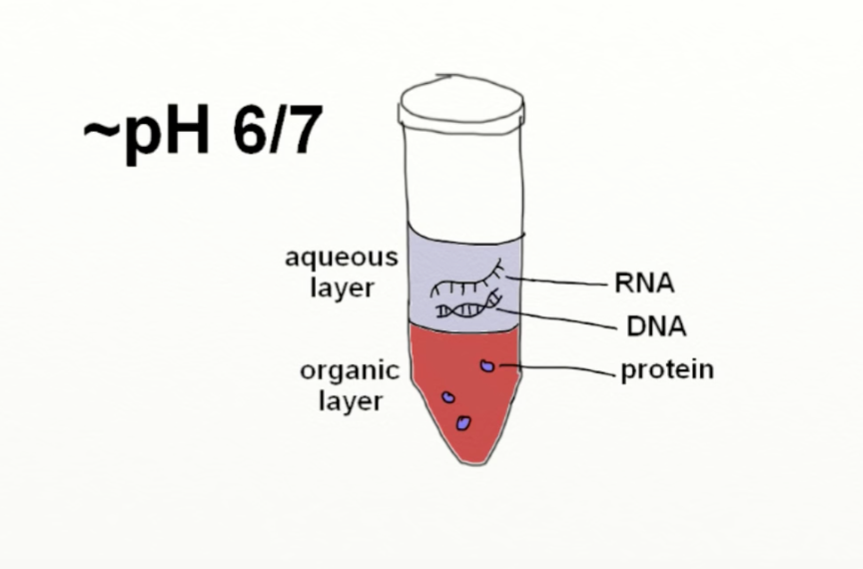
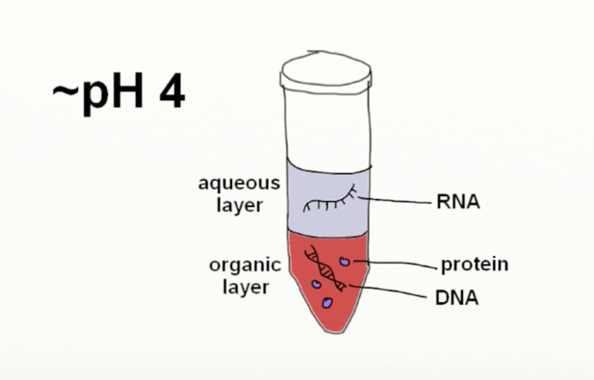
Effect of pH on Partitioning
7/8
Both DNA and RNA partition to the aqueous phase
DNA is neutralized and leaves to the organic phase but RNA remains in the aqueous layer

Slide 24
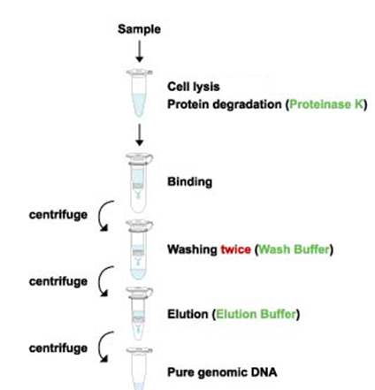
The principle of DNA Extraction
Minicolumn purification:
which depends on the binding and adsorption of nucleic acids to a solid phase (e.g. silica)
After cell lysis, inactivate endogenous nucleases (e.g. DNases) with proteinase K enzyme and chelating agents (e.g. EDTA)
Washing and column elution(with TE buffer or DNAse/ RNAse free water)
(Spin-column-based nucleic acid purification)

Slide 25
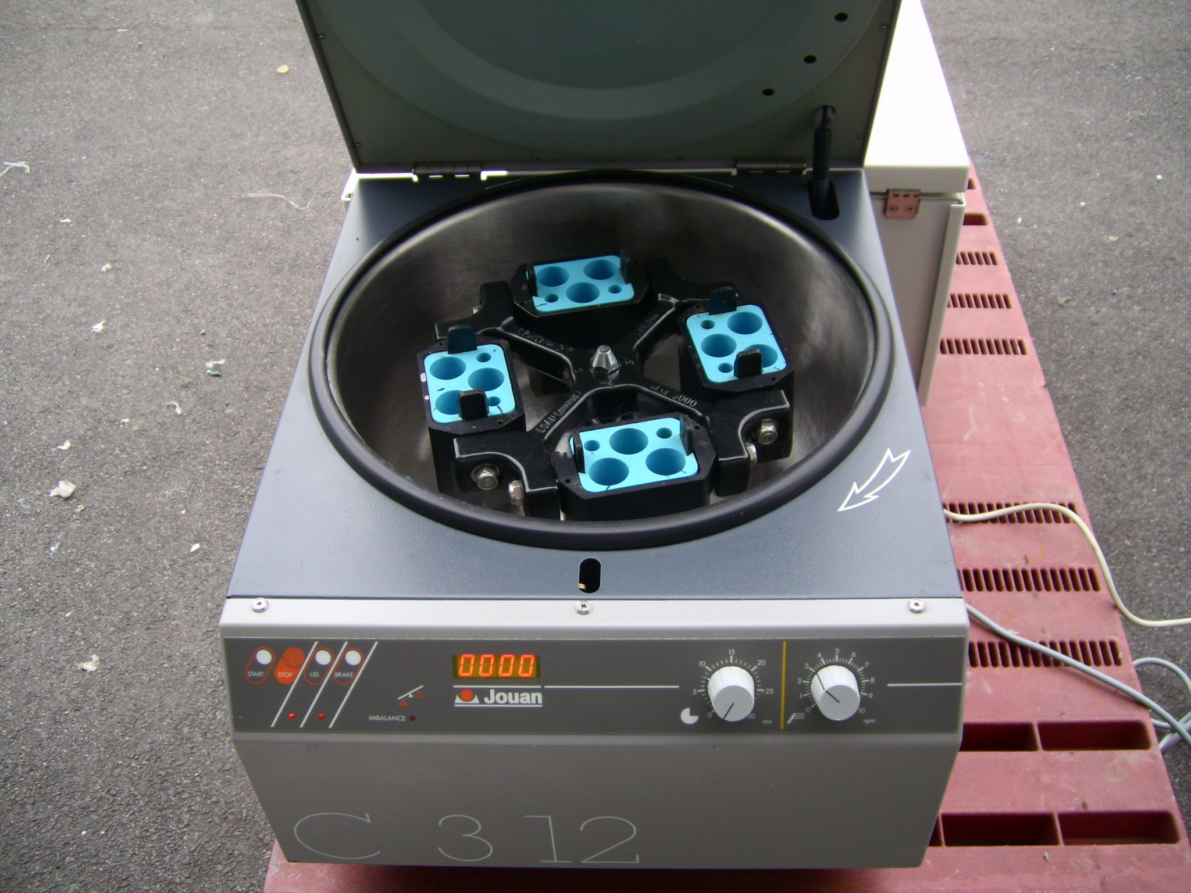
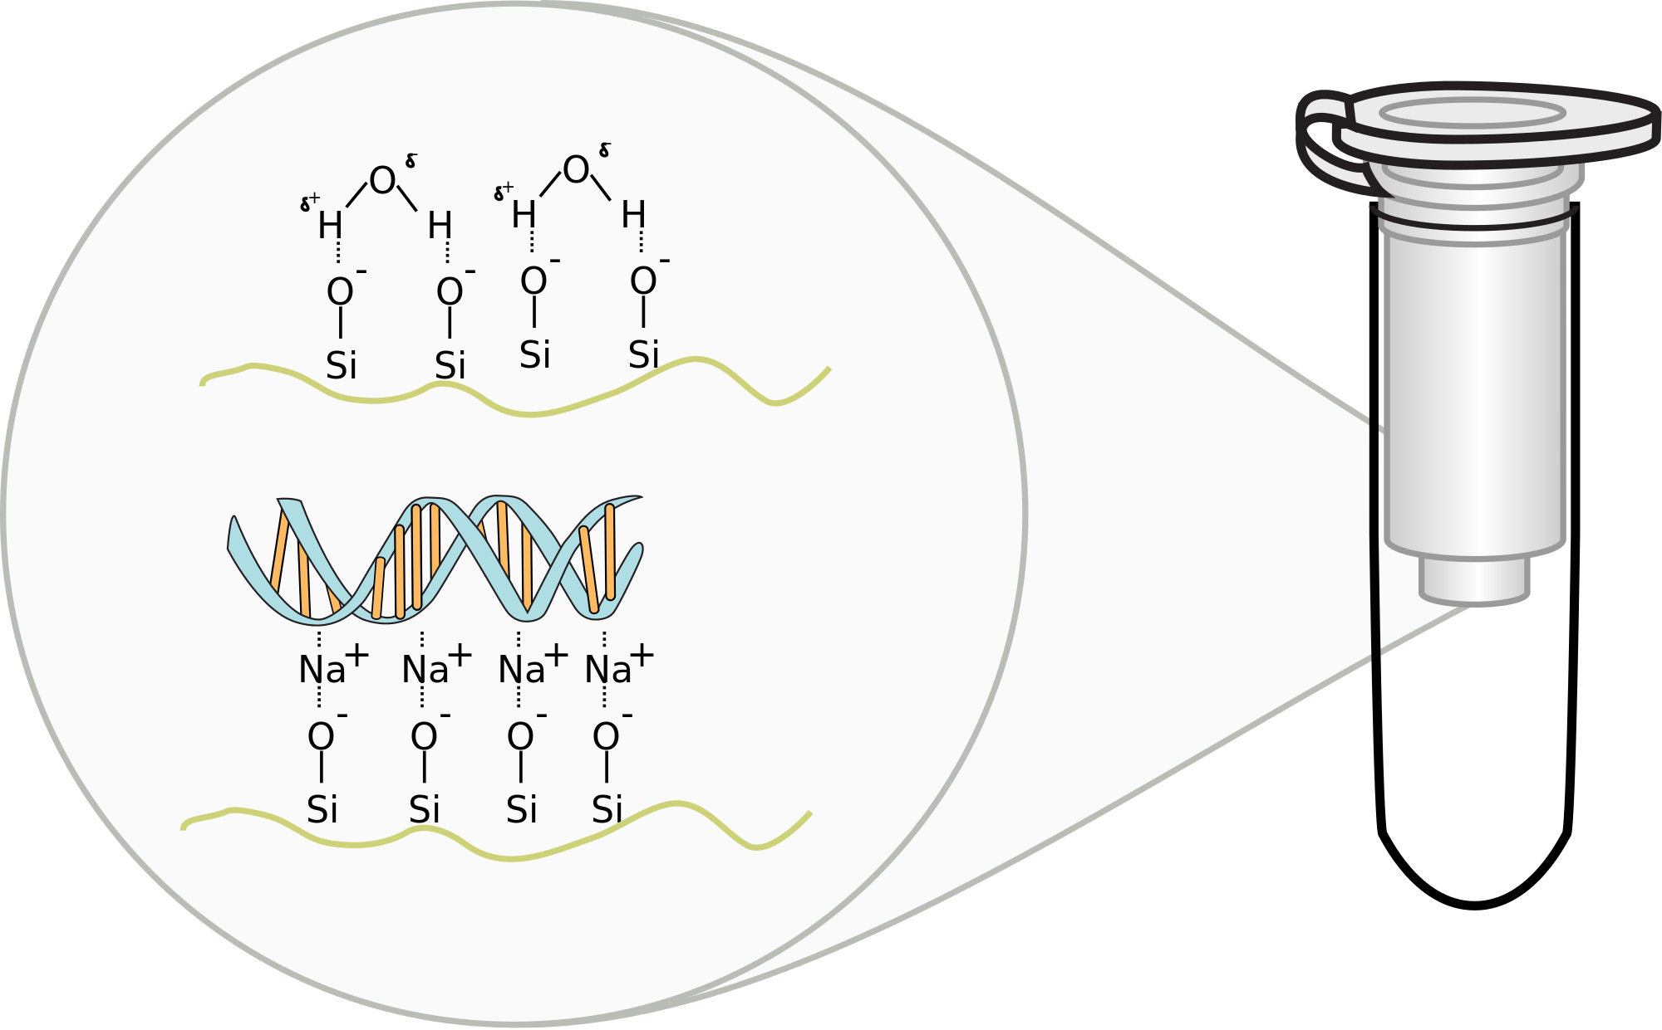
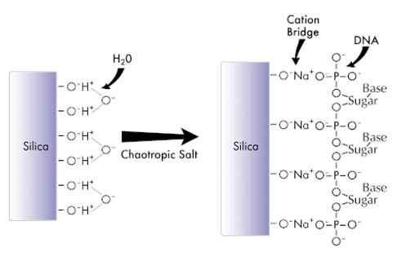
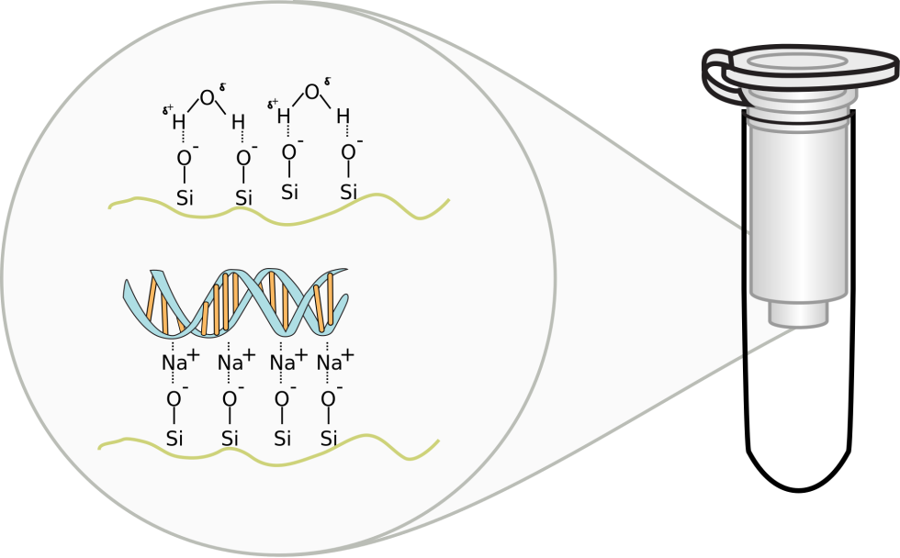
The principle of DNA Extraction
Chaotropic salt like
Guanidinium chloride
(SiO2)
Spin column-based nucleic acid purification

Slide 26
The principle of DNA Extraction

Slide 27
Part III
Assessment of Extracted DNA

Slide 28
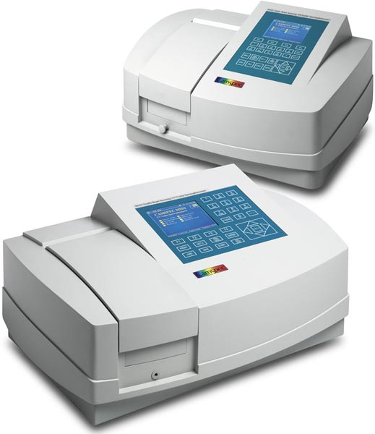
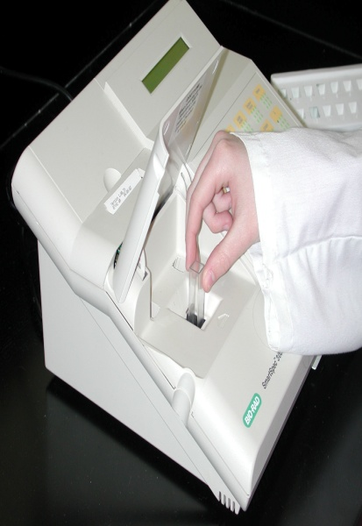
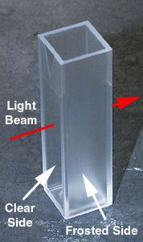
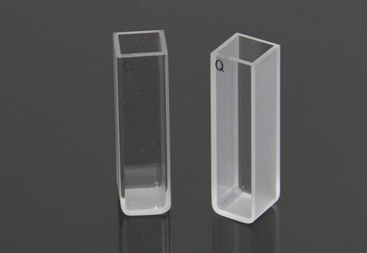
Assessment of Purified Nucleic Acid
Measurement of concentration

Slide 29
Assessment of Purified Nucleic Acid
Measurement of concentration
Nucleic acids absorb uv-light at wavelength of 260 nm (λ= 260nm)
The concentration is estimated per one optical density unit (1OD) according to the type of nucleic acid (e.g. 1 OD260 unit = 50 µg/ml dsDNA)
Nucleic Acid | Concentration (µg/ml) or (ng/µl) per A260 Unit
ds DNA | 50
ss DNA | 33
ss RNA | 40

Slide 30
Assessment of Purified Nucleic Acid
The concentration is calculated according to the following equation:
DNA Concentration (µg/ml) = OD₂₆₀ × dilution factor × 50 µg/ml
Example: OD₂₆₀ = 1.6, dilution factor = 100, sample of genomic DNA
Answer:
DNA conc. = 1.6 x 100 x 50 ng/µl or µg/ml
= 8000 ng/µl or 8000 µg/ml or 8 µg/µl
Note: 1g = 1000mg 1L = 1000 ml
1mg = 1000 µg 1ml = 1000 µl
1 µg = 1000 ng

Slide 31
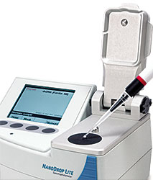
Assessment of Purified Nucleic Acid
NanoDrop is automatically
calculate the concentration in ng/µl

Slide 32
Assessment of Purified Nucleic Acid
Sample purity:
The reading of absorbance at 260nm is divided by the reading at 280nm to estimate sample purity
This ratio is most commonly used to determine the presence of protein in the isolated sample
The acceptable range for this ratio:
Sample type | Ideal | Accepted range
DNA | 1.8 | 1.7-1.9
RNA | 2.0 | 1.9-2.1

Slide 33
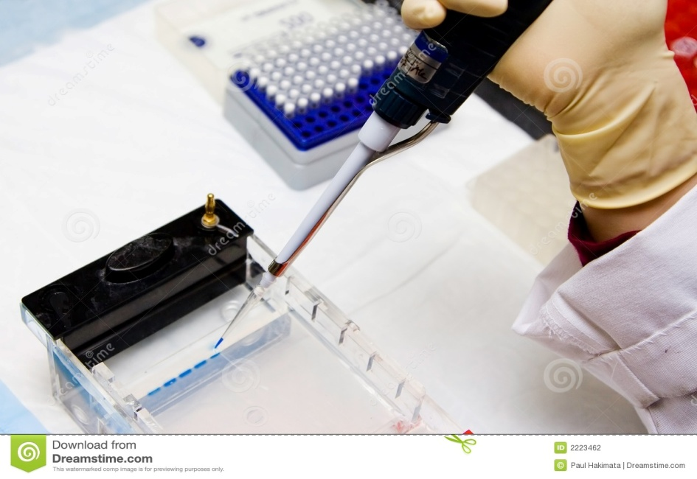
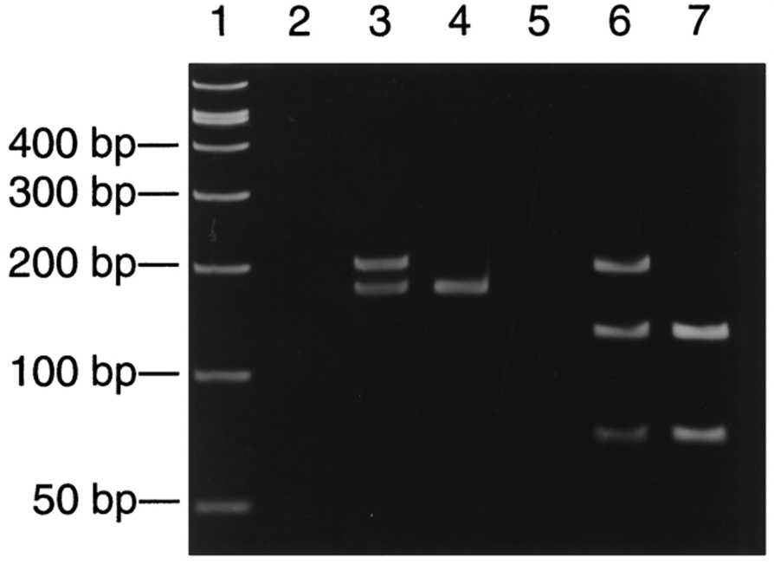
Assessment of Purified Nucleic Acid
Gel electrophoresis:

Slide 34
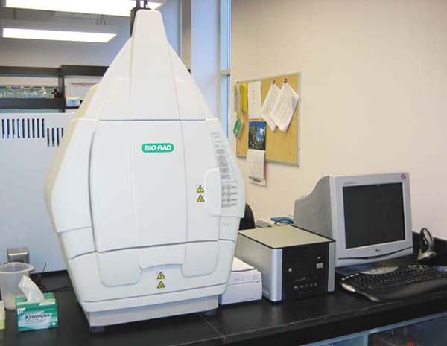
Assessment of Purified Nucleic Acid
Gel documentation system “Gel Doc System”

Slide 35
Assessment of Purified Nucleic Acid
1% agarose gel (1g/100ml)
Ethidium bromide is a fluorescent dye (carcinogenic dye) replaced with gel red to stain nucleic acid
Loading dye (blue in color) to track the migrated DNA/ RNA
DNA / RNA ladder (fragments with known sizes)

Slide 36
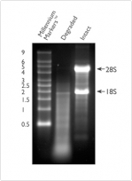
Assessment of Purified Nucleic Acid
Total RNA

Slide 37
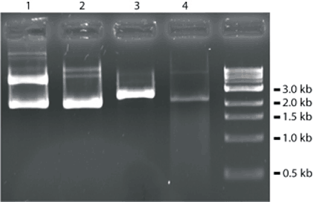
Assessment of Purified Nucleic Acid

