Slide 2
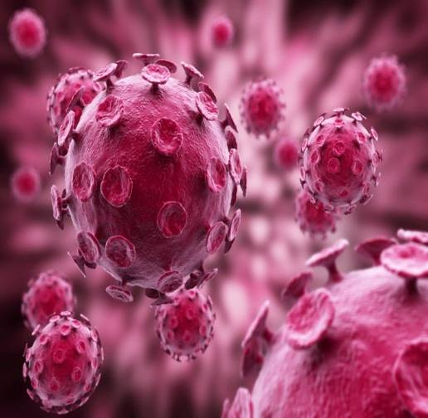
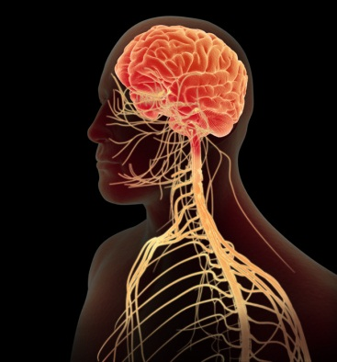
ENTEROVIRUSES
Prof. Dr. Ghada Fahmy Helaly
PNS Module
By:
Prof. Dr. Ghada Fahmy Helaly
Microbiology Department
Faculty of Medicine
Mu’tah University

Slide 3
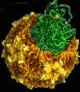
Family: Picornaviridae .
Characteristics:
Small, 20-30 nm, icosahedral particles.
Non-enveloped.
The viral genome is ss-RNA, with positive polarity.
They replicate in the cytoplasm .
Classification: nine genera, only five cause human diseases. Enteroviruses , rhinoviruses, hepatovirus (hepatitis A virus), kobuviruses and parechoviruses.

Slide 4
General characteristics of Enteroviruses:
Transmission : by fecal oral rout.
Replicate mainly in the gut.
Stable in acid pH.
SS. naked RNA virus with icosahedral symmetry.
Neurological and non-neurological diseases.
They are divided into five groups:
Polioviruses.
Coxsackie A viruses.
Coxsackie B viruses .
Echoviruses .
Others , Enteroviruses types 68 – 71.

Slide 5
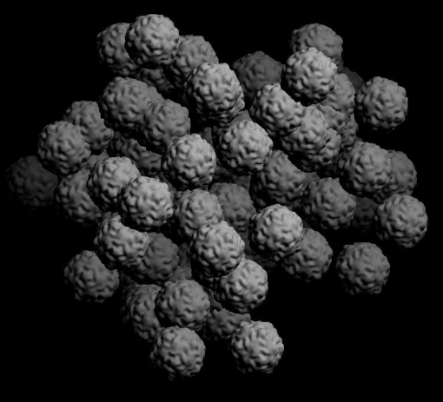
Poliovirus:
Important Properties:
Host range: ??
Fecal-oral route.
Naked , single-stranded, positive-polarity RNA.
Three serotypes:
Type 1 → most virulent
Vaccines are “trivalent”

Slide 6
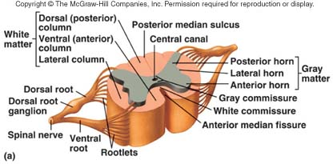
Pathogenesis:
The virus replicates in the pharynx and GIT.
In throat and stools before the onset of illness. No permanent carrier.
Quarantine??
It can spread →blood → CNS.
Most infections are asymptomatic or very mild aseptic meningitis.
Paralysis is the result of death of the motor neurons, especially anterior horn cells in the spinal cord.

Slide 7
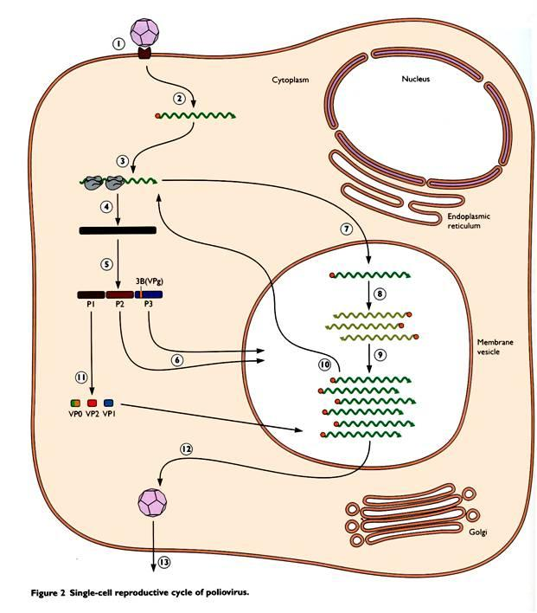
Replicative cycle:

Slide 8
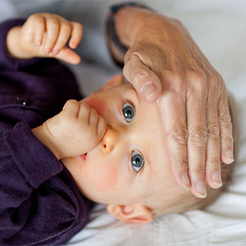
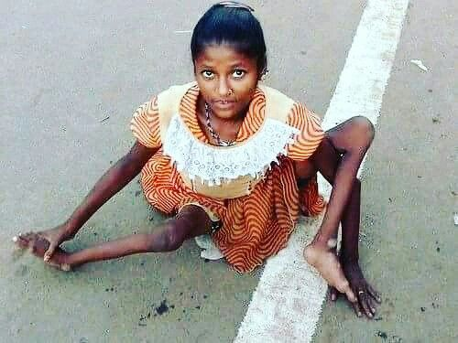
Clinical features:
IP 10-14 days.
Clinically, four forms:
Asymptomatic infection.
Abortive polio .
Aseptic meningitis.
Paralytic polio: flaccid paralysis , irreversible.
Postpolio syndrome.
Laboratory diagnosis:
Isolated from throat, stool, and CSF .
Treatment:
No antiviral therapy.

Slide 9
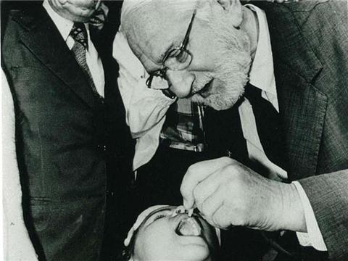
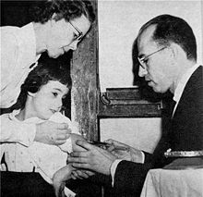
Prevention:
live attenuated vaccine( Sabin vaccine) Oral vaccine: (OPV)
Three polioviruses as attenuated strains.
Advantages: ??
Disadvantages:??
2. Inactivated( killed) vaccine(Salk vaccine): (IPV)
Three polioviruses.
Given by injections.

Slide 10
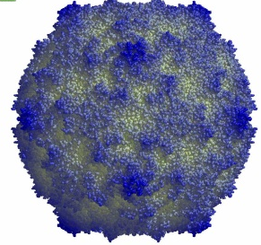
Coxackie viruses:
Characteristics:
- Naked neucleocapsid, SS, positive polarity RNA.
- Group A (24 serotypes) and B (6 serotypes) viruses.
- Feal-oral route
A→ skin and m.m.
B→ heart, liver, pancreas.
- Both A and B: Febrile rash.
URT infection.
Aseptic Meningitis.

Slide 11
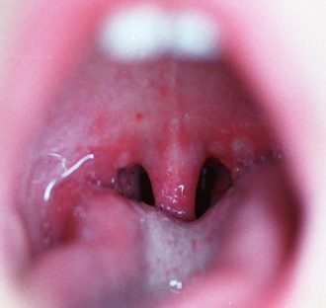
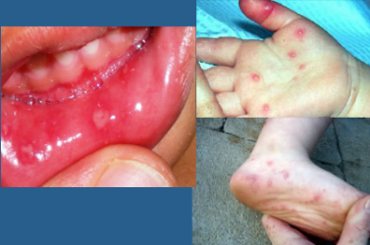
Herpangina:
Coxsackie A viruses specific diseases:
Hand, foot and mouth disease:

Slide 12
Coxsackie B viruses specific diseases:
Pleurodynia (Bornholm disease).
Peri & myocarditis.
Juvenile diabetes/ pancreatitis .
Laboratory diagnosis:
Isolating the virus
Rise in titer of neutralizing antibodies.
A rapid PCR-based test

Slide 13
Echoviruses:
ECHO is: enteric cytopathic human orphan.
More than 30 serotypes.
Fecal–oral route.
Aseptic meningitis, …….
Diagnosis: Isolation of the virus in cell culture.

Slide 14
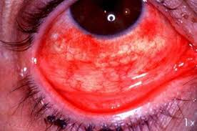
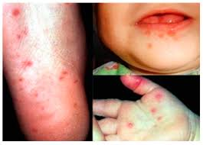
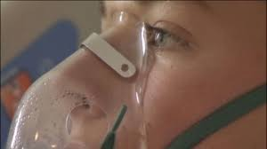
Other Enteroviruses
Enterovirus 70:
Acute hemorrhagic conjunctivitis.
Enterovirus 71
Meningitis, encephalitis, and paralysis.
Hand-foot-and-mouth disease and herpangina.
Enterovirus 68:
Respiratory illness, mild to severe---pneumonia, respiratory failure.
Acute flaccid polio-like paralysis in children.
Diagnosis: real-time PCR.

