Slide 1
وسهلا
أهلا
الأستاذ الدكتور/ يوسف حسين
أستاذ التشريح وعلم الأجنة
كلية الطب – جامعة الزقازيق- مصر
دكتوراة من جامعة كولونيا المانيا
د. يوسف حسين (استاذ التشريح)

Slide 2
Maxillary artery

Slide 3
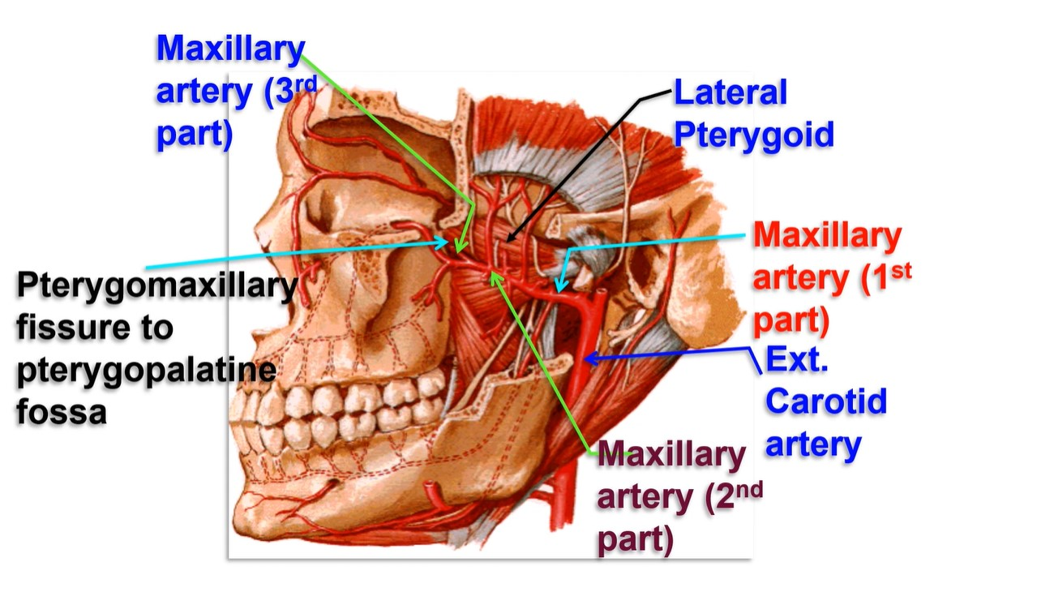

Slide 4
• Maxillary artery
• Origin: the larger of the 2 terminal branches of ECA inside the parotid gland.
• End, it ends in the pterygopalatine fossa.
• Course and relations : it is divided by lateral pterygoid muscle into 3 parts:
(1) First part: It leaves the parotid gland through its anterior surface.
(2) 2nd part: runs either deep or superficial to the lateral pterygoid muscle.
(3) 3rd part: passes through pterygomaxillary fissure to reach pterygopalatine fossa.
I- Branches from the 1st part: (MIADA) 5 branches
1- Middle meningeal artery
2- Inferior alveolar artery
3- Accessory meningeal artery enters the skull through foramen ovale to
meninges
4- Deep auricular artery to external auditory meatus and outer layer of the ear
drum
5- Anterior tympanic artery to the middle ear
N.B: posterior tympanic artery branch from posterior auricular artery.

Slide 5
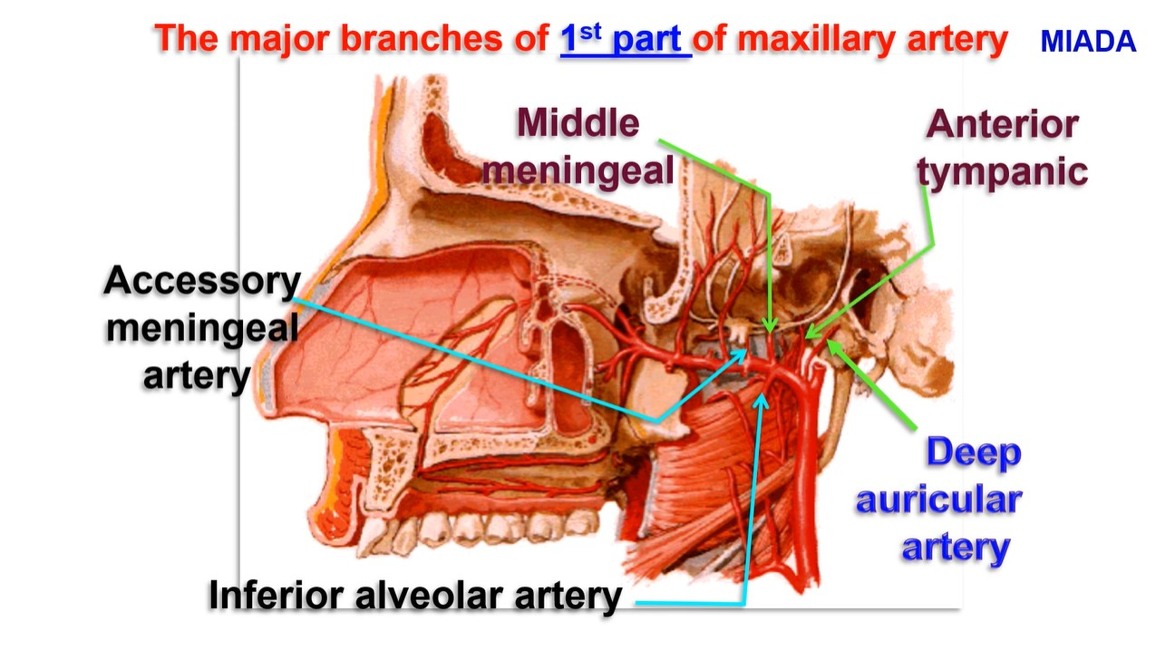

Slide 6
Middle
meningeal artery

Slide 7
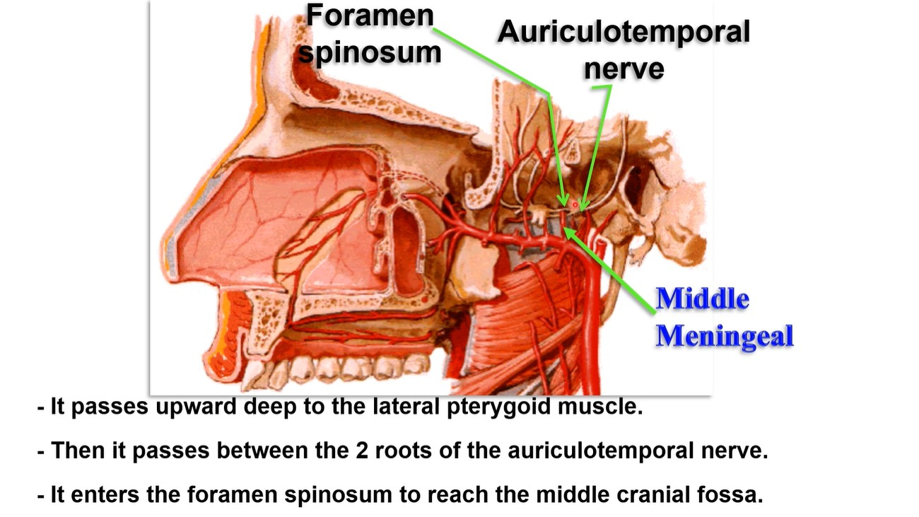
- It passes upward deep to the lateral pterygoid muscle.
- Then it passes between the 2 roots of the auriculotemporal nerve.
- It enters the foramen spinosum to reach the middle cranial fossa.

Slide 8
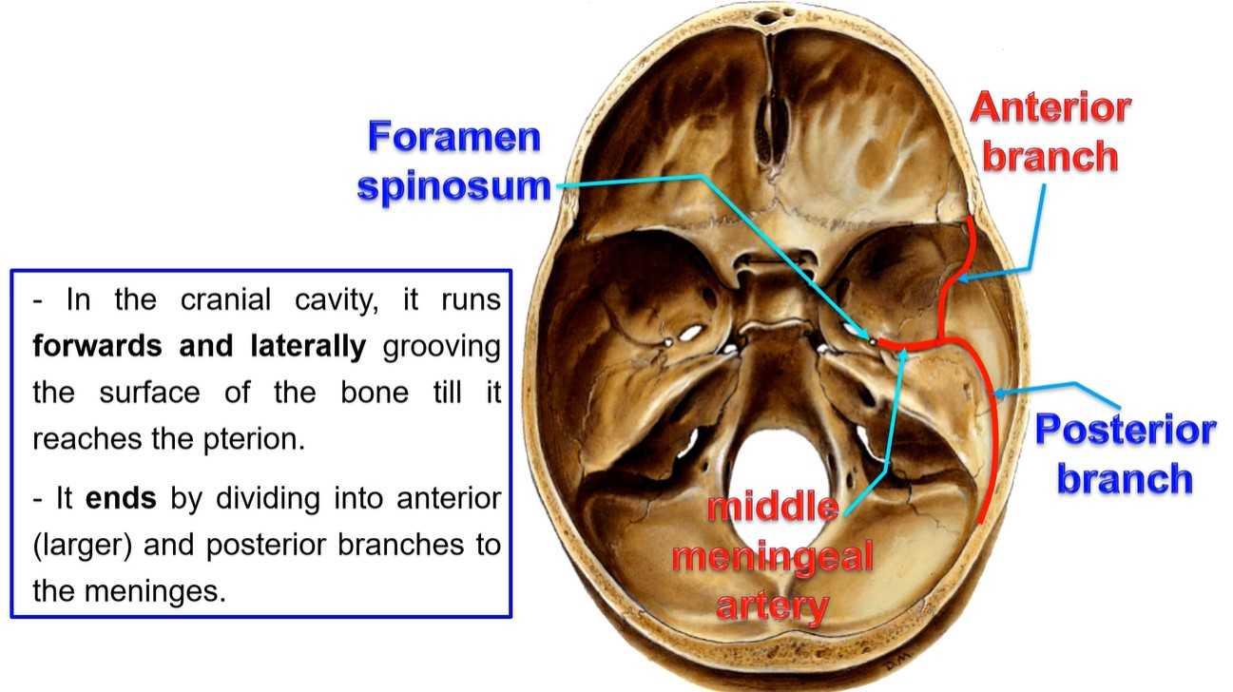
- In the cranial cavity. It turns forward & laterally grooving the surface of the bone till it reaches petrion.
- It ends by dividing into anterior (larger) & posterior branches to the meninges.

Slide 9
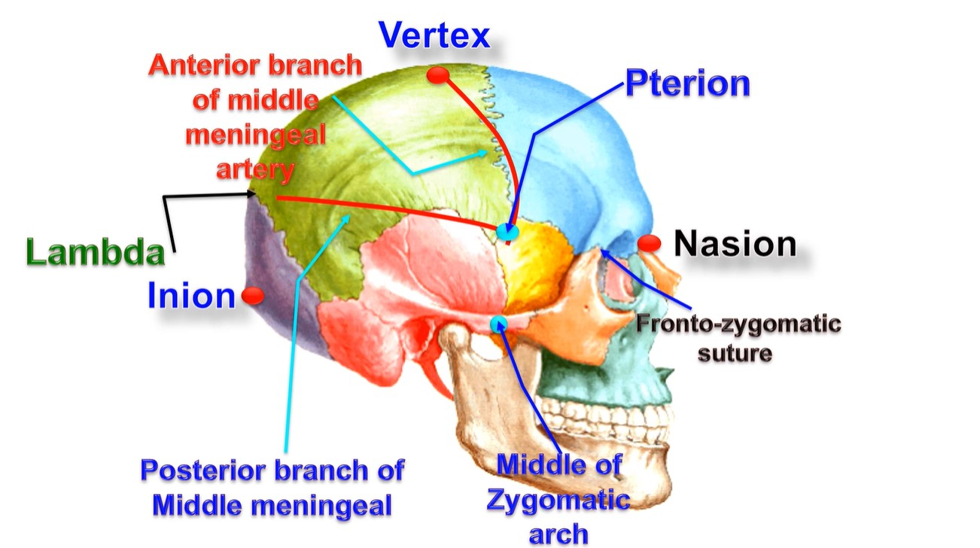

Slide 10
• Surface anatomy of middle meningeal artery:
1) Main trunk; from a point above the middle of the
zygomatic arch to the pterion.
2) Anterior branch: between 2 points
a- Pterion which is about point 3 cm behind the
frontozygomatic suture and about 3 cm above the
middle of the zygomatic arch.
b- Vertex, a point between the nasion (root of the nose)
and inion (tip of the external occipital protuberance).
3) Posterior branch: a line runs upwards and backwards from
the pterion to the lambda.

Slide 11
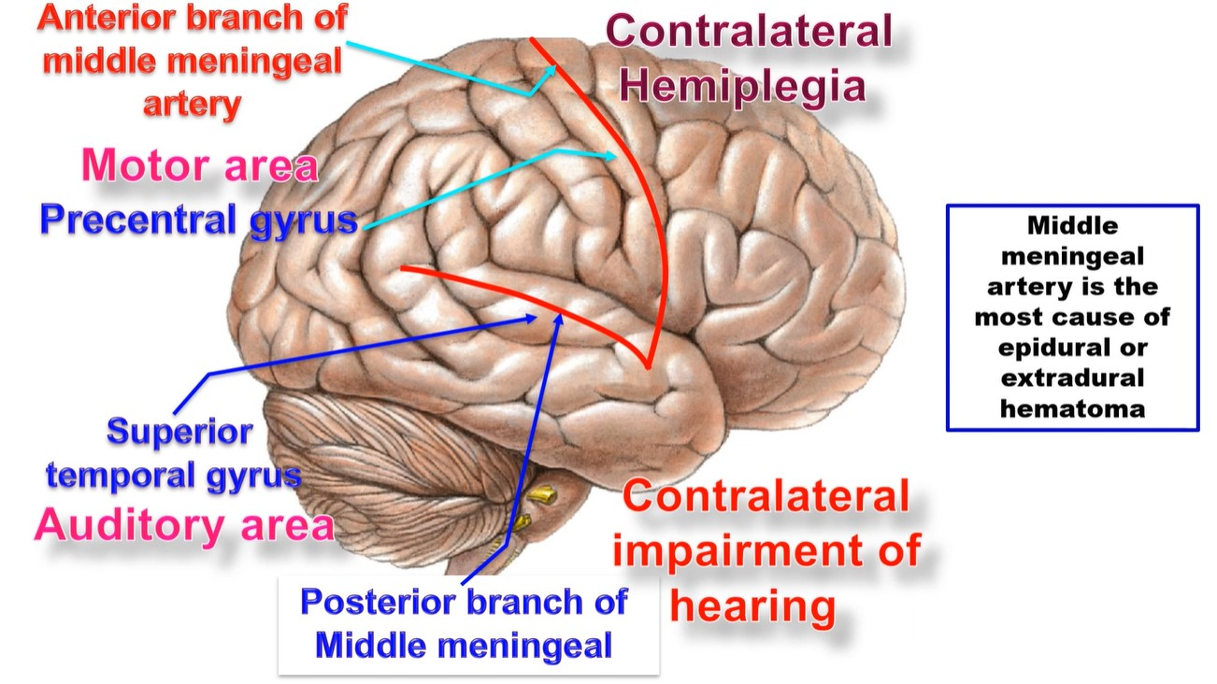
Middle meningeal artery is the most cause of epidural or extradural hematoma

Slide 12
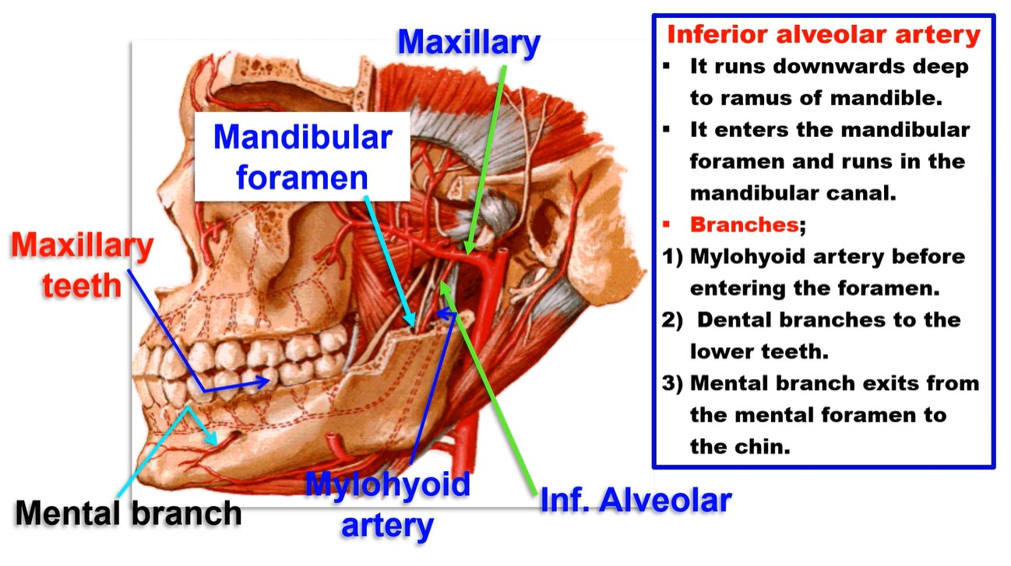
Inferior alveolar artery
It runs downwards deep to ramus of mandible.
It enters the mandibular foramen and runs in the mandibular canal.
Branches;
1) Mylohyoid artery
before entering the
foramen.
2) Dental branches to
the lower teeth.
3) Mental branch exits
from the mental
foramen to the chin.

Slide 13
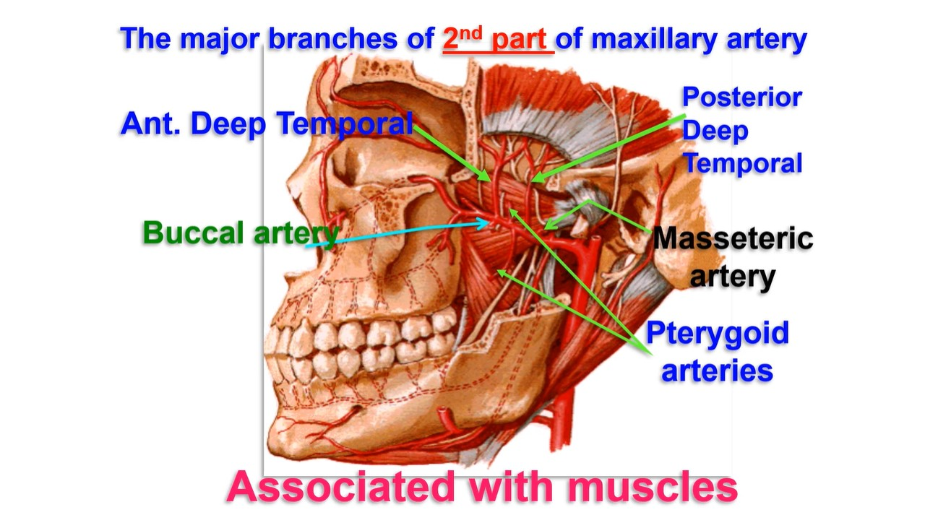

Slide 14
III- Branches of the 3rd part (PIG PPS):
(1) Posterior Superior alveolar artery to maxillary
sinus, upper molar and premolar teeth.
(2) Infra-orbital artery.
(3) Greater palatine artery.
(4) Pharyngeal branch: to the naso-pharynx.
(5) Pterygoid canal artery: to the naso-pharynx.
(6) Sphenopalatine artery: It is continuation of the
maxillary artery. It is the main blood supply of the
nose.

Slide 15
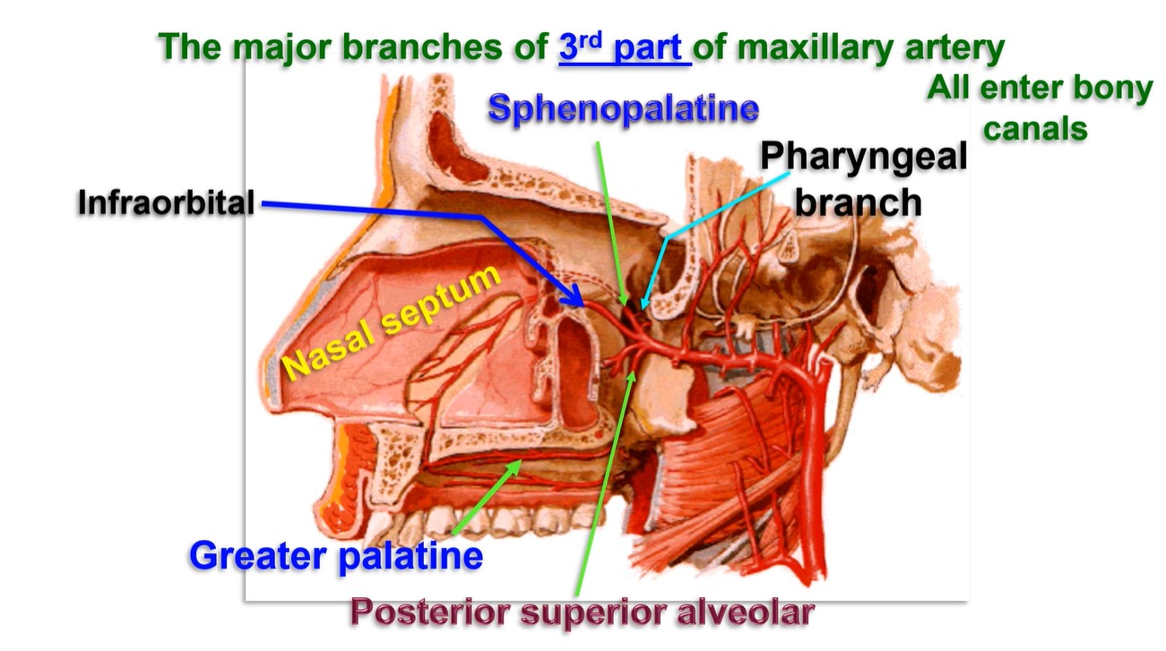

Slide 16
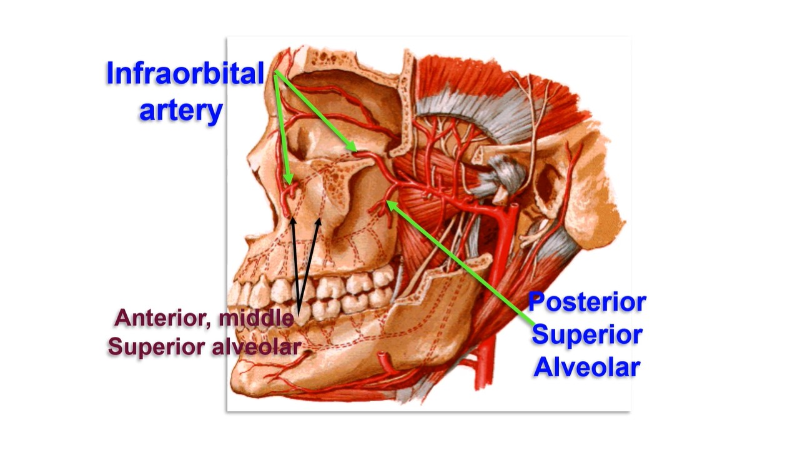

Slide 17
infra-orbital artery
- It enters orbit through inferior orbital fissure--- infraorbital canal -----infra orbital foramen finally reaches the face.
• Branches;
a- Middle and anterior superior alveolar artery to supply
the maxillary sinus, upper canine and incisor teeth.
b- Terminal branches in the face
1- Inferior palpebral artery to the lower eye lid.
2- Lateral nasal to the skin over the nose.
3- Superior labial artery to the upper lib.

Slide 18
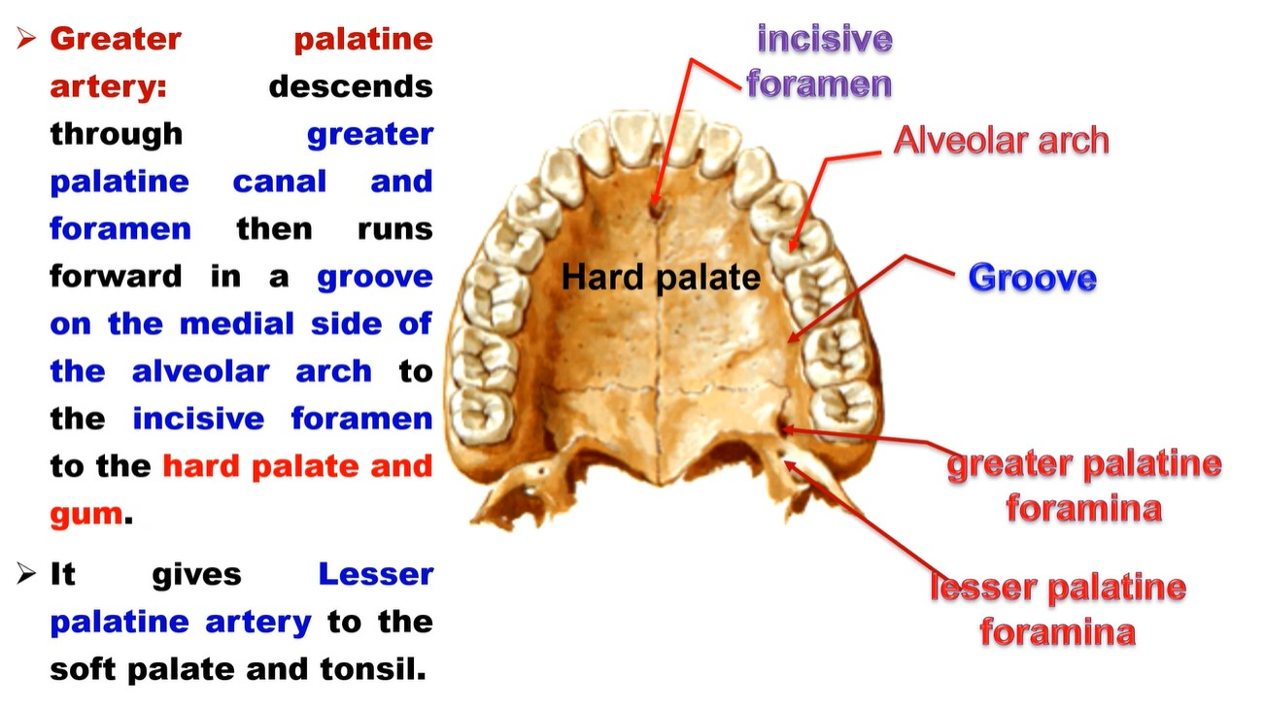
Greater palatine artery: descends through greater palatine canal and foramen then runs forward in a groove on the medial side of the alveolar arch to the incisive foramen to the hard palate and gum.
It gives Lesser palatine artery to the soft palate and tonsil.

Slide 19
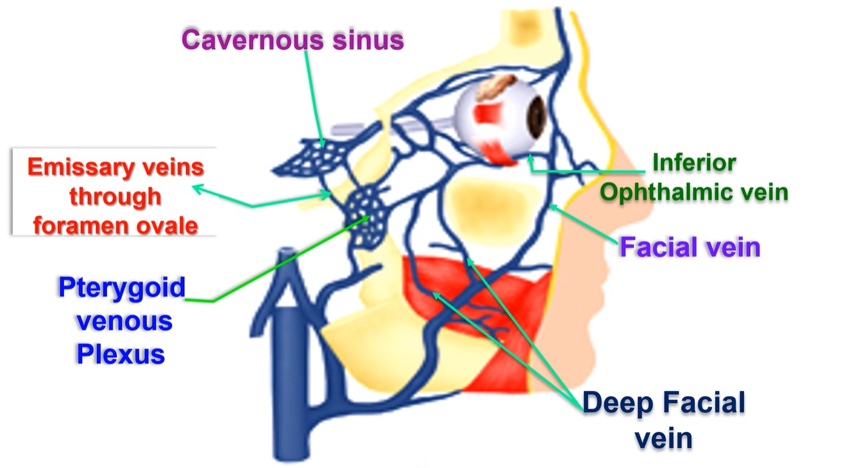

Slide 20
• Pterygoid venous plexus
• Site: around and inside the substance of lateral pterygoid muscle.
• Tributaries: the veins corresponding to the branches of maxillary artery.
• Drainage: by the maxillary vein which ends inside the parotid gland by
uniting with the superficial temporal vein to form the retromandibular
vein.
• Communications of the pterygoid plexus with:
(1) Facial vein through the deep facial vein.
(2) Cavernous sinus via emissary veins passing through the foramen ovale.
(3) Inferior ophthalmic vein through the inferior orbital fissure.
• Clinical importance: The veins of the face are valveless, So infection can
be carried to the cavernous sinus leads to meningitis and cavernous
sinus thrombosis

Slide 21
Thank you
Questions
I/Azzam - 2004

