Slide 1
General Microbiology
Biochemical reactions
Lab 5
MATHHAR AHMAD ABU MORAD MD
DEPARTMENT OF MICROBIOLOGY AND IMMUNOLOGY
FACULTY OF MEDICINE, MU’TAH UNIVERSITY

Slide 2
Objective
To become familiar with the biochemical tests used to isolate gram negative bacteria

Slide 3
Enterobacteriaceae
General Characteristics
Gram-negative bacilli
Oxidase –ve
Catalase +ve
Ferment glucose with or without gas production
facultative anaerobes
If motile, motility by flagella

Slide 4
Identification of Enterobacteriaceae
1- Using selective and differential media
2- Using special biochemical reactions

Slide 5
Identification of Enterobacteriaceae
1- Using selective and differential media
Enterobacteriaceae divided into two main groups according to lactose fermentation
Enterobacteriaceae
Lactose fermenters (Lf)
Non Lactose fermenters (nLf)
E. coli, Klebsiella, Enterobacter
Salmonella, Shigella, Proteus
There are several selective and differential media used to isolate and distinguish
between Lf & nLf including
MacConkey agar
Salmonella Shigella agar (SS agar)
Notes:
Triple Sugar iron (TSI)
Eosin Methylene blue (EMB)

Slide 6
Urine analysis
Midstream urine sample
Sample inoculation
Blood agar
MacConkey agar
Significant growth
Abundant growth
Gram stain
Gram stain
Gram positive cocci
Gram negative bacilli
catalase
Escherichia coli, Pseudomonas aeruginosa
Proteus vulgaris, Klebsiella pneumoniae
positive
negative
Biochemical reactions
Staphylococci
Streptococci
Mannitol salt agar

Slide 7
Identification of Enterobacteriaceae
2- Using special biochemical reactions
The differentiation of the principle groups of Enterobacteriaceae
Can be accomplished on the basis of their biochemical properities
and enzymatic reactions in the presence of the specific substrate
One important group of biochemical reactions is:
IMViC
I: Indole
M: Methyl red
V: Vogus Proskauer
C: Citrate utilization tests

Slide 8
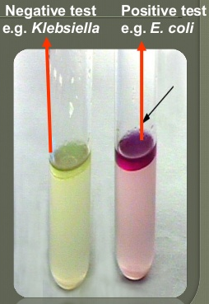
IMViC: Indole test
Principle
Some microorganisms can metabolize tryptophan by tryptophanase
The enzymatic degradation leads to the formation pyruvic acid, indole, and ammonia
The presence of indole is detected by addition of Kovac’s reagent
Media
tryptophan or peptone broth
Results
A bright pink color on the top layer indicated the presence of indole

Slide 9
IMViC: Methyl Red, Voges Prosakaur
Principle
Methyl Red test: to determine the ability of bacteria to oxidize glucose with the production and stabilization of high acidic end products.
Ex: Lactic acid, fromic acid
Voges Prosakaur: to determine the ability of bacteria to produce non-acidic or neutral end products
Ex: acetylmethyl carbinol
Procedure
Inoculate the tested organism into ONE tube of MR-VP broth
After incubation: pour 1/3 of the broth into a clean tube
Run the tests as following
For methyl red: run in the tube containing the 2/3 by adding 6-8 drops of methyl red reagent
Notes:
Methyl red is a pH indicator; it is red in pH under 4.4, yellow in pH over 6.2, and orange in between,

Slide 10
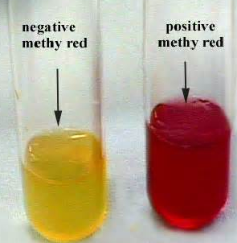
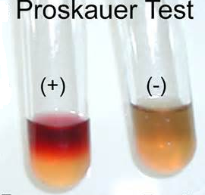
IMViC: Methyl Red, Voges Prosakaur
2. For Voges Prosakaur: in the tube containing the 1/3
add 12 drops of Barritt’s reagent A(α-naphthol), Mix
add 4 drops of Barritt’s B reagent (40% KOH), Mix
Let undisturbed for at least 1 hour
Methy red is red in pH under 4.4, yellow in pH over 6.2
Notes:
it is red in pH under 4.4, yellow in pH over 6.2

Slide 11
IMViC: Citrate utilization test
Purpose
To determine the organisms that are able to ferment citrate as a sole carbon source
Principle
Medium
Simmons citrate agar
Citrate Pyrovate CO2+Na+H2O Na2CO3
Alkaline, PH
Bromothymol blue
Green to Blue color

Slide 12
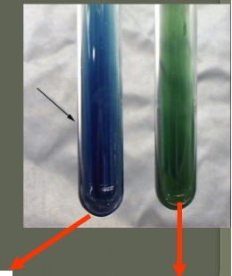
IMViC: Citrate utilization test
Results
Positive results: blue color (Klebsiella)
Negative results: green color (E. coli)

Slide 13
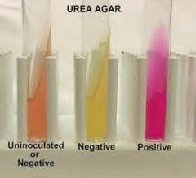
Urease test
Purpose
To isolate organisms that are urease positive
Principle
Medium
Urea agar
Results
Negative = yellow color e.g., E. coli
Positive = pink color e.g., klebsiella aregenes
Urease H2O
Urea CO2 + NH3 NH4OH in pH
Pink (Positive results)
Phenol red

Slide 14
Urease test

Slide 15
Sugar fermentation test
Purpose
Carbohydrate fermentation tests detect the ability of microorganisms
to ferment a specific carbohydrate.
Media
Sugar media
Sugars used
- Glucose - Lactose - Maltose - Mannitol - Sucrose
Results
pH indicator: Phenol-Red is red at pH > 7
If fermentation occurs, the acidic by-products will
change the from red to yellow.

Slide 16
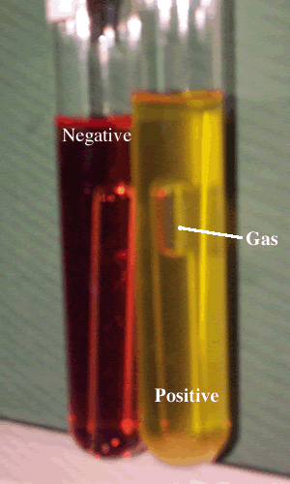
Sugar fermentation test

Slide 17
 | S. Dysenteriae | S. flexneri | S. sonni | Klebsiela | E. coli | V. cholera
Glucose | A, No G | A, No G | A, No G | A, G | A, G | A, No G
Lactose | -ve | -ve | A, No G | A, G | A, G | A, No G
Maltose | -ve | -ve | -ve | A, G | A, G | A, No G
Mannitol | -ve | A, No G | A, No G | A, G | A, G | A, No G
Sucrose | -ve | -ve | -ve | A, G | A, G | A, No G
indole | -ve | -ve | -ve | -ve | +ve | +ve
MR | +ve | +ve | +ve | -ve | +ve
VP | -ve | -ve | -ve | +ve | -ve
Citrate | -ve | -ve | -ve | +ve | -ve
Urease | -ve | -ve | -ve | +ve | -ve
H2S | -ve | -ve | -ve | -ve | -ve
Key
A: acid No G: No gas -ve: negative +ve: positive

Slide 18
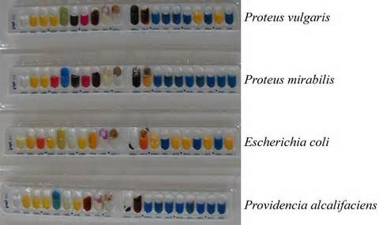
Analytical Profile Index System (API) for bacterial identification
API (Analytical Profile Index) 20E is a biochemical panel for identification and differentiation of members of the family Enterobacteriaceae.

Slide 19
Bacterial Barcodes
E. Coli Salmonella

