Slide 1
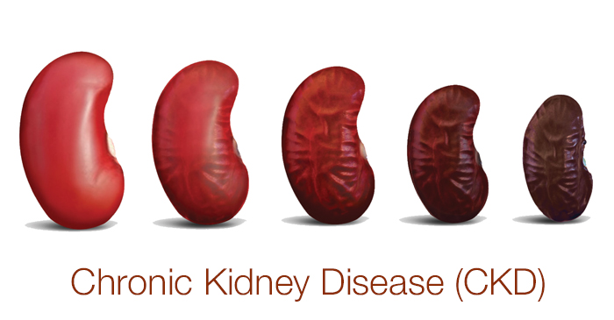
Dr aseel dmour

Slide 2
No Kiddin’

Slide 3
Definition
A state of irreversible kidney damage and/or reduction of kidney function that can lead to progressive decrease in kidney function
(kidney dysfunction as a continuum, rather than discrete change in renal function)

Slide 4
Glomerular Filtration Rate - GFR
Sum of the filtration rates in all functioning nephrons
i.e. Reduced GFR → decrease in number of functioning nephrons
eGFR = 0.413 x height in cm /serum creat

Slide 6
Diagnostic Criteria
The KDIGO diagnosis of pediatric CKD, diagnostic clinical criteria (one of) :
GFR < 60ml/min per 1.73 m² for greater than 3 months with implications for health regardless of whether other CKD markers are present
GFR > 60ml/min per 1.73 m² that is accompanied by evidence of
structural damage
Marker of functional kidney abnormalities (proteinuria, albuminuria, renal tubular disorders)
Pathologic abormalities detected by histology or inferred by imaging

Slide 7
KDIGO Staging
For children older than 2 years of age
Significance of this staging:
Stratifies risk of progression of CKD and its complications based on GFR
Used to guide management (What therapeutic interventions should be initiated and when)

Slide 8
CKD Staging – KDIGO 2012 CPG
GFR Category | GFR (ml/min per 1.73 m²) | Terms
G1 | ≥ 90 | Normal or high
G2 | 60-89 | Mildly decreased (relative to young adult level)
G3a | 45-59 | Mildly to moderately decreased
G3b | 30-44 | Moderately to severely decreased
G4 | 15-29 | Severely decreased
G5 | <15 | Kidney failure
In the absence of kidney damage, neither G1 nor G2 fulfill CKD criteria

Slide 9
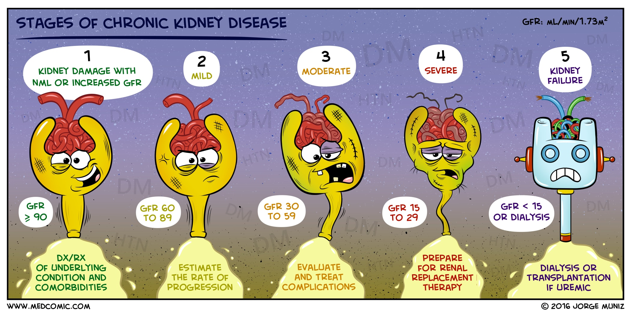

Slide 10
Normal GFR in chilren and young adults
Age (Gender) | Mean GFR ± S.D ml/min/1.73 m²
1 week (males & females) | 40.6 ± 14.8
2-8 weeks (males and females) | 65.8 ± 24.8
> 8 weeks (males and females) | 95.7 ± 21.7
2-12 years (males and females) | 133 ± 27
13-21 years (males) | 140 ± 30
13-21 years (females) | 126 ± 22

Slide 11
Etiology
Congenital Renal Anomalies:
Obstructive Uropathy
Renal aplasia/hypoplasia/dysplasia
Reflux nephropathy
Polycystic kidney disease
Glomerular diseases
More common in older chilren
Smaller of the etiology of overall CKD, larger proportion of ESRD patients (rapid rate of CKD progression)
Others
HUS
Genetic disorders (oxalosis, cystinosis, hereditary nephritis-Alport)
Interstitial nephritis

Slide 12
Distribution of the etiology of chronic kidney disease (CKD) in pediatric renal transplant recipients based on age at transplantation

Slide 13
Presentation
Clinical presentation of CKD is dependent upon :
Underlying Cause (Glomerular vs. Non-glomerular)
Severity of Renal Impairment

Slide 14
Clinical Presentation – Non-Glomerular
Affect tubulointerstitial Space:
CAKUT
Cystic kidney diseases
If not diagnosed early, pts may present with:
Polyuria (reduced concentrating ability) CAKUT(obstructive), inherited dis.(nephronophthisis), tubulointerstitial disease (Nephrogenic DI)
Elevated Creatinine
(Spina Bifida paradox ! : muscle wasting and neurogenic bladder)
Poor Growth → common manifestation

Slide 15
Clinical Presentation – Glomerular
Present with more prominent signs and symptoms of kidney disease:
Tea/Cola – colored urine RBCs casts → GN
Microscopic hematuria
Proteinuria
Edema (Nephrotic range proteinuria)
Elevated Serum Creat
Elevated Blood Pressure
Systemic Sx – Concurrent Systemic Disease (SLE, Wegner’s) : fever, skin rash, cough, arthralgia/arthritis

Slide 16
Clinical Presentation - Stage of CKD
Early Stages (GFR > 60ml/min per 1.73m²) i.e. G1/G2 → often Asymptomatic
As CKD progresses (renal fxn deteriorates), pt becomes increasingly symptomatic
Signs of severe renal impairment begin to appear with stage G3a/G3b
Uremia Symtpoms:
Anorexia
Vomitting
Weakness and fatigability
Uremia Complications:
Pericarditis
Neurocognitive function deficits
Mineral Bone Disorder

Slide 17
Initial Evaluation – History Sx onset and duration History looking for Signs of CKD or factors that increase CKD risk:
Family history of renal disease or hypertension
Growth history, particularly poor linear growth
Polyuria, polydipsia or enuresis
Elevated blood pressure
Antenatal Dx CAKUT
Orthopedic/Urologic abnormalities
Recurrent UTIs
Unexplained Anemia
Seizures
Fluid and electrolyte disturbances
Uremia Sx (weakness, fatigue, anorexia, vomitting)
Systemic Signs (fever, rash, arthralgias/arthritis) e.g. SLE, HSP
Gross Hematuria
Edema

Slide 18
Initial Evaluation – Physical Exam
Growth Parameters
Blood Pressure
Pallor
Signs of hypervolemia
Edema
Rales
Hepatic congestion
Cardiac gallop
Cardiac auscultation
Pericardial rub/pericarditis
Pericardial effusion
diminished heart sounds
Exteremity exam
Edema
Deformities - MBD

Slide 19
Initial Evaluation - Imaging
Ultrasound
Most widely used
Growth and structure of kidneys
(renal length in saggital plane)
Special Considerations:
Single Kidney
Growth failure
MCUG
UTCT
MRI
Careful with the contrast

Slide 20
Initial Evaluation - Labs
Serum Creatinine
Electrolytes:
Hematologic Profile, if anemic
RBC indices
Retics
Iron Status:
(Fe, TIBC, Tsat, ferritin)
Vit B12 and folate
Occult Blood
MBD workup:
Ca, PO4, 25(OH)Vit D, PTH
Fasting lipid profile
LDL, HDL, TG, Cholesterol
Urinalysis
Protein, pH, RBCs, WBCs
Kidney Biopsy
Diagnosis or excluding Dx
Disease Severity
Reversible changes
Interstitial fibrosis

Slide 21
Proteinuria
Indicator of underlying glomerular disease and/or tubular dysfunction
Important biomarker associated STRONGLY with CKD
Ongoing protein excretion may contribute to CKD progression
Severity of renal disease is generally associated with amount and duration of proteinuria
Persistent High grade proteinuria → look for other signs of renal dysfunction
Presence of persistent proteinuria → urine protein/creatinine ratio

Slide 22
Progression
The response to initial damage is variable and unpredictable.
Recovery with little or no sequelae
Ongoing progressive loss of function leading to CKD
ESRD
It is important to understand the factors associated with progression in order to put management strategies to prevent or slow the decline of kidney function to ESRD
Increased likelihood for progressive CKD:
Low baseline GFR
Greater degree of proteinuira
Higher 24 hours MAP
Age

Slide 23
Progression of CKD
Intraglomerular hypertension and glomerular hypertrophy
Increase in intraglomerular pressure:
Systemic hypertension
Glomerular specific processes
This leads to increased filtration in the remaining functional nephrons and increased glomerular size
Increased transglomerular ultrafiltration and pressure → glomerular damage and protein leak → interstitial inflammation and fibrosis
Histologically:
glomerulosclerosis, vascular sclerosis, tubulointerstitial fibrosis(2ry FSGS) → proteinuria and loss of renal function

Slide 24
Complications
A moderate to severe loss of glomerular filtration rate, i.e. G3 or greater, may result in a number of of complications due to renal impairment
Disorders of fluids and electrolytes
Mineral Bone Disorder
Anemia
Hypertension
Dyslipidemia
Endocrine Abnormalities
Growth Impairment
Decreased clearance of renally excreted substances from the body (e.g. hyperuricemia)

Slide 25
Management
General Management Components:
Treat reversible kidney dysfunction
Prevent or slow disease progression
Treat complications of CKD
Identify and adequately prepare child/family in whom renal replacement therapy will be required
Remember vaccinations

Slide 26
Reversible Kidney Dysfunction
Identifying and treating these causes may result in recovery of some kidney function
Most common potentially recoverable kidney dysfunction:
Decreased kidney perfusion
Nephrotoxic agents
NSAIDs, Radiocontrast, Aminoglycosides, Amphotericin B, Cyclosporine, Tacrolimus
NOTE !!! Some medications may increase measured serum creatinine (but NOT BUN) → cimetidine, trimethoprim, ciprofloxacin, flucytosine
(affect lab assay or tubular secretion withOUT truly affecting kidney function)

Slide 27
Slowing CKD Progression
Interventions to slow CKD progression:
Blood Pressure Control
Reducing Protein Secretion
Correcting Anemia
Controlling Dyslipidemia
Dietary Protein Restriction
Strongest evidence is for strict blood pressure control.
Best agents are ACEI and ARBs (HTN and proteinuria) → more protective than other agents in slowing CKD progression

Slide 28
Complications – fluids and electrolytes
Sodium and water (Intravascular Volume)
Usually maintained until GFR falls below 10-15ml/min per 1.73 m2
Patient with mild-moderate CKD → in relative volume balance BUT less able to respond to changes
Severely impaired kidney function : risk for water retention and overload → acute volume overload, hyponatremia and hypertension.
Some children with obstructive uropathy / dysplastic kidneys:
Propensity for hypovolemia and hyponatremia (poor urine concentrating ability) → careful, different managemeNT

Slide 29
Complications – fluids and electrolytes
Potassium → Hyperkalemia
↓GFR → ↓ K+ excretion → hyperkalemia
↓GFR → ↓Na+ delivery to distal tubules→ ↓exchange with K
Others: dietary, catabolism, Met Acidosis, type IV RTA (obstructive uropathy), Decreased renin from JGA, 1ry of 2ry hypoaldosteronism (ACEI/ARBs, calcineurin inhibitors, prostaglandin inhibitors)
Hypokalemia, rare but possible if:
Fanconi
Renal Tubular Acidosis
Excessive Diuretic Therapy

Slide 30
Fluids and Electrolytes - Management
GFR Drops → water and Sodium Retention → Volume Overload
Management : Sodium Restriction + Diuretics
Diuretics Choice :
Thiazides early on ,
Loop diuretics later on
( in advnaced stages when thiazides become less effective)
Both classes are less effective with decreasing GFR
Some children with poor urine concentrating ability : good urine output despite fluid losses, require ongoing and close monitoring of fluid and sodium replacement
Hyperkalemia Management:
Low Potassium Diet, formula or supplements → potassium free if no potassium free formula, mix with Kay exalate and decant then administer
Loop Diuretics
Correct Metabolic Acidosis

Slide 31
Complications - Metabolic Acidosis
Why do patient’s become acidotic with advancing renal disease ?
Fall in total ammonium excretion as GFR falls below 40-50ml/min per 1.73 m2 (G3)
Decreased in titratable acid secretion (phosphate)
Decreased bicarbonate resorption
As patient approaches ESRD → Serum HCO3- stabilizes between 12-20mEq/L
A level below 10 is unusual, why ?
various body buffers neutralize retained H+ and prevent further fall in HCO3-
Why is acidosis harmful ?!!
Negative impact on growth
(body utilizes bone buffering to bind some excess H+ ions)

Slide 32
Metabolic Acidosis - Managment
Target HCO₃ ⁻ at or above 22mEq/L
Sodium Bicarbonate:
Start at dose 1-2 mEq/Kg in two or three divided doses
Titrate the dose to the clinical target

Slide 33
Complications – CKD-MBD
Old Term → Renal Osteodytrophy (mineral bone disorder)
Abnormal mineral metabolism and bone structure with extraskeletal calcifications
If UNtreated → first detected in G2 may NOT have any sign or symptom of disease may have low calcidiol & calcitriol, elevated serum PTH and FGF-23
Calcium, phosphorus and PTH stay in normal range in mild CKD
More advanced CKD :
bone pain, difficulty walking &/or skeletal deformities
If untreated → mineral, skeletal & skeletal abnormalities
Significant Morbidity: growth failure, avasc necrosis, skeletal deformities and fractures and vascular calcifications

Slide 34
CKD – MBD - Pathophysiology
GFR declines (around 50%)
decreased functional kidney mass
decreased 1alpha hydroxylase activity
decreased activated Vit D
Decreased intestinal calcium absorption
hypocalcemia, increased PTH
Increased PTH → increased bone resorption
Futher decrease in GFR (20-25%)
failure in compensatory mechanisms that excrete phosphate
→ hyperphosphatemia→ further ↓Ca2+ and ↑PTH

Slide 35
CKD – MBD - Managment
Control Serum Phosphorus with diet and phosphate binders
Normalizing 25-OH-Vit D (Vit D supplements)
Control hyperparathyroidism with active vitamin D analogs
Calcimimetic drug therapy &/or parathyroid surgery while keeping serum calcium in the normal range

Slide 36
Complications - Anemia
Primarily due to DECREASED ERYTHROPOEITIN production.
(Generally GFR < 30 ml/min per 1.73 m²)
i.e. Common in severe CKD (G4 & G5)
Usually NORMOchromic NORMOcytic
What if it is HYPOchromic MICROcytic ?
Iron Deficiency
Aluminum Excess
What if it is Macrocytic ?
Folate Deficiency
Vit B12 Deficiency

Slide 37
Screening for Anemia
Annual CBC, Anemia in CKD pts defined by:
0.5-5 years : < 11g/dL
5-12 years : < 11.5 g/dL
12-15 years : < 12g/dL
> 15 years : < 13 g/dL (males), <12g/dL (females)
Once Anemia is detected, following W/U:
Red Blood Cell Indices
Reticulocyte Count
Iron Studies (Serum Iron, TIBC, TSAT, ferritin)
Stool for occult blood
Target Hb: (optimal Hb for pts receving ESA- erythropoeisis stimulating agent ) ????
11-12 f/dL

Slide 38
Anemia - Management
Erythropoeisis Stimulating Agents
Mostly used in ESRD, can be used in earlier CKD
Increasing Hb to target range:
Ameliorate anemia-induced symptoms (e.g. fatigue)
Cardiovascular Improvement
Possibly delay progression of CKD and decreased mortality
Monitor Hb 1-2 weeks after starting treatment then monthly
Types: Erythropoeitin, Darbepoetin alpha

Slide 39
Complications – Risk for Cardiovascular disease
CKD pts are at risk for early atherosclerosis and premature cardiovascular disease
CVD risk factors:
Hypertension
Dyslipidemia
Abnormal glucose metabolism (FBS > 110mg/dL)
Obesity
Pts with glomerular etiology and proteinuria are at higher risk for CVD
Left Ventricular Hypertrophy: (Mechanical or hemodynamic overload)
Concentric LVH: Hypertension
Hypertension, due to:
Volume expansion
Activation of RAAS
Medications (Steroids, CNI) used for underlying disease
Dyslipidemia
Abnormal lipid metabolism is common in CKD patients → Increased CVD risk
Overweight and obese patients are at an increased risk

Slide 40
Hypertension - Management
Hypertension is prevalent even when GFR is only mildly reduced
Need AGGRESSIVE blood pressure control (24 hour MAP below 50th centile)
(Systolic and Diastolic BP < 90th centile)
(In Adolescents, target ≤ 120/80 mm Hg)
Delays ESRD
Treatment should Include:
Specification of target BP (2017 AAP guidelines)
Non-pharmacologic therapy
Anti-hypertensive therapy

Slide 41
Nonpharmacologic treatment:
Lifestyle Changes : weight reduction (if obese), regular aerobic exercise regimen
Dietary Measures: diet rich in fruits and vegetables, ↓ fat and salt avoid alcohol, caffeine, energy drinks and smoking
Parmacologic treatment
ACEI/ARBs should be used if tolerated
(superior to other agents in slowing CKD progression)
Diuretics, recommended in early CKD
Thiazide becomes less effective with CKD progression
Loop diuretic is recommended for HTN and edema treatment in more severe CKD

Slide 42
Complications – Endocrine Dysfunction
In CKD patients, endocrine system becomes dysfunctional as the kidney deteriorates:
Growth Hormone Metabolism
Altered plasma concentration and release
End organ resistance
Thyroid Function
Altered production, distribution and excretion of thyroid hormones
↓T4,↓T3, NL TSH
Gonadal Hormones
Male: ↓ free testosterone, ↓dihydrotestosterone, ↓adrenal androgens, ↑LH/FSH
Female: ↓estrogen, ↑LH/FSH + loss of LH pulsatile pattern → anovulation

Slide 43
Complications – Growth Impairment
Multifactorial:
Malnutrition
Poor appetite
Decreased intestinal absorption
Nutritional assessment should be done on regular basis
(address Energy, Protein, vitamins and minerals)
Might consider Gastrostomy or transpyloric tubes.
Metabolic Acidosis
CKD-MBD
Altered function of GH and IGF-1 axis
Management of MBD, malnutrition, acid-base abNL and electrolyte disturbances before considering GH treatment.

Slide 44
Complications - Neurodevelopment
Uremia is associated with alterations of cognitive development in children
Neurologic findings can range:
subtle deficits (poor school performance)
Seizures and severe intellectual disabilities
Other findings:
Daytime sleepiness
Fatigue
Sleep disorders ( restless leg, sleep-disordered breathing, excessive daytime sleepiness, insomnia)

Slide 45
Impaired Neurodevelopment – Management
Identify modifiable risk factors that can negatively impact learning capacity
Special Education school services
Optimize:
Nutrition
Dialysis
Anemia

Slide 46
Complications - Decreased clearance of renally excreted substances
Uremia
ESRD → constellation of Sx Anorexia, nausea and vomitting, growth retardation, peripheral neuropathy, CNS abnormalities (loss of concentration and lethargy, seizures, coma and death)
Platelet Dysfunction (Adhesion and Aggregation)
Pericardial Disease (Pericarditis annd effusion) indication for dialysis in children with CKD
Hyperuricemia
Elevated serum levels due to decreased urinary excretion
Serum levels >7.5mg/dL → independent risk factor for accelerated CKD progression
No recommnedation for intervention or monitoring

Slide 47
Thank You =)

