Slide 1
Haitham Al-Dhmour, MD
Pediatric History

Slide 2
Differences of a Pediatric History
Prenatal and birth history
Developmental history
Vaccineation
Feeding History
Parents are historians

Slide 3
Profile
Name, age sex,
Historian relation to patient
When admitted if inpatient

Slide 4
Chief complaint
Patient own wards
Duration

Slide 5
History of present illness
Concise chronological account of the illness, including any previous treatment with full description of symptoms pertinent positives and pertinent negatives

Slide 6
Review of systems
Review of all possible symptoms either related or not related to chief complaint
System by system

Slide 7
Prenatal
Maternal health during pregnancy: bleeding, trauma, hypertension, fevers, infectious illnesses, medications, drugs, alcohol, smoking, Diabetes or any other disease
Rupture of membranes
Antenatal visits and findings
Supplements and drugs
Investigations and blood group

Slide 8
Natal
Gestation age at delivery
Birth weight
Mode of delivery
A/S
NICU admission and coarse
Jaundice

Slide 9
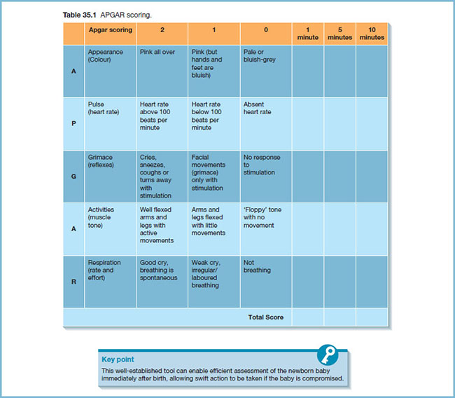

Slide 10
Past Medical History
Major medical illnesses
Major surgical illnesses-list operations and dates
Previous hospital admissions with dates and diagnoses

Slide 11
Immunization
Vaccines given
Side effects
Extra vaccines

Slide 12
Developmental History
Gross
Fine motor and vision
Language and hearing
Social

Slide 13
Feeding History
Breast or bottle fed, types of formula
Frequency and amount, reasons for any changes in formula
Weaning
Supplements

Slide 14
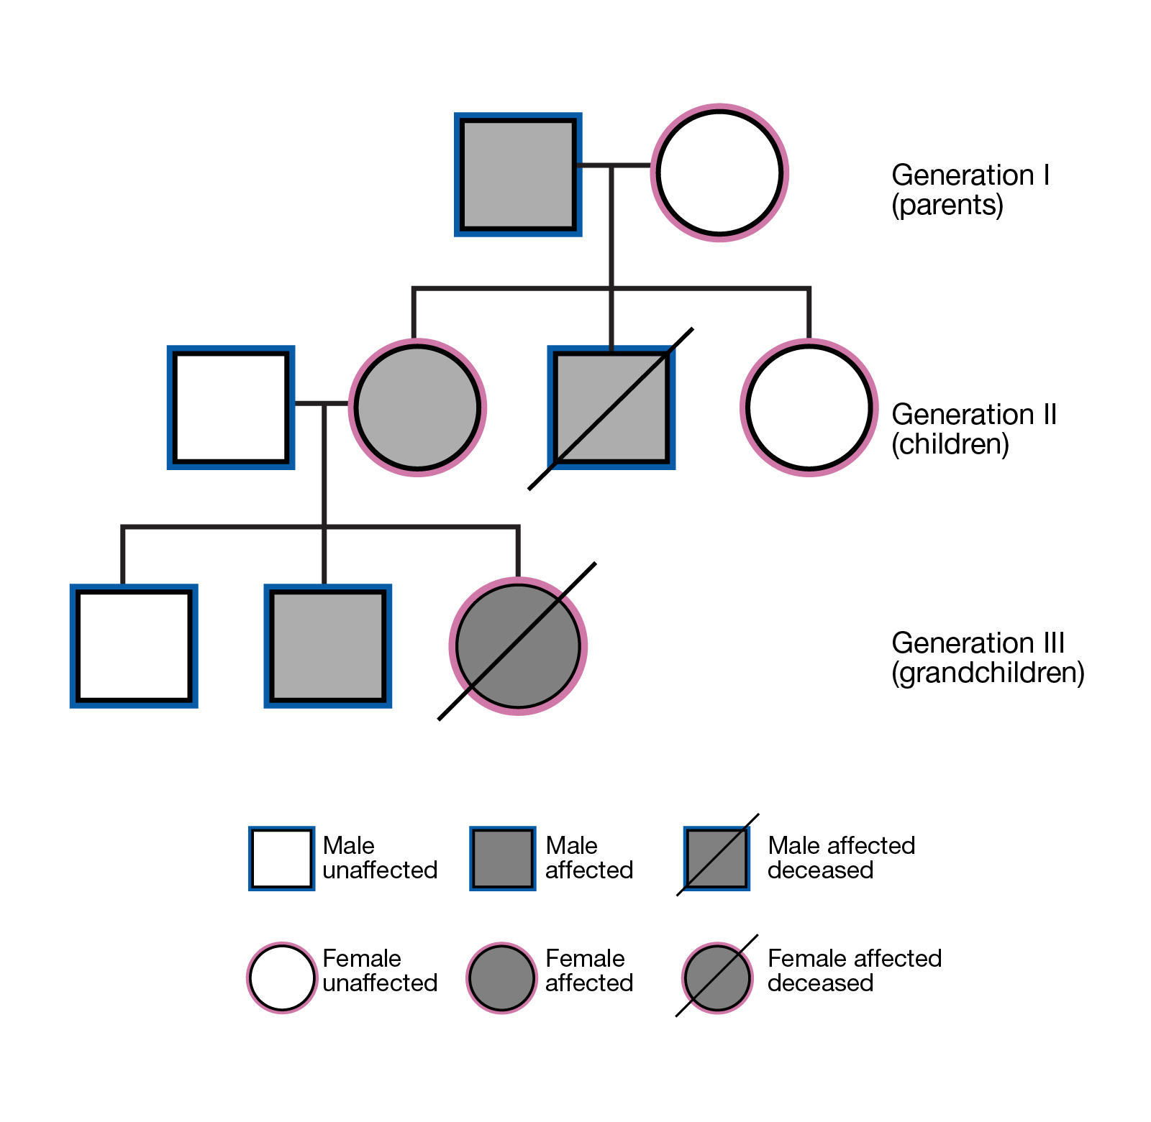

Slide 15
Family History
Consanguinity
Pedigree
Any genetic disease
Developmental delay

Slide 16
Social
Living situation and conditions - daycare, safety issues
Occupation of parents

Slide 17
Physical exam
General inspection
Vital signs
Growth parameters
General and systemic exam

Slide 18
Differences
Gather much information by observation
Stay at the child level
least distressing to most distressing

Slide 19
General inspection
Does the child looks well or ill?
Level of consciousness
Signs of dehydration
Dysmorphic features
Signs of respiratory distress
Suprasternl retraction
Intercostal retraction
Subcostal retraction
Nasal flaring
Use of accessory muscles
Behavior
Cyanosis:
Normal sat 95% or above
Appear if sat les 85%

Slide 20
Vital signs
Temperature
Oral, rectal, axillary
HR
Apical or femoral for infants
Antecupital or radial pulse for older children
Respiratory rate
Observe for a minute.
Blood pressure
Appropriate size cuff - 2/3 width of upper arm

Slide 21
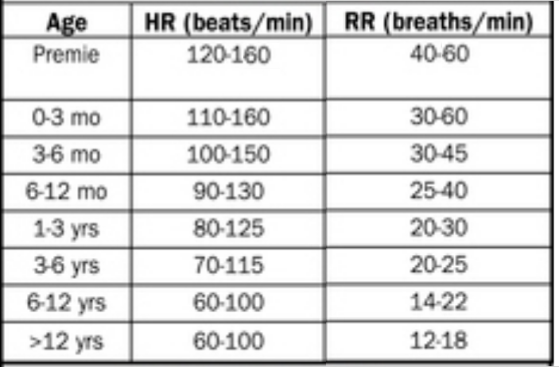

Slide 22
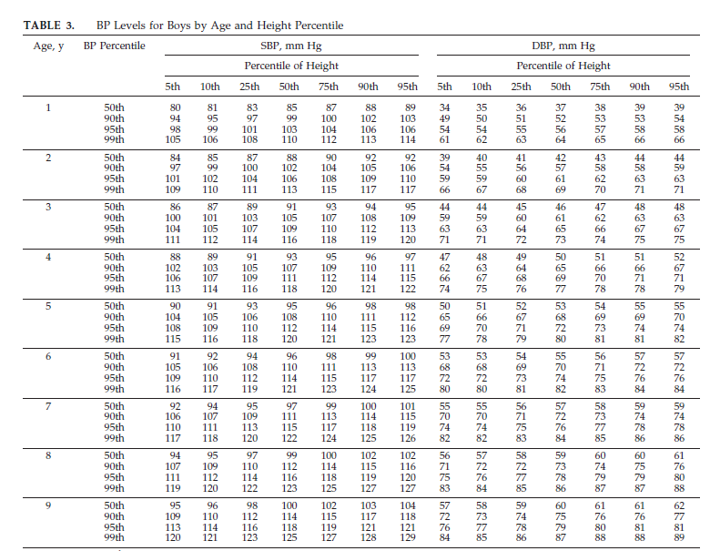

Slide 25
Growth parameters
Use growth charts
Weight
Length/Height
Head circumference
BMI

Slide 26
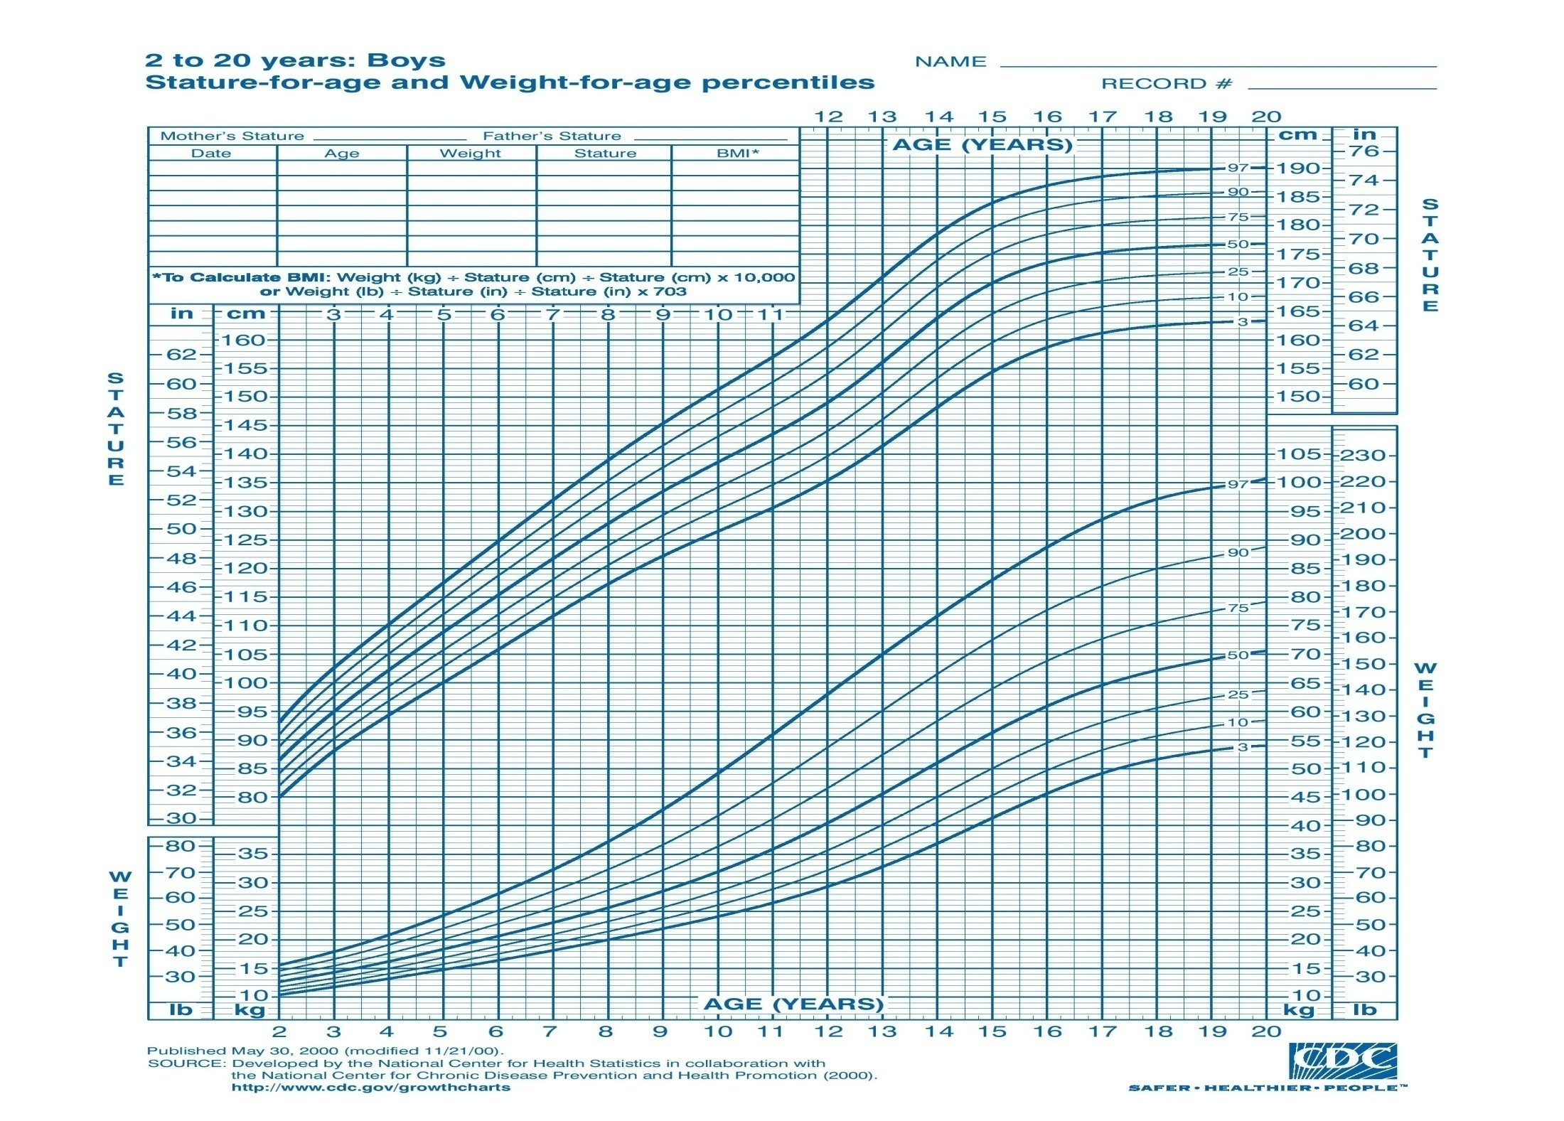

Slide 27
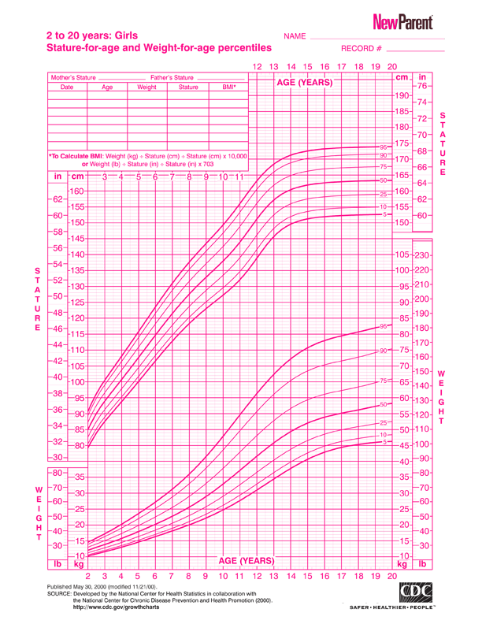

Slide 28
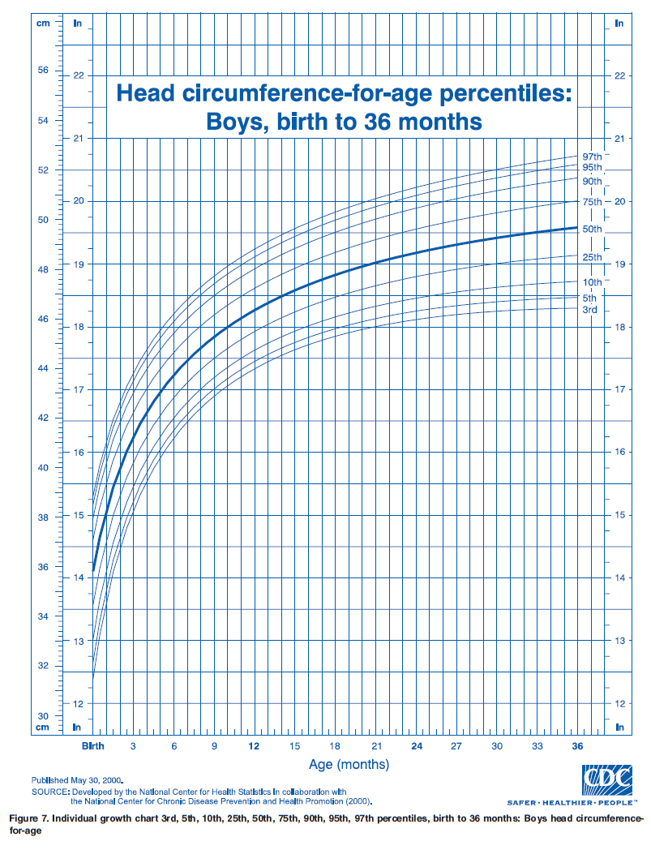

Slide 29
Terms
FFT:
fall over 2 or more percentile
are persistently below the third or fifth percentiles
are less than the 80th percentile of median weight for height measurement.
Stunting: Low height for age
Wasting: Low weight for height

Slide 30
Short stature: less than 3rd centile for age and sex
Microcephaly: less than 3rd centile for age and sex
Macrocephaly: more than 97th centile for age and sex

Slide 31
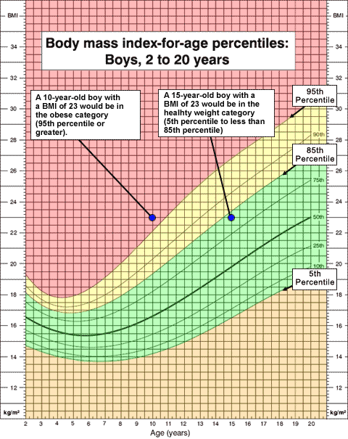

Slide 32
Skin and Lymphatics
A. Birth marks - nevi, hemangiomas, mongolian spots etc
B. Rashes, petechiae, desquamation, pigmentation, jaundice
C. Lymph node enlargement, location, mobility, consistency
D. Scars or injuries, especially in patterns suggestive of abuse

Slide 33
Head
Size and shape
Fontanelle(s)
Size
Tension - calm and in the sitting up position
Sutures - overriding

Slide 34
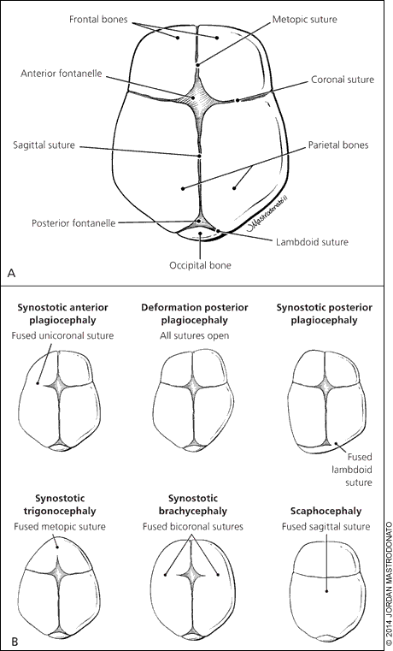

Slide 35
Eyes
Slant of palpebral fissures
Hypertelorism
Pupils
Conjunctiva, sclera, cornea
Red reflex
Visual fields - gross exam

Slide 36
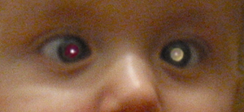

Slide 37
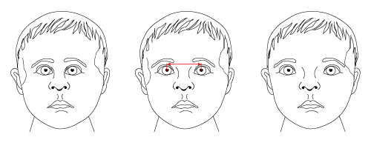
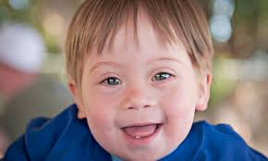
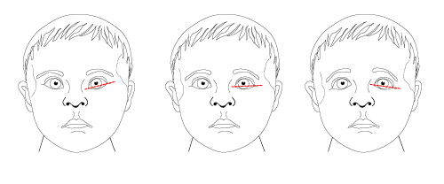

Slide 38
Ears
Ears Position of ears
Tympanic membranes
In infants pull pinna downward, in older children pull it back and up
look for swelling, perforation, redness and dullness

Slide 39
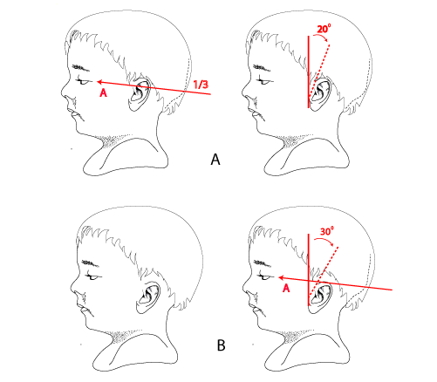

Slide 40
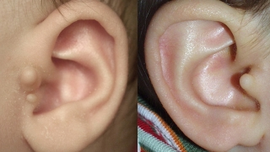

Slide 41
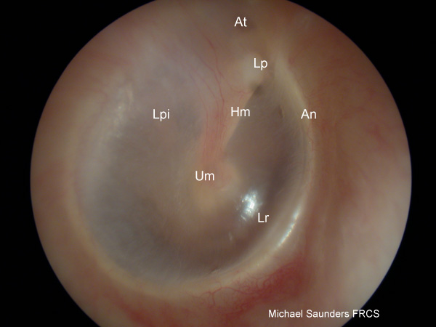
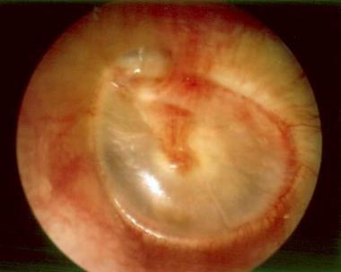

Slide 42
Nose
Nasal septum
Mucosa (color, polyps)
Sinus tenderness
Discharge
Notes:
salute

Slide 43
Mouth and Throat
Lips and buccal
Tongue
Teeth and gums
Palate (intact, arch)
Tonsils (size, color, exudates)
Posterior pharyngeal wall

Slide 44
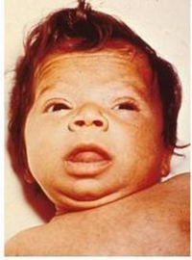

Slide 45
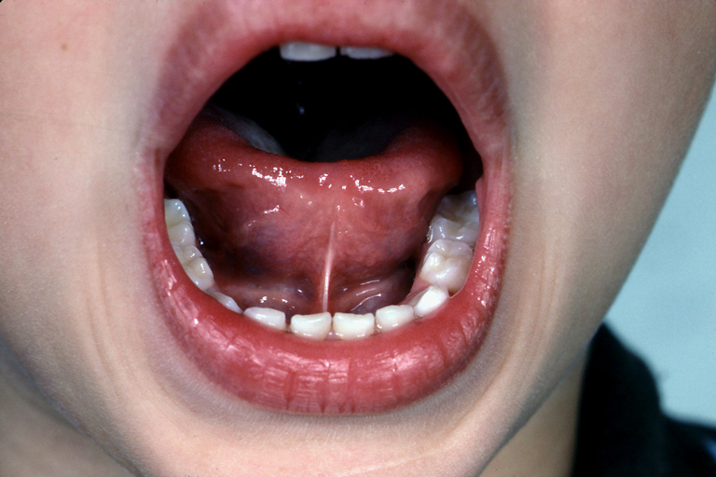
Notes:
ankyloglossia

Slide 46
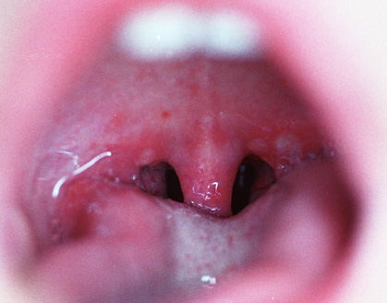
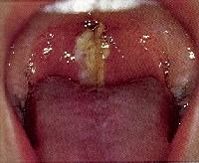

Slide 47
Neck
Thyroid
Trachea position
Masses (cysts, nodes)
Presence or absence of nuchal rigidity

Slide 48
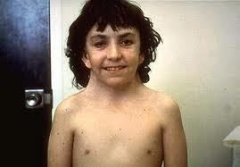
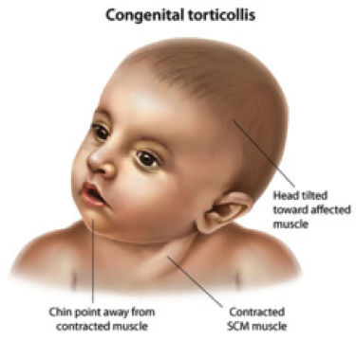
Notes:
Webbed
torticollus

Slide 49
Lungs/Thorax
Inspection
Pattern of breathing
Abdominal breathing is normal in infants
Periodic breathing is normal in infants (pause < 15 seconds)
Respiratory distress
Chest wall configuration
Kyphosis
b. Scolisis
c. Pectus excavatum or carniatum
d. Hyperinflated
4. Scars

Slide 50
Lungs/Thorax
Palpation and percussion
Tracheal deviation
Apex beat
Chest expansion in older children
Auscultation
Equality of breath sounds
wheezes, crackles
Upper airway noise

Slide 51
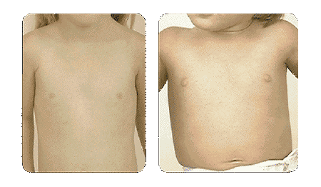
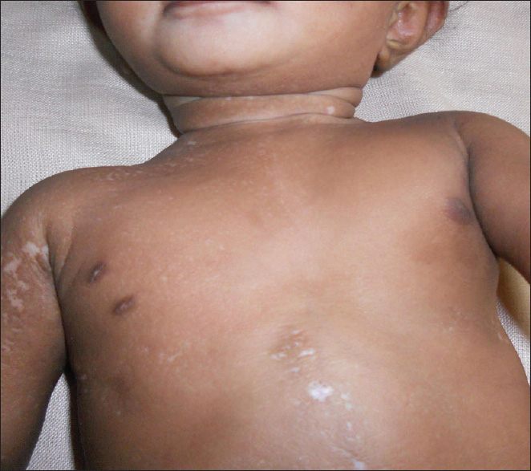

Slide 52
Cardiovascular
Vital signs
General Exam
Central cyanosis + pallor
Hands
Respiratory distress
JVP for age > 8 years
Pulse
Radio femoral delay in older children, or brachial femoral in infants
c. Heart auscultation
D. Liver and lung

Slide 53
Innocent murmur
Soft 1-3
Systolic
Not conducted posteriorly
Variable with position and respiration

Slide 54
Abdomen
Inspection
Shape
a. Infants usually have protuberant abdomens
b. Becomes more scaphoid as child matures
2. Umbilicus
Palpation
1. Tenderness - avoid tender area until end of exam
Liver, spleen, kidneys: May be palpable in normal setting
DRE is not routine

Slide 55
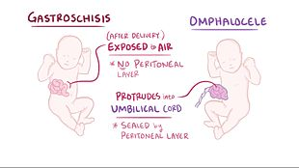

Slide 57
Musculoskeletal
Sacral dimple
Kyphosis, lordosis or scoliosis
Joints and muscles
Extremities
1. Deformity
2. Fingers
3. Edema
4. Clubbing

Slide 58
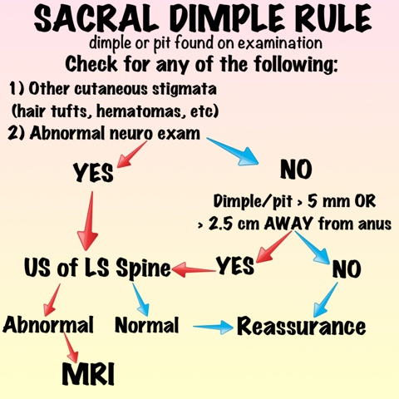
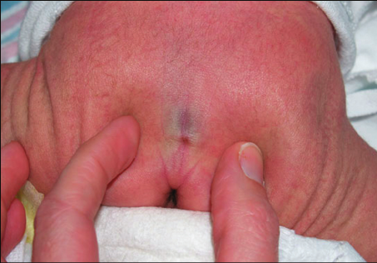

Slide 59
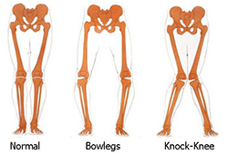
Notes:
BR

Slide 60
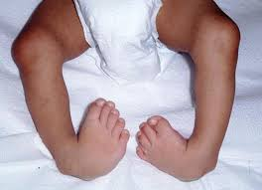
Club foot

Slide 61
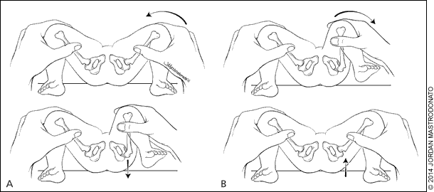
DDH

Slide 62
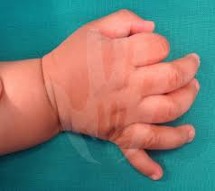
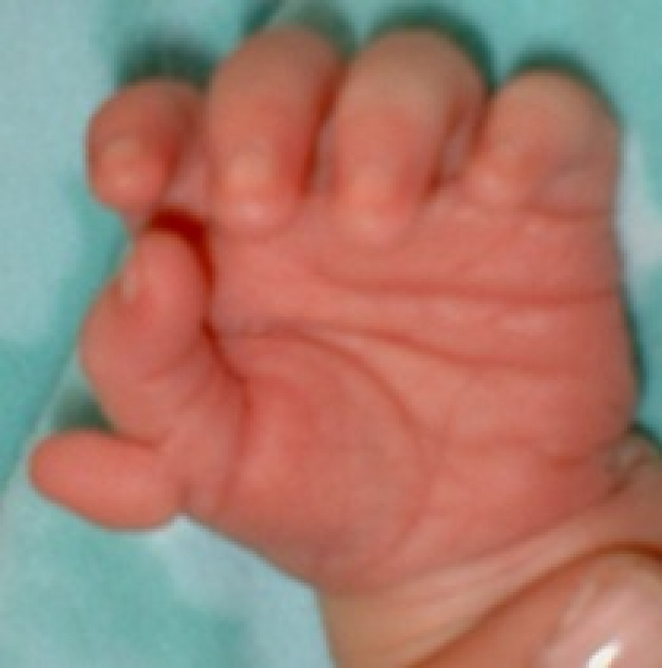
Postaxial (ulnar) Preaxial (radial) : more associated with syndrome
Common

Slide 63
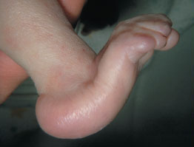
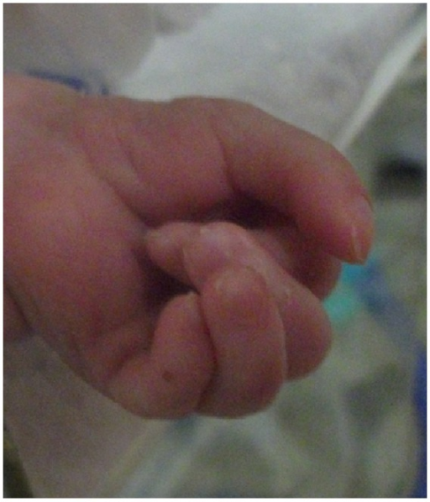
Rocker bottom feet Overriding fingers

Slide 64
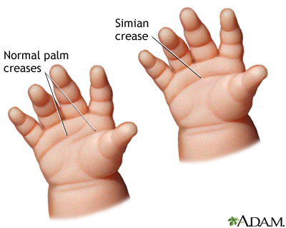
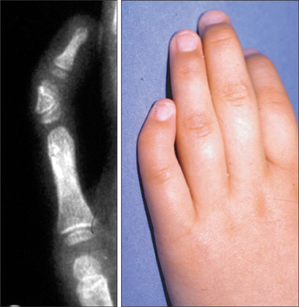
3-10% of normal population
May be associated with Down
Clinodactly: may be associated with Turner

Slide 65
Neurologic
Most accomplished through observation alone
Skin exam
Tone, Power, DTR
Sensory
Cerebellum
Cranial nerves
Primitive reflexes
Developmental evaluation

Slide 66
Reflex
Moro reflex
Stepping reflex
Rooting reflex
Sucking reflex
Asymmetrical tonic neck reflex
grasp reflex
Planter reflex
Galant reflex
Babkin reflex

Slide 67
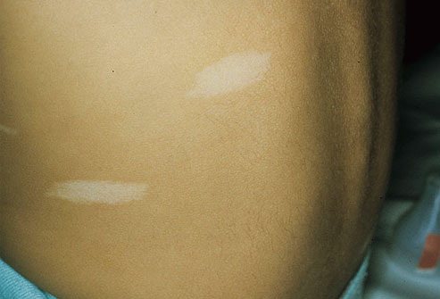
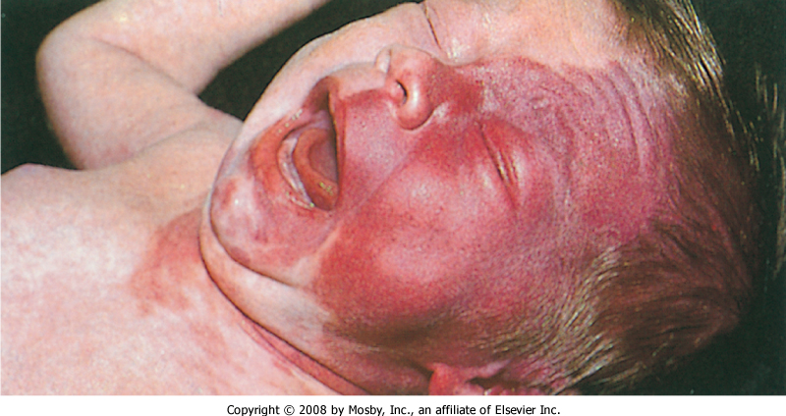
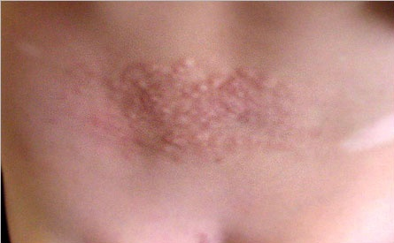

Slide 68
GU
Size of penis
Urethral opening
Scrotum and testicles
Testicular volume
Term female newborns have prominent labia majora, whereas preterm female newborns have prominent labia minora and clitoris
Vaginal discharge

Slide 69
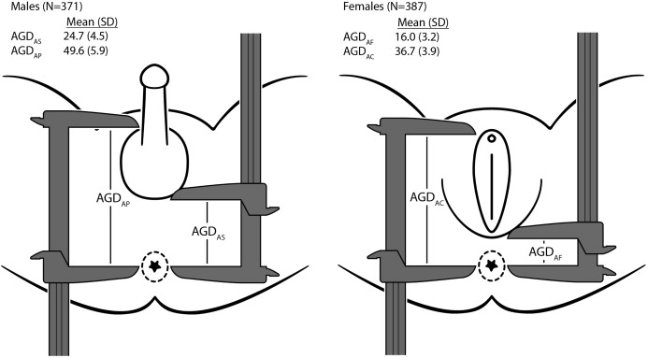
Ambiguous genitalia
Phallus length < 1.9 cm
Clitoromegaly ( length > 1cm)
Non palpable gonads in male
Hypospadias associated with undescended testis or separation of scrotal sac
Anogenital ratio > 0.5

Slide 70
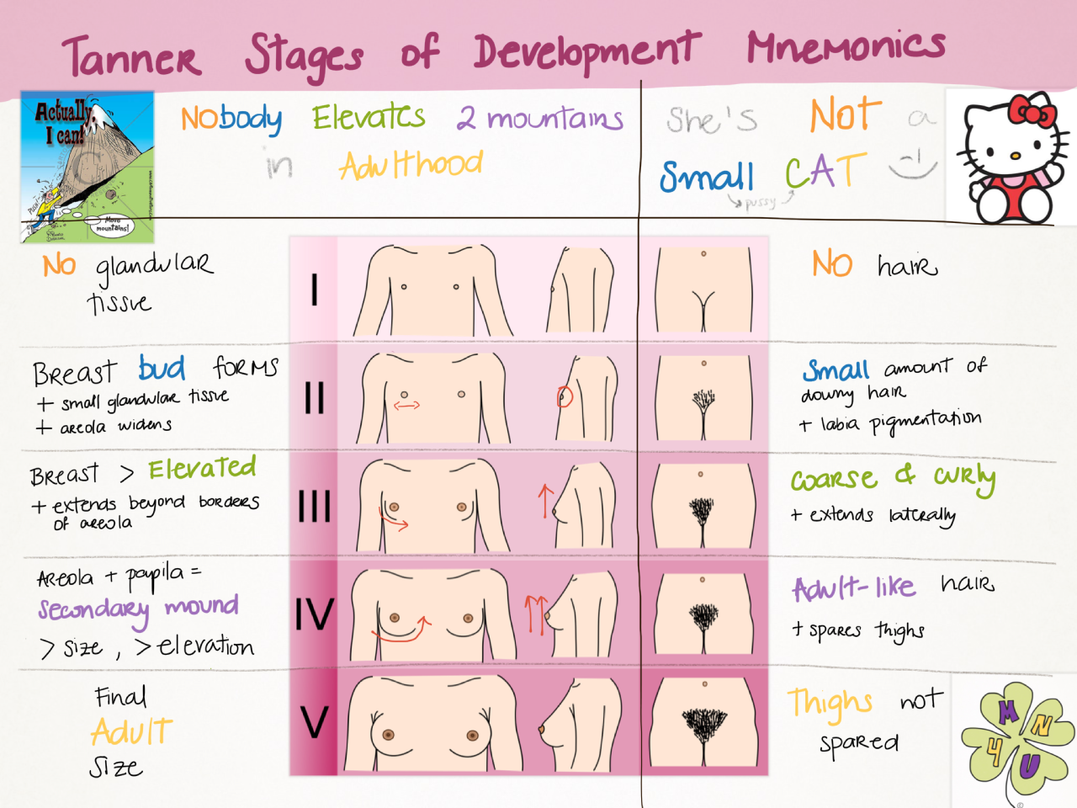
Tanner stage

Slide 71
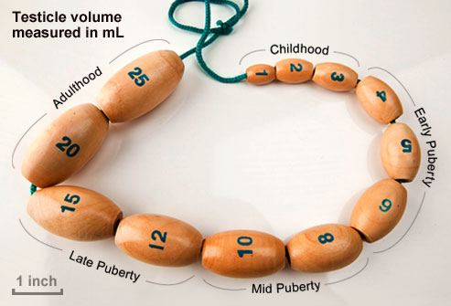
Orchidometer
Pubertal testicle:
4 ml
2.5 cm cm long axis

Slide 72
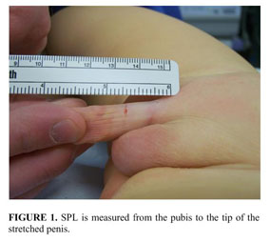
Stretched penile length
Normally 2.5 cm or more in term newborn

Slide 73
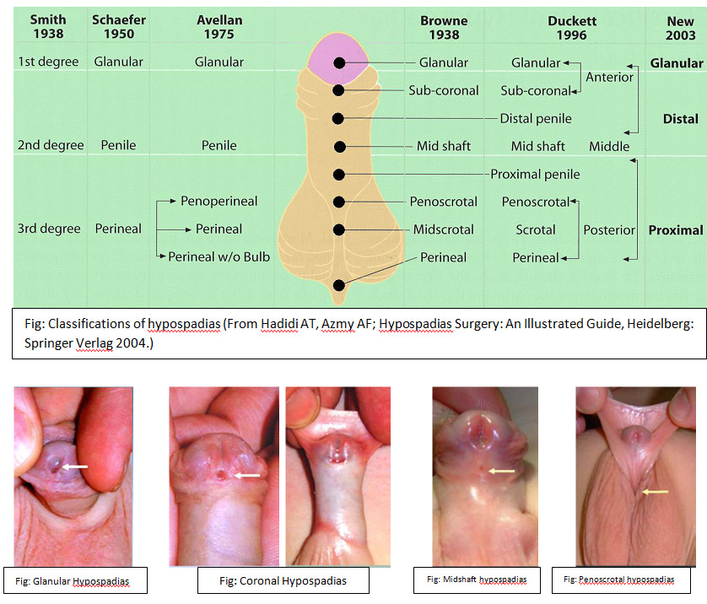
Hypospadius

Slide 75
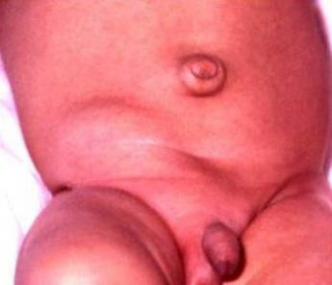
Inguinal hernia
More in prematures
More at right side
More in males

Slide 76
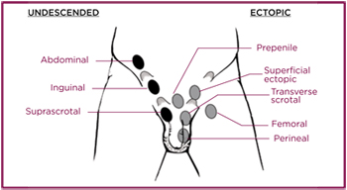
Undescended testicles
More in prematures
Most descended by age of 1 year except 0.3%
Check if retractile testicles

