Slide 1
MUSCULOSKELETAL SYSTEM
THE SKULL
Dr. Aiman Q. Afar
Surgical Anatomist
College of Medicine / University of Mutah

Slide 2
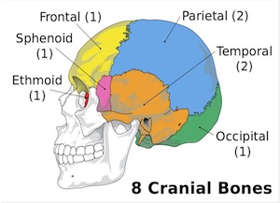
Bones of the Skull
The cranium consists of the following bones, two of which are paired
Frontal bone: 1
Parietal bones: 2
Occipital bone: 1
Temporal bones: 2
Sphenoid bone: 1
Ethmoid bone: 1

Slide 3
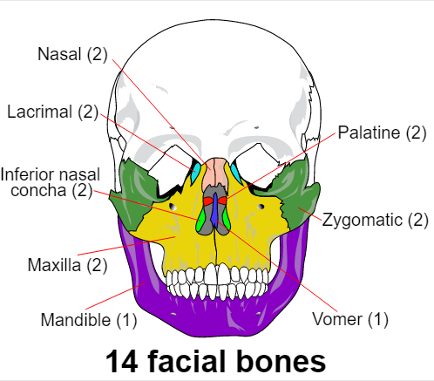
Bones of the Skull
The facial bones consist of the following, two of which are single:
Zygomatic bones: 2
Maxillae: 2
Nasal bones: 2
Lacrimal bones: 2
Vomer: 1
Palatine bones: 2
Inferior conchae: 2
Mandible: 1

Slide 4
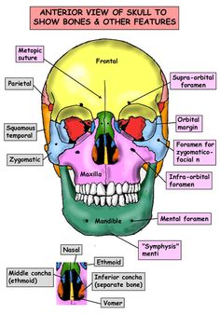
External Views of the Skull
Anterior View of the Skull
The frontal bone, or forehead bone, curves downward to make the upper margins of the orbits
The superciliary arches and the supraorbital notch, or foramen ,can be recognized.
The orbital margins are bounded by
The frontal bone superiorly,
The zygomatic bone laterally,
The maxilla inferiorly,
The processes of the maxilla and frontal bone medially.

Slide 5
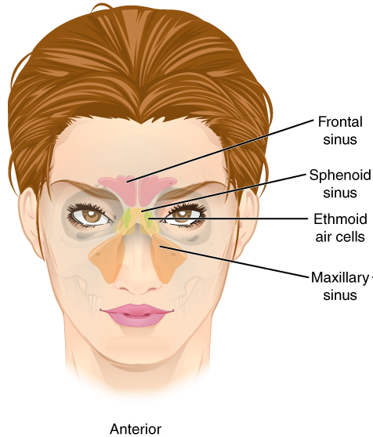
Anterior View of the Skull
Within the frontal bone, just above the orbital margins, are two hollow spaces lined with mucous membrane called the frontal air sinuses.
These communicate with the nose and serve as voice resonators.
The two nasal bones form the bridge of the nose. Their lower borders, with the maxillae, make the anterior nasal aperture.
The nasal cavity is divided into two by the bony nasal septum, which is largely formed by The Vomer.

Slide 6
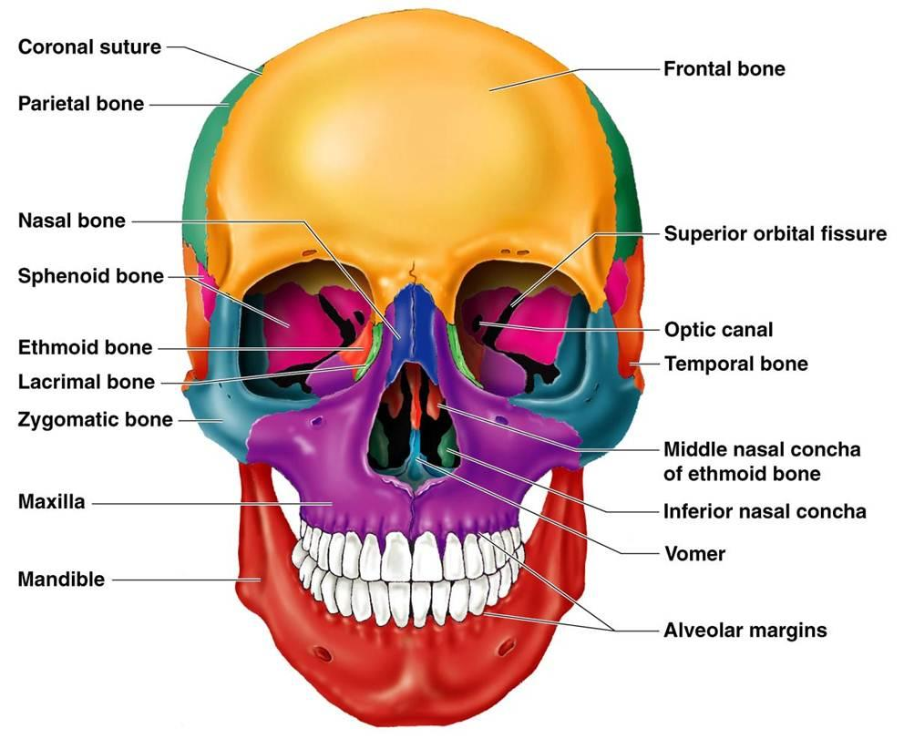
Anterior View of the Skull
The two maxillae form the upper jaw, the anterior part of the hard palate, part of the lateral walls of the nasal cavities, and part of the floors of the orbital cavities.
The two bones meet in the midline at the intermaxillary suture and form the lower margin of the nasal aperture.
Below the orbit, the maxilla is perforated by the infraorbital foramen.
Within each maxilla is a large, pyramid-shaped cavity lined with mucous membrane called the maxillary sinus

Slide 7
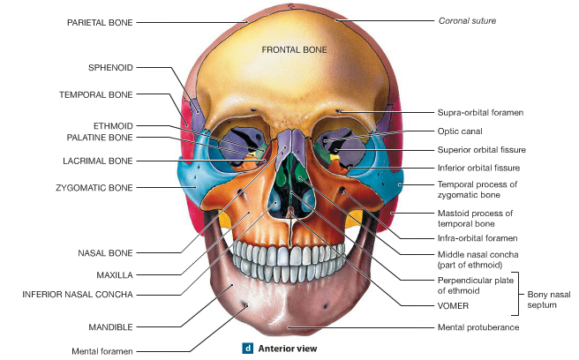
Anterior View of the Skull
The Zygomatic bone forms the prominence of the cheek and part of the lateral wall and floor of the orbital cavity.
The Zygomatic bone is perforated by two foramina for the zygomaticofacial and zygomaticotemporal nerves
The mandible, or lower jaw, consists of a horizontal body and two vertical rami

Slide 8
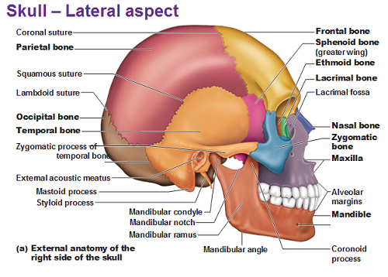
Lateral View of the Skull
The frontal bone forms the anterior part of the side of the skull and articulates with the parietal bone at the coronal suture
The parietal bones form the sides and roof of the cranium and articulate with each other in the midline at the sagittal suture.
They articulate with the occipital bone behind, at the lambdoid suture.

Slide 9
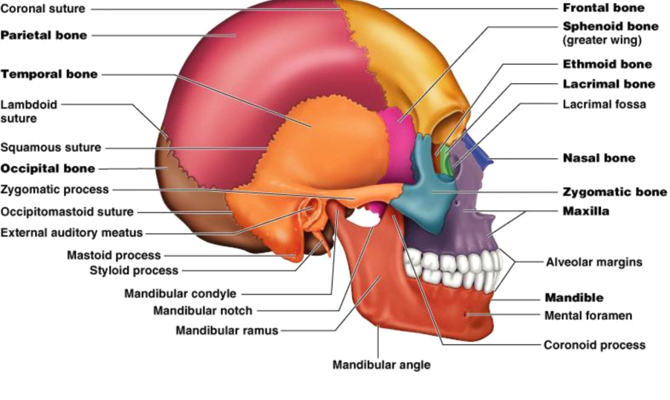
Lateral View of the Skull
The skull is completed at the side by the squamous part of the occipital bone; parts of the temporal bone, namely,
The squamous, tympanic, mastoid process, styloid process, and zygomatic process; and the greater wing of the sphenoid.
The ramus and body of the mandible lie inferiorly

Slide 10
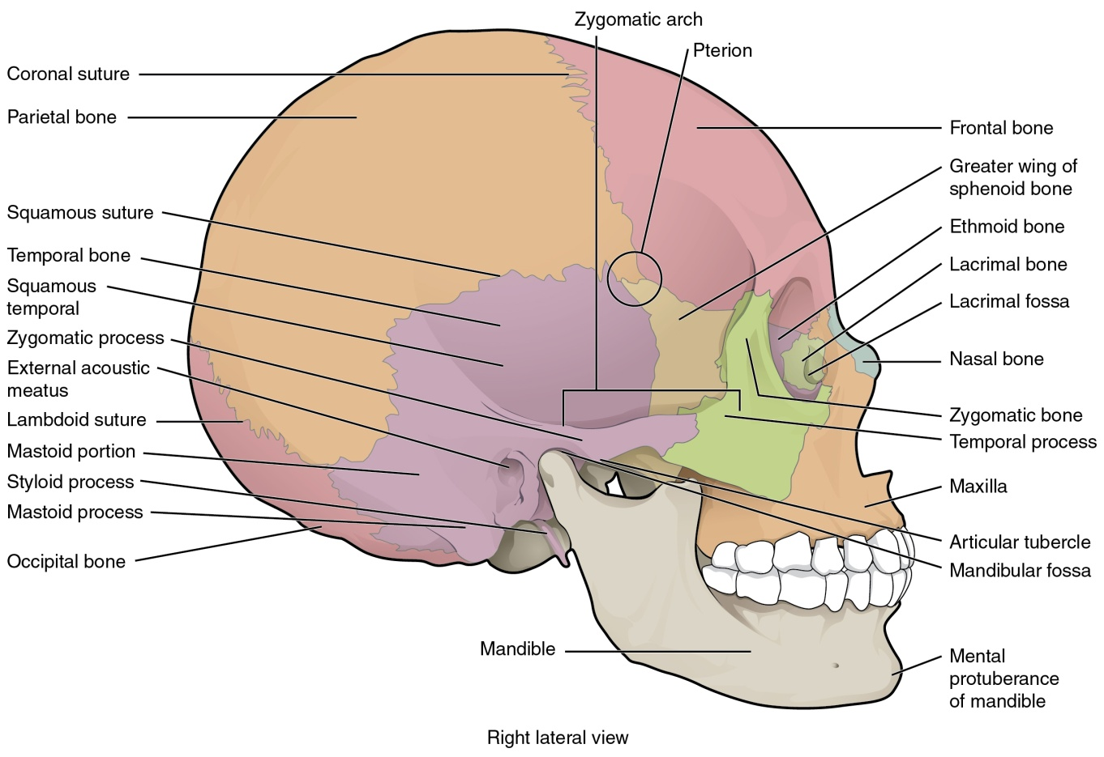
Lateral View of the Skull
Note that the thinnest part of the lateral wall of the skull is where the anteroinferior corner of the parietal bone articulates with the greater wing of the sphenoid; this point is referred to as the pterion.
Clinically, the pterion is an important area because it overlies the anterior division of the middle meningeal artery and vein.

Slide 11
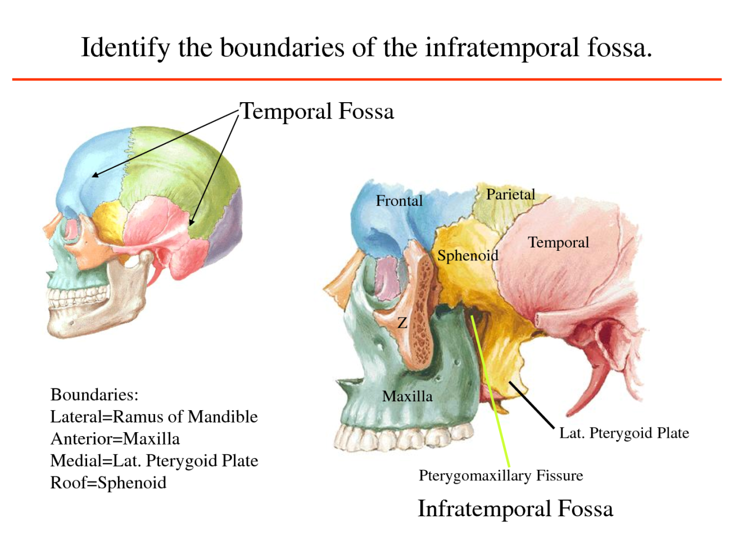
Lateral View of the Skull
The infratemporal fossa lies below the infratemporal crest on the greater wing of the sphenoid.
The pterygomaxillary fissure is a vertical fissure that lies within the fossa between the pterygoid process of the sphenoid bone and back of the maxilla. It leads medially into the pterygopalatine fossa

Slide 12
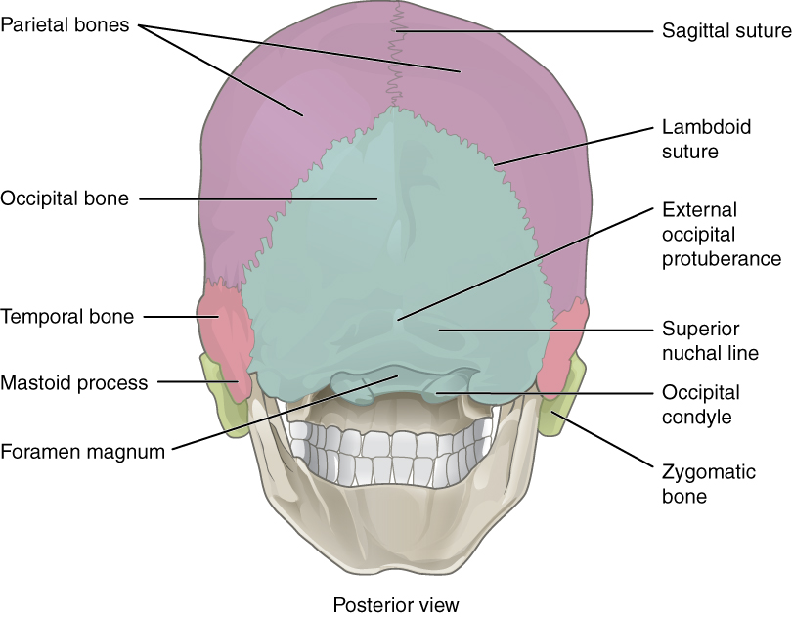
Posterior View of the Skull
The posterior parts of the two parietal bones with the intervening sagittal suture are seen above. Below, the parietal bones articulate with the squamous part of the occipital bone at the lambdoid suture.
On each side the occipital bone articulates with the temporal bone.
In the midline of the occipital bone is a roughened elevation called the external occipital protuberance, which gives attachment to muscles and the ligamentum nuchae.
On either side of the protuberance the superior nuchal lines extend laterally toward the temporal bone

Slide 13
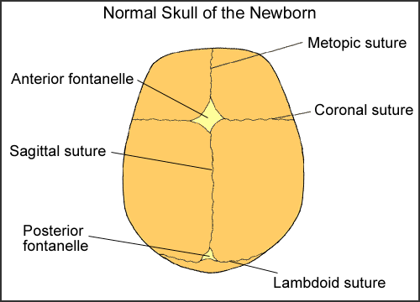
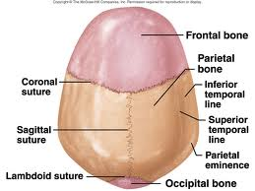
Superior View of the Skull
Anteriorly, the frontal bone articulates with the two parietal bones at the coronal suture.
Occasionally, the two halves of the frontal bone fail to fuse, leaving a midline metopic suture.
Behind, the two parietal bones articulate in the midline at the sagittal suture

Slide 14
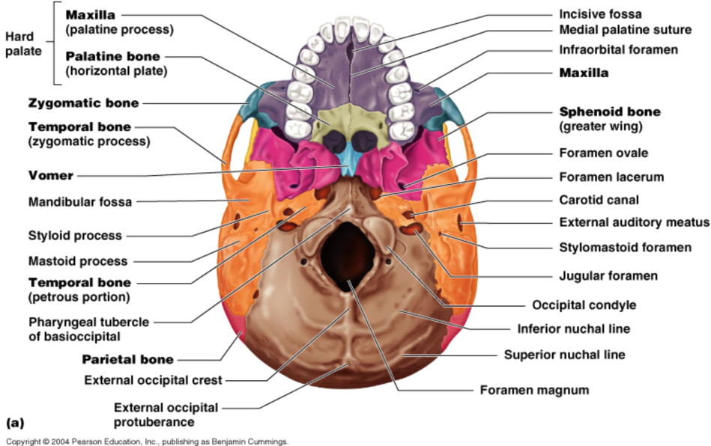
Inferior View of the Skull
The palatal processes of the maxillae and the horizontal plates of the palatine bones can be identified.
In the midline anteriorly is the incisive fossa and foramen.
Posterolaterally are the greater and lesser palatine foramina
The Choanae (posterior nasal apertures) are separated from each other by the posterior margin of the Vomer

Slide 15
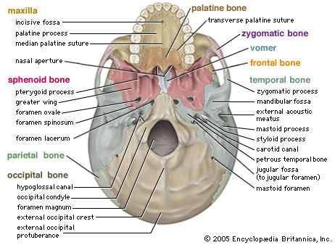
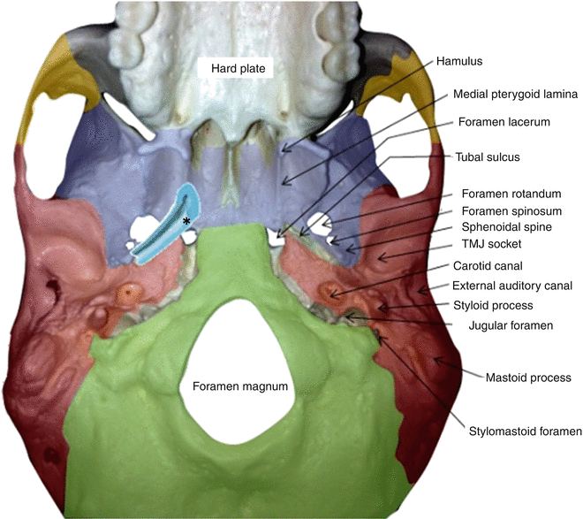
Inferior View of the Skull
The greater wing of the sphenoid is pierced by the large foramen ovale and the small foramen spinosum.
in the interval between the greater wing of the sphenoid and the petrous part of the temporal bone, is a groove for the cartilaginous part of the auditory tube.
The opening of the bony part of the tube can be identified

Slide 16
Inferior View of the Skull
The styloid process of the temporal bone projects downward and forward from its inferior aspect.
The opening of the carotid canal can be seen on the inferior surface of the petrous part of the temporal bone.
The medial end of the petrous part of the temporal bone is irregular and, together with the basilar part of the occipital bone and the greater wing of the sphenoid, forms the foramen lacerum.

Slide 17
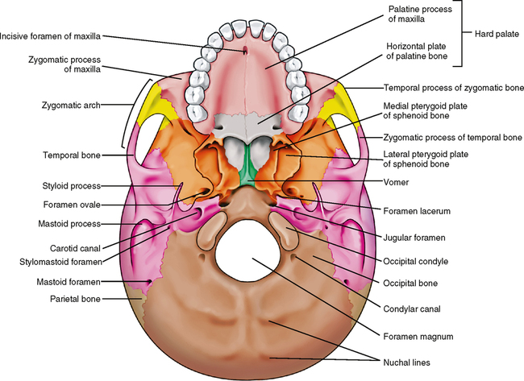
Inferior View of the Skull
In the interval between the styloid and mastoid processes, the stylomastoid foramen can be seen.
Medial to the styloid process, the petrous part of the temporal bone has a deep notch, which, together with a shallower notch on the occipital bone, forms the
jugular foramen.

Slide 18
Inferior View of the Skull
The pharyngeal tubercle is a small prominence on the under surface of the basilar part of the occipital bone in the midline.
The occipital condyles they articulate with the superior aspect of the lateral mass of the first cervical vertebra, the atlas.
Superior to the occipital condyle is the hypoglossal canal for transmission of the hypoglossal nerve
Posterior to the foramen magnum in the midline is the external occipital protuberance.

Slide 19
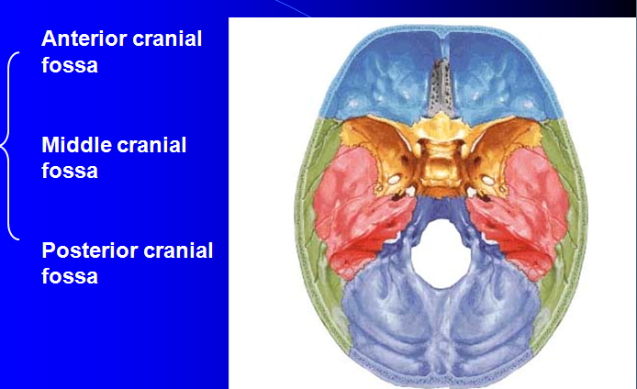
Base of the skull
The interior of the base of the skull is divided into three cranial fossae:
ANTERIOR, MIDDLE, AND POSTERIOR.
The anterior cranial fossa is separated from the middle cranial fossa by the lesser wing of the sphenoid,
and the middle cranial fossa is separated from the posterior cranial fossa by the petrous part of the temporal bone

Slide 20
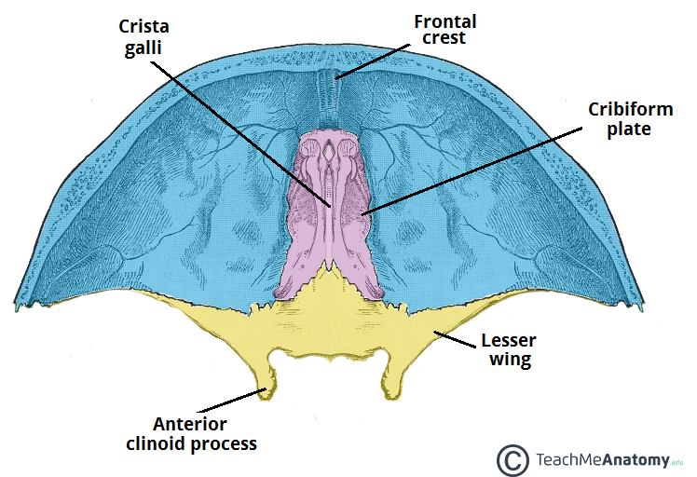
Anterior Cranial Fossa
The anterior cranial fossa lodges the frontal lobes of the cerebral hemispheres
It is bounded anteriorly by the inner surface of the frontal bone, and in the midline is a crest for the attachment of the falx cerebri.
Its posterior boundary is the sharp lesser wing of the sphenoid
The medial end of the lesser wing of the sphenoid forms the anterior clinoid process on each side, which gives attachment to the tentorium cerebelli

Slide 21
Anterior Cranial Fossa
The floor of the fossa is formed by the orbital plates of the frontal bone laterally and by the cribriform plate of the ethmoid medially
The crista galli is a sharp upward projection of the ethmoid bone in the midline for the attachment of the falx cerebri.
There is slit in the cribriform plate for the passage of the anterior ethmoid nerve into the nasal cavity.
The upper surface of the cribriform plate supports the olfactory bulbs, and the small perforations in the cribriform plate are for the olfactory nerves.

Slide 22
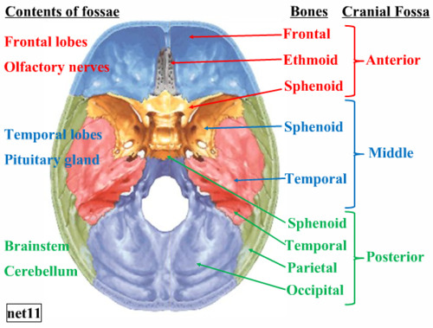
Middle Cranial Fossa
The median raised part is formed by the body of the sphenoid, and
the expanded lateral parts form concavities on either side, which lodge the temporal lobes of the cerebral hemispheres.
It is bounded
anteriorly by the lesser wings of the sphenoid
posteriorly by the superior borders of the petrous parts of the temporal bones.
Laterally lie the squamous parts of the temporal bones, the greater wings of the sphenoid, and the parietal bones
The floor of each lateral part of the middle cranial fossa is formed by the greater wing of the sphenoid and the squamous and petrous parts of the temporal bone.

Slide 23
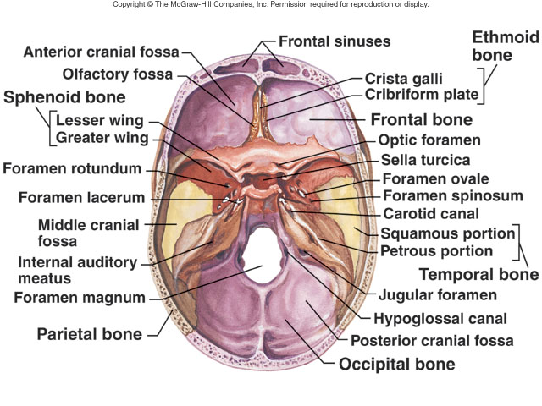
Posterior Cranial Fossa
It is deep and lodges the parts of the cerebellum, pons, and medulla oblongata.
Anteriorly, the fossa is bounded by the superior border of the petrous part of the temporal bone,
posteriorly it is bounded by the internal surface of the squamous part of the occipital bone
The floor of the posterior fossa is formed by the basilar, condylar, and squamous parts of the occipital bone and the mastoid part of the temporal bone.
The roof of the fossa is formed by a fold of dura, the tentorium cerebelli

Slide 24
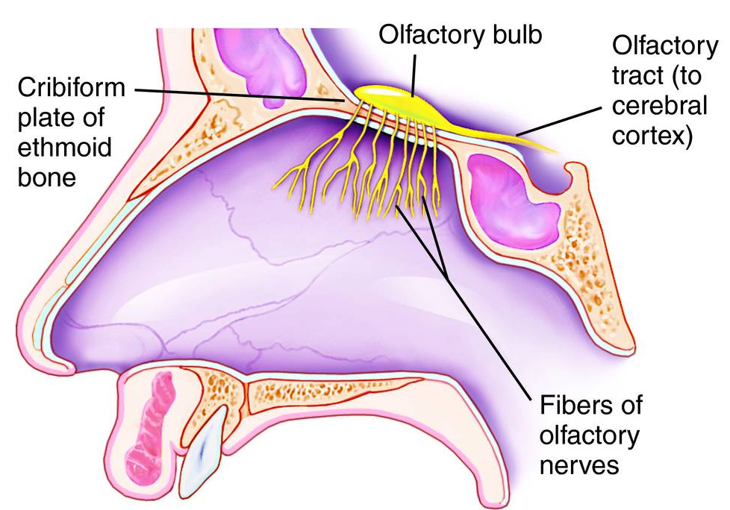
Summary of the More Important Openings in the Base of the Skull and the Structures That Pass Through Them
Opening in Skull Bone of Skull Structures Transmitted
Anterior Cranial Fossa
Perforations in cribriform plate Ethmoid Olfactory nerves

Slide 25
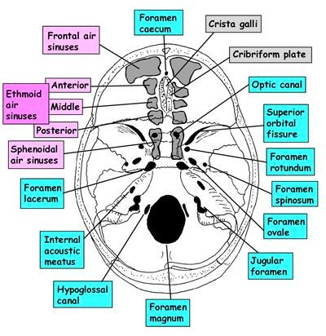
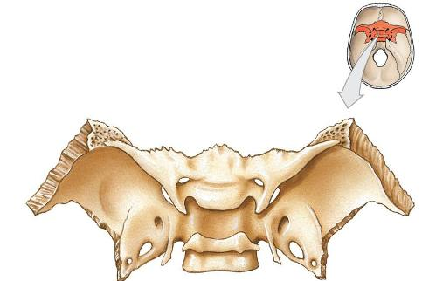
Summary of the More Important Openings in the Base of the Skull and the Structures That Pass Through Them
Opening in Skull Bone of Skull Structures Transmitted
Middle Cranial Fossa
Optic canal Lesser wing of sphenoid Optic N, ophthalmic A
Superior orbital fissure Between lesser and greater Lacrimal, frontal, trochlear,
nasociliary, and abducent nerves; superior ophthalmic vein

Slide 26
Summary of the More Important Openings in the Base of the Skull and the Structures That Pass Through Them
Opening in Skull Bone of Skull Structures Transmitted
Foramen rotundum Greater wing of sphenoid Maxillary division of the
trigeminal N.
Foramen ovale Greater wing of sphenoid Mandibular division of the
trigeminal N., lesser petrosal N.
Foramen spinosum Greater wing of sphenoid Middle meningeal artery
Foramen lacerum Between petrous part obliterated
of temporal and sphenoid

Slide 27
Summary of the More Important Openings in the Base of the Skull and the Structures That Pass Through Them
Opening in Skull Bone of Skull Structures Transmitted
Posterior Cranial Fossa
Foramen magnum Occipital Medulla oblongata
and right and left vertebral arteries
Hypoglossal canal Occipital Hypoglossal nerve
Glossopharyngeal, vagus, and accessory nerves; sigmoid sinus becomes internal jugular vein
Jugular foramen Between temporal
and occipital
Internal acoustic Petrous part of temporal Vestibulocochlear and facial Nn
meatus

Slide 28
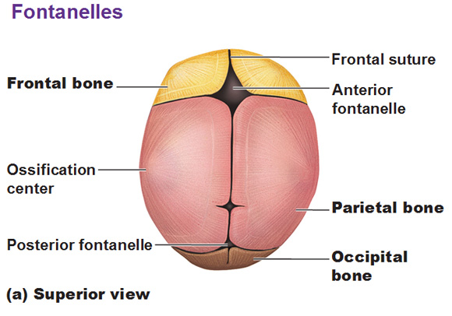
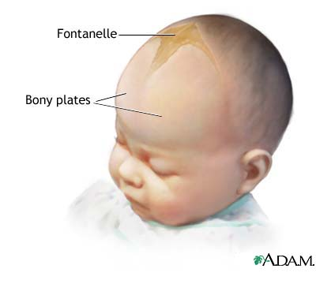
Neonatal Skull
The bones of the vault of neonate are separated by unossified membranous intervals called fontanelles
Clinically, the anterior and posterior fontanelles are most important and are easily examined in the midline of the vault.
The anterior fontanelle is diamond shaped and lies between the two halves of the frontal bone in front and the two parietal bones behind
The fibrous membrane forming the floor of the anterior fontanelle is replaced by bone and is closed by 18 months of age.
The posterior fontanelle is triangular and lies between the two parietal bones in front and the occipital bone behind. By the end of the 1st year, the fontanelle is usually closed and can no longer be palpated.

Slide 29
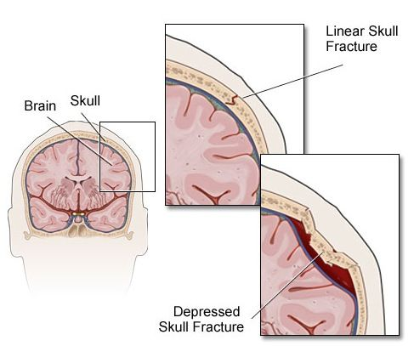
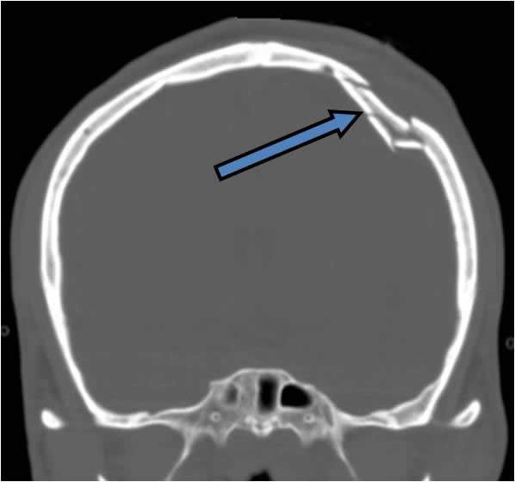
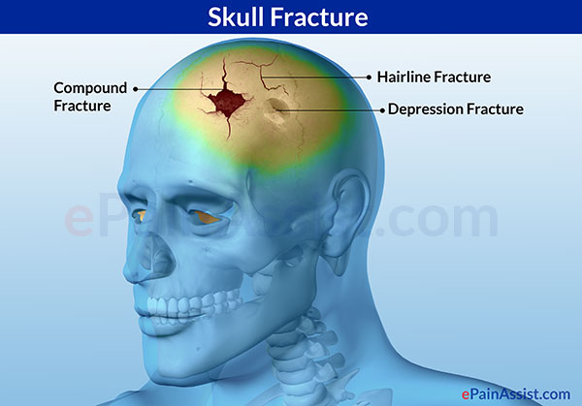

Slide 30
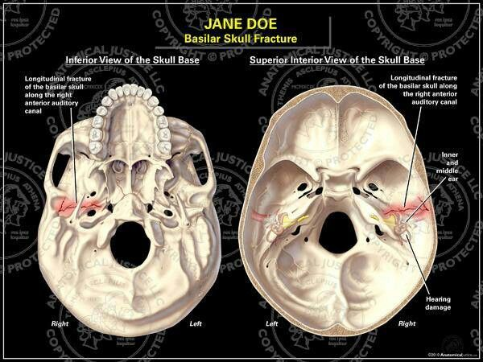
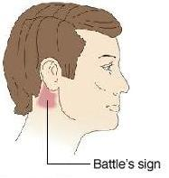

Slide 31
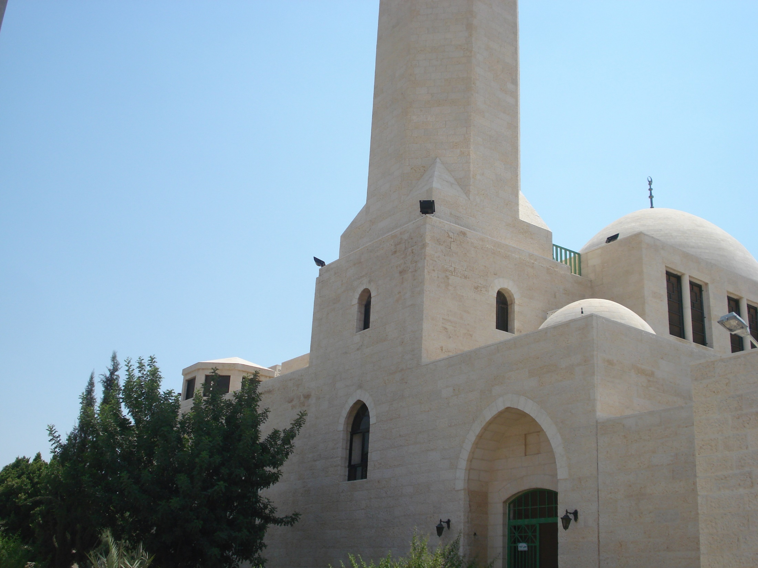
Dr Aiman Qais Afar
Sunday 21 February 2021

