Slide 1
- تم تفريغ اضافات الدكتور باللون الأخضر , #بالتوفيق زملائي

Slide 2
Acute Flaccid Paralysis Transverse Myelitis & SMA
Presented by : Afnan Mansour

Slide 3
ملاحظة من الدكتور عمر :
سمنارات سادسه عليها 14 سؤال من اصل 20 سؤال ع فاينل

Slide 4
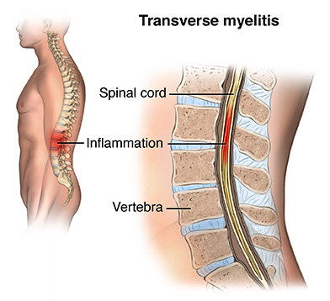
Transverse Myelitis

Slide 5
Transverse Myelitis
Is a neurological disorder caused by an inflammatory process of the spinal cord, and can cause axonal demyelination.
Transverse implies that the inflammation is across the full thickness of the spinal cord.
Abrupt onset of progressive weakness and sensory disturbances in LL.
sensory disturbances is permenant
*Mostly they have a history of preceding viral infection, fever and malaise :
EBV, HSV, Influenza, rubella, mumps, varicella
others;
M.pneumonia
Lyme disease
schistosomiasis

Slide 6
Pathophysiology
3 hypothesis:
Cell-mediated autoimmune response
Direct viral invasion
Autoimmune vasculitis , and insufficient blood flow through spinal cord vessels.

Slide 7
Clinical manifestations
With acute transverse myelitis, the onset is sudden and progresses rapidly in hours and days.
The symptoms and signs depend upon the level of the spinal cord involved and the extent of the involvement of the various long tracts.
LL weakness or paralysis
Low back or abdominal pain
Paresthesia of LL is the prominent feature
Sensory level of impairment is usually present (mid-thoracic region)
Pain, temp. and light touch are affected

Slide 8
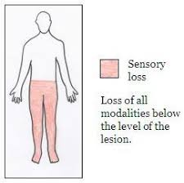
Clinical manifestations
Proprioception and vibration may be preserved
Bladder paralysis often occurs and urinary retention is an early manifestation.
Fever and nuchal rigidity early in the course of disease
Neurological deficit evolves over 2-3 days then plateaus, with flaccidity changing to spasticity and emerging of UMNL signs in LL
signs of spinal shock may be evident, in which the lower limbs will be flaccid and areflexic, rather than spastic and hyperreflexic as they should be in upper motor neuron paralysis

Slide 9
Clinical manifestations مهم
If the upper cervical cord is involved, all four limbs may be involved and there is risk of respiratory paralysis (segments C3,4,5 to diaphragm).
Lesions of the lower cervical (C5–T1) region will cause a combination of upper and lower motor neuron signs in the upper limbs, and exclusively upper motor neuron signs in the lower limbs.
A lesion of the thoracic spinal cord (T1–12) will produce upper motor neuron signs in the lower limbs, presenting as a spastic diplegia.
A lesion of the lower part of the spinal cord (L1–S5) often produces a combination of upper and lower motor neuron signs in the lower limbs.

Slide 10
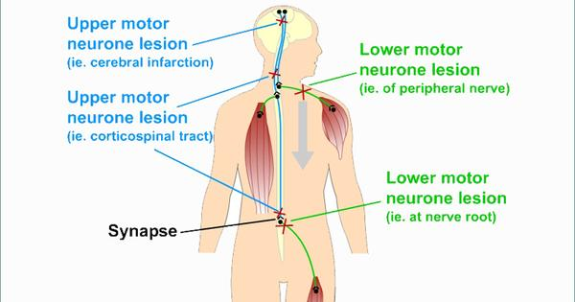

Slide 11
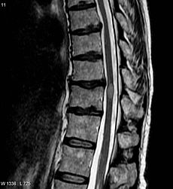
Investigations
CSF analysis :
Moderate lymphocyte pleocytosis
Normal or slightly elevated protein
CT/MRI :
May show fusiform swelling in the affected region (3-4 vertebral levels)
Mainly to r/o compressive lesions

Slide 12
Management
Management is supportive
Management is directed to bladder care and physiotherapy.
Studies have shown that high-dose methylprednisolone therapy early in the course is effective in shortening the duration of the disease and in improving the outcome.
Give IVIG

Slide 13
Outcome
Recovery from transverse myelitis usually begins between weeks 2 and 12 following onset and may continue for up to 2 years in some patients.
60% show spontaneous recovery over few weeks
if treated early, some patients experience complete or near complete recovery.
Residual deficits includes bowel and bladder dysfunction and weakness.

Slide 14
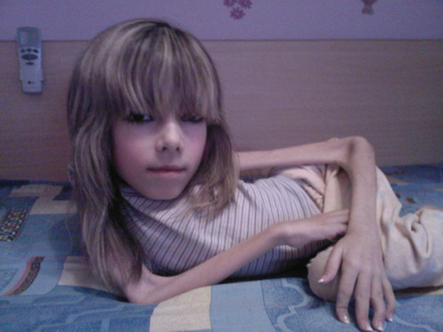
Spinal muscular atrophy الدكتور حكالنا انه مش داخل معكم بالمنهاج من سلايد 14 ل سلايد 29

Slide 15
Spinal muscular atrophy
Spinal muscular atrophy (SMA) is an incurable genetic autosomal recessive disease caused by a genetic defect in the SMN1 gene which codes SMN, a protein necessary for survival of motor neurons.
Resulting in death of neuronal cells in the anterior horn of spinal cord and subsequent system-wide muscle wasting (atrophy).

Slide 16
Spinal muscular atrophy
Spinal muscular atrophy “apoptosis” manifests in various degrees of severity which all have in common general muscle wasting and mobility impairment.
Sensation, which originates from the posterior horn cells of the
spinal cord, is spared, as is intelligence. Several muscles are
spared, including the diaphragm , EOM, the involuntary muscles of
the gastrointestinal system, the heart, and the sphincters.

Slide 17
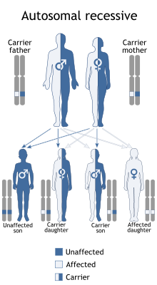
Causes
The SMN1 gene chromosome 5 is mutated so unable to code the SMN protein - due to either a deletion occurring at exon 7 or to other point mutations (frequently resulting in the functional conversion of the SMN1 sequence into SMN2).
All patients, however, retain at least one copy of the SMN2 gene which still code small amounts of SMN protein around 10-20% of the normal level allowing neurons to survive.

Slide 18
Muscles of lower extremities are usually affected first, followed by muscles of upper extremities, spine and neck and, in more severe cases, pulmonary and mastication muscles.
Proximal muscles are always affected earlier and in a greater degree than distal.
Associated with sever hypotonia

Slide 19
Types :
SMA manifests over a wide range of severity affecting infants through adults. The disease spectrum is variously divided into 3–5 types, in accordance either with the age of onset of symptoms or with the highest attained milestone of motor development.
Type I (Werdnig-Hoffmann disease): This acute infantile SMA is usually identified in patients from birth to age 6 months.
Type II: This chronic infantile SMA is diagnosed in infants aged 6-12 months.
Type III (Kugelberg-Welander disease): This type of SMA is diagnosed in children aged 2-15 years.
**The severity of SMA smptoms is broadly related to how well the remaining SMN2 genes can make up for the loss of SMN1, while SMA II and III patients usually have at least three SMN2 copies; and SMA IV patients normally have at least four of them.

Slide 20
History
Type I: Most mothers report abnormal inactivity of the fetus in the latter stages of pregnancy. The patient is unable to roll over or sit. Progressive clinical deterioration occurs. Death usually occurs from respiratory failure and its complications in patients by age 2 years.
Type II: Patients have normal development for the first 4-6 months of life. They may be able to sit independently, but they are never able to walk. They require a wheelchair for locomotion. Nasal speech and problems with swallowing develop later. Scoliosis becomes a major complication in many patients with long survival . They have a longer life span than patients with type I SMA.
Type III: the presenting complaint is difficulty climbing stairs or getting up from the floor (due to hip extensor weakness). The life span is nearly normal.

Slide 21
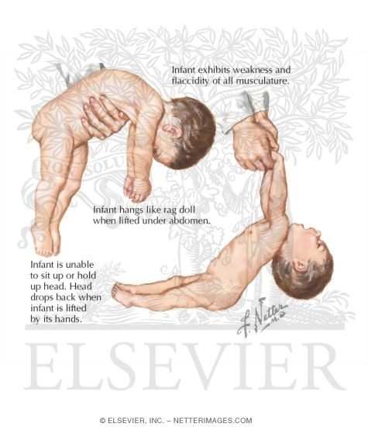
Signs & Symptoms
The symptoms vary greatly depending on the SMA type involved, the stage of the disease and individual factors and commonly include:
Areflexia, particularly in extremities.
Overall muscle weakness, poor muscle tone, limpness or a tendency to flop (the "floppy baby" syndrome).
In infants: adopting of a frog-leg position when sitting (hips abducted and knees flexed).
Difficulty achieving developmental milestones, difficulty sitting/standing/walking.

Slide 22
Signs & Symptoms
Loss of strength of the pulmonary muscles: weak cough, weak cry (infants), accumulation of secretions in the lungs or throat, respiratory distress.
Bell-shaped torso (caused by using only abdominal muscles for respiration)
Clenched fists with sweaty hands
Head often tilted to one side, even when lying down
Fasciculations (twitching) of the tongue
Difficulty sucking or swallowing, poor feeding
Arthrogryposis (multiple congenital contractures)
Weight lower than normal

Slide 24
Diagnosis
Prenatal screening is controversial, because of its cost
Very severe SMA (type I) can be sometimes evident before birth - reduction in fetal movement in the final trimester.
Further, for all SMA types:
Patient will present with hypotonia associated with hyporeflexia.
Results of motor nerve conduction studies are normal, except for mild slowing in terminal stages of the disease, an important feature distinguishing SMA from peripheral neuropathy.
Electromyogram will show fibrillation and muscle denervation
Serum creatine kinase may be normal or increased
Genetic testing will show bi-allelic deletion of exon 7 of the SMN1 gene – this is conclusive of the disease.

Slide 25
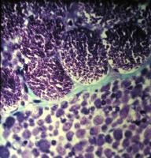
Histological findings
Spinal muscle atrophy, Werdnig-Hoffman disease.
Groups of giant type I fibers are mixed with fascicles of severely atrophic fibers

Slide 26
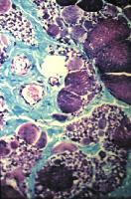
Histological findings
Kugelberg-Welander disease. Marked variation in muscle fiber size along with increased perimysial connective tissue.

Slide 27
Treatment
Care is symptomatic
Orthopaedics
Respiratory care
Nutritional care
Mobility — Assistive technologies
Mental health — SMA children do not differ from the general population in their behaviour; their cognitive development can be slightly faster, and certain aspects of their intelligence are above the average.

Slide 28
Prognosis
The younger the patient is at onset, the worse the prognosis is.
Patients with type I spinal muscle atrophy usually die by age 2 years.
Patients with type III SMA have nearly normal life expectancy.
Death occurs as a result of respiratory compromise. The life span of affected individuals has significantly increased with the use of intermittent positive pressure ventilation with or without a tracheostomy.
Patient Education
Prenatal diagnosis in the first trimester and proper genetic counseling are possible with DNA analysis. This enables more accurate carrier detection. Not all parents of children with spinal muscle atrophy are obligate carriers.
Carrier testing is important for reproductive decision-making. 3% of cases are sporadic.

Slide 29
THANK YOU

Slide 30
Flaccid paralysis
Presented by :Motasem Ellayan
Mohammad alzou’bi
Raed Ammareen

Slide 31
Poliomyelitis, Guillain-Barré Syndrome & Transverse Myelitis

Slide 32
Poliomyelitis

Slide 33
Polioviruses
Non-enveloped RNA-positive
Belonges to Picornaviridae family, Enterovirus genus
3 antigenically distinct serotypes (1,2 & 3)(no gross immunity between serotypes)
Spreads from GIT to the CNS (Enteroviruses)feco-oral root
Can retain activity at room temp. for days and can be stored frozen at -20˚C indefinitely
Easily inactivated by heat (>56˚C), formaldehyde, chlorination and UV light
Notes:
Positive stranded

Slide 34
Epidemiology
In 1952 about 58,000 cases were reported in the US ( including ~21,000 cases of paralytic polio ) that resulted in 3,000 deaths
The epidemics mostly affected adolescents and young adults
The universal use of Sabin (OPV) and Salk (IPV) vaccines has resulted in almost complete global eradication

Slide 35
The most devastating outcome is paralysis
90% of infections are asymptomatic or inapparent ( but do induce immunity )
Clinically apparent but non-paralytic illness occurs in ~5% of all infections
Paralytic polio occurs in
1/1,000 among infants (in developing countries)
1/100 among adolescents (in developed countries before vaccinations)

Slide 36
Transmission
Feco-oral route
Humans are the only reservoir
Virus has been isolated from stools more than 2 weeks before paralysis and several weeks ( 6 to 8 weeks ) after onset of symptoms

Slide 37
Pathogenesis
Entry through GI
1^{ry} site of replication : M cells in small intestine
Spread to regional LN
1^{ry} viremia after 2-3 days
Seeding to different sites (RES, Sk.m., brown fat)
2^{ry} viremia occurs due to replication and release from RES

Slide 38
CNS affected may be through (theories) :
Seeding due to 1^{ry} viremia
Access through peripheral nerves
Exact mechanism is unknown
Virus never cultured from CSF of paralytic polio pts.
Pts. With aseptic meningitis or polio encephalitis (due to polio) never had paralytic disease

Slide 39
Once access is gained, the virus may traverse through neuronal pathways and multiple sites within the CNS are affected
Mixed inflammatory reaction (PMN and lymphocytes) results in extensive destruction, with petechial h’ges and local edema
Tendency to affect motor neurons

Slide 40
Most common sites of infection in CNS :
AHC
Medulla oblongata (CN nuclei : bublar polio)
Less commonly :
Reticular formation & Brain stem (a/w bulbar polio)
Intermediate and dorsal horncells and dorsal root ganglia
Notes:
Because of the overlap in muscle innervation by adjacent 2–3 segments of the spinal cord, clinical signs of
weakness in the limbs develop when more than 50% of motor neurons are destroyed. In the medulla, less extensive lesions cause paralysis and involvement of the
reticular formation that contains the vital centers controlling respiration and circulation, which may have a catastrophic outcome.

Slide 41
Immunity
Infants acquire immunity trans-placentally (for 2 – 3 month after birth )
Immunity wanes at variable rates during first 4-6 mo. of life
Active immunity after natural disease is lifelong but is only against the infecting serotype
Polio neutralizing Ab develop several days after exposure
IgG protects against CNS invasion !!?
IgA protects against re-infection through GI
Notes:
IgG develops as a result of replication of the virus in the M cells in the intestinal tract and the deep lymphatic tissue ….

Slide 42
Clinical Manifestaion
I.P. 8-12 days
Infection follows on of several courses
In-apparent infection (~90%,)
Abortive polio
Non-paralytic polio
Paralytic polio
Paralysis (if occurs) appears 3-8 days after initial symptoms

Slide 43
Abortive Poliomyelitis
~5% of cases
Non-specific flu-like symptoms
Occurs 1-2 wks after infection
Fever, malaise, anorexia and headache
May have sore throat, abd. Pain, myalgias
Short-lived (2-3 days)
P/E normal or insignificant
Recovery is complete with no sequele

Slide 44
Non-paralytic Polio
~1% of cases
Signs of abortive polio but headache , nausea , vomiting are more intense
Sore and stiff posterior muscles of neck and trunk
Symptom-free period occurs between minor and major illness (CNS)
Nuchal and spinal rigidity are the basic for diagnosis of second phase non-paralytic polio

Slide 45
P/E reveals
nuchal and spinal rigidity
Changes in superficial and/or deep reflexes
If open anterior fontanel may be tense or bulging

Slide 46
Paralytic Polio
0.1% of persons infected
3 clinically recognized syndromes, according to site of involvement :
Spinal Paralytic Polio
Bulbar Paralytic Polio
Polio-encephalitis

Slide 47
Spinal Paralytic Polio (SPP)
Occurs as the second phase of a biphasic illness ( the 1st resembles abortive polio)
b/w( between) the phases there are no symptoms and the pt. feels better for about 2-5 days
After which severe headache and fever appear with exacerbation of the previous symptoms
Severe muscle pain and sensory and motor phenomena (paraesthesias, hypersthesias, fasiculations and spasms)

Slide 48
O/E ( on examination ) the distribution of paralysis is spotty (single or multiple muscles, or group of muscles may be affected by any pattern)
Within 1-2 days, asymmetric flaccid paralysis or paresis occurs

Slide 49
Involvement of one leg is common followed by one arm
Proximal muscles are affected more than distal ones
Nuchal/spinal stiffness, muscle tenderness
Hyperreflexia followed by hypo/areflexia
Sensation is intact (if not re-consider the diagnosis)
Note: the paralysis persistent for 24 h after that disappear

Slide 50
The paralytic phase is extremely variable
Some, progress from paresis to paralysis
Some, recover (either slowly or rapidly)
Progression of neurological manifestation is rare after 2-3 days of onset

Slide 51
Paralysis of the lower limb is often a/w( associated with) bowel and bladder dysfunction ranging from transient incontinence to paralysis with constipation and urinary retention (all these association is transient )

Slide 52
Little recovery from paralysis is noted in the first days, but if any, will be evident mostly after 6mo.
The return of strength and reflexes is slow and may continue over 18mo.
Lack of improvement over the first few weeks may predict permanent paralysis
When it occurs, atrophy failure of growth and deformity may develop

Slide 53
spinal paralytic polio:
guillain barre syndrome:
1-asymetrical limb affected
2- no sensory involvement
3- Proximal muscles are affected ( mainly)
4- paralysis during febrile illness( 24 h )
5- descending paralysis
1-symetrical limb affecte
2- often sensory involvement
3- distal muscles are affected ( mainly)
4- several week and gradual progress
5- Ascending paralysis

Slide 55
*Bulbar Poliomyelitis
Dysfunction of cranial nerves ( that originate from brain stem 10,11,12)and/or medullary centers
Clinical findings are extensive :
Nasal twang of voice and crying (consonants)
Inability to swallow smoothly, accum. Of secretion and interfere with respiration rhythm
Absent or ineffective cough reflexes
Nasal regurgitation
Deviation of the palate, uvula or tongue
Paralysis of vocal cord/s (hoarseness, aphonia or asphyxia)
ROPE sign (retracted hyoid bone)

Slide 56
Bulbar Poliomyelitis
Involvement of vital centers :
Irregularities in rate, depth and rhythm of resp
Cardiovascular alteration (mainly inc. BP, arrhythmia)
Flushing and mottling of skin
Rapid changes in body temp.
Uncommon presentation is ascending paralysis (Landry type)
Course of bulbar polio is variable and rarely permenant
It is most dangerous and associated with Ventilatory Insufficiency
Notes:
Landry : paralysis starts in LL and ascends to the cephalad

Slide 57
Polio-encephalitis
Rare form
Higher centers of the brain are involved
Same manifestation of other viral encephalitis
Seizures, coma, spastic paralysis with exaggerated reflexes (UMNL)
Irritability, disorientation and tremors
Respiratory insufficiency

Slide 58
Paralytic polio with Ventilatory Insufficiency
Higher vs. lower (respiratory muscle paralysis)
In resp. m. paralysis :
Anxious expression
Short jerky breathless sentences
Inc. RR
Flaring and using of accessory muscles
Paradoxical abdominal movement during respiration (check deltoid)
Relative immobility of ICS (segm. Uni. Bil.)
Notes:
Pure spinal poliomyelitis with respiratory insufficiency involves tightness, weakness, or paralysis of the respiratory
muscles (chiefly the diaphragm and intercostals) without discernible clinical involvement of the cranial nerves or vital centers that control respiration, circulation, and
body temperature. The cervical and thoracic spinal cord segments are chiefly affected. Pure bulbar poliomyelitis involves paralysis of the motor cranial nerve nuclei with
or without involvement of the vital centers. Involvement of the 9th, 10th, and 12th cranial nerves results in paralysis of the pharynx, tongue, and larynx with consequent
airway obstruction. Bulbospinal poliomyelitis with respiratory insufficiency affects the respiratory muscles and results in coexisting bulbar paralysis.

Slide 59
Diagnosis
Should be considered in any unimmunized or incompletely immunized child presenting with nonspecific febrile illness, aseptic meningitis or paralytic disease
Vaccine associated polio (VAPP) is considered in any child with paralytic disease occurring 7-14 days after OPV

Slide 60
According to WHO the diagnosis of poliovirus dependent on stool analysis ( take to sample , one at presentation and another after 24h , amount of sample is 80g , and after 60 days take another sample to conformation the recovery )
Any children(less than 15 years old)حكى 5 سنين ورجع حكى 15 سنه ) with acute flaccid paralysis , the diagnosis is poliovirus infection until proven otherwise

Slide 61
WHO recommendation for D_{x} :
Isolation and identification of the virus in the stool with specific identification of wild vs. vaccine types (DNA sequence analysis)
2 stool specimens collected 24-48 hrs apart
Poliovirus concentration is highest during 1st week after onset of paralysis
Constipation may be problematic
Constipation occurs in pts with spinal or bulbospinal polio …. So rectal swabs are used to cellect 8-10 gms of stool

Slide 62
CSF analysis :
Normal during minor illness
Pleocytosis (20-300cells/mm³) during CNS inv.
Cells may be PMN initially but shift to mononuclear later
By 2nd week of major illness CSF finding return back to near-normal
Protein may rise (50-100mg/dL) during this week

Slide 63
Serological testing
Raised Ab titers fourfolds during acute phase to 3-6 wks later

Slide 64
Differential Diagnosis
Guillain-Barré syndrome
Transverse myelitis
Traumatic paralysis (Sciatic nerve injury)

Slide 65
Management
Mainly supportive
Prevention of progression
Prevent skeletal deformities
Prepare parent for prolonged treatment
All IM inj. and surgical procedures are C/I during the acute phase of illness (may progress)

Slide 66
Abortive Polio
Supportive
Analgesics
Sedatives
Bed rest
Avoid exertion
F/U 2mo. later

Slide 67
Non-paralytic Polio
Similar to abortive polio
Relief muscle discomfort and spasm
Hot packs
Hot baths
Firm bed
Gentle physical therapy
F/U 2mo. later

Slide 68
Paralytic Polio
Requires Admission
Suitable body alignment (neutral position, changed q3-6hrs)
Opiates/sedatives unless C/I
Manage constipation
Manage urine retention (bethanechol)
Consult orthopedist and psychiatrist

Slide 69
Paralytic Polio
Pure bulbar polio :
Maintain airway
Avoid risk of inhalation (head-low position)
BP closely monitored
Sometimes tracheostomy and MV are indicated
Head low position : foot of the bed elevated 20-25 degrees

Slide 70
Complications
Melena (may need transfusion)
Acute gastric dilatation (decompression)
HTN
Hypercalcaemia, renal stones (immobility)
UTI (stasis)
Post-polio syndrome
30-40yrs later
30-40% of pts. Who survived paralytic polio
Severe myalgia
Exacerbation of existing weakness or even new weakness or paralysis
Notes:
Melena → from multiple intestinal erosions
Hypertension …. Due to injury to vasoregulatory centers in the medulla

Slide 71
Prevention
Vaccination is the only effective method
Hygienic measures limit transmission among young children
Inactivated polio vaccine (IPV)
Oral polio vaccine (OPV)
IPV induce immunity against the 3 strains
OPV induce immunity against 2 strains
IPV induces IgG
OPV induces secretory IgA

Slide 72
Prevention
Immunogenicity of IPV is not affected by maternal Ab
IPV has no adverse reactions
OPV may cause VAPP in 1/6.2million (live attenuated)
In the US only IPV is used (4 doses at 2m,4m,6m,4-6yrs)
In Jordan four doses – 2m,3m,4m,9m

Slide 73
Prevention
In 1988, WHO set a strategy to eradicate polio by the year 2000
Routine immunization
National Immunization Days
Acute Flaccid paralysis surveillance
OPV was used

Slide 74
Prevention
Vaccine-derived poliovirus (VDPV) which is stored in labs may acquire neurovirulent and transmission characteristic of the wild type
This happened in Egypt 1993 and Philippines 2000

Slide 75
Guillain-Barré Syndrome (GBS)

Slide 77
Introduction
Guillain-Barré syndrome (GBS) is an acute, frequently severe, and fulminant polyradiculoneuropathy that is autoimmune in nature.
Affects people of all ages.
Not hereditary.

Slide 78
Primarily demyelination but sometimes axonal degeneration may occur
1-4 cases per 100,000 per year in US (5000-6000/ y).
Males are at slightly higher risk for GBS than females, and in Western countries adults are more frequently affected than children.

Slide 79
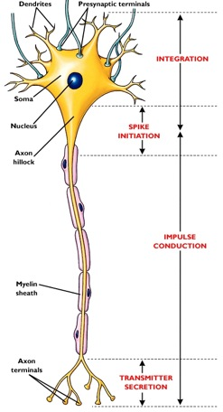
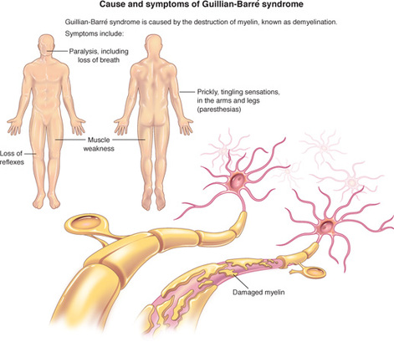
Pathophysiology

Slide 80
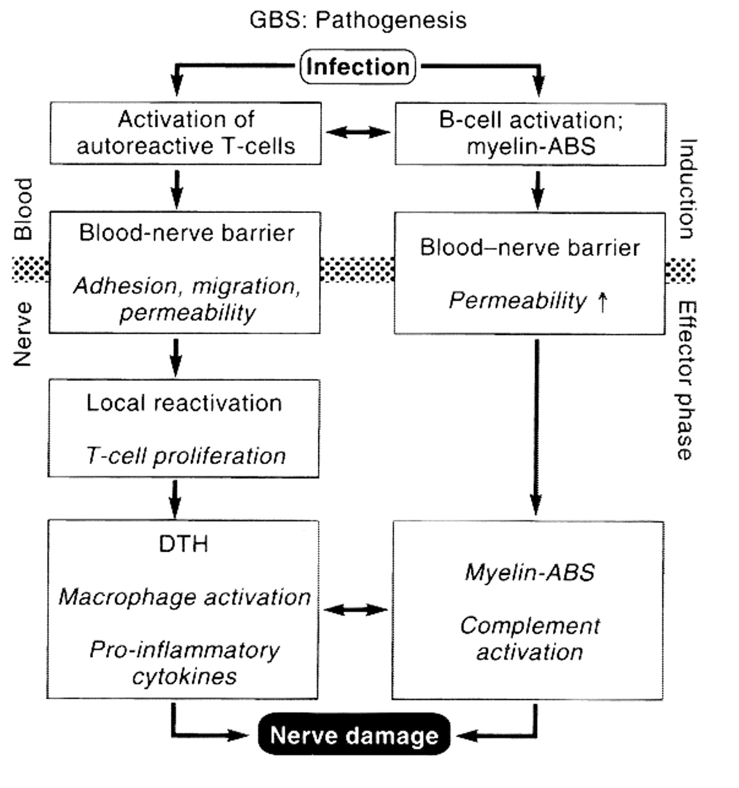

Slide 81
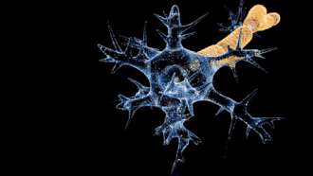
In the demyelinating conduction block. electrophysiologically, (delayed) axonal connections remain ( intact).
In severe cases of demyelinating GBS secondary axonal degeneration slower rate of recovery and a greater degree of residual disability.

Slide 82
severe primary axonal pattern axons have degenerated disconnected from their target neuromuscular junctions, and must therefore regenerate for recovery to take place.
In motor axonal cases in which recovery is rapid, the lesion is thought to be localized to preterminal motor branches, allowing regeneration and reinnervation to take place quickly.
Mild cases, collateral sprouting and reinnervation from surviving motor axons near the neuromuscular junction may begin to reestablish several months.

Slide 83
Antecedent Events
1.75% of GBS cases are preceded 1-3wks by an acute infectious process
2.Usually GI or respiratory
3.Campylobacter jejuni
4.Mycoplasma Pneumonia
5.Viral infections : CMV, EBV, HSV

Slide 84
6.Recent Immunization :
Swine influenza vaccine
Older types of rabies vaccines
7.Usual associations :
Hodgkin’s lymphoma
HIV+ve pts
SLE

Slide 85
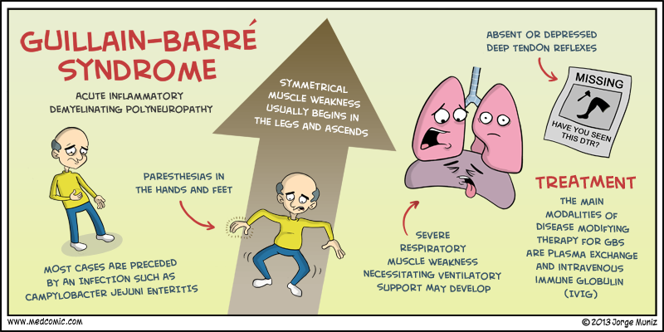
Clinical Manifestations

Slide 86
Clinical Manifestations
Rapidly evolving areflexic motor paralysis with or without sensory disturbances
Ascending paralysis is noticed as rubbery legs
Weakness evolves over hours to few days
LL > UL
50% have facial di-paresis
Lower CN are frequently involved (bulbar), causing difficulty in handling secretions and maintaining airways

Slide 87
Fever and constitutional symptoms are absent (if present re-consider the D_{x})
Sensory deficit can be present (propioception and deep tendon reflexes > pain& temp.)
Bladder dysfunction may occur (transient)

Slide 88
Autonomic involvement may occur
Fluctuation in BP
Cardiac arrhythmias
Postural hypotension
Pain is a common feature (deep and aching in weakened muscles, back pain) – self-limited
In sever cases Autonomic is common

Slide 89
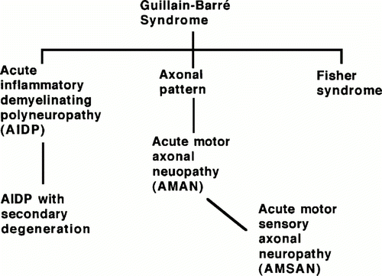
Clinical subtypes

Slide 90
1.Acute inflammatory demyelinating polyneuropathy (AIDP)
Adults affected more than children; 90% of cases in western world.
rapid recovery.
anti-GM1 antibodies (<50%)
Demyelination :
First attack on Schwann cell surface with widespread myelin damage , macrophage activation, and lymphocytic infiltration.
variable secondary axonal damage

Slide 91
2.Acute motor axonal neuropathy (AMAN)
Children and young adults.
prevalent in China and Mexico.
may be seasonal.
Rapid recovery.
anti-GD1a antibodies
Axon :
First attack at motor nodes of Ranvier with macrophage activation, few lymphocytes and frequent periaxonal macrophages.
extent of axonal damage highly variable.

Slide 92
3.Acute motor sensory axonal neuropathy (AMSAN)
Mostly adults .
Uncommon.
Slow recovery ,often incomplete.
closely related to AMAN
Axon :
Same as AMAN, but also affects sensory nerves and roots.
axonal damage usually severe

Slide 93
4.Miller-Fisher syndrome(~5% of GBS)
Acute ophthalmoplegia
Areflexia, w/o weakness
Papilledema, pupillary paralysis
+ve anti-GQ1b Ab
5.Pure sensory form
6.Ophthalmoplegia
7.Bulbar and facial GBS (a/w CMV, anti-GM2 Ab)
8.Acute pandysautonomia.

Slide 94
Clinical course
Usually benign.
Spontaneous recovery begins within 2-3wks.
Most pts. Regain full muscular strength, but some may have residual weakness.
Tendon reflexes are last to recover.
Improvement of weakness progresses for bulbar function downward.

Slide 95
Death may occur if recognized late
Poor prognostic signs :
CN involvement.
Intubation.
Maximum disability at presentation.

Slide 96
7% of children with GBS may have relapse.
Chronic form (variants)of GBS may be present in some pts. called:
Chronic Relapsing Polyradiculopathy OR
Chronic Inflammatory demyelinating polyradiculopathy OR
Chronic unremitting polyradiculopathy

Slide 97
Congenital GBS
Rare.
Generalized hypotonia, weakness and areflexia in neonates.
Full electrophysiological and CSF criteria are met, in the absence of maternal neuromuscular disease.
Gradual improvement over the first few months.
No evidence of residual disease.
Notes:
The mother may had ulcrative colitis and treated with prednisolone

Slide 98
Investigations
1.CSF findings :
Protein is elevated >2x the upper limit(100-1000 mg/dL)
<10 WBC/mm³
Glucose is normal
Culture is negative
2.Motor nerve conduction is severely reduced (EMG studies).
3.CK mildly elevated or normal.

Slide 99
4.Anti-gangliosides Ab ( anti-GM1 and anti-GD1)
If +ve indicates axonal injury
5.Muscle biopsy not usually required
If done : may be normal, or may show denervation atrophy
6.Sural nerve biopsy may show segmental demyelination, focal infl. And wallerian deg.
7.Serological tests for C.jejuni may be +ve

Slide 100
Diagnosis
CSF
Inc protine
Acellular
Normal
EMG and NCV
Delayed or blocke
Clinical symptoms

Slide 101
Diagnosis criterias
A.Required for Diagnosis:
1. Progressive weakness of variable degree from mild paresis to complete paralysis.
2. Generalized hypo- or areflexia.

Slide 102
B. Supportive of Diagnosis
Clinical Features:
a. Symptom progression: Motor weakness rapidly progresses initially but ceases by 4 weeks. Nadir attained by 2 weeks in 50%, 3 weeks 80%, and 90% by 4 weeks.
b. Demonstration of relative limb symmetry regarding paresis.
c. Mild to moderate sensory signs.

Slide 103
d. Frequent cranial nerve involvement: Facial (cranial nerve VII) 50% and typically bilateral but asymmetric; occasional involvement of cranial nerves XII, X, and occasionally III, IV, and VI as well as XI.
e. Recovery typically begins 2–4 weeks following plateau phase.
f. Autonomic dysfunction can include tachycardia, other arrhythmias, postural hypotension, hypertension, other vasomotor symptoms.
g. A preceding gastrointestinal illness (e.g., diarrhea) or upper respiratory tract infection is common.

Slide 104
2. Cerebrospinal Fluid Features Supporting Diagnosis
a. Elevated or serial elevation of CSF protein.
b. CSF cell counts are <10 mononuclear cell/mm³.

Slide 105
3. Electrodiagnostic Medicine Findings Supportive of Diagnosis
a. 80% of patients have evidence of NCV slowing/conduction block at some time during disease process.
b. Patchy reduction in NCV attaining values less than 60% of normal.
c. Distal motor latency increase may reach 3 times normal values.
d. F-waves indicate proximal NCV slowing.
e. About 15–20% of patients have normal NCV findings.
f. No abnormalities on nerve conduction studies may be seen for several weeks.

Slide 106
C.Findings Reducing Possibility of Diagnosis
1. Asymmetric weakness.
2. Failure of bowel/bladder symptoms to resolve.
3. Severe bowel/bladder dysfunction at initiation of disease.
4. Greater than 50 mononuclear cells/mm3 in CSF.
5. Well-demarcated sensory level.

Slide 107
D.Exclusionary Criteria
a. Diagnosis of other causes of acute neuromuscular weakness (e.g., myasthenia gravis, botulism, poliomyelitis, toxic neuropathy).
b. Abnormal CSF cytology suggesting carcinomatous invasion of the nerve roots

Slide 108
Differential Diagnosis
Myelopathies : prolonged back pain and sphincter disturbances .
Botulism : pupillary reflex lost early.
Diphtheria : early oropharyngeal disturbances.
Lyme polyradiculopathy.
Vasculitic neuropathy : inc. ESR.
Polio : fever and meningism.
CMV polyradiculitis : immunocompromised.
Neuromuscular disorders.

Slide 109
Treatment
2 weeks after the first motor symptoms, it is not known whether immunotherapy is still effective.
If the patient has already reached the plateau stage, then treatment probably is no longer indicated, unless the patient has severe motor weakness and one cannot exclude the possibility that an immunologic attack is still ongoing.
Either high-dose intravenous immune globulin (IVIG) or plasmapheresis can be initiated, as they are equally effective for typical GBS.
A combination of the two therapies is not significantly better than either alone.

Slide 110
1.IVIg is often the initial therapy chosen because of its ease of administration and good safety record. Anecdotal data has also suggested that IVIg may be preferable to PE for the AMAN and MFS variants of GBS.
IVIg is administered as five daily infusions for a total dose of 2g/kg body weight.

Slide 111
2.Plasmapheresis usually consists of 40-50 mL/kg plasma exchange (PE) four to five times over a week.
Meta-analysis of randomized clinical trials indicates that treatment reduces the need for mechanical ventilation by nearly half ( from 27%to 14% with PE) and increases the likelihood of full recovery at 1year( from 55%to 68% )
Functionally significant improvement may occur toward the end of the first week of treatment, or may be delayed for several weeks.

Slide 112
The lack of noticeable improvement following a course of IVIg or PE is not an indication to treat with the alternate treatment.
There are occasional patients who are treated early in the course of GBS and improve, who then relapse within a month
Brief retreatment with the original therapy is usually effective in such cases.
Glucocorticoids have not been found to be effective in GBS.
Occasional patients with very mild forms of GBS, especially those who appear to have already reached a plateau when initially seen, may be managed conservatively without IVIg or PE.

Slide 113
In the worsening phase of GBS
most patients require monitoring in a critical care setting, with particular attention to vital capacity, heart rhythm, blood pressure, nutrition, deep vein thrombosis prophylaxis, cardiovascular status, early consideration (after 2 weeks of intubation) of tracheotomy, and chest physiotherapy.
As noted 30% of patients with GBS require ventilatory assistance, sometimes for prolonged periods of time (several weeks or longer(
Frequent turning and assiduous skin care are important, as are daily range-of-motion exercises to avoid joint contractures and daily reassurance as to the generally good outlook for recovery.

Slide 114
Prognosis and Recovery
Approximately 85% of patients with GBS achieve a full functional recovery within several months to a year.
Areflexia may persist and patients often complain of continued symptoms, including fatigue.
The mortality rate is <5% in optimal settings; death usually results from secondary pulmonary complications.
The outlook is worst in patients with severe proximal motor and sensory axonal damage.

Slide 115
Axonal damage may be either primary or secondary in nature but in either case successful regeneration cannot occur.
advanced age, a fulminant or severe attack, and a delay in the onset of treatment Risk incr
Between 5 and 10% of patients with typical GBS have one or more late relapses; such cases are then classified as chronic inflammatory demyelinating polyneuropathy (CIDP).

Slide 116
References
Harrison's™ PRINCIPLES OF INTERNAL MEDICINE Eighteenth Edition
Previous seminar

