Slide 1
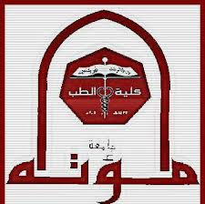
1- Muscle physiology- I
Prof. Sherif W. Mansour
Physiology dpt., Mutah School of medicine.

Slide 2
The Muscle
Muscles are divided into 3 types:
Skeletal muscle
- Functions of the skeletal muscle:
1-It generates force which is helpful in daily life.The muscle fibres are arranged in variable axis, longitudinal, oblique or radial to exert force in different planes.
2-It is very important in respiration.
3-It is very important in producing heat and keeping body temperature constant.
4-It is very important in return of the blood to heart against gravity (muscle pump).
5- It is very important in keeping equilibrium of the body.
6- It has a protective function.
7- It helps posture.
8- Contraction of anterior abdominal wall and pelvic diaphragm muscle keeps intra-abdominal pressure positive and keep organs in position and help respiration.
9-It is important in mechanism of hearing.
10-Movement of the extra-occular muscles increase range of vision.
 | Skeletal | Cardiac | Smooth
-Striations -control -innervation -Function -site | Striated Voluntary Somatic Movement Attached to bone | Striated Involuntary Autonomic N.S. Pumping of blood Heart | Non-striated Involuntary Autonomic N.S. According to site Gut, bl.vs, others

Slide 3
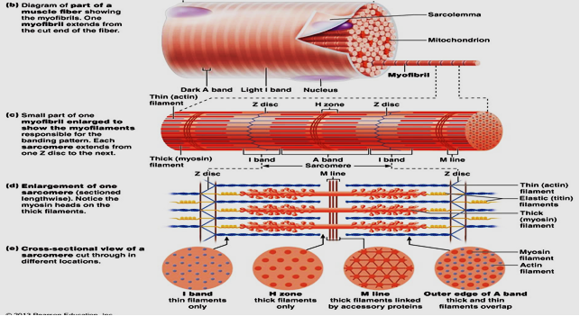

Slide 4
-The arrangement of these contractile proteins in the filament shows cross striations with alternative dark (A) and light (I) bands.
-The dark band:
.Called A band, 100 A° in diameter.
.Contain myosin filaments and ends of actin filaments.
.Has lighter central H-zone (has no actin filaments).
.M-line in middle of H-zone due to central bulge on thick myosin.
-The light band:
. Called I (Isotropic to light) band - 50 A° diameter.
. Contain thin actin filaments + troponin.
. Contain central Z-line (site of attachment of thin filaments).
-The area between two Z-lines is called sarcomere which is the contractile unit of the muscle.
-Longitudinal striations are due to longitudinal arrangement of the muscle fibres and transverse striations are due to alternating light and dark bands.

Slide 5
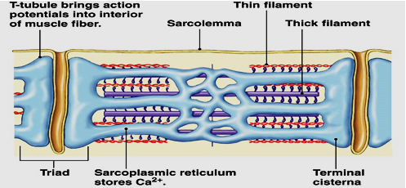
Sarco-tubular system
-It is a system of tubules present in the sarcoplasm of the muscle fibre and made of:
1) T- tubules (transverse system):
-It is a deep infolding of the sarcolemma near endings of the sarcomere (z-line) as an extension of the extracellular space, this infolding is in perpendicular direction of the myofibril so it is called transverse tubule.
-T-tubule membrane contains a voltage sensitive dihydropyridine (DHP) receptor that open the ryanidine Ca++ release channel on the sarcoplasmic reticulum
- Through this tubule the action potential from the cell membrane is rapidly spread to fibrils and fluids with ions move into and out the cell.
2) The sarcoplasmic reticulum:
- It is formed of irregular longitudinal tubules that run parallel and surround the muscle fibre to be a source of Ca++ ions, via Ryanodine Ca+2 channels.
- At site of contact to T-tubules it dilated to form terminal cisterns.
-Each 2 terminal cisterns with adjacent T-tubules is called triad.

Slide 6
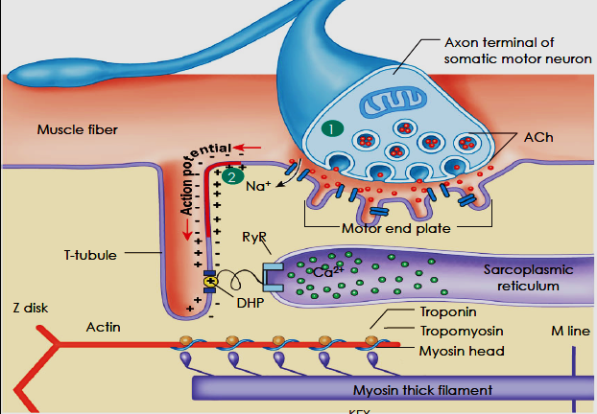
Muscle proteins
[A] Contractile proteins:
1- Myosin: -Myosin is complex protein with M.W. 480,000.
-Composed of 6 polypeptide chains (2 heavy chains and 4 light chains).
-The 2 heavy chains wrap spirally around each other as double helix forming long tail (light mero-myosin) and arm (heavy mero-myosin) while the terminal part combine with the 4 light chains forming 2 globular heads ,one head contains actin-binding sites and the other contain sites of ATP hydrolysis.
-Cross bridges arise from the head with arm of 2 flexible points called hinges (one between arm and tail and the other between the arm and heads) to bind to the actin.
2- Actin: - It is small globular protein with M.W. 42,000.
- The globules attached to each other to form filamentous structure arranged in two chains as long double helix.

Slide 7
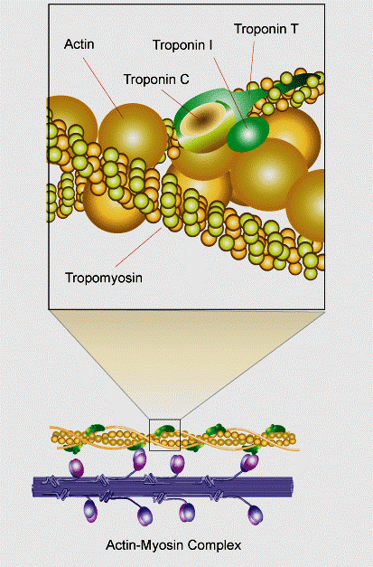
[B] Regulatory protein:
1- Tropomyosin:
-It is long filament of two polypeptide chains twisting on each other and located between the 2 chains of actin covering its active sites which combine to myosin and keeps the actin structure.
2- Troponin:
-Small globules located at intervals along tropomyosin.
-Of 3 subunits with MW 18,000-25,000.
1-Troponin T: binds troponin to tropomyosin.
2-Troponin I: inhibit binding of actin & myosin.
3-Troponin C: bind Ca+2 ions  contraction.

Slide 8
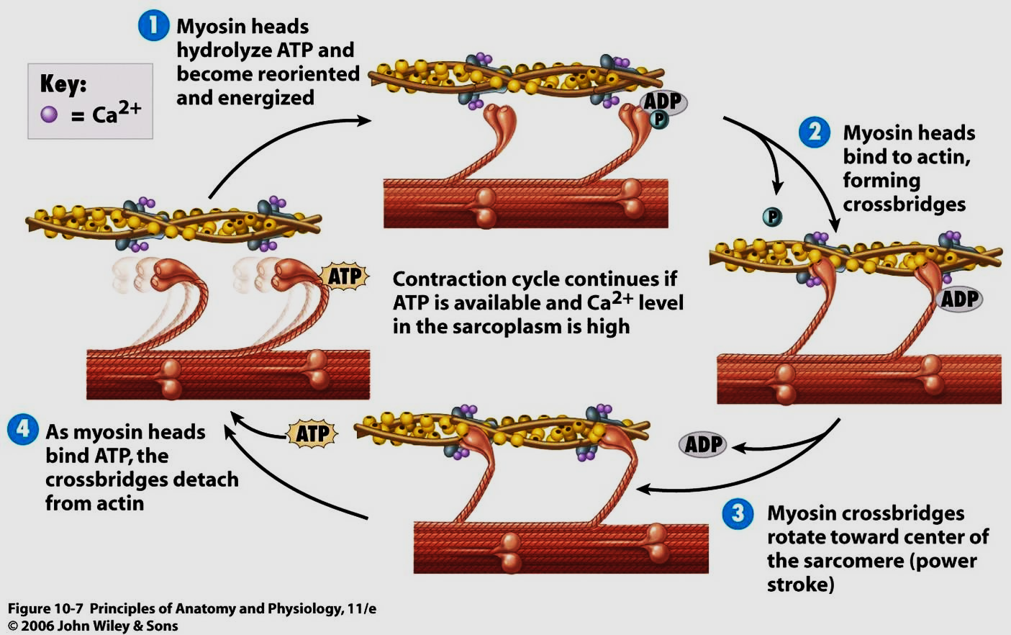
Mechanism of muscle contraction (Excitation - contraction coupling)
It is the process by which depolarization of the muscle fiber initiate contraction.
1-When a nerve impulse reach the MEP, it leads to Ach release from the nerve terminals.
2-Ach combines with the cholinergic receptors on the muscle membrane →↑ Na+ permeability → depolarization of the membrane (End plate potential).
3-When the EPP reaches the firing level → action potential that propagates along the muscle membrane and transmitted to all fibers via the T tubules.
4-This action potential triggers the release of Ca++ ions from the terminal cisternae of sarcoplasmic R.
5-The concentration of Ca+2 increases and initiates contraction by binding to troponin-c leading to:
a- Weakness of the binding of troponin I to actin.
b- Movement of tropomyosin laterally into the groove between the thin filaments → uncovering the binding sites of actin for the myosin heads.
6-The interaction between actin & myosin heads leads to sliding of actin filaments between myosin filaments → muscle contraction.
6-The energy required for this mechanism is provided by breakdown of ATP to ADP by ATPase activity of myosin heads in the presence of Ca++ ions.

Slide 9
Results of contraction
-The sarcomere becomes short.
-The width of I band is decreased.
-The width of A band is remained constant.
-H-zone becomes narrow.
Mechanism of muscle relaxation
-The Ca+2 is actively reuptake back to the SR by active Ca+2 pump to be stored in the cisterns.
-Decrease the intracellular Ca+2 ions to 10-7 mol/L, the troponin-tropomyosin complex return to its original position separating myosin head from actin that is covered and inhibited by tropomyosin resulting in muscle relaxation.
-Breakdown of ATP is necessary to Ca+2 pump.
So, ATP hydrolysis is required for contraction and relaxation and ↓ ATP → no relaxation.
Electrical changes during M. contraction: Similar to the nerve with the following differences
 | Muscle | Nerve
- RMP | - 90 mV. | - 70 mV. to – 90
- Firing level | - 70 mV. | - 55 mV or - 65
- Overshoot | + 40 mV | + 35 mV
-Amplitude of A.P. | 130 mV | 105 mV or 125
- Duration of spike P. | 2-4 msec | 2 msec
- Rate of conduction | 5 meter/sec | Variable
- Chronaxi | Long (less excitable) | Short (more excitable)

Slide 10
Rigors : (contracture)
-It is a state of stiffness (sustained contraction) in the muscle. -Of four types:
1-Rigor mortis:
-It is a state of stiffness in the muscle five hours after death due to depletion of ATP, which is required for muscle relaxation.
-Then autolysis of the muscle proteins by lysosomes and bacterial putrefaction within 15-25 hours.
-It is important medico legally for determination of death time.
2-Ca+2 rigor: increase in extracellular Ca2+may stop the heart in the systole.
3-Heat rigor: in case of increase body temperature as high fever lead to destruction of enzymes responsible for relaxation and Ca2+
4-Physiological rigor: (Contracture) means contraction not preceded by stimulation and not followed by relaxation because in extreme fatigue or untrained muscle → ↓ ATP → sustained contraction.
N.B.: Difference between:
Contraction: Shortening of muscle , preceded by stimulation and followed by relaxation.
Contracture: Shortening of muscle, not preceded by stimulation, not followed by spontaneous relaxation.

Slide 11
-Mechanical changes: there are 2 types of contraction:
-In isometric cont: (CE) shortens but (SE) stretched and elongated so the total ms. length is constant.
-In isotonic cont: CE shortens but (SE) not stretched → shorten ms.
 | Isotonic | Isometric
- The muscle length | Decrease | Constant
- Muscle tension | Constant | Increased
- Energy | Great and used for work & waste heat | Less and is waste heat (no work)
- Sliding | Great sliding | less
- Duration | Longer | Short
- O₂ required | Greater | Less
- Heat production | Less | Great waste heat
-Mechanical efficiency and work done | 25-30% e.g. contraction of biceps to lift objects | Zero (no work done) e.g. when the weight is too heavy to be moved.

Slide 12
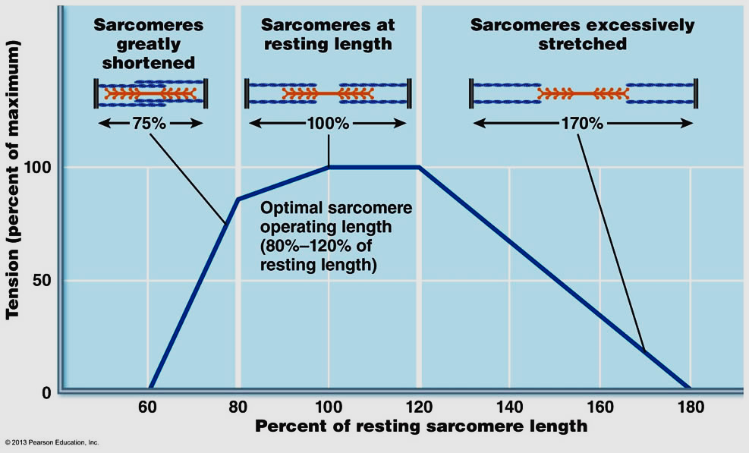
-Muscle tension:
•Passive (rest) tension: is that exerted by unstimulated muscle.
•Active tension: is the increase in tension during contraction.
•Total tension = passive t. + active t. in isometric cont.
-Muscle length: •Resting length: is the length of unstimulated muscle
•Equilibrium length: is the length of relaxed and detached muscle from bony attachment
•Optimal length: is the length at which we get the best contraction.
-Relation between muscle length and tension:
Starling law states that “Within limits, the greater the initial muscle length (preload), the more will be the tension developed in isometric contraction” as increase in muscle length leads to increase number of cross bridges→ ↑ tension.
But overstretching → ↓ number of cross bridges → ↓tension. This law is applied also in the cardiac and smooth muscles as it is myogenic law (depend on the muscle not on the nerve supply).

Slide 13
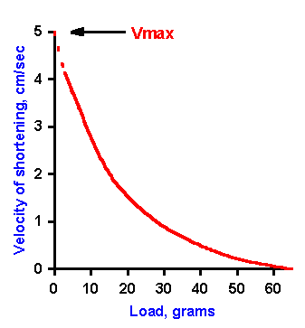
-Relation between the load and velocity of contraction:
-The velocity of contraction is inversely proportional to the load carried as in the cardiac muscle.
-Maximal velocity is obtained when the load is zero.
-Zero velocity is obtained when the load is more than power of contraction.

Slide 14
Thank You

