Slide 1
Kawasaki disease
Dr Aya Abu Haweleh
Fellow of pediatric cardiology
MBBS, JBP.

Slide 2
Kawasaki Disease: Mucocutaneous Lymph Node Syndrome
“A self-limited vasculitis of unknown etiology that predominantly affects children younger than 5 years. It is now the most common cause of acquired heart disease in children in the United States and Japan.”
Jane Burns, MD*
*Burns, J. Adv. Pediatr. 48:157. 2001.
Notes:
A good place to start is to define the disease. This quote is a as good a definition as I’ve found.
Kawasaki disease is a self-limited vasculitis of unknown etiology that predominantly affects children younger than 5 years. It is now the most common cause of acquired heart disease in children in the United States and Japan.
Another important point to make is that, in part due to the fact that we have no etiology, there is no specific diagnostic test for Kawasaki disease.
For this reason, some people call it Kawasaki syndrome and not Kawasaki disease.
Therefore, guideline have been developed to make the diagnosis.
But, the diagnosis of Kawasaki disease is still one of exclusion.

Slide 3
What is Kawasaki Disease?
Idiopathic multisystem disease characterized by vasculitis of medium blood vessels, including coronary arteries
Notes:
MCOS was the original name of Kawasaki disease --- it stands for mucocutaneous ocular syndrome. This child had died suddenly & unexpectedly.

Slide 4
Why is it important to identify kawasaki???
Approximately 20–25% of untreated children develop coronary artery abnormalities (CAA) including aneurysms
<5% of children treated with intravenous immune globulin (IVIG) develop CAA.

Slide 5
Epidemiology
Median age of affected children = 2.3 years
80% of cases in children < 4 yrs, 5% of cases in children > 10 yrs
Males:females = 1.5-1.7:1
Recurs in 3%
Positive family history in 1% but 13% risk of occurrence in twins
Overall U.S. in-hospital mortality ≈ 0.17%
Notes:
Kawasaki disease is virtually unheard of in children older than 15 years of age.

Slide 6
Etiology
Infectious agent most likely
Age-restricted susceptible population
Seasonal variation
Well-defined epidemics
Acute self-limited illness similar to known infections
No causative agent identified
Bacterial, retroviral, superantigenic bacterial toxin
Immunologic response triggered by one of several microbial agents
No known etiology
Notes:
A number of each of these has been implicated in individual cases or clinical series but typically data are conflicting.
A variant strain of Propionibacterium acnes with dust mites playing a role as vectors has been proposed as the causative agent by several investigators but no causative link has been established despite multiple investigations.

Slide 7
New Haven Coronavirus
Identified a novel human coronavirus in respiratory secretions from a 6-month-old with typical Kawasaki Disease
Subsequently isolated from 8/11 (72.7%) of Kawasaki patients & 1/22 (4.5%) matched controls (p = 0.0015)
Suggests association between viral infection & Kawasaki disease
Esper F, et . J Inf Dis. 2005; 191:499-502

Slide 8
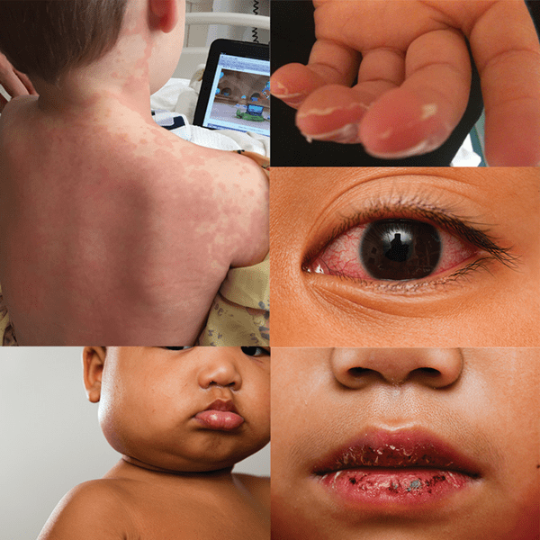
Diagnostic Criteria
Fever for at least 5 days
At least 4 of the following 5 features:
Changes in the extremities
Edema, erythema, desquamation
2. Polymorphous exanthem, usually truncal
3. Conjunctival injection
4. Erythema&/or fissuring of lips and oral cavity
5. Cervical lymphadenopathy
Illness not explained by other known disease process
Modified from Centers for Disease Control. Kawasaki Disease. MMWR 29:61-63, 1980
Notes:
The diagnosis of Kawasaki Disease requires fever persisting at least 5 days (although US and Japanese experts now agree that only 4 days of treatment are necessary before initiating treatment) and the presence of at least 4 of the following 5 principal features: changes in extremities, a polymorphous rash, conjunctival injection, changes in lips and oral cavity, and cervical lymphadenopathy.
In addition, other diagnoses must also be ruled out.
For example scarlet fever, toxic shock syndrome, and adenoviral infections have similar presentation.
The fever is usually high, greater than 102°F, does not respond well to antipyretics, and can last 1-2 weeks.
The important thing to remember though is that Kawasaki disease is a diagnosis of exclusion without confirmatory tests s and based on a constellation of signs and symptoms and/or consistent ultrasound findings

Slide 9
Atypical or Incomplete Kawasaki Disease
Present with < 4 of 5 diagnostic criteria
Compatible laboratory findings
Still develop coronary artery aneurysms
No other explanation for the illness
More common in children < 1 year of age
2004 AHA guidelines offer new evaluation and treatment algorithm

Slide 10
Predictors of poor outcome across
Young age
Male gender
Persistent fever
Poor response to IVIG
laboratory abnormalities, including neutrophilia, thrombocytopenia, transaminitis, hyponatremia, hypoalbuminemia, elevated levels of N-terminal–brain natriuretic protein and elevated C-reactive protein (CRP) levels.

Slide 11
Differential Diagnosis
Infectious
Measles & Group A beta-hemolytic strep can closely resemble KD
Bacterial: severe staph infections w/toxin release
Viral: adenovirus, enterovirus, EBV, roseola
Notes:
In fact, these 2 etiologies have been found to account for over 80% of patients initially thought to have Kawasaki disease but ultimately not diagnosed as such.
These would include toxic shock syndrome & staph scalded skin syndrome.

Slide 12
Differential Diagnosis
Infectious
Spirocheteal: Lyme disease, Leptospirosis
Parasitic: Toxoplasmosis
Rickettsial: Rocky Mountain spotted fever, Typhus

Slide 13
Differential Diagnosis
Immunological/Allergic
JRA (systemic onset)
Atypical ARF
Hypersensitivity reactions
Stevens-Johnson syndrome
Toxins
Mercury
Notes:
As I said at the onset, Kawasaki disease is a vasculitis of small and medium-sized vessels so we must consider some immunologic/rheumatologic etiologies in the differential diagnosis.
However, in Stevens-Johnson the conjunctivitis is more likely to be exudative while the rash is typically vesicular with crusting. If you remember back to the description of typical physical exam I gave earlier these characteristics don’t really fit with the conjunctivitis or the rash we expect to see in Kawasaki disease.

Slide 14
Phases of Disease
Acute (1-2 weeks from onset)
Febrile, irritable, toxic appearing
Oral changes, rash, edema/erythema of feet
Subacute (2-8 weeks from onset)
Desquamation, may have persistent arthritis or arthralgias
Gradual improvement even without treatment
Convalescent (Months to years later)
Notes:
In this convalescent phase remaining symptoms resolve & laboratory values normalize.

Slide 15
Course
Fever
high spiking (≥38.3°C [101°F]), remitting, and unresponsive to antipyretics.
The duration of fever without treatment is generally 1-2 wk but may be as short as 5 days or may persist for 3-4 wk.
5 principal clinical criteria of KD are
(1) bilateral nonexudative conjunctival injection with limbal sparing
(2) erythema of the oral and pharyngeal mucosa with strawberry tongue and red, cracked lips
(3) Edema (induration) and erythema of the hands and feet
(4) rash of various forms (maculopapular, erythema multiforme, scarlatiniform or less often psoriatic-like, urticarial or micropustular)
(5) nonsuppurative cervical lymphadenopathy, usually unilateral, with node size >1.5 cm

Slide 16
(4) rash of various forms (maculopapular, erythema multiforme, scarlatiniform or less often psoriatic-like, urticarial or micropustular)
(5) nonsuppurative cervical lymphadenopathy, usually unilateral, with node size >1.5 cm
Perineal desquamation is common in the acute phase.
Periungual desquamation of the fingers and toes begins 2-3 wk after the onset of illness and may progress to involve the entire hand and foot.

Slide 17
Irritability??
Notes:
Other clinical findings include significant irritability that is
especially prominent in infants and likely caused by aseptic meningitis, mild
hepatitis, hydrops of the gallbladder, urethritis and meatitis with sterile pyuria,
and arthritis.

Slide 18
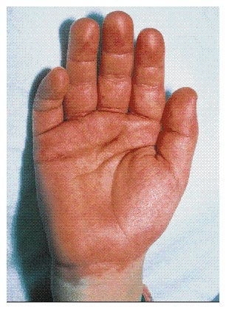
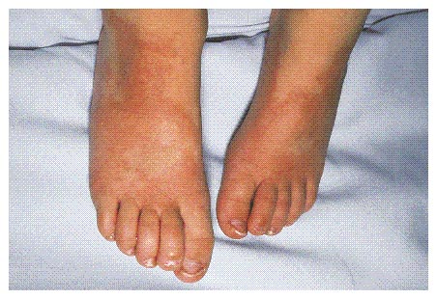
Trager, J. D. N Engl J Med 333(21): 1391. 1995.
Notes:
Acute changes seen in the hands and feet are usually seen several days into the course.
There is erythema and edema of hands and feet, usually on the dorsal surfaces.
Children may also refuse to walk or have trouble putting on their shoes.
Erythema of palms & soles &/or painful edema of hands/feet
Usually start 3-5 days after onset of fevers
Subungual desquamation in subacute phase
Beau lines may be seen 2-3 months after onset

Slide 19
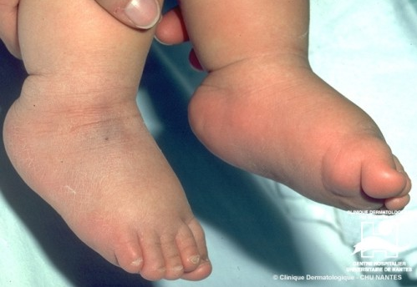

Slide 21
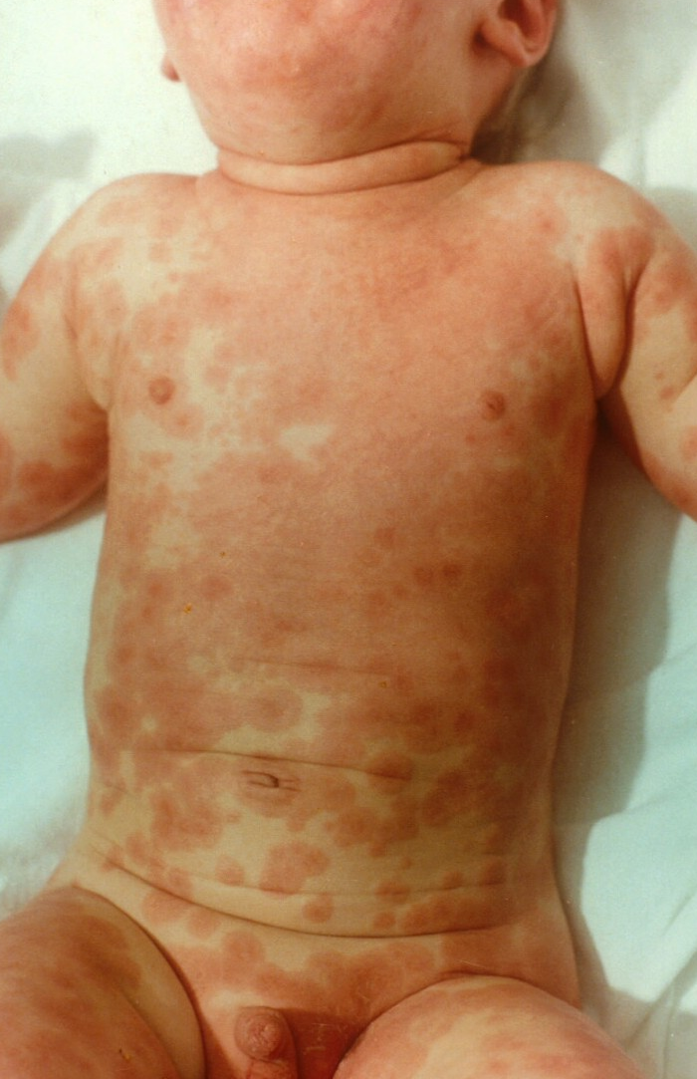
Notes:
Polymorphous, non-vesicular rash
Present in 99% of cases
Usually maculopapular
Characteristic confluence in perineum (60%)
Often not pruritic

Slide 23
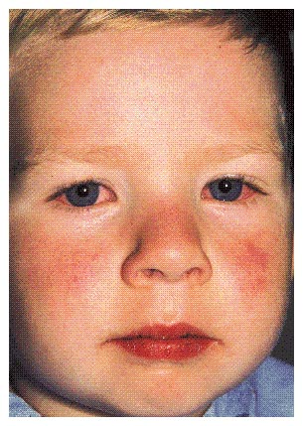
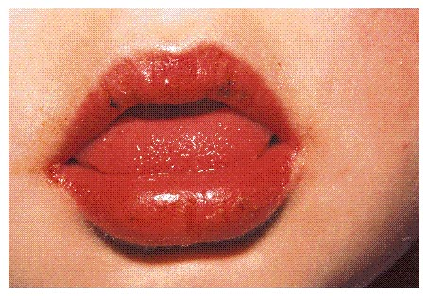
Trager, J. D. N Engl J Med 333(21): 1391. 1995.
Notes:
In the first week, patients can develop bilateral, painless bulbar conjunctival injection without exudate. There tends to be no redness adjacent to the pupil and these patients may also have anterior uveitis which is shown on acute phase slit lamp exam in 80%
In the first week, they may also have erythema and cracking of lips, a strawberry tongue, and/or diffuse injection of oral and pharyngeal mucosae.

Slide 24
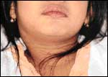
Han, R. CMAJ 162:807. 2000.
Notes:
The lymphadenopathy occurs early in the disease, and can be very transient. It may or may not be bilateral but is not generalized throughout the body.
Lymph nodes, by definition, must be 1.5 cm in diameter or larger.
About 90% of patients will have fever, conjunctival erythema, and oral changes and 70% will have lymphadenopathy.

Slide 25
Kawasaki Disease: S&S
Respiratory
- Rhinorrhea, cough, pulmonary infiltrate
GI
- Diarrhea, vomiting, abdominal pain, hydrops of the gallbladder, jaundice
Neurologic
- Irritability, aseptic meningitis, facial palsy, hearing loss
Musculoskeletal
- Myositis, arthralgia, arthritis
Notes:
The complete list of associated symptom is too long to go into in detail here,but virtually every organ system can be involved.
Patients can have cough, rhinorrhea, or a pulmonary infiltrate.
They can have diarrhea, vomiting, abdominal pain, hydrops of gallbladder, mild jaundice, and mild increase of serum transaminase levels.
They can have striking irritability and an aseptic meningitis with a mononuclear pleocytosis in cerebrospinal fluid as well as a facial palsy and hearing loss.
Finally, they can develop myositis, arthralgias, and arthritis.
Heme: hemophagocytosis
Renal: ARF, renal artery aneurysms
Skin: transverse furrows of fingernails (Beau’s lines) during convalescence
Others: Peripheral gangrene, orbital myositis, Avascular necrosis of the femoral head

Slide 26
Notes:
An abdominal ultrasound was obtained which revealed an extremely distended gallbladder (11 cm) without wall thickening, and no visible stone nor enlargement of the common bile duct or biliary tree. This picture suggested gallbladder hydrops.

Slide 28
Clinical features that are not consistent with KD
exudative conjunctivitis
exudative pharyngitis
generalized lymphadenopathy
discrete oral lesions (ulceration or exudative pharyngitis)
splenomegaly
bullous, petechial, or vesicular rashes.

Slide 29
Kawasaki Disease: Labs
Late
Thrombocytosis
Elevated CRP
Early
Leukocytosis
Left shift
Mild anemia
Thrombocytopenia/ Thrombocytosis
Elevated ESR
Elevated CRP
Hypoalbuminemia
Elevated transaminases
Sterile pyuria
Notes:
In acute phase, the most common blood laboratory findings are: a leukocytosis with left shift, mild anemia, an increased erythrocyte sedimentation rate or C-reactive protein, hypoalbuminemia, elevation of liver transaminases
Later in the illness, the platelet count tends to rise during the second week and can remain elevated for longer than 6-8 weeks.
Finally, the urine can show sterile pyuria of urethral origin and occasional proteinuria.

Slide 30
Cardiovascular Manifestations of Acute Kawasaki Disease
None
Suggestive of myocarditis (50%)
Tachycardia, murmur, gallop rhythms
Disproportionate to degree of fever & anemia
Suggestive of pericarditis
Present in 25% although symptoms are rare
Distant heart tones, pericardial friction rub, tamponade
Notes:
The murmur may be due to valvar insufficiency or to flow in a high output state.

Slide 31
Cardiology in the Acute Setting
Usually just to document baseline coronary artery status–not an emergency
If myocarditis suspected–an emergency
Can help diagnose “atypical” disease
Notes:
Despite all of these potential findings, cardiologists are usually consulted in the acute phase to document the baseline status of the coronary arteries and to meet the family.
If myocarditis or a pericardial effusion is suspected, we should be consulted immediately.
However, the risk of acute mortality is low (0.08 % in the latest Japanese survey).
In addition, our input can be helpful in diagnosing atypical Kawasaki disease.

Slide 32
Echocardiographic Findings
Myocarditis with dysfunction
Pericarditis with an effusion
Valvar insufficiency
Coronary arterial changes
Notes:
Echocardiographic finding include myocarditis and depressed function, pericarditis with an effusion, valvular insufficiency, or coronary artery changes.
The most common finding is mild coronary artery changes.
Echo is 80-90% sensitive for the diagnosis of proximal coronary artery aneurysms

Slide 33
Coronary Arterial Changes
15% to 25 % of untreated patients develop coronary artery changes
3-7% if treated in first 10 days of fever with IVIG
Most commonly proximal, can be distal
Left main > LAD > Right
Notes:
Ectasia is defined as coronary artery size larger than normal for age but without discrete aneurysm.

Slide 34
Coronary Arterial Changes
Vary in severity from echogenicity due to thickening and edema or asymptomatic coronary artery ectasia to giant aneurysms
May lead to myocardial infarction, sudden death, or ischemic heart disease
Notes:
Ectasia is defined as coronary artery size larger than normal for age but without discrete aneurysm.

Slide 35
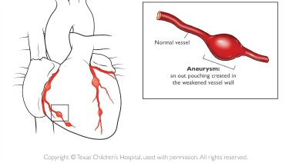
Coronary Aneurysms
Size
Small = <5 mm diameter
Medium = 5-8 mm
Giant = ≥ 8 mm
Highest risk for sequelae
Shape
Saccular
Fusiform
Notes:
Aneurysms are classified as small, medium and giant.
Giant aneurysms have the greatest risk for complications and have an incidence of 0.8 % in the latest Japanese survey.
The aneurysms are also classified as saccular, if they have axial and lateral dimensions being of about equal size, or fusiform, if there is dilation with proximal and distal tapering.

Slide 36
Coronary Aneurysms
• Patients most likely to develop aneurysms
Younger than 6 months, older than 8 years
Males
Fevers persist for greater than 14 days
Persistently elevated ESR
Thrombocytosis
Pts who manifest s/s of cardiac involvement
Notes:
These signs/symptoms would include mitral regurgitation or pericardial effusion.

Slide 38
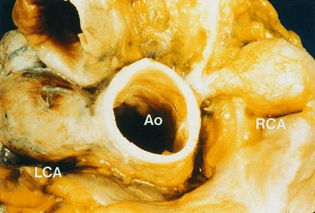
Bruckheimer, E. Circulation 97:410. 1998.
Notes:
This is a specimen from a 33 year old woman who died after labor.
In retrospect, she had had an illness at 16 years of age consistent with Kawasaki disease.
There are giant aneurysms of the proximal right and left main and left anterior descending coronary arteries.
Also of note, the child that was born prior to her death was admitted at 5 years of age with Kawasaki disease.

Slide 39
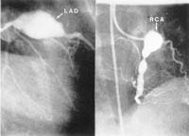
Circulation 103(2):335-336. 2001.
Notes:
Angiography is the gold standard and can define proximal and distal coronary anatomy better than echocardiography.
However, performing angiography on all patients is unreasonable.
In addition, angiography may miss abnormalities in the arterial wall, including thromboses or dysfunction.

Slide 41
Coronary Aneurysm History
50 % regress to normal by echo
25 % become smaller
25 % do not regress
7-20 % develop stenosis or myocardial infarction attributed to their aneurysms
Notes:
Many studies, especially in Japan, have documented the history of coronary aneurysms.
About 50 % of all aneurysms regress to normal and 25 % become smaller.
This leaves 25 % that don’t regress.
Overall, about 7-20 % of patients with aneurysms will develop stenosis or a myocardial infarction from their aneurysm.
This is more common in patients with giant or multiple smaller aneurysms.
In the pre-IVIG era, about 2-3 % of all patients developed ischemic heart disease.
This incidence is lower now, but our follow-up is only about 30 years, so we really aren’t sure of the long-term consequences.

Slide 42
Coronary Aneurysm History
Approximately 50% of aneurysms resolve
Smaller size
Fusiform morphology
Female gender
Age less than 1 year
Giant aneurysms (>8mm) worst prognosis
Notes:
And this is non-giant aneurysms. Resolution usually occurs within 1 to 2 years. Factors associated with an increased likelihood of resolution are…
Some people opt to treat these patients with an anticoagulant such as coumadin to prevent thrombosis.

Slide 43
Cardiovascular Sequelae
0.3-2% mortality rate due to cardiac disease
10% from early myocarditis
Aneurysms may thrombose, cause MI/death
MI is principal cause of death in KD
32% mortality
Most often in the first year
Majority while at rest/sleeping
About 1/3 asymptomatic
Notes:
Rarely, aneurysms may rupture.

Slide 44
Acute Kawasaki Disease: Treatment
IVIG: 2g/kg as one-time dose
Beneficial effect 1st reported by Japanese
Mechanism of action is unclear
Significant reduction in CAA in pts treated with IVIG plus aspirin vs. aspirin alone (15-25%→3-5%)
Efficacy unclear after day 10 of illness
Notes:
Typically given as this one time dose although different regimens have been used including 500/kg/day x 4 days.
…and actually it was tried after the publication of successful IVIG therapy of ITP in 1981. It was endorsed as recommended therapy by the Committee on Infectious Diseases of the AAP in 1988.
A multicenter prospective trial in the US has demonstrated …
In addition to fewer giant coronary aneurysms children receiving IVIG also had more rapid resolution of abnormalities of myocardial function.
Despite this, it’s typically recommended that children diagnosed after 10 days still be treated if there is evidence of continuing inflammation or evolving coronary artery disease.

Slide 45
Acute Kawasaki Disease: Treatment
IVIG
70-90% defervesce & show symptom resolution within 2-3 days of treatment
Retreat those with failure of response to 1st dose or recurrent symptoms → Up to 2/3 respond to a second course

Slide 46
Acute Kawasaki Disease: Treatment
Aspirin
High dose (80-100 mg/kg/day) until afebrile x 48 hrs &/or decrease in acute phase reactants
Need high doses in acute phase due to malabsorption of ASA
Dosage of ASA in acute phase does not seem to affect subsequent incidence of CAA
Notes:
High-dose aspirin theoretically suppresses inflammation while low doses inhibit platelet aggregation.

Slide 47
Acute Kawasaki Disease: Treatment
Aspirin
Decrease to low dose (3-5 mg/kg/day) for 6-8 weeks or until platelet levels normalize
No evidence of effect on CAA when used alone
Due to potential risk of Reye syndrome instruct parents about symptoms of influenza or varicella
Notes:
Otherwise the platelet level can be repeated a month later .
By 6-8 weeks if the coronaries continue to remain normal appearing it is extremely unlikely that they will develop any any any late changes.

Slide 48
Acute Kawasaki Disease: Treatment
Aggressive support with diuretics & inotropes for some patients with myocarditis
Antibiotics while excluding bacterial infection

Slide 49
Acute Kawasaki Disease: Treatment
Conflicting data about steroids
Reports of higher incidence of aneurysms & more ischemic heart dis in pts w/aneurysms
Case report of KD refractory to IVIG but responsive to high-dose steroids & cyclosporine A
Ongoing NHLBI multicenter randomized placebo-blind trial in progress
Notes:
However there have also been studies that have shown either no ill effects or even possible benefits such as lower prevalence of aneurysms, shorter duration of fever, and shorter duration of hospitalization

Slide 51
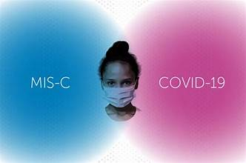
MIS-C

Slide 52
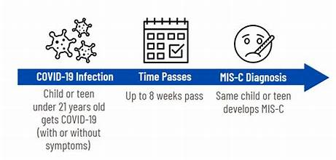
In March 2020 as COVID19 evolved in UK, Pediatricians noticed unusual illness
They collected 37 cases from 8 hospitals in England and systematically reviewed their clinical features.
Severe illness admitted to pediatric ward, or PICU
Varied presentations -prolonged fever, sore throat, headache, abdominal pain and vomiting, rash, conjunctivitis
Some developed shock, organ dysfunction

Slide 53
In common -↑ CRP, ↑ Neutrophil, ↓ lymphocytes, ↑ D-Dimers
•Some -typical Kawasaki disease features
•Majority SARS-CoV-2 PCR negative

Slide 55
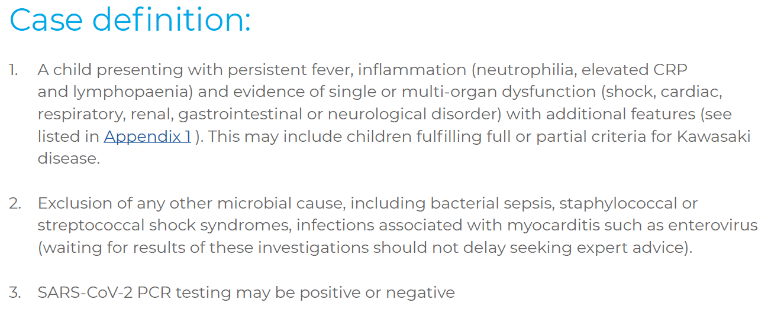

Slide 56
Clinical presentations
75% shock, 51% Myocardial involvement
54% rash
30% conjunctivitis, 20% mucus membrane
57% abdominal involvement

Slide 57
Clinical presentations
38% acute kidney injury, only 1 required renal replacement therapy
Unlike adults -only 32% respiratory symptoms

Slide 58
Laboratory Features
Lymphopaenia
Neutrophilia
Anaemia
Raised D-dimer
Raised Troponin
Raised CRP

Slide 59
Patients with MIS-C encompass a broader age range, have more prominent GI and neurologic symptoms, present more frequently in shock, and are more likely to display cardiac dysfunction (arrhythmias and ventricular dysfunction) than children with KD.

Slide 60
At presentation, patients with MIS-C tend to have lower platelet counts, lower absolute lymphocyte counts, and higher CRP levels than patients with KD.

Slide 61
Radiology –summary of findings
Chest X-ray:
–Some normal
–Small bilateral pleural effusions
–Patchy consolidation
–Focal consolidation
–Atelectasis

Slide 62
Radiology –summary of findings
CT chest :
–Findings as for CXR
–Nodular ground glass opacification

Slide 63
Radiology –summary of findings
Abdominal USS/CT
Some normal
Free fluid
Ascites
Bowel inflammation
ileum/ascending colon/RIF
Lymphadenopathy
Pericholecystic oedema

Slide 64
Echocardiography
19/25 at least 1 echo performed
08/19 significantly impaired ventricular function (SF% <28 or equivalent)
05/19 dilated coronaries or aneurysms

Slide 65
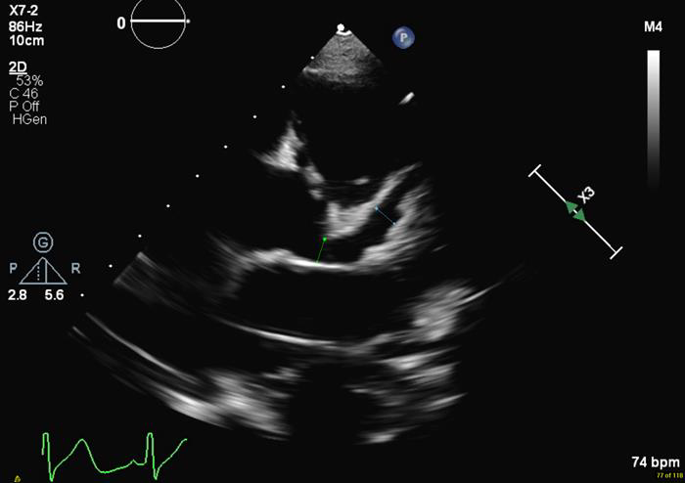

Slide 66
Management
All admitted to HDU/PICU for supportive care
All required fluid resuscitation
Inotropes required for 26 (70%)
38% of children did not received IVIG, just supportive care

Slide 67
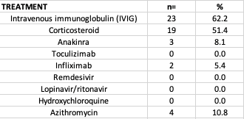

Slide 68
OUTCOME
Majority respond to treatment
1 child has been noted to have coronary artery dilatation at follow up ECHO, did not receive immunosuppression

Slide 69
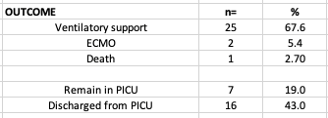

Slide 70
SARS-CoV-2 Results
SARS-CoV-2 PCR –
–12 positive
–24 negative
–1 refused

Slide 71
•SARS-CoV-2 IgG
–19 positive total
–11 IgG pos, PCR neg
–5 IgG pos, PCR pos
–3 IgG neg, PCR neg
–18 not done, 7 PCR pos
TotalSARS-CoV-2 pos (PCR & IgG) is 23

Slide 72
DX
Kawasaki disease /KD shock syndrome syndrome
Staphylococcal or streptococcal toxic shock syndrome
HLH / Macrophage activation syndromes
Haemorrhagic shock and encephalopathy syndrome
SLE/Vasculitic disease

Slide 74
Immunomodulatory treatment in MIS-C:
Low-moderate dose glucocorticoids (1-2 mg/kg/day) should be given with IVIG as adjunctive therapy for treatment of MIS-C in patients with shock and/or organ threatening disease (M).

Slide 75
Immunomodulatory treatment in MIS-C:
In patients who do not respond to IVIG and low-moderate dose glucocorticoids, high dose, IV pulse glucocorticoids (10-30 mg/kg/day) may be considered, especially if a patient requires high dose or multiple inotropes and/or vasopressors .

Slide 76
Immunomodulatory treatment in MIS-C:
Anakinra (>4 mg/kg/day IV or SQ) may be considered for treatment of MIS-C refractory to IVIG and glucocorticoids, in patients with MIS-C and features of macrophage activation syndrome (MAS), or in patients with contraindications to long-term

Slide 77
Antiplatelet in MIS-C:
Low dose aspirin (3-5 mg/kg/day; max 81 mg/day) should be used in patients with MIS-C and continued until normalization of platelet count and confirmed normal coronary arteries at ≥4 weeks after diagnosis.
Treatment with aspirin should be avoided in patients with active bleeding, significant bleeding risk, and/or platelet count ≤80,000/μL .

Slide 78
Anticoagulation therapy
Patients with MIS-C and documented thrombosis or an ejection fraction (EF) <35% should receive therapeutic anticoagulation with enoxaparin until at least 2 weeks after discharge from the hospital .

Slide 79
