Slide 1
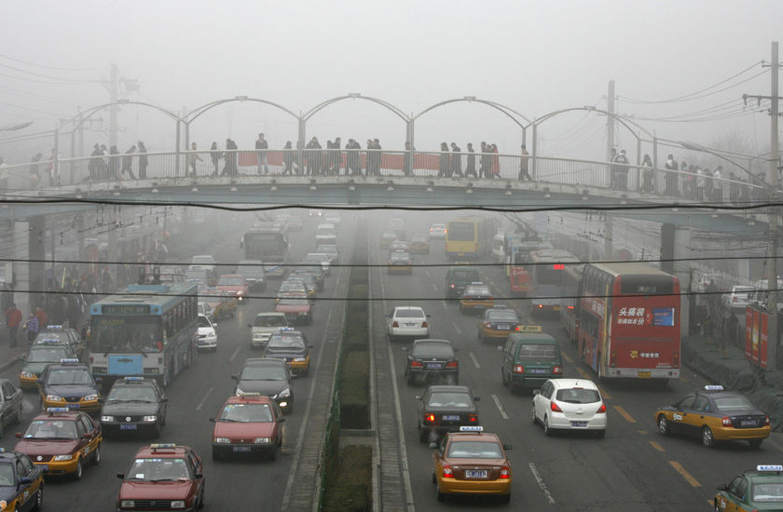
Air Pollution

Slide 2
Climate Processes And Air Pollution
Air pollution is defined as any contaminant added to the air that is harmful to the health of living organisms.
Due to the nature of air and wind, this pollution can be carried great distances.

Slide 3
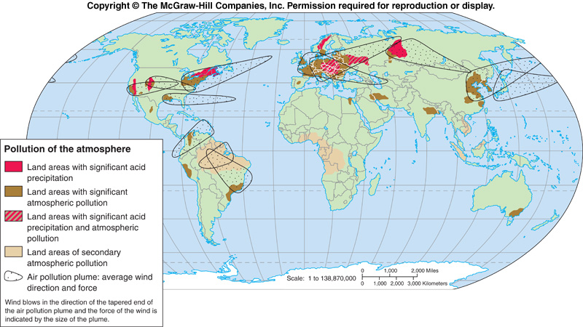
Long-Range Transport

Slide 4
Air Pollution Classification
Primary Pollutants
Released directly into the air
Secondary Pollutants
Formed as a result of a chemical reaction in the air.
Smog: Reaction of sunlight with nitrogen oxide (NOx), the words smoke and fog
Acid Rain: Reaction of sulfur dioxide (SO2) with water to form sulfuric acid.
Ozone: Tropospheric, or ground level ozone, is not emitted directly into the air, but is created by chemical reactions between oxides of nitrogen (NOx) and volatile organic compounds (VOC).

Slide 5
AIR POLLUTION SOURCES
Anthropogenic Activities
Industrial Activities
Combustion Fossil Fuel
Vehicular Emission
2. Natural Processes
High Concentration of Air Pollutants
CO
Ozone
Particulate Matter (TSP, PM10)
NOx
SO2
Lead
ASSOCIATED FACTORS
Environmental Factors
Physical Environment
Temperature
Humidity
Altitude
Climatic Changes
Geographical Distribution
Distance From the Main Roads
Closed Area
Human Factors
History
Socioeconomic Status
Indoor Air Quality
Demographics
HEALTH EFFECTS
Respiratory Symptoms
Cough
Phlegm
Wheezing
Breathlessness
Respiratory diseases
Bronchitis
Pneumonia
Hay fever
Bronchial Asthma
Chronic Bronchitis
Medical visits
Hospital admissions

Slide 6
Air Pollution and Topography
The effects of air pollution are also influenced by the shape of the land.
Temperature inversions occur when a layer of dense, cool air is trapped below a layer of lighter, warmer air. ظاهرة الانقلاب
Most likely to occur in valleys and canyons.

Slide 7
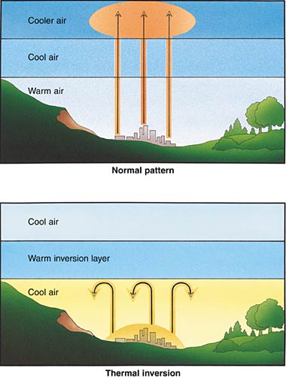
Temperature Inversion
Temperature inversions trap any air pollution produced, allowing it to accumulate to much higher than normal levels.
Two major air pollution events occurred in the 20th century because of this phenomenon.

Slide 8
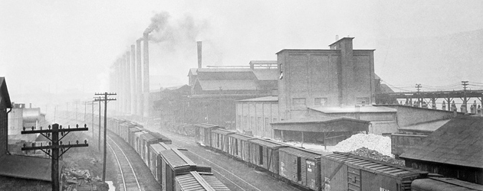
Air Pollution History
The Donora Fluoride Fog of 1948
In late October, the town of Donora experienced a temperature inversion.
The town is located along the Monongahela River south of Pittsburgh, within a small valley.
The main employer of the town was a US Steel Zinc smelting plant.

Slide 9
Donora Fluoride Fog
Emissions of sulfur dioxide, nitrogen dioxide, and fluoride from the zinc smelting plant began to accumulate.
The smog became so thick that driving was impossible.
The plant itself did not cease operations until 4 days later.
The smog finally broke up as a rainstorm entered the area after 5 days.

Slide 10
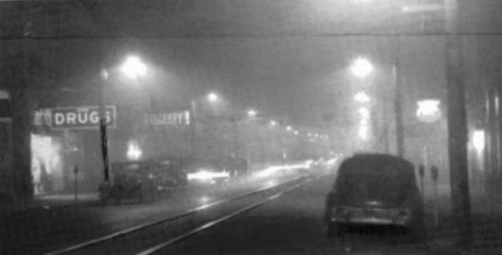
Donora Fluoride Fog
A total of 20 residents died; About a 1/3 to a 1/2 of the town’s entire population of 14,000 became sickened.
Donora experienced higher than normal mortality rates for 10 years afterwards.
Noon in Donora

Slide 11
Air Pollution History
The London Smog of 1952
London naturally has very calm air, and regularly experiences thick sea fog.
The weather turned unusually cold, causing the residents to burn greater amounts of coal to heat their homes.
This combined with a temperature inversion to create a thick smog of sulfur dioxide over the city.
The number of fatalities is unknown, but estimated to be around 12,000.

Slide 12
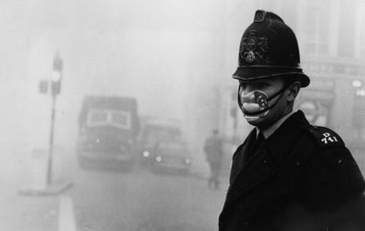
The London Smog of 1952
As a result of this disaster, London passed its own Clean Air Act.
One of the specific changes made was to make chimneys taller to reach above a temperature inversion.

Slide 13
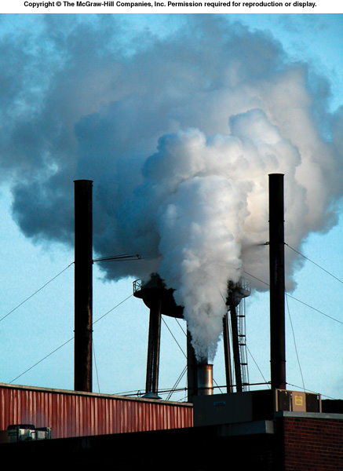
Clean Air Act
Initially, the law ( in USA) required the EPA to set and enforce limits for 6 different air pollutants.
These are called criteria pollutants.
Sulfur Dioxide
Carbon Monoxide
Particulates
Ozone
Nitrogen Oxides
Lead

Slide 14
Criteria Pollutants
1. Sulfur dioxide
Colorless gas often associated with “rotten eggs” smell
Forms sulfuric acid in clouds.
Biggest source: coal burning power plants
2. Nitrogen oxides
Reddish brown gas
Reacts with water vapor to form nitric acid (HNO3)
Reacts with sunlight to form smog
Biggest source: car exhaust (traffic)

Slide 15
Criteria Pollutants
3. Carbon Monoxide
Colorless, odorless, highly toxic gas
Binds to hemoglobin in red blood cells, interfering with oxygen transport
Biggest source: car exhaust
4. Particulate Matter
Dust, ash, soot, lint, smoke, pollen, spores, and all other suspended matter.
Cause the most visibility problems
Biggest source: unpaved road dust and construction

Slide 16
Criteria Pollutants
5. Ozone
Molecule made of three oxygen atoms O3
Pale blue gas, odor resembling chlorine bleach
Secondary pollutant; not released directly
6. Lead
Enters the air as particles or part of dust.
The biggest source used to be exhaust from cars using leaded gas

Slide 17
Clean Air Act
The Clean Air Act was amended in 1990 and included additional provisions and controls for:
Acid Rain
Urban Smog
Toxic and Hazardous Air Pollutants
Protection of the Ozone Layer
Leakage of volatile organic compounds

Slide 18
Other Major Pollutants
Volatile organic compounds
Organic (carbon-based) gases like methane (CH₄) that can decompose or react easily, forming carbon dioxide or carbon monoxide in the air.
Biggest sources:
Spilled/leaking gasoline that evaporates
Paint and paint cleaners

Slide 19
Acid Deposition
Acid Precipitation – Rainfall or snowfall that contains an lower than normal pH.
pH scale ranges from 0-14.
7 = Neutral; <7 = Acidic; >7 = Basic
Unpolluted rain generally has pH of 5.6.
Carbonic acid from atmospheric CO₂.
In industrialized areas, the pH level can reach as low as 4.3
Rain of pH 2.1 was recorded in the 1970s and 1980s

Slide 20
Acid Deposition Cont’d
Aquatic Effects
Fish and other aquatic organisms are extremely sensitive to pH changes.
pH below 5 = eggs will not hatch
pH below 4 = kills adult fish

Slide 21
Acid Deposition Cont’d
Forest Damage
Acid rain can cause the pH of soil to decrease.
This interferes with trees’ ability to absorb nutrients properly.
Buildings and Monuments
Limestone and marble are slowly dissolved as they are exposed to acid rain.
Acid rain can also corrode steel, weakening structures like bridges.

Slide 22
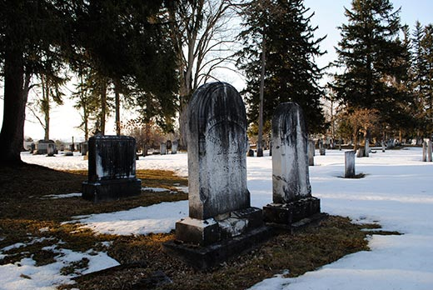
Tombstone in Hamilton, NY

Slide 23
Indoor Air Pollution
Indoor air pollution can have more significant effects on human health than outdoor pollution.
People generally spend more time indoors.
Cigarette smoke is the most common indoor air pollutant in the U.S.

Slide 24
Indoor Air Pollution Cont’d
Less-developed countries also suffer from indoor air pollution.
Organic fuels make up majority of household energy.
These fuels are often burned in smoky, poorly ventilated heating and cooking fires.

Slide 25
Atmospheric Ozone
Ozone is a gas found in the upper atmosphere that blocks some UV radiation.
Scientists discovered that atmospheric ozone levels were dropping rapidly every year, during September and October.
Occurring since at least 1960.
A 1% decrease in ozone results in a 2% increase in UV rays reaching the earth.
The ozone was being depleted by pollutants containing chlorine.

Slide 27
Stratospheric Ozone Cont’d
A concentration of pollution at the poles and other factors caused chlorine pollution to be concentrated in Antarctica.
When the sun returns in the spring, the energy liberates the chlorine from ice.
Chlorine causes ozone (O₃) to be broken down into oxygen (O₂).

Slide 28
Montreal Protocol
The main pollutant behind ozone depletion was Chloroflurocarbons (CFCs).
Used in coolants (refrigerators, air conditioners) and aerosols (hair spray, spray paint).
The Montreal Protocol was passed in 1989.
Countries agreed to phase out CFC use by the year 2000.
CFC levels in the atmosphere decreased and the ozone layer is beginning to recover.

Slide 29
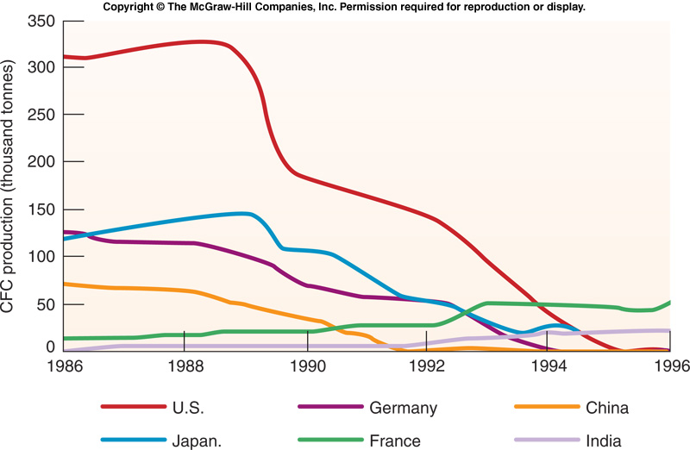
CFC Production

Slide 30
EFFECTS OF AIR POLLUTION
Human Health
EPA estimates each year 50,000 people die prematurely from illnesses related to air pollution.
Likelihood of suffering ill health is related to intensity and duration of exposure.
Inhalation is the most common route, but absorption through the skin and consumption via food can also occur.

Slide 31
Plant Pathology
Chemical pollutants can directly damage plants, or can cause indirect damage by disrupting normal growth and development patterns.

Slide 32
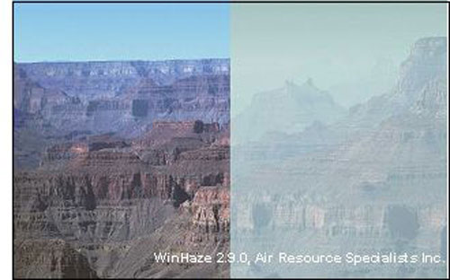
Visibility Reduction
The production of pollution haze or smog can reduce visibility by as much as 80 percent.

Slide 33
AIR POLLUTION CONTROL
Most effective strategy for controlling pollution is to not produce it in the first place.
Particulate Removal - Remove particles physically by trapping them in a porous mesh which allows air to pass through but holds back solids.
Electrostatic Precipitators – Pass air across electrically charged plates that attract the particles of pollution.

Slide 34
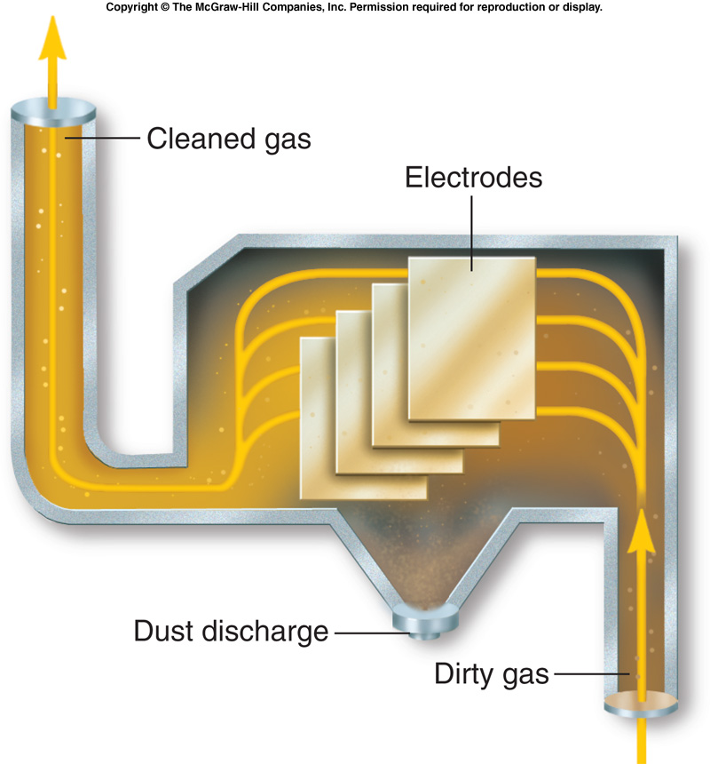

Slide 35
Reducing Pollution
Sulfur Dioxide Reduction
Heating Fuel Switching
Switch from soft coal with a high sulfur content (like was used in London in 1952) to low sulfur coal.
Change to another fuel (natural gas).
Limestone Injection
Can reduce sulfur emissions by 90% by mixing crushed limestone with coal before it is fed into a boiler.

Slide 36
