Slide 1
PNS module / 3rd year medicine Microbiology subject
Prof. Hamed Al-Zoubi

Slide 2
Lecture 1
Clostridium botulinum
Clostridium tetani

Slide 3
Clostridium botulinum
Characteristics:
Gram positive spore forming anaerobic
Motile by flagella
Clostridium seven main types A-G: A, B and E are the commonest
Each secretes antigenically distinct but functionally similar toxin (very potent)

Slide 4
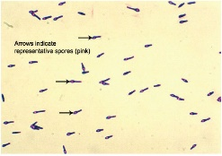
Clostridium botulinum
Spores:
Heat resistant
Widely distributed in the environment; Soil, dust water, vegetable, fruit, meat and Honey..
Oval and subterminal

Slide 5
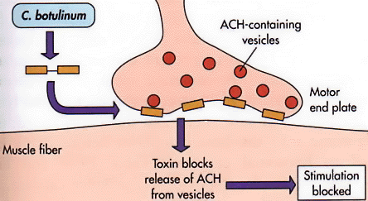
Clostridium botulinum
Pathogenesis:
Neurotoxin production > stomach absorption > circulation >
neuromuscular junction (NMJ) > inhibition of acetylcholine release
at the NMJ > flaccid descending motor paralysis

Slide 6
Clostridium botulinum
The toxin (heat labile):
Preformed in food (canned) that is badly preserved and processed (hygiene and heat) > food borne botulism
Spores ingestion e.g Honey > germinate in the gut > toxin production > infantile or (intestinal) botulism
3. Spores contaminating wounds (e.g fractures, drug abusers)> germinate > toxin production > wound botulism
4. Iatrogenic

Slide 7
Clostridium botulinum
Clinically:
Incubation period 12-48hrs in food borne, longer in wound botulism (days – 2 weeks)
Early: nausea, vomiting, constipation, weakness, dizziness but no fever
Late: cranial nerves palsy, double vision, difficulty in swallowing, speaking and respiratory failure (descending motor paralysis)
Infantile: weakness, altered cry, loss of appetite , loss of head control, Floppy child syndrome and sudden infant death syndrome

Slide 8
Clostridium botulinum
Diagnosis:
Clinical
Detecting the organism / toxin
Toxin-antitoxin approach: Mouse bioassay
Alert the lab

Slide 9
Clostridium botulinum
Treatment: start on suspicion
Gastric wash
Antitoxin
Supportive: ICU and respiratory support,
In Wound botulinum: antitoxin + cleaning and debridement plus antibiotics (metronidazole and penicillin) to reduce bacterial load
Prevention:
Proper cooking and heating of food
Avoid suspicious canned food, no honey to infants
Proper processing, preservation and canning of food

Slide 10
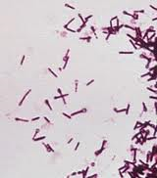
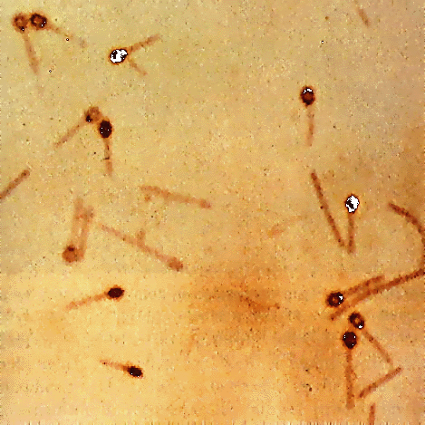
Clostridium tetani
Widely distributed in the environment and in the soil
Gram positive, motile anaerobic rods
β-Haemolysis when grown on blood agar
Spore forming: round terminal (drumstick, tennis racket)

Slide 11
Clostridium tetani
Produce two plasmid coded exotoxins:
1. Tetnospasmin:
Neurotoxin
Heavy (binding ) and light chain (neurotoxic part)
One antigenic toxin
2. Tetanolysin (haemolysin): pathogenesis not clearly known but ? RBCs haemolysis

Slide 12
Clostridium tetani
Pathogenesis:
Local secretion of the toxin > binding to the presynaptic neurons (heavy chain) > retrograde diffusion of the light chain to the spinal cord > inhibition of the inhibitory neurotransmitter
gamma aminobutyric acid (GABA) > loss of inhibitory action on motor and autonomic neurons> uncontrolled muscle contractions (spasms) > Spastic paralysis

Slide 13
Clostridium tetani / pathogenesis

Slide 14
Clostridium tetani
Clinically (tetanus):
Mode of transmission:
Spores > wound contamination(low oxygen) > germination to bacilli that secrete the toxins
Incubation period: 3days – 3 weeks
Source:
Dirty or Infected wound and abscesses (~65%), which often is minor (eg, wood or metal splinters, thorns, nails...)
Chronic skin ulcers are the source in approximately 5% of cases
Remainder of cases; no source is identified (cryptogenic)

Slide 15
Clostridium tetani
Local: muscles spasm and pain at/near injury site
Cephalic:
Following head trauma for example
Localised picture that may progress to generalised
cranial nerves palsy (7th cranial nerve is commonly involved)
Generalised:
Trismus (locked jaw): may bite the tongue
Opisthotonus: flexion and adduction of the arms, clenching of the fists, extension of the lower extremities

Slide 16
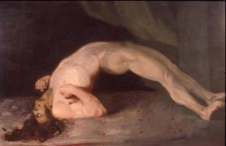
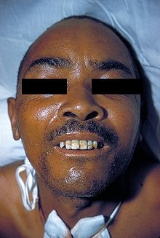
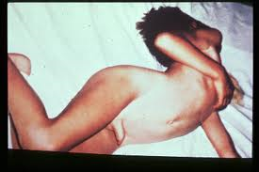
Clostridium tetani

Slide 17
Clostridium tetani
3. Generalised cont’d:
Risus sardonicus (sardonic grin): abnormal, sustained spasm of the facial muscles that appears to produce grinning or the scornful smile of tetanus
spasm is stimulated by noise and light
The patient is afebrile
Seizures and coma

Slide 18
Clostridium tetani
3. Generalised cont’d:
During these episodes, patients have intact sensation and feel severe pain
The spasms can cause fractures, tendon ruptures
Arrhythmia, tachycardia and respiratory failure

Slide 19
Clostridium tetani
Other forms tetanus:
Infantile:
Following umbilical cord contamination
Develops within the first week and is usually fatal
Otogenic tetanus:
source is from external auditory meatus (piercing, cleaning)

Slide 20
Clostridium tetani
Diagnosis:
Clinical (mainly):
Sign and symptoms
Vaccination history (part of the national childhood program)
History of a trauma
Wound smear staining and culture: may help
Toxin-antitoxin test in mice

Slide 21
Treatment:
Wound debridement
Treat in In a dark quite room in ICU
Sedation, Muscle relaxant (e.g diazepam) and artificial ventilation
Antibiotics:
may be given to kill any vegetative forms: use metronidazole
Tetanus immunoglobulin (TIG) single IM dose (dirty wounds)
Vaccinate if no history of vaccine or unknown or if the patient received incomplete vaccine doses in the past

Slide 22
Prevention of Tetanus
* A highly effective vaccine is available.
* Tetanus immunity is achieved using:
- A formalized tetanus toxoid.
- Toxoid is administered as part of DTP vaccine
* Boosters every 10 yrs.

Slide 23
The End

