Slide 1
Metabolism

Slide 2
Bioenergetics:
It is the study of the energy changes accompanying
biochemical reactions.
Biologic systems are essentially isothermic and use
chemical energy to power living processes.
Free energy:
G is energy that can do work when temperature and pressure
are uniform, as in a (living cell.)
The free energy change (ΔG)
It is difference between the free-energy content of the
products and the free-energy content of the reactants under
standard conditions. It depends on the nature and
concentration of initial reactants and the final products.
Starting from unicellular organism which is the bacteria, ending with the multi cellular organism which is the human or animals or plants

Slide 3
Principle goal of metabolic reactions → produce energy
Reactants (L. side) → products (R. side)
Importance of studying bioenergetics
Exo. → G-
Endo. → G+
Iso. →no G
Know which type of reaction I have
Isothermic, exothermic, endothermic
1) Iso thermic :
→Amount of energy in left = right
→NO loss of energy, NO increase
→Equation = zero
2) Endothermic
→Right > left
→Absorption of energy
→Endergonic G+
3) Exothermic
→Left > right
→Exergonic
→Liberation of energy to surrounding environment
** this reaction has the tendency to be completed unlike endo.
→ G-
**type of reaction is reversible or irreversible
>>Reversible = isometric (some exceptions)
NOTE→ all reactions in biological system are iso thermic (with standard based conditions → temp./ h+ / pressure)

Slide 4
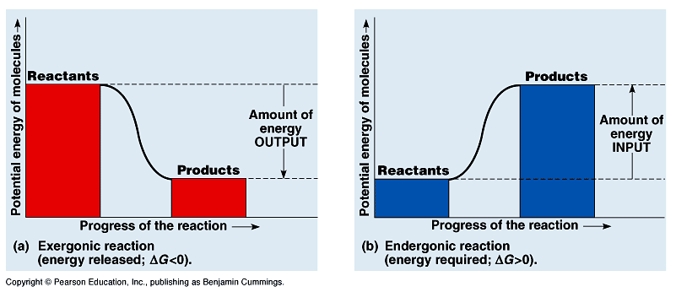
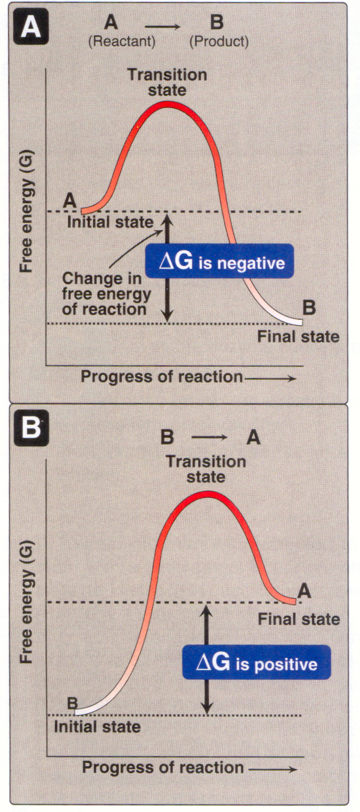

Slide 5
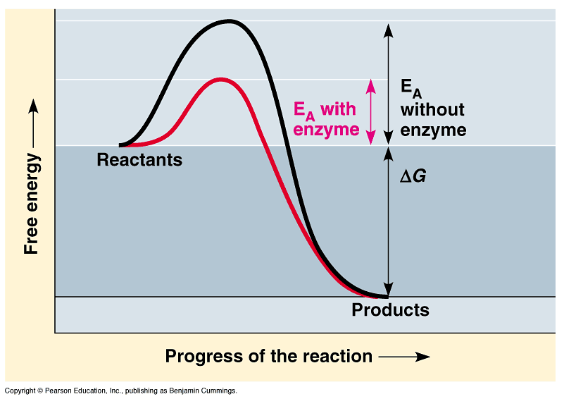
Stages of chemical reactions
1- Activation Energy:
- Amount of energy that reactant molecules must absorb to start a
reaction.
- This energy is usually provided in the form of heat absorbed by the
reactant molecules form the surroundings.
2- Transition State:
- Unstable condition of reactant molecules that have absorbed sufficient
free energy to react.
3- Products
In transition state: there is large amount of energy which is suitable for them to be in the transition state
The reactant molecule will absorb an amount of energy from the surrounding environment and not to be in this unstable state
Then substrate converted to product +The enzyme exit as is

Slide 6
Metabolic pathways can be grouped into two pathways:
1- Catabolic reactions: degrade molecules to create smaller molecules
and energy (accompany with oxidation of these building unit, association with liberation energy)
2- Anabolic reactions: synthesize molecules for cell maintenance,
growth and reproduction
Catabolism is characterized by oxidation reactions and by release of
free energy which is transformed to ATP.
.
Anabolism is characterized by reduction reactions and by utilization of
energy accumulated in ATP molecules. (reduction reaction)
.
Catabolism and anabolism are tightly linked together by their
coordinated energy requirements: catabolic processes release the energy
from food and collect it in the ATP; anabolic processes use the free
energy stored in ATP to perform work.
Summation of the reactions occur in our cells either be catabolism or anabolism
**Single step pathway (energy produced once) will be huge amount of energy & it can cause harmful effect (dangerous to our cells)
**multiple step pathway: 1) glycolysis→ (3 reaction called key regulation steps) which do regulation of glycolytic pathway 2) citric acid cycle→ (3 reactions key regulation steps) by it the cell control the cycle. Which is better? Multiple step pathway

Slide 7
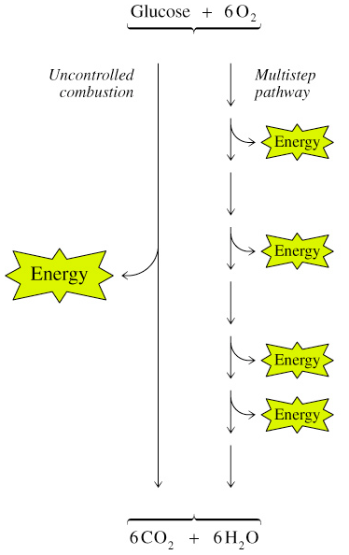
Metabolism proceeds by discrete steps
Multiplestep pathways permit control
of energy input and output
Catabolic multi-step pathways provide
energy in smaller stepwise amounts
Each enzyme in a multi-step pathway
usually catalyzes only one single
step in the pathway
Control points occur in multistep pathways
- Metabolic pathways are regulated
to permit organisms to respond
to changing conditions
Most pathways are irreversible
Flux: flow of material through
a metabolic pathway which depends
upon: 1-Supply of substrates 2- Removal of products 3- Pathway enzyme activities
Single-step versus multi-step
pathways
A multistep enzyme pathway releases energy in smaller amounts that can be used by the cell
Flux mean→ continuation at these reactions and to occur this it has to be 1) continuous supply of substrates (the availability of substrate is stimulating the activity of the enzyme) 2) removal of products (by end product inhibition or feedback inhibition) 3) pathway enzyme activates (depending on different factor including hormonal factor)

Slide 8
Levels of metabolism regulation
1- Nervous system.
2- Endocrine system.
3- Interaction between organs. (e.g. brain depend on glucose)
4- Cell (membrane) level. Or compartmentation or compartmentalization)
5- Molecular level (genetic level regulation by controlling activity of different genes)
Stages of metabolism
Catabolism
Stage I. Breakdown of macromolecules (proteins, carbohydrates and lipids to respective building blocks.
Stage II. Amino acids, fatty acids and glucose are oxidized to common metabolite (acetyl CoA)
Stage III. Acetyl CoA is oxidized in citric acid cycle to CO₂ and water. As result reduced cofactor, NADH₂ and FADH₂, are formed which give up their electrons. Electrons are transported via the tissue respiration chain and released energy is coupled directly to ATP synthesis.
Not all metabolic pathways occur on the same side of the cell

Slide 9
Slide7:
**stage 1→ by enzymes (lipase…etc)
**stage 2→ oxidation of small molecules to produce common intermediate metabolite
**stage 3→ returning of acytel Co-A to CAC to produce energy
>>NOTE: conversion reaction because it end to one molecule (acetyl Co-A)
Slide8:
** the coupling between (ana. & cata.) / (LIMITED)
Part of energy produced by cata. Used in ana.
COMPARTMENTATION:
2. Allow cell to carry opposing reactions like:
(fatty acid oxidation & synthesis) → coupling but to limited stage
..Reactions depend on enzymes

Slide 10
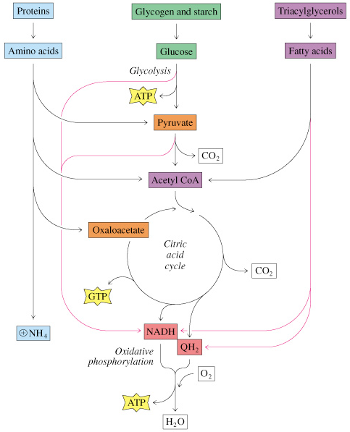
Catabolism is characterized by convergence of three major routs toward a final common pathway.
Different proteins, fats and carbohydrates enter the same pathway TCA cycle.
Catabolism

Slide 11
Anabolism can also be divided into stages, however the anabolic pathways are characterized by divergence.
Monosaccharide synthesis begin with CO₂, oxaloacetate, pyruvate or lactate.
Amino acids are synthesized from acetyl CoA, pyruvate or keto acids of Krebs cycle.
Fatty acids are constructed from acetyl CoA.
On the next stage monosaccharides, amino acids and fatty acids are used for the synthesis of polysaccharides, proteins and fats.
Compartmentation of metabolic processes in cell
permits:
1- Separate pools of metabolites within a cell
2- Simultaneous operation of opposing metabolic paths
3- High local concentrations of metabolites
Example: fatty acid synthesis enzymes (cytosol), fatty acid breakdown
enzymes (mitochondria)
They are catabolic reaction in the fatty acid oxidation and anabolic reaction in the fatty acid synthesis
Is very important

Slide 12
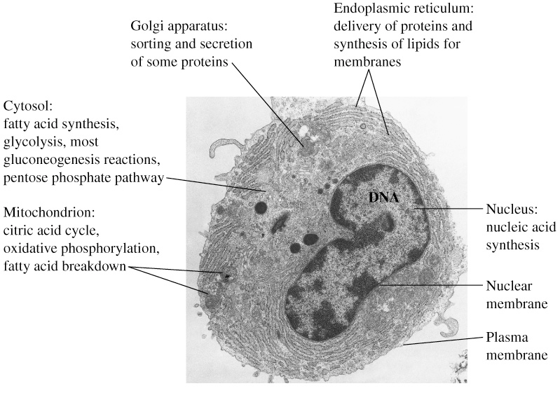
The chemistry of metabolism
There are about 3000 reactions in human cell.
All these reactions are divided into six categories:
1- Oxidation-reduction reactions
2- Group transfer reactions
3- Hydrolysis reactions
4- Nonhydrolytic cleavage reactions
5- Isomerization and rearrangement reactions (rearrange molecule intracellular)
6- Bond formation reactions using energy from ATP (DNA ligase enzyme which is responsible for linking of bonding of different fragment of the DNA)

Slide 13
How energy can be produced?
1) Common obligatory intermediate
A+B with energy → I →B+D
I: represent the common obligatory intermediate
By dehydrogenation (H+ carriers) NAD +NADP+FAD→ ETC in mitochondria → translation of H+ in oxidation/reduction reactions into energy
2) Alternative way
Substrate level phosphorylation. Why? no ETC
High energy compound → low energy compound. Or
High potential → high , intermediate compound
e.g. Creatine phosphate +energy → ADP → creatine + ATP
*Phosphoenolpyruvate because the energy in it is higher than the required energy for formation of high energy bond in ATP can transfer energy with phosphate to ADP for formation of another molecule of ATP when hydrolysis of high energy bond.
Which facilitate the hydrolysis of high energy bond→2 oxygen adjacent to each other and each of them carry –ive charge and will be rebaliture between –ive charge allow breaking down of this high energy bond

Slide 14
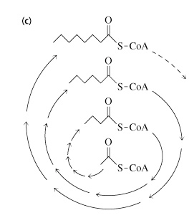
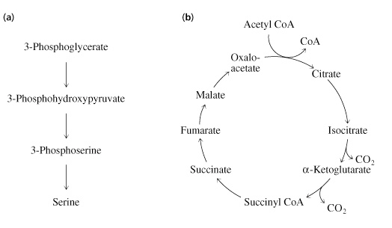
Metabolic pathway may be:
(a) Linear (b) Cyclic (c) Spiral pathway
(Glycolysis) (TCA cycle) (Fatty acid biosynthesis)
*Uranic acid pathway
*Phosphate pathway
Kreps cycle
The end product of the first cycle is the reactant of the second cycle and so on.
e.g. fatty acid oxidation

Slide 15
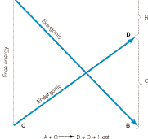
In practice, an endergonic process cannot exist independently
but must be a component of a coupled exergonic- endergonic
system where the overall net change is exergonic.
One possible mechanism of coupling could be observed if
common obligatory intermediate (I) took part in both
reactions. A + C→I→B+D
Some exergonic and endergonic
reactions in biologic
systems are coupled in this way.
Indeed, these relationships supply
a basis for the concept of
respiratory control, the process
that prevents an organism from burning out of control.
The coupling concept is provided by forming an intermediate
carrier through dehydrogenation/hydrogenations reactions

Slide 16
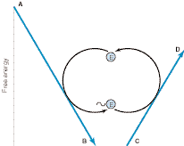
An alternative method of coupling an exergonic to an endergonic
process is to synthesize a compound of high-energy potential in the
exergonic reaction and to incorporate this new compound into the
endergonic reaction, thus effecting a transference of free energy from
the exergonic to the endergonic pathway.
The biologic advantage of this mechanism is that the compound of high
potential energy, (~E) , unlike I in the previous system.
Transfer of free energy from an exergonic to an endergonic reaction via
a high-energy intermediate compound (~E)
** energy transfer from one compound to another which called substrate level phosphorylation NO ETC

Slide 17
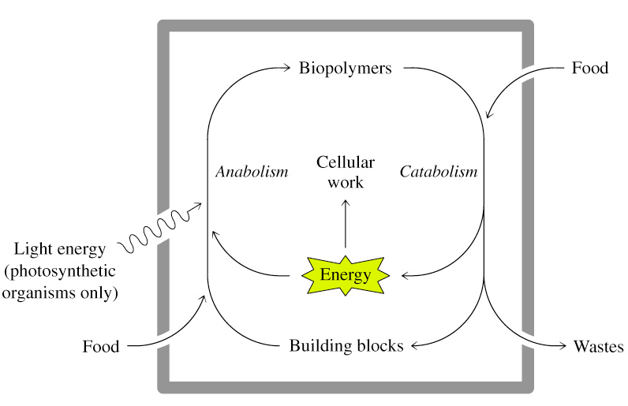
Anabolism and catabolism are coupled by energy

Slide 18
The Intermediate value for the free energy of hydrolysis of ATP
The standard free energy of hydrolysis of a number of biochemically
important phosphates.
The tendency of each of the phosphate groups to transfer to a suitable
acceptor may be obtained from the ΔG0′ of hydrolysis at 37 °C.
The value for the hydrolysis of the terminal phosphate of ATP divides
the list of energy compounds into two groups:
Low-energy phosphates, exemplified by the ester phosphates found in
the intermediates of glycolysis, have ΔG0 values smaller than that of
ATP, while in high-energy phosphates the value is higher than that
of ATP.
The components of the high-energy phosphates compounds , including
ATP, are usually anhydrides (1-phosphate of 1,3-biphosphoglycerate),
enolphosphates (phosphoenolpyruvate), and phosphoguanidines
(creatine phosphate, arginine phosphate).
The intermediate position of ATP allows it to play an important role in
energy transfer.
ΔG0 → determine the tendency of transfer phosphate and energy from one compound to another one

Slide 19
The high free energy change on hydrolysis of ATP is due to relief of
charge repulsion of adjacent negatively charged oxygen atoms.
Other “high-energy compounds, but they are not contain phosphate” are thiol esters as coenzyme A (acetyl-CoA), acyl carrier protein, amino acid esters involved in
protein synthesis, S- adenosylmethionine (SAM), UDPGlc
(uridine diphosphate glucose), and PRPP (5-phosphoribosyl-1-
pyrophosphate).SAM:
**SAM: participate in methyl group transfer
**PRPP: play role in synthesis of nucleated of RNA and DNA
Compound | kJ/mol | kcal/mol
Phosphoenolpyruvate | −61.9 | −14.8
Carbamoyl phosphate | −51.4 | −12.3
1,3-Bisphosphoglycerate | −49.3 | −11.8
Creatine phosphate | −43.1 | −10.3
ATP →ADP + Pi | −30.5 | −7.3
ADP →AMP + Pi | −27.6 | −6.6
Pyrophosphate | −27.6 | −6.6
Glucose 1-phosphate | −20.9 | −5.0
G0> amount of energy needed for the formation of ATP → formation of ATP
G0< amount of energy needed energy → NO formation

Slide 20
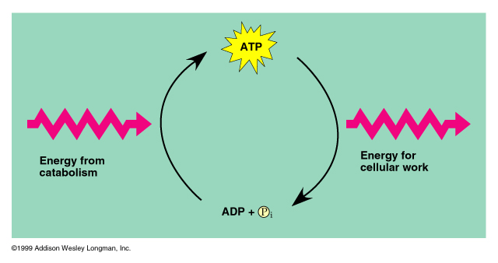
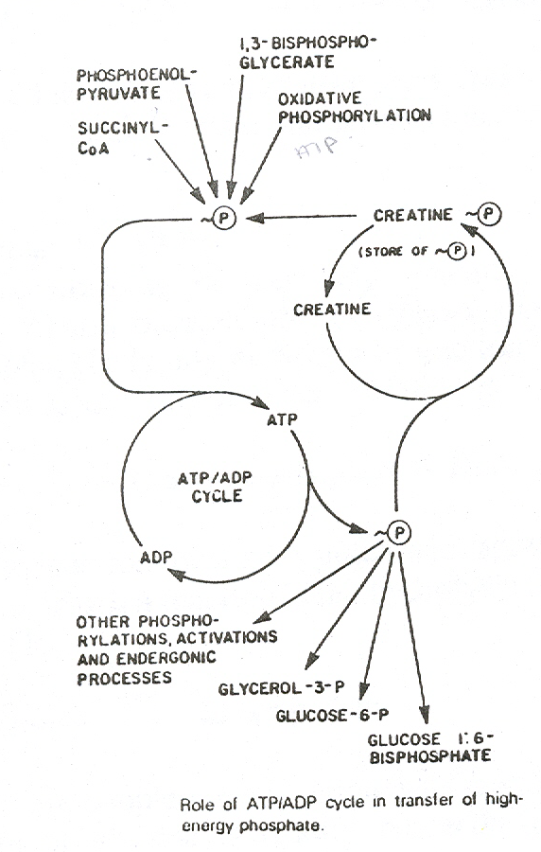
ATP powers cellular work by
coupling exergonic reactions to
endergonic reactions
- A cell does three main kinds of
work: Mechanical, Transport and
Chemical
To do work, cells manage energy
resources by energy coupling, the
use of an exergonic process to
drive an endergonic one
ATP is the cell’s energy shuttle
providing energy for cellular
functions
ATP
**ATP splitting down into → AMP + pyrophosphate
Which mean loss of 2 high energy bond
**2ATP splitting down into → ADP + phosphate . There is one high energy bond broken down in these molecule
* Is the ADP that produce here can be utilize as a source of energy?! NO
2 high energy bond
1 low energy

Slide 21
Sources of ATP.
ATP levels are maintained through several processes:
1. Adenylate kinase.
ATP has two "high-energy" phosphate groups. Splitting off the gamma
phosphate group of ATP yields ADP and inorganic phosphate.
Splitting off both high-energy groups in one step yields AMP and
inorganic pyrophosphate (ppi). (loss of 2 high energy bond)
Adenylate kinase, an enzyme found in all tissues, catalyzes a transfer of
the energy-rich phosphate bond from one ADP molecule to another,
giving ATP and AMP.
- The conversion is very rapid in muscle and liver.
2ADP ATP + AMP
AMP levels are crucial in adjusting the balance between carbohydrate
and fatty acid metabolism in varying physiological situations.
- AMP is an active intracellular signal substance.
AMP is also an activator of glycogen mobilization and, therefore, sugar
metabolism.
(1) ADP: use as phosphate group and energy donor
(2) ADP: use as phosphate group and energy acceptor

Slide 22
2. Creatine Phosphokinase / Phosphocreatine. (Fastest source of energy)
- Used during explosive or maximal intensity of muscular exercise
Most of our body tissues contain phosphocreatine at
concentrations approximately three times that of ATP.
- Phosphocreatine is a reserve source of high-energy phosphate.
This reserve can be transferred to ADP, thus forming ATP to
replace that used by working muscle.
While the creatine phosphokinase reaction is the most rapid ATP-
yielding reaction we possess, the amount of ATP which is
produced is quite small.
- Muscle tissues have about 5 mmol/l ATP and approximately 17- 20 mmol/l of creatine phosphate.
Under extreme work (sprinting, for example) the phosphocreatine
reserves are used up in about 30-40 seconds.
However, "seconds do count" in sport. During those few seconds
muscles can and do work with "explosive force".

Slide 23
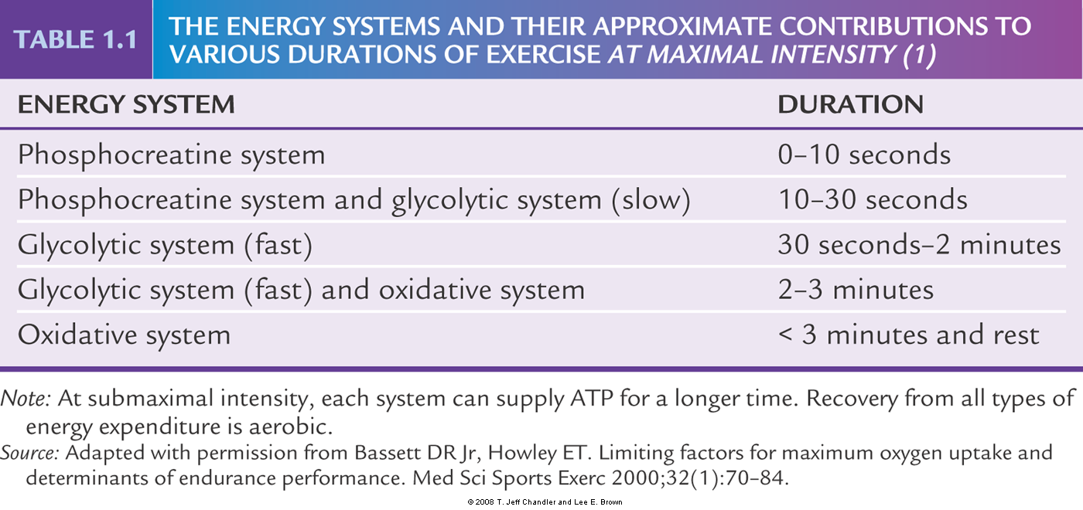
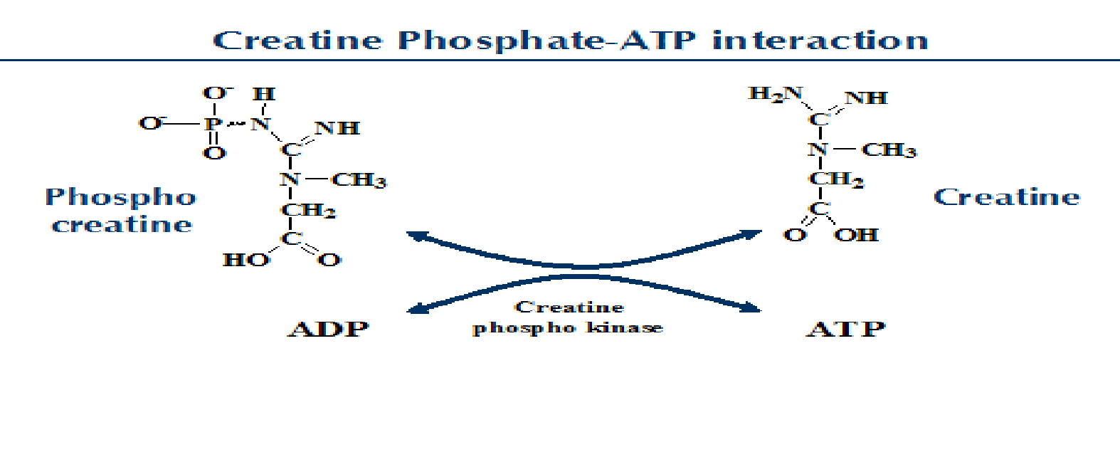
Only ETS
Starting to utilize of activity of ETS
:storage form in the muscle
Glycolytic system (fast)→ because the creatine phosphate already complete depletion

Slide 24
5-10s
Because it the fastest source of energy

Slide 25
3. Anaerobic Metabolism.
In "second place" in the ATP-synthesis race (after phosphocreatine)
comes ATP synthesis coupled to anaerobic metabolism.
This is the cytosolic formation of ATP driven by oxidation of glucose
(or glucosyl groups from glycogen) to pyruvate and lactate.
ATP formation through cytosolic glycolysis proceeds with a speed
equal to about 50% of that we see using creatine phosphate and creatine
phosphokinase.
Rapid, yes, but how much ATP can we make when the oxidation
process is limited to formation of pyruvate and lactate from glucose or
glycogen?
Only two ATP molecules result for each glucose molecule that is
processed.
Three ATPs are formed for each glucosyl group that derived from
glycogen.
The anaerobic glycolysis is very rapid. While it is relatively ineffective
measured by energy production per glucose molecule consumed,
glycolysis does turn out a lot of ATP in a short time.
Anaerobic condition cannot supplied in sufficient amount of oxygen or cannot contain mitochondria as RBC and muscle
Muscle
Some region of it not supply with sufficient amount of O2
Periphery (little contraction) → aerobic
Central part during contraction (maximal contraction) → anaerobic

Slide 26
The big (and painful) disadvantage is that a lot of lactic acid is
produced and accumulates in the working muscle. Leading to fatigue
- Furthermore, lipids cannot be used as substrates for anaerobic
metabolism.
- Only glucose or glycogen work here.
If we press anaerobic glycolysis to the limits, muscles exhaust their
stored glycogen and take up so much glucose from the blood that
hypoglycemia and CNS malfunction result. (because CNS depend on glucose and if there is decrease in glucose)
there will be sufficient oxygen and mitochondria to produce more energy 4. Aerobic Metabolism. (slower)
ATP-balancing
ATP synthesis
All of our cells, with the important exception of blood cells, contain
Mitochondria which use oxygen and form water while oxidizing
our "food".
Mitochondrial substrate is acetyl-CoA.
All food that can be reduced to 2-carbon fragments can serve as a
substrate for mitochondrial ATP production.
The net result pyruvic acid which will be converted inside the mitochondria into acetyl Co-A

Slide 27
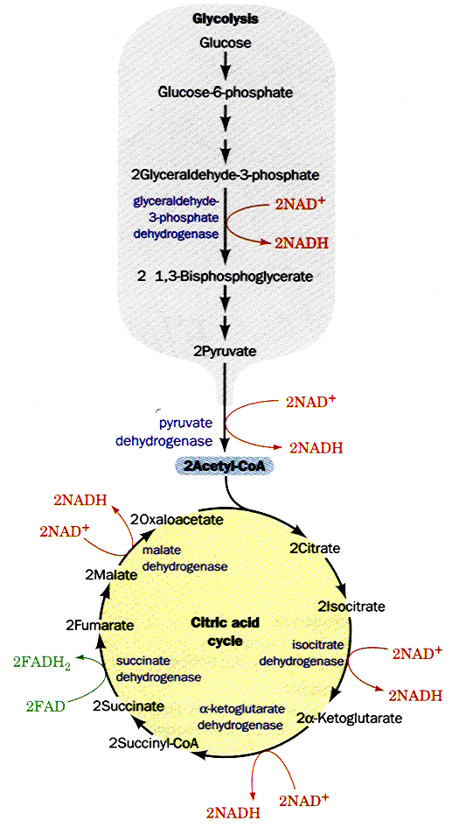
The combustion process is coupled to reduction of oxygen giving water
as a product.
Approximately 30% of the energy
released in this process is trapped
in the terminal phosphate group
in ATP.
The rest of the energy in
acetyl-CoA escapes as heat,
keeping us nice and warm!
We produce around 10 moles
of ATP for each mole of
acetyl-CoA that is processed.
While aerobic synthesis of ATP
is the most effective way to
produce "useable energy",
it is a relatively slow process.
Creatine phosphate > glycolysis (anaerobic condition) > aerobic

Slide 28
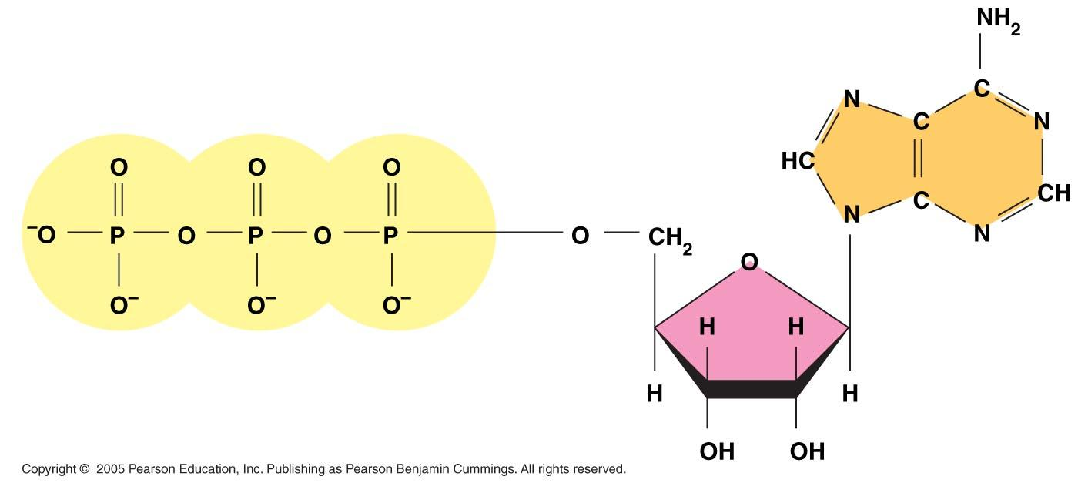
ATP (adenosine triphosphate)
Compounds with high energy bonds release large quantities of free
energy on hydrolysis.
-The most important parts of the ATP molecule are its two
phosphodiester bonds (high energy bonds).
Breaking down either of these bonds is accompanied by the release of
energy (7.3 Kcal/mol for each bond).
Importance of ATP as a source of energy :
1- Synthesis of macromolecules: such as DNA and RNA, protein, ….etc
2- Support the endergonic reaction in metabolic pathways.
3- Important for active transport across membranes.
4- Important for muscle contraction…etc.
5- transmission of impulses along neurons.
1- adenine
3- phosphate group
2- ribose

Slide 29
Electron transport chain (ETC)
Found in the inner mitochondrial membrane
**to release the energy from nutrient it depend on redox reaction

Slide 30
Oxidation reduction reactions (Redox reactions)
Commonly the oxidation reactions are accompanied by
reduction reactions and they are called redox reaction.
Redox reactions are accompanied by energy liberation,
necessary for the cells.
In the redox reaction. H₂ is oxidized while, O₂ is reduced,
and if occurs it will be accompanied by a massive energy
explosion (produced in multistep not one).
2H₂ +O₂ 2H₂O + energy
Instead of massive energy is liberated, hydrogen must be
transferred to oxygen in gradual steps. Thus, small fractions
of energy are liberated and stored for further use (and large part of energy will be liberated as heat (50-60%) of the total amount of energy produced)
Liberation energy

Slide 31
Electrons are transferred from one molecule to another in one of four different ways
- They may be transferred directly as electrons as the Fe 2+ / Fe 3+ redox
pair.
- Electrons may be transferred as incorporated in hydrogen atoms as in
case of FAD
AH₂ A
FAD FADH₂
- Electrons may be transferred as hydride ions (H+)
AH₂ A
NAD NADH+H⁺
- Electron may be transferred as a direct combination of an organic
reductant with oxygen
R-CH₂ + ½ O₂ R-CH₂OH (alcohol)
Oxidation of A + reduction of FAD
Act as H carrier
1)a) ETC depend on reduction /oxidation reaction, b) electron should be transferred from the least affinity to the highest affinity (for electron), c) electron will be jumping from C1 (least) → C2 → C3 (highest) with gradual increase in e- affinity (C2)
2) Depend on organization of different components in ETC

