Slide 1
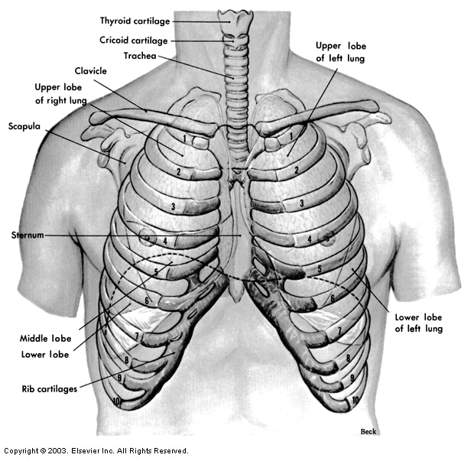
Thorax-Lecture one
Dr Amal AlBtoosh
Al-Rawashdeh

Slide 2
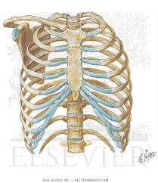
THORACIC WALL Bones of the Thoracic Wall
The bones of the thoracic wall consist of
The sternum,
The ribs
The costal cartilages

Slide 3
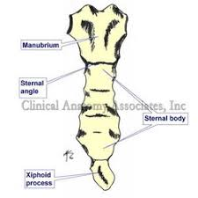
Bones of the Thoracic Wall
STERNUM
The sternum is a flat bone that is divided into three parts: the
manubrium, the body, and the xiphoid process.
Manubrium
The sternal angle (angle of Louis) is formed by the articulation of the manubrium with the body of the sternum
It is an important surface landmark, and it lies at the level of:
1. The second costal cartilage.
2. The intervertebral disc between the fourth and fifth
thoracic vertebrae.
3. The junction of the ascending aorta and the aortic arch and the junction of the aortic arch and the descendingthoracic aorta.
4. The bifurcation of the trachea.
5. The junction of the superior mediastinum and the
inferior mediastinum

Slide 4
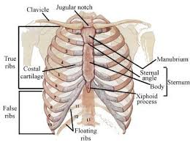
RIBS
There are twelve pairs of ribs, all of which are attached posteriorly to the thoracic vertebrae.
Ribs are divided into three categories:
• True ribs: The upper seven pairs are attached to the sternum by their costal cartilages.
• False ribs: The eighth, ninth, and tenth pairs are attached anteriorly to each other and to the seventh rib by their costal cartilages and small synovial joints.
• Floating ribs: The eleventh and twelfth pairs have no anterior attachment.

Slide 5
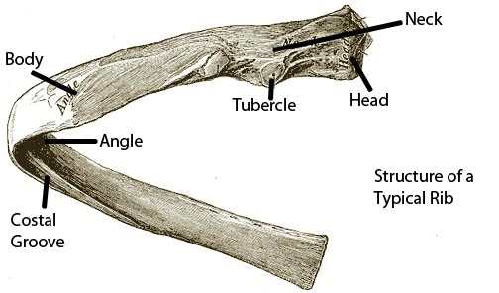
Typical Rib
The typical rib is a long, twisted flat bone with a rounded superior
border and a grooved inferior border (the costal groove), which accommodates the intercostal vessels and nerve.
The anterior end of each rib is attached to the corresponding costal cartilage.
A rib has a head, neck, tubercle, shaft, and angle.

Slide 6
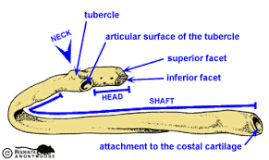
Typical Rib
The head has two facets for articulation with the numerically
corresponding vertebral body and the vertebra immediately
above it.
The tubercle has a facet for articulation with the
transverse process of the numerically corresponding
vertebra.
The angle is where the shaft bends forward
sharply.

Slide 7
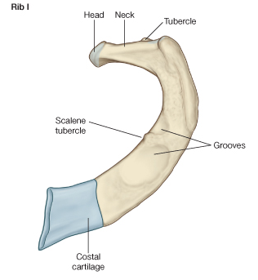
Atypical Rib
The first rib is important clinically because of its close relationship to the nerves of the brachial plexus and the subclavian artery and vein.
The rib is small and flattened from above downward.
The scalenus anterior is attached to its upper surface and inner border.
Anterior to the scalenus anterior, the subclavian vein crosses the rib;
posterior to the muscle attachment, the subclavian artery and lower trunk ofthe brachial plexus lie in contact with the bone.

Slide 8
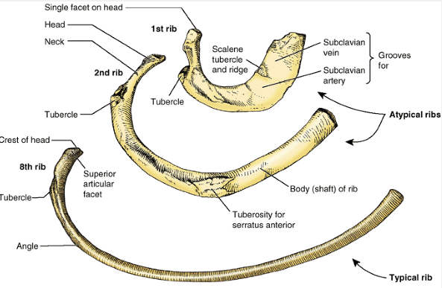

Slide 9
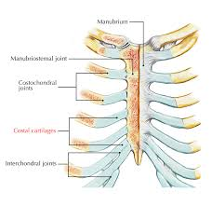
COSTAL CARTILAGES
The costal cartilages are bars of cartilage connecting the upper seven ribs to the lateral edge of the sternum
The eighth, ninth, and tenth ribs to the cartilage immediately above them
The cartilages of the eleventh and twelfth ribs end in the abdominal musculature.

Slide 10
Joints of the Thoracic Wall
MANUBRIOSTERNAL JOINT
Type: a cartilaginous joint.
The bony surfaces are covered with hyaline cartilage and joined by a disc of fibrocartilage.
Movement: A small amount of movement is possible during respiration

Slide 11
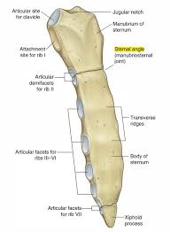
XIPHISTERNAL JOINT
Type: a cartilaginous joint.
The xiphoid process usually fuses with the body of the sternum during middle age.

Slide 12
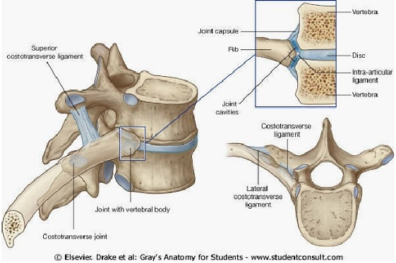
COSTOVERTEBRAL/COSTOCHONDRAL JOINTS
From the second to the ninth ribs,
Type: the head articulates by a synovial joint with the corresponding vertebral body and that of the vertebra above it. There is a strong
intra-articular ligament that connects the head to the intervertebral disc.
The heads of the first and the lowest three ribs have a simple synovial joint with the corresponding vertebral body.
The tubercle of a rib articulates by a synovial joint with the transverse process of the corresponding vertebra. (This joint is absent on the eleventh and twelfth ribs.)
COSTOCHONDRAL JOINTS
Costochondral joints are cartilaginous joints.
No movement is possible.

Slide 13
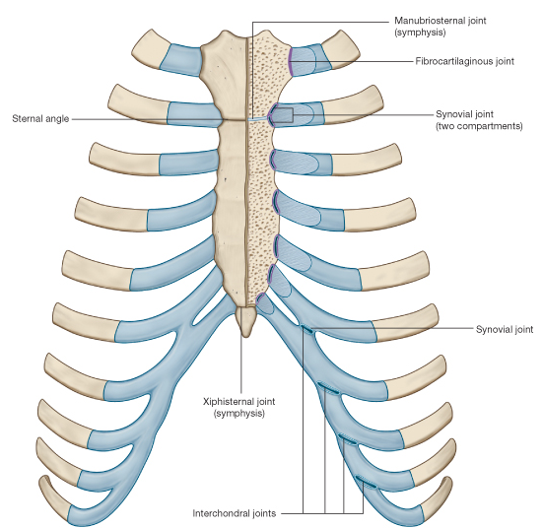
JOINTS OF THE COSTAL CARTILAGES WITH THE STERNUM
The first costal cartilages articulate with the manubrium by cartilaginous joints that permit no movement.
The second to the seventh costal cartilages articulate with the lateral border of the sternum by synovial joints.
In addition, the sixth,seventh, eighth, ninth, and tenth costal cartilages articulate
with one another along their borders by small synovial joints.
The cartilages of the eleventh and twelfth ribs are embedded in the abdominal musculature.
The raising and lowering of the ribs during respiration result in rotation of the neck of each rib around its own axis.

Slide 14
Muscles of the Thoracic Wall
INTERCOSTAL SPACES
The spaces between the ribs contain three muscles of respiration:
The external intercostal, the internal intercostal, and
the innermost intercostal muscle.
The intercostal nerves and vessels are arranged in the following order from above downward: intercostal vein, intercostal artery, and intercostal nerve (i.e., VAN).

Slide 15
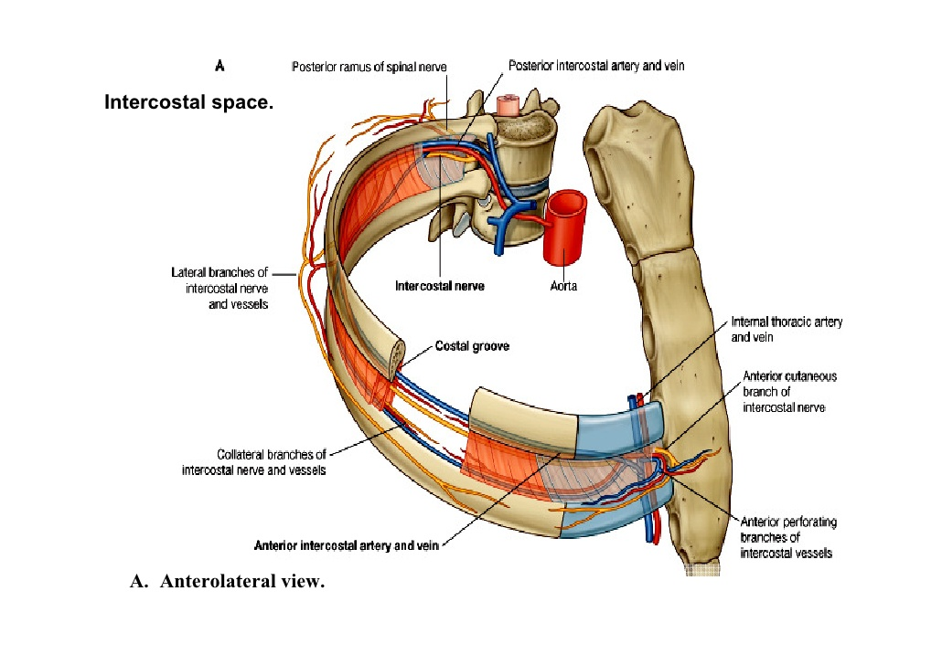
Blood Vessels of the Thoracic Wall
INTERCOSTAL ARTERIES AND VEINS
Each intercostal space possesses a large, single posterior intercostal artery and two small anterior intercostal arteries.
The corresponding posterior intercostal veins drain
into the azygos or hemiazygos veins.
The corresponding anterior intercostal veins drain into the internal thoracic and musculophrenic veins.

Slide 16
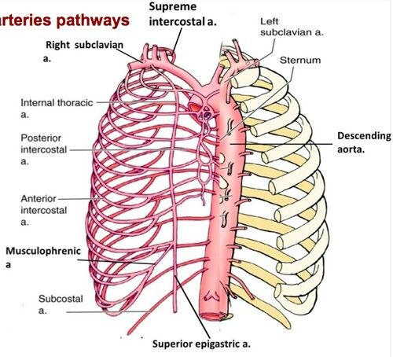
Posterior Intercostal Arteries
The posterior intercostal arteries of the first two
spaces are branches of the superior intercostal artery, which in turn is a branch of the costocervical trunk of the subclavian artery.
The posterior intercostal arteries of the lower nine spaces are branches of the thoracic aorta.

Slide 17
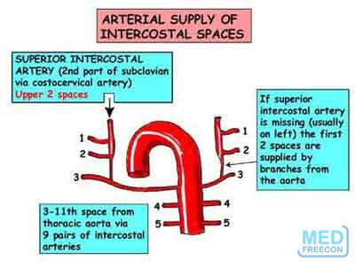
Anterior Intercostal Arteries
The anterior intercostal arteries of the first six
spaces are branches of the internal thoracic artery.
The anterior intercostal arteries of the lower spaces are branches of the musculophrenic artery (one of the terminal branches of
the internal thoracic artery).

Slide 18
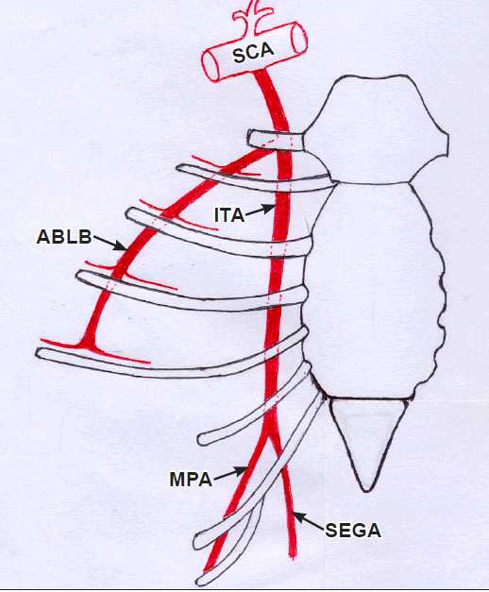
INTERNAL THORACIC ARTERY
Internal Thoracic Artery
The internal thoracic artery arises from the first part of the subclavian artery.
It descends directly behind the first six costal cartilages and in front of the parietal pleura,
it lies about a fingerbreadth lateral to the sternum.
It terminates in the sixth intercostal space by dividing into the superior epigastric artery and the musculophrenic arteries

Slide 19
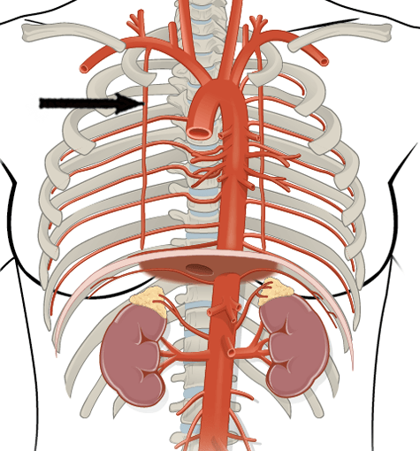
INTERNAL THORACIC ARTERY /Branches
• Anterior intercostal arteries supply the upper six intercostal
spaces.
• Perforating arteries pierce the intercostal muscles and
supply the skin and the mammary gland.
• Pericardiophrenic artery supplies the pericardium and
the diaphragm.
• Mediastinal arteries supply the mediastinum, including
the thymus.
• Superior epigastric artery enters the rectus sheath and
supplies the upper part of the rectus muscle.
• Musculophrenic artery follows the costal margin on the
upper surface of the diaphragm and supplies the diaphragm
and the lower intercostal spaces

Slide 20
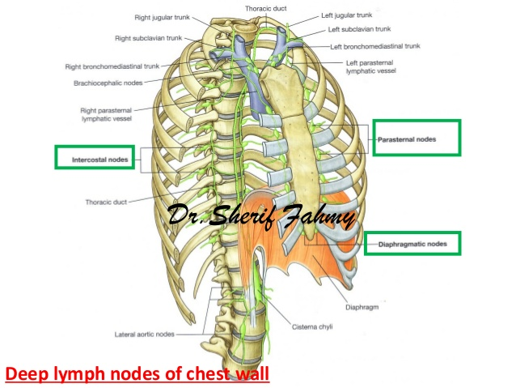
Lymphatic Drainage of the Thoracic Wall
The skin of the anterior chest wall drains to the anterior axillary lymph nodes.
The skin of the posterior chest wall drains to the posterior axillary nodes.
The intercostal spaces drain forward to
the internal thoracic nodes, which are situated along the internal thoracic artery,
and posteriorly to the posterior intercostal nodes, which is close to the heads of the ribs and the paraaortic nodes in the posterior mediastinum.

Slide 21
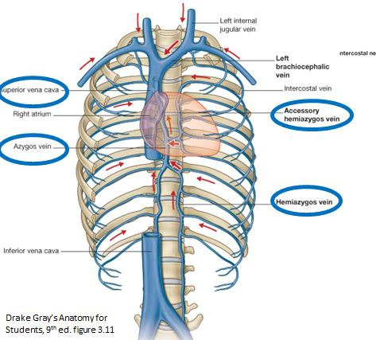
Internal Thoracic Vein
The internal thoracic vein begins as venae comitantes of the internal thoracic artery.
The venae eventually join to form a
single vessel that drains into the brachiocephalic vein on each side.

Slide 22
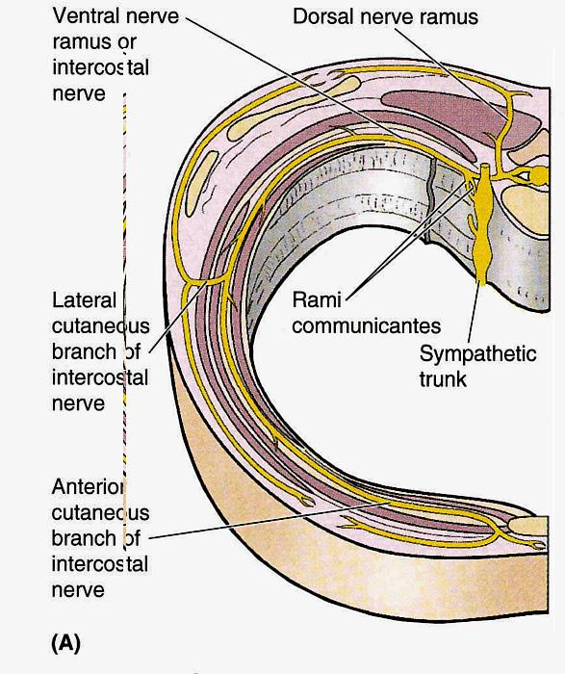
Nerves of the Thoracic Wall
INTERCOSTAL NERVES
The intercostal nerves are the anterior rami of the first
eleven thoracic spinal nerves .
Each nerve enters an intercostal space and runs forward inferiorly to the intercostal
vessels in the subcostal groove of the corresponding
rib, between the innermost and the internal intercostal muscles
The FIRST SIX nerves are distributed within their intercostal
Spaces.

Slide 23
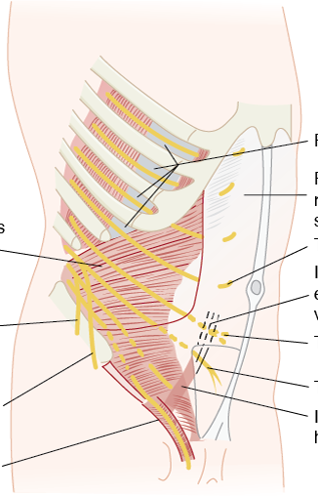
INTERCOSTAL NERVES
The SEVENTH, EIGHTH, AND NINTH intercostal nerves
leave the anterior ends of their intercostal spaces by passing
deep to the costal cartilages to enter the abdominal wall.
The TENTH AND ELEVENTH nerves pass forward directly into the abdominal wall.
Branches
• Collateral branch runs forward below the main nerve.
• Lateral cutaneous branch divides into anterior and posterior
branches that supply the skin.
• Anterior cutaneous branch forms the terminal part of
the main nerve. It divides into a medial and a lateral branch, and it supplies the skin near the midline.
• Muscular branches run to the intercostal muscles

