Slide 1
وسهلا
أهلا
الأستاذ الدكتور يوسف حسين
أستاذ التشريح وعلم الأجنة - كلية الطب – جامعة الزقازيق – مصر
رئيس قسم التشريح و الأنسجة و الأجنة - كلية الطب - جامعة مؤتة - الأردن
دكتوراة من جامعة كولونيا المانيا
اليوتيوب Prof. Dr. Youssef Hussein Anatomy
جروب الفيس د. يوسف حسين (استاذ التشريح)

Slide 2
Veins of
Upper Limb

Slide 3
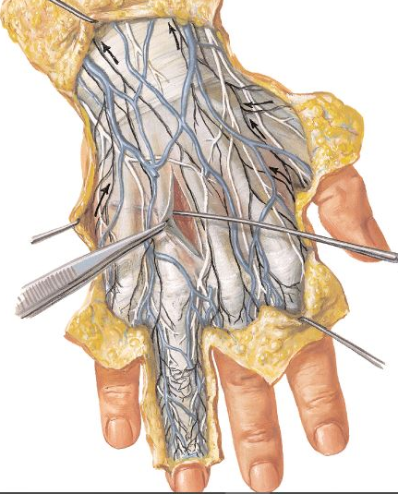
Cephalic vein
Basilic vein
Dorsal venous arch
Dorsal metacarpal veins
Dorsal Venous arch
- This is a venous plexus in the superficial fascia of the dorsum of the hand.
- It receives three dorsal metacarpal veins which are formed by the union of dorsal digital veins from adjacent sides of the fingers.

Slide 4
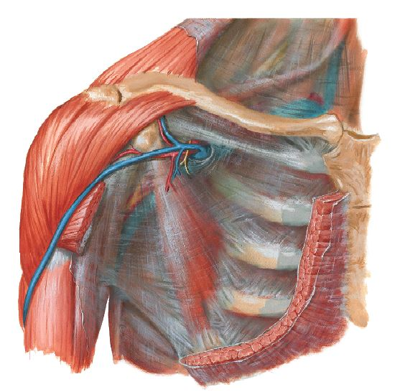
Cephalic vein in deltopectoral groove
cephalic vein lateral to biceps brachii
cephalic vein
cephalic vein
Dorsal venous arch

Slide 5
Cephalic Vein
** Origin; union of the lateral end of the dorsal venous arch with the dorsal digital veins of the radial side of the thumb.
** Course; It is formed over the anatomical snuff-box.
- It curves around the lateral side of the forearm to ascend on the lateral part of the front of the forearm up to the front of the elbow,.
- It ascends close to the lateral side of the biceps brachii muscle.
- It pierces the deep fascia and ascends in the deltopectoral groove.
** Termination; It ends in the upper part of the axillary vein.
** Tributaries, It receives the venous blood of superficial structures of the dorsal surface of the thumb and lateral aspect of the arm, Forearm and shoulder,.

Slide 6
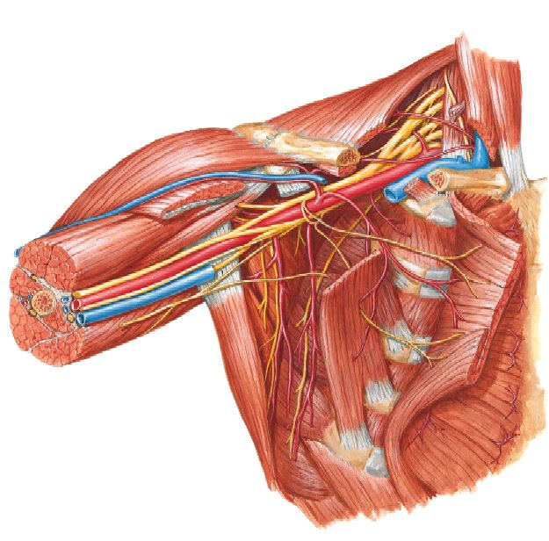
Brachial artery
axillary vein
Basilic vein
Basilic vein
Basilic vein

Slide 7
Basilic Vein
** Origin; by the union of the medial end of the dorsal venous arch with the dorsal digital vein of the ulnar side of the little finger.
** Course; It ascends along the medial side of the back of the forearm; and near the elbow it inclines forwards to reach the front of the elbow.
- Then, it continues up close to the medial side of the biceps brachii.
- At the insertion of coracobrachialis muscle, it pierces the deep fascia and ascends close to the medial side of the brachial artery.
** Termination; it continues up into the axilla as the axillary vein at the lower border of teres major muscle.
** Tributaries, It receives the venous blood of superficial structures of the dorsal surface of the little finger and medial aspect of the arm, and Forearm

Slide 8
cephalic vein
Median Cubital Vein
Median vein of forearm
Basilic vein
Basilic vein
cephalic vein

Slide 9
Median Cubital Vein
- This is a short oblique vein which lies across the front of the elbow.
- It arises from the cephalic vein, it runs upwards and medially to join the basilic vein.
- The bicipital aponeurosis separates the vein (superficial) from the end of the brachial artery and median nerve (deep).
Brachial artery
Median nerve
Bicipital aponeurosis

Slide 10
Median Vein of the Forearm
- This vein is commonly present on the front of the forearm.
- It arises from a superficial venous plexus in the palm and ascends to the front of the forearm.
- At the front of the elbow it joins the median cubital vein or basilic vein.
- But, commonly it divides into a lateral branch joins the cephalic vein and a medial branch joins the basilic vein (NO Median cubital vein).
** Applied anatomy: The median cubital vein and veins on the front of the elbow are commonly used for intravenous injections, infusions and transfusion.
- The cephalic vein just above the anatomical snuff-box is also commonly used for inserting a cannula.

Slide 11
Great saphenous vein

Slide 12
Great saphenous vein
Great
saphenous v.
Beginning.
Termination.
Course.
Surface anatomy.
Tributaries.
Sites of perforating veins.
Normal and abnormal venous return.
Great
saphenous v.
It is the longest vein in the body.

Slide 13
Termination
Femoral vein
Beginning
Dorsal venous arch
Saphenous opening
Great saphenous vein
Dorsal digital vein of big toe
Beginning, on the dorsum of the foot by the union of Medial end of the dorsal venous arch and Dorsal digital vein of the big toe.
Termination, it hooks the saphenous opening, piercing the cribriform fascia to end in the femoral vein.

Slide 14
Femoral vein
Great saphenous vein

Slide 15
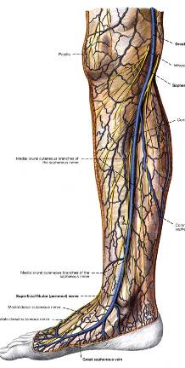
Patella
Saphenous opening
Hand breadth
Saphenous nerve
Medial malleolus

Slide 16
Great saphenous vein
Great saphenous vein
Course,
- It passes posteriorly on the medial border of the dorsum of the foot.
- The vein ascends to the leg infront of the medial malleolus.
It continues up on the medial side of the leg and knee
Hand's breadth behind the medial border of the patella.
Along its course on the dorsum of foot, infront the medial malleolus and medial side of the leg, it is accompanied by saphenous nerve.
It ascends to the thigh, it deviates laterally to reach the saphenous opening (A point 3-4 cm below and lateral to the pubic tubercle).
It hooks the saphenous opening and piercing the cribriform fascia to end in the femoral vein

Slide 17
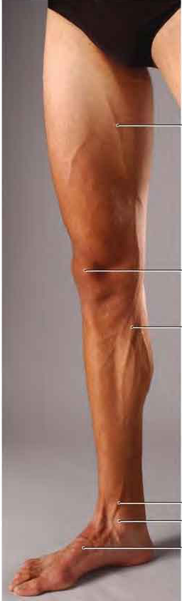
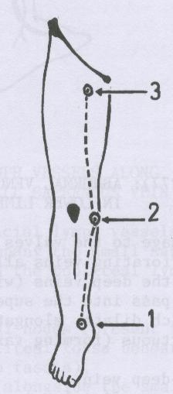
Pubic tubercle
3-4 cm below and lateral to pubic tubercle
Hand breadth behind medial border of patella
In front of medial malleolus
Surface anatomy of GSV
Notes:
Adductor Longus
** Origin: by a rounded tendon from the body of the pubis just below the pubic tubercle.

Slide 18
Tributaries of great saphenous vein
Superficial epigastric vein
Superficial circumflex
iliac vein
Superficial External pudendal vein
Superficial vein from front of the thigh
Superficial vein from
medial of the thigh
Great saphenous v.
Superficial vein from
medial of the foot
Superficial vein from
medial of the leg

Slide 19
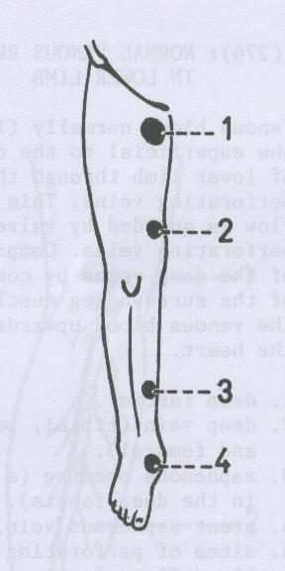
Normal venous return
Muscular pump
Sites of perforated veins
The normal venous return of great saphenous vein to
A- Deep vein through perforating veins
B- The femoral vein
Great saphenous vein contains many valves along its course, the most important valve at its termination
The valves allow passage of the blood from greater saphenous vein to the deep vein and femoral vein.
Femoral vein
Saphenous opening
Perforating vein
Great saphenous vein
Contraction of muscles leads to pump blood upward and pump blood from superficial veins to deep vein (muscular pump)
Deep vein

Slide 20
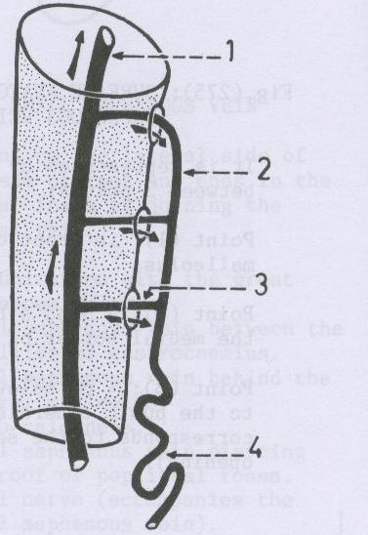
abnormal venous return
Valve of perforated vein
Varicose vein
Damage of these valves (Valves incompetent) leads to regurgitation of blood to great saphenous vein resulting varicose veins (the great saphenous vein become dilated, tortuous and engorged with blood).

Slide 21
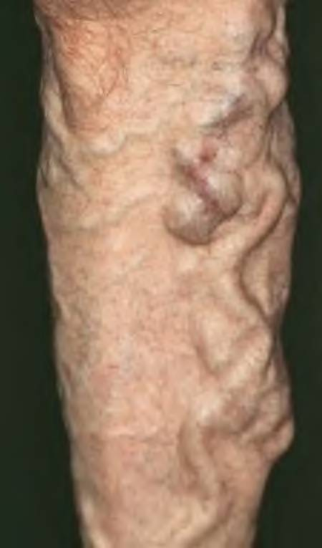
Notes:
1- شبكة مثل العنكبوت

Slide 22
Clinical notes of great saphenous vein
It is commonly used for coronary artery bypass surgery, and the vein should be reversed so its valves do not obstruct blood flow in the graft.
Saphenous vein Cutdown: vein is not visible in infants, obese people, patients in shock whose veins are collapsed, the great saphenous vein can always be located by making a skin incision anterior to the medial malleolus. This procedure is used to insert a cannula for prolonged administration of blood, plasma, electrolytes, or drugs.
Saphenous Nerve Injury: The saphenous nerve accompanies the great saphenous vein anterior to the medial malleolus, So nerve may be cut during a saphenous vein cutdown, the patient may complain of pain or numbness along the medial side of the foot.
The soleus muscle contains a rich venous plexus which drains the superficial veins and pumps it to the deep veins against gravity (peripheral heart). Venous stasis (stagnation) is an important cause of thrombus formation especially with old age, bed rest for long time, sitting for long time, bone fracture or Venous inflammation (Thrombophlebitis)

Slide 23
Small saphenous vein

Slide 24
Small saphenous vein
Small saphenous vein
Dorsal venous arch
Lat. Dorsal digital vein of little toe

Slide 25
Small Saphenous Vein
** Origin: on the dorsum of the foot by the union of the lateral end of the dorsal venous arch with the lateral dorsal digital vein of the little toe.
** Course and relations:
- It passes backwards along the lateral border of the dorsum of the foot.
- Then, it curves up passing behind the lateral malleolus and ascends on the back of the leg.
- About the middle of the popliteal ossa, it pierces the popliteal fascia to end in the popliteal vein.
- Along its course it is closely accompanied by the sural nerve.

Slide 26
Thank you
Questions
I/Azzam - 2004

