Slide 1
بسم الله الرحمن الرحيم
DR. Waqar Al – Kubaisy

Slide 2
Biostatistics
L I
Prof. Dr. WAQAR AL-KUBAISY
2
Notes:
2

Slide 3
:
The terms/concepts:
Variable
Distinguish between
Nominal
Ordinal
Discrete
continuous variable
Distinguish between quantitative and quantitative data
Frequency distribution
Relative frequency
Cumulative frequency
Transform data set into information in the form of
Tables,
Graphs

Slide 4
Biostatistics consist of
1-Collection of data .
2-Presentation of data
3-.Estimation of data

Slide 5
Statistics
Is a field of study that concern with
The Collection ,Organization and Summarization of data.
And
Drawing of inference about a body of data when only part of data are observed
Biostatistics
When data being analyzed are derived from
biological sciences and Medical observation .
Notes:
5

Slide 6
Biostatistics Is a field of study that concern with the Collection Organization and Summarization of data. Drawing of inference about a body of data when only part of data are observed
Biostatistics breaks into two main distinct components or
two distinct subcategories:
I- Descriptive Biostatistics.
II- Inferential Biostatistics.
Notes:
6

Slide 7
I Descriptive Statistics
It is a series of procedures designed
to clarify the data ,
so that
its principal characteristics and
main features.
are revealed
for the purpose of
reaching conclusion at a late stage.
This one serve as devices for
organizing and summarizing data
and
bringing into a focus their essential characteristics
Reduce the information to a manageable size
This include
7
Notes:
7

Slide 8
This include:
Presentation of data by
Graph and or
Tables
Calculation or numerical summaries, such as
Frequency, Average, Mean, Median, Mode Percentages
Descriptive statistics
Biostatistics consist of
1-Collection of data .
2-Presentation of data
3-.Estimation of data

Slide 9
Data
Data are the values you get when you measure a variable example
20 years old, (age)
55 males. (Sex)
170 cm height
The values of the observations for the variable is known as data.
Data are the raw material of statistics
Data carry little or no meaning when considered alone
needs further steps to become valuable (information)
Data consist one or more variable

Slide 10
Variable (Y)
It is the characteristics ,that observed in:
persons, places or things .
This characteristic is not the same when observed in different possessors
It is any aspect of an individual that is measured Like;
B.P. cholesterol age, sex ,Blood sugar ??
Variable
is some thing whose value can vary
example
age ,sex, weight height??
An important thing is the type of the variable concerned

Slide 11
Type of variable
There are two major types of variable
Each of these can be subdivided into two subtypes
Categorical variable
(Qualitative Variable )
1.Categorical variable
a- Nominal
b- ordinal
2 Metric variable
(Quantitative Variable )
2 Metric variable
a-Continuous
b-Discrete

Slide 12
1.Categorical variable
a- Nominal
b- ordinal
1. Categorical variable
a- Nominal
Example
Blood group of 100 persons Just categorize the blood group into
A, B, AB, & O
then counting the No. of individuals (frequency )
in each group
(1) Data do not have any unit
(2) ordering of the categories is
completely subjective,
AB, A, B,& O
O, AB, A & B

Slide 13
1.Categorical variable
a- Nominal
b- ordinal
b- Ordinal ترتيبي
example
grading of tumor I II III IV V
the order category in a meaningful
The difference between any adjacent two grades is not necessarily be the same ( equal)
Therefore
1-the data are not properly measures
but
assessed in some way
2-these data are not real numbers and

Slide 14
Continou.. ordinal
as it is not real data
3--we cannot apply any arithmetic's roles
no adding,
no subtracting.
no multiply or
no divide
4- Data do not have any unit
5- ordering of the categories is not subjective
the order category in a meaningful way
the ordinal vales

Slide 15
Ordinal
* order category in a meaningful way
*difference between any adjacent two grades is not necessarily be equal
Have no interval property
*not properly measures
*not real numbers
cannot apply any arithmetic's roles
Data do not have any unit

Slide 16
2 Metric variable
a-Continuous
b-Discrete
Metric variable
Continuous variable
Example Height ,Weight
1-usually comes from measuring
Can be properly measured
so
2- they are a real numbers
so
3- we can apply all mathematics' operations
4- All have units of measurement attached to them
5-The difference between any pairs of adjacent values are exactly the same (equal) this is
known as
the interval property
50-60-70-80

Slide 17
continuous Variable cont.
Can be properly measured
may assume any value along a continuum .
The value of a C.V. is not limited to the set of integers .Height :158,160,
157.9 , 16o.6 160.8
dose not possess a gap or interruptions.
ex.
B.P. Hb Blood sugar .
???????????
17

Slide 18
2 Metric variable
a-Continuous
b-Discrete
Discrete variable
usually comes from counting such as
No. of death.
No. of students
No. of patients
??????
It is real numbers So……..???
It can be counted
It have a unit of measurements
It is integer, measurement or values are integers
They have the same interval and ratio properties as the continues variables
all are
discrete metric variable

Slide 19
Have the variable got unit
can the data put in a meaning
full order
Categorical Nominal
Categorical Ordinal
Do the data come from measuring
or counting
counting
Discrete, Metric
measuring
Continuous Metric
Yes
No
Yes
Yes
No
Yes
An important thing is the type of the variable concerned.
19

Slide 20
Quantitative Variable
The one that can be measured by the usual sense .
Qualitative Variable
The one which are not capable of being measured by the usual sense .
20
Notes:
20

Slide 21
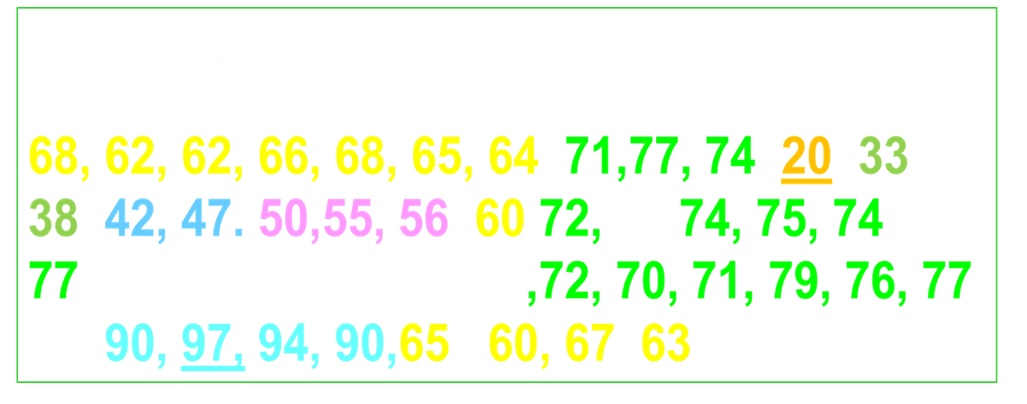
Biostatistics consist of
1-Collection of data .
2-Presentation of data .
3- Estimation of data
???????
21
Notes:
21

Slide 22
Descriptive Statistics
organizing and summarizing data and
bringing into a focus their essential characteristics
Descriptive statis.
reduce the information to a manageable size
Presentation of Data
Data that collected from any source, are inadequate for planning .
Data need to be transformed into information
by reducing them,
by summarization and
Arrange it in a simple and useful way
to
bring out the important point clearly & concise
This mean that
display the important feature of the sample .
This is Descriptive Statistics
22
Notes:
22

Slide 23
Descriptive Statistics
This one serve as devices for
organizing and summarizing data
and
bringing into a focus their essential characteristics
Descriptive statistics .
reduce the information to a manageable size
This include
table
graph, chart or
Numerical Description
An important thing is the type of the variable concerned.
23
Notes:
23

Slide 24
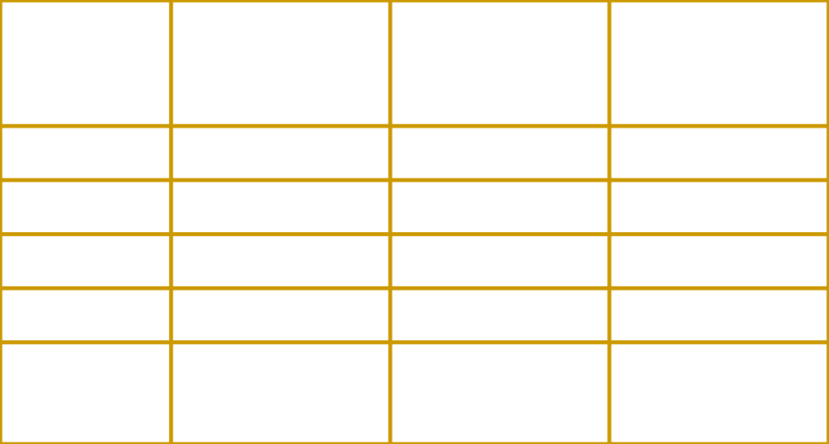
Table
It is first step in data presentation .
Is the simplest and often most useful summary of data
An important thing is the type of the variable concerned.
24
Notes:
24

Slide 25
Nominal Simple Frequency Table
example
Blood group of 95 children with leukemia shows as
(22)A, (25)B, (18)AB, & O(30)
count the No. of observation in each category,
these count are called Frequencies .
frequency
Relative frequency
percentage frequency
of Bl. group distribution
for of 95 children with leukemia
An important thing is the type of the variable concerned.
Notes:
25

Slide 26
Simple Frequency Table
Blood group | Frequency N=95 | Relative Frequency | Percentage %
A | 22 | ??? | ??
B | 25
AB | 18
O | 30
Total | 95
Notes:
26

Slide 27
Nominal Simple Frequency Table continuo..
Relative frequency
Frequency each category divided by the total frequency.
No. of children of each category (Bg) divided by the total no of children.
Percentage frequency
Frequency of each category divided by the total frequency X 100
Relative or percentage frequency are often more useful than the actual number of individuals in each category. ???????
27
Notes:
27

Slide 28
Simple Frequency Table
Blood group | Frequency N=95 | Relative Frequency | Percentage %
A | 22 | 22/95=0.231 | 23.15
B | 25 | 0.26315 | 26.315
AB | 18 | 0.18947 | 18.947
O | 30 | 0.3157 | 31.5789
Total | 95 | ????? | ????
Relative or percentage frequency are often more useful than the actual number of individuals in each category. Why ????????
Notes:
28

Slide 29
Type of feeding
Infants
Breast 478
Bottle 65
Mixed 57
Simple Frequency Table
Type of feeding | No. of cases (F) | R.F. | percentage %
Breast | 478 | 0.79 | 79. 7
Bottle | 65 | 0.108 | 10.8
Mixed | 57 | 0.095 | 9.8
Total | 600 | ???? | 100

Slide 30
b- ordinal Variable
120 individuals were asked about their level of satisfaction toward the health care given by Hospital X. The response as follows
16 very satisfied 22 satisfied 36 neutral 28 unsatisfied
18 highly unsatisfied
level of satisfaction | Frequency N=120 | Relative Frequency | Percentage %
very satisfied | 29 | 0.24166?? | 24.166
satisfied | 39 | 0.325 ?? | 32.5
neutral | 20 | 0.1666 | 16.66
unsatisfied | 18 | 0.15 | 15
highly unsatisfied | 14 | 0.11666 | 11.66
Total | 120 | ???? | 99.929
Notes:
30

Slide 31
Ex.
The mathematic marks of 26 secondary school students at Amman in 201 15.2 31.3 14.9 16.3 19.3 18.2 20.2 12.8 14.7 29.4 21.1 20.4 13.6 22.4 14.0 14.3 22.8 26.7 18.9 13.7 17.7 27.2 19.3 16.1 13.5 11.2
? ? ? ?
? ? ? ?
31

Slide 32
Continuous Metric variable
The most useful way for presenting data of CMV to produce grouped frequency distribution
grouping data first
These group of data
we call it
class interval
Each group of data
(class interval )consist
of values within
certain range
mathematic marks | Frequency | Cumulative frequency
10.0- 14.9 | 9 | 9
15.0- 19.9 | 8 | 17
20.0- 24.9 | 5 | 22
25.0- 29.9 | 3 | 25
30.0- 34.9 | 1 | 26
 | 26
32

Slide 33
Continuous Metric variable
to produce grouped frequency distribution table
Grouping data into groups
of equal width
then construct
frequency distribution table
for grouped data
Counting the frequency
of observation within
the groups(class interval)
Each group of data
contain No. of observation
mathematic marks | Frequency | Cumulative frequency
10.0- 14.9 | 9 | 9
15.0- 19.9 | 8 | 17
20.0- 24.9 | 5 | 22
25.0- 29.9 | 3 | 25
30.0- 34.9 | 1 | 26
 | 26
33
Notes:
33

Slide 34
Use sturges rule :
K= No. of class intervals. N= sample size .
Width of class intervals :
W= width .
R= Range = highest – lowest .
K= No. of class intervals .

Slide 35
Continuous Metric variable
Frequency distribution of mathematic marks of
26 secondary school students at Amman in 2019
mathematic marks | Frequency | Cumulative frequency
10.0- 14.9 | 9 | 9
15.0- 19.9 | 8 | 17
20.0- 24.9 | 5 | 22
25.0- 29.9 | 3 | 25
30.0- 34.9 | 1 | 26
Total | 26
frequency distribution table
? ? ? ?
35
Notes:
35

Slide 36
Example
The following data representing age of 50 (years)
patients with diabetes Mellitus collected from Al Karak Hospital during march 2019
68, 62, 62, 66, 68, 65, 64, 71,77, 74, 20, 33, 38. 42, 47. 50,55, 56, 60 72, 80 74, 75, 74, 77,80, 81, 89, 86, 85, 83,72, 70, 71, 79, 76, 77, 80, 90, 97, 94, 90,65, .60, 67, 63 88, 84, 84, 87
? ? ? ?
????????/
36
Notes:
36

Slide 37
Age(year) of 50 patients with diabetes Mellitus attending
Al Karak Hospital during march 2015
AGE year | Freq | Commul. frequency | Relative frequency | % R.F. | Cumul. R.F. | %cum Freq.
20-29 | 1 |  | ?? | ??
30-39 | 2 |  | ??? | ??
40-49 | 2 |  | ??
50-59 | 3 | ?
60-69 | 12
70-79 | 14 | ?
80-89 | 12
90-99 | 4
total | 50 | ? | ? | ? | ? | ?
37

Slide 38
Relative Frequency ( proportion )
Dividing the No. of values (observation, frequency) in a particular class interval by the total No. of values (observation frequency) in whole data
Percentage of Frequency
Dividing frequency of each class interval by the total No. of observation and then multiply by 100 .
Notes:
38

Slide 39
Cumulative Freq. Dist.
That is to convert the frequencies distribution into less than and more than .
This is done by simply
Adding two or more classes frequency
Starting either at the top or at the bottom of the distribution .
1+2+ +2+3+12+14+12+4= 50
Cumulative Relative and Percentage Dist.
add two or more Relative frequencies together . 0.02+0.04+0.04+0.06+0.24+0.28+0.24+0.08=1
Add the % instead of the frequencies, starting either at the top or at the bottom .
39
Notes:
39

Slide 40
AGE year | frequency | Commutative frequency | Relative frequency | % R.F. | Cumulativ R.F. | %cum Freq.
20-29 | 1 | 1 | 0.02 | 2 | 0.02 | 2
30-39 | 2 | 3 | 0.04 | 4 | 0.06 | 6
40-49 | 2 | 5 | 0.04 | 4 | 0.1 | 10
50-59 | 3 | 8 | 0.06 | 6 | 0.16 | 16
60-69 | 12 | 20 | 0.24 | 24 | 0.4 | 40
70-79 | 14 | 34 | 0.28 | 28 | 0.68 | 68
80-89 | 12 | 46 | 0.24 | 24 | 0.92 | 92
90-99 | 4 | 50 | 0.08 | 8 | 1.00 | 100
total | 50 | --- | 1 | 100 | --- | ---
40

Slide 41
Points should be keep in mind
1-No. of class intervals (5-15) .
2-Classes interval should notoverlapping .
3-All classes interval should have the same width across
all data (constant width) .
4-There should be no gaps between class interval .
5-Every observation will be uniquely classifiable into one
and only one class interval .
Class Marks
It is the midpoint of the class interval .
It could be obtain by adding the lower and upper limits of a class interval then divided by two .
41
Notes:
41

Slide 42
Thank You

Slide 43
Presentation of Data
table
graph, chart or
Numerical Description
Graphical Techniques
some times table presentation will give some difficulties to the reader especially to non numerical readers
Picture speaks lauder than thousand words .
Graph have powerful impact on the imagination of
population .
Relationships, Trends and Contrasts are often more readily appreciated from diagram than table ..
An important thing is the type of the variable concerned.
43
Notes:
43

