Slide 1
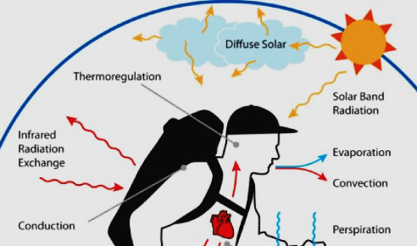
3- Thermoregulation -!
Prof. Sherif W. Mansour
Physiology dpt., Mutah School of medicine

Slide 2
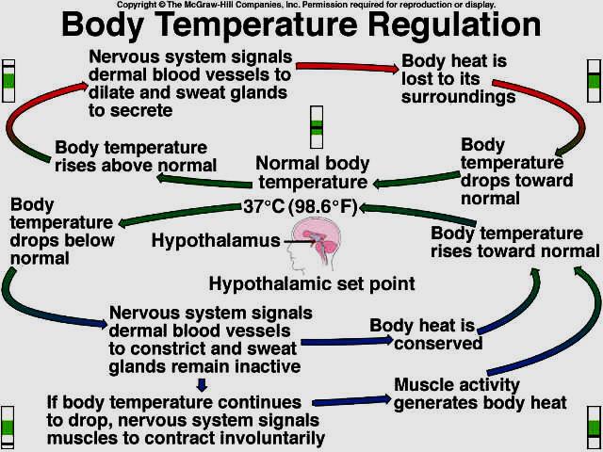
REGULATION OF BODY TEMPERATURE
-Vertebrate animals are divided into:
1-Cold blooded or poikilothermic animals: in which its body temperature varies with that of the medium.
2-Warm blooded or homeothermic animals: in which its body temperature regulated to remain constant.
-Human body temperature: -In young adult: * oral temperature =37 °C ± 0.3
* rectal temperature is higher by 0.5 °C * axillary temperature is lower by 0.5 °C
* skin temperature (shell temperature) is lower than the central (core) temperature .

Slide 3
* Factors affecting body temperature:
1.Age: the body temperature is higher in younger individual than in the elderly and in the premature baby, the temperature is lower than in mature one. Old age tend to have slight decrease in temperature due to:
-Sedentary life
- decrease in metabolic rate.
- Decrease tissue activity.
- Decrease muscle tone.
2.Sex: the basal body temperature in females increases by 0.5 C° in the second half of menstrual cycle and during pregnancy by progesterone hormone.
3.Diurnal variation: it is lowest during sleep and early morning and slightly higher during awake state or afternoon (+0.5 C°)
4.Environmental temperature: its increase lead to increase the body temperature.
5.Emotions ↑ body temperature (tension of ms. & hormones)
6.Muscular exercise :↑body temperature(may reach 40C°)
7.Food intake: ↑ body temperature due to stimulation of metabolic rate
8.Diseases : hyperthyroidism ↑ body temperature.
-febrile diseases → fever
-peripheral circulatory disorder causes coldness of the skin

Slide 4
Heat production
1-Basal rate of metabolism : metabolic activity of all cells
2-Extra metabolic rate by:
a- Muscular activity:
- Increased muscle tone → 25% of heat
- Voluntary muscle Contraction → 75% of heat.
- Shivering
b-Thyroxin secretion: It increases heat production slowly but for long time.
c-Catecholamines secretion: Catecholamines and sympathetic stimulation → ↑ heat rapidly but for short period .
3- Food intake: especially proteins → ↑ specific dynamic action & heat production.
4- Brown fat: which present in infant around scapulae → high rate of metabolism
5- Sun radiation: body heat gained from sun radiation.

Slide 5
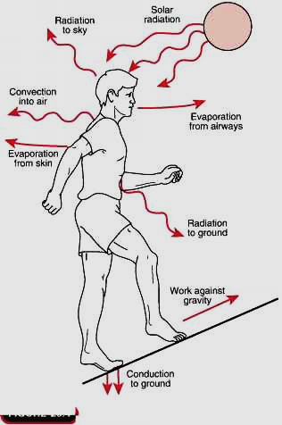
Heat loss
Heat is transferred by the blood from hot deep parts of the body to the skin surface from which heat is lost by the following mechanisms which determined by temperature gradient between skin surface and the surroundings by :
I-Non-evaporative heat loss:
a) Radiation: The most important → 60% of heat loss
- In the form of infrared (electromagnetic wave)
- From hot to cold objects not in contact to each other.
N.B. Dark clothes absorb radiated heat while light clothes reflect radiated heat.
b) Conduction: 3 % of heat loss as it’s self limited
- From hot objects to surrounding objects in direct contact as chair, bed or immersion in cold water.
c) Convection : 15 % of heat loss.
-Heat must be conducted to air or water and then carried away by convection current as wind.

Slide 6
II- Evaporative heat loss: 22% of heat loss
a) Insensible perspiration: At comfortable environmental temperature during rest (24C°), 25 ml (gm) H2O are evaporated/hour from the skin and lungs. As 0.58 k calorie of heat is lost by evaporation of 1 gm H2O, the heat loss = 12-16 k. calorie/hour.
b) Sweat secretion:
- ↑ body temperature by 1C° → enough sweating to remove 10 times the basal rate of body heat production.
- Each 1 ml of sweat evaporated remove 0.6 k. calorie.
- Sweat secretion starts when environmental temp. is 32-34C°.
- Sweat evaporation is helped by moving dry atmosphere.
- Sweat glands are of 2 types:
Eccrine glands: spread all over the body, supplied by sympathetic cholinergic fibers, for heat loss by sweating
Apocrine glands: in axilla, pubic & perineal regions (hairy skin), supplied by sympathetic adrenergic fibers for sexual attraction.
C) Heat loss via urine and stool: (1%)

Slide 7
Thank You

