Slide 2
Organ transplantation
An organ transplant is a surgical operation in which a failure or damaged organ in human body is removed and replaced with a functioning one. The donated organ may be from a deceased donor, a living donor or an animal.
Organs that can be transplanted are the heart, kidneys, liver, lungs, pancreas, intestine and thymus.
Tissues include bones, tendons, cornea, skin, heart valves, nerves and veins.
Worldwide, the kidneys are the most commonly transplanted organs, followed by the liver and then the heart.

Slide 3
Legal rules have been followed before blood transfusion
The first discussion of this issue was on starting blood transfusion early in the twentieth century. when a person looses blood due to an injury, a blood disease or during surgical interference.
The need for the blood transfusion: Conditions
- No alternative method of treatment
- No harm or damage to the donor
- Consent of the donor
- Under medical supervision
- The donor should be clinically free from a transmissible disease

Slide 4
Organ transplantation has been widely known in the mass media as offering new hope for thousands of ill patients .
The major clinical problems include
tissue rejection
organ preservation
insufficient facilities and manpower
and the high cost of each operation
The law has an additional restriction
Community

Slide 5
Types of organ transplantation :
Classification of organ transplantation:-
Auto-transplantation:- (to him or back to him)
It involves the transplantation of tissue from one individual back to the same individual (e.g., skin, teeth, hair…etc).
Isograft:- Graft=Transplant (Between genetically identical individuals)
Donor and recipient are genetically individuals of the same species, such as graft between monozygotic twins.
Allo-transplants:- (genetically different ones)
Transplants from one individual into another genetically different one, it including cornea, teeth, bone….etc.
Xenograft:- (between different species)
Where grafts between different species have been performed in the part for skin & heart valves.

Slide 6
Living or dead
Transplantation from a living person to another living one.
Transplantation from a dead to a living

Slide 7
Transplantation from a living person to another living one
- There should be no harm or danger on the donor’s life.
-The operation should be done in a recognized hospital.
-The donor should be related to the recipient up to the third degree, so as to prevent selling organs

Slide 8
Transplantation from a dead to a living
The importance of brain death appeared in recent years.
It is the irreversible cessation of all brain function including the brainstem. When the brain cells die, they do not grow back, thus any damage is permanent and irreversible function.

Slide 9
Nowadays modern resuscitative devices and techniques can maintain the function of the heart, lungs & visceral organs for a period of time after the brain stem centers have stopped

Slide 10
The development of transplant surgery and the need of viable organs have resulted in the need for accurate
determination of the medical criteria of brain death.

Slide 11
The medical criteria of brain death
Know cause of coma: structural brain damage.
Exclusion of revisable causes of coma as toxic or metabolic.
No hypothermia: temp more 35.
Absent brain stem reflexes:
No motor response within cranial nerves areas.
No pupillary response to light.
No corneal reflex.

Slide 12
No oculovestibular reflex.
No oculocephalic reflex
No gag reflex
Apnea test

Slide 13
the rules that should be followed are:
1.Death certificate should be signed by three physicians of good qualification and not from transplant team.
2.The dead person should have given a will وصية before death or permission for transplantation.
3.Consent of his relatives.
These rules are put to prevent abuse and loss of confidence in physicians.

Slide 14
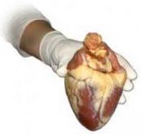
Organ donation and transplantation:
Adult of legal age and sound mind :
They must give informed consent for donation of their
organ voluntarily after being informed of potential risks.
Fetuses and anencephalics:
Organs from stillbirths and infants dying a disease are not suitable.
Although anencephalic infants have no higher cortical function they may have good brain stem function.
The legal criteria for brain death are not easily applied on them.

Slide 15
Anencephaly is a condition that prevents the normal development of the brain and the bones of the skull.
People with anencephaly are missing large parts of the brain. called the cerebrum and cerebellum. The bones of the skull are also missing or incompletely formed.
Anencephaly is one of the most common types of neural tube defect, affecting about 1 in 1,000 pregnancies. However, most of these pregnancies end in miscarriage,

Slide 16
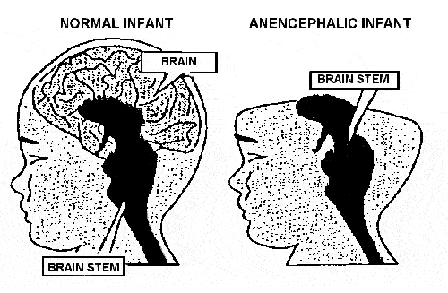
Maximal life support systems at birth and the organ are removed as soon as possible .
(2) As 1st approach but the organs are removed only after brain stem functions are stopped.
(3) Minimal care until he deteriorates, then placed on maximal life support systems, and organs are removed brain stem functions are stopped.
(4) Minimal care until the infant dies, and then the organ are harvested.
Approaches to organ donation from an encephalic infant:
The success rate was 100% for the 1st approach but
0% - 11% for the other 3 approaches

Slide 17
THANK YOU

