Slide 1
Menses Key terms and definitions
Menarche: Age at onset of menstruation
Primary amenorrhea: Absence of menstruation despite signs of puberty
Secondary amenorrhea: Absence of menstruation for 3-6 months in a woman who previously menstruated
Dysfunctional uterine bleeding (DUB): Irregular bleeding due to anovulation or anovulatory cycle
Oligomenorrhea: Menstrual interval greater than 35 days

Slide 2
Key terms and definitions
Menorrhagia: Regular menstrual intervals, excessive flow and duration
Metrorrhagia: Irregular menstrual intervals, excessive flow and duration
Anovulation/anovulatory: Menstrual cycle without ovulation
Mittleschmertz: Pain with ovulation
Molimina: Symptoms preceding menses
Dysmenorrhea: Menstrual cramping/pain

Slide 3
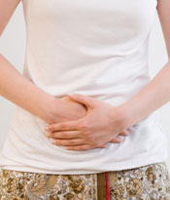
PROBLEM ASSOCIATED WITH MENSTURATION

Slide 4
Key terms and definitions
Threatened abortion: Vaginal bleeding within first 12 weeks of pregnancy
Inevitable abortion: Dilation of cervix, vaginal bleeding, products visible
Incomplete abortion: Some products of conception expelled but not all, +bleeding, cervical dilation
Complete abortion: Products of conception expelled, cervical os closed, minimal bleeding
Missed abortion: Embryonic demise, no products of conception passed

Slide 5
Abortion/Miscarriage
Threatened
Incomplete
Complete
Bleeding in first trimester
Bleeding, cx dilitation, some products expelled
Min. bleeding, cx closed, products expelled

Slide 6
Ectopic Pregnancy
Implantation of pregnancy outside of uterus
Risk factors
STDs, PID, cervical dysplasia
Abdominal pain, amenorrhea, vaginal bleeding
Physical exam findings: ruptured/unruptured
Quantitative hCG
Medical vs. surgical management
Notes:
Unruptured ectopic—min findings on exam
Ruptured ectopic—acute abdomen, hypovolemic shock—remember that young healthy women can compensate for large amount of blood loss—normotensive but tachy, shoulder pain

Slide 7
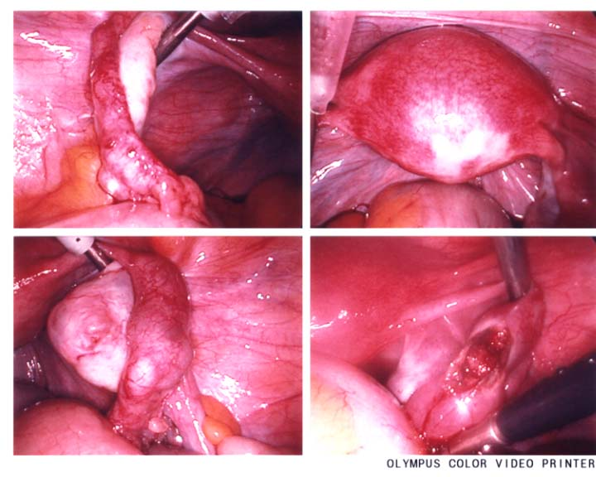
Unruptured Ectopic Pregnancy
C. Stalburg

Slide 8
Molar Pregnancy Gestational trophoblastic neoplasia Hydatidiform mole
COMPLETE
Diploid
46 XX
Paternal only
“Empty egg”
Rarely a fetus
PARTIAL/INCOMPLETE
Triploid
69XXY (80%)
Dispermy
Fetus often present

Slide 9
Differential diagnosis of Abnormal Uterine Bleeding
AUB due to pregnancy
Dysfunctional uterine bleeding/anovulation
Anatomical causes
Systemic causes

Slide 10
Polycystic Ovarian Syndrome: PCOS A special case of DUB
Persistent anovulation
Polycystic ovaries
Obesity
Hirsutism
Insulin resistance
Hyperinsulinemia
Hyperandrogenism

Slide 11
Amenorrhea
Primary--lack of menses by age 16
Secondary--cessation of menses for > 3 months.
Most common cause of secondary amenorrhea is…….. Pregnancy
Notes:
WHY??? Congenital abnormality, genetic disorder, defective gonad

Slide 12
Outflow Obstruction Leading to Amenorrhea
Imperforate hymen
Bulging at hymen
Membrane or partial membrane
Absent uterus/vagina
Mayer-Rokitansky-Kuster-Hauser Syndrome
Asherman’s syndrome
Scarring of uterine cavity after D&C with interruption of basalis layer
Notes:
MRKH: mullerian agenesis. Primary amenorrhea and no apparent vagina. Associated with urinary tract (ectopic kidney, renal agenesis, horseshoe kidney) and skeletal abnormality, usually spine.
Asherman’s: intrauterine scarring/synechiae
TB

Slide 13
Menstrual Hygiene Management

Slide 14
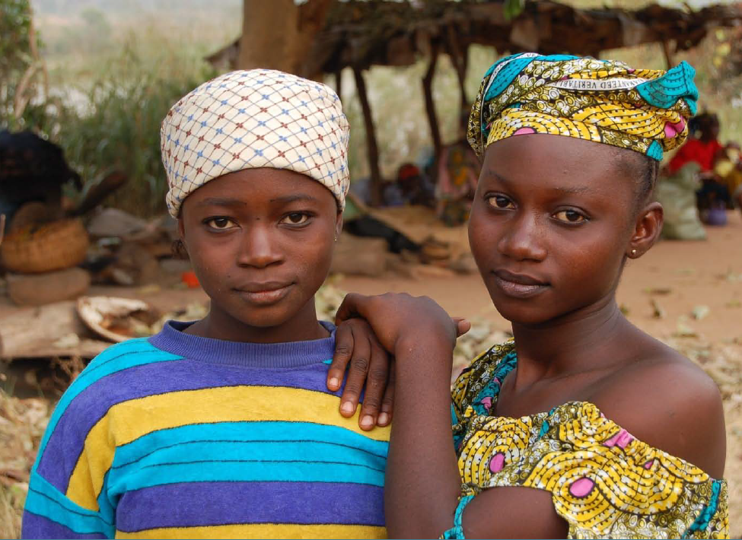
Menstruation
1. Introduction
52% of women worldwide are in reproductive age and most of them thus are menstruating monthly.
Still, the majority of them are not in conditions to take care of their menstruation in a hygienic manner or are impaired by it.
Menstruation is supposed to be invisible and silent.
Source: http://www.mcmaster.ca/museum/Exhibitions_Fierce.html [Accessed: 07.08.2013]
Source: KJELLEN ET AL. (2012)

Slide 15
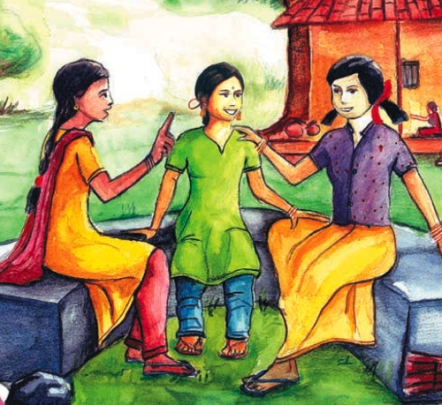
Harmful restrictions
2. Beliefs, Myths and Taboos
In some cultures, women and girls are told that
During their menstrual cycle they should not bathe (or they will become infertile)
Touch a cow (or it will become infertile)
Look in a mirror (or it will lose its brightness)
Touch a plant (or it will die)
Young women chatting about menstrual issues. Source: UNICEF (2008)

Slide 16
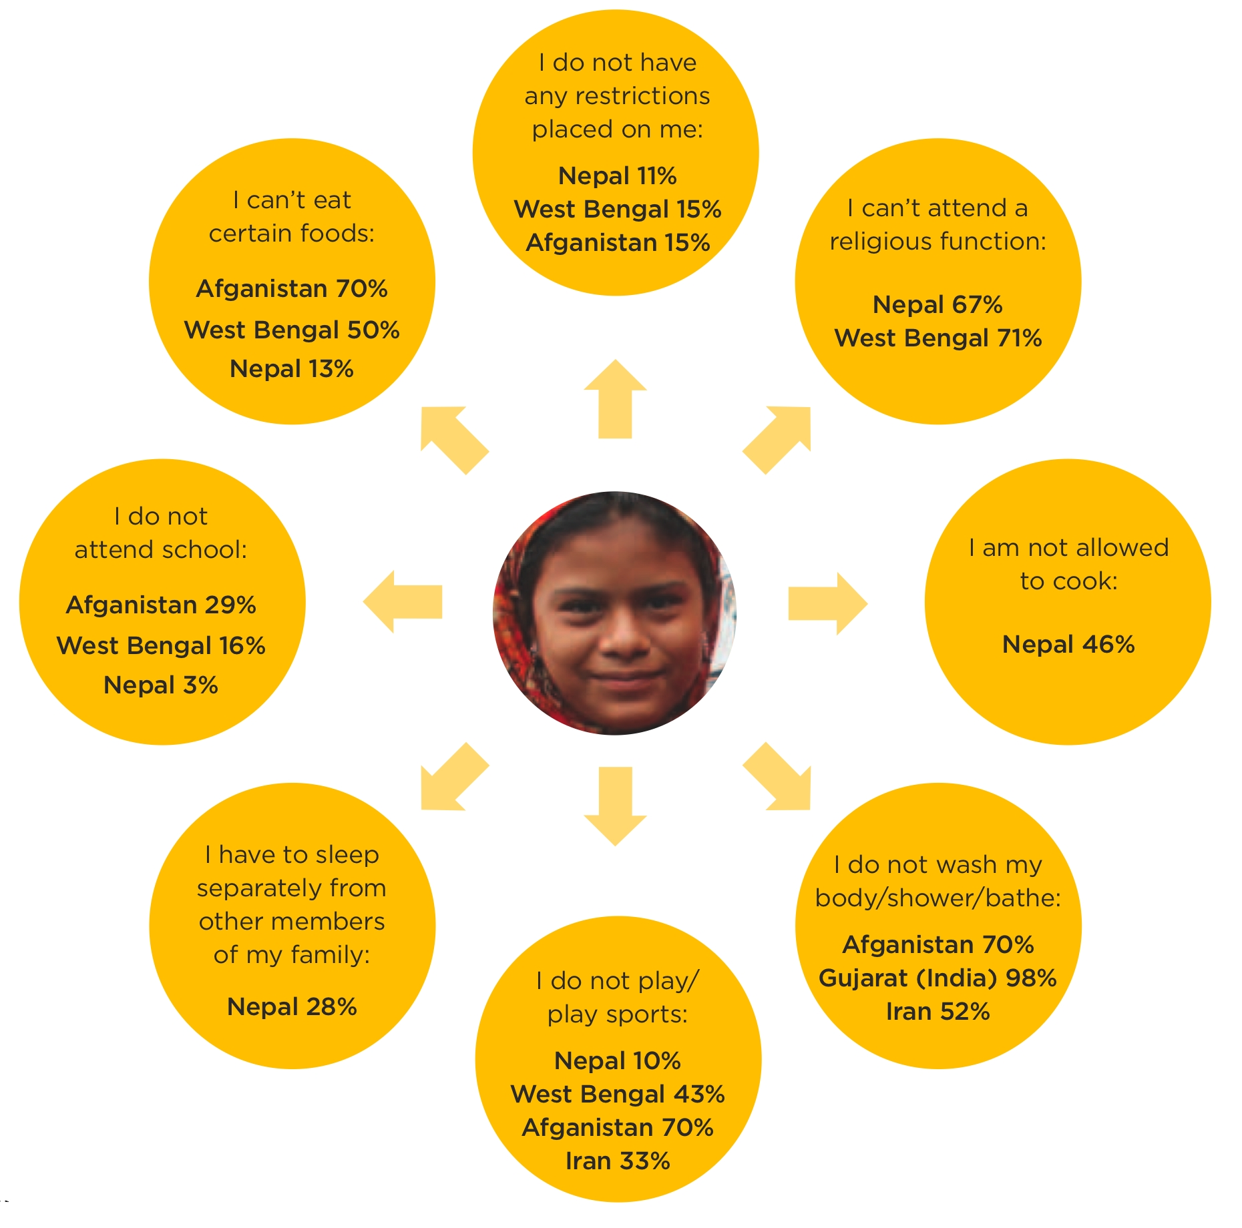
Other restrictions
2. Beliefs, Myths and Taboos
Restrictions on girls during their menstrual period in Afghanistan, India, Iran and Nepal. Source: (HOUSE et al. 2012).

Slide 17
Relieving restrictions
2. Beliefs, Myths and Taboos
Women may appreciate the ‘banishment’ to menstrual huts as they are given a rest period from the normal intensity of daily chores.
Zulu menstruation hut.
Source: RINDSTAD (2013)

Slide 18
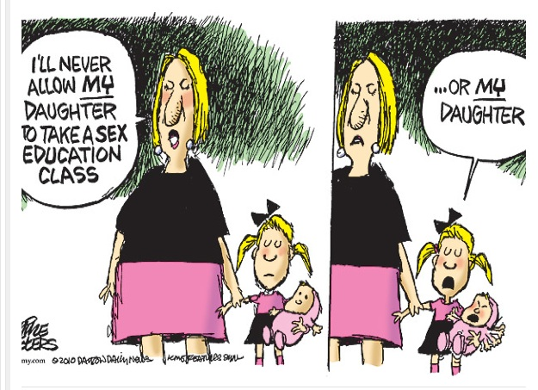
Parental Education
2. Beliefs, Myths and Taboos
Education by parents about reproductive health, sexuality and related issues is often a no-go area leading to a low knowledge and understanding on these issue
Source: http://phil2100dsu12a.wordpress.com/2012/07/10/abortion-the-solution-is-viability/ [Accessed: 07.08.2013]

Slide 19
Lack of facilities and sanitary products
3. Menstrual Hygiene, Human Rights and MDGs
... Can push many girls out of school.
Relationship between menstrual hygiene and school drop-out of girls from the higher forms due to lack of facilities, affordable sanitary products, fear of bloodstains and more.
Millenium Development Goal (MDG) 2: Achieve universal primary education
→ Participation of girls especially in Africa and Asia lags far behind the boys’ in higher forms of primary education
Millenium Development Goal (MDG) 3: Promote gender equality and promote women
→ The lacking behind in primary education to not providing adequate facilities and sanitary products infringes gender equality and the promotion of women

Slide 20
Lack of facilities and sanitary products
3. Menstrual Hygiene, Human Rights and MDGs
Stigma around menstruation hurts human rights, especially human dignity but also the right to non-discrimination, equality, bodily integrity, health, privacy and the right to freedom from inhumane and degrading treatment from abuse and violence.

Slide 21
Health risks
4. Health Risks of Poor Menstrual Hygiene Management
Poor protection and inadequate washing facilities may increase susceptibility to infection
In case of female genital cutting: blockage and build-up of blood clots is created behind the infibulated area: pain, additional infection risk
Risk of infection higher than normal during period as the blood forms a pathway into the uterus

Slide 22
Inappropriate hygiene practices
4. Health Risks of Poor Menstrual Hygiene Management
Certain practices are more likely to increase the risk of infection e.g. using unclean rags. Inappropriate practices often due to the non-affordability of sanitary products for poor women.
Findings from Bangladesh:
80% of factory workers are women
60% of them were using highly chemically charged rags from the factory floor for menstrual cloths
Infections are common, leading to 73% of women missing work for on average six days a month
Women had no safe place either to purchase cloth or pads or to change/dispose of them
When women are paid by piece, those six days away present a huge economic damage to them but also to the business supply chain

Slide 23
Inappropriate hygiene practices
4. Health Risks of Poor Menstrual Hygiene Management
Unclean sanitary pad materials (local infections/bacteria can travel up the vagina and enter uterine cavity)
Changing pads infrequently (skin irritation by wet pads)
Insertion of unclean material into vagina (easier infection , also of uterine cavity)
Using highly absorbent tampons during light blood loss or no menstruation (toxic shock syndrome, vaginal irritation)
Source: HOUSE ET AL. (2012)

Slide 24
Inappropriate hygiene practices
4. Health Risks of Poor Menstrual Hygiene Management
Wiping from back to front following urination or defecation (bacteria can travel easier into vagina)
Unprotected sex (increased risk of sexually transmitted diseases)
Unsafe disposal of used sanitary materials or blood (risk of infecting others with diseases)
Frequent douching (forcing liquid into vagina can introduce bacteria into uterine cavity)
Lack of hand-washing after changing a sanitary towel (can spread infections)
Source: HOUSE ET AL. (2012)

Slide 25
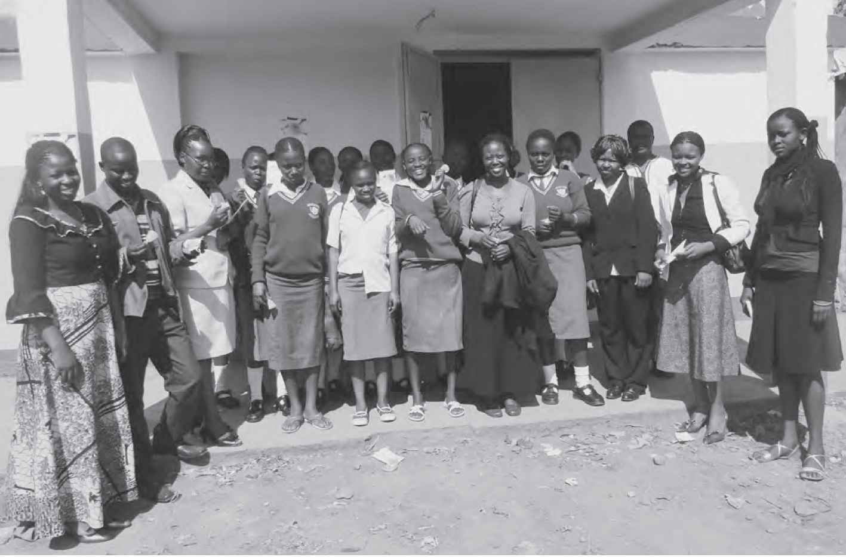
Sanitary protection materials
5. Menstrual Hygiene Management: Hardware
It is critical that any programme aiming to support women or girls with sanitary protection materials involves them in the planning discussions and decisions about the options to be supported.
Schoolgirls participating in a menstrual cup project.
Source: APHRC (2010)

