Slide 1
وسهلا
أهلا
الأستاذ الدكتور/ يوسف حسين
أستاذ التشريح وعلم الأجنة
كلية الطب – جامعة الزقازيق- مصر
رئيس قسم التشريح والأنسجة - كلية الطب - جامعة مؤتة
دكتوراة من جامعة كولونيا المانيا
جروب الفيس
د. يوسف حسين (استاذ التشريح)

Slide 2
Derivatives of Mesogastrium

Slide 3
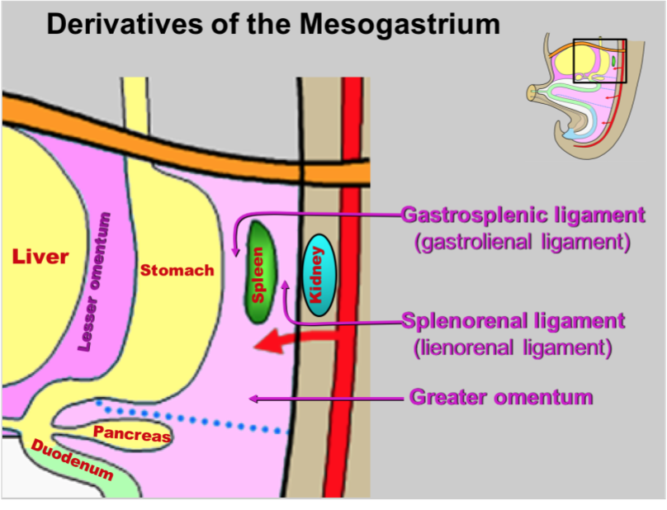
** Derivatives of dorsal meso-gastrium:
1- Cranial part forms gastro-phrenic ligament between the fundus of stomach and diaphragm.
2- Middle part is divided by the growth of the spleen into:
A- Ventral part between the stomach and spleen called gastro-splenic ligament.
B- Dorsal part between the spleen and front of the left kidney forming the lieno-renal ligament.
3- Caudal part gives rise to the greater omentum.
Gastrophrenic ligament

Slide 4
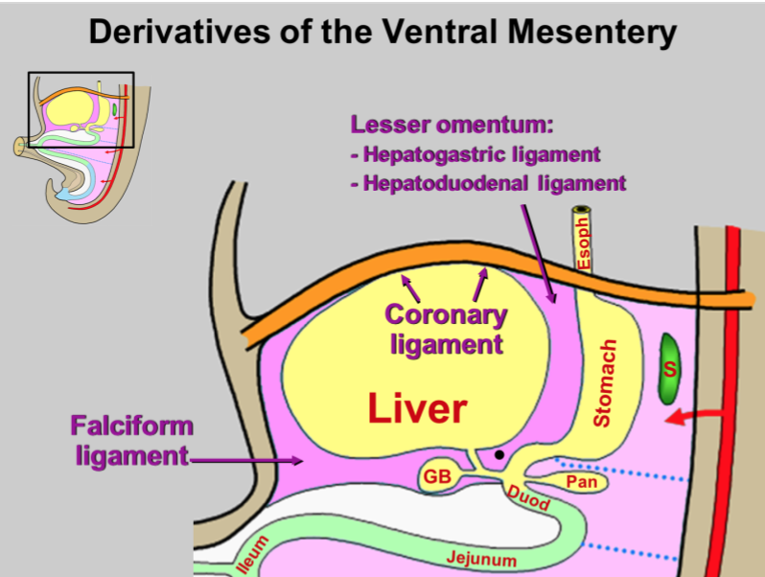
** Derivatives of ventral meso-gastrium:
- It shows growth of the liver between its 2 layers dividing it into:
A- Ventral part connecting the liver to the anterior body wall forming the falciform ligament.
B- Dorsal part connects the liver and the lesser curvature of the stomach forming the lesser omentum.

Slide 5
Development of duodenum

Slide 6
a- The upper part: from the caudal part of the foregut.
b- The lower part: from proximal part of the midgut.
- The C-shaped duodenal loop rotates 90 degrees (clockwise) with the rotation of the stomach leading to this concavity of duodenum directed to the left side.
- The meso-duodenum is degenerated. This will make the duodenum a retroperitoneal and fixed organ.
- The wall of the duodenum shows appearance of the hepatopancreatic bud that give rise to the development of the liver, gall bladder and pancreas.

Slide 7
** Congenital anomalies of duodenum
1- Congenital atresia.
2- Congenital stenosis.
3- Reversed rotation of duodenum leading to transverse colon passing posterior to the duodenum leading to obstruction.
4- Mobile duodenum due to persistence of its mesentery.

Slide 8
Development of Mid & hindgut (Intestine)

Slide 9
Development of intestine
Cranial
Caudal

Slide 10
** Stages of development of the intestine
(I) Preherniation Stage:
- The midgut and hindgut tubes form a C- shaped intestinal loop convex anteriorly.
- The summit of intestinal loop is connected to definitive yolk sac by the vitello-intestinal duct through umbilical ring.
- The VID divides the intestinal loop into cranial limb and caudal limb.
- The intestinal loop rotates for 90° in an anti­clockwise direction around an axis formed by the superior mesenteric artery.
- Result of the rotation; it brings cranial limb to the right side and caudal limb to the left side.

Slide 11
(II) Stage of Umbilical Hernia
- The midgut loop passes through umbilical ring and forming the umbilical hernia.
** Causes of herniation:
1- Small of the abdominal and pelvic cavity.
2- Rapid growth of the liver.
- The right limb elongates rapidly and becomes coiled to form small intestine.
The left limb grows slow and remains relatively straight to form large intestine.
- The caecum develops as a conical pouch from the left limb near its apex.
- The appendix develops as a diverticulum from the apex of the caecum.

Slide 12
Development of intestine

Slide 13
(III) Stage of Reduction of the Umbilical Hernia:
- During reduction of the herniated loop rotates 180° in the anti-clockwise direction.
1- The small intestine (right limb) enters the abdomen firstly and occupies the left side of the abdominal cavity.
2- The large intestine (left limb) enters to the right side of the abdominal cavity.
3- The caecum lies at first below right lobe of liver and later descends downward to the right iliac fossa and forms the ascending colon.
4- The transverse colon passes in front of the 2nd part of duodenum.
5- Superior mesenteric vessels lie in front of the 3rd part of duodenum.

Slide 14
(VI) Fixation of the Intestine:
- The mesentery of the intestine shows different ways of changes:
The ventral mesentery is absorbed and degenerated
The dorsal mesentery persists in the following parts;
Jejunum and ileum forms the mesentery.
Transverse colon form transverse mesocolon.
Appendix forms mesoappendix.
- The dorsal mesentery of the ascending and descending colons is absorbed and thus they are fixed to the posterior abdominal wall (retroperitoneal).

Slide 15
Anomalies of the vitello-intestinal duct
Anomalies of the vitello-intestinal duct (V.I.D)
Vitelline fistula (patent VID): persistence of the duct. This will lead to discharge of the intestinal contents through the umbilicus.
Meckel's diverticulum, persistence of the proximal end of the duct in 2% of the people at the terminal part of the ileum. Its inflammation resembles the appendicitis
Vitelline sinus: persistence of distal end of the duct leading to discharge mucus.
Vitelline cyst: persistence of the middle part of the duct.
Fibrous band, the duct completely fibrosed and persistence leading to Volvulus and intestinal obstruction

Slide 16
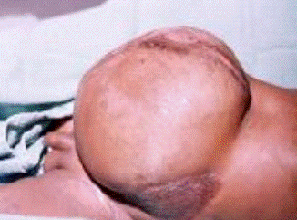
Gastroschisis: The intestines are found outside of the body through defect in the abdominal wall
Congenital umbilical hernia (omphalocele): due to failure of normal reduction of the intestinal loop

Slide 17
Abnormal rotation
Subhepatic caecum and appendix
Rotation only for 90° instead of 270° caecum and appendix will lie in the left side.
Reversed rotation for 90° in clockwise direction, the transverse colon will pass behind the duodenum. This could result in Intestinal obstruction.
Congenital volvulus: due to excessive rotation of the intestine.
- Subhepatic caecum and appendix: due to failure of descent of the caecum.

Slide 18
Development of Rectum & anal canal

Slide 19
Derivatives of the cloaca
- The cloaca is caudal dilated part of hindgut, which is closed by cloacal membrane and connected to umbilicus by allantois.
Urorectal septum extends caudally dividing cloaca into 2 parts:
1- Ventral part called urogenital sinus, closed by urogenital membrane.
2- Dorsal part called anorectal sinus, closed by anal membrane.
the site of fusion of the urorectal septum with cloacal membrane corresponds to the perineal body

Slide 20
Development of the rectum and anal canal:
The mucosa of the rectum and the upper 1/2 of the anal canal developed from the cloaca (endoderm).
The lower 1/2 of the anal canal developed from ectodermal depression outside the cloacal membrane called the proctodeum.
The upper and lower parts of the anal canal are separated by the anal membrane that ruptures at about the 9th week.
The site of anal membrane is represented by the pectinate (dentate) line.
The dorsal mesentery of the rectum disappears and the rectum becomes a retroperitoneal organ.
The mesoderm around the anorectal sinus form;
Muscles of the rectum and anal canal.
External anal sphincter.

Slide 21
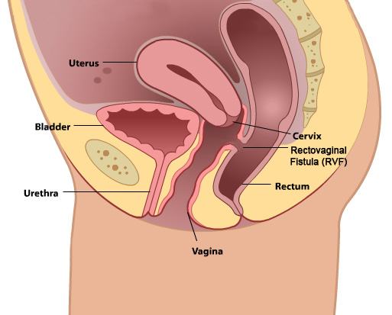
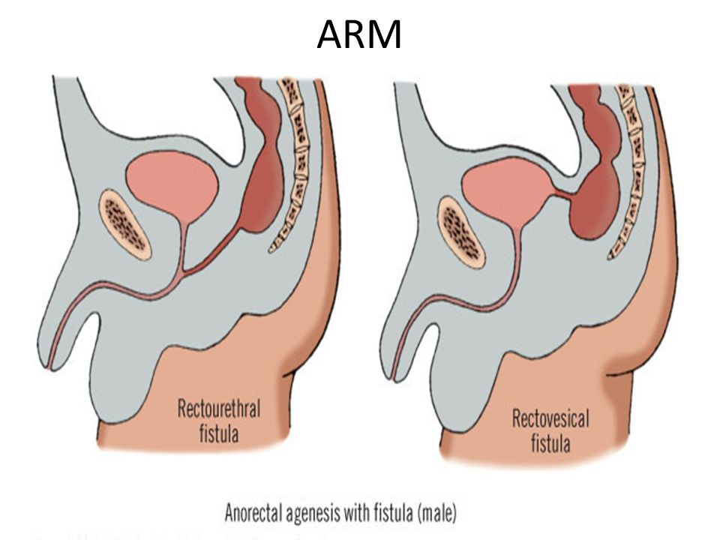
Rectal fistulae: due to incomplete descends of the urorectal septum leading to,
a- Female, Rectovaginal fistula: communication between the rectum and vagina.
b- Male, Rectourethral fistula: communication between rectum and urethra
Rectovesical fistula: communication between rectum and urinary bladder

Slide 22
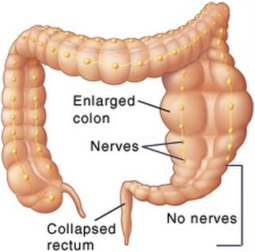
Congenital megacolon (Hirshsprung disease):
Congenital megacolon (Hirshsprung disease): abnormal dilatation of the colon due to congenital absence of its nerve plexus
Rectal stenosis: abnormal narrowing of the rectum and anal canal.
Imperforate anus: due to failure of rupture of the anal membrane

Slide 23
Thank you
Questions

