Slide 1
Pediatric History and Examination
Abedulrhman Abdelfattah, MD
Pediatrician at Mutah University

Slide 2
Differences of a Pediatric History
Prenatal and birth history
Developmental history
Vaccination
Feeding History
Parents are historians

Slide 3
Profile
Name, age, sex and residence
When admitted if inpatient by date and time and through what department was admitted.
Historian relation to patient
Who took history.

Slide 4
Chief complaint
Patient own wards
Duration prior to admission to each complaint.
Maximum 3.

Slide 5
History of present illness
Analyze the chief complaint >> SOCRATES.
Concise chronological account of the illness, including any previous treatment with full description of symptoms pertinent positives and pertinent negatives.
Patients own words.
Any relative symptoms, past hx, family hx, vaccination hx, developmental hx, natal hx and social hx.

Slide 6
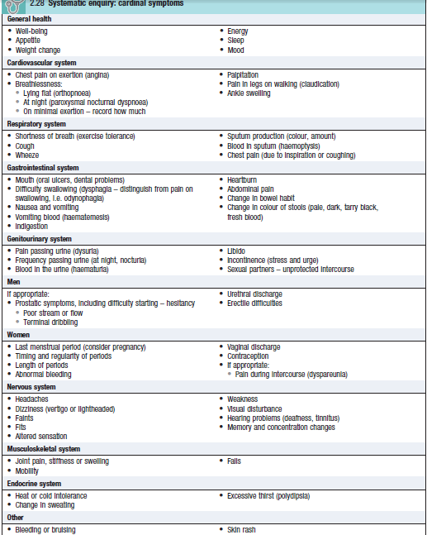

Slide 7
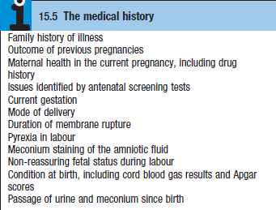
Prenatal
Maternal health during pregnancy: bleeding, trauma, hypertension, fevers, infectious illnesses, medications, drugs, alcohol, smoking, rupture of membranes
Antenatal visits and findings
Supplements and drugs
Investigations and blood group

Slide 8
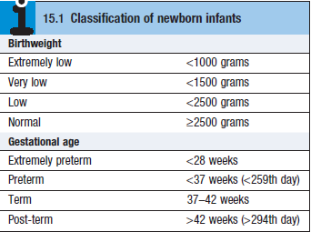
Natal and postnatal
Gestation age at delivery
Birth weight
Mode of delivery
A/S
NICU admission and coarse
Jaundice

Slide 9
Past Medical History
Major medical illnesses
Major surgical illnesses-list operations and dates
Previous hospital admissions with dates and diagnoses
Blood transfusions.

Slide 10
Drug History
Drug allergies and other allergies.
Drug: Scientific name, dose, frequency, indication and duration.
Compliance.
Herbs and OTCs.

Slide 11
Immunization
Vaccines given.
Side effects and allergy.
Extra vaccines.

Slide 12
Developmental History
Gross
Fine motor and vision
Language and hearing
Social

Slide 13
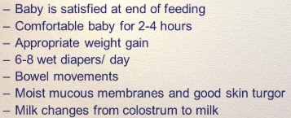
Feeding History
Breast or bottle fed, types of formula and indication.
Adequate feeding.
Frequency and amount, reasons for any changes in formula.
Weaning: when solid food introduced.
Supplements.

Slide 14
Family History
Consanguinity
Pedigree 2 generations and 3 if there is inherited disease.
Include any abortions.
Same conditions in family.
Any genetic disease, chronic illnesses or developmental delay.

Slide 15
Social
Living situation and conditions - daycare, safety issues
Occupation of parents
Exposure to smoking.
Travel hx.
Pets and trees.

Slide 16
Physical exam
General inspection
Vital signs
Growth parameters
General and systemic exam

Slide 17
Differences
Gather much information by observation
Stay at the child level
Least distressing to most distressing

Slide 18
General examination
Introduction and permission.
Privacy.
Chaperone.
Examination equipment.
Suitable couch.
Hand hygiene.
Warm and well lit room.
Exposure.
Position of the patient.
Position of the doctor.

Slide 19
General Inspection
Does the child looks well or ill?
Level of consciousness
Signs of dehydration
Dysmorphic features
Signs of respiratory distress
Suprasternl retraction
Intercostal retraction
Subcostal retraction
Nasal flaring
Use of accessory muscles
Any O2 support.
Behavior.
Odor.
Sounds.
Color >> Pallor or Cyanosis:
Normal sat 95% or above
Appear if sat les 85%

Slide 20
Vital signs
Temperature
Oral, rectal, axillary, otic.
HR
Apical or femoral for infants
Antecupital or radial pulse for older children
Respiratory rate
Observe for a minute.
Blood pressure
Appropriate size cuff - 2/3 width of upper arm

Slide 21
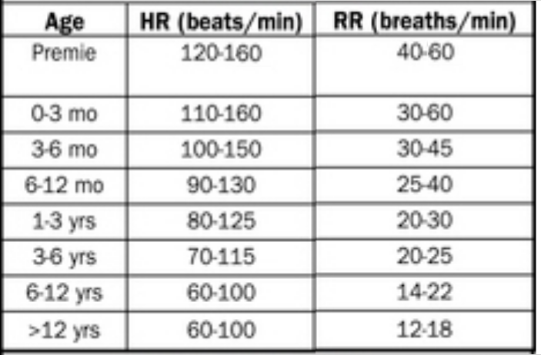

Slide 22
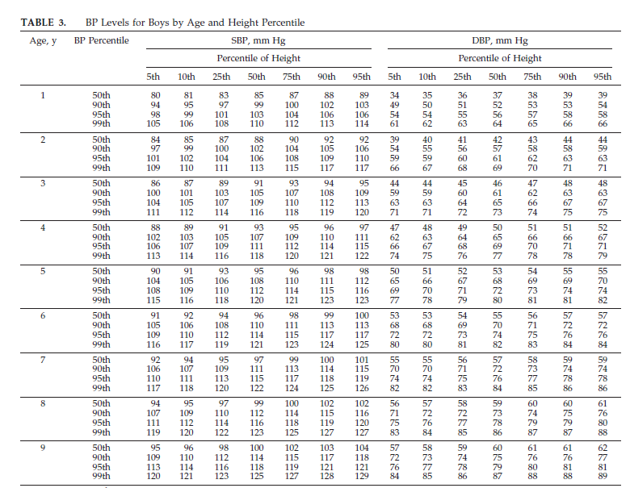

Slide 26
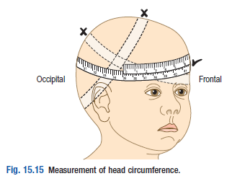
Growth parameters
Use growth charts
Weight
Length/Height
Head circumference
BMI
***Standard Vs special charts.
Notes:
Occipitofrontal

Slide 27
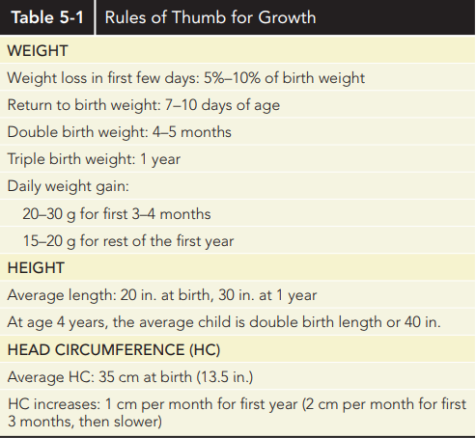

Slide 28
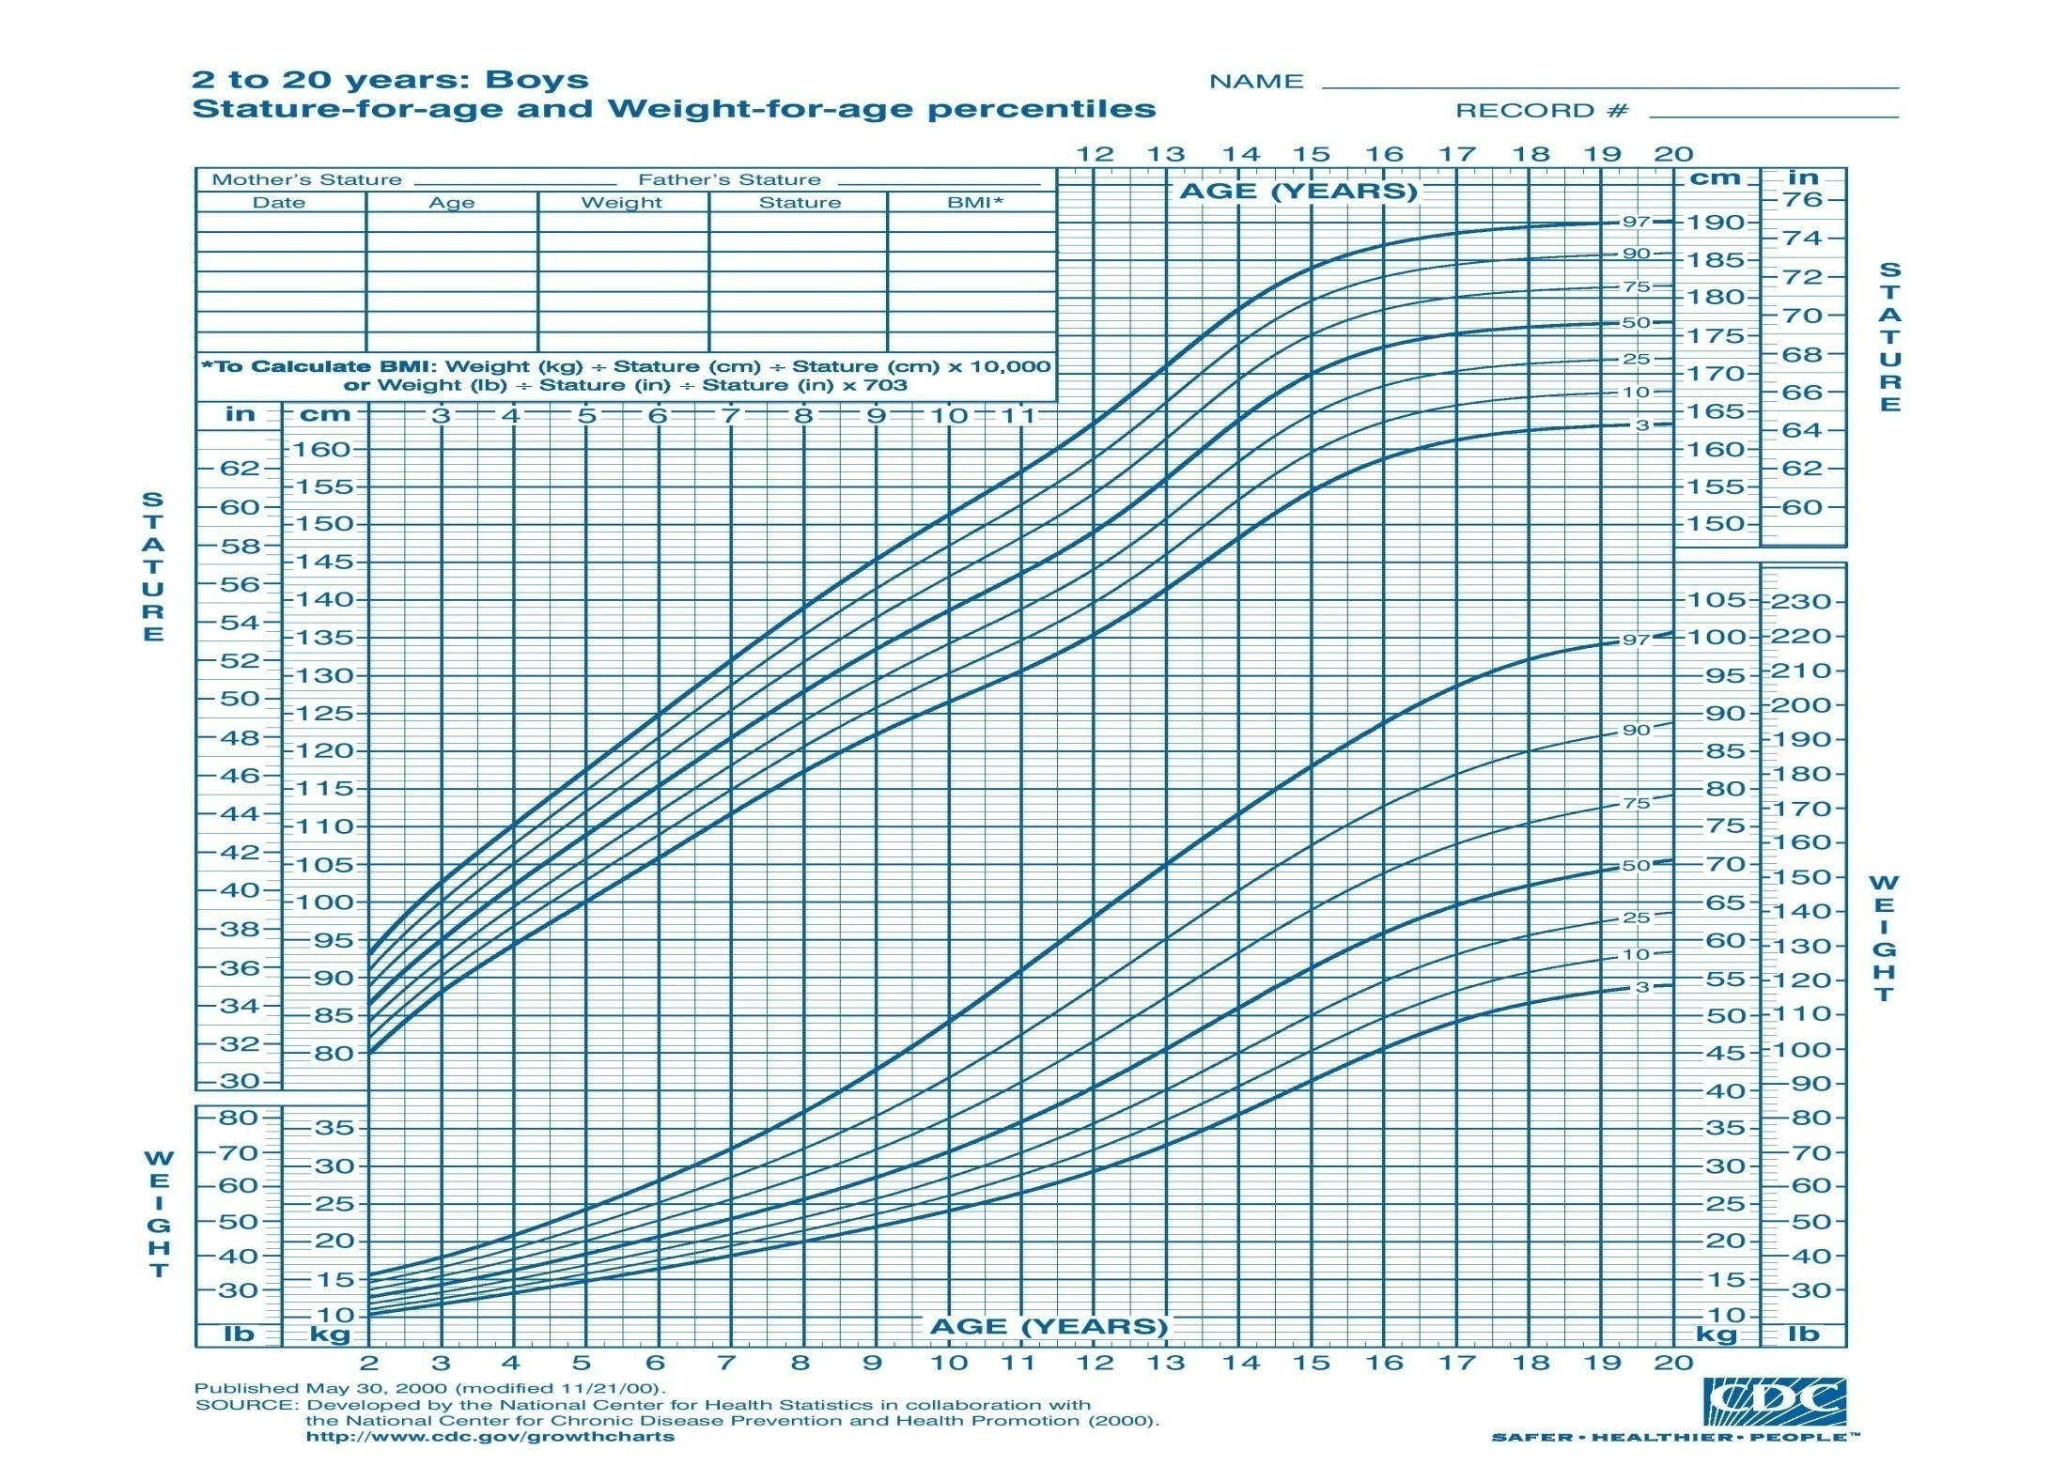

Slide 29
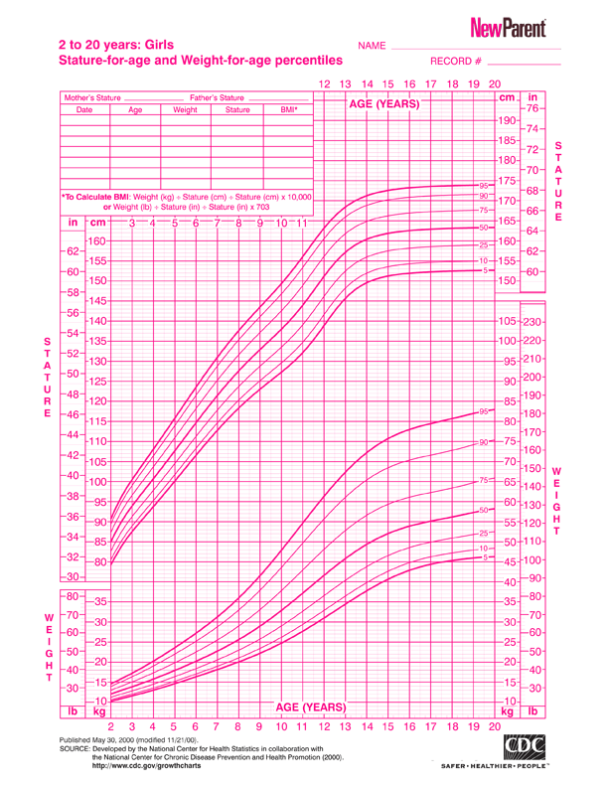

Slide 30
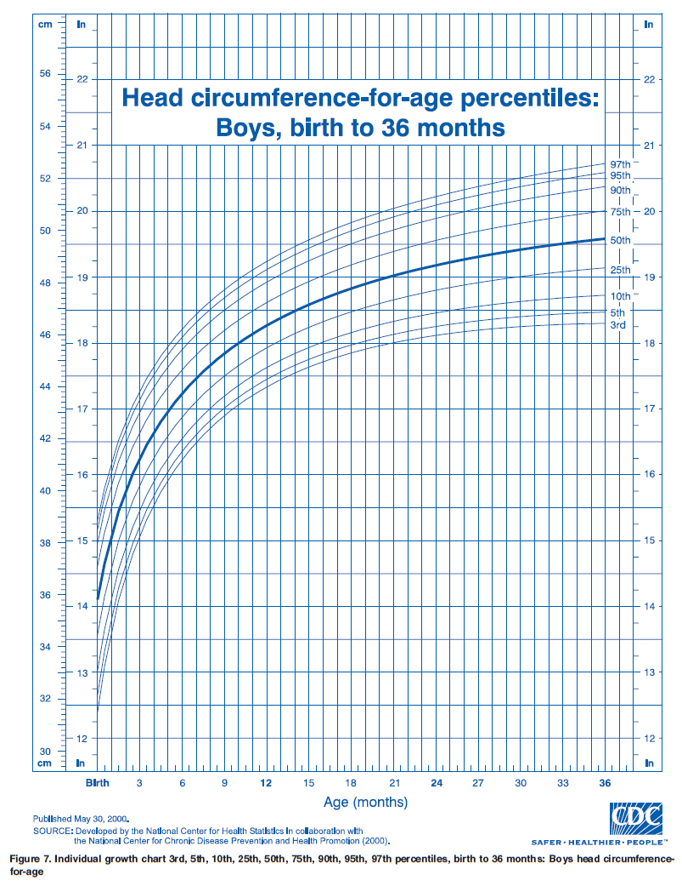

Slide 31
Terms
FFT:
fall over 2 or more percentile
are persistently below the third or fifth percentiles
are less than the 80th percentile of median weight for height measurement.
Stunting: Low height for age
Wasting: Low weight for height

Slide 32
Terms
Short stature: less than 3rd centile for age and sex
Microcephaly: less than 3rd centile for age and sex
Macrocephaly: more than 97th centile for age and sex

Slide 33
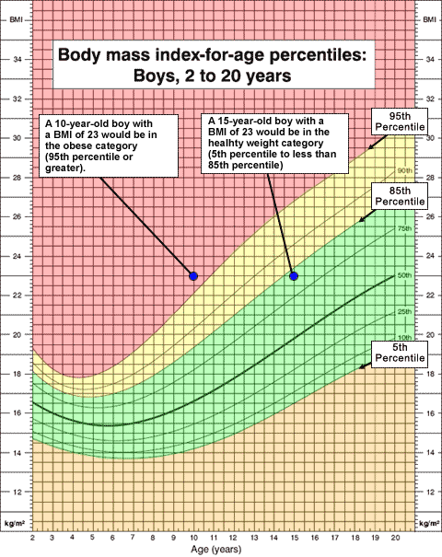

Slide 34
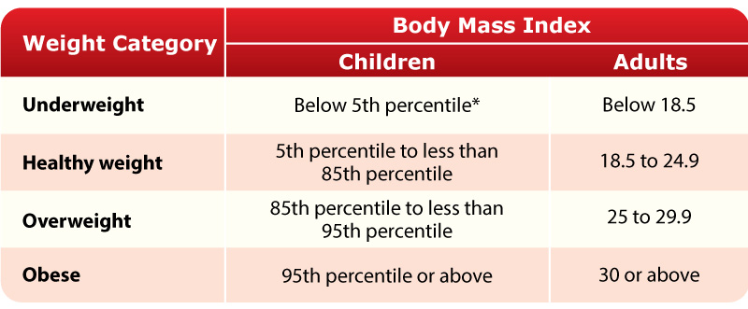
BMI

Slide 35
Skin and Lymphatics
A. Birth marks - nevi, hemangiomas, mongolian spots etc
B. Rashes, petechiae, desquamation, pigmentation, jaundice
C. Lymph node enlargement, location, mobility, consistency
D. Scars or injuries, especially in patterns suggestive of abuse

Slide 36
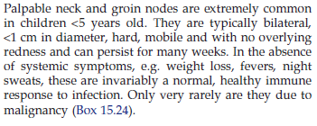
Lymphatics

Slide 37
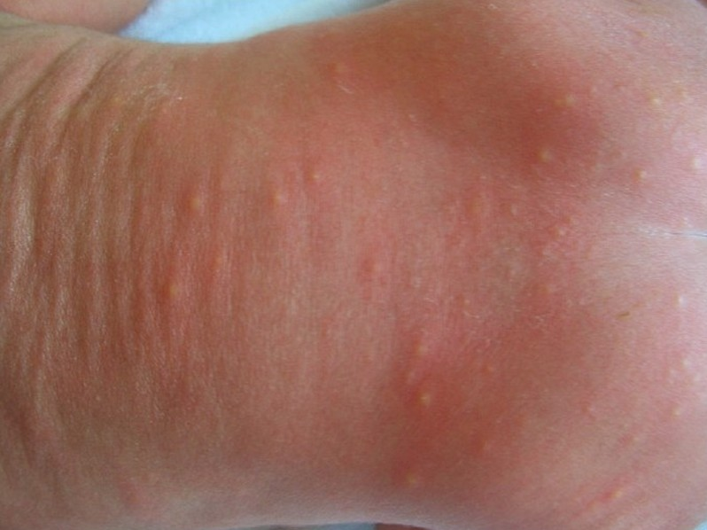
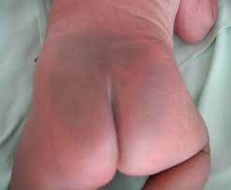
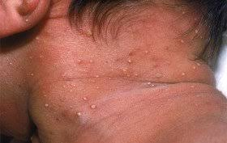
Erythema toxicum
Mongolian spot
Pustular melanosis

Slide 38
Head
Size and shape
Fontanelle(s)
Size
Tension - calm and in the sitting up position
Sutures - overriding

Slide 39
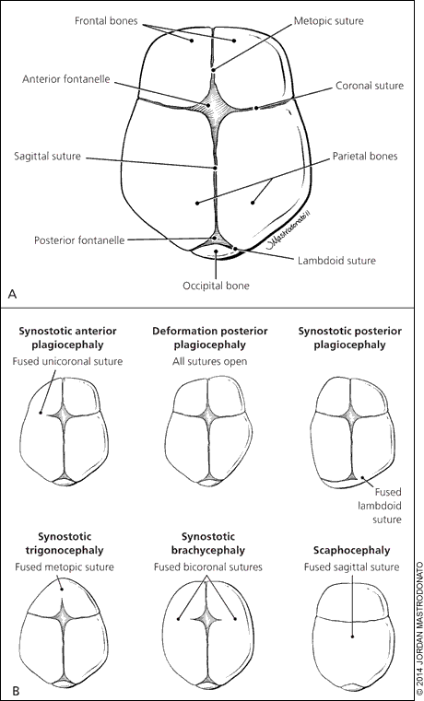

Slide 41
Eyes
Slant of palpebral fissures
Hypertelorism
Pupils
Conjunctiva, sclera, cornea
Red reflex
Visual fields - gross exam
Notes:
Micro
red

Slide 42
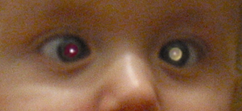
Leukorea

Slide 43
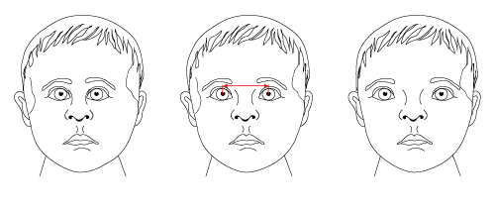
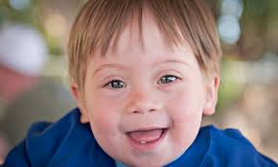
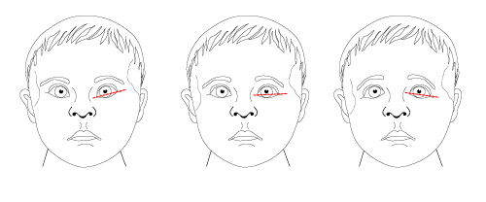

Slide 44
Ears
Ears Position of ears
Tympanic membranes
In infants pull pinna downward, in older children pull it back and up
look for swelling, perforation, redness and dullness
Notes:
Skin tag

Slide 45
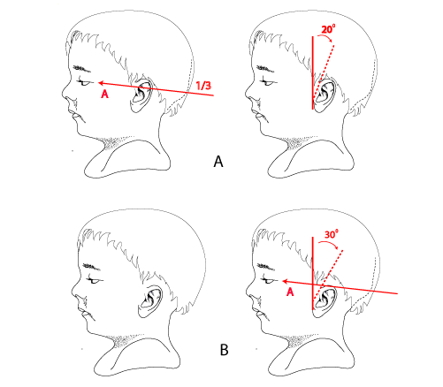

Slide 46
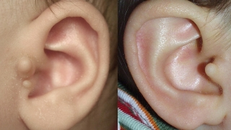

Slide 47
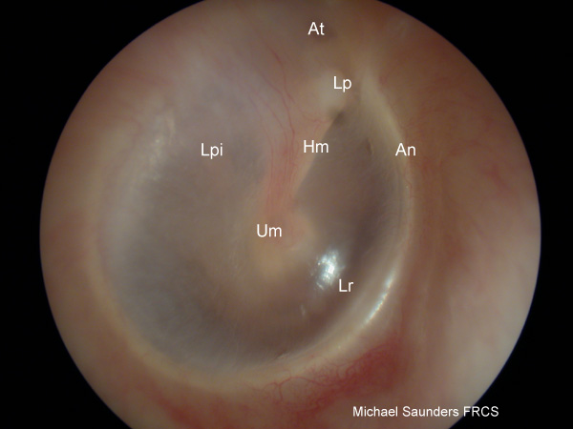
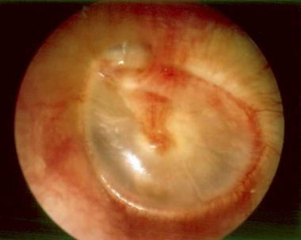

Slide 48
Nose
Nasal septum >> choanal atresia.
Nasal bridge.
Mucosa (color, polyps)
Sinus tenderness
Discharge
Notes:
salute

Slide 49
Mouth and Throat
Lips and buccal
Tongue
Teeth and gums
Palate (intact, arch)
Tonsils (size, color, exudates)
Posterior pharyngeal wall
Notes:
Downinfectiom

Slide 50
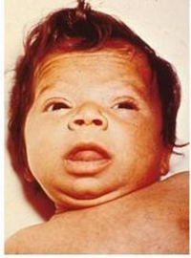
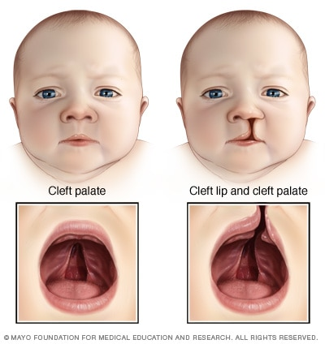

Slide 51
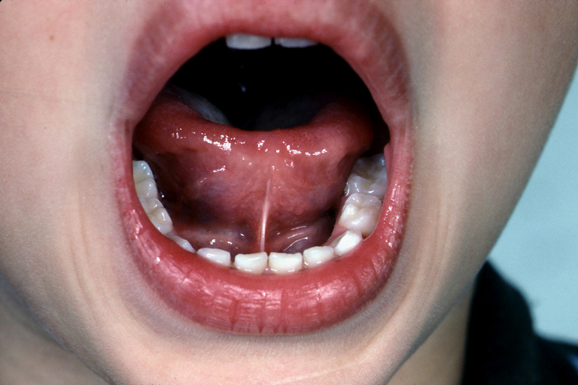
Ankyloglosia (tongue tie)

Slide 52
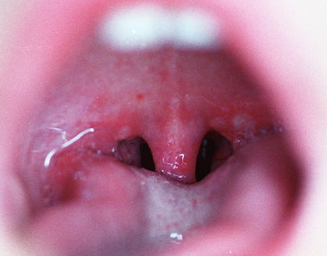
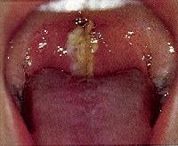

Slide 53
Neck
Thyroid
Trachea position
Masses (cysts, nodes)
Presence or absence of nuchal rigidity

Slide 54
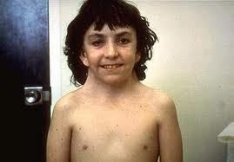
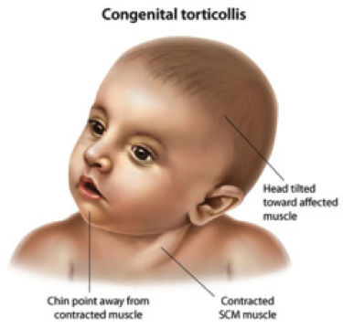

Slide 55
Lungs/Thorax
Inspection
Pattern of breathing
Abdominal breathing is normal in infants
Periodic breathing is normal in infants (pause < 15 seconds)
Respiratory distress
Chest wall configuration
Kyphosis
b. Scolisis
c. Pectus excavatum or carniatum
d. Hyperinflated
4. Scars. Skin lesions, dilated veins, masses, visible pulses.
5. Stridor or audible wheezes.

Slide 56
Lungs/Thorax
Palpation and percussion
Tracheal deviation
Apex beat
Chest expansion in older children
Palpation for tenderness, masses and crepitation.
Auscultation
Equality of breath sounds
Type of breath sounds ( vesicular or bronchial)
Expiratory phase prolongation.
wheezes, crackles
Upper airway noise
Do not forget to examine the axilla and the posterior wall.
Tactile vocal fremitus not done in pediatrics unless adolescents.

Slide 57
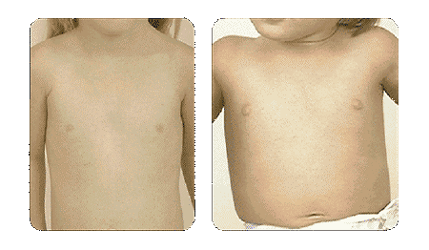
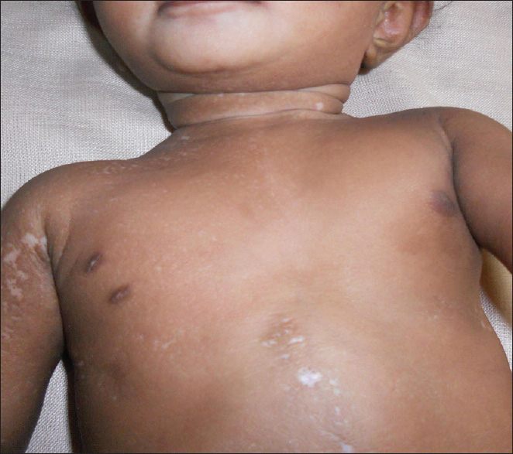

Slide 58
Cardiovascular
Vital signs
General Exam
Central cyanosis + pallor
Hands
Respiratory distress
JVP for age > 8 years
Pulses
Radio femoral delay in older children, or brachial femoral in infants.
C. Inspect the chest and palpate for heaves or thrills and Apex beat.
D. Heart auscultation ( comment on heart sounds, extra sounds and murmur).
E. Liver and lung

Slide 59
Innocent murmur
Soft 1-3
Systolic
Not conducted posteriorly
Variable with position and respiration

Slide 60
Abdomen
Inspection
Shape (Infants usually have protuberant abdomens , Becomes more scaphoid as child matures), moves with respiration, symmetry, umbilicus, rash, dilated veins, scars, stomas, masses.
Hernial orifices (ask to cough).
Pull to sit ( diastasis recti or masses)
Palpation (superficial then deep)
Tenderness - avoid tender area until end of exam
Masses
Liver, spleen, kidneys, bladder: May be palpable in normal setting
Percussion
Percuss for shifting dullness and ascites , fluid thrill for moderate ascites.
Renal angle tenderness
Auscultation
For bowel sounds ( normal every 5-10 sec) and bruit.
Digital Rectal exam is not routine
Genital exam

Slide 61
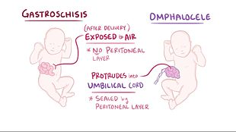

Slide 62
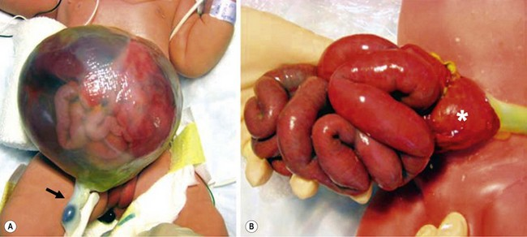

Slide 64
Musculoskeletal
Sacral dimple
Kyphosis, lordosis or scoliosis
Joints and muscles
Extremities
1. Deformity
2. Fingers
3. Edema
4. Clubbing

Slide 65
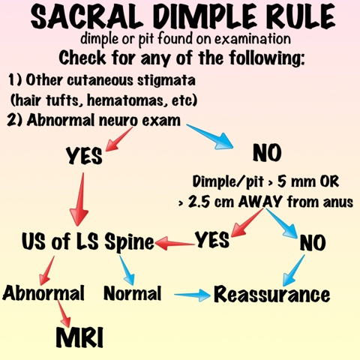
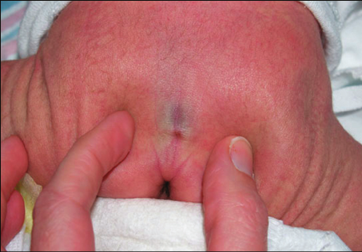

Slide 66
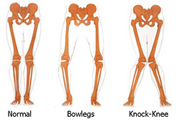
Notes:
BR

Slide 67
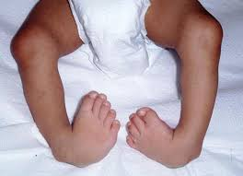
Club foot

Slide 68
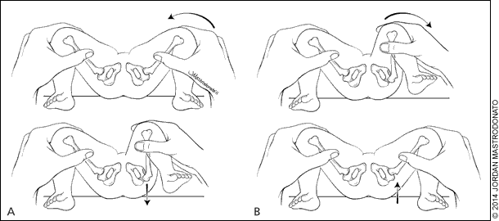
DDH

Slide 69
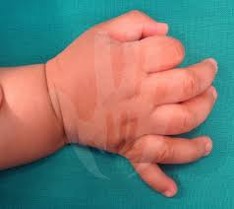
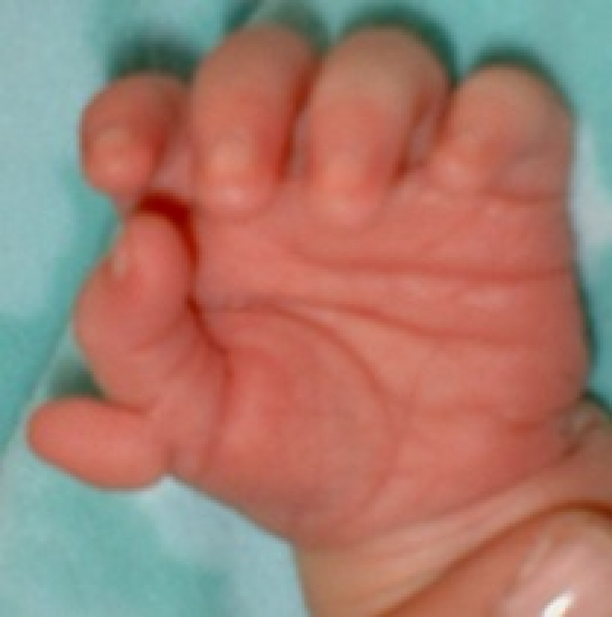
Postaxial (ulnar) Preaxial (radial) : more associated with syndrome
Common

Slide 70
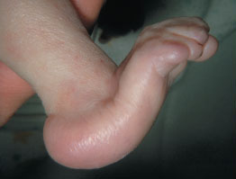
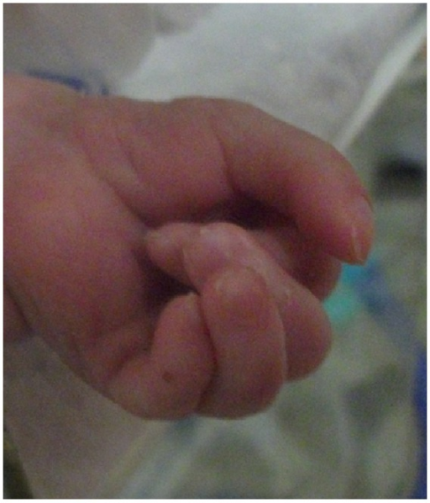
Rocker bottom feet Overriding fingers

Slide 71
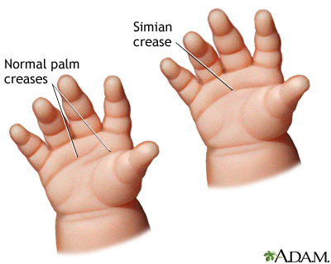
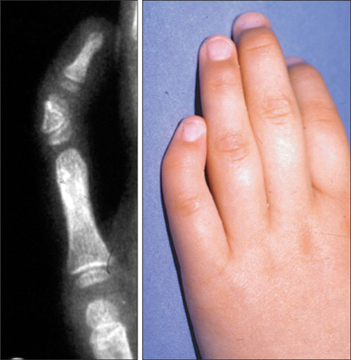
3-10% of normal population
May be associated with Down
Clinodactly: may be associated with Turner

Slide 72
Neurologic
Most accomplished through observation alone
Skin exam
Meningeal signs
Tone, Power, DTR
Sensory
Cerebellum
Cranial nerves
Primitive reflexes
Developmental evaluation

Slide 73
Reflex
Moro reflex
Stepping reflex
Rooting reflex
Sucking reflex
Asymmetrical tonic neck reflex
grasp reflex
Planter reflex
Galant reflex
Babkin reflex

Slide 74
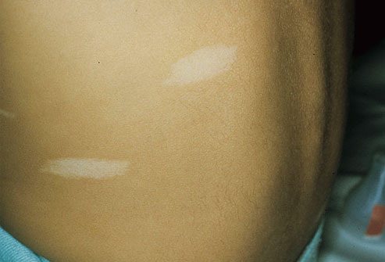
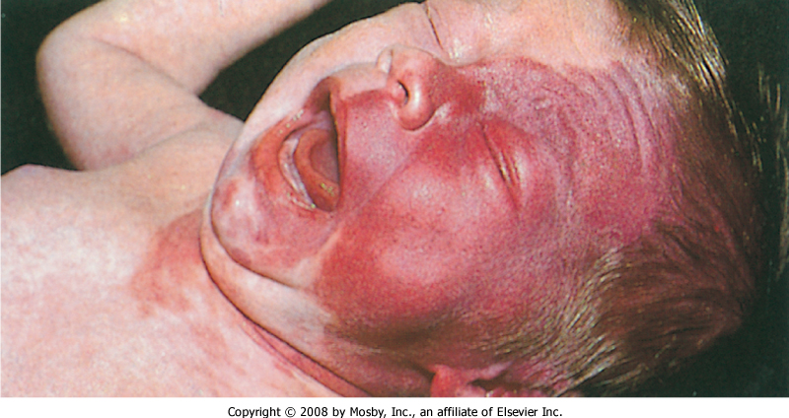

Slide 75
GU
Size of penis
Urethral opening
Scrotum and testicles
Testicular volume
Term female newborns have prominent labia majora, whereas preterm female newborns have prominent labia minora and clitoris.
Vaginal discharge with/out blood is normal after birth.
Notes:
A. External genitalia
Hernias and Hydrocoeles 1. Almost all hernias are indirect 2. Can gently palpate; do not poke finger into the inguinal canal
Cryptorchidism 1. Distinguish from hyper-retractile testis 2. Most will spontaneously descend by several months of life
Tanner staging in adolescents - See Tanner Staging handout
Rectal and pelvic exam not done routinely - special indications may exist

Slide 76
Ambiguous genitalia
Phallus length < 1.9 cm
Clitoromegaly ( length > 1cm)
Non palpable gonads in male
Hypospadias associated with undescended testis or separation of scrotal sac

Slide 77
Tanner stage

Slide 78
Orchidometer
Pubertal testicle:
4 ml
2.5 cm cm long axis

Slide 79
Stretched penile length
Normally 2.5 cm or more in term newborn

Slide 80
Hypospadius

Slide 82
Inguinal hernia
More in prematures
More at right side
More in males

Slide 83
Undescended testicles
More in prematures
Most descended by age of 1 year except 0.3%
Check if retractile testicles

Slide 84
Thank you

