Slide 1
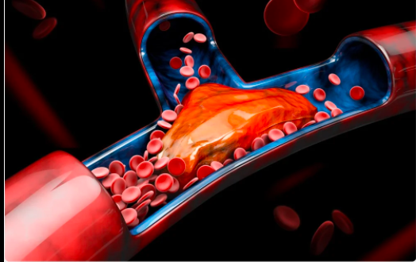
Thrombosis
Eman kreishan, M.D
21-12-2022.

Slide 3
Thrombosis
Thrombosis is the formation of a blood clot, known as a thrombus, within a blood vessel.
The primary abnormalities that lead to intravascular thrombosis are:
(1) endothelial injury.
(2) stasis or turbulent blood flow.
(3) hypercoagulability of the blood

Slide 4
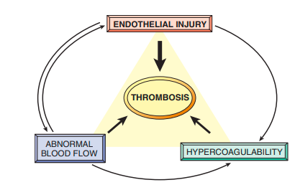
(the so-called “Virchow triad”)

Slide 5
1. Endothelial Injury
Endothelial injury leading to platelet activation.
cardiac and arterial clots are typically rich in platelets.
Endothelial injury may be caused by:
physical injury.
infectious agents.
inflammatory mediators.
metabolic abnormalities, such as hypercholesterolemia or homocystinemia,
toxins absorbed from cigarette smoking.

Slide 6
severe endothelial injury may trigger thrombosis by exposing VWF and tissue factor

Slide 7
Endothelial injury …..that’s mean:
platelet activation: exposed VWF, TF.
Endothelial dysfunction : prothrombotic endothelium.
Procoagulant changes:
thrombomodulin, thrombin
Anti-fibrinolytic effects:
Plasminogen activator inhibitors (PAI).
t-PA.

Slide 8
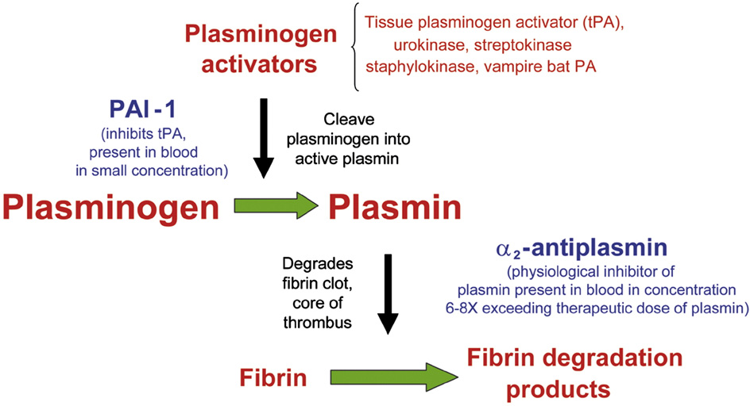

Slide 9
2. Abnormal Blood Flow
Stasis is a major factor in the development of venous thrombus.
stasis and turbulence have the following effects:
Stasis allows platelets and leukocytes to come into contact with the endothelium when the flow is sluggish.
Stasis also slows the washout of activated clotting factors and impedes the inflow of clotting factor inhibitors.

Slide 10
Notes:
normal laminar blood flow, platelets (and other blood cells) are found mainly in the center of the vessel lumen, separated from the endothelium by a slower-moving layer of plasma.

Slide 12
Turbulent and static blood flow contributes to thrombosis in a number of clinical setting:
1. Ulcerated atherosclerotic plaques.
2. aortic aneurysms create local stasis and consequently are fertile sites for thrombosis
Notes:
1. Ulcerated atherosclerotic plaques not only expose subendothelial ECM but also cause turbulence

Slide 13
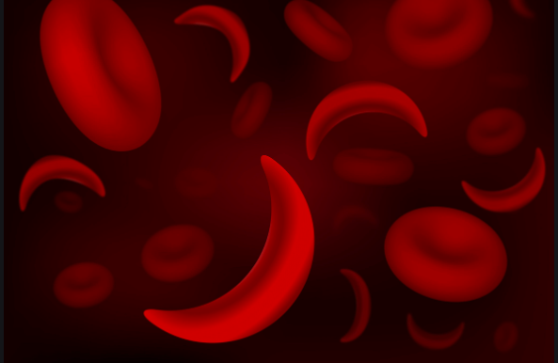
3. Hyperviscosity syndromes (such as polycythemia vera )increase resistance to flow and cause small vessel stasis.
4. sickle cell anemia:
The deformed red cells in cause vascular occlusions.

Slide 14
3. Hypercoagulability
Hypercoagulability refers to an abnormally high tendency of the blood to clot, and is typically caused by alterations in coagulation factors.
Is an important underlying risk factor for venous thrombosis

Slide 15
The alterations of the coagulation pathways that predispose affected persons to thrombosis can be divided into:
Primary (genetic):
mutations in the factor V .
elevated levels of homocysteine *
secondary (acquired) disorders:
oral contraceptive.
Pregnancy**.
Cancers***.
Notes:
*The prothrombotic effects of homocysteine may be due to thioester linkages formed between homocysteine metabolites and a variety of proteins, including fibrinogen
**hyperestrogenic state of pregnancy may be related to increased hepatic synthesis of coagulation factors and reduced synthesis of anti-thrombin III
***release of procoagulant tumor products (e.g., mucin from adenocarcinoma) predisposes to thrombosis

Slide 16
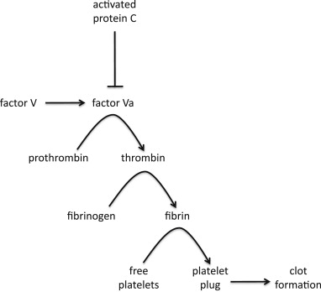

Slide 17
Among the acquired thrombophilic states, two are particularly important clinical problems and deserve special mention:

Slide 18
1. Heparin-induced thrombocytopenia (HIT) syndrome:
occurs in patients treated with unfractionated heparin.
It is marked by the development of autoantibodies that bind complexes of heparin and platelet membrane protein (platelet factor-4).
Its resulting in platelet activation, aggregation, and consumption (hence thrombocytopenia), as well as causing endothelial cell injury.

Slide 19
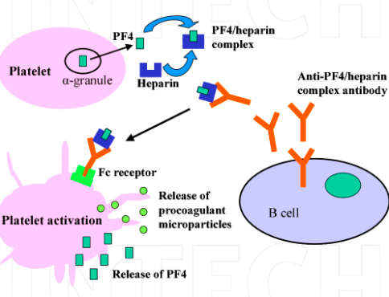

Slide 20
2. Anti-phospholipid antibody syndrome:
Acquired antibodies against phospholipid - protein complexes.
Suspected antibody targets include β2-glycoprotein I, a plasma protein that associates with the surfaces of endothelial cells, trophoblasts, and prothrombin
clinical manifestations, including :
recurrent thromboses.
repeated miscarriages.
cardiac valve vegetations.
thrombocytopenia

Slide 21
Depending on the vascular bed involved, the clinical presentations can include:
pulmonary embolism (following lower extremity venous thrombosis).
pulmonary hypertension (from recurrent subclinical pulmonary emboli)
Stroke.
bowel infarction.
renovascular hypertension.

Slide 22
MORPHOLOGY
Thrombi can develop anywhere in the cardiovascular system.
Arterial or cardiac thrombi typically arise at sites of endothelial injury or turbulence.
venous thrombi characteristically occur at sites of stasis.

Slide 23
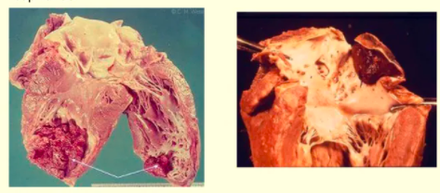
Mural thrombi:
Thrombi occurring in heart chambers or in the aortic lumen

Slide 24
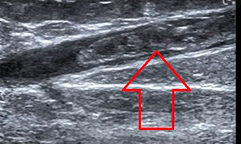
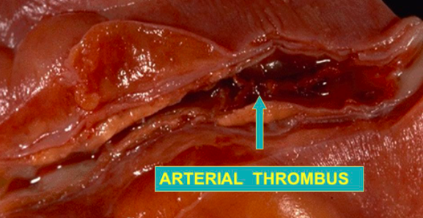
*Arterial thrombi are frequently occlusive. They are typically rich in platelets

Slide 25
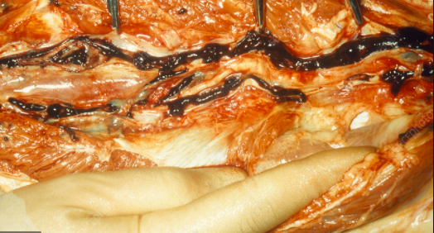
Venous thrombi (phlebothrombosis):
they frequently propagate some distance toward the heart, forming a long cast within the vessel lumen that is prone to give rise to emboli.
they tend to contain more red cells.

Slide 26
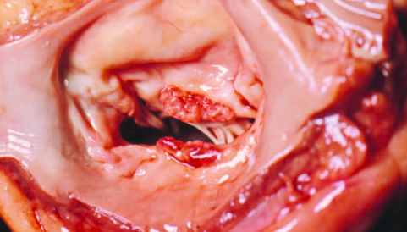
Vegetations: Thrombi on heart valves , divided into :
infective endocarditis: Infective thrombotic masses
nonbacterial thrombotic endocarditis: Sterile vegetations.
LibmanSacks endocarditis:
Sterile, occur in the systemic lupus erythematosus.

Slide 27
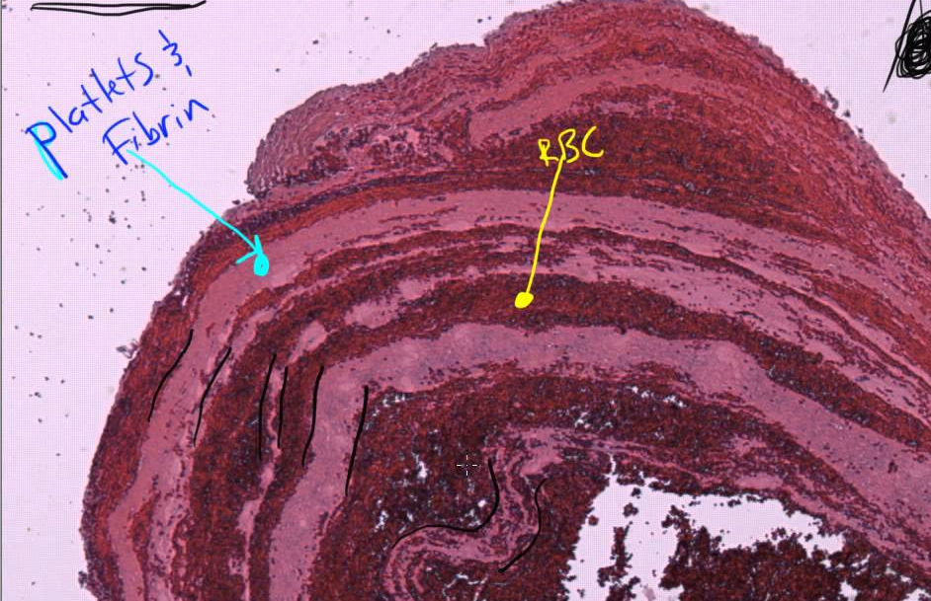
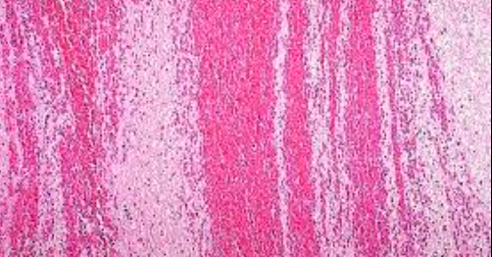
Thrombi can have grossly (and microscopically) apparent laminations called lines of Zahn; these represent
pale platelet and fibrin layers alternating with darker red cell–rich layers.

Slide 28
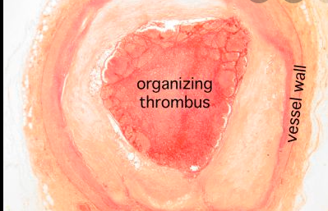

Slide 29
Fate of the Thrombus
1. Propagation: The thrombus enlargment.
2. Embolization: transported in the vasculature.
3. Dissolution: shrinkage and complete dissolution.
4. Organization
ingrowth of endothelial cells, smooth muscle cells, and fibroblasts.
5. Recanalization: capillary channels are formed create canal along the length of the thrombus, thereby reestablishing the continuity of the original lumen.

Slide 30
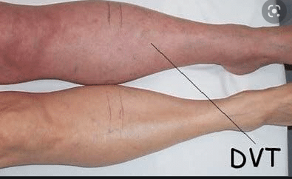
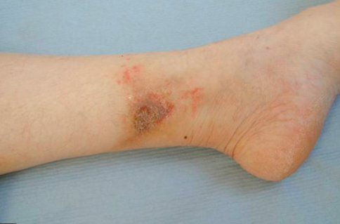
Clinical Features
1. Venous Thrombosis (Phlebothrombosis)
Pain.
local congestion and swelling from impaired venous outflow.
varicose ulcers.
rarely embolize.

Slide 31
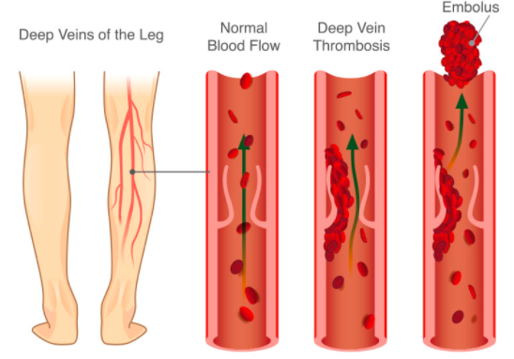

Slide 32
2. Arterial and Cardiac Thrombosis;
Atherosclerosis is a major cause of arterial thromboses because it is associated with the loss of endothelial integrity and with abnormal blood flow.
Both cardiac and aortic mural thrombi are prone to embolization. . The brain, kidneys, and spleen are particularly likely targets because of their rich blood supply.

Slide 33
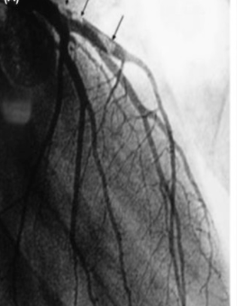
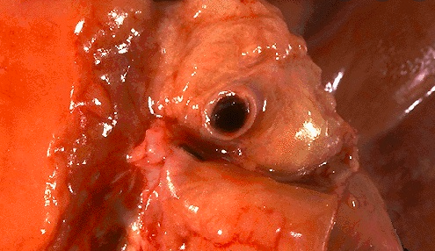
thrombosis of a coronary artery
Massive thrombosis (arrows) from distal portion of left main coronary artery

Slide 34
Disseminated Intravascular Coagulation (DIC)
DIC is widespread thrombosis within the microcirculation that may be of sudden or insidious onset.
DIC = widespread microvascular thrombosis + fibrinolytic mechanisms activation.
DIC consumes platelets and coagulation proteins (hence the synonym consumptive coagulopathy).

Slide 36
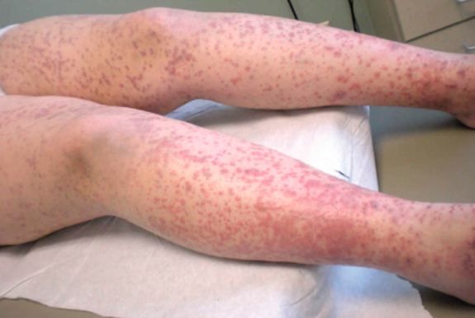
Excessive hemorrhage (Bruising, petechiae).

