Slide 1
UROGENITAL SYSTEM
THE PERINEUM
Dr. Aiman Q. Afar
Surgical Anatomist
College of Medicine /University Of Mutah

Slide 2
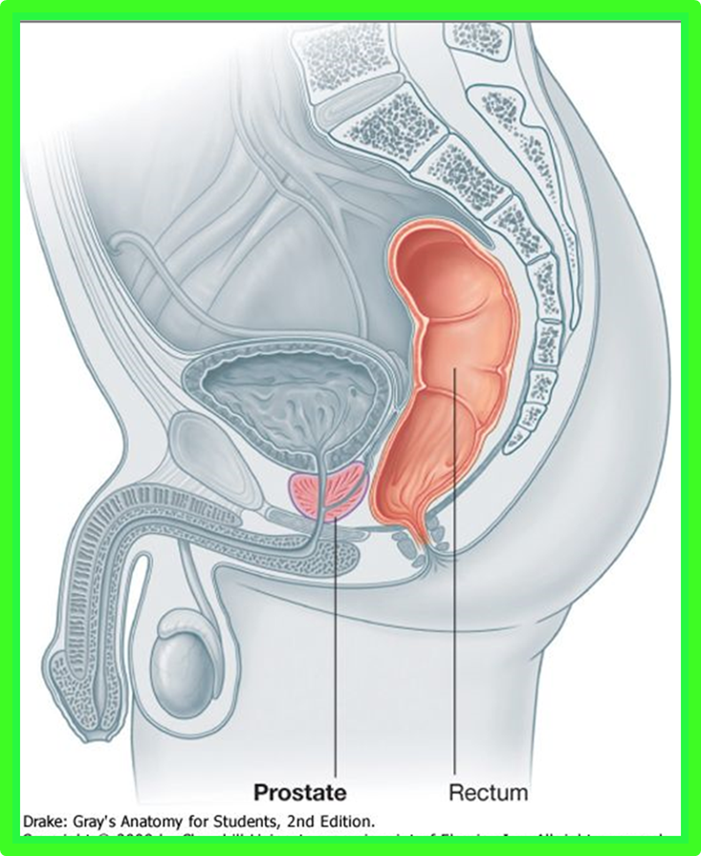
The Perineum
The cavity of the pelvis is divided by the pelvic diaphragm into the main pelvic cavity above and the perineum below .
The perineum is diamond shaped and is bounded:
Anteriorly by the symphysis pubis
Posteriorly by the tip of the coccyx and
Laterally by the ischial tuberosities

Slide 3
The Perineum
Diamond-shaped perineum divided by a broken line into the:
Urogenital triangle
Anal triangle.
The Urogenital triangle is bounded in front by the pubic arch and laterally by the ischial tuberosities

Slide 4
Urogenital Triangle
Superficial Fascia
Can be divided into a fatty layer and a membranous layer.
The fatty layer (fascia of Camper) is continuous with the fat of the ischiorectal fossa and the superficial fascia of the thighs
In the scrotum, the fat is replaced by smooth muscle the dartos muscle.
The dartos muscle contracts in response to cold and reduces the surface area of the scrotal skin

Slide 5
Urogenital Triangle
Superficial Fascia
The membranous layer (Colles' fascia) is attached:
Posteriorly to the posterior border of the urogenital diaphragm
Laterally to the margins of the pubic arch
Anteriorly it is continuous with the membranous layer of superficial fascia of the anterior abdominal wall (Scarpa's fascia).
The fascia is continued over the penis (or clitoris) as a tubular sheath

Slide 6
Superficial Perineal Pouch
Is bounded below by the membranous layer of superficial fascia and above by the urogenital diaphragm .
It is closed behind by the fusion of its upper and lower walls.
Laterally, it is closed by the attachment of the membranous layer of superficial fascia and the urogenital diaphragm to the margins of the pubic arch .
Anteriorly, the space communicates freely with the potential space lying between the superficial fascia of the anterior abdominal wall and the anterior abdominal muscles

Slide 7
Contents of the Superficial Perineal Pouch
In males, the superficial perineal pouch contains the:
Root (bulb and crura) of the penis and associated muscles (ischiocavernosus and bulbospongiosus).
Proximal (bulbous) part of the spongy urethra.
Superficial transverse perineal muscles.
Deep perineal branches of the internal pudendal vessels and pudendal nerves

Slide 8
Urogenital Diaphragm
Is a triangular musculofascial diaphragm situated in the anterior part of the perineum
filling in the gap of the pubic arch

Slide 9
Urogenital Diaphragm
It is formed by the sphincter urethrae and the deep transverse perineal muscles, which are enclosed between a superior and an inferior layer of fascia of the Urogenital diaphragm.
The inferior layer of fascia is often referred to as the perineal membrane.

Slide 10
Urogenital Diaphragm
Anteriorly: the two layers of fascia fuse, leaving a small gap beneath the symphysis pubis.
Posteriorly: the two layers of fascia fuse with the membranous layer of the superficial fascia and the perineal body
Laterally, the layers of fascia are attached to the pubic arch.
The closed space that is contained between the superficial and deep layers of fascia is known as:
The deep perineal pouch.

Slide 11
Contents of the Male Urogenital Triangle
In the male, the triangle contains the penis and scrotum.
Penis
Root of the Penis
Is made up of three masses of erectile tissue called the bulb of the penis and the right and left crura of the penis
The bulb is situated in the midline and is attached to the undersurface of the urogenital diaphragm
It is traversed by the urethra and is covered on its outer surface by the bulbospongiosus muscles

Slide 12
Contents of the Superficial Perineal Pouch in the Male
The bulbospongiosus
muscles situated one on each side of the midline. It compress the penile urethra and empty it of residual urine or semen.
Ischiocavernosus muscles
cover the crus penis on each side
The action of each muscle is to compress the crus penis and assist in the process of erection of the penis.

Slide 13
Contents of the Superficial Perineal Pouch in the Male
Superficial Transverse Perineal Muscles
Lie in the posterior part of the superficial perineal pouch
Each muscle arises from the ischial ramus and is inserted into the perineal body.
The function of these muscles is to fix the perineal body in the center of the perineum.

Slide 14
Contents of the Superficial Perineal Pouch in the Male
Perineal Body
This small mass of fibrous tissue is attached to the center of the posterior margin of the Urogenital Diaphragm
It serves as a point of attachment for the following muscles: External anal sphincter, bulbospongiosus muscle, and superficial transverse perineal muscles
Perineal Branch of the Pudendal Nerve
On each side it terminates in the superficial perineal pouch by supplying the muscles and skin.

Slide 15
Contents of the Deep Perineal Pouch in the Male
Membranous part of the urethra
The sphincter urethrae
The bulbourethral glands
The deep transverse perineal muscles
The internal pudendal vessels and their branches
The dorsal nerves of the penis

Slide 16
Contents of the Deep Perineal Pouch in the Male
Membranous Part of the Urethra
It is about 0.5 in. (1.3 cm) long and lies within the urogenital diaphragm, surrounded by the sphincter urethrae muscle
it is continuous above with the prostatic urethra and below with the penile urethra.
It is the shortest and least dilatable part of the urethra

Slide 17
Contents of the Deep Perineal Pouch in the Male
Sphincter Urethrae Muscle
Surrounds the urethra in the deep perineal pouch. It arises from the pubic arch on the two sides and passes medially to encircle the urethra
Action
The muscle compresses the membranous part of the urethra and relaxes during micturition. It is the means by which micturition can be voluntarily stopped

Slide 18
Contents of the Deep Perineal Pouch in the Male
Bulbourethral Glands
Are two small glands that lie beneath the sphincter urethrae muscle . Their ducts pierce the perineal membrane (inferior fascial layer of the Urogenital diaphragm) and enter the penile portion of the urethra.
The secretion is poured into the urethra as a result of erotic stimulation

Slide 19
Contents of the Deep Perineal Pouch in the Male
Deep Transverse Perineal Muscles
Lie posterior to the sphincter urethrae muscle.
Each muscle arises from the ischial ramus and passes medially to be inserted into the perineal body. These muscles are clinically unimportant

Slide 20
Contents of the Deep Perineal Pouch in the Male
Internal Pudendal Artery
On each side enters the deep perineal pouch and passes forward, giving rise to the artery to the bulb of the penis; the arteries to the crura of the penis (deep artery of penis); and the dorsal artery of the penis, which supplies the skin and fascia of the penis.

Slide 21
Contents of the Deep Perineal Pouch in the Male
Dorsal Nerve of the Penis
The dorsal nerve of the penis on each side passes forward through the deep perineal pouch and supplies the skin of the penis

Slide 22
Female Urogenital Triangle
In the female, the triangle contains the external genitalia and the orifices of the urethra and the vagina
Contents of the Female Urogenital Triangle
Clitoris
The clitoris, which corresponds to the penis in the male, is situated at the apex of the vestibule anteriorly.
It has a structure similar to the penis.
The glans of the clitoris is partly hidden by the prepuce.

Slide 23
Contents of the Female Urogenital Triangle
Root of the Clitoris
is made up of three masses of erectile tissue called:
The bulb of the vestibule and
The right and left crura of the clitoris
The bulb of the vestibule corresponds to the bulb of the penis, but because of the presence of the vagina, it is divided into two halves
It is attached to the undersurface of the Urogenital diaphragm and is covered by the bulbospongiosus muscles.

Slide 24
Contents of the Female Urogenital Triangle
The crura of the clitoris :
correspond to the crura of the penis and become the corpora cavernosa anteriorly.
Each remains separate and is covered by an ischiocavernosus muscle .

Slide 25
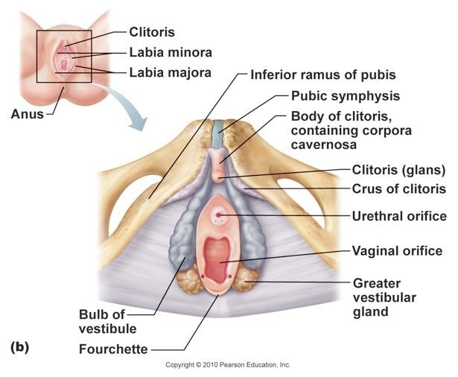
Contents of the Female Urogenital Triangle
Body of the Clitoris
Consists of the two corpora cavernosa
The corpus spongiosum contain of the small amount of erectile tissue
Glans of the Clitoris
Is a small mass of erectile tissue that caps the body of the clitoris.
It is provided with numerous sensory endings.
The glans is partly hidden by the prepuce

Slide 26
Contents of the Superficial Perineal Pouch in the Female
Contains structures forming :
The root of the clitoris and the muscles that cover them, namely, the bulbospongiosus muscles and the ischiocavernosus muscles .

Slide 27
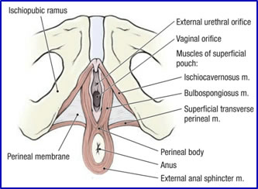
Bulbospongiosus Muscle
Surrounds the orifice of the vagina and covers the vestibular bulbs.
Its fibers extend forward to gain attachment to the corpora cavernosa of the clitoris.
It reduces the size of the vaginal orifice and…..
Compresses the deep dorsal vein of the clitoris, thereby assisting in the mechanism of erection in the clitoris

Slide 28
Ischiocavernosus Muscle
The ischiocavernosus muscle on each side covers the crus of the clitoris.
Contraction of this muscle assists in causing the erection of the clitoris

Slide 29
Perineal Body
The perineal body is larger than that of the male and is clinically important.
It is a wedge-shaped mass of fibrous tissue situated between the lower end of the vagina and the anal canal
It is the point of attachment of many perineal muscles including the levatores ani muscles
the latter assist the perineal body in supporting the posterior wall of the vagina

Slide 30
Contents of the Deep Perineal Pouch in the Female
Contains:
Part of the urethra
Part of the vagina
The sphincter urethrae which is pierced by the urethra and the vagina
The deep transverse perineal muscles
The internal pudendal vessels and their branches; and
The dorsal nerves of the clitoris.

Slide 31
Paraurethral Glands
The paraurethral glands, which correspond to the prostate in the male
Open into the vestibule by small ducts on either side of the urethral orifice

Slide 32
Greater Vestibular Glands
Are a pair of small mucus-secreting glands that lie under cover of the posterior parts of the bulb of the vestibule and the labia majora
Each drains its secretion into the vestibule by a small duct, which opens into the groove between the hymen and the posterior part of the labium minus
These glands secrete a lubricating mucus during sexual intercourse

Slide 33
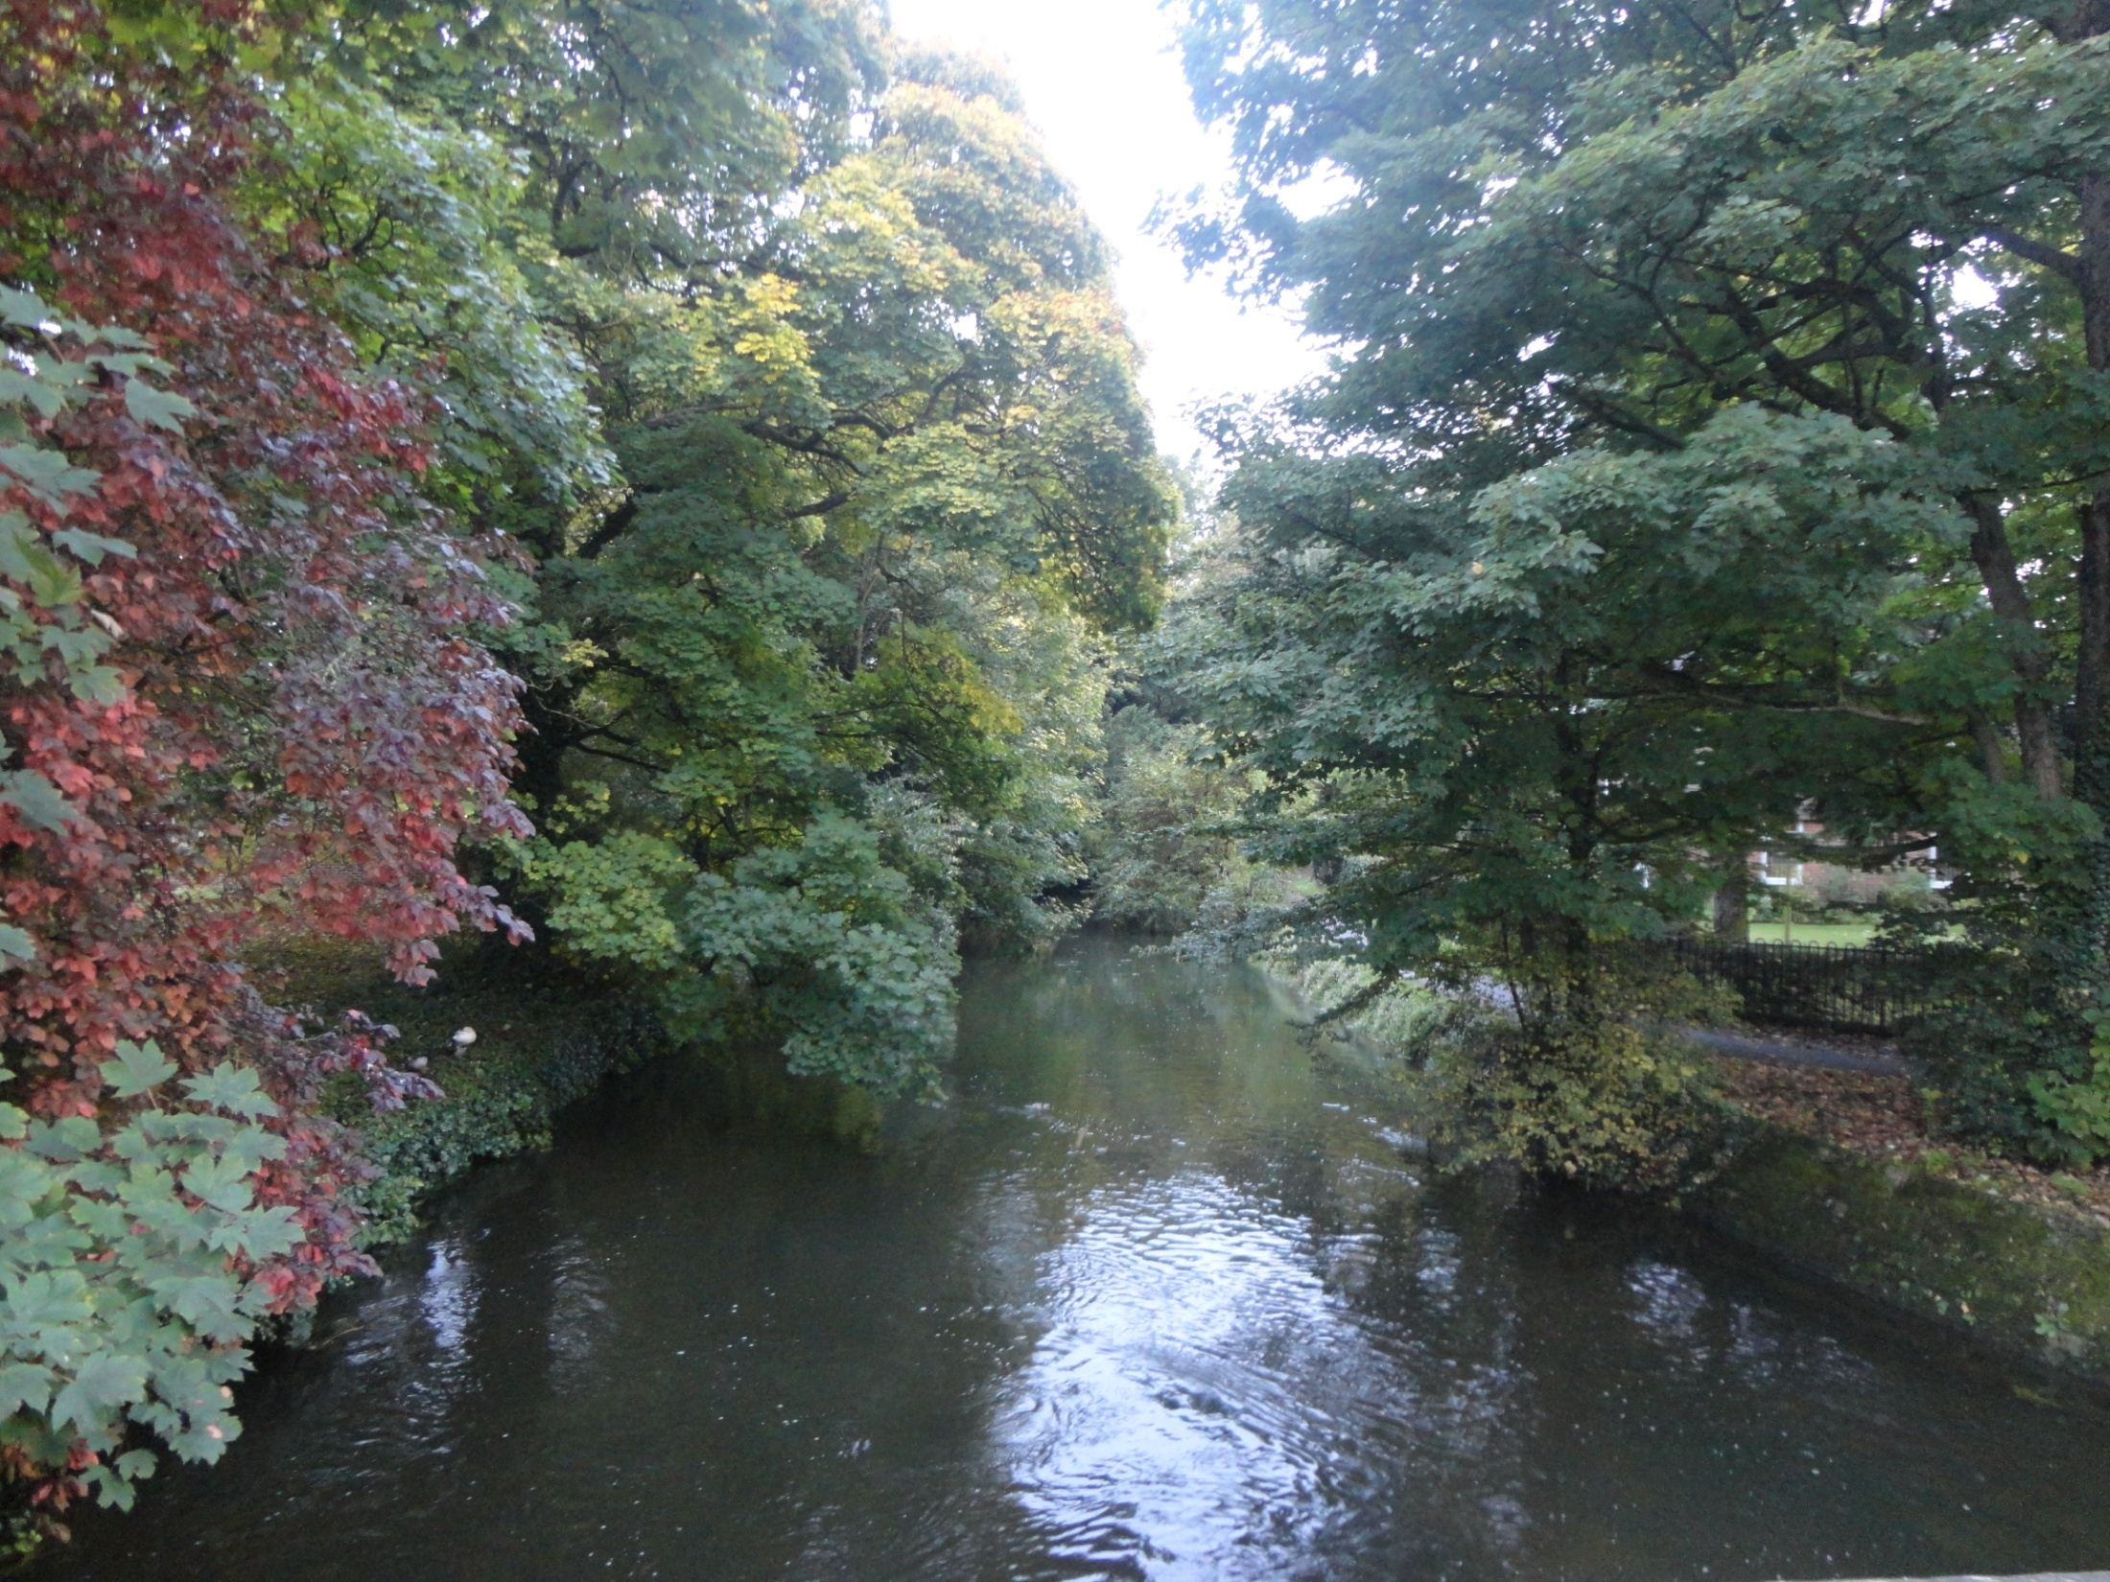
Dr. Aiman Q Afar
Tuesday 20 April. 2021

