Slide 1
IV Fluids- electrolytes
Done by :
Moath Al-harasis
Yousef murad
Hala Al-zenaty
Moath AL-zoubi
Ahmad al-sarayreh
Khalil Abuawad
Dr-Ashraf Al-dmour

Slide 2
IV Fluids

Slide 3
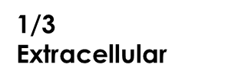
Fluid compartments
40%
Non-Water
1/4
Plasma
60%
Water
3/4
Interstitial
2/3
Intracellular

Slide 4
Fluid Intake and Output
• Normal oral intake ~2 L/day • Output: • Urine: 1.0 L/day • Insensible losses: • Stool: 0.25 L/day • respiration, sweating: 0.75 L/day •Insensible losses: pathologic states • Fever • Burns
Notes:
Insensible fluid loss is the amount of body fluid lost daily that is not easily measured, from the respiratory system, skin, and water in the excreted stool.

Slide 5
IV fluid therapy indications
• IV fluid therapy is used to maintain homeostasis when: • intake is insufficient • to replace any additional losses.
• These losses may occur from: GIT (due to severe vomiting, diarrhoea), urinary tract (eg, diabetes insipidus), blood loss from trauma or surgery. In addition, insensible losses can increase during fever or after suffering from burns because the barrier function of the skin is impaired.

Slide 6
Types of IV fluids
Crystalloid solutions
• Contain water and salts (NA+,K+,CL-,CA+2,HC03-)
dont stay intravascular spread to interstitium
• Examples: • Normal saline (isotonic) • Lactated ringers (isotonic) • half normal saline (hypotonic) • D5W (hypotonic) • Hypertonic saline.
•infusion : fluid loss ratio = 1:1
•infusion : blood loss ratio = 4:1
Notes:
Fluid losses (urine and insensible perspiration) are replaced in a 1:1 ratio with a balanced crystalloid infusion solution. Additionally, intravascular blood loss must be replaced in a 4–5:1 ratio.

Slide 7
Colloid solutions
• Contain water and large molecules
• Mainly remains in the intravascular compartment.
• used for resuscitation in severe hypovolemia , blood loss and burns.
• Examples: albumin, gelatin, dextran solutions, hydroxyethyl starches
• Expensive
• infusion : blood loss ratio = 1:1

Slide 8
osmolarity
Osmosis: simple diffusion of water from high conc of water to low conc of water across semi permeable membrane.
Osmolarity of solution is equal to number of osmoles per liter of solution.
Normal range of osmolarity in plasma is about 280-295 milli-osmoles per liter.
Tonicity is the total conc. of solutes which make an osmotic force across a membrane.
The term tonicity is used to describe the osmolarity of a solution relative to plasma. • Isotonic (osmolarity of a solution ~ to plasma) • hypertonic (osmolarity of a solution > to plasma) • hypotonic (osmolarity of a solution < to plasma)
Notes:
the osmolality of the extracellular fluid (ECF) is approximately equal to that of the intracellular fluid (ICF).
Osmole: the osmosis caused by a mole.

Slide 9
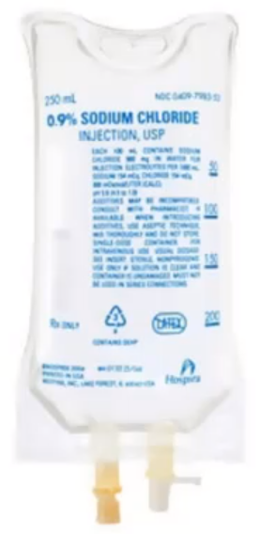
Normal Saline
0.9% Normal Saline
• Approximately same osmolarity as plasma • [Na] = [Cl] = 154 mmol/liter • total osmolarity = 308 mOsmol/liter vs. 285 m0sm/L plasma
• isotonic
• 25% remains in intravascular space
•Used for volume replacement ? • Hypovolemic shock • Septic shock

Slide 10
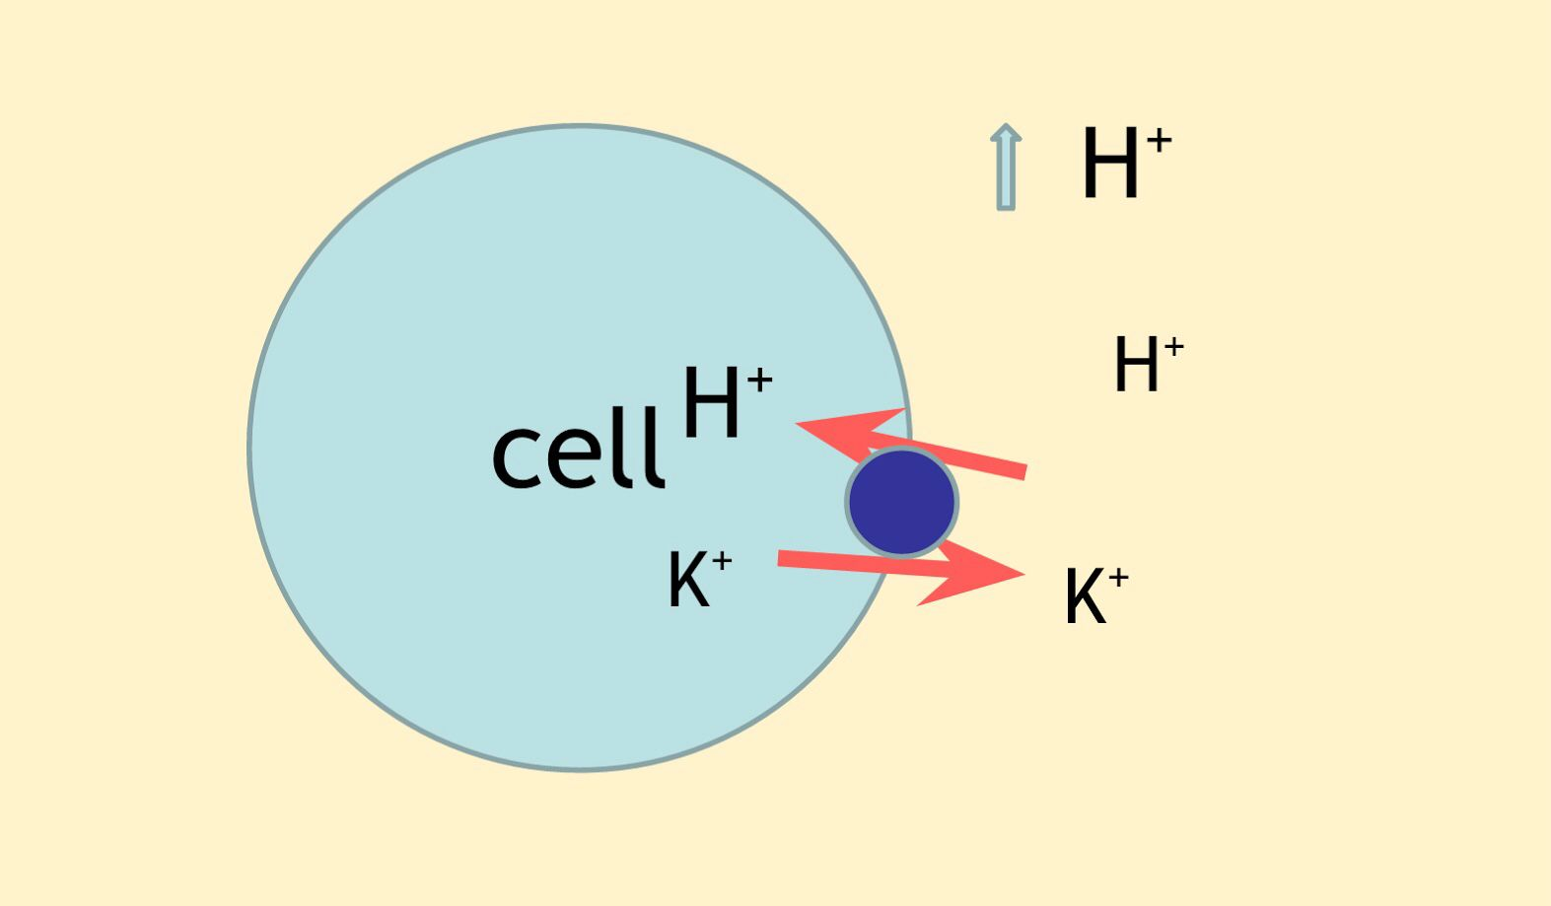
Normal Saline
• Normal Saline Results in influx of chloride ions (Cl)
• Causes shift of bicarbonate ions (HCO3) into cells
• Causes acidosis ( pH)
• Acidosis → potassium shift out of cells
• ↑ serum potassium
•Contraindications:
CHF, CKD, Liver cirrhosis
Notes:
Hyperchloremic metabolic acidosis

Slide 11
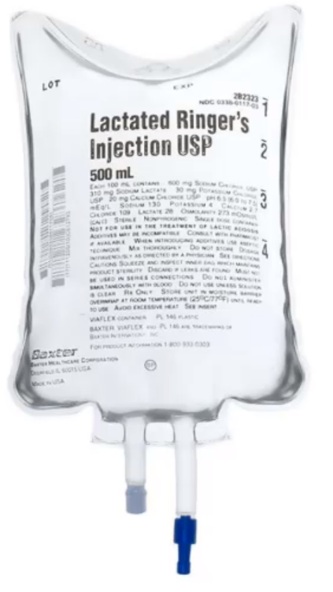
Lactated Ringers
• Sodium, chloride, potassium, calcium, and lactate.
• "Balanced fluid"
• Isotonic: osmolarity 286 mOsm/L
• Lactate converted to bicarbonate
• Acts as buffer in acidotic states
Used for?
trauma resuscitation

Slide 12
INDICATION ?
1) First-line replacement therapy in the perioperative period.
2) Fluid resuscitation after a blood loss due to trauma, surgery, or a burn injury.
3) Replace GI tract fluid losses.
4) Metabolic acidosis.
CONRTAINDICATION ?
1) Poor liver function. ( cant metabolize lactate )
2) Hyperkalemia
(renal patient)
3) Citrated blood transfusions (Clumping of red cells if it is co-administered with blood products)

Slide 13
Half Normal Saline
0.45% Normal Saline
• [Na] = [Cl] = 77 mmol/liter
• total osmolarity = 154 mOsmol/liter vs. 285 m0sm/L plasma
• Hypotonic solution concentration of sodium chloride
• Does not remain intravascular
• Used as "maintenance fluids"
• Replaces daily losses of sodium and water
• 5% dextrose often added: D5 half NS
• Potassium can be added: D5 half NS with 20mEq K
• Often used when oral intake is low
Avoid with ? Hyponataremia ,burns,head trauma

Slide 14
D5W
5% Dextrose
• IV fluid that contains Dextrose and free water.
Cautously? Renal patient
• Dextrose is metabolized leaving only free water
• Used for?
hypernatremia to dilute sodium.
Notes:
Dextrose is not considered to have an osmotic effect because it is rapidly metabolized in blood

Slide 15
Hypertonic Saline
3% Saline
• Hypertonic: ~900 mOsm/liter
• Draws fluid out of tissues into vascular space
• ICF ECF
• Used in ? • Elevated intracerebral pressure • Severe hyponatremia

Slide 17
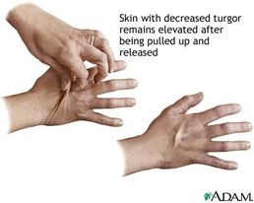
Hypovolemia
• Many causes: • Vomiting/diarrhea • Poor oral intake • Third spacing/fluid leak: sepsis, trauma
• Clinical features: • Decreased urine output • Dry mucous membranes • Poor skin turgor Hypotension
• Treatment: oral intake, IV fluids

Slide 18
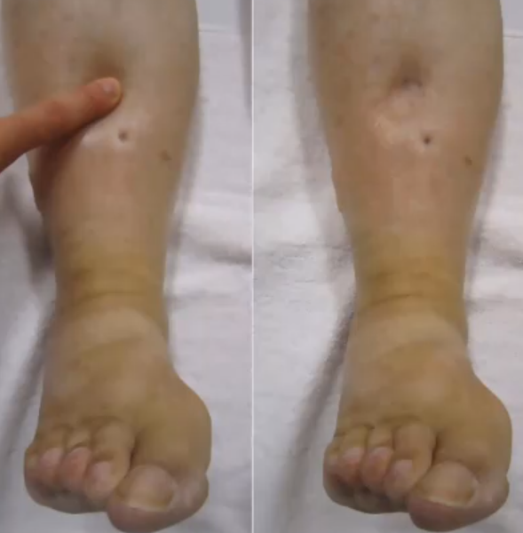
Hypervolemia
• Classic causes • Heart failure • Cirrhosis • Nephrotic syndrome
• Clinical features: • Weight gain • Pitting edema • Elevated jugular venous pressure • Pulmonary edema
• Treatment: diuretics

Slide 19
Maintenance of Fluids:
(4-2-1 rule)
(4ml/kg for the first 10kg) + (2ml/kg for kg 11-20) + (1ml/kg for every kg above 20) = hourly rate
Example: Calculate the hourly maintenance fluid rate for a child who weighs 25kg
(4ml x 10kg) + (2ml x 10kg) + (1ml x 5kg) = hourly rate
40ml + 20ml + 5ml = 65ml/hr
Maintenance of electrolytes:
Na+: 3 mEq/kg/day, K+ : 1 mEq/kg/day
e.g. 50 kg patient maintenance requirements
• fluid = 40 + 20 + 30 = 90 mL/hour = 2160 mL/day
• Na+ = 150 mEq/day
• K+ = 50 mEq/day

Slide 20
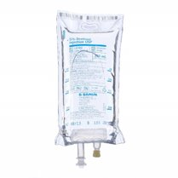
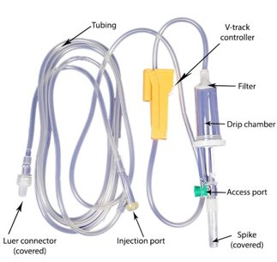
Equipment of I.V. therapy
I. Solution containers.
II. I.V. administration sets.

Slide 21
IV CANNULA
Present day IV cannula are available from sizes 14 gauge to 26 gauge with universal color coding for easy recognition of IV cannula. Smaller the gauge, wider is the cannula and has higher flow rate.
Normal adult size: 18-20 G
Situations requiring rapid fluid transfusion like trauma: 14-16 G
Preferred pediatric size: 22 G
Infants and neonates: 24-26 G
+pink (20 G) is most commonly used

Slide 22
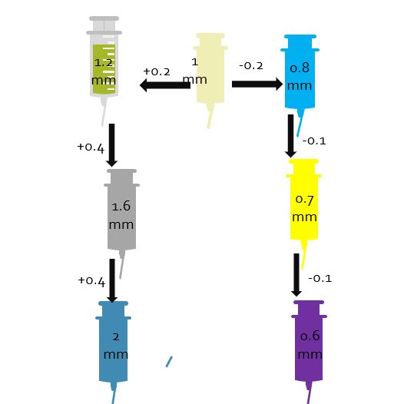
External diameter of cannula :
Remember the pink (20 G) cannula is 1 mm in diameter. For cannula next to pink: 1 +/- 0.2 mm
18 G (green): 1.2 mm
22 G (blue): 0.8 mm
For cannula smaller “gauge” than 18 G:
16 G (grey): 1.2 + 0.4 = 1.6 mm
14 G (orange):1.6 + 0.4 = 2 mm
For cannula larger than 22 G:
24 G (yellow): 0.8 – 0.1 = 0.7 mm
26 G (purple): 0.7 – 0.1 = 0.6 mm

Slide 23
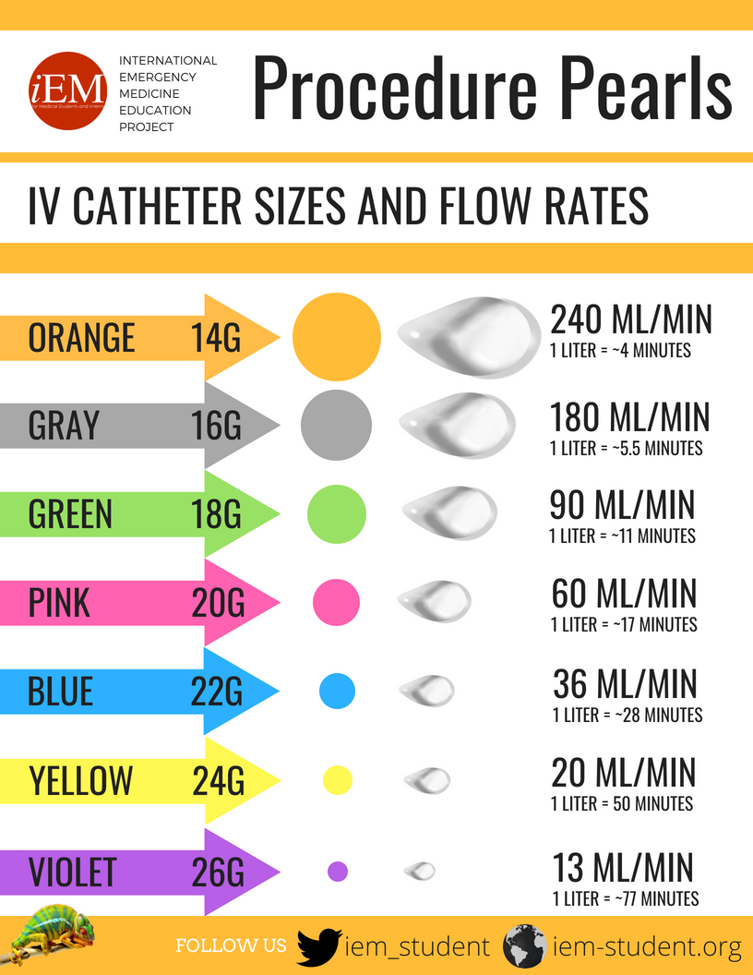
This Photo by Unknown Author is licensed under CC BY-SA-NC

Slide 24
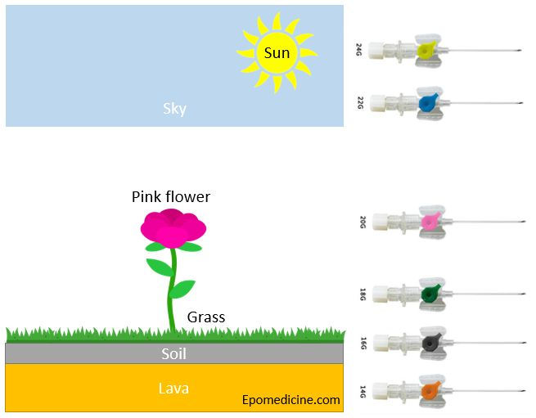

Slide 25
Electrolytes

Slide 26
Sodium (135 - 145 mEq/L)

Slide 27
HYPOnatremia plasma Na+ concentration <135 mmol/L. Symptoms usually begin when the Na+ level falls to <120 mmol/L.
Hyponatremia Plasma Osmolality
The osmolality of ECF is equal to the sum of the concentrations of all dissolved solutes.
Because Na+ and its anions account for nearly 90% of these solutes,
• Osmolality should be LOW in HYPOnatremia
• 1st step in hyponatremia is to make sure it's low
Serum Osmolality = 2 * [Na] + (Glucose/18) + (BUN/2.8)
*Normal = 285 (275 to 295)

Slide 28
HYPOnatremia (hypo/ hyper/ euvolemic)
1) Hypovolemic
There’s a depletion of both Na+ and water, but the sodium deficit exceeds the water deficit.
Causes of Na+ loss:
Extra-renal causes:
Low urine sodium (<10 mEq/L)
Na+ loss can be from GIT or skin (diarrhea, vomiting, diaphoresis, burn, nasogastric suction).
Implies increased sodium retention by the kidneys to compensate for extrarenal losses of sodium containing fluid.
Renal causes:
High urine sodium (>20 mEq/L)
Causes are either :
Diuretic therapy (thiazides)
Adrenocortical failure

Slide 29
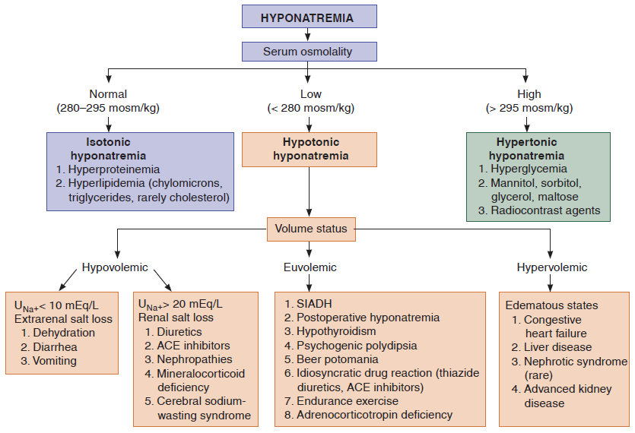

Slide 30
HYPOnatremia (hypo/ hyper/ euvolemic)
Euvolemic
There’s no evidence of ECF expansion or contraction
Caused by:
Primary polydipsia
SIADH: Causes are numerous and include : CNS pathologies, malignancy (most commonly small cell lung cancer), surgery (postoperative hyponatremia)
Excessive electrolyte-free water infusion: if a patient is given D5W (or other hypotonic solution) to replace fluids, or if water alone is consumed after intensive exertion (with profuse sweating)
Hypothyroidism
Diagnosis mandates that the patient is euvolemic with the absence of renal, cardiac or hepatic diseases
Notes:
Syndrome of inappropriate antidiuretic hormone secretion (SIADH)

Slide 31
HYPOnatremia (hypo/ hyper/ euvolemic)
Hypervolemic
This is due to water-retaining states that are with volume expansion
The relative excess of water in relation to sodium results in hyponatremia
Causes are:
CHF
Cirrhosis
Nephrotic syndrome
CKD; during free water intake

Slide 32
*Clinical Features
Symptoms development is upon rapidity of development of hyponatremia than severity of it
Hyponatremia can be classified into:
Upon chronicity:
Acute: develops within (24-48) h
Chronic: develops after 48 h
Upon severity:
Mild: (130-135) mmol/L
Moderate: (125-129) mmol/L
Severe: less than 124 mmol/L

Slide 33
Symptoms:
Neurologic:
Water shifts to brain causing brain swelling or oedema
Headache, delirium and irritability
Muscle twitching and weakness
Hyperactive deep tendon reflexes
Increased ICP and coma
GIT:
N & V, Ileus and watery diarrhea
CVS: hypertension and bradycardia if ICP increase significantly
Increased salivation and lacrimation
Oliguria and anuria

Slide 34
HYPOnatremia (hypo/ hyper/ euvolemic)
Hypertonic saline rapidly increases the tonicity of ECF.
Do not increase sodium more than 8 mmol/L during the first 24 hours. An overly rapid increase in serum sodium concentration may produce central
pontine demyelination.
Diagnosis
1. Plasma osmolality — low in a patient with true hyponatremia
2. Urine osmolality (low when kidneys respond appropriately and dilute urine, high when ADH is increased as in SIADH, Hypothyroidism and CHF)
3. Urine sodium concentration
Urine Na+ should be low in the setting of hyponatremia
Treatment
The following correction rates have been suggested:
mild symptoms: 0.5 mEq/L/h or less; moderate symptoms: 1 mEq/L/h or less;
severe symptoms: 1.5 mEq/L/h or less.
Vaptan
antagonizes ADH activity at the renal tubules, is often used as an adjunct in the treatment
of SIADH when water restriction alone is insufficient.

Slide 35
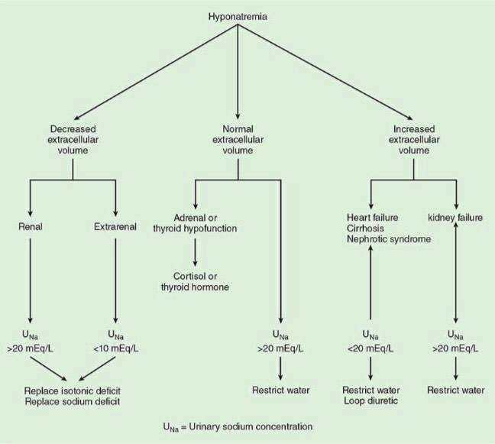
Treatment
1.Isotonic & hypertonic--- treat the underlying cause
2. Hypotonic

Slide 36
Anesthetic Considerations
Hyponatremia, in association with its underlying disorder(s), increases perioperative morbidity and mortality
as plasma [Na+] should be corrected to greater than 130 mEq/L for elective procedures, even in the absence of neurological symptoms.
Lower concentrations may result in significant cerebral edema that can be manifested intraoperatively as a decrease in minimum alveolar concentration
Or postoperatively as agitation, confusion, or somnolence.

Slide 37
HYPERnatremia plasma Na+ concentration >145 mmol/L
Refers to excess sodium in relation to water; can result from water loss or rarely, sodium infusion.
Isovolemic hypernatremia (sodium stores normal, water lost)
Diabetes insipidus: central or peripheral
(causes include lithium toxicity, hypercalcemia, hypokalemia, renal disease, drugs)
Hypovolemic hypernatremia (sodium stores are depleted, but relatively more water has been lost)
Renal loss—from diuretics, osmotic diuresis (most commonly due to glycosuria in diabetics), renal failure
Extrarenal loss—from diarrhea, diaphoresis, respiratory losses
Hypervolemic hypernatremia (sodium excess)—occurs infrequently
Iatrogenic—most common cause of hypervolemic hypernatremia (e.g., large amounts of parenteral NaHCO3, TPN)
Exogenous glucocorticoids ( increases in Na retention)
Cushing syndrome
Notes:
Total parenteral nutrition (TPN)

Slide 38
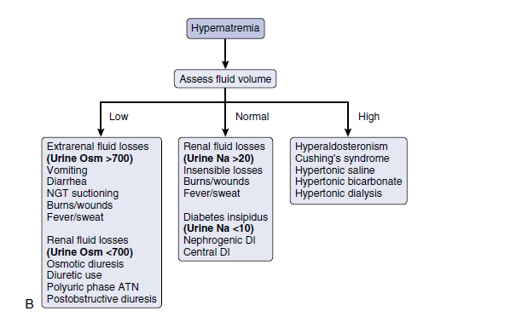

Slide 39
Treatment
1. Hypovolemic hypernatremia—Give isotonic NaCl to achieve euvolemia and restore hemodynamics initially. Correction of hypernatremia can wait until the patient is hemodynamically stable, then replace the free water deficit.
2. Isovolemic hypernatremia—Patients with diabetes insipidus require vasopressin, low sodium diet, and thiazide diuretics. Prescribe oral fluids, or if the patient cannot drink, give D5W.
3. Hypervolemic hypernatremia—Give diuretics (such as furosemide, to correct
volume status) and D5W (to achieve normal sodium concentration) to remove
excess sodium. Dialyze patients with renal failure.

Slide 41
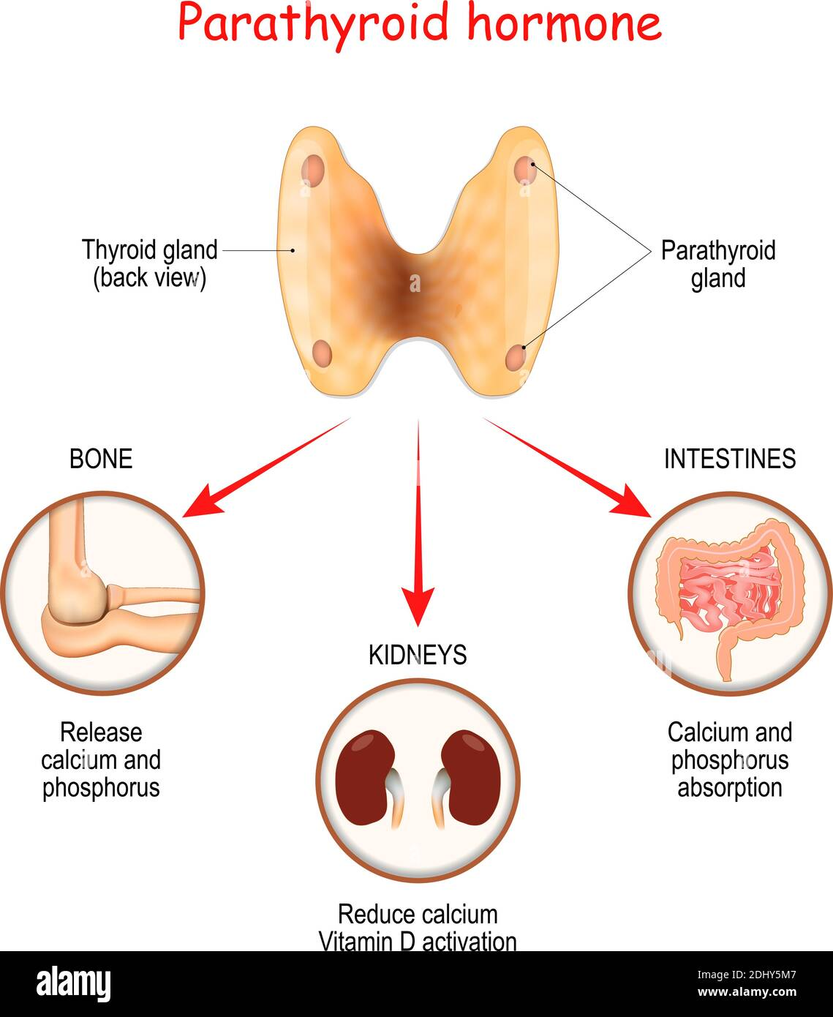

Slide 42
Calcium(8.5 to 10.5 mg/dL)
Calcium balance is regulated by hormonal control, but the levels are also affected by albumin and pH.
Albumin
Calcium in plasma exists in three forms:
Protein-bound form(40%): most calcium ions are bound to albumin, so the total calcium concentration fluctuates with the protein (albumin) concentration.
Free ionized form(50%): physiologically active fraction; under tight hormonal control (PTH), independent of albumin levels.
Complexed to phosphate and other anion(10%)
In hypoalbuminemia, the total calcium is low, but ionized calcium is normal, and can be estimated by the following formula:
total calcium—(serum albumin ×0.8).
pH
An increase in pH increases the binding of calcium to albumin. Therefore, in alkalemic states (especially acute
respiratory alkalosis), total calcium is normal, but ionized calcium is low and the patient frequently manifests the signs and symptoms of hypocalcemia..
Hormonal Control
Maintenance of calcium balance is a function of PTH , calcitonin, and vitamin D, and their target organs bone,
kidney, and gut.

Slide 43
Calcium(8.5 to 10.5 mg/dL)
Causes
HYPOcalcemia
1. Hypoparathyroidism (most common cause)
2. Renal insufficiency/ pancreatitis
3. Hyperphosphatemia
4. Hypomagnesemia—results in decreased PTH secretion.
5. Alkalemia— increase in pH causes increased calcium binding, serum levels will be normal but clinically important as ionized fraction is low
6. Blood transfusion (with citrated blood)—calcium binds to citrate
HYPERcalcemia
1. Hyperparathyroidism (most common cause in outpatients)
2. Malignancies (most common cause in inpatients) -- bony metastases, Multiple Myeloma

Slide 44
Calcium(8.5 to 10.5 mg/dL)
Clinical features
HYPOcalcemia
1. Asymptomatic
2. Rickets and osteomalacia
3. Increased neuromuscular irritability
Numbness /tingling /tetany /
Hyperactive deep tendon reflexes
4. Cardiac manifestations
a. Arrhythmias
b. Prolonged QT interval on ECG—hypocalcemia should always be in the differential diagnosis for a prolonged QT interval
HYPERcalcemia
“Stones”
Incresed risk for kidney store
“Bones”
Abnormal bone remodeling and fracture
“Grunts and groans”
Abdominalncramping,nausea, conistpation
“Psychiatric overtones”
Depressed mood
“ECG—shortened QT interval”

Slide 45
Calcium(8.5 to 10.5 mg/dL)
Diagnosis
HYPOcalcemia & HYPERcalcemia
1. To evaluate for the above-listed etiologies, obtain the following: BUN, Cr,
magnesium, albumin, and ionized calcium. Amylase, lipase, and liver function
tests may also be warranted.
2. Serum PO43
3. PTH

Slide 46
Calcium(8.5 to 10.5 mg/dL)
Treatment
HYPOcalcemia
1. If symptomatic, provide emergency treatment with IV calcium gluconate.
2. For long-term management, use oral calcium supplements (calcium carbonate) and vitamin D.
3. It is also important to correct hypomagnesemia. It is very difficult to correct the calcium level if the magnesium is not replaced first.
HYPERcalcemia
1. Patients usually do not require management beyond correction of underlying etiology unless hypercalcemia is severe (>14 mg/dL) or significant symptoms are present.
2. Increase urinary excretion in all patients.
a. IV fluids (NS)—first step in management
b. Diuretics (furosemide)—further inhibit calcium reabsorption

Slide 47
Magnesium (1.8 to 2.5 mg/dL)
Location in the body—Most of the magnesium in the body (two-thirds) is in bones the remainder (one-third) is intracellular only 1% of magnesium is extracellular.
Magnesium absorption and balance—About 30% to 40% of dietary magnesium is absorbed in the GI tract, but this percentage increases when magnesium levels are low.
The kidney has a great capacity to reabsorb magnesium and is the major regulator of magnesium balance.
Many hormones can alter urinary magnesium excretion (e.g., insulin , PTH , calcitonin and steroids ).

Slide 48
Causes
HYPOmagnesemia
1. GI causes
Malabsorption, steatorrhea (most common cause), Prolonged fasting
2. Alcoholism (common cause)—due to increased urinary excretion as well as
diarrhea, pancreatitis, and poor diet
3. Renal causes
4.DKA, burns, pancreatitis, lactation
HYPERmagnesemia
1. Renal failure (most common cause)
2. Iatrogenic—usually in the obstetric setting in women with preeclampsia or
eclampsia being treated with magnesium sulfate

Slide 49
Clinical feature
HYPOmagnesemia
1. Marked neuromuscular and CNS hyperirritability
2. Effect on calcium levels: coexisting hypocalcemia is common because of decreased release of PTH and bone resistance to PTH when Mg2+ is severely low
3. Effect on potassium levels
Coexisting hypokalemia—in up to 50% of cases, usually due to etiology which leads to loss of both
4. ECG changes—prolonged QT interval and T-wave flattening
HYPERmagnesemia
Nausea, weakness
2. Facial paresthesia
3. Progressive loss of deep tendon reflexes (classically the first sign)
4. ECG changes resemble those seen with hyperkalemia (increased P-R interval, widened QRS complex, and elevated T waves)
5.Death is usually caused by respiratory failure or cardiac arrest

Slide 50
treatment
HYPOmagnesemia
1. For mild hypomagnesemia—oral Mg2+ (e.g., magnesium oxide)
2. For severe hypomagnesemia—parenteral Mg2+ (e.g., magnesium sulfate)
HYPERmagnesemia
1. Withhold exogenously administered magnesium.
2. Prescribe IV calcium gluconate for emergent symptoms (cardioprotection as in hyperkalemia).
3. Administer saline and furosemide.
4. Order dialysis in renal failure patients.
5. Prepare to intubate if respiratory depression is severe.

Slide 51
Potassium(3.5 - 5 mEq/L)
Most of the body’s potassium (98%) is intracellular.
Hypokalemia—alkalosis and insulin administration may cause hypokalemia
because they cause a shift of potassium into the cells.
Hyperkalemia—acidosis and anything resulting in cell lysis increase serum K+ (both force K+ out of cells into the ECF).
Potassium secretion—most of the excretion of potassium occurs through the kidneys (80%); the remainder occurs via the GI tract. Aldosterone plays an important role in renal potassium secretion.

Slide 52
Hypokalemia
Causes
Clinical features
GI losses
(diarrhea, Vomiting and nasogastric drainage {volume depletion and metabolic alkalosis also result} , intestinal malabsorption)
Renal losses (Diuretics, Renal tubular or parenchymal disease, Primary and secondary hyperaldosteronism)
Other causes (insulin administration, β2 agonists)
1. Arrhythmias—prolongs normal cardiac conduction
2. Muscular weakness, fatigue, paralysis, and muscle cramps
3. Decreased deep tendon reflexes
4. Paralytic ileus
5. Polyuria and polydipsia
6. Nausea/vomiting

Slide 53
Hypokalemia
Diagnosis
Treatment
1. Treat the underlying cause & stop any medication that may cause hypokalemia.
2. Oral KCl is the preferred (safest) method of replacement and is appropriate in most instances, IV if severe
ECG changes : T wave flattens out; if severe, T wave inverts, U wave appears
urine potassium in hypokalemia:
Low with GI losses (<20 mEq/L)
High with renal losses (>20 mEq/L)
Serum K+ > 3.5 mEq/L
Cautions
Monitor K+ concentration and monitor cardiac rhythm when giving IV potassium.
May add 1% lidocaine to bag to decrease pain (potassium burns!)
Correct hypomagnesemia

Slide 54
Hyperkalemia
Increased total-body potassium
a. Renal failure (acute or chronic)
b. Hypoaldosterone states
ACE inhibitors, potassium-sparing diuretics (spironolactone)
c. Blood transfusion—usually due to lysed cells
Pseudohyperkalemia (spurious)
a. This refers to an artificially elevated plasma K+ concentration due to K+ movement out of cells immediately before or after venipuncture. (Repeat the test to confirm)
b. if the sample is not processed quickly, some red blood cells will hemolyze and cause spillage of K+ leading to a falsely elevate result.
Causes
Transcellular shifting
(from intracellular to extracellular)
a. Acidosis
b. Tissue/cell breakdown (chemotherapy,
hemolysis, burns)
c. GI bleeding
d. Insulin deficiency—insulin stimulates
the Na+-K+-ATPase and causes K+ to shift into cells.
e. Rapid administration of β-blocker

Slide 55
Hyperkalemia
Diagnosis
Treatment
ECG changes (when K+ >6)
Peaked T waves (by 10 mm)
A prolonged PR interval
Widening of QRS and merging of QRS with T wave
Ventricular fibrillation and cardiac arrest (with increasing levels of K+)
1. If the hyperkalemia is severe, or if ECG changes are present, first give IV Calcium, Why? Calcium stabilizes the resting membrane potential of the myocardial membrane that is, it decreases membrane excitability
2. Shift potassium into the intracellular compartment (by glucose & insulin, β-agonists)
3. Remove potassium from the body.
a. Kayexalate
b. Hemodialysis

