Slide 1
Otitis Media with Effusion
Supervised by : Dr Abdullah
Presented by : Besan Othman & Leen Alja’afreh

Slide 2
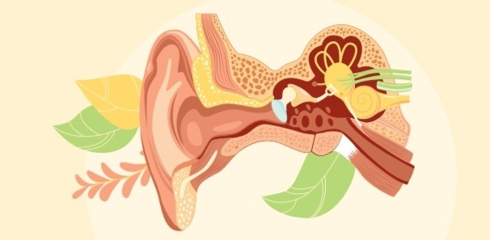
INTRODUCTION
Otitis media with effusion (OME), secretory otitis media or ‘glue ear’,The condition is due to the accumulation of non-infected fluid, either serous or viscous, within the middle-ear cleft, resulting in conductive deafness.
It is commonest in small children (6 months- 3 years) and those of primary school age and may cause significant deafness.
It occurs in adults, usually as a serous effusion and may rarely be a sign of nasopharyngeal malignancy.
Self-limited , takes 4-6 weeks to resolve .

Slide 3
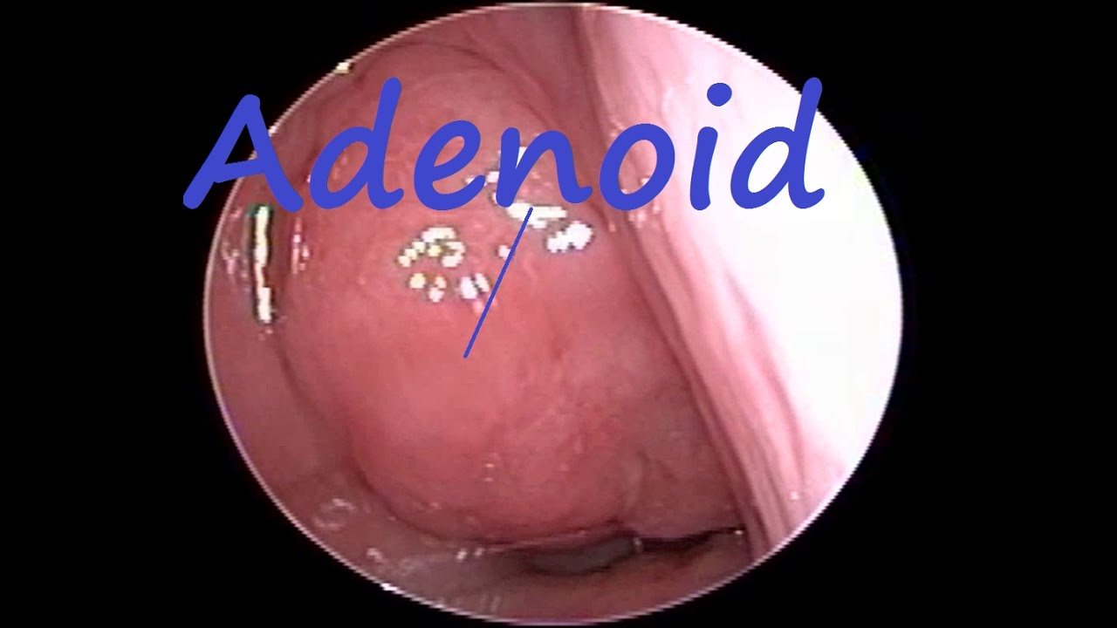
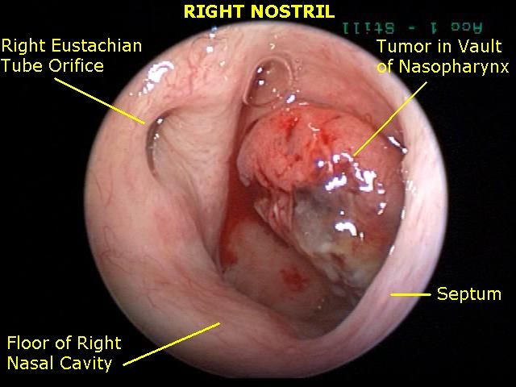
CAUSES
1- Nasopharyngeal obstruction, e.g. large adenoids(mc cause in children) or tumor resulting in Eustachian tube dysfunction.
2- untreated Acute otitis media, , will often give rise to a spontaneous perforation and drainage of the middle ear.

Slide 4
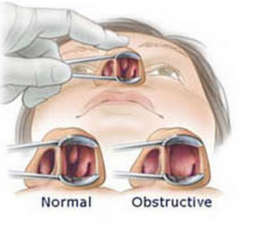
CAUSES
3- Allergic rhinitis and GERD.
4- Parental smoking has been shown to predispose to OME in children.
5- OME is commoner in winter months.
6- Upper respiratory tract infection .

Slide 5
SYMPTOMS
Not all children with OME have symptoms , painless .
Symptoms are often mild or minimal. They can vary based on the child’s age.
It may be responsible for developmental and educational impairment (delayed speech development) , and if untreated may result in permanent middle-ear changes.
Deafness may be the only symptom.
Discomfort in the ear —rarely severe.
Occasionally, tinnitus or unsteadiness.

Slide 6
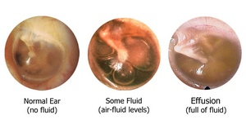
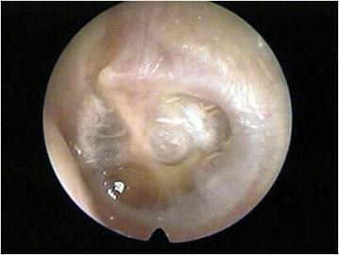
SIGNS
Fluid in the middle ear —a variable appearance that may be difficult to recognize.
Dull appearance with radial vessels visible on the tympanic membrane and handle of the malleus.
Retraction of the tympanic membrane.
Yellow/orange tinge to tympanic membrane.

Slide 7
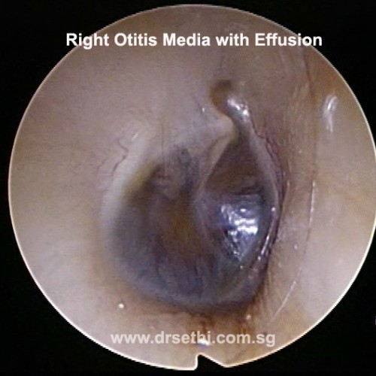
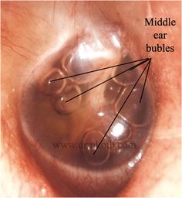
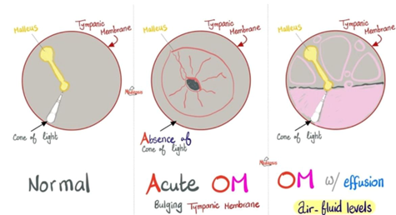
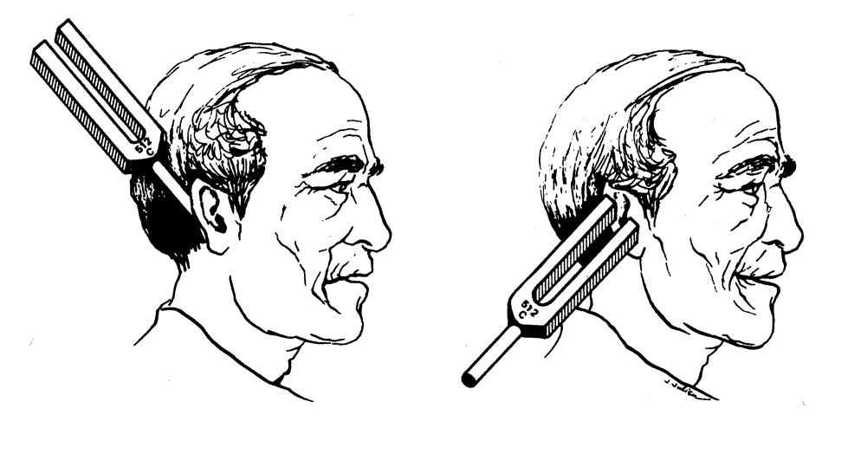
SIGNS
Dark blue or grey color of tympanic membrane.
Hair lines or bubbles —rarely seen.
Tuning fork tests show conductive deafness, i.e. bone conduction > air conduction.

Slide 8
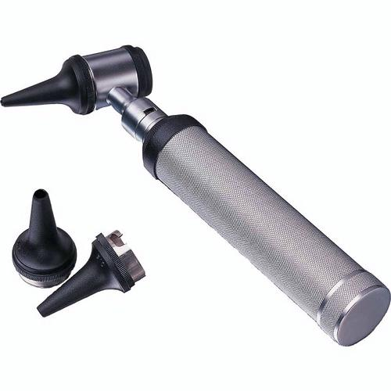
DIAGNOSIS
1- Pneumatic otoscopy: Primary diagnostic method.
Using an otoscope.
The doctor will be looking for:
Air bubbles on the tympanic membrane surface.
A tympanic membrane that appear dull instead of smooth and shiny.
Visible fluid behind the tympanic membrane.
A tympanic membrane that does not move when a small amount of air is blown into it.

Slide 9
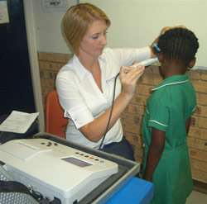
DIAGNOSIS
2- Tympanometry: Flat, type B tympanogram , with normal volume .
Notes:
Tympanometry is an examination used to test the condition of the middle ear^{[1]} and mobility of the eardrum (tympanic membrane) and the conduction bones by creating variations of air pressure in the ear canal.
the test is performed by inserting the tympanometer probe in the ear canal. The instrument changes the pressure in the ear, generates a pure tone, and measures the eardrum responses to the sound at different pressures. This produces a series of data measuring how admittance varies with pressure, which is plotted as a tympanogram.

Slide 10
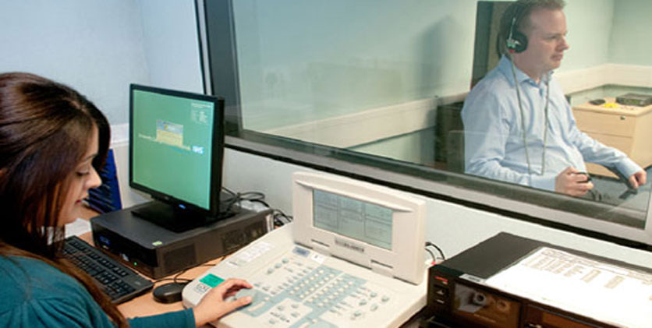
DIAGNOSIS
3- Audiometry: Unilateral conductive hearing loss.

Slide 11
TREATMENT >> In children
Many cases will resolve spontaneously, and the child should usually be observed for 3 months before embarking on surgery.
The use of antihistamines and mucolytics is of no proven benefit.
Antibiotic therapy may help in the short term.
Surgery is indicated if hearing loss persists for 3 months or if there is recurring pain.
Surgical treatment.

Slide 12
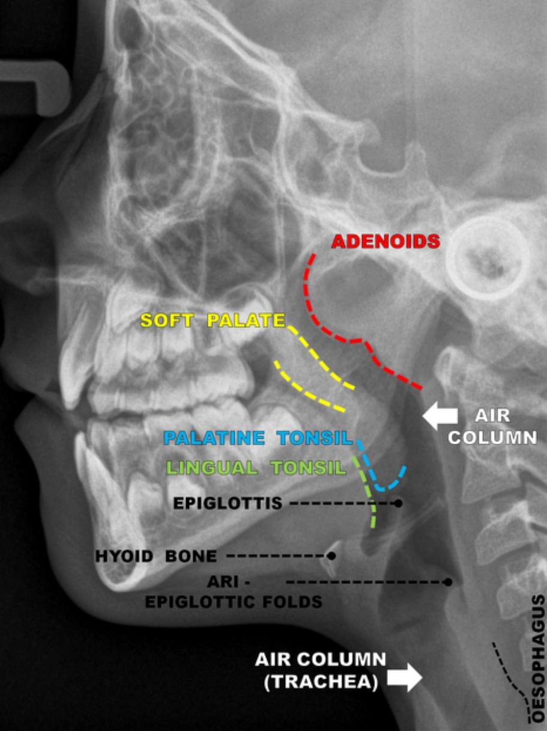
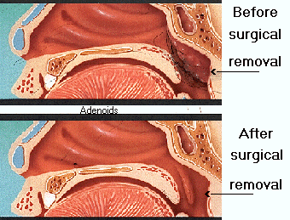
Adenoidectomy
It has been shown that adenoidectomy is beneficial in the long-term resolution of OME.
The maximum benefit occurs between the ages of 4 and 8 years.

Slide 13
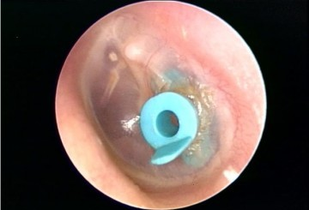
Myringotomy and grommet insertion
Under general anaesthetic, the tympanic membrane is incised antero-inferiorly.
The glue is aspirated and a grommet inserted into the incision.
The function of the grommet is to ventilate the middle ear and not to drain the fluid.

Slide 14
TREATMENT >> In adults
Examination of the nasopharynx to exclude tumour is essential, especially if the effusion is unilateral.
Under the same anaesthetic, a grommet may be inserted.
Secretory otitis media in adults not due to tumour usually follows a cold. Resolution is usually spontaneous, but may take up to 6 weeks.

Slide 15
Complications and Long-Term Effects
If OME is associated with frequent ear infections, more complications can occur.
These can include:
Acute ear infections .
Cysts in the middle ear .
Eardrum scarring .
Damage to the ear that causes hearing loss .
Affected speech or language delay .

Slide 16
thanks

