Slide 1
Health care administration/ Overview 2
Dr. Israa Al-Rawashdeh MD, MPH, PhD
Faculty of Medicine
Mutah University
2022

Slide 2
Functions of Administration: There are several functions for administration In practice all these functions are interrelated to one another
Planning
Organization
Staffing
Directing
Coordinating
Reporting
Budgeting
Supervising
Evaluation
+

Slide 3
Remember POSDCORB

Slide 4
POSDCORB Planning
“Planning is a projected or predetermined course of action designed to achieve a specific goal or objective.”
Planning determines What? When? Where? How? Why? And by whom? Things will be done.
Planning always involves “decision making for future events”.
Planning should be done at several levels and each level has its own challenges and particular methods.

Slide 5
POSDCORB Planning
Planning is considered the most important element of the administrative process.
The higher the level of management, the more the involvement and time spent on planning.
A good plan is the basis of any successful program.
Sufficient time should be given to the process of planning.
More than one plan should be available to choose from to meet the goals.

Slide 6
Plan criteria
A good plan should be:
1) Consistent with immediate and future needs.
2) Consistent with the organization and the health profession philosophy.
3) Based on accurate statistical researches.
4) Feasible and flexible enough for an expected changes within the available resources
5) Simple and easy to interpret by health professionals and public.
6) Has criteria that can be evaluated and improved .

Slide 7
Stages of planning
Stage 1: Goal setting.
Stage 2: Diagnosis of the problem/s or situation.
Stage 3: Putting priorities.
Stage 4: Suggesting alternatives.
Stage 5: Putting plan details.
Stage 6: implementation planning.
Stage 7: Evaluation planning

Slide 8
Summary:
Planning is a dynamic (non-static) process
It is a continuous circular process
Planning
Evaluation
Execution
(implementation)
Futuristic
Decision making process
Dynamic
Flexible

Slide 9
POSDCORB Organizing
Definitions:
Organizing The process of organization and arrangement of human and non-human resources to make a meaningful whole that accomplishes organizational objectives.

Slide 10
Principles of organizing:
Departmentation
Acquisition of human and non-human resources
Specialization and division of labor
Authority and responsibility (delegation?)
Centralization and de-centralization
Unity/ chain of command
Line and staff

Slide 11
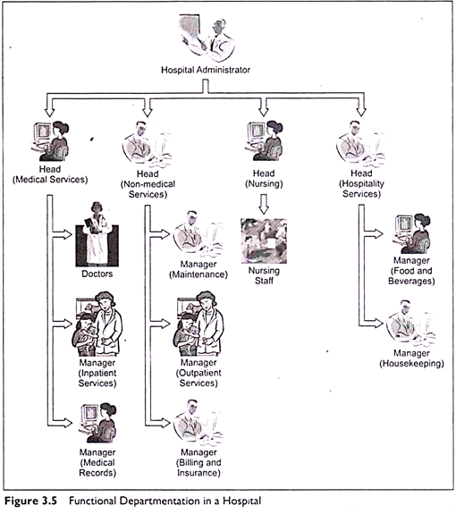
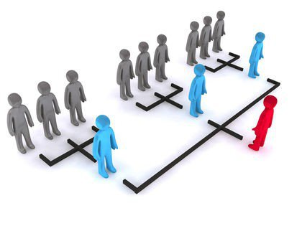
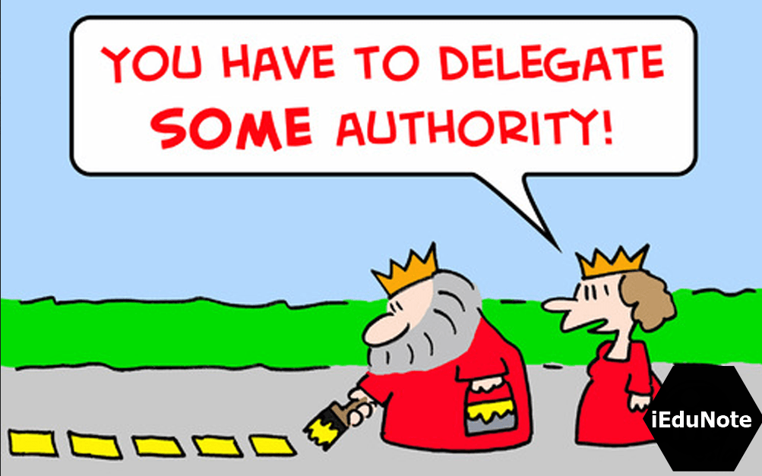

Slide 12
POSDCORB Staffing
It is the process of personnelising (hiring personnel) in the organization to fill up the positions described in various units in the organizational chart.
Staffing steps:
Identifying the type and number of personnel needed.
Recruitment (job description, person specification, and advertising)
Selection (shortlisting applicants, interviewing, references, decision)
Orientation
Job analysis
Job description
Job specification

Slide 13
POSDCORB Staffing
Other methods of filling staff vacancies:
Reallocation of duties
Transfer of posts
Redeployment
Outsourcing
Appointment of a previously identified successor (rarely used)

Slide 14
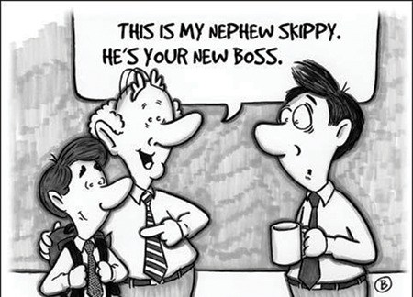
POSDCORB Staffing
Discrimination: the tendency to give preference to one special group and disregard the merits of other groups.
Nepotism or favouritism: the tendency to ignore considerations of abilities by giving preference to members of one’s own family, ethnic group, geographical region or some other personal reason.

Slide 15
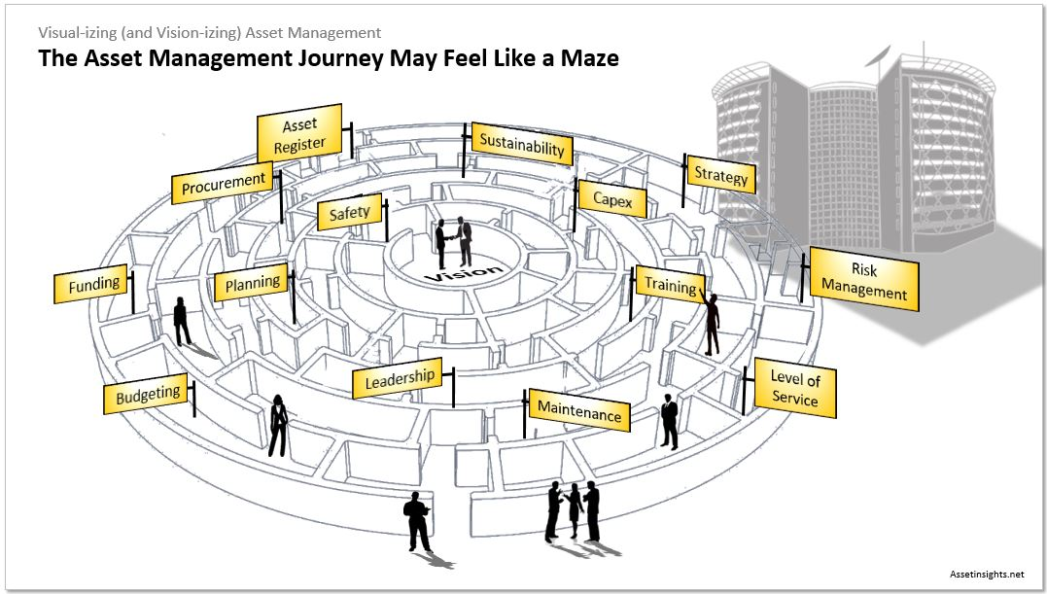
POSDCORB Directing
The continuous task of making decisions and translating them into orders and instructions and serving as the leader of the organization.
Includes building an effective work environment and creating opportunity for motivation, supervising, scheduling, and disciplining.

Slide 16
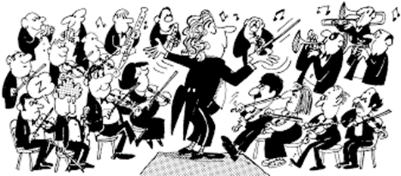
POSDCORB Directing
Planning, organizing and staffing are the initial steps in the administrative process (preparatory steps).
Directing is the next essential step in initiating the activities of the organization (sets the action) toward the designed goals.

Slide 17
POSDCORB Directing
Direction has following elements:
Motivation
Leadership
Communication
Motivation- means inspiring, stimulating or encouraging the sub-ordinates to work. Positive, negative, monetary, non-monetary incentives may be used for this purpose.
Communications- is the process of passing information, experience, opinion etc from one person to another (public, organization, employees)

Slide 18
Katz 3-skill approach
Robert L. Katz in 1974, has set the relationship of managerial skills and management levels.
-Three areas of managerial skills are required:
Technical skills - proficiency and knowledge in a specific area
• Example: Technology
Human skills - knowledge and ability to work with people
• Example: trust, team building
Conceptual skills - ability to work with ideas and concepts
• Example: setting vision, plans and goals

Slide 19
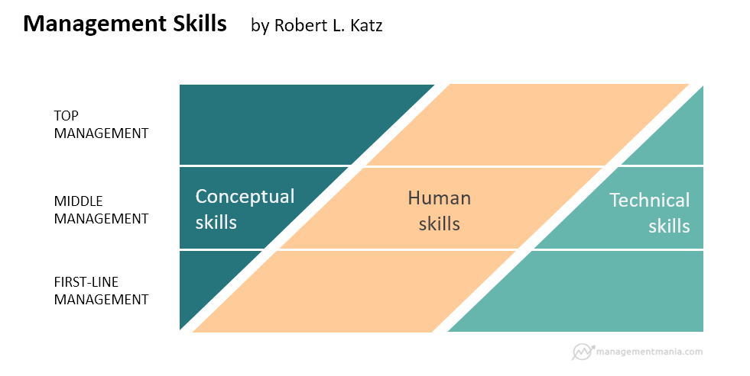

Slide 20
POSDCORB COordination
It is the act of synchronising people and activities so that they function smoothly to achieve organization objectives.
Coordination is more important in the health services organization, because functionally they are departmentalized.
Different kinds of organizations require different amount of coordination (larger scale!).
The coordinating function of the management prevents overlapping and conflict so that the duplication is avoided.

Slide 21
POSDCORB COordination
Coordinating function of management is necessary because
it affects all the functions of management (planning, organizing, and directing etc.), and
It is a mother principle of management and all other principles are included in this one principle.

Slide 22
POSDCORB Reporting
Controlling function as well.
The reporting is a process of providing information to various levels of management to enable measuring the effectiveness of work and making corrections, if necessary.
Reporting is done according to the flow of positions in the organizational chart. It could be from bottom to top, from top to bottom, and even lateral.

Slide 23
POSDCORB Reporting
Purposes of reporting:
To show the rate of progress and completion of tasks over a specified period.
Helps in studying health conditions.
Helps in planning.
To make public and the other interested agencies understand provided services.
Used as motivational method
Good when asking for more details
For Consultation
Records and reports must be functional, accurate, complete, current organized and confidential.

Slide 24
POSDCORB Budgeting
It is expressed in financial terms and based on expected income and expenditure. Budget is the heart of administrative management.
It helps in coordination and an effective way of eliminating duplicating and wastage (cost control).

Slide 25
POSDCORB Budgeting
The main activities are:
Budgeting
Accounting
Auditing
Purchasing

Slide 26
Definitions
Budgeting:
It is the allocation of financial resources for programs or projects for a specific period of time.
A budget
is defined as “a balanced estimate of expenditures and receipts for a given period of time”.

Slide 27
POSDCORB Budgeting
Features of budget:
Should be flexible.
Should be a synthesis of past, present and future.
It should be in the form of statistical standard written in specific numerical terms.
It should have support of top management throughout the period of its planning and supplementation

Slide 28
Accounting: المحاسبة
“The process of systematically recording and managing financial accounts”
Example: Preparing a Profit and Loss Statement

Slide 29
Auditing: المراقبة والتفتيش
An assessment of how well an organization's management team is applying its strategies and resources.

Slide 30
Purchasing: المشتريات
The act of obtaining or buying goods and services.

Slide 31
THANK YOU

