Slide 1
Puberty and pubertal disorders
Dr.Randa S.Alqaisi,MD .
MRCPCH
Pediatric Endocrinologist

Slide 2
Definition
Refers to the process of physical changes by which a child's body becomes an adult body capable of reproduction, it takes around 2 years to be completed .
Transitional stage from sexual immaturity to maturity manifested by physiological changes & development of SSC., statural growth , brain , and cardiovascular system development which would be variable in the start point and the end point .
The normal age of puberty :
1- in male : about 9-14 years, testicular enlargement
2- in female : about 8-13 years, variable range , breast bud

Slide 3
Menarche the first menstrual period; the establishment of menstruation usually without ovulation.
thelarche: the beginning of development of the breasts in the female due to the effect of estradiol.
Pubarche: The onset of puberty, particularly as manifested by the appea-rance of pubic hair, controlled by the adrenal glands
Adrenarche is the term for the maturational increase in adrenal androgen production→ appearance pf pubic hair, axillary hair, acne, adult type body odor or oily hair.

Slide 4
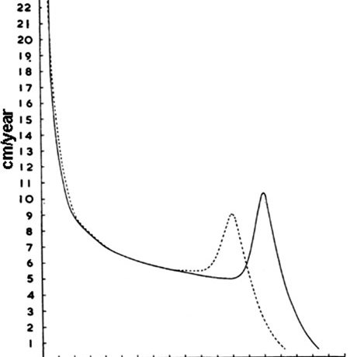

Slide 5
ICP concept of growth
Its importatnt to integrate the pubertal phase with any complaint of short stature or when the assessment of the height is necessary , because of the growth spurt that will happen during the pubertal phase
The pubertal phase is characterized by a growth spurt of 8 to 14 cm per year due to the synergistic effects of increasing gonadal steroids and growth hormone
Average difference between male and female height about 12-14 cm
What happened in puberty, high level estrogen will cause the closure of epiphysis
Notes:
Intrauterine environment , chromosomal abnormality
No role of growth hormone at birth

Slide 6
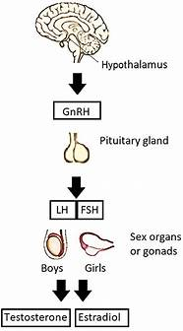
A simple description of hormonal puberty is :
The hypothalamic-pituitary-gonadal axis is biologically active in utero and briefly during the first week of life. It then becomes more active again during infancy, with peak activity between one and three months of age ..mini –puberty
Between early childhood and approximately 8-9 yr of age (prepubertal stage), the hypothalamic-pituitary-gonadal axis is dormant*active suppression *, as reflected by undetectable serum (LH) and sex hormones (estradiol in girls, testosterone in boys. >> serum level of LH increases during sleep >>episodic discharge of GnRH(disinhibition of the axis )
The ovaries or testes respond to the rising amounts of LH and FSH by growing and beginning to produce estradiol and testosterone
Estrogen cause epiphyseal closure and can mediate the increased production of growth hormone, which along with a direct effect of sex steroids on bone growth, is responsible for the pubertal growth spurt

Slide 7
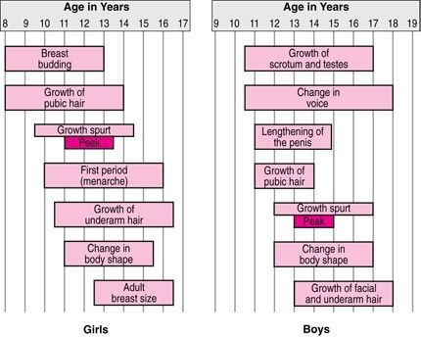

Slide 8
Physical changes in males ( secondary sexual characteristics)

Slide 9
1-Testicular size, function, and fertility
In boys, testicular enlargement is the first physical sign of puberty (more than 4 ml in size and 2.5 cm in length )
Testes in prepubertal boys change little in size from about 1 year of age to the onset of puberty, averaging about 2–3 cc in volume and about 1.5-2 cm in length.
Testicular size continue to increase throughout puberty, reaching maximal adult size about 6 years later.
While 18-20 cc is an average adult size, there is wide variation in the normal population

Slide 10
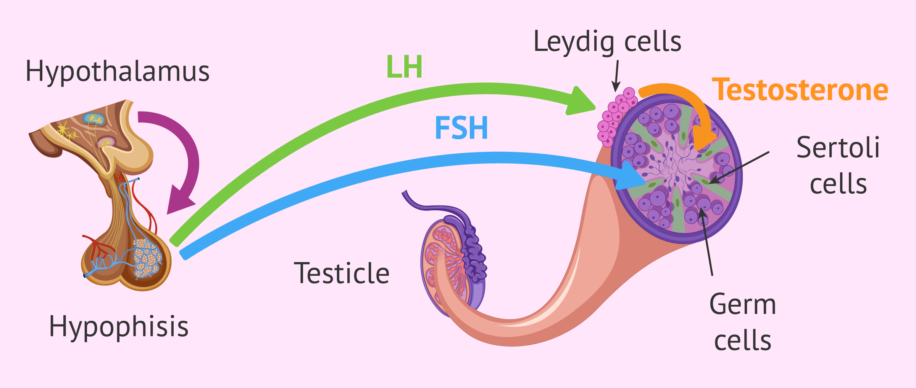
The testes have two primary functions:
1- to produce hormones, by Leydig cells
2- to produce sperms, by Sertoli cells.
The Leydig cells produce testosterone , which in turn produces most of the changes of male sexual maturation and maintains libido , Testosterone modulates LH secretion
However, most of the increasing bulk of testicular tissue is spermatogenic tissue..
Inhibin B produced by the Sertoli cells exerts a negative feedback effect on FSH secretion.
Sperm can be detected in the morning urine of most boys after the first year of pubertal changes
Potential fertility is reached at about 13 years old in boys, but full fertility will not be gained until 14-16 years of age.

Slide 11
Orchidometer
Testicular size beads

Slide 12
Pubic hair often appears shortly after the genitalia begin to grow.. the hair growing continue till it spread the thighs and upward towards the umbilicus as part of the developing abdominal hair. 3-Body and facial hair Other areas of skin which respond to androgens develop heavier hair (androgenic hair) in roughly the following sequence: axillary hair, perianal hair, upper lip hair, preauricular hair, and the rest of the body area. There is a large range in amount of body hair among adult men, and significant differences in timing and quantity of hair growth among different ethnic groups
2-Pubic hair
4-Voice changes

Slide 13
5-muscle development and body shape
- By the end of puberty, adult men have heavier bones and nearly twice as much as skeletal muscle.
- Arms, legs, hands, and feet may grow faster than rest of body.
- Grow taller and shoulders grow broader.
- Muscles get bigger.
- Gain more weight
6-Body odor, skin changes, acne
Rising levels of androgens can change the fatty acid composition of perspiration, resulting in a more "adult" body odor.

Slide 14
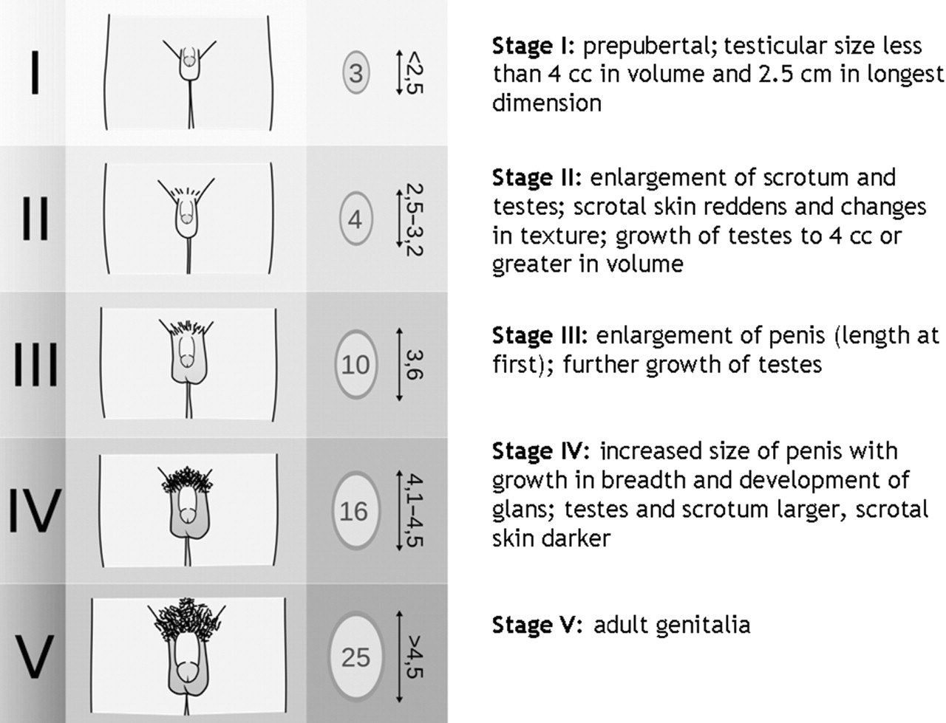
Tanner staging for males
Pubic Hair Scale (both males and females)
Stage 1: No hair
Stage 2: scant hair
Stage 3: terminal hair
Stage 4: Terminal hair that fills the entire triangle overlying the pubic region
Stage 5: Terminal hair that extends beyond the inguinal crease onto the thigh
Male External Genitalia Scale
Stage 1: Testicular volume < 4 ml
Stage 2: 4 ml-8 ml , 1st pubertal sign in males
Stage 3: 9 ml-12 ml
Stage 4: 15-20 ml
Stage 5: > 20 ml

Slide 15
Physical changes in females

Slide 16
LH stimulates proliferation of follicular and theca cells, and during the follicular phase of the menstrual cycle induces androgen secretion by theca cells.
FSH induces proliferation of granulosa cells; enhances aromatase activity so that androstenedione is converted to oestradiol (E2); and increases progesterone (P) production.
E2 induces secondary sexual development.

Slide 17
1-Breast development
The first physical sign of puberty in females is usually a firm, tender lump under the center of the areola of one or both breasts, occurring on average at about 10 years of age. ( breast budding)
Within six to 12 months, the swelling has clearly begun in both sides, softened, and can be felt and seen extending under the edges of the areola .
By another 12 months , the breasts are becomes mature size and shape .there is so much variation in sizes and shapes of adult breasts
Peak height velocity occurs early (at breast stage II–III, typically between 11 and 12 yr of age) in girls and always precedes menarche.

Slide 18
2-Hair:
increased activity of the suprarenal cortex at puberty with increased production of adrenal androgens which lead to appearance of pubic and axillary hair
Hair growth begins shortly after breast development .
3- Vagina, uterus, ovaries
The mucosal surface of the vagina also changes in response to increasing levels of estrogen, becoming thicker and a more pink in color
Whitish secretions are a normal effect of estrogen as well.
The uterus and ovaries increase in size, and follicles in the ovaries reach larger sizes.

Slide 19
4- Menstruation and fertility
The first Menses is referred to as menarche which is usually not regular and occurs monthly and last from 3 to 7 days .
Ovulation is necessary for fertility, but may or may not present in The first Menses.
The mean age of menarche is about 12¾ yr.
Positive correlation with adiposity
4- Body shape, fat distribution, and body composition
During this period, also in response to rising levels of estrogen, the lower part of the pelvis and hips widen.
Fat tissue increases to a greater percentage of the body composition than in males, especially in the typical female distribution of breasts, hips, buttocks, thighs, upper arms, and pubis.
Notes:
Positive correlations between the degree of adiposity and earlier pubertal development in girls have, indeed, been reported. Conversely, female athletes in whom leanness and strenuous physical activity have coexisted from early childhood frequently exhibit a marked delay in puberty or menarche, and they frequently have oligomenorrhea or amenorrhea as adults

Slide 20
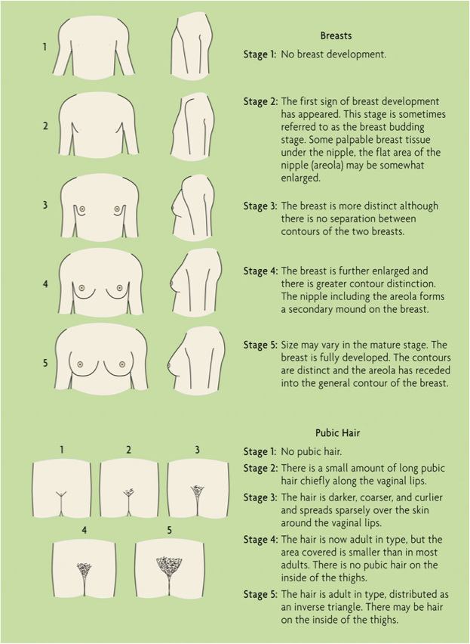
Female Breast Development Scale
Stage 1: No glandular breast tissue palpable
Stage 2: Breast bud palpable under the areola (1st pubertal sign in females)
Stage 3: Breast tissue palpable outside areola; no areolar development
Stage 4: Areola elevated above the contour of the breast, forming a “double scoop” appearance
Stage 5: Areolar mound recedes into single breast contour with areolar hyperpigmentation, papillae development, and nipple protrusion

Slide 21
Precocious puberty
appearance of any of the secondary sexual characters before the age of:
8 years in females
9 years in males
It could be central or peripheral
OR
Pseudo precocious puberty or true

Slide 22
In females
Is usually idiopathic or familial and follows the normal sequence of puberty.
the organic causes are rare and are associated with :
Dissociative when the sequence of pubertal changes is abnormal , eg: isolated pubic hair with virillisation of the genitalia , suggesting excess androgen
rapid onset
neurological symptoms and signs , eg : neurofibromatosis

Slide 23
In males
this is uncommon and usually has an organic cause.
examination of the testes may be helpful :
bilateral enlargement suggest gonadotrophin release
small testes suggest an adrenal cause
a unilateral enlarge testis suggest a gonadal tumor

Slide 24
Causes of precocious puberty:
1) Gonadotrophin dependent = (central , true )
(increased LH, FSH ), more in females .
familial /idiopathic
CNS abnormalities
congenital anomalies , eg: hydrocephalus
acquired , eg: post irradiation , infections
Hypothyroidism , FSH like action by TSH (dec growth velocity, delayed bone age )
2) Gonadotropin independent = (peripheral , false )
(decreased LH, FSH)
adrenal disorders - tumors, congenital adrenal hyperplasia
ovarian tumors
testicular tumors
Inadverant exposure to estrogen and testosterone , tea tree oil , lavender oil .
3). Mixed : happened in MaCcune –Albright syndrome

Slide 26
NORMAL VARIANTS
Premature Thelarche:
isolated breast development before 8 years ,with 2 peaks at years and 6 years
Key features of premature telarche are:(early activation of the access )
Isolated breast development, either unilateral or bilateral – Typically not developing beyond Tanner stage 3
Absence of other secondary sexual characteristics
Normal height velocity for age (not accelerated)
●Normal or near-normal bone age
Exaggerated Thelarche
increased growth rate and bone age, intermediate between PP an PT
FSH, LH, E2 usually low
Pelvic Us
Bone Age
Height, looking for growth spurt
It may regress with time …it should be followed up regularly
Notes:
Benign clinical pubertal variants include isolated estrogen-mediated breast development in females (premature thelarche) or isolated androgen-mediated sexual characteristics (such as pubic and/or axillary hair, acne, and apocrine odor) in males or females (premature adrenarche, which results from early activation of the hypothalamic-pituitary-adrenal axis, as confirmed by mildly elevated levels of dehydroepiandrosterone sulfate [DHEAS] for age)

Slide 27
Premature Adrenarche
- Adrenarche is the onset of the adrenal androgen production
- Premature adrenarche occurs before 8 years of age.
is more common in girls than boys.
Usually overweight and taller.
Dx requires exclusion of other causes of androgen excess.
- Usually no need for treatment.
- DHEAS (high), bone age, height (accelerated growth), puberty.
Link to polycystic ovarian syndrome or insulin resistance

Slide 28
Investigations
Basal LH with sensitive assays (>0.3 -0.6 u/l in Central PP)
FSH
Estradiol> 10pg/mL
GnRh stimulation test : LH( > 5 units/L in central pp) , FSH and on second day E2 (>50 pg/mL).
Pelvic US in girls: enlargement of the ovaries and the uterus (uterine length > 3.8 cm. ,uterine volume more than 2.5 ml , ovary >1.6 -3 ml) .
Pituitary MRI ?
Adrenal CT / MRI?
Pelvic US
Notes:
All males with CPP,females less than 6 years

Slide 29
Rx
In Central PP
The object of treatment is:
to prevent early epiphyseal closure to maintain the height
To decrease psychological distress to the girl and her family.
Treatment with GnRH agonist

Slide 30
Rx
In peripheral PP
• Androgen receptor blockers—cyproterone acetate, flutamide and spironolactone
• 5 alpha-reductase inhibitors
• Testosterone biosynthesis inhibitors—ketoconazole
• Aromatase inhibitors—testolactone, anastrozole, letrozole
Estrogen receptor blocker-----Tamoxifen

Slide 31
Delayed puberty
The absence of pubertal development by 14 years of age in males,,,
and by 13 years in females if no SSC appeared or, by 15 if SSC appeared but menses is still absent.
In contrast to precocious puberty , the problem is common in males , in whom it is mostly due to constitutional delay.

Slide 32
Causes of delayed puberty :
1) constitutional delay of growth and puberty
2) High gonadotrophin secretion
(hypergonadotropic hypogonadism)
chromosomal abnormalities ( klinefelters
syndrome,turner syndrome)—primary gonadal
failure.
- steroid hormone enzyme deficiencies.
acquired gonadal damage –secondary gonadal
failure

Slide 33
3) Low gonadotrophin secretion (hypogonadotropic
hypogonadism)
- Systemic disease (functional): cystic fibrosis , severe asthma , crohns disease , anorexia nervosa
- Hypothalamic-pituitary disorders (organic): panhypopituitarism , intracranial tumors,
kallmanns syndrome (LHRH deficiency and anosmia )
The patient need to be evaluated ,if there's hx of medical disease , family hx of the same complaint, recent intervention ,anosmia
PE: growth parameters,dysmorphic features, pubertal assesment
Then general tests like CBC,CRP,celiac screen
LH , FSH , Sex hormones,T4,TSH,IGF-1
Treatment : estrogen and testosterone to induce puberty
Hormone replacement in hypo hypo

Slide 34
Ambiguous genitalia , DSD
Infants born with genitals that do not appear typically male or female, or that have an appearance discordant with the chromosomal sex

Slide 35
TYPICAL SEX DEVELOPMENT
Gonadal differentiation : absence or presence of SRY genes
Individuals with DSDs may have complete absence of gonadal development , incomplete gonadal development , a gonad atypical for chromosomal sex (eg, XX testicular DSD).
Gonadal function: The Leydig cells of the testis produce testosterone, which is converted to dihydrotestosterone by the enzyme 5-alpha-reductase type 2, which is expressed outside of the testis
Gonadal position: testosterone cause the gonads to descend into the scrotum.
Development of the labioscrotal folds: The embryonic genital swellings give rise to the labioscrotal folds. In typical XY individuals, the action of testosterone and dihydrotestosterone cause the labioscrotal folds to fuse to form the scrotum and become rugated (wrinkled) and pigmented
Size and shape of the clitorophallus :
In typical XY individuals, the action of testosterone and dihydrotestosterone cause the genital tubercle to increase in size and straighten to form the penis.
Location of the urethra
Internal reproductive structures –

Slide 36
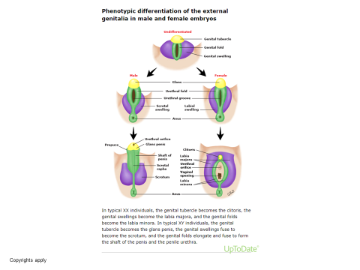

Slide 37
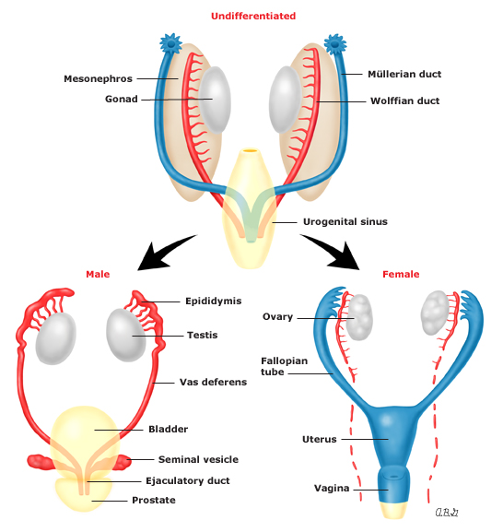

Slide 40
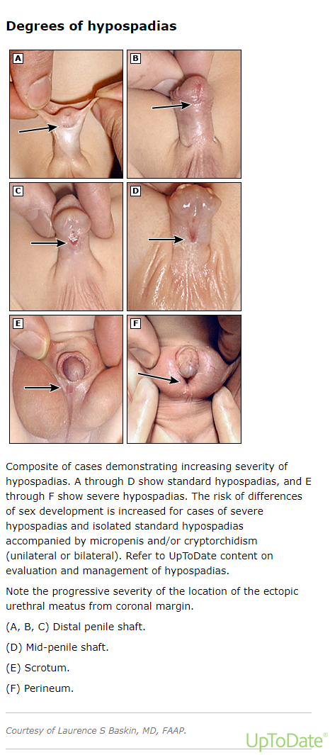

Slide 41
History and physical
1.Prenatal exposure to androgens
2. History of consanguinity or genetically homogeneous population
Measurement of the clitorophallic structure:In a typical XY term infant, penile length is ≥2.5 cm and penile diameter measured at the middle of the shaft is ≥0.9 cm
Micropenis (microphallus) in XY >>deficiencies of growth hormone and/or gonadotropins during the second and third trimesters, idiopathic hypogonadotropic hypogonadism/Kallmann syndrome, isolated growth hormone deficiency, and panhypopituitarism
Clitoral width in a typical XX neonate ranges from 2 to 6 mm. Clitoral length in the newborn infant may vary in different population groups, but lengths of more than 9 mm are unusual
Urethral opening
Associated features:high blood pressure
Associated GI anomalies
Assesment of the gonads

Slide 42
Investigation
Karyotyping with SRY gene sequencing
FSH ,LH ,Testesterone*after one week and before 6 months* , AMH ,DHEA
17OHP
Electrolyte
pelvic US

Slide 43
Management:
Factors to consider – Guidance given to families about sex of rearing should be based on:
•The most probable adult gender identity, based on the clinical outcomes for the specific DSD type (when available)
•Potential for adult psychosocial and psychosexual function, including fertility potential
•Degree of virilization as a marker of prenatal androgen exposure
•The family's preferences and expectations, which may be influenced by their sociocultural background

Slide 44
Thank you

