Slide 1
بِسْمِ اللّهِ الرَّحْمَنِ الرَّحِيمِ

Slide 2
Viral Hepatitis
Prof DR. Waqar Al – Kubaisy
11th Nov. 2020

Slide 3
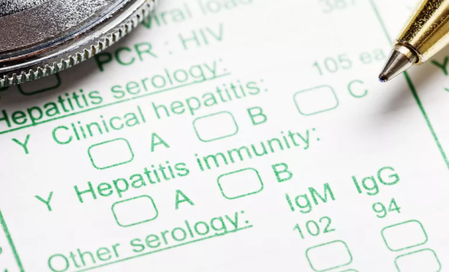
Viral hepatitis
Define as infection of liver caused by dozen
of viruses.
30 years ago only hepatitis A virus (HAV) and hepatitis virus B (HBV)were known.
Hepatitis non-A, non-B (HNANB)
Today’s HAV. HBV, HCV. HDV HEV, and HGV have been identified and are recognised as aetiological agent of viral hepatitis.
In addition many other viruses may be implicated in hepatitis as
Cytomegalo-virus,
Epstein-Barr virus,
Yellow fever virus
Rubella virus .
Herpes simplex viruses,
Varicella viruses and
adenoviruses

Slide 4
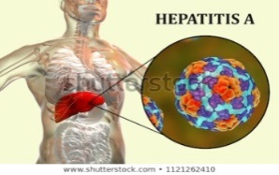
HEPATITIS A
Hepatitis A
is an acute infectious disease caused by hepatitis A virus (HAV). (formerly known as "infectious" hepatitis or epidemic jaundice)
The disease is having nonspecific symptoms such as
fever, chills, headache, fatigue, generalized weakness and aches andpains, followed by anorexia, nausea, vomiting, dark urine and jaundice.
Disease spectrum is characterized by the occurrence of
subclinical or asymptomatic cases.
HAV disease is benign with complete recovery in several weeks.
case fatality rate of icteric cases is <0.1%, usually from
acute liver failure and mainly affects older adults.

Slide 5
Hepatitis A
HAV is endemic in most developing countries, with
frequent minor or major outbreak
The exact incidence of the disease is difficult to estimate because of
the high proportion of asymptomatic cases. However,,
WHO estimates the global burden that about
1.4 million cases /y or about
10-50 persons /100,000 annually affected WW
Poor standard of hygiene and sanitation, facilitated the spread of infection
For practical purposes the world divided into areas
Geographical areas having
Areas with high, levels of HAV infection
Areas with intermediate levels of HAV infection or
Areas with low levels of HAV infection

Slide 6
Areas with high levels of HAV infection (High Endemicity)
In developing countries with very poor sanitation and hygienic practices
Most infection occurs at Early childhood and are asymptomatic
Thus clinically apparent HAV is rarely seen in this areas
Most children (90%) have been infected with the HAV before
the age of 10 yrs.
Those infected in childhood do not experience any noticeable symptoms.
Epidemics are uncommon because older children and adults are generally immune.
Symptomatic disease rates in these areas are low and outbreaks are rare ??

Slide 7
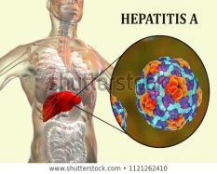
Areas with intermediate levels of HAV infection
(Intermediate Endemicity)
Countries transit from developing to developed economies,
where sanitary conditions are variable gradually
will move from high endemicity to intermediate endemicity HAV become more serious problems in these areas.
children often escape infection in early childhood. and
reach adulthood without immunity
but are expose later in life.
so in these areas most cases occurs during
late childhood & early adulthood..
Ironically, these improved economic and sanitary conditions
may lead to a higher susceptibility in older age groups and
Higher disease rates, occur in adolescents and adults, and
large outbreaks can occur.
Thus, interestingly
with the transition from high to intermediate endemicity,
the incidence of clinically significant hepatitis A increases.??

Slide 8
Intermediate Endemicity Cont. ..
Thus, interestingly
with the transition from high to intermediate endemicity,
the incidence of clinically significant hepatitis A increases.??
Areas with low levels of HAV infection (Low Endemicity)
In developed countries with good sanitary and hygienic conditions
infection rates are low.
Disease may occur among adolescents and adults in high-risk groups,
such as, homosexual men, people travelling to areas of high endemicity

Slide 9
Epidemiological determinants
,
AGENT FACTORS
a AGENT :
The causative agent, the HAV,
It multiplies only in hepatocytes.
Faecal shedding of the HAV is at its highest during
* the later part of the incubation period and
*early acute phase of illness.
(b) Resistance
The virus is fairly resistant to
low pH, heat & chemicals.
It survive more than 10 wks
in well H2O
It withstands heating to 60 Cº
for one hour,
not affected by chlorine doses usually employed for chlorination
The virus is inactivated by ultraviolet rays and
by boiling for 5 minutes
or autoclaving
Formalin is an effective disinfectant

Slide 10
Reservoir of Infection :
The human cases are the only reservoir of infection.
The cases range from asymptomatic to severe infections
Asymptomatic (anicteric) infections are especially common in children.
These cases play an important role in maintaining the chain of transmission in the community.
There is no evidence of a chronic carrier state.
(d) Period of Infectivity :
Risk of HAV transition is greatest
from 2 weeks before to 1 week after the onset of jaundice.
infectivity falls rapidly with the onset of jaundice
(e) Infective Material :
Mainly man's faeces.
Blood, serum and other fluids are
infective during the brief stage of viraemia

Slide 11
Cont. .AGENT FACTORS
(F) Virus Excretion :
HAV is excreted in the faeces for about 2 weeks before the onset of jaundice and for up to 2 weeks thereafter.
virus may also be excreted in the urine
There is little evidence for HAV transmission by exposure to urine or
nose-pharyngeal secretions of infected patients
HOST FACTORS
( a) AGE :
People from all ages may be infected if susceptible.
Infection with HAV is more frequent among children than in adults.
In young children, infections tend to be mild or subclinical
the clinical severity increases with age.
The ratio of anicteric to icteric cases in adults is about 1 :3;
in children, it may be as high as 12: 1.
However, faecal excretion of HAV antigen and RNA persists longer in the young than in adults
(b) SEX :
Both sexes are equally susceptible

Slide 12
Cont….HOST FACTORS
(c) Immunity:
Immunity after attack probably lasts for life;
second attacks have been reported in about 5 % of patients.
Most people in endemic areas acquire immunity through subclinical infection.
Who is at risk?
Anyone who has not been vaccinated or previously infected can get HAV infection
In a high endemicity areas most HAV infection occur during early child hood.
Risk factors in intermediate and high endemicity areas include:
*poor sanitation;
** lack of safe water;
**travelling to areas of high endemicity without being immunized
***Living in a household with an infected person;
**** being a sexual partner of someone with acute HA infection

Slide 13
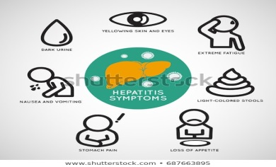
Environmental Factors
Cases may occur throughout the year.
Poor sanitation and overcrowding favour the spread of infection
giving rise to water-borne and food-borne epidemics.
when standards of hygiene and sanitation are improved,
morbidity may increase.?????
Incubation Period ( IP)
10-50 days (usually 14-28 days}.
Length of the IP is proportional to the dose of the virus ingested
Clinical Spectrum
The onset of jaundice is often preceded by as nausea, vomiting
BUT anicteric hepatitis is more common.
98 % of HAV cases resolves completely
The outcome of infection with HAV is as shown

Slide 14
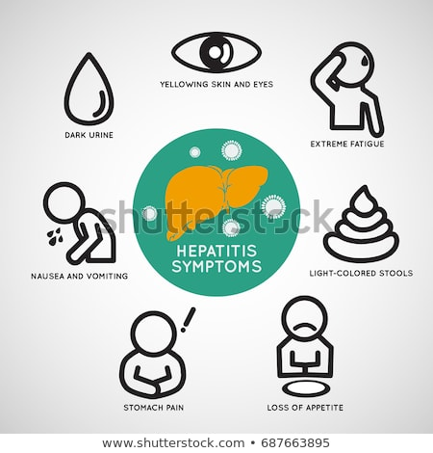
outcome of infection with HAV
outcome | Child | Adult
Unapparent (subclinical infection) | 80-95% | 10-25%
Icteric disease | 5-20% | 75-90%
Complete recovery | >98% | >98%
Chronic disease | None | None
Mortality rate | 0.1% | 0.3-2.1%

Slide 15
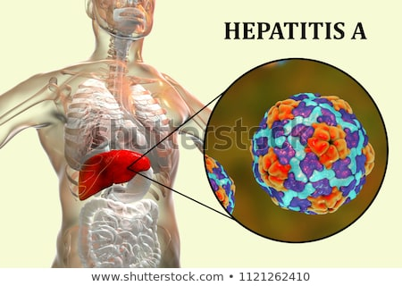
Modes Of Transmission
Faecal-Oral Route :
This is the major route of transmission. It may occur by
DIRECT (person-to-person) contact or
INDIRECTLY by contaminated water, food or milk.
in developed countries Water-borne transmission, is not a major factor, where food-borne outbreaks are becoming more frequent. For example, consumption of salads and vegetables, and of raw or inadequately cooked shellfish and oyesters cultivated in sewage polluted water is associated with epidemic outbreaks of hepatitis A.
Food handlers are critical role in common-source food-borne HAV transmission.
Children play an important role in HAV transmission ????
as they generally have asymptomatic or unrecognized illness

Slide 16
(b} Parenteral Route:
HAV very is rarely, (i.e. by blood and blood products or
by skin penetration through contaminated needles.
This may occur during the stage of viraemia.
Health care personnel do not have an increased prevalence
of HAV infection and nosocomial HAV transmission is rare.
(c} Sexual Transmission:
mainly may occur among homosexual men because of oral-anal contact.
Diagnosis
HA cases clinically are not distinguishable from other types of acute viral hepatitis.
abnormal liver function tests, such as
serum alanine amino transferase (ALT) and bilirubin,
Anti-HAV appears in the lgM fraction during
the acute phase,
peaking about 2 weeks after elevation of liver enzymes.

Slide 17
Cont. ..Diagnosis
Anti-HAV appears in the lgM fraction during
the acute phase,
peaking about 2 weeks after elevation of liver enzymes.
Anti-HAV lgM usually declines to non-detectable levels
within 3-6 months.
Anti-HAV lgG appears soon after the onset of disease and
persists for decades.
Thus, detection of lgM-specific anti-HAV in the blood of an acutely infected patient confirms the diagnosis of HAV
Demonstration of HAV particles or HAV antigens specific viral antigens in the faeces, bile and blood.
HAV is detected in the stool from about
2 weeks prior to the onset of jaundice, up to 2 weeks after.
Additional tests include reverse transcriptase polymerase chain reaction (RT-PCR) to detect the hepatitis A virus RNA, and may require specialised laboratory facilities

Slide 18
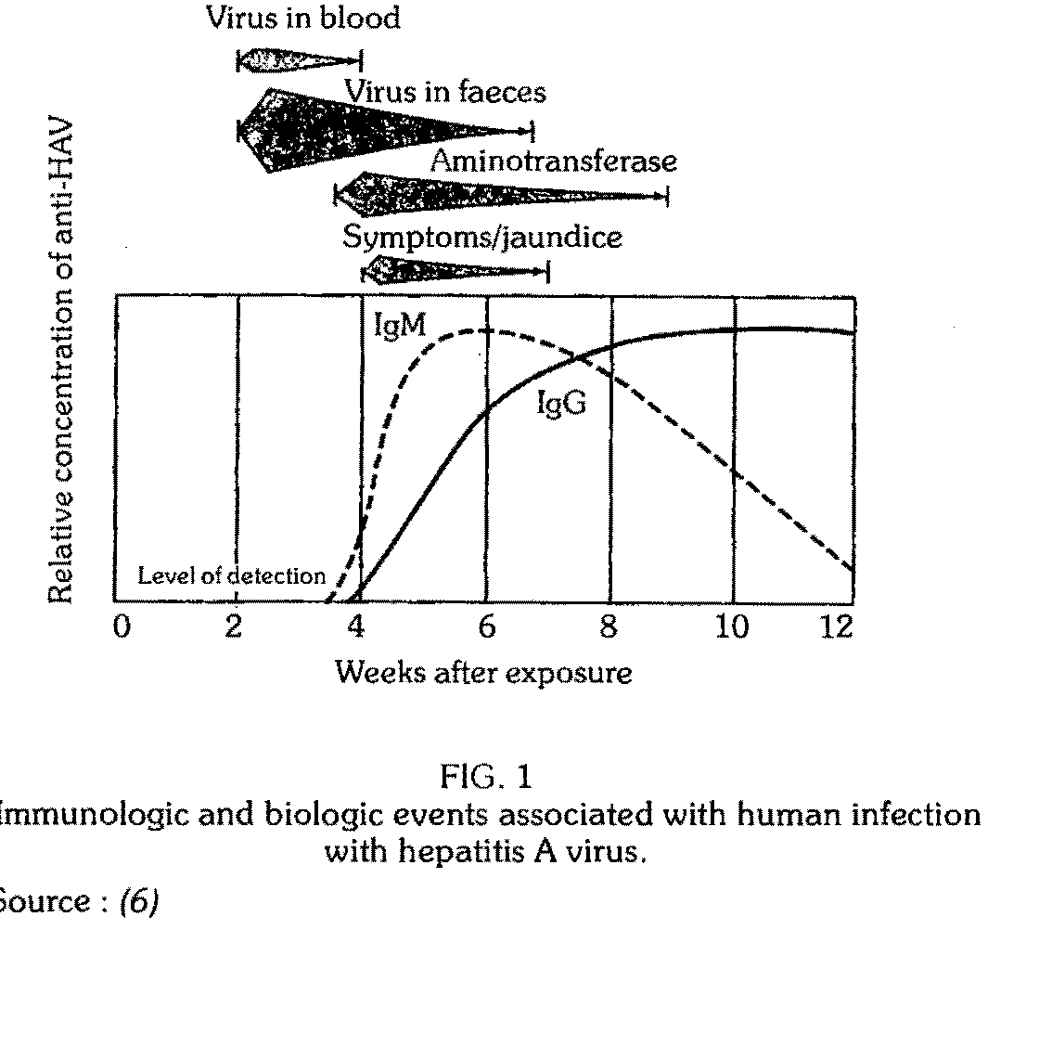
The clinical, virologic and serological events following exposure to HAV are
as shown in Fig. 1.

Slide 19
PREVENTION AND CONTAINMENT
I. Control of Reservoir
Control of reservoir is DIFFICULT because of the following
(a)faecal shedding of the virus is at its height during the
incubation period and early phase of illness
(b) the occurrence of large number of subclinical cases
(c) absence of specific treatment, and
(d) low socio-economic profile of the population usually involved.
Strict isolation of cases is not a useful control measure because of (a)&{b)
However, attention should be paid to the usual control measures such as notification, complete bed rest and disinfection of faeces and fomites.
The use of 0.5 %sodium hypochlorite has been strongly recommended an effective disinfectant

Slide 20
II. Control of Transmission
The best means of reducing the spread of infection is by
promoting of personal and community hygiene,
e.g. hand washing before eating and after toilet;
Sanitary disposal of excreta
Prevent H2O, food & milk contamination
purification of community water with
adequate chlorination 1mg/L of free residual chlorine can cause distraction of the virus in 30 minutes at Ph ≤ 8.5
boiling water is recommended during epidemic
. Proper autoclaving of needles syringes other equipment
III . Control of susceptible population
Targeted protection of high-risk groups should be considered
in low and very low endemicity, settings.
Groups at increased risk of hepatitis A include
Travellers to areas of intermediate or high endemicity,
Men having sex with men,
In addition, pts with chronic liver disease are at increased risk for fulminant hepatitis A and should be vaccinated .

Slide 21
Vaccines :
Two types of hepatitis A vaccines are currently used (WW)
(a) Formaldehyde inactivated vaccines - produced in several countries and which are most commonly used WW
{b) Live attenuated vaccines - which are manufactured
in China and are available in several countries.
Inactivated hepatitis A vaccine
licensed for use in persons ≥12 months of age.
2 dose administration into the deltoid muscle.
The interval between the first (primary) dose and second (booster) dose is commonly 6-12 months;
however, the interval between the doses is flexible and can be extended to 18-36 mths
It can be administered simultaneously with other vaccines.
Protective efficacy is about 94 %..
Live attenuated vaccine is
administered as a single subcutaneous dose

Slide 22
Both inactivated and live attenuated hepatitis A vaccines are highly immunogenic and immunization will generate long-lasting possibly
life-long, protection against the disease in children and adults.
Immunization
Vaccination against HA should be part of a comprehensive plan
for the prevention and control of viral hepatitis.
Generally speaking,
Countries with intermediate endemicity will benefit the most f
rom universal immunization of children.
Countries with low endemicity may consider vaccinating
high-risk adults.
In countries with high endemicity, the use of vaccine is limited as most adults are naturally immune

Slide 23
Cont…Control of susceptible population
Human Immunoglobulin to induce passive immunity
Recommended for;
a-susceptible person traveling to endemic areas.
b- close personal contacts of Pt with HVA .
c- for the control of outbreaks in institutions
Gamma globulin given:
Before exposure to virus or Early during IP will prevent or
attenuate a clinical illness BUT NOT always prevent infection and excretion of the virus
unapparent or subclinical illness may develop. .
The efficacy of the passive immunization
given in proper dosage
within 1-2 Ws of exposure it prevent 80-90%
if given after onset of symptoms no benefit
duration of protection is,, limited to approximately
1-2 months and 3-5 months following administration of lgG at dose of 0.02 and 0.06 ml/kg body weight, respectively.

Slide 24
Hepatitis A In Jordan by Health District Years : 2000 To 2017
Year | 2000 | 2001 | 2002 | 2003 | 2004 | 2005 | 2006 | 2007 | 2008 | 2010 | 2011 | 2012 | 2013 | 2014 | 2015 | 2016 | 2017
Capital Directorate | 229 | 120 | 100 | 116 | 62 | 40 | 53 | 34 | 35 | 65 | 48 | 110 | 160 | 50 | 48 | 36 | 37
Madaba Directorate | 15 | 6 | 5 | 4 | 3 | 6 | 10 | 6 | 7 | 3 | 14 | 7 | 28 | 5 | 0 | 2 | 0
Balqa Directorate | 80 | 60 | 21 | 28 | 22 | 16 | 23 | 52 | 31 | 39 | 26 | 20 | 73 | 37 | 25 | 10 | 8
Ramtha Directorate | 67 | 56 | 30 | 27 | 22 | 33 | 25 | 36 | 17 | 7 | 9 | 52 | 85 | 23 | 23 | 10 | 16
Ma'an Directorate | 32 | 17 | 3 | 34 | 22 | 11 | 11 | 0 | 0 | 1 | 0 | 1 | 51 | 18 | 3 | 10 | 1
Deir Alla Directorate | 26 | 4 | 5 | 3 | 13 | 5 | 10 | 10 | 34 | 4 | 12 | 11 | 18 | 25 | 1 | 3 | 11
Agwar Shamaliyah Directorate | 14 | 22 | 150 | 116 | 26 | 26 | 102 | 38 | 15 | 65 | 73 | 73 | 10 | 11 | 3 | 1 | 2
Tafeileh Directorate | 3 | 11 | 2 | 3 | 6 | 2 | 6 | 0 | 5 | 1 | 0 | 0 | 8 | 2 | 5 | 2 | 5
Bani Kenaneh Directorate | 4 | 3 | 4 | 30 | 16 | 2 | 2 | 6 | 4 | 2 | 1 | 8 | 16 | 5 | 3 | 2 | 12
Badia Shamaliyah Directorate | 27 | 47 | 6 | 18 | 7 | 2 | 0 | 2 | 5 | 4 | 1 | 6 | 160 | 18 | 0 | 7 | 35
Betra Directorate | 0 | 0 | 0 | 0 | 0 | 0 | 0 | 0 | 0 | 0 | 0 | 0 | 0 | 0 | 0 | 0 | 2
Irbid Directorate | 96 | 71 | 35 | 20 | 11 | 5 | 104 | 16 | 19 | 17 | 50 | 67 | 68 | 24 | 36 | 13 | 15
Ajloun Directorate | 62 | 32 | 7 | 13 | 27 | 13 | 9 | 5 | 0 | 7 | 23 | 26 | 16 | 13 | 1 | 0 | 5
Mafraq Directorate | 71 | 92 | 20 | 13 | 35 | 8 | 56 | 28 | 74 | 38 | 33 | 22 | 143 | 128 | 34 | 14 | 25
Karak Directorate | 45 | 25 | 4 | 9 | 3 | 4 | 3 | 18 | 17 | 7 | 13 | 6 | 2 | 21 | 34 | 25 | 8
East Amman Directorate | 18 | 18 | 38 | 38 | 14 | 21 | 22 | 48 | 29 | 14 | 13 | 10 | 52 | 11 | 13 | 14 | 20
Shounah Janoobiyah Directorate | 11 | 4 | 5 | 2 | 4 | 5 | 4 | 10 | 10 | 2 | 19 | 24 | 9 | 1 | 3 | 10 | 0
Koura Directorate | 5 | 9 | 27 | 22 | 4 | 4 | 2 | 8 | 2 | 1 | 0 | 4 | 14 | 10 | 2 | 1 | 0
Zarqa Directorate | 125 | 81 | 33 | 35 | 21 | 27 | 25 | 34 | 101 | 40 | 49 | 49 | 138 | 91 | 30 | 7 | 32
Aqaba Directorate | 0 | 13 | 0 | 4 | 2 | 0 | 0 | 5 | 4 | 0 | 0 | 0 | 1 | 6 | 2 | 7 | 5
Jerash Directorate | 17 | 63 | 11 | 17 | 22 | 36 | 14 | 30 | 47 | 60 | 34 | 8 | 24 | 45 | 25 | 77 | 26
Agwar Janoobiyah Directorate | - | - | - | - | - | - | 1 | 1 | 8 | 0 | 0 | 5 | 6 | 0 | 0 | 0 | 1
Total | 947 | 754 | 506 | 552 | 342 | 266 | 482 | 387 | 464 | 377 | 418 | 509 | 1082 | 544 | 291 | 251 | 266

Slide 25
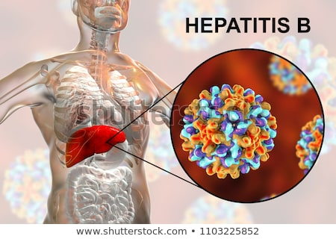
HEPATITIS B
Brucellosis | 467
Incidence Rate | 4.645

