Slide 1
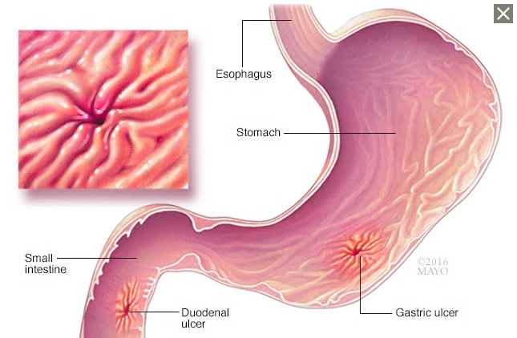
Drugs For Peptic Ulcer
Peptic Ulcer Disease (PUD)
Peptic ulcers commonly involve stomach (gastric) ulcer or duodenum (duodenal) ulcer
The most common symptom is burning stomach pain
Complications is bleeding
Relapse is common when treatment is stopped

Slide 2
Major Causative Factors
Long-term use of aspirin & NSAIDs (elderly)
Infection with gram negative Helicobacter pylori
Increased hydrochloric acid (HCL) secretion
Steroids, smoking, alcohol, stress

Slide 3
Treatment Approach
Eradicate H. pylori infection
Reduce gastric acid secretion
H2-receptor antagonists or
Proton pump inhibitors (PPIs)
Agents that protect gastric mucosa from damage such as misoprostol and sucralfate
Patients unable to tolerate above therapies, neutralized gastric acid with antacids
The goals of treatment for peptic ulcer:
Relieve pain
Heal ulcer
Prevent recurrence and complications

Slide 4
Classes of Drugs to Treat PUD
Antimicrobial agents: Amoxicillin, clarithromycin, metronidazole, tetracycline
H2 receptor blockers: cimetidine, famotidine, ranitidine
Proton pump inhibitors (PPIs): esomeprazole, lansoprazole, omeprazole, pantoprazole
Prostaglandins: misoprostol
Antacids: Aluminum hydroxide, magnesium hydroxide, calcium carbonate
Mucosal protective agents: Bismuth subsalicylate, sucralfate

Slide 5
Antimicrobial Agents
Useful for patients with PU infected with H. pylori
Diagnosis of H.pylori: Enscopic biopsy of gastric mucosa, serological tests, urea breath tests
Eradication of H.pylori results in rapid healing of active peptic ulcer, low recurrence rate and reduce risk of bleeding
Successful eradication 80-90%

Slide 6
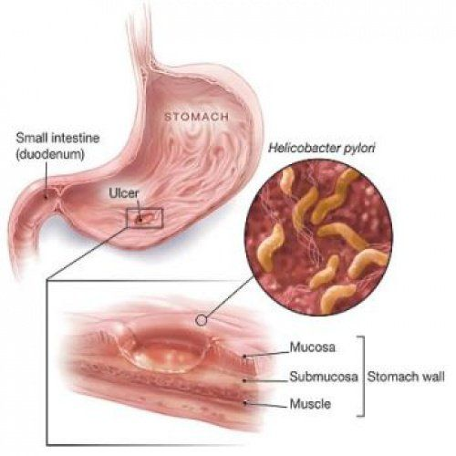

Slide 7
Combination therapy:
Triple therapy: PPI, clarithromycin, plus either amoxicillin or metronidazole
Quadrable therapy: PPI, metronidazole, tetracycline, bismuth subsalicylate
Duration: for 2-week course
GERD (Gastroesophageal reflux disease) (heartburn sensation) is not associated with H.pylori infection and does not response to treatment with antibiotics

Slide 8
H2-Recptor Antagonists
Cimetidine, famotidine (famodar), ranitidine (zantac)
Block actions of histamine at all H2 receptors
Completely inhibit gastric acid secretion induced by histamine or gastrin
Uses of these agents has decreased with the use of PPIs
Therapeutic uses:
Healing of Peptic ulcers
Prevention & treatment of GERD (50% no benefit, use PPIs)

Slide 9
All H2 antagonists can be given orally or IV
Cimetidine: short half-life, inhibits CYP P450 (slow metabolism of warfarin, diazepam, phenytoin, carbamazepine)
Ranitidine: longer half-life, more potent than cimetidine
Famotidine: similar to ranitidine, 20-50 more potent than cimetidine
They need 45 mins to relieve symptoms
Dose should be reduced in hepatic and renal failure
Side effects:
Headache, dizziness, diarrhea, muscular pain
CNS: confusion, hallucinations (elderly, after IV administration)
Cimetidine: Endocrine (antiandrogen) effects (gynecomastia, galactorrhea, reduced sperm count, impotence) (limited use)

Slide 10
Proton pump inhibitors (PPIs)
Omeprazole, esomeprazole (Nexium), lansoprazole, pantoprazole
Bind to H/K ATPase (proton mump) of parietal cell, suppressing secretion of hydrogen ions into gastric lumen
PPIs superior than H2 antagonists in suppression of acid production and peptic ulcer healing

Slide 12
Therapeutic Uses
Eradication of H. pylori
GERD
Prevention & treatment of NSAIDs-induced ulcer
Reduce risk of bleeding from NSAIDs-induced ulcer
Erosive esophagitis
Active duodenal ulcer
Hypersecretion conditions (Zollinger-Ellison syndrome: gastrin –producing tumor causes hypersecretion of HCL)

Slide 13
Should be taken 30 mins before meal
Acid suppression takes 1-2 hrs
Given orally (sustained release formulation)
Intravenous injections
Omeprazole inhibits metabolism of warfarin, phenytoin, diazepam, cyclosporine
Adverse effects:
Flatulence, diarrhea, Clostridium difficile colitis
Dry mouth, sleep disturbances, taste disturbances
Prolonged therapy: low B12

Slide 14
Prostaglandins
Prostaglandins E2, produced by gastric mucosa, inhibits secretion of HCL, stimulates secretion of mucus and bicarbonate (cytoprotective effect)
Misoprostol (Cytotec) is analog of prostaglandin E1
Uses: prevention of NSAID-induced ulcers (elderly, patients with ulcer complications)
Less effective than H2 antagonists and PPIs for acute treatment of peptic ulcer
Adverse effects: Diarrhea, nausea, abdominal pain
Misoprostol produces uterine contractions, contraindicated during pregnancy

Slide 15
Antacids
Aluminum hydroxide (Maalox) , magnesium hydroxide, calcium carbonate
React with gastric acid to form water and salt, diminish gastric acidity
Uses: They are used as last-line therapy for GERD, duodenal ulcer
Adverse effects:
Aluminum hydroxide: constipation
Magnesium hydroxide: diarrhea

Slide 16
Mucosal Protective Agents
Bismuth subsalicylate, sucralfate
Cytoprotective compounds, enhances mucosal protection, prevent mucosal injury, reduce inflammation, healing ulcers
Sucralfate:
Complex of aluminum hydroxide and sulfate sucrose
Form gel with epithelia cells, creates physical barrier that impairs diffusion of HCL
Stimulate prostaglandin release
Heals duodenal ulcers, long-term therapy to prevent recurrence
Should not be administered with H2 antagonists or antacids ( requires acidic PH for activation)

