Slide 1
Done By : Bashar AL Talaheen Supervised By : Dr. malek
Baker AL Manasyeh

Slide 2
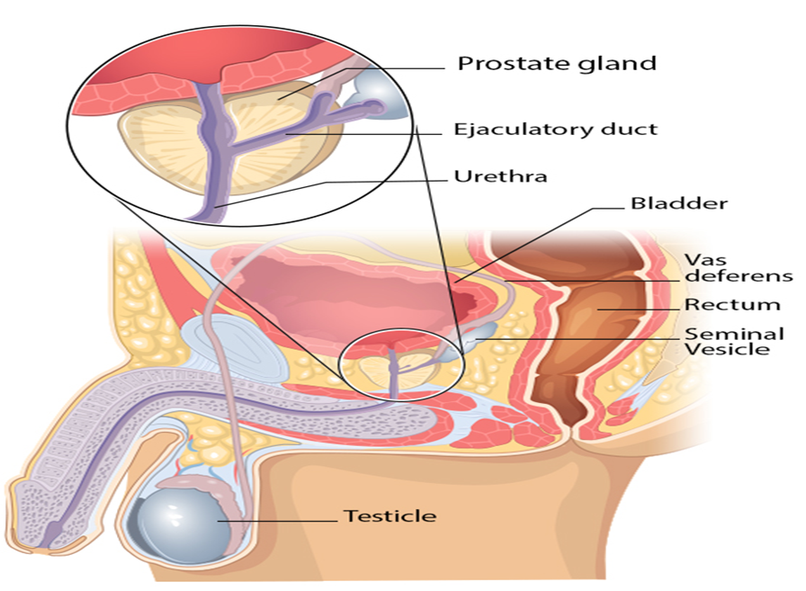
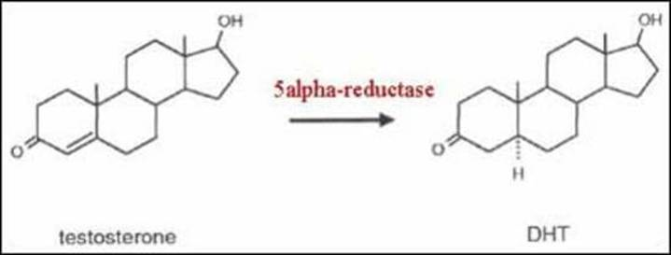
walnut-shaped gland at base of bladder
Anterior to the rectum
Palpation on digital rectal exam
Encircles urethra
Produces prostatic ﬂuid
Stimulated by androgens (testosterone, DHT)

Slide 3
Physiology
The prostate is an accessory sex gland whose primary function is the support and promotion of male sperm function and fertility.
During ejaculation it is thought that the prostate contracts to secrete about 0.5–1.0 mL of fluid which is added to the ejaculate.
The acini of these ducts are composed of secretory cells, basal cells and neuroendocrine cells.

Slide 4
Surgical anatomy
The prostate is closely related to the three elements of the sphincter in the male:
The bladder neck (internal sphincter mechanism) is a collection of alpha-adrenergic smooth muscle, supplied by sympathetic nerve fibers.
The supramembranous external sphincter, partly smooth muscle, partly striated, is just below the verumontanum, and also supplied by sympathetic nerve fibers.
The levator ani, voluntary striated muscle supplied by the pudendal nerve.

Slide 5
Surgical anatomy
The prostate is covered by a capsule of connective tissue and smooth muscle. Beneath this layer, the prostate can be divided into a few zones ;
Peripheral zone ; the outermost and largest zone (contains about 70% of prostate glandular tissue)
Central zone; contains 25% of the glandular tissue as well as the ejaculatory ducts that join with the prostatic urethra
Transition zone; contains around 5% of the glandular tissue as well as portion of the prostatic urethra

Slide 7
Microscopically
Each of the tiny glands (acini) that make up the prostate is surrounded by a basement membrane made largely of collagen .
Beneath it , there is a ring of cube shaped basal cells as few neuroendocrine cells.
Finally, inner ring of luminal columnar cells which are within the lumen or center of the gland that secret substances into prostatic fluid that make it slightly alkaline and nourish sperms to help them survive the acidic vagina .

Slide 8
It is produced by the epithelial secretory cells .
PSA is produced for the ejaculate, where it liquefies semen in the seminal coagulum and allows sperm to swim freely.
It is also believed to be instrumental in dissolving cervical mucus, allowing the entry of sperm into the uterus.
PSA is present in small quantities in the serum of men with healthy prostates, but is often elevated in the presence of prostate cancer or other prostate disorders.
PSA is not a unique indicator of prostate cancer, but may also detect prostatitis or benign prostatic hyperplasia.

Slide 9
PSA (prostate specific antigen)
There’s no such thing as a normal PSA for any man at any given age, but most men with prostate cancer have a higher than normal level. In general:
Safe: 0 to 2.5 ng/mL
Safe for most: 2.6 to 4 ng/mL .
Suspicious (gray zone): 4 to 10 ng/mL . There’s a 25% chance you have prostate cancer >> order PSA kinetics
Dangerous: 10 ng/mL and above. There’s a 50% chance you have prostate cancer.
Finding prostate cancer early doesn’t always protect you.

Slide 10
PSA kinetics
Free to total PSA ratio
< 18% ratio>> suggestion of cancer or other differentials (prostatitis)
>18% ratio>> suggest benign cause (BPH)
PSA Density = Serum PSA / Prostate volume
>18% density>> suggestion of cancer
<18% density>> suggestion of benign cause
PSA velocity
Change of > 0.75 ng/ml/year associated with increase risk of cancer
PSA doubling time
Used in staging and follow up of prostate
cancer

Slide 11
cause of increased PSA level :
Getting older
BPH
Prostate cancer
Acute prostatitis
UTI
Ejaculation
DRE (Prostatic massage)
Biopsy
Instrumentation, TURP, and any surgeries of the prostate

Slide 12
1 prostatitis

Slide 13
Prostatitis is a painful condition that involves inﬂammation of the prostate and sometimes the areas around the prostate .
prostatitis has been identiﬁed into : Category 1: Acute bacterial prostatitis Category 2: Chronic bacterial prostatitis Category 3: Chronic pelvic pain syndrome
Category 4: Asymptomatic inﬂammatory prostatitis

Slide 14
Acute bacterial Prostatitis
Acute inflammation of the prostate
Older men
Similar organisms to cystitis
E. coli most common
Also proteus ,pseudomonas
Sexually-active younger men
Neisseria gonorrhoeae
Chlamydia trachomatis

Slide 15
Acute bacterial Prostatitis
Symptoms
Fever, chills , malaise
Dysuria , frequency
Cloudy urine
Digital rectal exam
Prostate edematous/enlarged (“boggy”)
Exquisitely tender
Workup: Urine analysis (WBC) and culture

Slide 16
Chronic bacterial prostatitis Chronic/recurrent prostatitis symptoms Evidence of bacterial infection
Chronic abacterial prostatitis
Symptoms of prostatitis (pain, di culty voiding) May present as chronic pelvic and low back pain Sometimes blood in semen
No bacteria identiﬁed Etiology unclear

Slide 17
2 BPH

Slide 18
Incidence & Epidemiology
BPH is the most common benign tumor in men , and its incidence is age related.
Some studies have suggested a genetic predisposition & some have noted racial differences as risk factors for development of BPH.
Heritable form of BPH is most likely an autosomal dominant trait, and first degree male relatives carry an increased relative risk of approximately 4 folds.
The etiology of BPH is not completely understood, but it seems to be multifactorial and endocrine controlled.

Slide 19
It is truly a hyperplastic process resulting from an increase in cell number.
Microscopic evaluation reveals a nodular growth pattern that is composed of varying amounts of stroma and epithelium.
Hyperplasia of stromal and epithelial cells “ Nodular” hyperplasia
Results in partial or complete urinary obstruction
Not a premalignant condition
Transitional zone most commonly to be affected

Slide 20
Stroma is composed of varying amounts of collagen and smooth muscle.
The differential representation of the histologic components of BPH explain , in part, the potential responsiveness to medical therapy; Thus alpha blocker
therapy may result in excellent response in patients with BPH that has a
signiﬁcant component of smooth muscle ,While those with BPH predominantly composed of epithelium might respond better to 5 alpha reductase inhibitors.

Slide 21
Mechanism of prostatic enlargement causing bladder outlet Obstruction:
A combination of hormonal factors, stem cell
proliferation and genetic susceptibility → glandular and stromal hyperplasia in the transition zone → formation of smooth, ﬁrm hyperplastic nodule → slit-like prostatic urethral compression → bladder outlet obstruction → obstructive symptoms
of BPH

Slide 22
Symptoms :
Obstructive symptoms (voiding ) include : hesitancy , decrease force of stream , sensation of incomplete bladder emptying , double voiding (urinating a second time within 2 hours of the previous void) , straining to urinate , and post voiding dribbling.
Irritative symptoms (storage ) include : urgency , frequency & nocturia.
Overﬂow incontinence

Slide 23
Signs :
A physical examination (Palpate suprapubic area to determine if there is urine retention), DRE (BPH usually results in a smooth, ﬁrm, enlargement of the prostate) , and focused neurologic examination are performed on all patients
LAB investigations :
A urinalysis to exclude infection or hematuria and serum creatinine measurement to assess renal function are required (Renal insufficiency may be observed in 10% of patients) .
Serum PSA is considered optional but most physicians will include it in the initial evaluation.

Slide 24
IMAGING :
recommended only in the presence of concomitant
urinary tract disease (e.g. stones) or complications from BPH ( e.g. hematuria, UTI , retention , renal insufficiency and hydronephrosis) .

Slide 25
Differential Diagnosis
Other obstructive conditions of the lower urinary tract, such as urethral stricture, bladder neck contracture, bladder stone, or Prostatic CA must be entertained when evaluating men with presumptive BPH.
A history of previous urethral instrumentation, urethritis or trauma should be elucidated to exclude urethral stricture or bladder neck contracture.
Hematuria and pain are commonly associated with bladder stone.
Prostatic CA may be detected by abnormalities on the DRE or an elevated PSA.

Slide 26
Treatment :
If patient presented with acute Bladder outlet obstruction then the 1st
step management is Bladder drainage by foley’s catheter
o Watchful waiting
is the appropriate management of men with mild symptoms

Slide 27
Treatment :
Medical treatment :
5α‐reductase inhibitors (Finasteride)
Slow onset symptom relief
This drug affects the epithelial component of the prostate by inhibiting conversion of testosterone into DHT and thus suppressing prostate growth
Side effects include decreased libido, decreased ejaculate volume, and impotence.
Serum PSA is reduced by approximately 50% in patients being treated with ﬁnasteride
α1-blockers
Smooth muscle relaxation (bladder neck muscle and prostate muscle ﬁbers)
Tamsulosin: Uroselective (α1A not α1B –no hypotension) / doxazosin S.Es: postural hypotension , Decrease libido and ejaculation dysfunction

Slide 28
o Medical treatment :
PDE-5 inhibitors (Tadalaﬁl)
Also cause smooth muscle relaxation
Combination therapy:
The use of combined alpha blocker and 5 alpha-reductase inhibitor therapy.
Benefits of this therapy haven't been reported yet.
But decreased symptoms was seen in the alpha blocker arm only.

Slide 29
CONVENTIONAL SURGICAL THERAPY :
indications of surgery :
Failure of medical treatment
Recurrent UTI
Refractory urinary retention
Recurrent gross hematuria
Bladder stone or concomitant abnormality
Complications (Hydronephrosis ,Renal insufficiency)

Slide 30
o CONVENTIONAL SURGICAL THERAPY : Transurethral resection of the prostate (TURP) :
- Symptom score & ﬂow rate improvement with TURP is superior to that of any minimally invasive therapy.
- Risks of TURP include retrograde ejaculation (75%), impotence (5-10%), & incontinence (> 1%).
- Complications include bleeding, urethral stricture or bladder neck contracture, perforation of the prostate capsule with extravasation, and if sever, TUR syndrome.

Slide 31
o CONVENTIONAL SURGICAL THERAPY :
Transurethral resection of the prostate (TURP) :
- TUR syndrome results from hypervolemic hyponatremic state due to the absorption of hypotonic irrigating solution (glycine + water ).
- Clinical manifestation of the TUR syndrome include nausea, vomiting, confusion, seizure , hypertension due to ﬂuid overload , bradycardia &visual disturbance.
- The risk of the TUR syndrome increase with resection times over 90 min.

Slide 32
Treatment :
CONVENTIONAL SURGICAL THERAPY : Transurethral resection of the prostate (TURP) : Prevention of TUR syndrome :
limit resection time and avoid aggressive resection near the capsule
For prolonged procedures, measure serum Na+ → give 20-40mg IV furosemide
Treatment of TUR syndrome includes diuresis and, in severe cases, hypertonic saline administration.

Slide 33
CONVENTIONAL SURGICAL THERAPY :
Transurethral incision of the prostate:
Men with moderate to sever symptoms & small prostate often have posterior commissure hyperplasia (elevated bladder neck).
These patients will often benefit from an incision of the prostate.
This procedure is more rapid & less morbid than TURP.
Lower rates of retrograde ejaculation ( 25% ).

Slide 34
CONVENTIONAL SURGICAL THERAPY :
Open simple prostatectomy :
Excellent outcomes in terms of improvement of symptoms, but higher morbidity rate, associated with risk of signiﬁcant blood loss
Open prostatectomy is indicated when :
concomitant bladder diverticulum or bladder stone
dorsal lithotomy positioning is not possible
Very large prostate over 60 g
Long urethra
Urethral stricture
Concomitant inguinal hernia
Intraoperative bleeding during TURP obscuring vision

Slide 35
MIMIMALLY INVASIVE THERAPY
1.Laser therapy :
Advantages: minimal blood loss, rare instances of TUR syndrome, ability to treat patients receiving anticoagulation therapy, and ability to be done as an outpatient procedure.
Disadvantages: lack of availability of tissue for pathologic examination, long postoperative catheterization time, more irritative voiding complaints, and high cost .
2.Transurethral electrovaporization of the prostate :
3.Transurethral needle ablation of the prostate :
4.Transurethral balloon dilation of the prostate :
5.Intraurethral stents :

Slide 36
THANKS

