Slide 1
Preterm Labor: One Syndrome, Many Causes
Malek Al Qasem , MFM
Mutah university

Slide 2
Introduction
Preterm birth is associated with 5-18% of pregnancies
Is a leading cause of infant morbidity and mortality
Spontaneous preterm labor, a syndrome caused by multiple pathologic processes

Slide 3
The prevention and treatment of preterm labor have been a long-standing challenge

Slide 4
Definition
All births before 37 weeks of gestation are defined as preterm and these are subdivided according to the gestation at delivery into:
Extreme (<28 weeks), which occurs in about 0.25% of pregnancies
Early (28-30 weeks), which occurs in about 0.25% of pregnancies
Moderate (31-33 weeks), which occurs in about 0.6% of pregnancies
Mild or late (34-36 weeks), which occurs in about 3.0% of pregnancies

Slide 5
The occurrence of regular uterine contraction associated with cervical changes before 37 completed weeks Threatened PTL: regular uterine contractions without cervical changes

Slide 6
Preterm birth and neonatal complications
The leading cause of neonatal death
The second cause of childhood death below the age of 5 years
Neonates born preterm are at an increased risk of short-term complications attributed to immaturity of multiple organ systems
Neurodevelopmental disorders, such as cerebral palsy, intellectual disabilities, and vision/hearing impairments
Preterm birth is a leading cause of disability-adjusted life years, the number of years lost due to ill health, disability or early death

Slide 7
Preterm uterine contraction are not the case of preterm labor But the clinical manifestations of the pathological insult

Slide 8
Risk factors
Strongest predictor and most significant risk factor is previous PTL
Previous 1 PTL recurrence 15 %
Previous 2 PTL 30 %
Previous 3 PTL 45 %

Slide 9
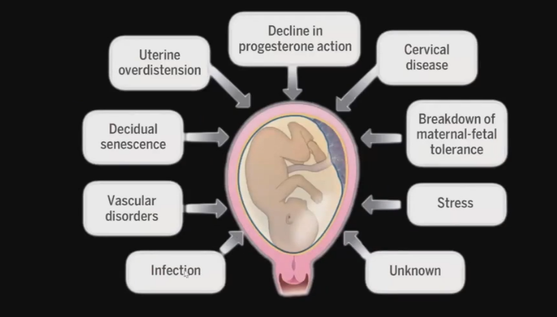
Preterm Labor: Not Just Labor Before Term

Slide 11
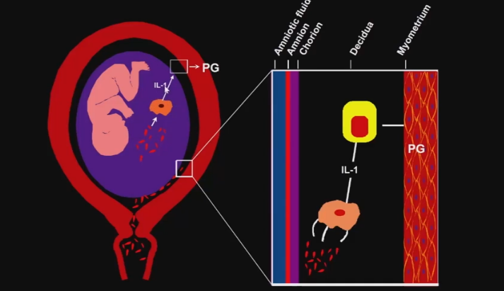
Infection as a pathophysiology

Slide 12
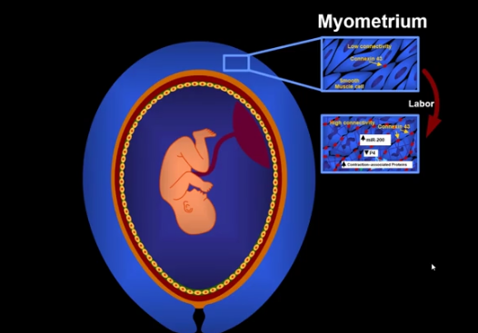

Slide 13
Amniotic fluid tests

Slide 14
Highlighted points
History
Sure date and confirmation by early first trimester records
Vital signs(temperature>38 fever ,hypotension with abruption)
Abdominal pain –tenderness—localized—PTL true—(Braxton hicks)
Assessment of presentation
Assessment of engagement
Sterile speculum (swab vaginal, group B strep)
Discharge offensive and possible pooling liquor
CTG
Ultrasound

Slide 15
Screening
The two most important predictors of spontaneous preterm birth are:
Sonographeic short cervix in the midtrimester
Spontaneous preterm birth in a prior pregnancy

Slide 16
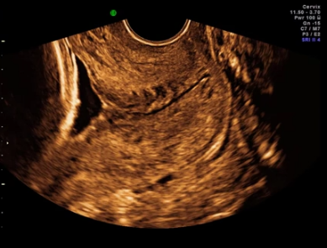
Cervical length
Fetal head

Slide 17
Cervical length at 18-22 weeks in pregnancies that deliver at term is normally distributed with a mean of 34 mm
In pregnancies with sPTB at <34 weeks there is a bimodal distribution in cervical length. The cervical length is <15 mm in 1% of the population and this group contains 20% of cases of sPTB at <34 weeks. The cervical length is <25 mm in 10% of the population and this group contains 40% of cases of sPTB at <34 weeks

Slide 18
Screening
Cervico-vaginal fetal fibronectin
Fetal fibronectin is an extracellular matrix glycoprotein produced by amniocytes and by cytotrophoblast
It is localized between chorion and decidua and acts as a ’glue’ between the pregnancy and the uterus

Slide 19
Cell-free Fetal DNA
A role for cell-free fetal (cff) DNA as a signal for the onset of labor has recently been proposed
In pregnant women, cff DNA is normally present in the plasma, and concentrations increase as a function of gestational age - peaking at the end of pregnancy just prior to the onset of labor
cff DNA (in contrast with adult cell-free DNA) is hypomethylated and induce an inflammatory response

Slide 20
Cell-free Fetal DNA
The downstream consequences could include activating the common pathway of labor
Patients who have an elevation of cff DNA in the midtrimester are at increased risk for spontaneous preterm delivery later in gestation
Patients with preterm labor and high plasma concentrations of cff DNA are also at increased risk for preterm delivery

Slide 21
Management
Goals :
Delay delivery
Identification etiology
Administration of steroids
GBs prophylaxis

Slide 23
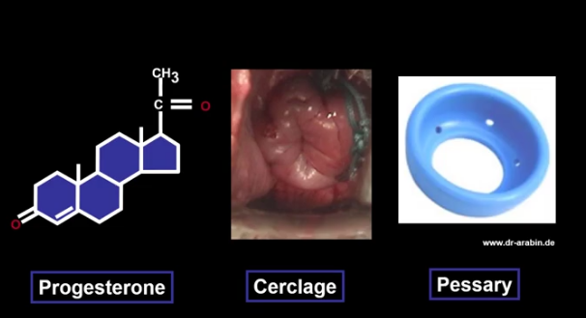
Prevention PTB in short cervix

Slide 24
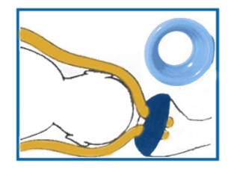
Cervical pessary
Weak evidence

Slide 25
According to obstetric history Studies investigating the value of preventative measures have essentially focused in two groups of women:
Women with a previous preterm birth
Women with no previous preterm delivery but found through a screening test in pregnancy to be at increased risk of preterm birth

Slide 26
Preventions

Slide 27
Bed rest in hospital or at home is widely recommended for the prevention of preterm birth but there is no scientific evidence to support this practice
Bed rest may also have some adverse effects for women, including increased likelihood of venous thrombosis, muscle atrophy and stress
Betamimetics given prophylactically.
Life style interventions, such as decrease in manual labor, increase in visits to antenatal clinics, psychological support, or diet supplementation with iron, folate, calcium, zinc magnesium, vitamins, or fish oil.

Slide 28
women with previous preterm birth
No benefit from bed rest, prophylactic tocolytics or lifestyle interventions
Vaginal progesterone every night from 20 to 34 weeks reduces PTB by 25%
Measurement of cervical length every 2 weeks between 14 and 24 weeks and cervical cerclage if the cervix becomes less than 25 mm reduces PTB by 25%

Slide 29
women with no previous preterm birth but positive screening test
Short cervix at 20-24 weeks consider Cervical cerclage it may reduce PTB at <34 weeks by 15%
Vaginal progesterone every night from 20 to 34 weeks reduces PTB at <34 weeks by 35-40%
In women with asymptomatic bacteruria the risk of PTB and pyelonephritis is increased
Antibiotic treatment reduces the risk of pyelonephritis but does not reduce the risk of PTB

Slide 30
Threatened preterm labor
Management Women presenting with threatened preterm labor are often with:
Hospitalization in a unit with facilities for neonatal intensive care
Administration of tocolytics to prevent preterm birth
Administration of steroids to improve fetal lung maturity

Slide 31
Tests For Fetal Lung Maturity

Slide 32
Fetal Lung Maturity
Respiratory distress syndrome of the newborn infant is caused by immaturity of the fetal lung
Measurement of pulmonary surfactant production is the most effective way to evaluate pulmonary maturity

Slide 33
As the lung develops, significant quantities of surfactant are washed out of the fetal lung and accumulate into the amniotic fluid
The amount of surfactant in fetal lungs can be estimated by measuring the amount of surfactants and surface tension in amniotic fluid.

Slide 34
What are the benefit to perform a lung maturity test
Assessment of the risk/benefit ratio in case of elective delivery in late pregnancy complications ( iatrogenic preterm delivery)
Decision on the administration of corticosteroids

Slide 35
Surfactant
Type I
pneumocyte
Type II
pneumocyte
Air/liquid
interface
Air space
Lamellar
body

Slide 36
Tests for fetal lung maturity
Invasive Tests Requiring Amniocentesis
Non Invasive Tests
Direct Test
Indirect Test
Lecithin/Sphingomyelin
Phosphatidylglycerol
Foam Stability Test (or Shake Test)
Lamellar Body Count

Slide 37
Direct Tests

Slide 38
Lecithin/Sphingomyelin Ratio
The most popular test was reported in 1971 using by thin layer chromatography procedure
3-4 ml amniotic fluid centrifuged at low speed mixed with methanol
Lipid extraction and then application to thin layer chromatography plate vs controls
Visualization of phospholipid components
L/S ratio of 2.0 or greater indicates maturity

Slide 39
Phosphatidylglycerol (PG)
It can be detected by two-dimensional thin-layer chromatography or polyclonal antibodies
The detection decreases the rate of false immature results
The presence of PG in amniotic fluid specimens contaminated with blood or meconium remained a valid finding even when the results of the L/S ratio were called into question.

Slide 40
Phosphatidylglycerol
Presence indicates a more advanced state of fetal pulmonary maturity
But the disadvantage they are late appearance in pregnancy

Slide 41
Indirect tests

Slide 42
Foam Stability
The principle:
Addition of amniotic fluid to different concentrations of 95% ethanol solution followed by shaking and observing the meniscus for the presence of a ring of bubbles

Slide 43
Shaking test
https://www.youtube.com/watch?v=t_HLlbPNCuM

Slide 44
Shaking test
https://www.youtube.com/watch?v=t_HLlbPNCuM

Slide 45
Lamellar Body Count
Phospholipids are packaged into multi-layered lamellar bodies
They are similar in size to platelets
Therefore they can be counted with automated cell counter
The lamellar body count method is a indirect reflection of surfactant concentration

Slide 46
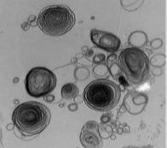
Lamellar body count
If the count :
<= 8.000 immature no further testing
9.000-32.000 transitional perform L/S and PG
>32.000 mature no further testing

Slide 47
Non invasive tests

Slide 48
The Fetal Pulmonary Maturity: the Ultrasound Role
Ultrasound can evaluate the development of fetal pulmonary parenchyma by measuring the diameter and area of fetal lungs
Color Doppler can show the distribution of fetal pulmonary vessels, helping to understand the development of fetal pulmonary circulation, as well as the fetal pulmonary maturity

Slide 49
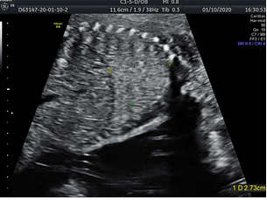
Measurement Methods Of Fetal Lung

Slide 50
Ultrasound features for fetal lung maturity detection
Gray-Scale Measurements
Lung Tissue Motion
Relationship Between Image Features of Fetal Lung vs Placental or Liver Tissue
Doppler ultrasound

Slide 51
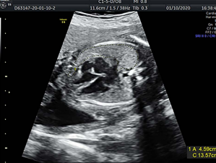
Ultrasound Test For Lung Maturity

Slide 52
Neonates delivered at 36-38 weeks after confirmed fetal lung maturity are at higher risk of adverse outcomes than those delivered at 39- 40 weeks

Slide 53
Treatment
Patients with following complications are not candidate for tocolysis:
APH
Infections
advanced labour active phase
PROM

Slide 54
B -mimetics
Ritodrine and salbutamol
Stimulate B2 receptors and relax smooth muscle (uterus)
Highly side effects : tremor ,nausea, hyperglycemia, pulmonary edema

Slide 55
Calcium channel blockers
Nifedipne ---inhibit myometrial contractions
Effective –reduce PTD within 7 days and decreased RDS
Fewer side effects comparing B-agonist
Inexpensive and easy to use
Side effects : hypotension ,flushing. diarrhea, constipation ,headaches.

Slide 56
NSAIDs
Indomethacin :Prostaglandin inhibitor (PGf2a)—50-100 mg orally
Side effects ---oligohydramnios , constriction of the ducts arteriosus, renal effect

Slide 57
Magnesium sulfate use in pregnancy
For managing preeclampsia – eclampsia
As tocolytics agent
As fetal-neonatal neuroprotective agent

Slide 58
Use 4 g, the smallest effective dose, with or without a 1 g/hour maintenance dose

Slide 59
Atosiban (tractocile)
Oxytocin-vasopressin antagonist
Fewer side effects
The most common side effect with Tractocile is nausea
Reported cases of fetal demise
Expensive

Slide 60
Preterm prelabor rupture of membranes

Slide 61
PPROM
Rupture of the membrane before the onset of labor <37 week
PPROM complicates 2-4% of all birth and 30-40 of all preterm births
Associated with inflammatory reaction +- infection

Slide 62
PPROM and complications
Prolonged maternal hospitalization
Early onset neonatal sepsis
Fetal Pulmonary hypoplasia depending on gestational age
Higher neonatal morbidity and mortality
Inflammation related adverse neurodevelopmental outcomes

Slide 63
Complications of PPROM
Infection includes chorioamnionitis
Retained placenta
Placental abruption

Slide 64
Risk factors
Prior PPROM or PTL of any cause
Bleeding in any trimester
Genital tract infections
Tobacco exposure
Collagen disease
Psychosocial stressors

Slide 65
Fetal membranes
Surface area of 1500 cm2
200-300 um thick at term
Resistant and elastic mechanical barrier
Rich source of functionally relevant biochemicals
Fetal membrane matrix is maintained by progesterone
Provide mechanical ,structural ,immune ,antimicrobial and endocrine functions

Slide 66
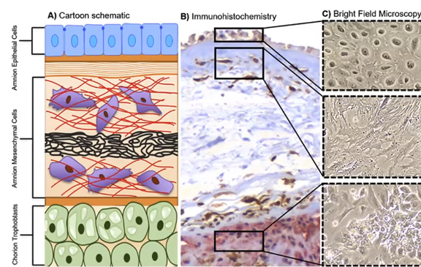
Fetal membranes
Protection mechanism reduced in inflammation

Slide 67
Etiology
Inflammation
Microfractures
Fetal membrane aging

Slide 69
Clinical evaluation
History
( sudden gush of fluid , soaking clothes, dampness of underwear mistaken urinary incontinence)
Odder and color
Abdominal pain , contractions
Mild pyrexia , feeling unwell ,abnormal vaginal discharge
Vaginal bleeding
Dysuria
Cord prolapse

Slide 70
Diagnosis

Slide 71
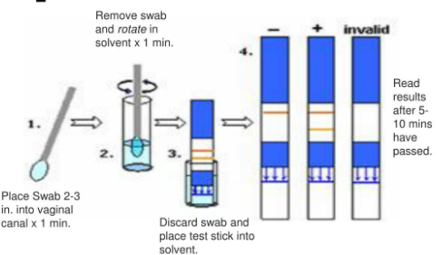
PPROM Diagnosis
Amnisure –sensitivity 94-99% specificity 87-100%
non-invasive strip test for the detection of the placental alphamicroglobulin-1 protein

Slide 72
Actim PPROM
Actim-PPROM sensitivity 95-100%
Specificity 93-98%
rapid test that reliably detects PROM, even before any visible signs can be detected

Slide 73
ROM Plus
Sensitivity 99% specificity 91%
Detect IGFBP-1 and AFP

Slide 74
Differential diagnosis
Urinary incontinence: leakage of small amounts of urine is common in the last part of pregnancy
Normal vaginal secretions of pregnancy
Increased sweat or moisture around the perineum
Increased cervical discharge
Semen
Douching

Slide 75
Investigation
CBC
Urinalysis
High vaginal swab
CRP
US

Slide 76
Management
Screening for infection including GBS
Antenatal corticosteroids
Tocolysis only to achieve benefit of corticosteroids
Antibiotics prolong latency based on numerous trial
(penicillin plus macrolide)
Fetal monitoring NST,AFV and fetal growth
Maternal monitoring for infection or labor
Timing of delivery –dependent on NICU capability

Slide 77
Majority of pregnancies with PPROM deliver within one week of rupture

Slide 78
Managements
Malpresentation may require cesarean delivery
Risk of cord prolapse should be evaluated
Delivery at 34 weeks or sooner if indicated

Slide 79
Chorioamnionitis
Acute chorioamnionitis is the most frequent diagnosis in placental pathology reports, and is generally considered to represent the presence of intra-amniotic infection or “amniotic fluid infection syndrome”

Slide 80
Clinical chorioamnionitis
Diagnosed by the presence of maternal fever
(temperature ≥37.8°C )
plus two or more of the five following clinical signs:
Maternal tachycardia (heart rate >100 beats/min)
Fetal tachycardia (heart rate >160 beats/min)
Uterine tenderness
Purulent or foul-smelling amniotic fluid or vaginal discharge
Maternal leukocytosis (white blood cell count >15,000/mm3)

Slide 81
The most frequent microorganisms identified in the amniotic fluid of women with clinical chorioamnionitis include Ureaplasma urealyticum, Gardnerella vaginalis, Mycoplasma hominis, Streptococcus agalactiae, Lactobacillus species, and Bacteroides species

Slide 82
The standard treatment for clinical chorioamnionitis has been administration of antibiotics and antipyretics and expedited delivery

Slide 83
PPROM

Slide 84
Surgical treatment of rupture of membrane
Amniograft
Amniotic patch
The procedure can seal membrane defects up to 4 mm in diameter

Slide 85
Amniopatch technique
22- gauge needle
Injection into available pocket of fluid
½ unit of platelets
1 unit of cryoprecipitate

Slide 86
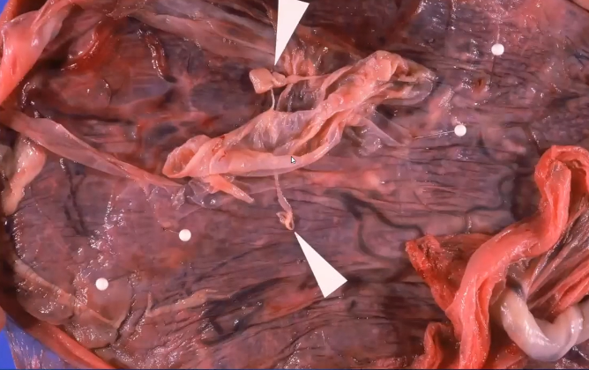
Amniopatch

Slide 87
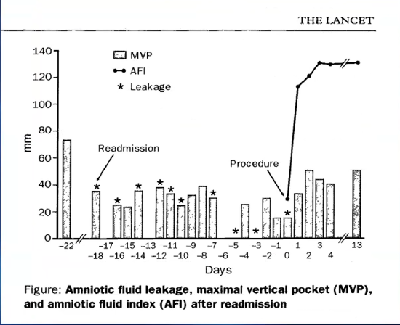

Slide 88
Antenatal corticosteroids potent drugs with potent side effects
Reduced placental weight
Reduced fetal weight and height
Reduced head circumference

Slide 89
Mgso4 is an important drug in early PPROM

Slide 90
Thank you

