Slide 1
Approach to amenorrhea
Done by :
Batool Gharaibeh
Danah jehad
Khalid almajali
Mohammed maaitah
Supervised by : Dr Mohammed ramadneh

Slide 2
Definition
Primary amenorrhea:- Absence of menses by age 14 years in a girls has not developed secondary sexual characteristics (Breast bud , pubic and axillary hair).
Absence of menses by age 16 years in a female who has normal development of secondary sexual characteristics.
Secondary amenorrhea:-No menses for 3 months if previous menses were regular.
No menses for 6 months if previous menses were irregular.

Slide 3
Events of puberty
Thelarce
(Breast development)
Puberchae
(Pubic hair development)
Menarche
-GnRH
-LH&FSH
-ESTROGEN&
PROGESTEONE
-OUTFLOW
Estrogen
Androgen
Pitch deck title
7/1/20XX

Slide 4
PCOS
Premature ovarian failure
Pitch deck title
7/1/20XX

Slide 5
Hypothalamus
1-Kallmann syndrome
Kallman's syndrome (X-linked recessive condition resulting in deficiency in GnRH causing
underdeveloped genitalia it’s a form of hypogonadotropic hypogonadism.
neuronal defect affects GNRH releasing and there is failure of olfactory blubs to develop SO
amenorrhea and anosmia
No GnRh🡪 No LH & FSH🡪 No E&P SO
No Thelarche
No puberchae
No menarche
Pitch deck title
7/1/20XX

Slide 6
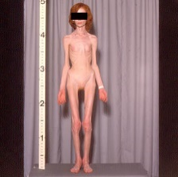
2-Weight-related amenorrhea
Anorexia Nervosa
FUNCTIONAL HYPOTHALAMIC AMENORRHEA (FHA) :
A body mass index (BMI) <17 kg/m².
Hypothalamic dysregulation due to the lack of nutrition in anorexia nervosa. This dysfunction suppresses the release of gonadotropin-releasing hormone (GnRH)
Low estradiol 🡪 risk of osteoporosis
Notes:
Affects gnrh pulsatility

Slide 7
3-Systemic disorders
• including sarcoidosis, tuberculosis resulting in an infiltrative process in the hypothalamo-hypophyseal region
4-Drugs
progestogens, HRT or dopamine antagonist (antipsychotics , metoclopramide )
5-Hypothalamic lesions
(craniopharyngioma, glioma), which can compress hypothalamic tissue or block dopamine.
Pitch deck title
7/1/20XX

Slide 8
Most Relevant History and examination
Weight:- Dramatic weight loss
Lifestyle:– excessive exercise, stress
Medications:– dopmine antagonist, HRT
Anosmia
Pitch deck title
7/1/20XX

Slide 9
Management
Kallmann syndrome:- MRI(for excloud other cause),Tx hormone replacement therapy to address hypogonadism and associated symptoms. Additional treatments include GnRH therapy for fertility.
Weight loss and stress:- psychiatric referral
Hypothalamic lesions:- Surgery
Pitch deck title
7/1/20XX

Slide 10
Pituitary
1-Adenoma
Prolactinoma: Macro > 1 cm , Micro < 1cm
Symptoms – galactorrhea, amenorrhea , infertility,
Mx – if macro: surgical resection (transsphenoidal )
_ if micro medication (dopamine agonists: bromocriptine, cabergoline)
Pitch deck title
7/1/20XX

Slide 11
2-Pituitary necrosis
(Sheehan syndrome)
due to prolonged hypotension following major obstetric haemorrhage).
Presented with failure to lactate, and amenorrhea , cold intolerance.
Tx: lifelong hormone replacement therapy (HRT) to compensate for the hormones that are no longer being produced by the damaged pituitary gland. The specific hormones to replace depend on the extent of the pituitary damage and which hormones are deficient.
Pitch deck title
7/1/20XX

Slide 12
3-Iatrogenic damage (surgery or radiotherapy)
4-Congenital failure of pituitary development
5- Empty sella syndrome (ESS) is a condition in which the sella turcica, a bony structure in the skull that houses the pituitary gland, appears partially or completely empty on image.
Pitch deck title
7/1/20XX

Slide 13
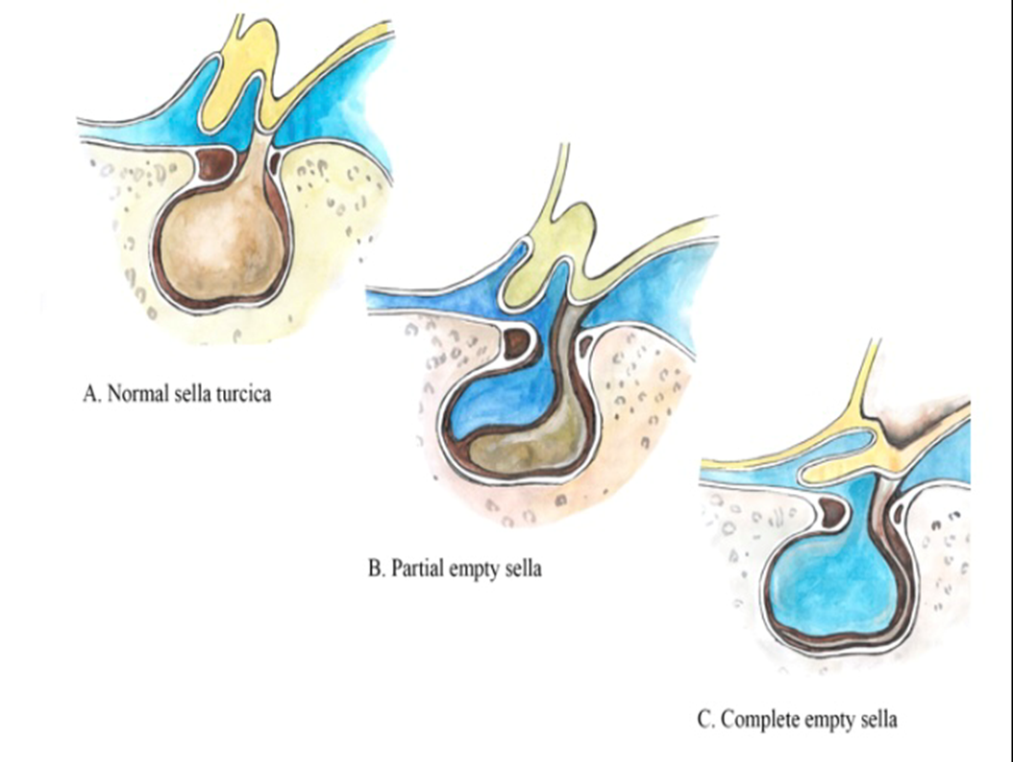
1. Primary Empty Sella Syndrome:
related to a defect in the membrane (diaphragma sellae) that covers the sella turcica, allowing CSF to herniate into the sella and compress the pituitary.
2. Secondary Empty Sella Syndrome:
• This type develops when the pituitary gland is damaged or reduced in size due to various factors, such as surgery, radiation, head trauma, or pituitary tumors that were treated or spontaneously shrunk.
Tx Hormone Replacement Therapy:
• If there are hormonal deficiencies due to pituitary dysfunction (e.g., low levels of ACTH, TSH, LH, FSH, or growth hormone), hormone replacement therapy may be required
Pitch deck title
7/1/20XX

Slide 14
Etiology of primary amenorrhea
Ambiguous external genitalia :
5-Alpha-reductase deficiency —inability to convert testosterone into DHT male internal genitalia, atypical external genitalia until puberty (when testosterone levels cause masculinization)

Slide 15
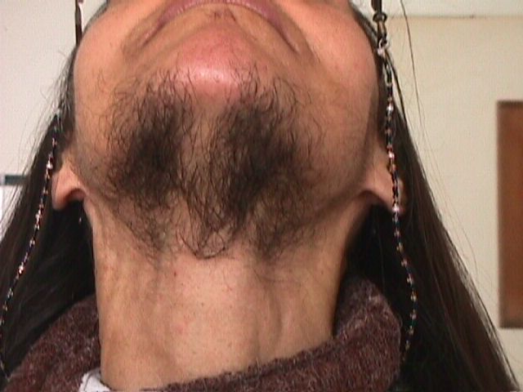
Androgen-secreting tumor (Sertoli-Leydig cell tumour) : produce androgens >>> virilization (hirsutism , male pattern baldness , Clitoral enlargement.
Sertoli-Leydig Cell Tumor
Virilization.
Pitch deck title

Slide 16
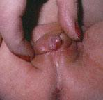
Congenital adrenal hyperplasia (CAH). Ovarian present but external genitalia are virilized or atypical due to excessive exposure to androgens early in life
CAH
Labial fusion ( looking like a scrotum) and Clitoromegaly.
Pitch deck title

Slide 17
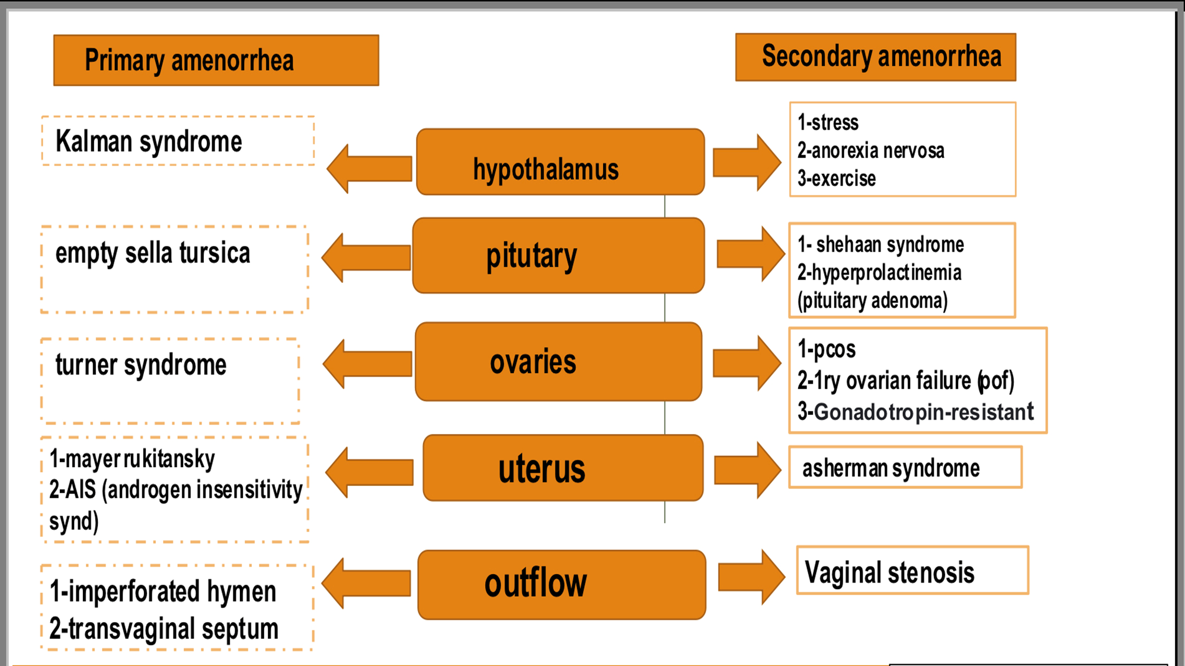
PCOS
Premature ovarian failure
Pitch deck title
7/1/20XX

Slide 18
Ovarian
PCOS
PCOS is a syndrome of ovarian dysfunction along with the cardinal features of hyperandrogenism and polycystic ovary morphology.
It affects around 5–10% of women of reproductive age
The prevalence of polycystic ovaries seen on ultrasound is around 25% of all women but is not always associated with the full syndrome.
Elevated serum LH levels, biochemical evidence of hyperandrogenism and raised insulin resistance are also common features.

Slide 19
Classical pictures :
-Amenorrhea
-Obese
- SubInfertility
- Hirsuitism

Slide 20
Clinical features
Oligomenorrhoea/amenorrhoea in up to 75% of patients, predominantly related to chronic anovulation.
• Hirsutism, Acne.
• Subfertility in up to 75% of women.
Obesity in at least 40% of patients.
• Acanthosis nigricans (areas of increased velvety skin pigmentation occur in the axillae and other flexures).
• May be asymptomatic.

Slide 21
PCOS
PCOS is associated with an increased risk of:
type 2 diabetes.
cardiovascular events.
. The aetiology of PCOS is not completely clear, probably related to insulin resistance with failure of normal follicular development and ovulation although the frequent familial trend points to a genetic cause.

Slide 22
Diagnosis
Patients must have two out of the three features 2/3below:
• Amenorrhoea/oligomenorrhoea.
• Clinical or biochemical hyperandrogenism.
• Polycystic ovaries on ultrasound. The ultrasound criteria for the diagnosis of a polycystic ovary are eight or more subcapsular follicular cysts <10 mm in diameter and increased ovarian stroma.
While these findings support a diagnosis of PCOS, they are not by themselves sufficient to identify the syndrome.
7/1/20XX

Slide 23
Management
Management of PCOS involves the following:
• Lifestyle advice: dietary modification and exercise is appropriate in these patients as they are at an increased risk of developing diabetes and cardiovascular disease later in life. Aerobic exercise has been shown to improve insulin resistance.
• Weight reduction.
• metformin: this is beneficial in a subset of patients with PCOS, those with hyperinsulinaemia and cardiovascular risk factors. It improves parameters of insulin resistance, hyperandrogenaemia, anovulation and acne in PCOS, and may aid weight loss. It is less effective than clomiphene for ovulation induction and does not improve pregnancy outcome;
Notes:
Clomiphene triggers the brain's pituitary gland to secrete an increased amount of follicle stimulating hormone (FSH) and LH (luteinizing hormone). This action stimulates the growth of the ovarian follicle and thus initiates ovulation. During a normal menstrual cycle only one egg is ovulated.

Slide 24
• Combined oral contraceptive pill (COCP) to regulate menstruation. This also increases sex hormone- binding globulin, which will help reduce androgenic symptoms.
• Clomiphene: this can be used to induce ovulation where subfertility is a factor.
• Ovarian drilling, a laparoscopic procedure to destroy some of the ovarian stroma that may prompt ovulation.
For HIRSTUISIM
eflornithine cream (VaniquaTM) applied topical.
Laser.
Pitch deck title
7/1/20XX
Notes:
irreversible inhibition of ornithine decarboxylase (ODC) in the skin.

Slide 25
Gonadal dysgenesis
Turner syndrome :
Is the most common chromosomal anomaly in Females
1: 2,500 live female births
Is caused by either a complete absence or a partial abnormality of one of the two X chromosomes.
Associated with streak ovarian tissue, atrophic internal genitalia and primary amenorrhea.
Variants :
Classic turner’s syndrome (45XO): 80%.
Mosaicism (46XX/45XO) and (45XO/46XY) : 20%.
Notes:
Mosaic Turner syndrome (TS) is a condition in which cells inside the same person have different chromosome packages

Slide 26
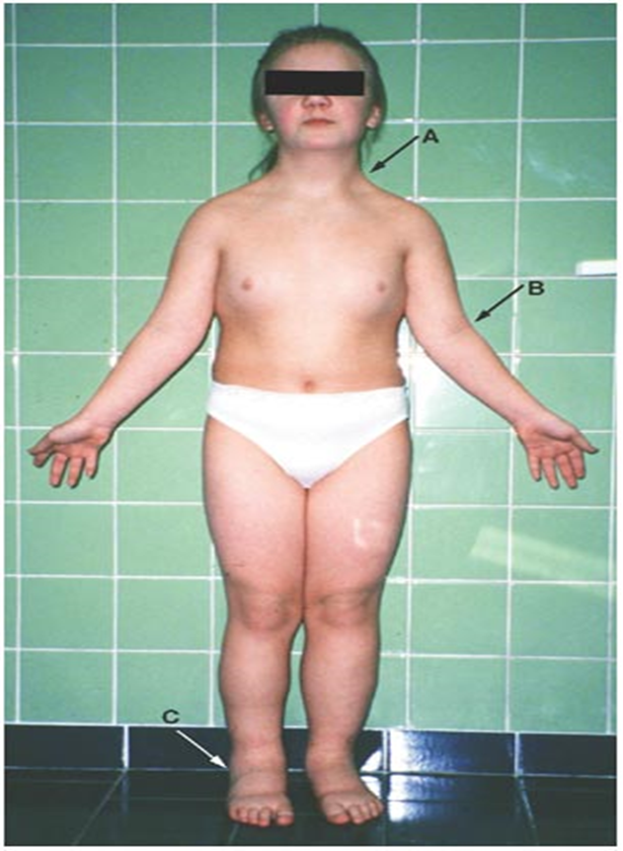
**Features of classic Turner syndrome :
Short stature.
Webbed neck.
Lymphedema.
Shield chest with widely spaced nipples. (Atrophic)
Short metacarpal bones.
Renal anomalies (horse-shoe kidney).
Wide carrying angle.
Coarctation of the aorta.
7/1/20XX

Slide 27
Ovaries in Turner syndrome
In classic type :
ovary does not complete its normal development and only the stroma is present at birth.
The gonads are called ‘streak gonads’ and do not function to produce oestrogen or oocytes. Diagnosis is usually made at birth or in early childhood from the clinical appearance of the baby or due to short stature during childhood.
10% of women, the diagnosis is not made until adolescence with delayed puberty. The ovaries do not produce oestrogen, so the normal physical changes of puberty cannot happen. In childhood, treatment is focused on growth, but in adolescence it focuses on induction of puberty.
Pregnancy is only possible with ovum donation.

Slide 28
A mosaic karyotype leads to a variable presentation. Although there can be variation, the most typical clinical features include:
Short stature.
Webbing of the neck.
Wide carrying angle.
Associated medical conditions include coarctation of the aorta, inflammatory bowel disease, sensorineural and conduction deafness, renal anomalies and endocrine dysfunction, such as autoimmune thyroid disease.
normal puberty and menstruation can occur, with early cessation of periods.
Pitch deck title
7/1/20XX
Notes:
Cubitus valgus

Slide 29
Premature ovarian failure
Menopause/ovarian failure occurring before the age of 40 years is considered premature (Confirmed by high FSH).
Possible causes :
Auto-immune disease is the most common cause; auto-antibodies to ovarian cells, gonadotrophin receptors, and oocytes have been reported in 80% of cases.
Super female (XXX).
Before puberty or in adolescents, ovarian failure is usually due to a chromosomal abnormality (Turner mosaic) , or previous radiotherapy, or chemotherapy.
The most common association is with thyroid disease, but the parathyroid and adrenals can also be affected
Several studies have shown laboratory evidence of immune problems in about 15-40% of women with premature ovarian failure
In general, ovarian biopsy is not indicated in patients with premature ovarian failure since no clinically useful information will be obtained
Management : HRT.

Slide 30
Premature ovarian failure
Chromosomal anomalies
Autoimmune disease
If the woman is under 30, a karyotype should be performed to rule out any mosaicism involving a Y chromosome
It is necessary to screen for thyroid, parathyroid, pancreas and adrenal dysfunction
If a Y chromosome is found the gonads should be surgically excised
Notes:
If a Y chromosome is found the gonads should be surgically excised
Risk of malignancy

Slide 31
Constitutional delay
It is caused by immature pulsatile release of gonadotrophin-releasing hormone; maturation eventually occurs spontaneously.
There is no anatomical abnormality or endocrine investigations show normal results
Diagnosis by exclusion and follow up ( Karyotyping , US , Laparoscope , FSH level).
Positive family history.
Delayed bone age by 2 years : ( X-ray Wrist joint) confirms the diagnosis.
Management :
Follow up every 6 months.

Slide 32
Outlines
Approach to amenorrhea
Embryology of female reproductive system
Primary and secondary amenorrhea etiologies related to uterine and outflow abnormalities , such as:
Imperforate hymen
Transverse vaginal septum
Androgen insensitivity syndrome
Mullerían agenesis
Asherman syndrome

Slide 33
Embryology Of female reproductive system
The female reproductive system is comprised of Internal and external parts.
Internal : ovaries, fallopian tubes, uterus, cervix and upper part of the vagina ( mallerian duct. Except for ovaries which come from genital ridge )
External : lower part of the vagina, vulva( urogenital sinus)

Slide 34
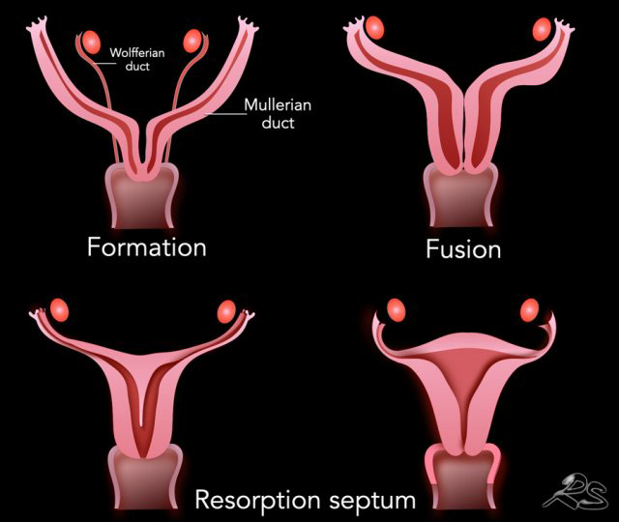
Now starting with Müllerian ducts , The process by which the Müllerian ducts form these organs is comprised of two parts. First fusion with urogenital sinus second fusion of both ducts.
Müllerian duct fuses with urogenital sinus , canalize to form vagina( upper and lower)
Each duct fuses with each other starting inferiorly ending the process with the superior parts fusing leaving the fallopian tubes free

Slide 35
All the previously mentioned causes of amenorrhea affects estrogen, progesterone and androgen release causing retardation in secondary sexual characteristic appearance on top of other signs and symptoms.
Disorders we will talk about in this section of the seminar will not effect secondary sexual characteristic.

Slide 36
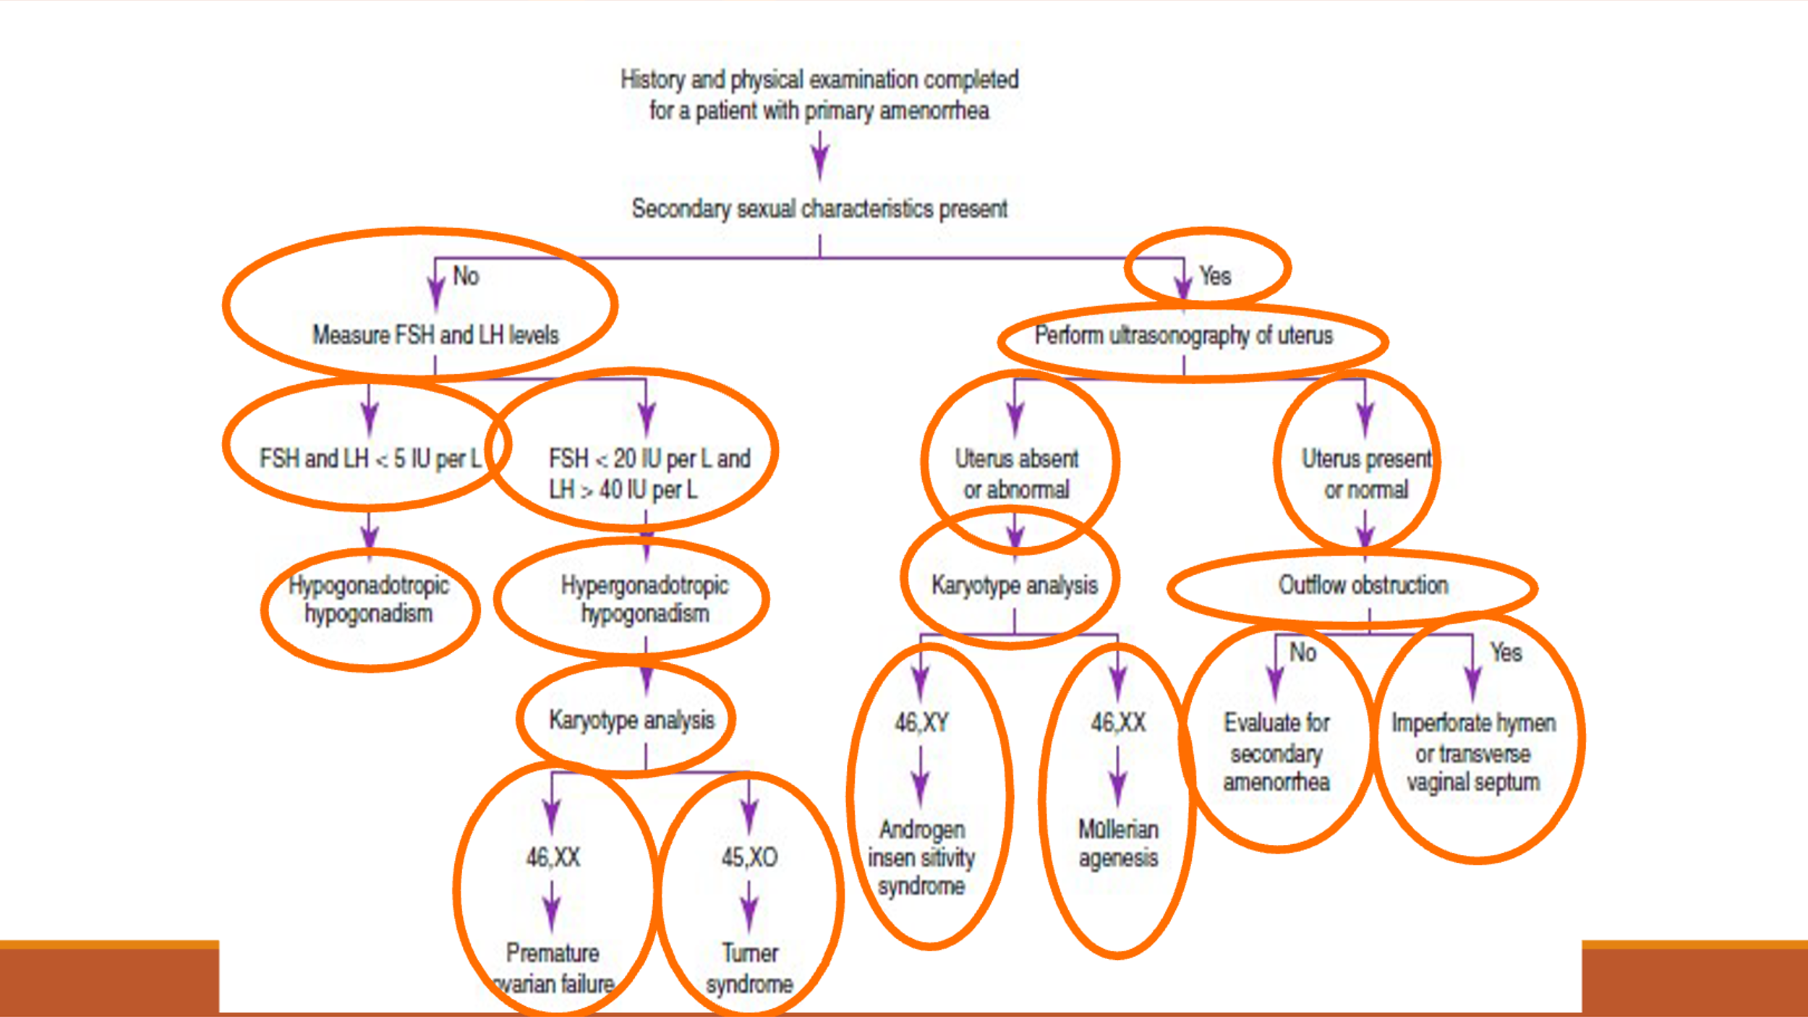

Slide 37
Imperforate hymen
An imperforate hymen is the simplest most common defect in outflow obstruction that results in primary amenorrhea.
As the name suggests it’s obliteration of the Normal anatomical opening in the hymen.
Not only it’ll cause amenorrhea, but also will cause build up of blood in the vagina ( hematocolpos ) or uterus ( hematometra ) can be assessed via USS. Leading to signs and symptoms ,such as:
cyclic abdominal pain , abd swelling , difficult micturition
On physical examination bluish bulging of the hymen

Slide 38
Management
Hymenectomy (Incise the Hymen, cruciate incision). And drainage of the blood
Notes:
Needs IVP as there is up to 30% association with renal tract abnormalities.
Should be followed up for endometriosis 1 year after treatment ( Retrograde menstruation).

Slide 39
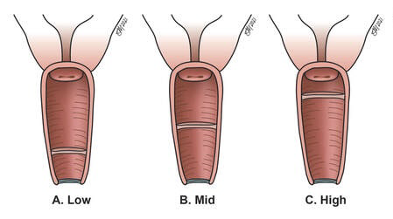
Transverse vaginal septum
This anomaly results from either failure of fusion Or canalization of the müllerian duct and urogenital sinus.
This septum forms above the level of the hymen at various levels in the vagina; it might be lower, middle or upper part of the vagina.
The septum can be completely obliterated or incomplete, causing different presentation.

Slide 40
If it was complete:
Abdominal pain
Primary amenorrhea
* The abdominal pain is one to blood accumulating in the vagina ( Hematocolpos ), uterus ( hematometra ) or fallopian tubes ( hematosalpiux )
If it was incomplete : asymptomatic with only
Dysparunia
Infertility

Slide 41
It’s important to distinguish transverse vaginal septum from imperforate hymen via physical exam.
With transverse vaginal septum their won’t be bluish bulging.
Now its important to locate the septum and assess it’s thickness, it can be down via vaginal ( pv exam ) and / or rectal ( Pr exam ) due to the discomfort it night inflict upon the pt.
We can offer ( EUA ) or via imaging either uss( abd, rectal or perineal) or mri
Also these test’s help US locate the extent of blood accumulation.

Slide 42
Management
drainage of the haematocolpos at an early age is necessary to preserve fertility and reduce the risk of endometriosis.
transverse incision of the vaginal septum with sutarring of the edges with a sponge containing ostrogen left two days from the postop.
* Possible complications from surgery
Vaginal stenosis ( causing recurrence of symptoms ) ; incidence can he reduced with the use of estrogen

Slide 43
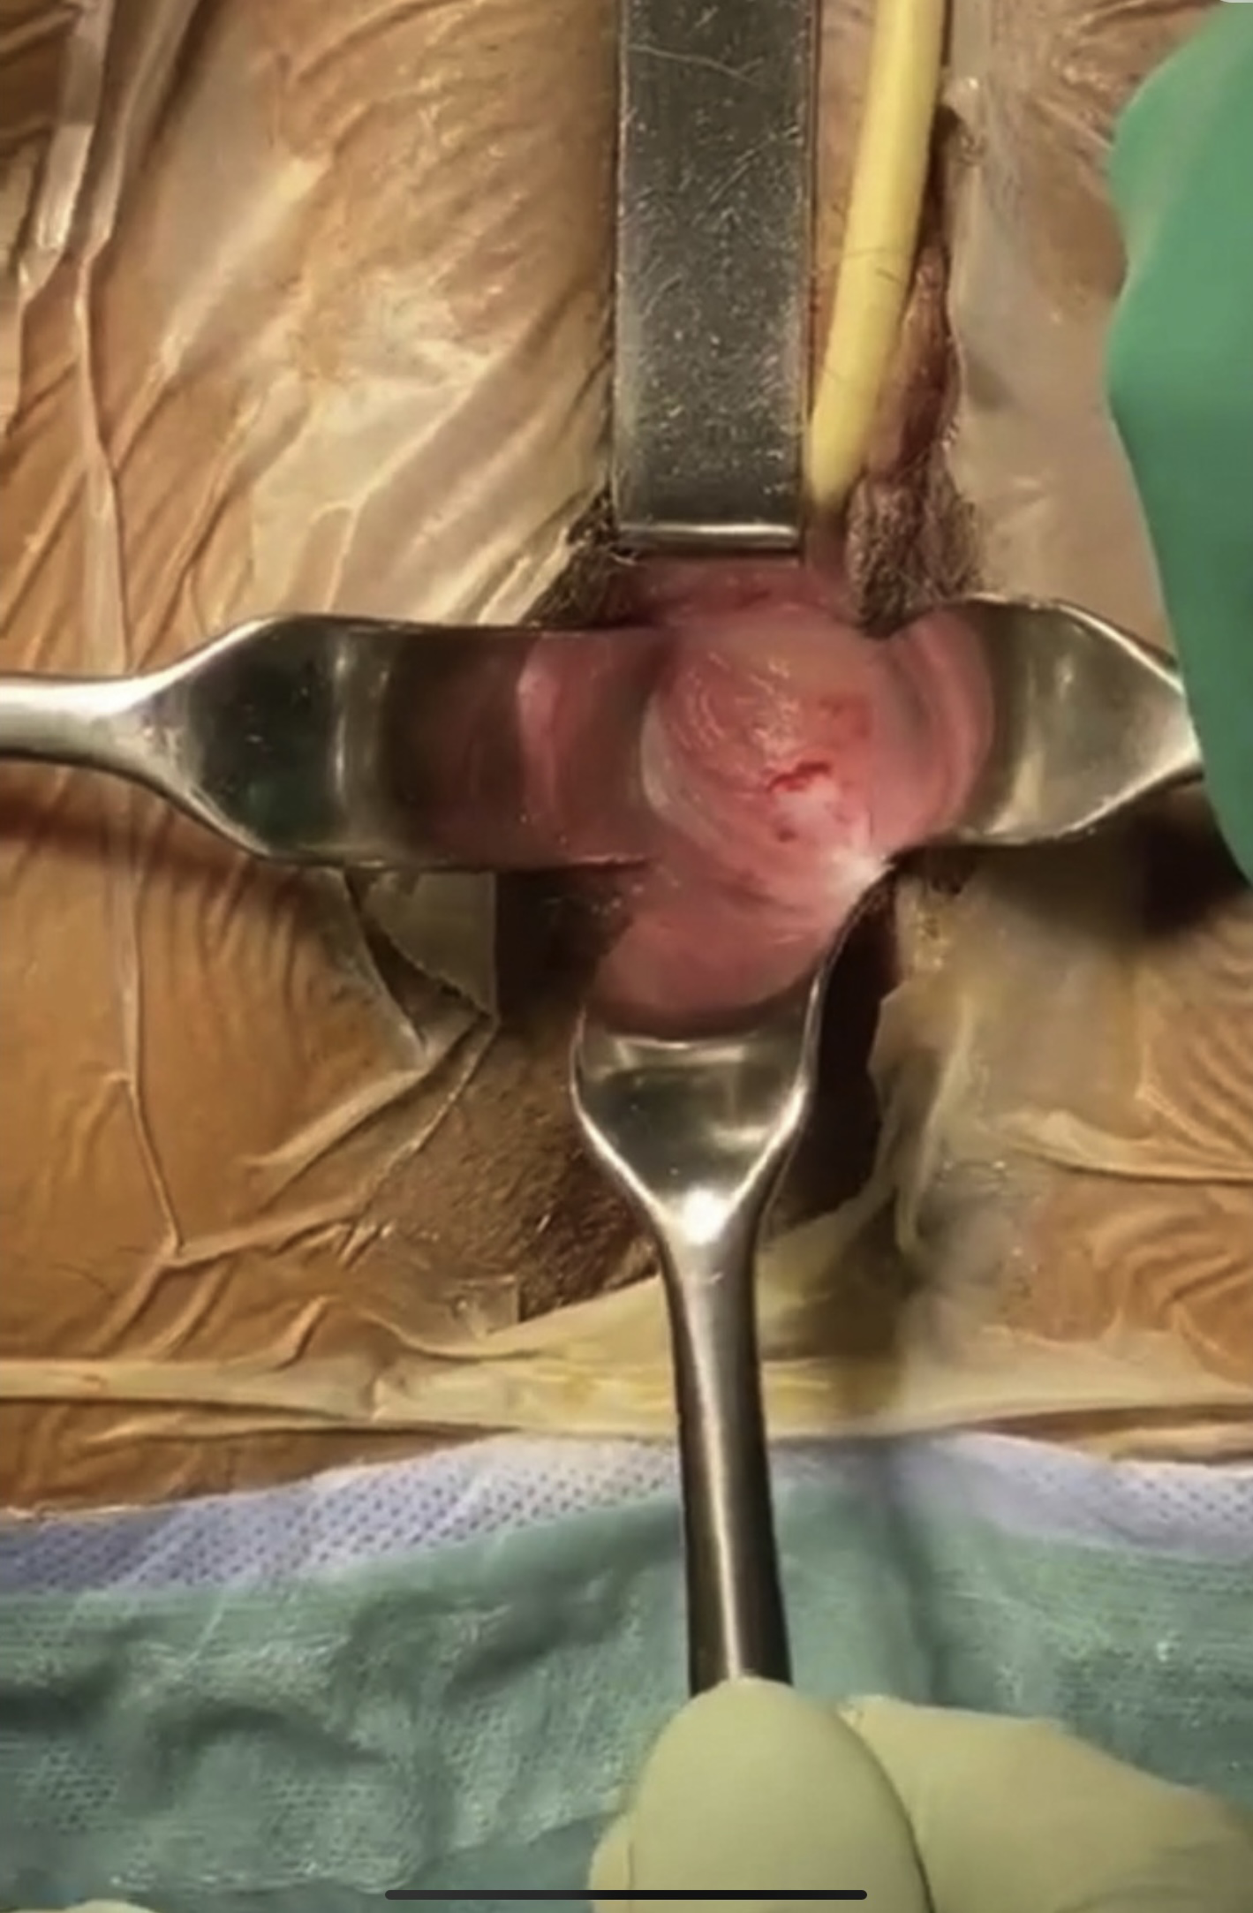
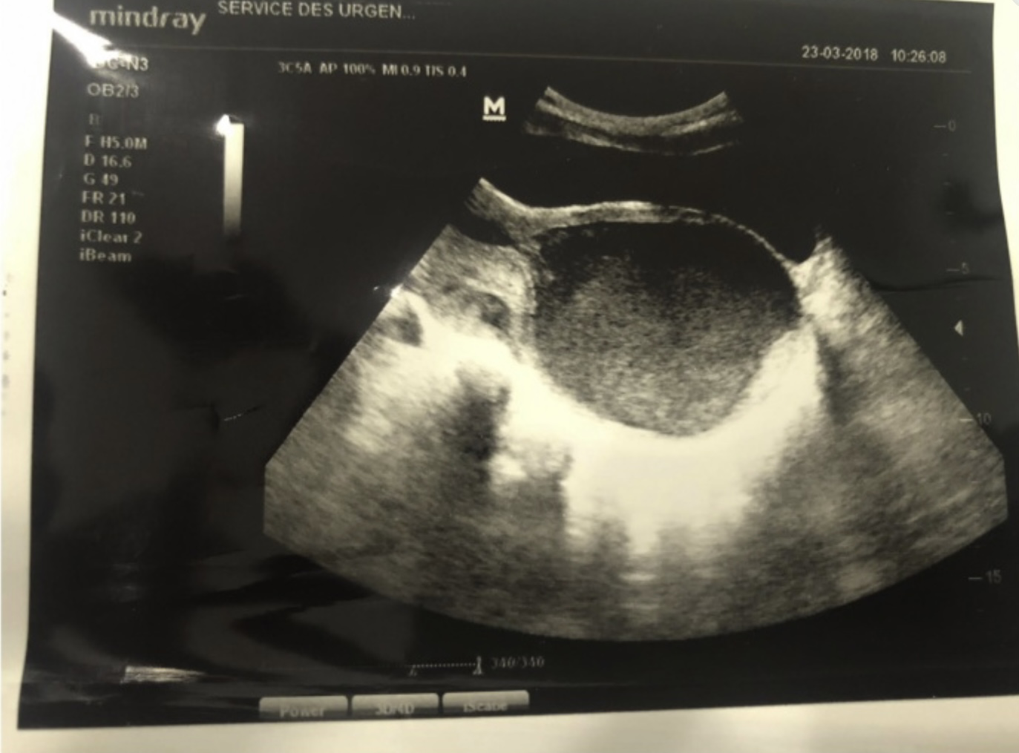

Slide 44
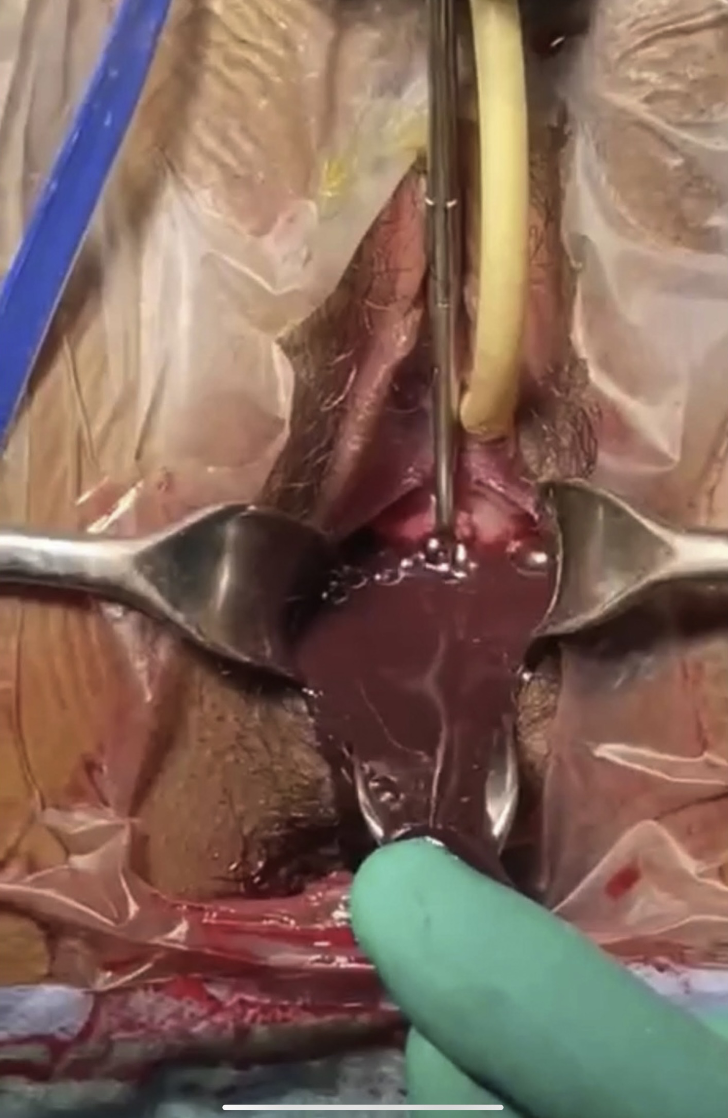
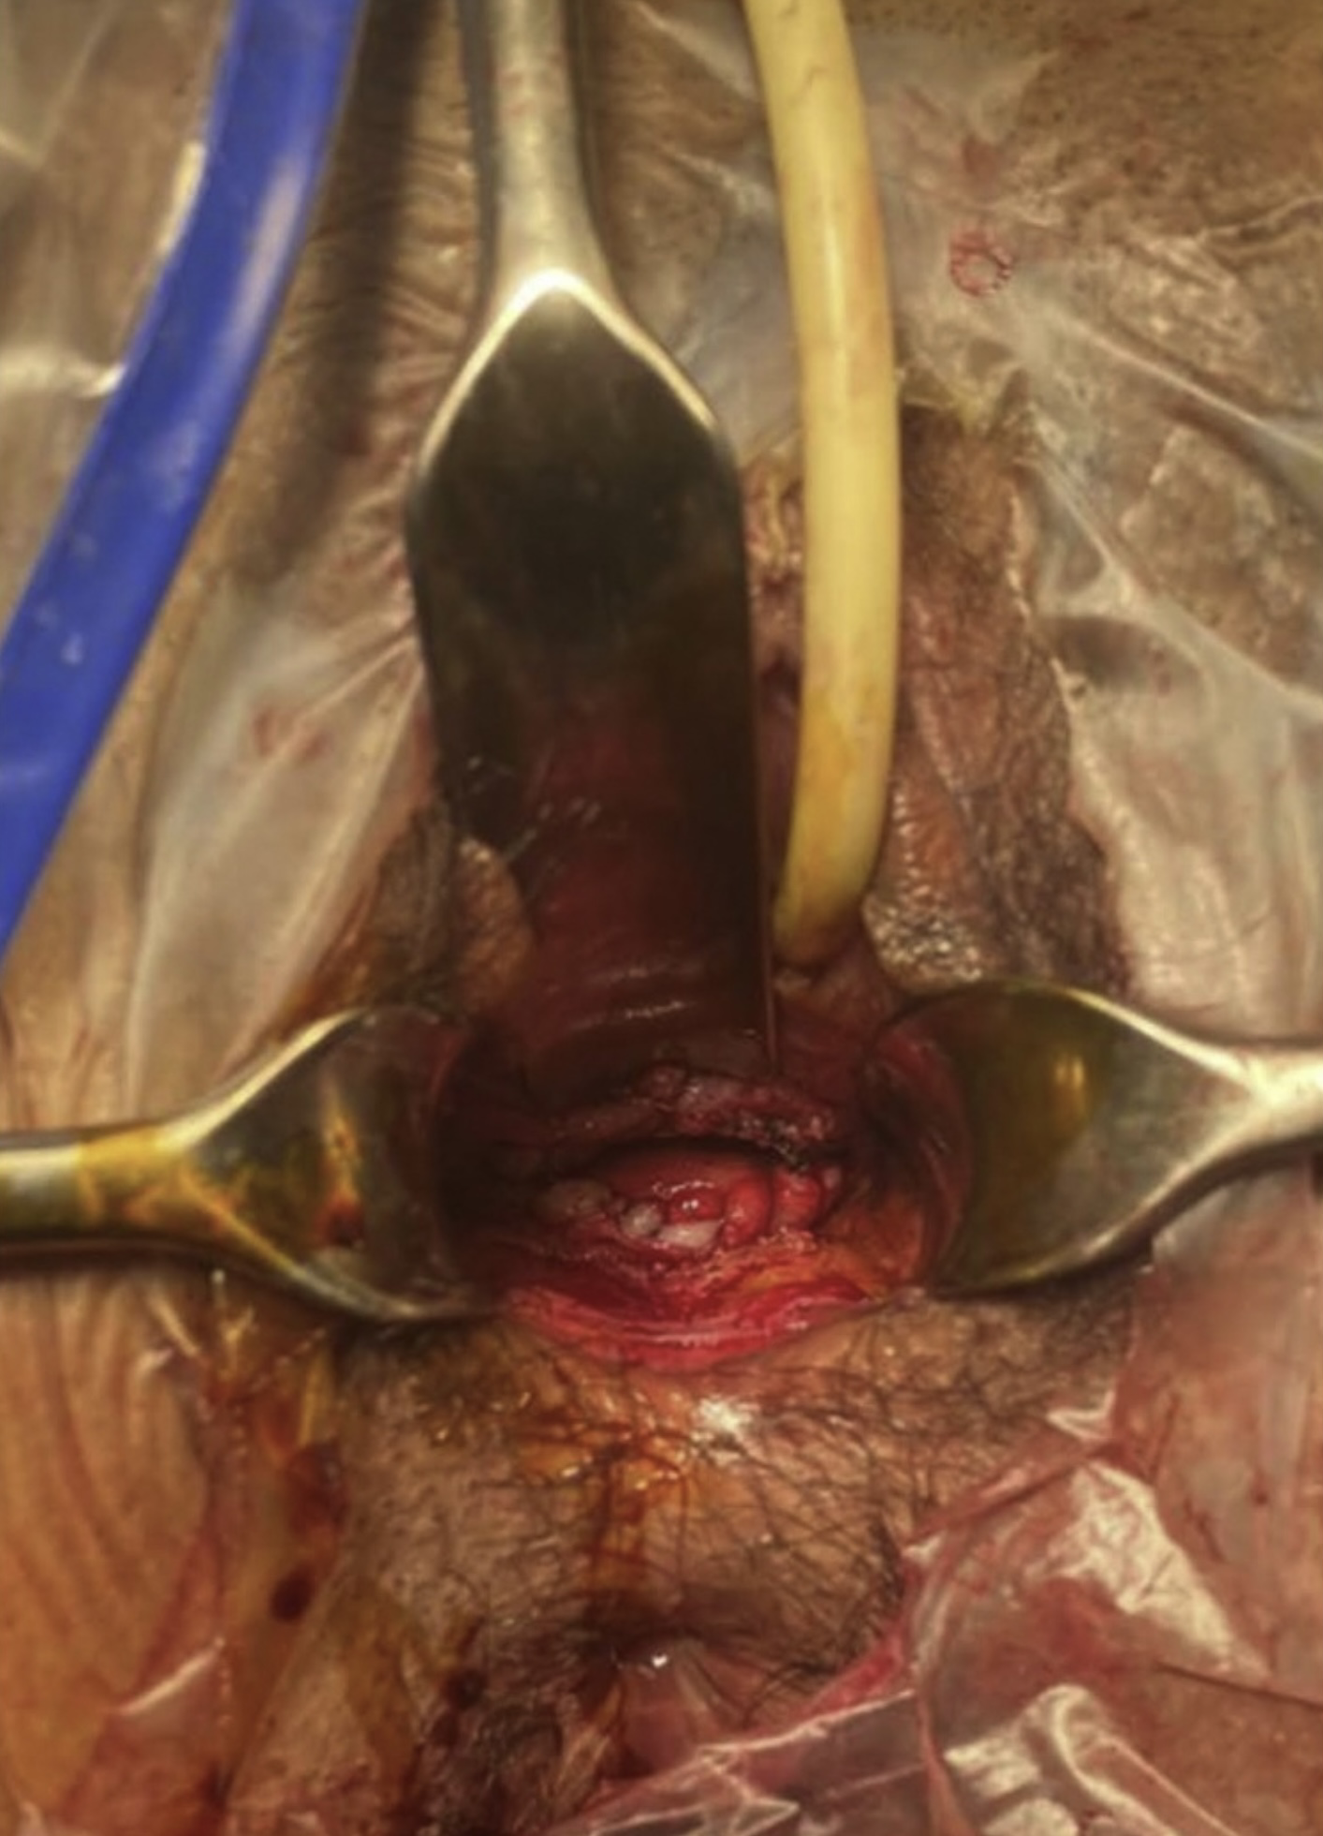

Slide 45
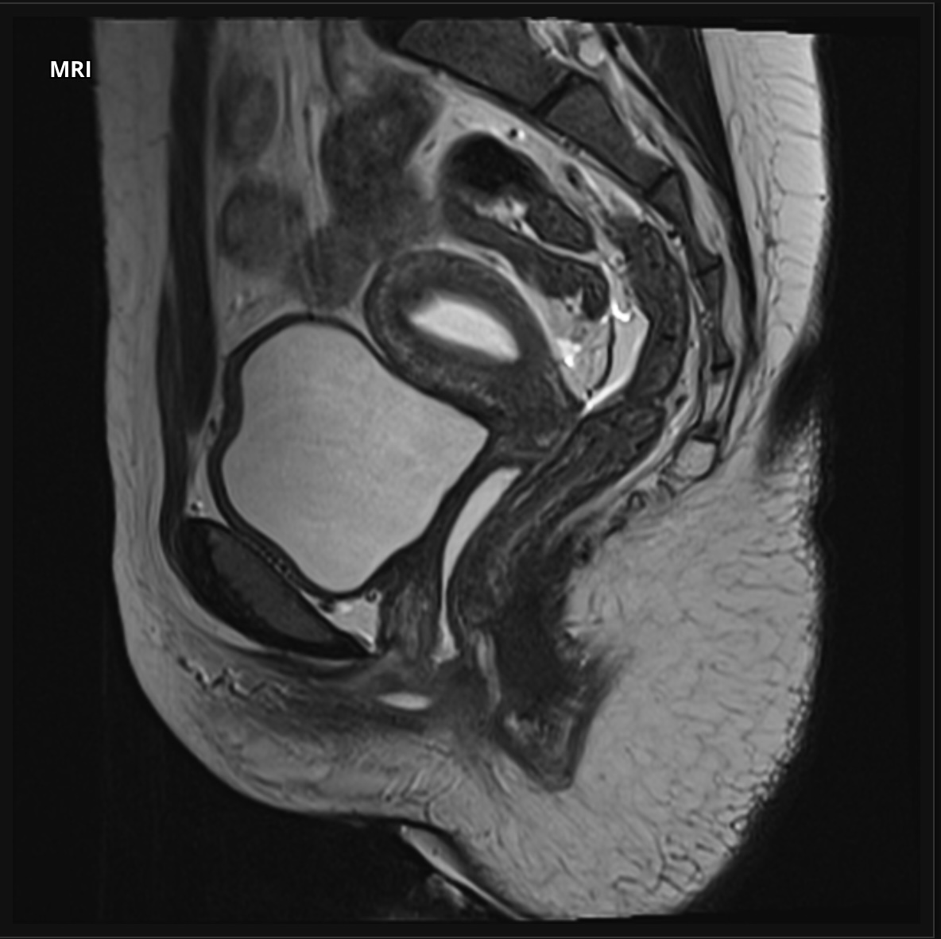
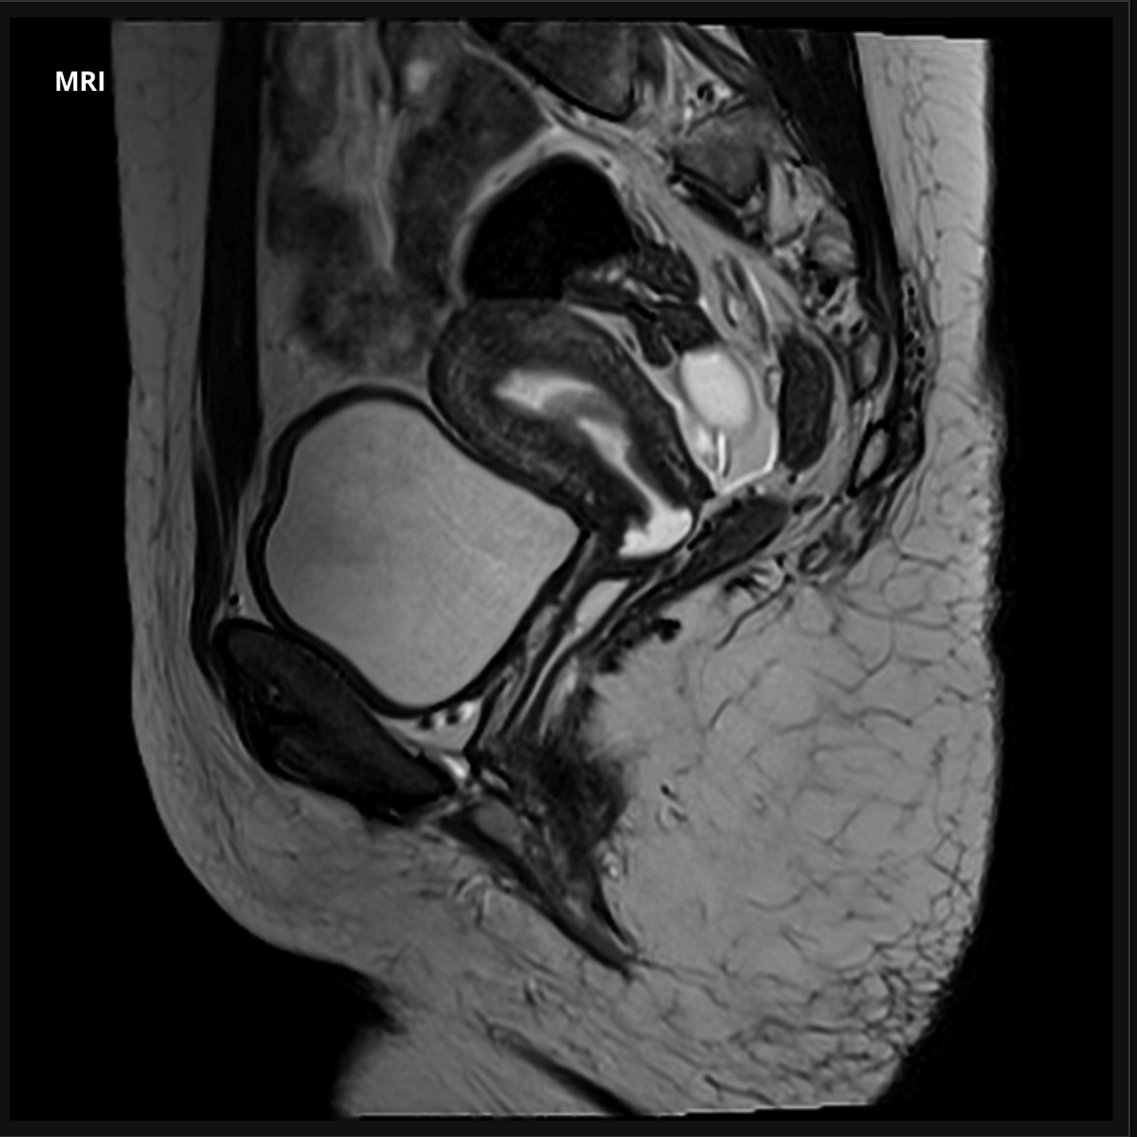
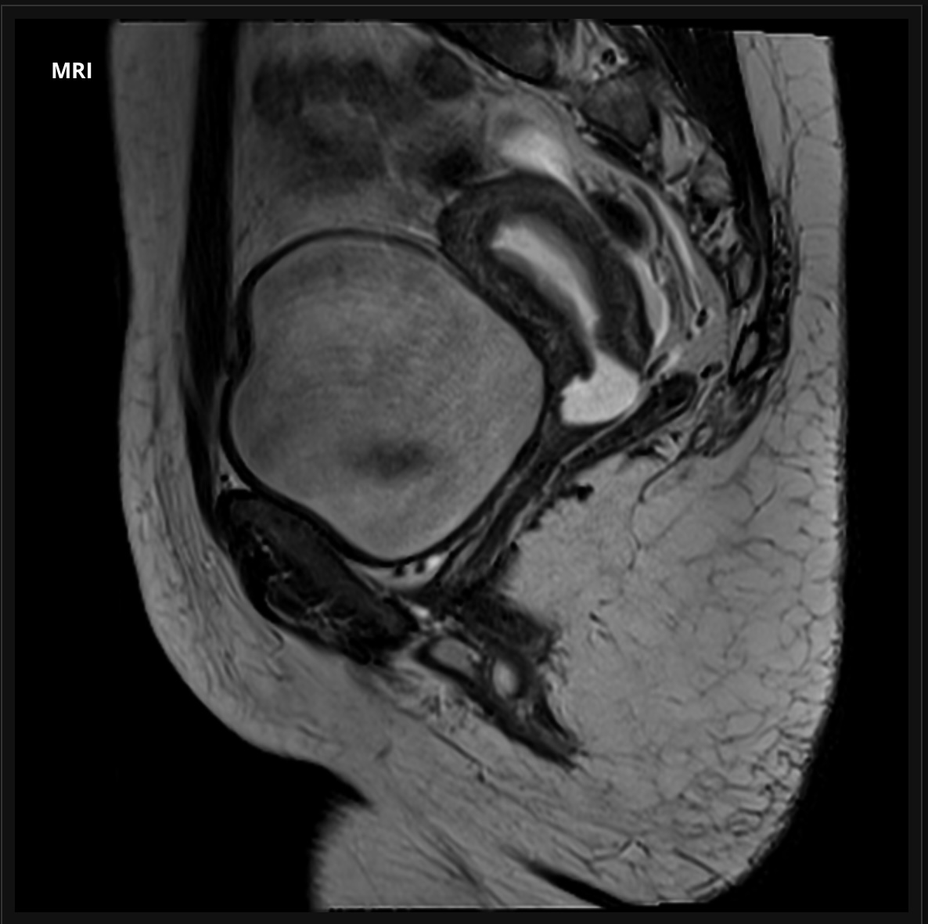
The endometrial cavity is distended by hemorrhage. Transverse band in the upper vagina which is visualised more clearly after intravaginal administration of gel (right T2 sagittal stack).

Slide 46
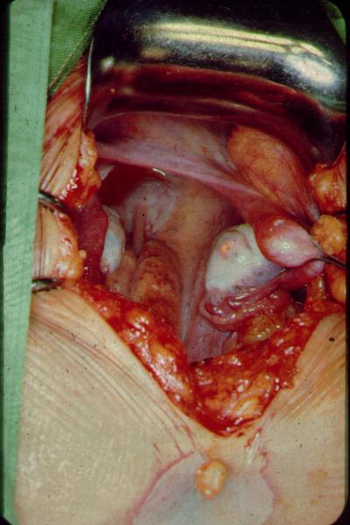
Mayer-Rokitansky-Kuster-Hauser syndrome
Also known us müllerian agenesis, it’s failure of fusion of both Müllerian ducts resulting in absence of:
Upper vagina
Cervix
Uterus
These pt. Still have their ovaries and fallopian tubes
They have Normal breast, public hair and external genitalia
Normal female testosterone levels
Karyotyping: 46 XX

Slide 47
Androgen insensitivity syndrome
It’s x-linked recessive affecting 46 XY ( male) the defect originate from the fact their androgen receptors are resistant to androgen; effecting the formation of male 2nd sexual characteristics. Features:
No labial fusion to form scrotum
No clitromegally to form phallus
Scares to No pubic hair
No upper vagina , cervix, uterus, Fallopian tubes Or ovaries
Breast development ( and androgens are converted to estrogen )
undescended testis ( inguinal region or high in the abdomen )

Slide 48
After confirming Normal 2nd sexual characteristics
We check USS, testosterone and Karyotyping
Müllerian genesis
AIS
Female testosterone levels
USS:
No uterus
fallopian tubes and ovaries present
Karyotyping: 46 XX
Male testosterone levels
USS:
No uterus
No fallopian tubes or ovaries
Karyotyping: 46 XY

Slide 49
Management
Müllerian genesis
AIS
They can get pregnant with uterine transplantation
Vaginoplasty
They can’t get pregnant
Vaginoplasty
Gonadectomy after puberty ( Risk for testicular Ca )
HRT(Protection against Osteoporosis and Ischemic heart disease).

Slide 50
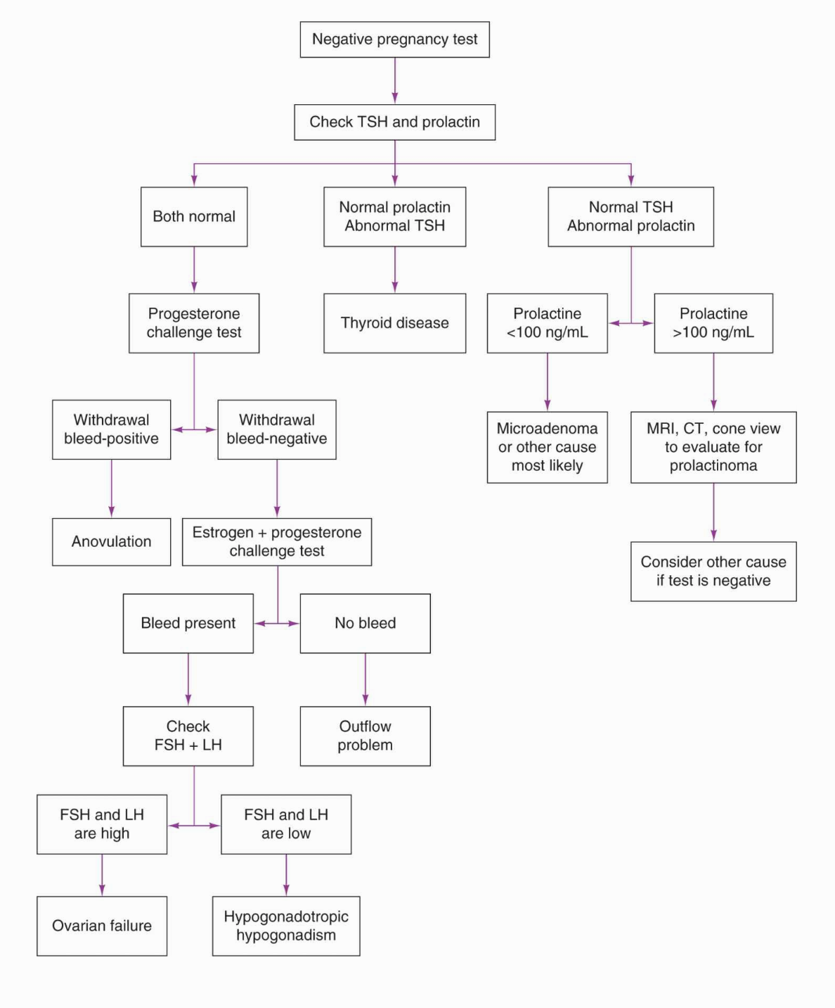

Slide 51
Asherman syndrome
Formation of intrauterine advesious due to injury to basal layer of the endometrium in opposing points in the cavity
Etiology: D/C for 1 and 2
Miscarriage
AUB , endometrial polyp or fibroid
Tb or schistosomiasis( Rare )

Slide 52
Presentation
Light or absent mens
Dysmenorrhea
recurrent miscarriage and/or infertility due to deficient endometrium and its poor vascularisation.

Slide 53
Evaluation
Hysteroscopy is gold standard. Also can be used as therapeutic method
But we can use saline sonography or hysterosalpingorgram
MRI is needed when there is a total obliteration of the uterine cavity.

Slide 54
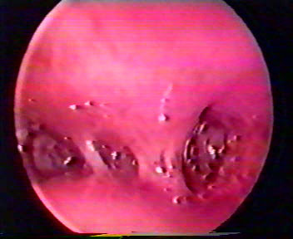
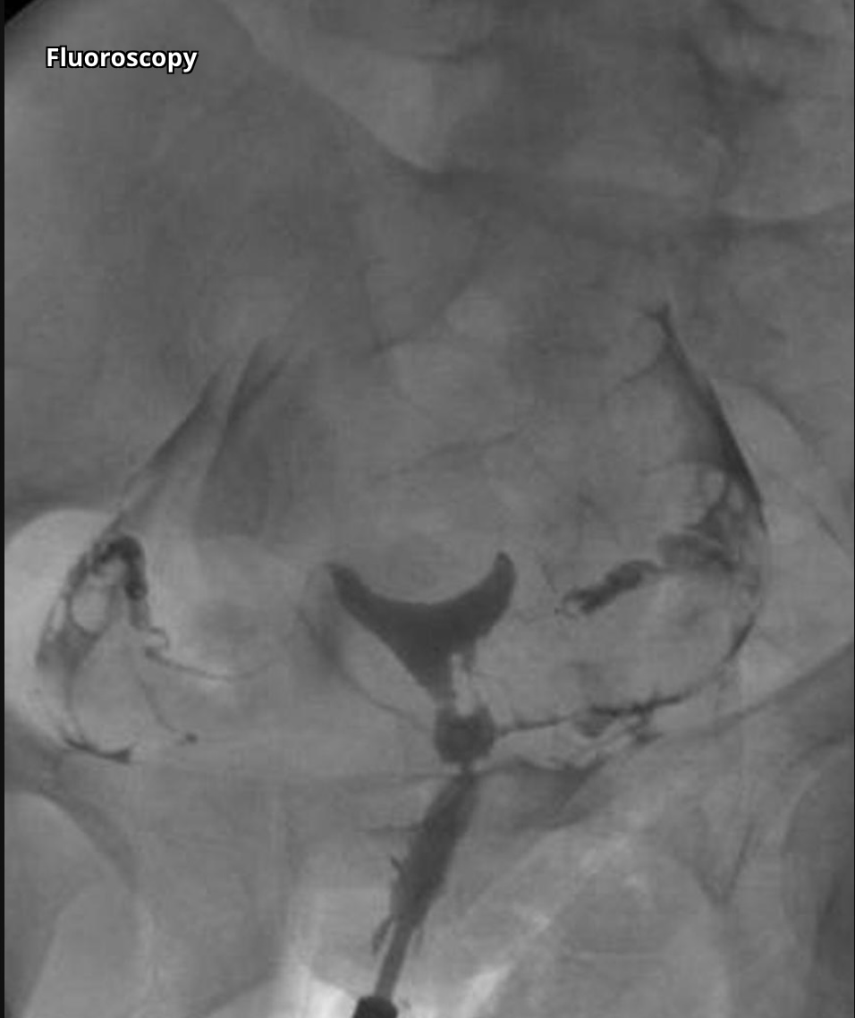
Asherman’s Syndrome
Adhesions viewed by hysteroscopy.
Hysterosalpingogram showing filling defect inside the Uterus.
Notes:
Multiple images from a hysterosalpingogram demonstrate multiple linear intrauterine filling defects termed synechiae with free spillage of contrast bilaterally. Imaging appearance is characteristic of Asherman syndrome.

Slide 55
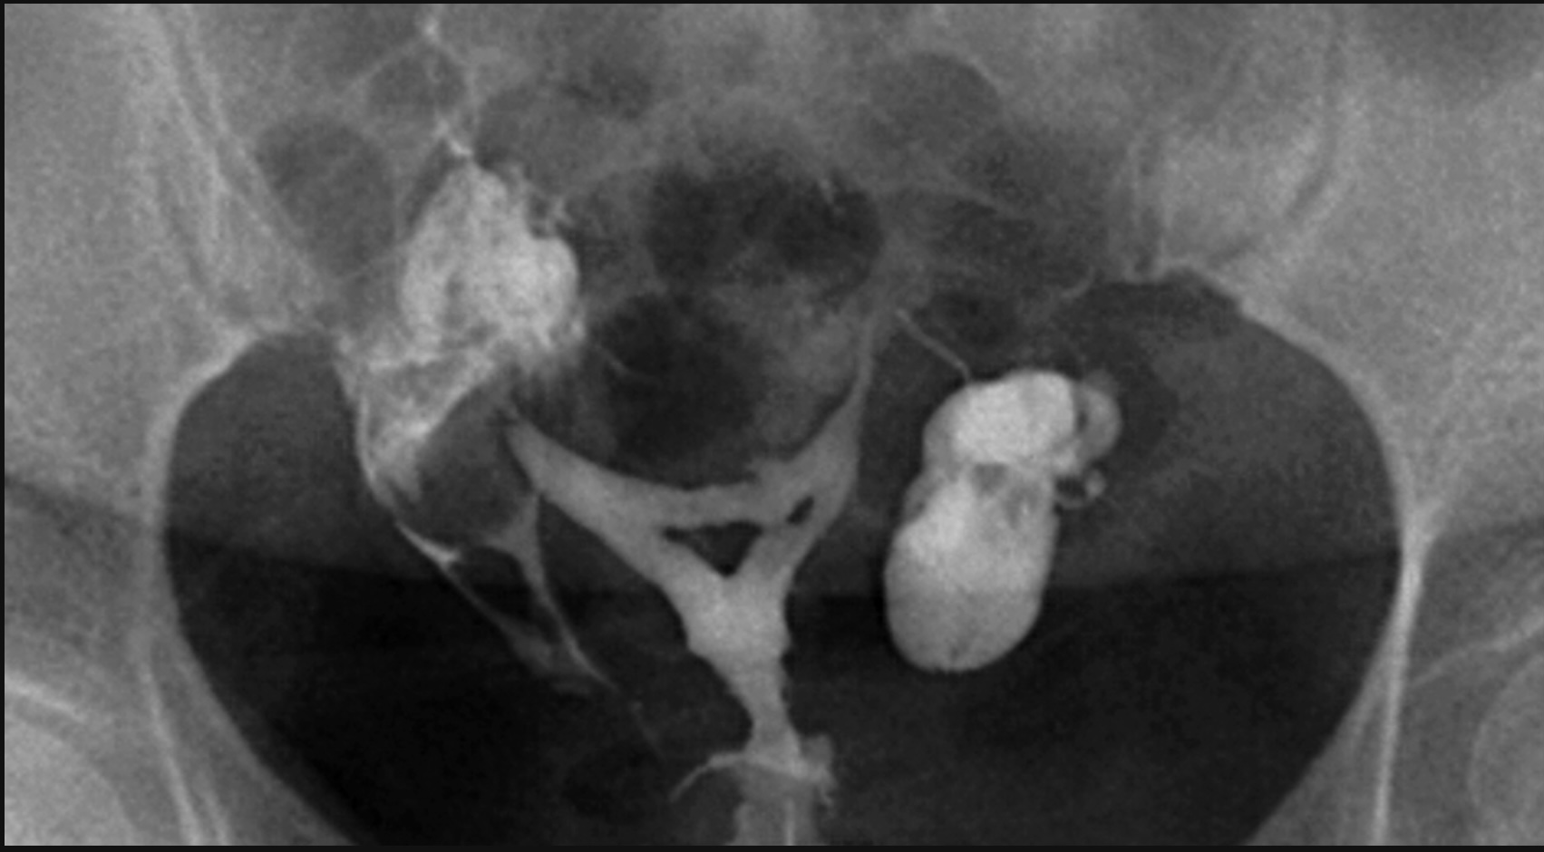
Notes:
The hysterosalpingography demonstrated classical findings of intrauterine adhesions (Asherman syndrome), the triangular-shaped filling defects in the uterine cavity.
In addition, left hydrosalpinx was identified, characterised by dilation of the ampullary part of the fallopian tube and the absence of extravasation of contrast into the peritoneal cavity on this side.

Slide 56
Management
Preoperative and postoperative treatment with oral, transdermal, or intramuscular estrogen preparations may help to reduce scarring postoperatively and promote regeneration of the normal endometrium.
Main treatment is adhesolysis
Devices to prevent the apposition of the uterine walls may also reduce scar formation. risk of atrophy of the wall due to pressure from the device.

Slide 57
Staging is important as it affects prognosis.
Mild disease: few filmy adhesions involving less than a third of the uterine cavity with normal menses or hypomenorrhea.
Moderate disease: filmy and dense adhesions, the involvement of one-third to two- thirds of the cavity, and hypomenorrhea.
Severe Disease: dense adhesions involving more than two-thirds of the cavity with amenorrhea.
Prognosis:
The chances of conceiving and delivery after surgery are lower in patients with moderate to severe disease

Slide 58
Complications
repetitive pregnancy loss/abortions
Recurrence of the adhesions can be seen even after adhesiolysis.
Although the risk of endometrial cancer in women with Asherman syndrome may be lower than the general population, but symptoms suggestive of endometrial ca (early or abnormal bleeding, thickened endometrium) may be missed due to the scarring or cervical obstruction; therefore, these women may benefit from a routine sonographic evaluation of the endometrium to monitor changes.
obstetric complications that include preterm labor, Low birth weight(LBW), and placental complications that include retained placenta and placenta accreta.

Slide 59
These next slides are tables that somewhat summarizes AMENORRHEA

Slide 61
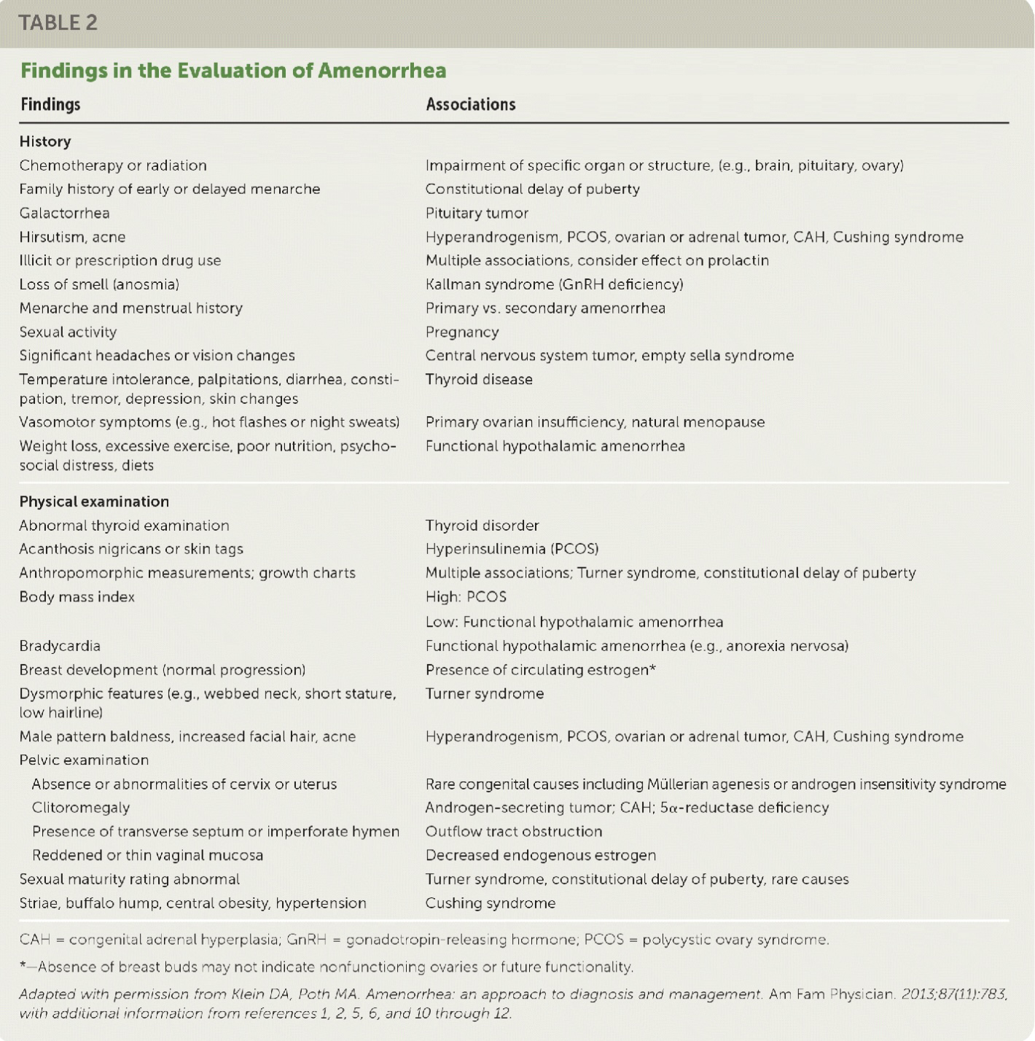

Slide 62
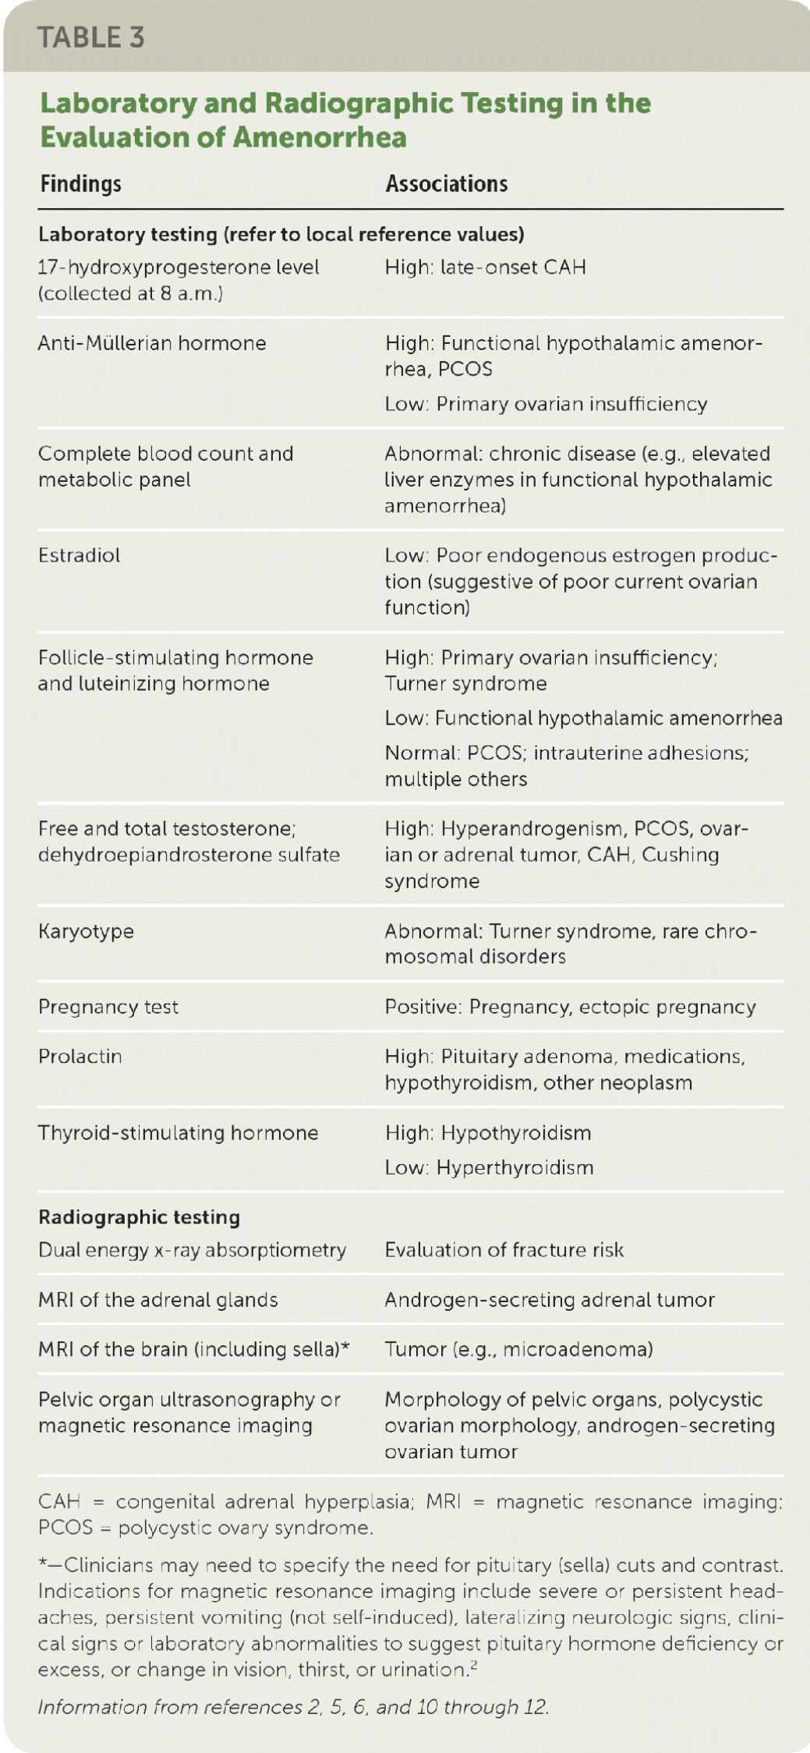

Slide 64
References
Ten teachers 20th edition
Uptodate
Causes of primary and secondary amenorrhea
Management of primary amenorrhea
Management of secondary amenorrhea
https://www.aafp.org/pubs/afp/issues/2019/0701/p39.html
( approach to amenorrhea )
https://www.ncbi.nlm.nih.gov/pmc/articles/PMC7718141/
( management of transverse vaginal septum )
https://radiopaedia.org/cases/71067/studies/81302?lang=gb
( MRI images for transverse vaginal septum )
https://www.ncbi.nlm.nih.gov/books/NBK448088/
( management of Asherman syndrome )
https://radiopaedia.org/cases/12230/studies/12538?lang=gb
https://radiopaedia.org/cases/31328/studies/32062?lang=gb
(hysterosalpingography for Asherman syndrome )

