Slide 1
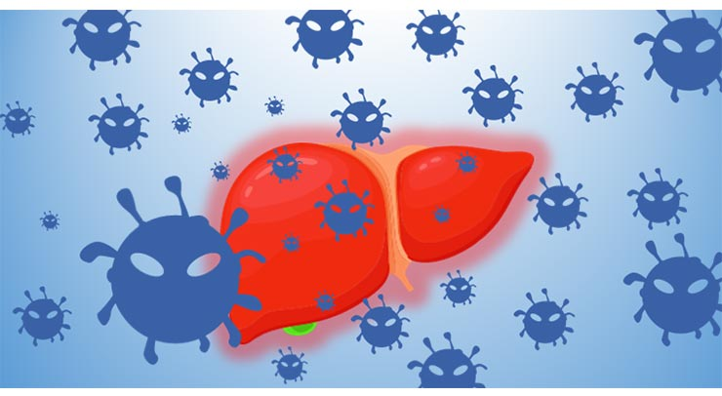
Viral hepatitis and alcoholic liver disease
Dr. eman Krieshan, m.d.
10/4/2022.

Slide 2
hepatitis
Hepatitis is applied to patterns of acute and chronic hepatic injuries that are produced by:
Hepatotropic viruses (have a specific affinity for the liver).
Other viruses such as EBV, CMV .
Yellow fever
Autoimmune reactions.
Drugs and toxins.

Slide 3
Case study
A 27-year-old man develops malaise, fatigue, and loss of appetite three weeks after a meal at café. He notes passing dark urine. On physical examination, he has mild scleral icterus and right upper quadrant tenderness. Laboratory studies show serum AST of 62 U/L and ALT of 58 U/L. The total bilirubin concentration is 3.9 mg/dL, and the direct bilirubin concentration is 2.8 mg/dL. His symptoms abate over the next 3 weeks.

Slide 4
Diagnosis
Clinical history and examination.
Laboratory testing.
Biopsy.

Slide 5
Signs and symptoms
infection with hepatitis viruses produces a wide range of outcomes including:
Acute Asymptomatic Infection:
elevated serum transaminases or the presence of anti-viral antibodies, HAV and HBV infections, particularly in childhood.
Acute Symptomatic Infection, consisting of:
(1) an incubation period of variable length.
(2) a symptomatic preicteric phase.
(3) a symptomatic icteric phase.
(4) convalescence.

Slide 6
Fulminant Hepatic Failure:
Occur with HBV and HAV.
Chronic Hepatitis:
persistent or relapsing hepatic disease for a period of more than 6 months.
Possible symptoms:
elevations of serum transaminases.
fatigue;, malaise, loss of appetite, and bouts of mild jaundice.
The Carrier State:
A carrier is an individual who is chronically infected with a hepatropic virus and has no or subclinical evidence of liver disease.

Slide 7
Associated signs and symptoms include:
General: fatigue (most common), malaise, mild discomfort in the right upper quadrant, anorexia
Impaired biliary tract function: jaundice, pruritus
Portal hypertension: gastroesophageal varices, ascites, edema, splenomegaly
Impaired hepatocyte metabolism: spider angiomata, hepatic encephalopathy, easy bleeding / bruising

Slide 8
Laboratory findings
Aminotransferase levels (AST, ALT may be elevated).
Serological testing for hepatitis B, C and D and autoantibodies

Slide 10
1. Hepatitis A Virus (HAV).
HAV usually is a benign self-limited infection that does not cause chronic hepatitis and rarely produces fulminant hepatitis.
incubation period of 3-6 weeks, shed in the stool for 2 to 3 weeks before and 1 week after the onset of jaundice.
The infection associated with poor hygiene and sanitation, ingestion of steamed shellfish.
Acute HAV tends to cause a febrile illness, jaundice and nonspecific symptoms such as fatigue and loss of appetite.

Slide 11
HAV is a small, nonenveloped, positive-strand RNA picornavirus
The cellular immune response, particularly that involving cytotoxic CD8+ T cells, plays a key role in HAV-mediated hepatocellular injury.

Slide 12
IgM antibody against HAV appears in blood at the onset of symptoms and is a reliable marker of acute infection
The IgM response usually declines in a few months followed by the appearance of IgG anti-HAV that persists for years, often conferring lifelong immunity.

Slide 13
2. Hepatitis B Virus (HBV).
The outcome of HBV infection varies widely, from:
(1) acute hepatitis with recovery and clearance of the virus.
(2) nonprogressive chronic hepatitis.
(3) progressive chronic disease ending in cirrhosis.
(4) fulminant hepatitis with massive liver necrosis.
(5) an asymptomatic “healthy” carrier state.

Slide 15
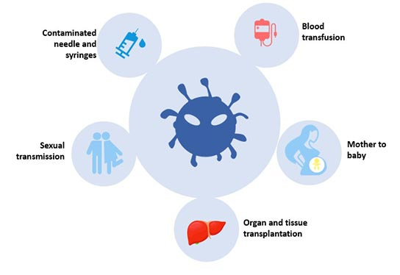
transmission of HBV.

Slide 16
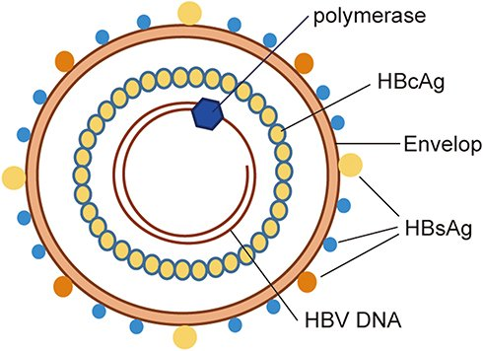
HBV is a member of Hepadnaviridae, a family of DNA viruses.
The HBV genome is a partially double-stranded, which encode the following proteins:
Nucleocapsid “core” protein (HBcAg).
Envelope glycoproteins (HBsAg).
A polymerase (Pol) with both DNA polymerase activity and reverse transcriptase activity.
HBx protein, which is required for virus replication.

Slide 17
The course of the disease

Slide 18
HBV generally is not directly hepatotoxic, and most hepatocyte injury is caused by CD8+ cytotoxic T cells attacking infected cells.
Patient age at the time of infection is the best predictor of chronicity. In general, the younger the age at the time of HBV infection, the higher the chance of chronic infection.
Treatment of chronic hepatitis B with viral polymerase inhibitors and interferon can slow disease progression.

Slide 19
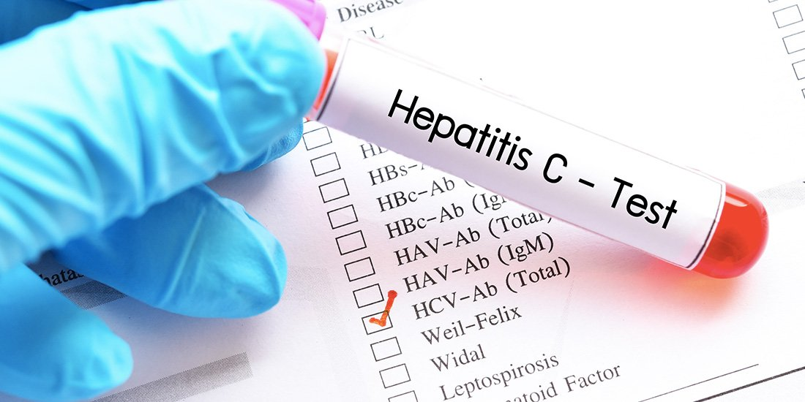
3. Hepatitis C Virus (HCV).
According to data from the Centers for Disease Control and Prevention (CDC), the most common risk factors for HCV infection are as follows:
• Intravenous drug abuse
• Multiple sex partners
• Having had surgery within the last 6 months
• Needle stick injury
• Multiple contacts with an HCV-infected individual
• Employment in the medical or dental field.
perinatal transmission from the mother.

Slide 20
HCV is a small, enveloped, single-stranded RNA virus, member of the Flaviviridae family.

Slide 21
4. Hepatitis D Virus (HDV).
HDV is a unique RNA virus that is dependent for its life cycle on HBV. Infection with HDV arises in the following settings:
Coinfection by HDV and HBV.
Superinfection of a chronic HBV carrier by HDV.

Slide 22
5. Hepatitis E Virus (HEV).
HEV is an enterically transmitted, water-borne infection that usually produces a self-limiting disease.
HEV is an unenveloped, positive stranded RNA virus in the Hepevirus genus.
The virus typically infects young to middle-aged adults.
HEV is a zoonotic disease with animal reservoirs that include monkeys, cats, pigs, and dogs.
A characteristic feature of HEV infection is the high mortality rate among pregnant.

Slide 23
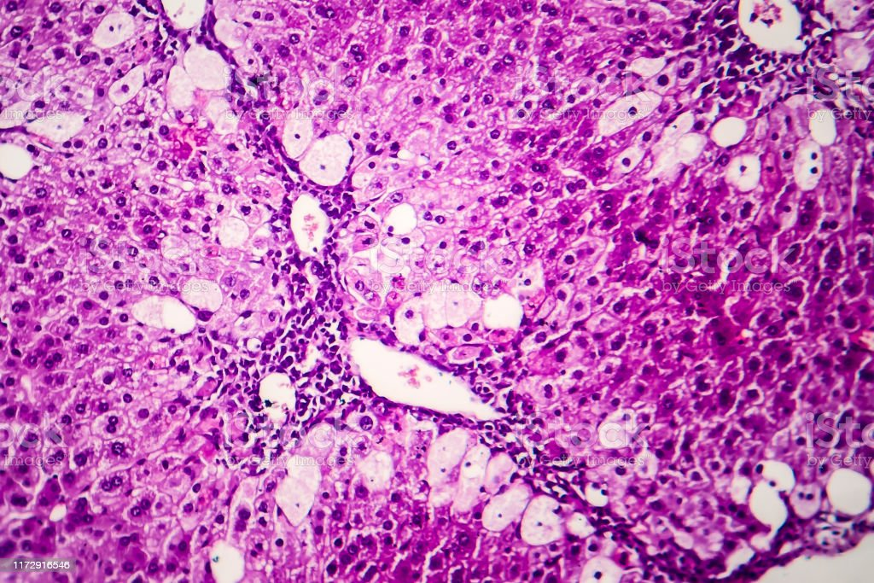
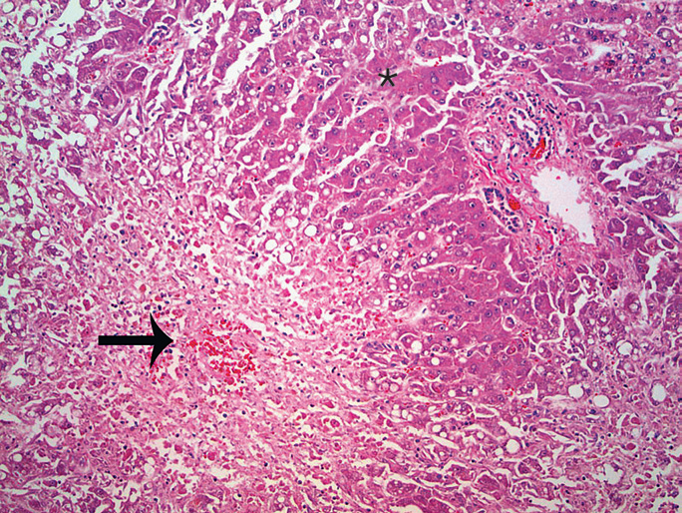
III. Biopsy.

Slide 24
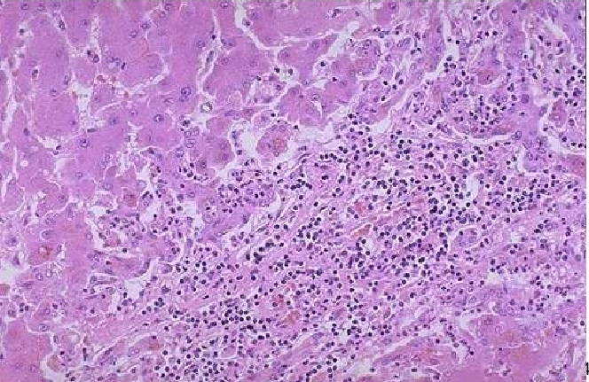

Slide 26
Alcoholic Liver Disease
Excessive ethanol consumption causes more than 60% of chronic liver disease in Western countries and accounts for 40% to 50% of deaths due to cirrhosis.
Short-term ingestion of as much as 80 g of ethanol per day generally produces mild reversible hepatic changes.
Chronic intake of 40 to 80 g/day is considered a borderline risk factor for severe injury.
women are more susceptible than men to hepatic injury??

Slide 27
