Slide 1
Anti-neoplastic Drugs II
Dr. Yousef Al-saraireh
Assistant Professor
Faculty of Medicine

Slide 2
Anti-neoplastic Drugs
1. Antimetabolites
2. Antibiotics
3. Alkylating agents
4. Microtubule inhibitors
5. Topoisomerase inhibitors
6. Steroid hormones & their antagonists
7. Monoclonal antibodies
8. Others

Slide 3
4.Microtubule inhibitors
Vinca alkaloids :
They include mainly Vincristine (Oncovin) and Vinblastin (Velban).
These are obtained from the Periwinkle plant
cell-cycle specific & phase specific, because they block mitosis in metaphase (M phase).
Mechanism of action
They bind to tubular protein (Tubulin) to cause its depolymerization , thus prevent assembly of tubulin diamers into micro-tubules which would prevent the formation of mitotic spindle; they act mainly in mitosis phase of cell cycle leading to arrest of mitosis in metaphase stage .

Slide 5
Uses:
Vincristine is used IV for:
Acute lymphoblastic leukemia in children
Wilms’ tumor
Ewing soft-tissue sarcoma
Hodgkin & non-Hodgkin lymphomas
Vinblastin is used IV for:
With bleomycin & cisplatin for metastatic testicular carcinoma
Hodgkin & non-Hodgkin lymphomas
Adverse effects:
Vincristine is relatively not myelotoxic, but is neurotoxic and thus may cause peripheral neuropathy and also autonomic neuropathy;
Vinblastine is mainly toxic to bone marrow but least neurotoxic; both may cause local thrombophlebitis and alopecia .

Slide 6
B. Taxanes :
Paclitaxel and Docetaxel
These plant alkaloids are obtained from Western or European yaws (Taxus).
They are cell-cycle specific
Mechanism of action
In comparison to Vinca alkaloids, these drugs enhance polymerization of tubulin and this would prevent microtubule dis-assembly into tubulin monomers, thus preventing separation of chromosomes and also causing arrest of mitosis in metaphase stage .
Uses
They are useful IV for wide variety of cancers such as advanced breast or ovarian cancer;
Adverse effects
They may cause myelosuppression, peripheral neuropathy and , with paclitaxel , anaphylactic reaction (due to vehicle)

Slide 7
5. Topoisomerase (Top) inhibitors
Tops are essential enzymes involved in maintaining DNA structure during replication and transcription
They cleave DNA strands and form intermediates
with the strands, producing a gap through which DNA strands can pass, then reseal the strand breaks.
Top I produces single-strand breaks; Top II produces double-strand breaks.
Mechanism of action
These drugs bind Topisomerases to inhibit its function, and thus cause DNA strand breaks.
They are cell cycle specific

Slide 8
Epipodophylotoxins :
Etoposide and teniposide
This is semisynthetic and is derived from podophylotoxin that is obtained from the mayapple (mandrake) root.
They inhibits Top II.
They are given orally and sometimes IV for small cell lung cancer, lymphoma, testicular cancer, and acute monocytic leukemia.
They cause bone marrow toxicity, stomatitis and vomiting .

Slide 9
2. Camptothecin :
Obtained from a Chinese tree.
Irinotecan and topotecan
They inhibits Top I.
Uses:
A. Irinotecan
Colon cancer; NSCLC; SCLC; cervical and ovarian
cancers; gastric cancer and pancreatic cancer
B. Topotecan
Ovarian cancer and SCLC
Adverse effects
diarrhea and bone marrow depression

Slide 10
6. Steroid hormones & their antagonists
Tumors that are steroid hormone-sensitive may be either:
Hormone-responsive tumor: tumor regresses following treatment with hormone
Hormone-dependent tumor: removal of hormonal stimulus causes tumor regression
e.g. Antiestrogen (Tamoxifen) in breast cancer

Slide 11
A. Prednisone
Is a potent anti-inflammatory corticosteroid
Is used to induce remission in patients with acute lymphocytic leukemia and, Hodgkin & non-Hodgkin lymphomas
Mechanism of action
Prednisone is inactive, must be reduced to prednisolone, binds to intracellular receptor that triggers production of specific proteins
Is given orally
Adverse effects:
Predisposition to infections, ulcers & pancreatitis, hyperglycemia, cataract, glycauma, osteoporosis & change in mood

Slide 12
B. Tamoxifen
Is an estrogen antagonist
Is a selective estrogen-receptor modulator (SERM)
Has weak estrogenic activity
Mechanism of action
Tamoxifen binds to estrogen receptor forming inactive drug-receptor complex, resulting in inhibition of tumor growth
Uses
First-line therapy in treatment of estrogen-receptor-positive breast cancer

Slide 13
Is given orally
Adverse effects:
Hot flashes, nausea, vomiting, skin rash, vaginal bleeding & discharge, hypercalcemia, endometrial cancer, thromboembolism

Slide 14
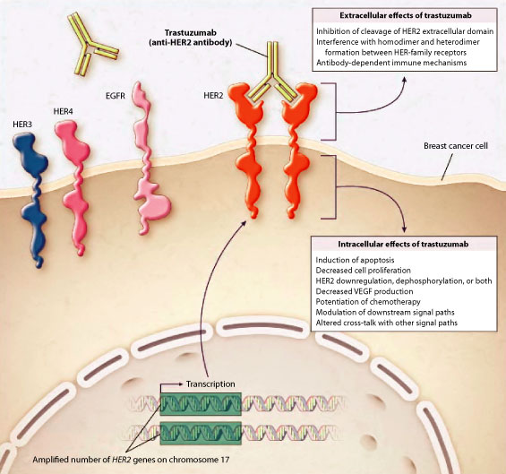
7. Monoclonal antibodies
They are directed against specific tumour-associated antigens
Have fewer side effects
A. Trastuzumab
It binds to extracellular domain of the human epidermal growth factor receptor HER-2/neu.
It blocks the natural ligand from binding and down-regulates the receptor.
It is approved IV for the treatment of metastatic breast cancer in patients whose tumors overexpress HER-2/neu
Adverse effects include congestive heart failure, fever, chills

Slide 15
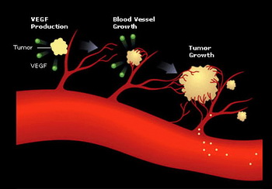
B. Bevacizumab
first in a new class of anticancer drugs called antiangiogenesis agents.
It attaches to and stops vascular endothelial growth factor(VEGF) from stimulating the formation of new blood vessels leading to tumor shrinkage and death
It is approved IV for use as a first-line drug against metastatic colorectal cancer.
Common adverse effects are hypertension, stomatitis, and diarrhea.

Slide 16
C. Rituximab
It binds to the CD20 molecule on malignant B lymphocytes
is approved for the therapy of patients with non-Hodgkin's lymphoma.
The mechanism of action includes complement-mediated lysis, antibody-dependent cellular cytotoxicity, and induction of apoptosis in the malignant lymphoma cells.
Adverse effects include Hypotension, bronchospasm, angioedema, chills and fever.

Slide 17
8. Others
Platinum coordination complexes
Cisplatin, carboplatin, and oxaliplatin: platinum derivatives
They act similarly to alkylating agents.
Platinum binds to DNA and forms cross-links between neighboring guanines causing a major bending of the DNA leading to cellular damage.
Uses: IV
non-small cell and small cell lung cancer, esophageal and gastric cancer, head and neck cancer, and genitourinary cancers, particularly testicular, ovarian, and bladder cancer
Adverse effects:
vomiting, nephrotoxicity, ototoxicity, neurotoxicity

Slide 18
B. Tyrosine kinase inhibitors
Imatinib:
It acts as a signal transduction inhibitor, used specifically to inhibit bcr-abl tyrosine kinase
It prevents the phosphorylation of tyrosine on the substrate molecule and, hence, inhibits subsequent steps that lead to cell proliferation
It is used orally for of chronic myelogenous leukemia
Adverse effects
fluid retention and edema, hepatotoxicity, and neutropenia as well as nausea and vomiting

Slide 19
2. Gefitinib
It targets the epidermal growth factor receptor.
It is approved for the treatment of non–small cell lung cancer
It is administered orally
The most common adverse effects are diarrhoea, nausea, and acne-like skin rashes

