Slide 1
GIT Micro Lab 2
2020-2021
Dr. Mohammad Odaibat
Department of Microbiology and Pathology
Faculty of Medicine, Mu’tah University

Slide 2
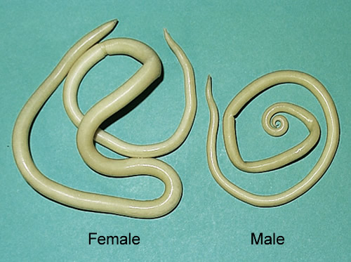
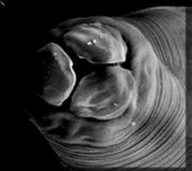
Ascaris lumbricoides adult
Long, cylindrical with tapering ends.
Creamy or pink in color.
Mouth surrounded by 3 lips, one dorsal and 2 subventral.
Each lip is provided with
2 sensory papillae and fine teeth.
Club-shaped oesophagus.

Slide 3
Ascaris lumbricoides adult female
Female:
Straight posterior end.
2 sets of genitalia.
Each female lays about 200.000 eggs / day (oviparous).

Slide 4
Ascaris lumbricoides adult male
Male:
Shorter than female.
The posterior end is curved ventrally
2 equal spicules.

Slide 5
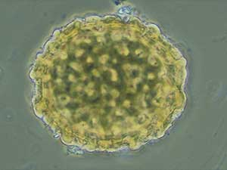
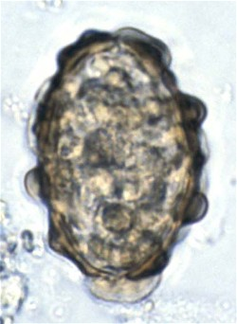
Eggs of Ascaris lumbricoides (D.S)
Fertilized egg
Unfertilized egg
-Size: 60 × 45 µm
-Shape: Oval to round.
-Shell: Inner thick shell & outer
mamillated coat.
-Color: Golden brown (bile stained).
-Content: Immature
(one- cell stage).
-Size: 90 × 45 µm.
- Shape: Elongated.
- Shell: Thinner with ill developed
mamillated coat
- Color: Golden brown.
- Content: Multiple granules.

Slide 6
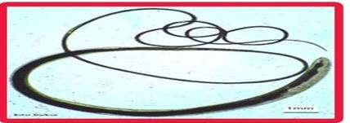
Tichuris trichiura adult female
Female:
Straight posterior end.
One set of genitalia.
Vulva opens at junction of narrow thin and broad parts.
Oviparous (3000-10000 eggs/day).

Slide 7
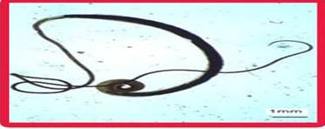
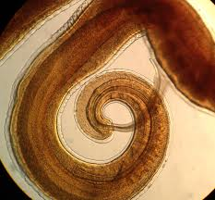
Tichuris trichiura adult male
Male:
Shorter than female
Posterior end curved ventrally.
One spicule inside a retractile sheath.

Slide 8
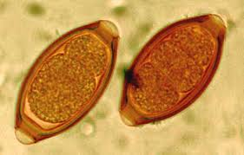
Egg of Trichuris trichura (D.S)
Shape: Barrel shaped.
Shell: Thick with two polars.
Color: Brownish.
Content: Immature
(one cell stage).

Slide 9
Hookworm
Ancylostoma duodenale
Necator americanus
Common name
Old world hookworm
New world hookworm
Larger
♀ 12mm
♂ 10mm
Slightly smaller
♀ 10mm
♂ 8mm
Size
Anterior end
Slightly bent dorsally
Strongly bent dorsally
Daily egg output
20.000 eggs / female
10.000 eggs / female
-More pathogenic due to higher blood loss by feeding worm (0.5 cc of blood daily/parasite)
-Less pathogenic, blood loss is lower (single worm can consume 0.03 cc of blood/ day)
Pathogenesis

Slide 10
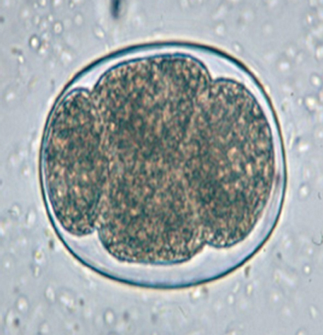
Egg of Ancylostoma duodenale (D.S)
Shape: Oval with blunt rounded poles.
Shell: Thin.
Color: Translucent.
Contents: Immature (4-cell stage) with empty space between the shell and contents.

Slide 11
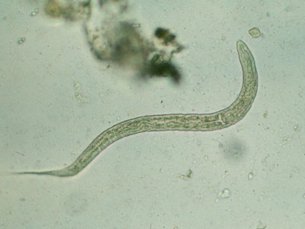
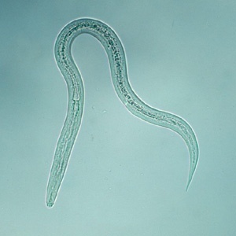
Ancylostoma rhabditiform larva
-Smaller.
-Rhabditiform oesophagus.
-Pointed tail end.
Ancylostoma filariform larva (I.S)
-Longer.
-Cylindrical oesophagus.
-Pointed tail end.
-Sheathed.

Slide 12
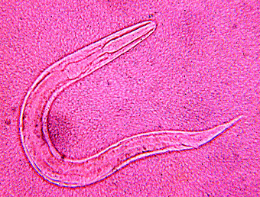
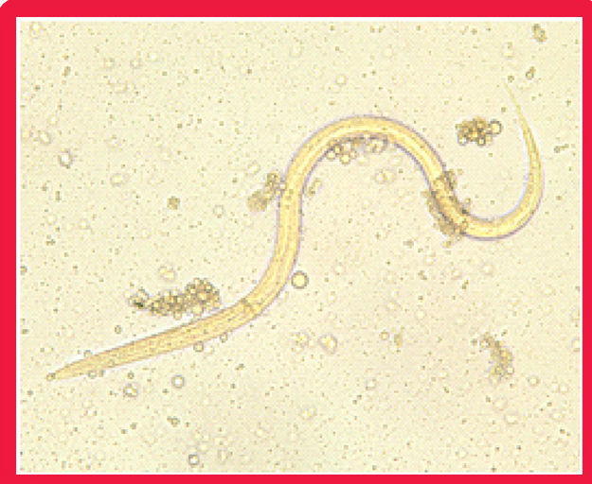
Strongyloides stercoralis
Filariform larva (I.S)
Rhabditiform larva (D.S)
-Larger.
-Cylindrical oesophagus.
-Non sheathed.
Shorter.
Rhabditiform oesophagus.
Blunt end.

Slide 13
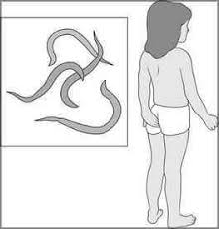
Enterobius vermicularis (pin worm)
Location of adult: Large intestine of man
Infective stage: Embryonated egg
Mode of transmission: Ingestion of food contaminated with embryonated egg or autoinfection via nails scratching the perianal region
Disease: Enterobiasis

Slide 14
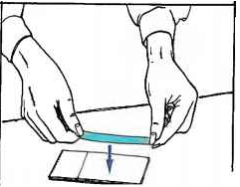
Enterobius vermicularis (pin worm)
Diagnosis
Recovery and identification of eggs or adults from the perianal region utilizing the cellophane tape preparation.
Specimens must be collected the first thing in the morning upon waking, especially before bathing or bowel movements.
Eggs are rarely found in fecal samples because release is usually external to the intestines.

Slide 15
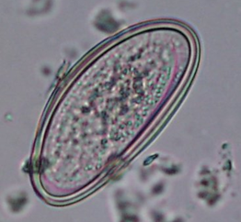
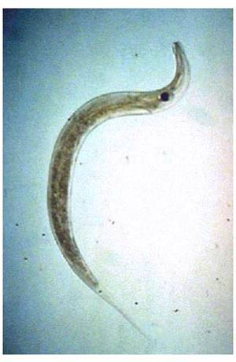
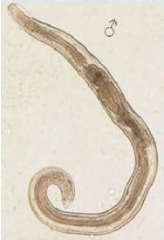
Laboratory Diagnosis- Enterobius vermicularis (Pin Worm)
Female (10mm) Posterior end is straight with long pointed tail (4X)
Male (5mm): Posterior end is curved with one spicule
Egg: Planoconvex or D-shaped egg. embryonated (contain a larva).

