Slide 1
Newborn infants Classification, History, physical examination and common issues
^{5th} year rotation
Dr. Amjad Tarawneh
Pediatrician , Neonatologist

Slide 2
Classification of newborn by weight and gestational age
Help in predict potential problems
LBW: <=2500gm
VLBW: <1500gm
ELBW: <1000gm
Term :completed 37 weeks gestation till 42 week
Liveborn infants delivered before 37 wk from the 1st day of the last menstrual period are termed premature by the World Health Organization.
Premature; less than 37 weeks gestation

Slide 3
Other Classification
SGA <10th centile
LGA>90th centile
AGA 10-90th centiles
IUGR; describe less than optimal pattern of growth over a period of time intrauterine. It is possible to be IUGR not SGA

Slide 4
SGA / IUGR problems
Stillbirth
More RDS
High mortality
Hpoglycemia
Hypocalcemia
Polycythemia
Depression needing resuscitation at birth
Low Apgar score

Slide 5
LGA
Associated with maternal diabetes
High fetal insulin even in absence of maternal diabetes
Morbidity
Birth trauma
Hypoglycemia
Polycythemia
Congenital heart disease TGA
High cesarean delivery
Sacral agenisis

Slide 6
Important History points in caring of newborn
Maternal diabetes
Metabolic and congenital defect
Polyhydramnios
Swallowing defect, GI obstruction
Oligohydramnios
Renal disease , pulmonary hypoplasia
Maternal age
Old age and chromosomal
Breach presentation
IUGR
Consanguinity, family history

Slide 7
Important History points in caring of newborn
Rupture of membrane
sepsis
Delivery type
c/s TTN
Prenatal care
Maternal blood group
ABO, Rh disease
Infection risk
Maternal Hepatitis carrier
Maternal GBS colonization

Slide 8
Patient Name:
Patient Identification Number:
Admission Date:
Problems on Admission: Current Problems:
1.
2.
Birth Parameters
Gestational age: :
Weight:____ g (%ile)
Head circumference:____cm (%ile)
Maternal History and Delivery:
____________was born at Al-Karak Hospital/elsewhere on ______, at __ weeks
gestational age to (parents’ full names). (Mother’s name) is a (age) G T P A L woman whose antenatal screens were: rubella (immune/nonimmune), VDRL (reactive/nonreactive), hepatitis B serum antigen (-/+), HIV (-/+ __ GA), GBS (+/- at __ GA) and blood group __. This pregnancy was uneventful/complicated by__________. (Celestone was administered at __ weeks gestation.)
Membranes ruptured __hours prior to delivery. The infant was born vaginally/caesarian section. Apgar scores were __ at one minute and __at five minutes. (Insert post-delivery management.) He/she was appropriate/small/IUGR for gestational age with dysmorphic/ no dysmorphic features seen. The infant was admitted to the NICU and observed for the following problems

Slide 9
Examination precaution
Hand washing
Thermal environment
Light and noise
5-10 minutes examination time

Slide 10
Cardiopulmonary stability
Apgar score
Heart rate
Respiratory effort
Color
Tone
Reflex

Slide 11
Apgar Evaluation of Newborn Infants
SIGN | 0 | 1 | 2
Respiratory effort | Absent | Slow,irregular | Good, cry
HR | absent | < 100 | > 100
 | LIMP | SOME FLEXION | ACTIVE MOTION
COLOR | Blue, PALE | Body pink, extremities blue | Completely pink
Response to catheter in nostril (tested after oropharynx is clear | NO RESPONSE | GRIMACE | COUGH OR SNEEZE

Slide 16
Physical Eamination
Vital signs
RR 40-60
HR 120-160
Temperature axilary 35.5-37.5
Over bundling
Heater

Slide 17
Physical Examination
skin
Pink is normal
Acrocyanosis is normal
Cyanosis
Jaunduce
1st 24 hours
Cephalopedal distribution
Pale and grayish color in anemia and acidosis respectively

Slide 18
Common skin rash
mongolian spot
Mottling : general circulatory instability, may be associated with serious illness or related to a transient fluctuation in skin temperature
harlequin color change : An extraordinary division of the body from the forehead to the pubis into red and pale halves is known as, a transient and harmless condition
Cavernous hemangiomas are deeper, blue masses that if large, may trap platelets and produce disseminated intravascular coagulation or interfere with local organ function

Slide 19
skin of premature infants is thin and tends to be deep red; in extremely premature infants, the skin appears almost gelatinous and bleeds and bruises easily
lanugo HAIR : Fine, soft, immature hair,, frequently covers the scalp and brow and may also cover the face of premature infants
erythema toxicum : small, white, occasionally vesiculopustular papules on an erythematous base develop 1–3 days after birth.This benign rash, persists for as long as 1 wk, contains eosinophils, and is usually distributed on the face, trunk, and extremities
Pustular melanosis: a benign lesion seen predominantly in black neonates, contains neutrophils and is present at birth as a vesiculopustular eruption around the chin, neck, back, extremities, and palms or soles; it lasts 2–3 days

Slide 20
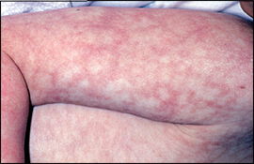
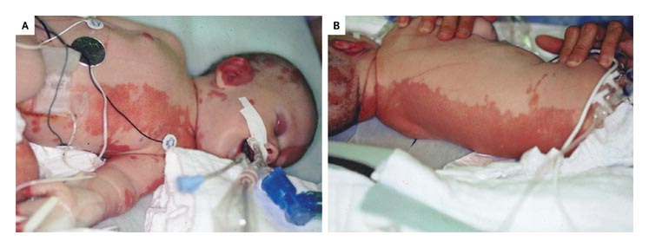

Slide 21
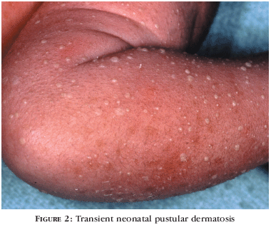
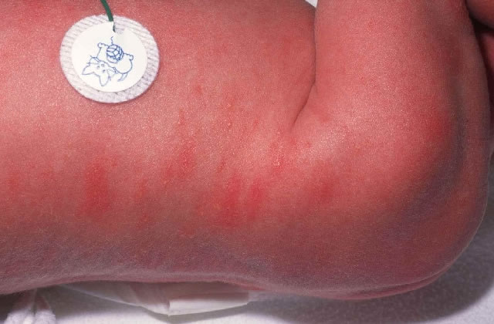

Slide 22
General inspection
Flexion of upper and lower extremities
Asymetric movement
Brachial plexus and fractured humerous
Ventral, vertical suspension and head control for tone assessment

Slide 23
General inspection
Symmetry of the mouth and face
Facial nerve
Vigorous cry is assuring
Weak cry
sepsis, asphyxia,metabolic, narcotic use
Hoarseness
Hypocalcemia, airway injury
High pitch cry
CNS causes, kernicterus

Slide 24
Congenital anomalies
Facial ; overall look of facial features that give impression of diagnosis ie: Down syndrome
Minor anomaly: common and no effect on organ function such as simian crease or ear tag
Major anomaly: less common and involve main organ dysfunction like neural tube defect, multicystic dysplastic kidney

Slide 25
Head
Forceps and vaccum marks
Caput succedaneum
Boggy edema in presenting part of head
Cross suture lines
Disapear in few days
Cephalhematoma
Subperiosteal
Weeks to resolve
Dose not cross sutures

Slide 26
head
Head cicumference
Molding
Brachycephaly: flat occiput
Widening of suture
Fontanelles
Head auscultation: bruits

Slide 27
Ears, Nose, Mouth
Low set ears?
Natal teath
Choanal atresia
Epstein pearls
Cleft, submucosal

Slide 28
Neck and clavicle
Webbing; turner syndrome
Excess skin at base of neck posterior in Down syndrome
Goiter
Fracture in clavicle
Asymmetric moro reflex

Slide 29
Respiratory
Tachypnea
Nasal flaring
Respiratory effort
Mild retraction
Grunting
asymetric chest rise
supra-sternal, intercostal, subcostal retraction

Slide 30
Respiratory
Auscultate
Air entry, symmetry
Early crepitation sound is transmitted upper sound
Late inspiratory crepitation

Slide 31
Chest, back
Pectus excavatum
Pectus carinatum
Supramammary nipple
Breast hypertrophy
Milk production
No redness
Back
abnormal curvature
Sinus tract, tuft of hair, MMC…

Slide 32
cardiovascular
HR 100-160 beats/min
Color, perfusion
Central cyanosis
Single S1
Splited S2
No split ;single ventricle, pulmonary hypertension

Slide 33
Abdomen
Inspection
Scaphoid
Distention
Abdominal wall defect (gastroschisis)
Palpation; baby sucking and use warm hands
Kidneys are normaly palpable
Liver 2-3 cm
Spleen palpable
Umblical vessels
2 artery, one vein
Hernias ; umbilical and inguinal

Slide 34
Genitalia and anus
Penile size
Hypospadias, epispadias
Testes
2% crypoorchid
Hydrocele
Prminent clitoris and minora
Vaginal skin tag
Vaginal discharge /blood
Labial fusion

Slide 35
Extremities
Erb’s palsy: extended arm and internal rotation with limited movement
Humerous fracture
Digital abnormality
Syndactaly, polydactaly
Single palmar crease
Hip dislocation
Female, breach

Slide 36
Anus
Patency
location

Slide 37
CNS
Awakenes and alertness
moving extremities
Flexed body posture
Minimal Head lag
Ventral suspension
Vertical suspension
Moro reflex

Slide 38
Postnatal assessment of gestational age
Accuracy within 1-2 weeks
New Ballard Score
Neurologic characterstic
Physical characterstic
Part of general examination

Slide 39
Physical exam: Image 7
Breast nodule
Preterm Term
Notes:
‹#›
‹#›

Slide 40
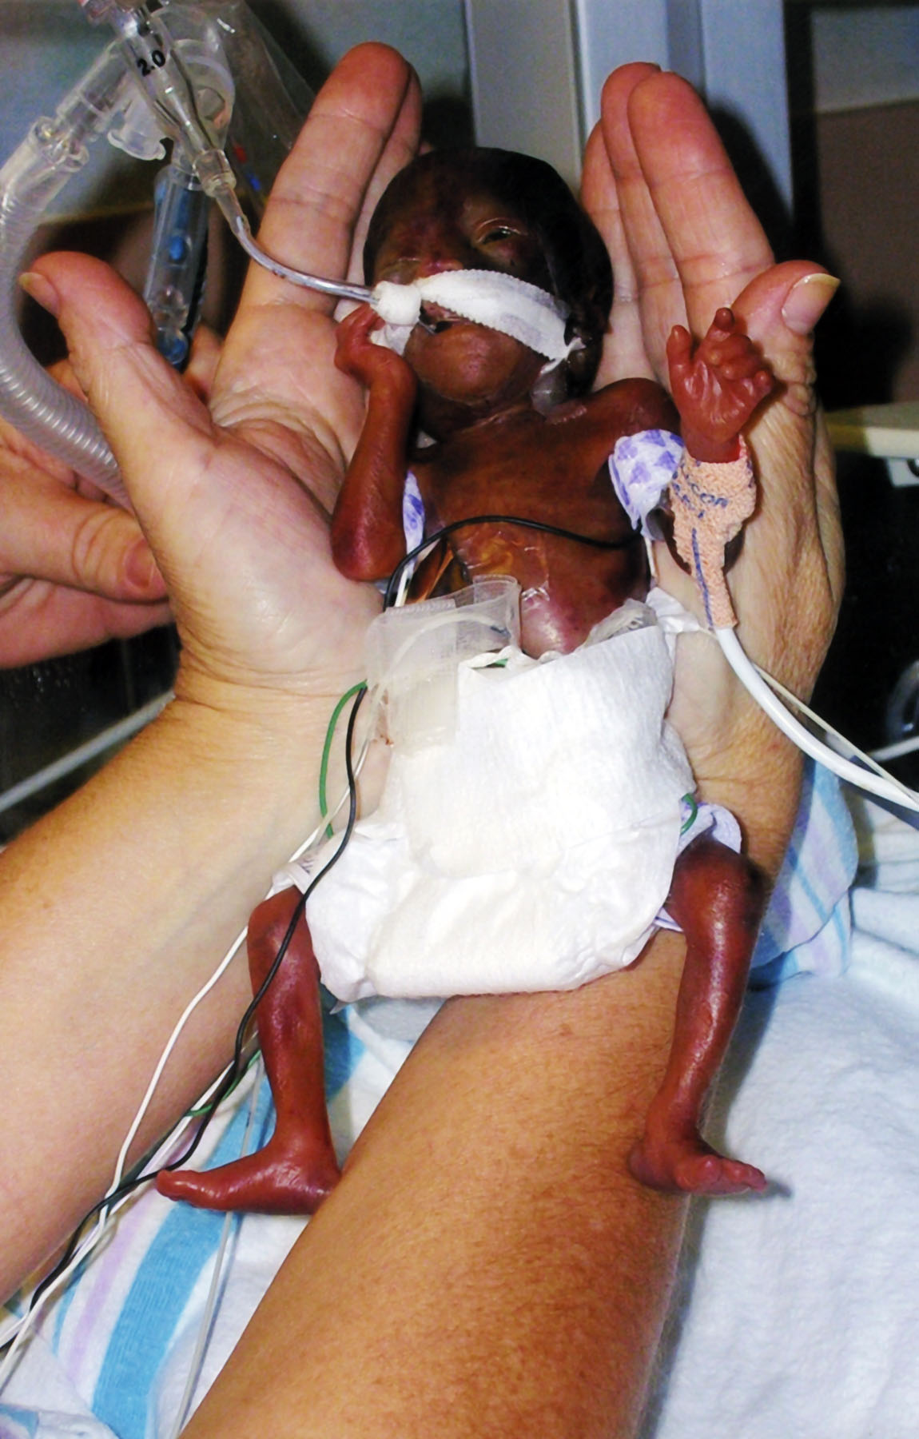
Physical exam: Image 6

Slide 41
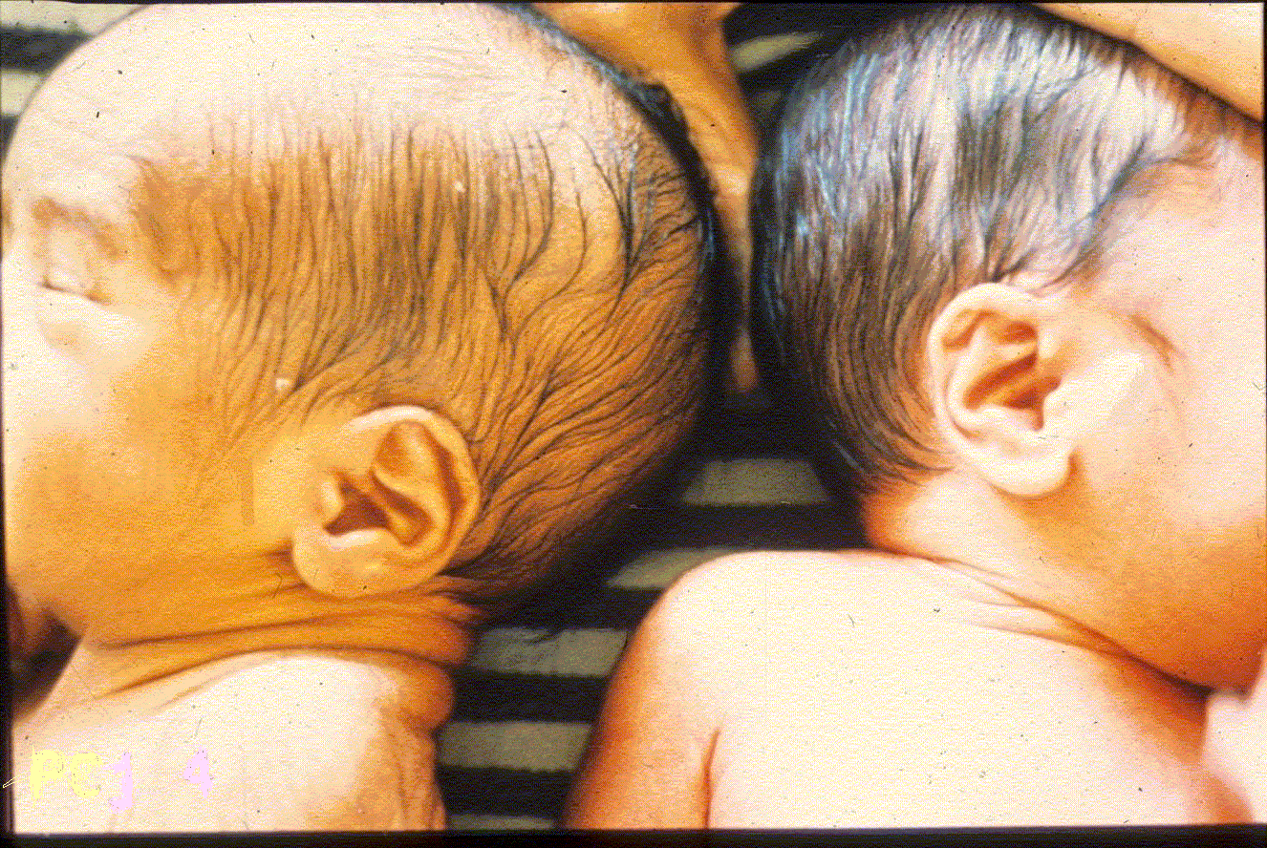
Physical exam: Image 11
Preterm
Term
Notes:
‹#›
‹#›

Slide 42
Physical exam: Image 10
Sole creases
Preterm Term
Notes:
‹#›
‹#›

Slide 43
Physical exam: Image 9
Preterm Term
Notes:
‹#›
‹#›

Slide 44
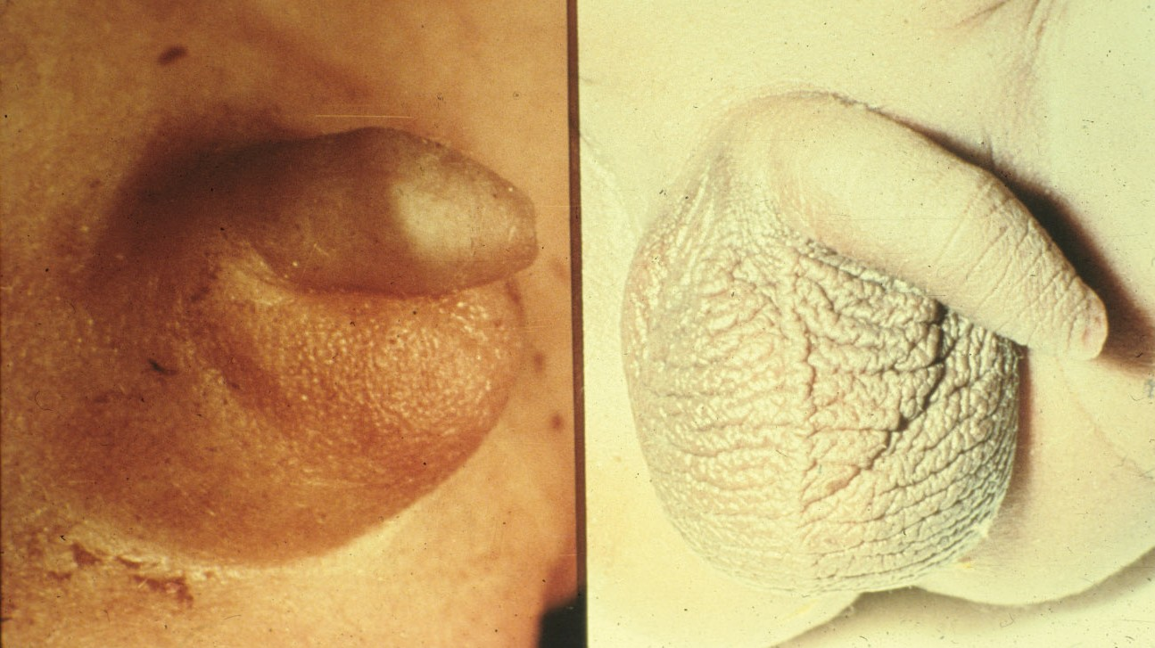
Physical exam: Image 8
Preterm Term
Notes:
‹#›
‹#›

