Slide 1
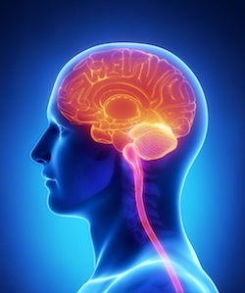
Meningitis
DR.OMAR ALI NAFI MBBS,CJBP,MRCP
Presented by:
Hasan Salahat
Almothana Alrfoo
Rana zaid
Raghad Amr
Safaa Matter
Sara Bani Hani
Roa’a Alzawahreh

Slide 2
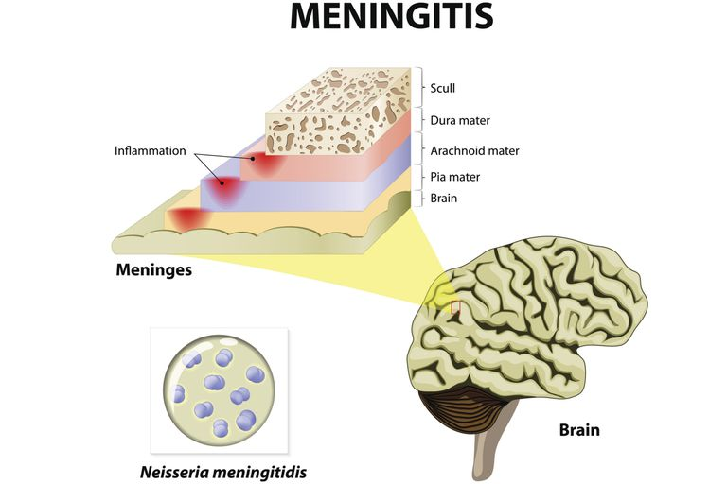
Introduction :
Meningitis : is inflammation of the leptomeninges .
One of the most common CNS infections .
It may involve both the meninges and brain parenchyma (meningoencephalitis) .

Slide 3
Acute bacterial meningitis .
Aseptic meningites .

Slide 4
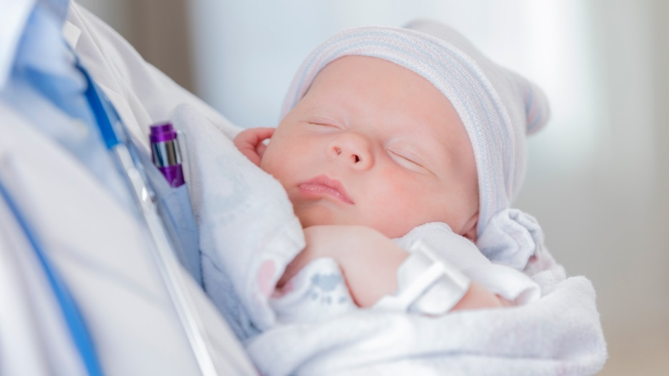
Acute Bacterial Meningitis:
NEONATAL MENINGITIS
POST-NEONATAL MENINGITIS .

Slide 5
Neonatal Meningitis (Definition):
It’s inflammation of meninges due to bacterial invasion in the first 90 days of life .

Slide 6
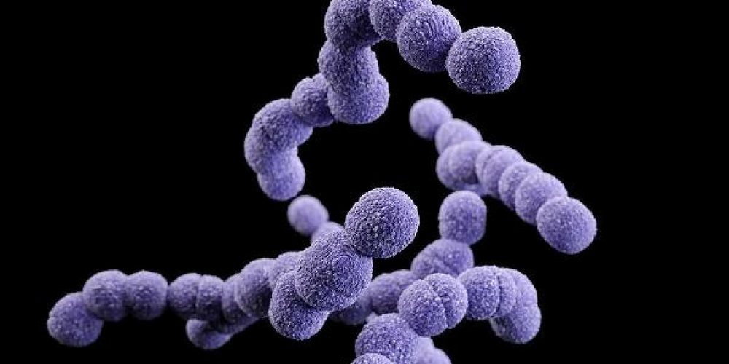
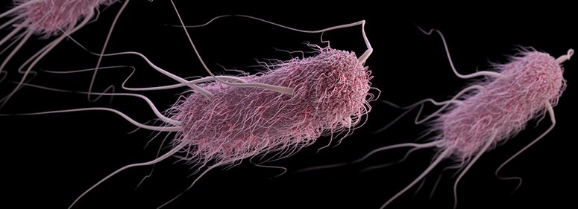
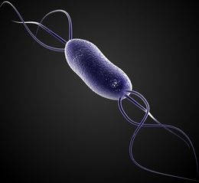
Neonatal Meningitis (Etiology) :`
GBS (predominantly type 3)
E.coli (predominantly those containing the K1 polysaccharide) .
Listeria Monocytogenes .
These 3 categories constitute about 75% of the causes .
The 25 % ( peusomonas ,proteus ,klibsella ….)

Slide 7
Neonatal Meningitis (Etiology) :
Neonatal meningitis most frequently results from the bacteremia that occurs with neonatal sepsis .
Meningitis can also result from scalp lesions , particularly when developmental defects lead to communcation between the skin surface and the subarachnoid space , which predisposes to thrombophlibitis of the diploic veins .
Less commonly , meningitis can result from direct extension to the CNS from a contagious otic focus (otits media) .

Slide 8
The most important symptom is :
Poor feeding
Its always indication of admission

Slide 10
Neonatal Meningitis (S & S) :
Usually , manifestations are those associated with neonatal sepsis : temperature instability, respiratory distress, jaundice, apnea .
CNS signs : lethargy , seizures (particularly focal) , vomiting and irritability more specifically suggest meningitis .
A bulging or full fontanelle occurs in about 25% and nuchal rigidity in only 15% .
Cranial nerve abnormalities ( especially the 3rd , 6th and 7th ) may also be present .

Slide 11
Diagnosis !

Slide 12
Definitive Diagnosis is made by CSF examination via LP , which should be performed in any neonate suspected of having sepsis or meningitis .

Slide 13
Lumbar puncture
Put the patient in left lateral position with neck flexion and knee in full extension ( fetal position ) .
Determine L3 –L4 OR L4 –L5 depend on post. iliac crest .
Sterile the area in circular manner .
Inject local anesthesia under the skin .
By spinal needle enter to subarachnoid space

Slide 14
Neonatal Meningitis (Diagnosis) :
However, LP can be difficult to perform in a neonate , and there is some risk for hypoxia.
Poor clinical condition (resoiratory distress, shock , thrombocytopenia) makes LP risky .
If LP is delayed , the neonate should be treated as though meningitis is present .

Slide 15
We have to take 5 tubes of CSF FOR :
Cytology .
Chemistry
Gram stain
Antiginicity
Culture .

Slide 16
Laboratory Values :
 | WBCs (/microL) | Protein (mg/dL) | Glucose (mg/dL)
Normal | 0 - 5 (Lymphocytes) | 20 – 40 | 50 – 100 ½ - 2/3 blood glcouse
ABM | 100 - 10,000 (PMNs) | > 100 | > 25

Slide 17
Normal RBC = 0
If there is blood
with CSF
Trauma
1- Clear with time .
2- Do centrifugation
and see
RBC-WBC ratio.
Subarachnoid hmg

Slide 18
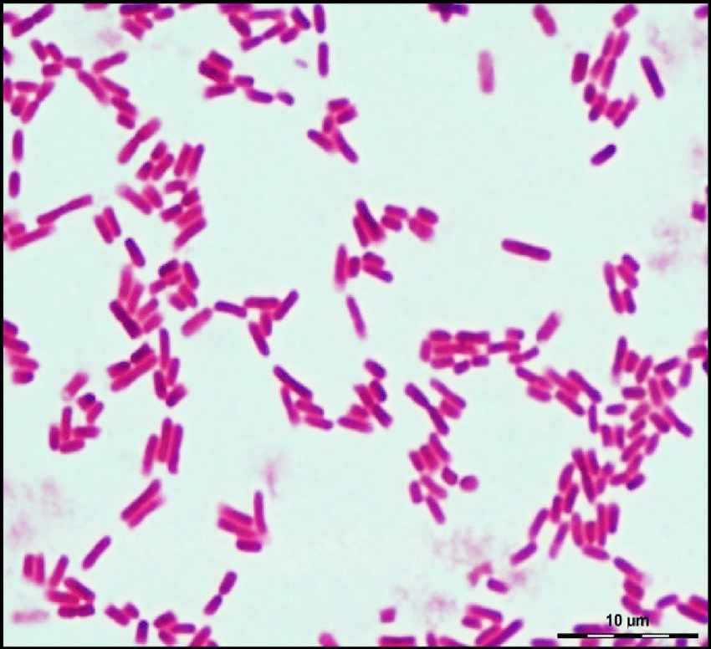
Gram stain result
Need 10 min ……..
E coli | gram – bacilli
Listeria | Gram + bacilli
H.Infulenza | Gram - cocobacilli
N.Meningitidis | Gram – diplococi
GBS | Gram + coci
Strep pneumonia | Gram + dipolccoi

Slide 19
Don’t forget :
Blood glucose
Blood culture

Slide 20
Neonatal Meningitis (Diagnosis) :
When I have to repeat LP ?
LP should be repeated at 24 - 48 hr if clinical response is questionable and at 72 hr when gram-negative organisms are involved (to ensure sterilization) .
Some experts believe that a repeat LP at 24 hr in neonates with GBS meningitis has prognostic value .
LP should not be repeated at the end of therapy if the neonate is doing well .

Slide 21
Neonatal Meningitis (Prognosis) :
Without treatment , the mortality rate from neonatal meningitis approaches 100% .
With treatment , prognosis is determined by birth weight, organism and clinical severity .

Slide 22
Neonatal Meningitis (Prognosis) :
Mortality rate for gram-negative neonatal meningitis is 20 - 30% .
Mortality rate for gram-positive neonatal meningitis (e.g. GBS) is 10 - 20% .
For organisms that produce vasculitis , meningitis and brain abscess (necrotizing meningitis) , the mortality rate may approach 75% .
Neurological sequelae (hydrocephalus , hearing loss, mental retardation) develop in 20 - 50% of infants who survive , with a poorer prognosis when gram-negative enteric bacilli are the cause .

Slide 23
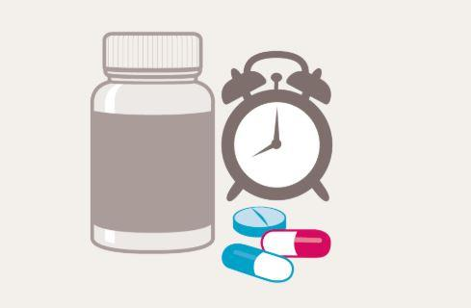
Neonatal Meningitis (Treatment) :
Empiric treatment is begun with :
ampicillin plus cefotaxime .
Drug should be :
Cross BBB .
I V .
Broad spectrum .
Bactericidal .

Slide 24
Neonatal Meningitis (Treatment duration)
Parenteral therapy for gram-positive meningitis is given for a minimum of 14 days, and for complicated gram-positive or gram-negative meningitis , a minimum of 21 days .

Slide 25
Neonatal Meningitis (Treatment) :
Patients should be closely followed for neurological complications during the first 2 years of life :
Head circumference .
Hearing assessment .
Developmental assessment .

Slide 26
♥Thank you
ANY QUESTIONS ? 😈🔫

Slide 27
POST-NEONATAL MENINGITIS

Slide 28
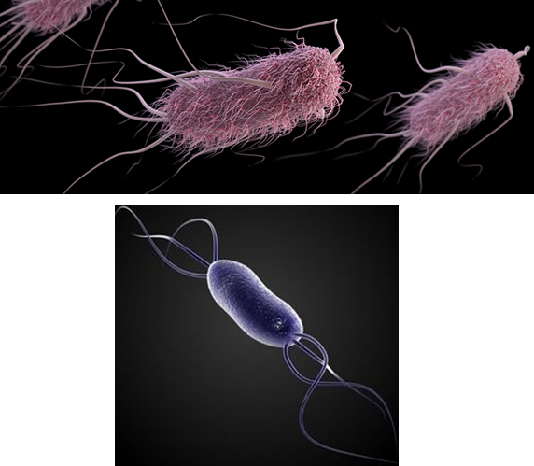
Post-Neonatal Meningitis (Etiology):
In post-neonatal period , the most common organisms causing meningitis are :
Neisseria meningitidis (meningococci).
Streptococcus pneumoniae (pneumococci).
Hemophilus influenza type b .

Slide 29
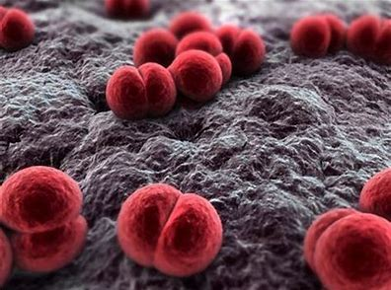
Post-neonatal meningitis ( etiology ):
Meningococci exist in the nasopharynx of about 5% of people and spread by respiratory droplets and close contact . Only a small fraction of carriers develop meningitis; what makes them susceptible is unknown .
Children between 6 mo and 3 yr (peak = 1st year) are mostly affected , it also tends to occur in epidemics among closed populations ( e.g. boarding schools ,military barracks and college dormitories )

Slide 30
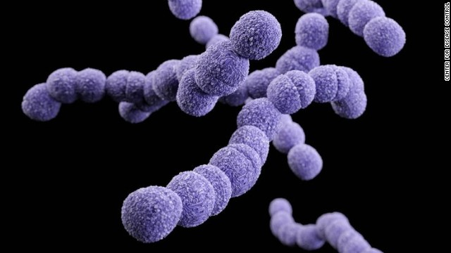
Pneumococci are the most common cause of meningitis in older children and adults .
Especially at risk are patients with chronic otitis , sinusitis , mastoiditis , CSF leaks , recurrent meningitis , pneumococcal pneumonia , sickle cell disease or asplenia .
Incidence of pneumococcal meningitis is decreasing because of routine vaccination (ideally!!!) .

Slide 31
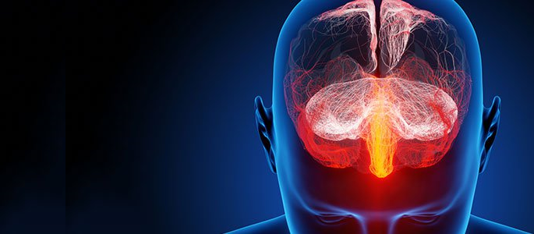
Bacteria typically reaches the meninges by hematogenous spread from sites of colonization in the nasopharynx or other foci of infection (e.g. pneumonia) .
Bacteria can also enter CSF by direct extension from nearby infections (sinusitis, mastoiditis) or through exterior openings in normally closed CSF pathways (e.g. due to meningocele , spinal dermal sinus , penetrating injuries and neurosurgical procedures)

Slide 33
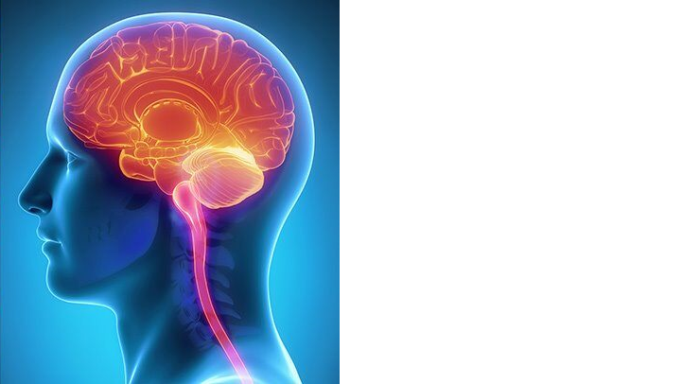
A respiratory illness or sore throat often precedes the more characteristic symptoms of fever, headache, stiff neck and vomiting.
Brudzinski’s and Kernig’s signs are present in ½ of patients .
Neck stiffness and Brudzinski’s and Kernig’s signs are termed meningeal signs or meningismus ; they occur because tension on nerve roots passing through inflammed meninges causes irritation .

Slide 35
Brudzinski’s Sign :
Attempts at neck flexion induce flexion of the hip or knee .

Slide 36
Kernig’s Sign :
Resistance to passive extension of the knee while the hip is flexed.

Slide 37
Adults may become desperately ill within 24 hr , and children even sooner .
Seizures occur in about 30% of patients .
Cranial nerve abnormalities (e.g. 3rd or 7th cranial nerve palsy ; occasionally deafness) and other focal deficits occur in 10 - 20% .
In patients > 2 yr , changes in consciousness progress through irritability , confusion , drowsiness , stupor and coma .
Opisthotonos posturing may occur .
Dehydration is common , and vascular collapse produces shock .

Slide 38
A maculopapular or hemorrhagic petechial rash often appears soon after disease onset .
Fulminant meningococcemia syndromes include Waterhouse-Friderichsen syndrome (septicemia, profound shock, cutaneous purpura and adrenal hemorrhage), sepsis with multiple-organ failure , shock and DIC .

Slide 39
Meningococcal
Rash

Slide 40
Opisthotonos Position:
Arching of the trunk
bad prognosis..

Slide 41
Post-Neonatal Meningitis (Complications) :
* Systemic complications include hyponatremia due to SIADH , DIC and septic shock .

Slide 43
Post-Neonatal Meningitis (Diagnosis):
Because acute bacterial meningitis , especially meningococcal , can be lethal within hours , it must be diagnosed and treated rapidly .
Prompt LP is required but it should not delay immediate treatment with antibiotics and corticosteroids .

Slide 44
Post-Neonatal Meningitis (Diagnosis):
- Gram stain shows organisms in CSF in 80% of patients
- CSF neutrophil count usually exceeds 2000/microL .
- Glucose is usually < 40 mg/dL because of impaired - CNS glucose transport and glucose consumption by neutrophils and bacteria .
- Protein is typically > 100 mg/dL (up to 14% of patients may have a CSF protein level < 100 mg/dL on the initial LP) .
- Cultures are positive in 90% of patients ; they may be falsely negative in patients who are partially treated .

Slide 45
Post-Neonatal Meningitis (Diagnosis):
Peripheral blood tests include blood cultures (positive in 80 % ).
cell count with differential , electrolytes , glucose , renal function and coagulation tests .
Serum Na is monitored for evidence of SIADH , and coagulation results are monitored for evidence of DIC .
Urine and any nasopharyngeal or respiratory secretions and skin lesions are cultured .

Slide 46
Post-Neonatal Meningitis (Diagnosis):
Waterhouse-Friderichsen syndrome should be suspected in any febrile patient who remains in shock despite adequate volume replacement and who has rapidly evolving purpura and evidence of DIC .
Serum cortisol level is measured , and CT , MRI , or USS of the adrenal gland is done .

Slide 47
Post-Neonatal Meningitis (Prognosis):
Early antibiotics and supportive care have reduced the mortality rate of ABM to < 10% .
However , if meningitis is treated late or occurs in neonates or immunocompromised patients, death is common .
A poor outcome is predicted by persistent leukopenia or development of Waterhouse-Friderichsen syndrome .
Survivors occasionally have deafness , other cranial nerve deficits , cerebral infarction , recurrent seizures or mental retardation .

Slide 48
Post-Neonatal Meningitis (Treatment):
If meningitis is suspected, antibiotics and corticosteroids are given as soon as blood cultures are drawn or even before .

Slide 49
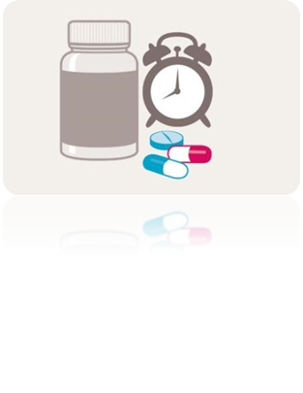
Post-Neonatal Meningitis (Treatment):
Dexamethasone (0.15 mg/kg IV q 6 hrs.) should be given 15 min before the 1st dose of antibiotics and continued for 4 days .
It may prevent hearing loss and other neurologic sequelae , possibly by inhibiting release of proinflammatory cytokines triggered by antibiotic-induced bacterial lysis.
Dexamethasone should not be given to patients with immunodeficiency because it may impair host defenses against non-bacterial meningitis.

Slide 50
Post-Neonatal Meningitis (Treatment):
A- 3 generation cephalosporin
(Cefotaxime or ceftriaxone)
B- vancomycin

Slide 51
Post-Neonatal Meningitis (Treatment Duration)
Generally :
If N .MENINGITIDS : 5 -7 DAYS .
IF H.INFLUENZA : 7- 10 DAYS .
PNEUMPCOCUS : 10 – 14 DAYS .
- Drug doses are not reduced when clinical improvement occurs because drug penetration commonly decreases as meningeal inflammation decreases .

Slide 52
Post-Neonatal Meningitis (Prevention):
A conjugated pneumococcal vaccine effective against 7 serotypes , including > 80% of organisms that cause meningitis is recommended for all children .
It is recommended for children aged 2 - 23 mo.
Prevnar , peumovax …….

Slide 53
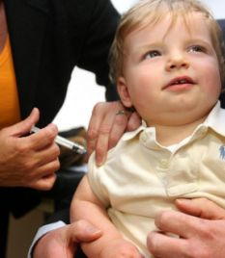
Post-Neonatal Meningitis (Prevention):
Routine vaccination for H.influenza type b is highly effective and begins at age of 2 months .
a quadrivalent meningococcal vaccine is given to children > 2 years with immunodeficiency or functional asplenia .

Slide 54
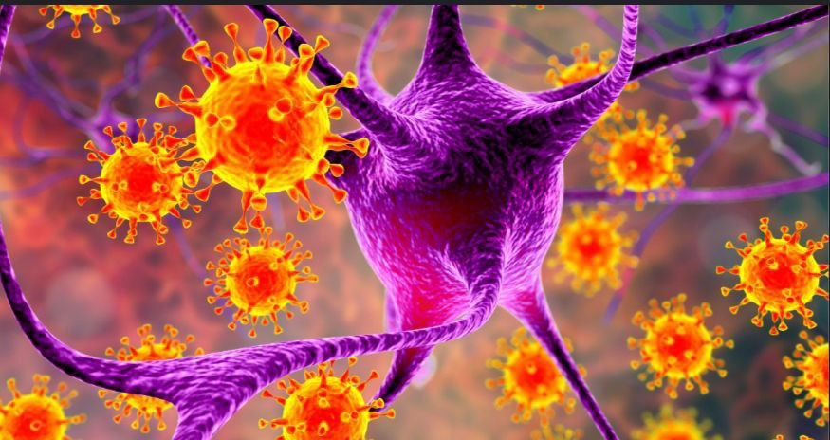
Aseptic meningitis

Slide 55
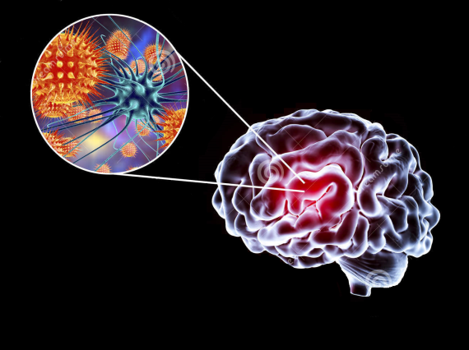
Aseptic meningitis definition:
* A syndrome characterised by acute onset of meningeal symptoms and fever, with pleocytosis of the cerebrospinal fluid and no growth on routine bacterial.
* All non-bacterial causes of meningitis .. Viral (Most common) , fungi , TP , drug induce

Slide 56
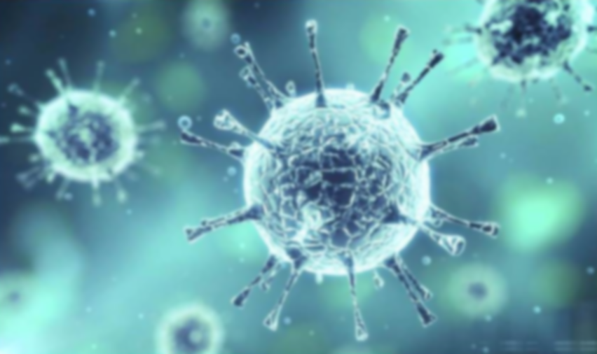
Viral meningitis
* Most common
* Typically less ill appearing than bacterial meningitis
* Viral meningitis can occur at any age but is most common in young children. Usually affected children under 5 years of age and infant < 1 month
* most patients usually cure without treatment .

Slide 57
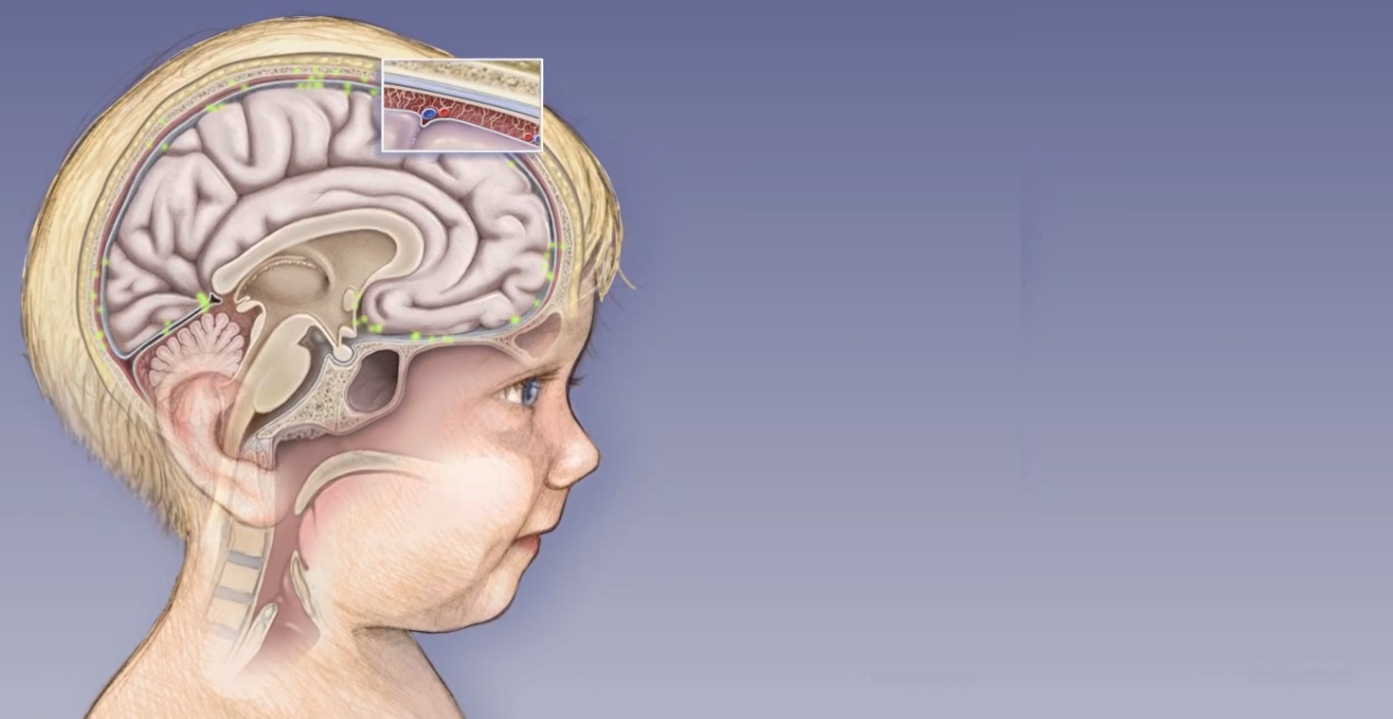
The most common cause of viral meningitis:
Mump & measles viruses
Enteroviruses
Herpes virus
HIV

Slide 58
Viral meningitis is common and often goes unreported.
In the absence of a LP, viral and bacterial meningitis cannot be differentiated with certainty, and all suspected cases should therefore be referred.
LP & analysis of cerebrospinal fluid may be done primarily to exclude bacterial meningitis, but identification of the specific viral cause is itself beneficial.

Slide 59
`
diagnosis:
1- informs prognosis 2-enhances care of the patient 3-reduces the use of antibiotics 4-decreases length of stay in hospital 5- help to prevent further spread of infection.

Slide 60
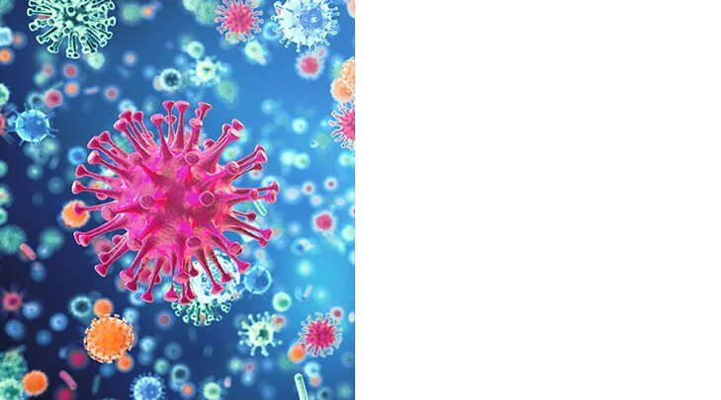
What is the initial approach to the patient?
1) Clinically Viral meningitis and bacterial meningitis are both characterized by acute onset of fever, headache, photophobia, and neck stiffness, often accompanied by nausea and vomiting.
Untreated patients with bacterial meningitis show progressive deterioration in mental status, whereas spontaneous recovery is usual in viral cases.

Slide 61
Particular caution is warranted with young children < 1 year , in whom meningitis is manifest as fever and irritability, without, as a rule, evidence of meningeal irritation.
Assessment should include evaluation for possible encephalitis, suggested by seizures, reduced Glasgow coma score, or focal neurological signs.
2) Physical examination

Slide 62
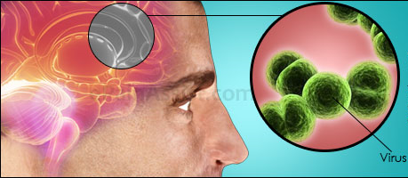
Suspected encephalitis warrants empirical antiviral treatment with intravenous aciclovir.

Slide 63
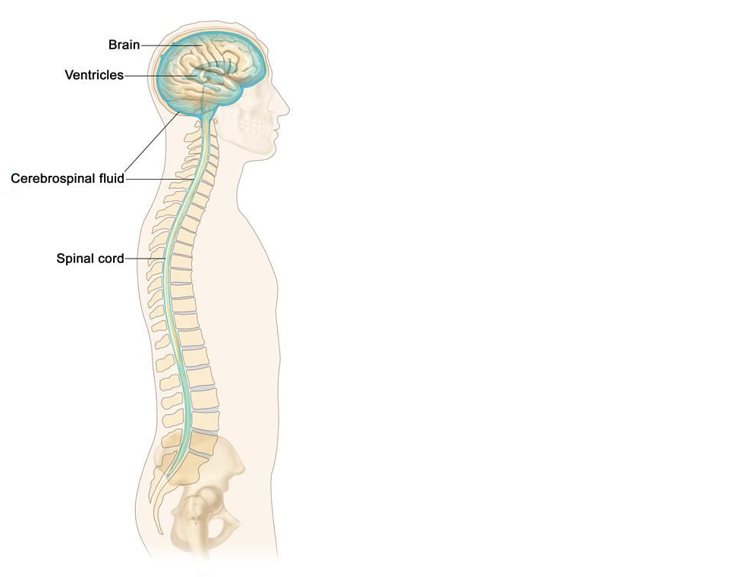
3) LP , CSF analysis
CSF needs to be processed promptly to avoid depletion of cell counts during transport or storage.
Although characteristically associated with a mononuclear pleocytosis, neutrophils may predominate initially in viral meningitis

Slide 64
CSF finding
turbid
clear

Slide 65
The usual initial approach to viral diagnosis is to test the CSF for enteroviruses, HSV, varicella zoster virus by using PCR technology, estimated to be threefold to 1000-fold more sensitive than routine viral culture.
identification of a viral cause has been shown to be beneficial, facilitating reduced administration of antibiotics and decreased length of stay in hospital.

Slide 66
TREATMENT
* Most patients who get viral meningitis completely recover
* Supportive .
* Herpesvirusis acyclovir

