Slide 1
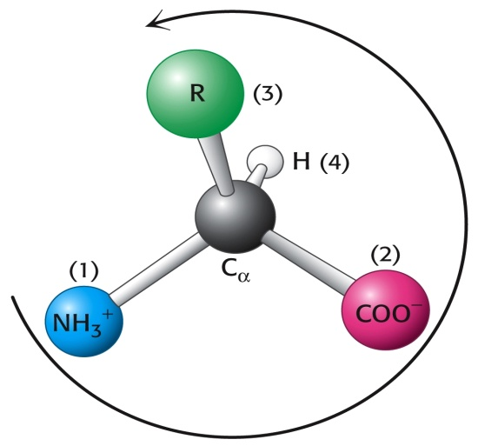
Amino Acids 1
Dr. Nesrin Mwafi
Biochemistry & Molecular Biology Department
Faculty of Medicine, Mutah University

Slide 2
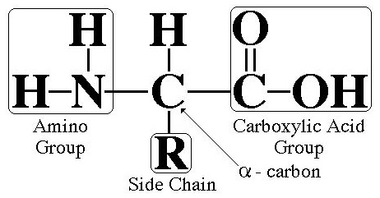
Amino Acid Structure
Amino acids are biologically important organic molecules that contain both carboxylic acid (-COOH) as well as amine (-NH₂) groups
The side-chain also called “R” group is specific to each amino acid
Amino group is attached to α-carbon
C, N, O and H are the key elements of amino acids

Slide 3
Biological significance of Amino Acids
Amino acids are N-containing molecules
The basic structural building units (monomers) of proteins
Precursors of many biomolecules like neurotransmitters (non-protein role)
They are also utilized as an energy source
There are 20 standard (canonical) amino acids which are encoded directly by triplet codons in the genetic code during protein synthesis process (mRNA translation)

Slide 4
Genetic Code Table
The 20 standard
amino acids are known
as proteinogenic or
natural amino acids

Slide 5
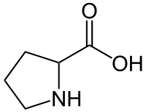
Standard Amino Acids
They are proteinogenic and natural amino acids (the other proteinogenic amino acids N-formyl methionine, pyrrolysine and selenocysteine are called non-standard or non-canonical amino acids)
Known as 2-, alpha- or α-amino acids as the primary amino group (-NH₂) is attached to α-carbon (the carbon next to –COOH group). Proline is an exception which has a secondary amino group (-NH-)
α-carbon
proline

Slide 6
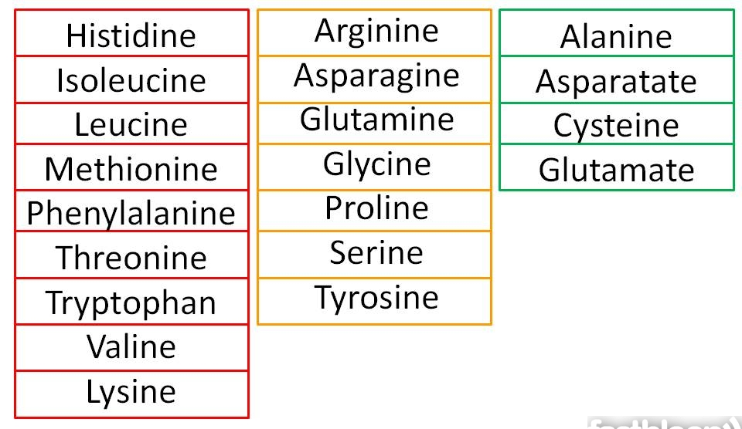
Standard Amino Acids List

Slide 7
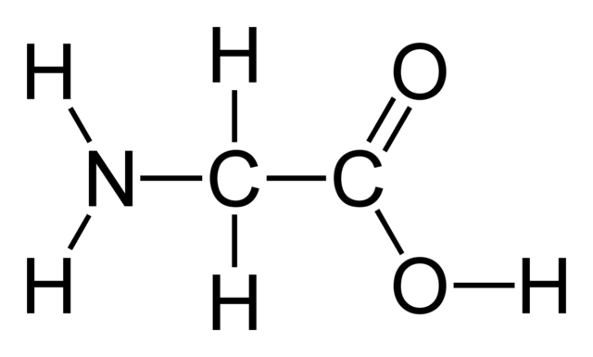
Standard Amino Acids
They are all chiral molecules (except glycine which has achiral C) with L- stereochemical configuration (left-handed isomers)
Chiral carbon: asymmetric carbon atom attached to 4 different groups of atoms
Glycine

Slide 8
Isomerization
Isomers: are molecules with same molecular
formula but different chemical structures
Constitutional (structural) isomers: atoms and functional groups bind together in different ways
Stereoisomers (spatial isomers): differ in the configuration of atoms rather than the order of atomic connectivity

Slide 9
D/L Amino Acids
Enantiomers: are two stereoisomers that are mirror images to each other but not superimposable
D- (dexter)/L- (laevus) Nomenclature system: commonly used to assign the configurations in sugars (carbohydrates) and amino acids
As a rule of thumb: if the amino group is on the right side of α-carbon at Fisher projection , the configuration is D. If it is on the left, the configuration is L.

Slide 10
Fischer Projections of Amino Acids
Fisher Projection: is one way commonly used to represent the structure of chiral molecules like carbohydrates and amino acids
mirror
mirror
L-alanine D-alanine
L-cysteine D-cysteine

Slide 11
D/L Amino Acids
Most naturally occurring sugars are D-isomers while most naturally occurring amino acids are L-isomers (amino acids of protein)
D-amino acids polypeptides (right-handed isomers) are components of bacterial cell walls to resist digestion by other organisms

Slide 12
3D and Fischer Projection
mirror
COOH
COOH
H₂N
H
H
H₂N
CH₃
CH₃
COOH
COOH
H₂N
H
H
H₂N
CH₃
CH₃
L-alanine D-alanine

Slide 13
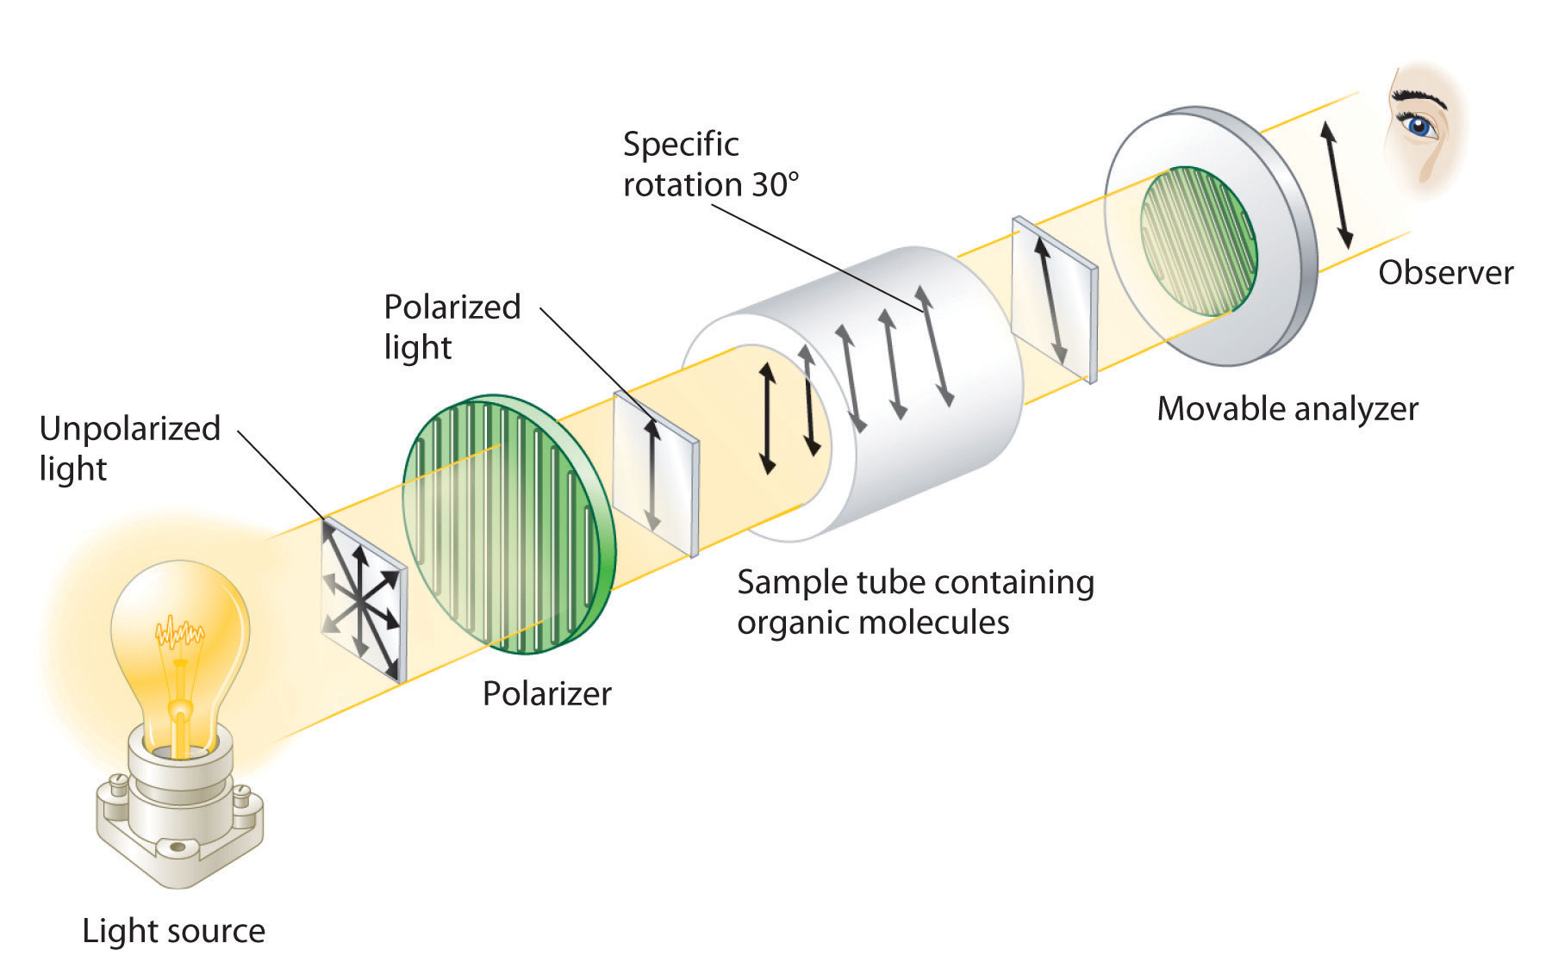
Optical Activity
Enantiomers are optically active and can rotate the polarized light plane either clockwise or counterclockwise
Polarimeter is used to measure optical rotation

Slide 14
Optical Activity
(+)/(-) nomenclature system: if one enantiomer rotates the light clockwise, it is labeled (+) or (d) (dextrorotatory). The second mirror image enantiomer is labeled (-) or (l) laevorotatory
D/L system should not be confused with +/- or d/l system. For example, D-isomer might be levorotatory
9 of 19 L-amino acids commonly found in proteins are dextrorotatory
Racemic mixture contains equal amounts of each enantiomer

Slide 15
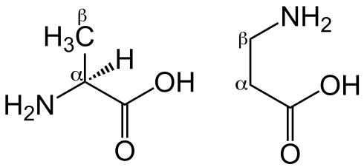
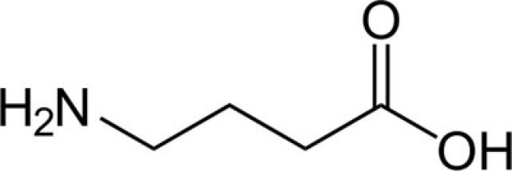
Classification of Amino Acids
>300 amino acids classified in many ways:
Proteinogenic (natural) and non-proteinogenic (not natural) amino acids (either have non-protein role like GABA and carnitine or formed by post-translational modification of protein like hydroxyproline )
Standard and non-standard amino acids
α, β, γ and δ amino acids
β
γ
α
α-alanine β-alanine
γ-aminobutyric acid (GABA)

Slide 16
Classification of Amino Acids
β-amino acids are non-proteinogenic with β-alanine is the only common naturally occurring β-amino acid. β-alanine is used in plants and microorganisms in the synthesis of pantothenic acid (vitamin B₅)
β-peptides are artificial peptides used in some antibiotics to counter resistance as they are more stable against proteolytic degradation

Slide 17
Categories of Standard Amino Acids
The 20 standard amino acids are classified into 3 major categories according to the polarities of their “R” groups:
Amino acids with non-polar R groups
Amino acids with charged polar R groups
Amino acids with uncharged polar R groups

Slide 18
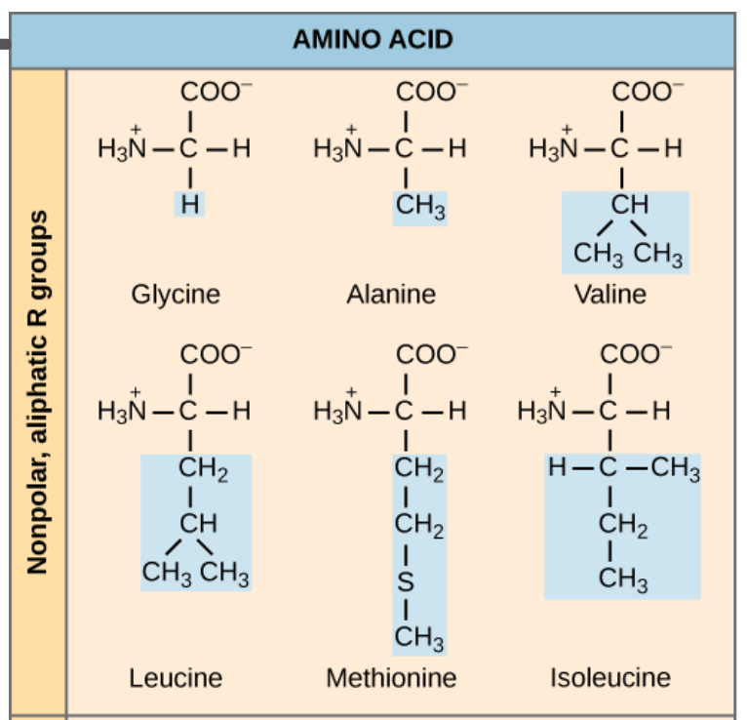
Amino acids with non-polar R groups
6 amino acids with aliphatic, 2 with aromatic and one with cyclic side chains
Nonpolar, cyclic R group

Slide 19
Amino acids with non-polar R groups
Glycine has the simplest side chain: H atom
Alanine, valine, leucine and isoleucine have aliphatic hydrocarbon side chains
Methionine has a thioether side chain (sulfur atom)
Proline has a cyclic pyrrolidine side chain
Phenylalanine has a phenyl moiety
Tryptophan has an indole group

Slide 20
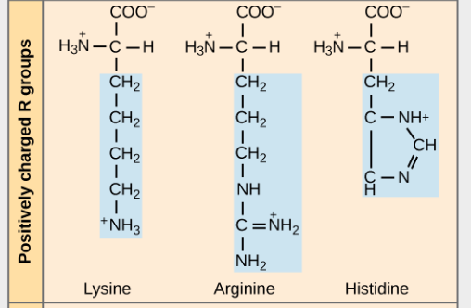
Amino acids with charged polar R groups
3 amino acids are positively charged (basic) and 2 amino acids are negatively charged (acidic)

Slide 21
Amino acids with charged polar R groups
Arginine has a guanidine group
Lysine has a butyl ammonium side chain
Histidine has imidazole group
Aspartic and glutamic acids in their ionized state are called aspartate and glutamate, respectively

Slide 22
Amino acids with uncharged polar R groups
6 amino acids with hydroxyl, amide or thiol groups

Slide 23
Amino acids with uncharged polar R groups
Serine and threonine bear hydroxyl (-OH) R group
Asparagine and glutamine have amide bearing side chains. They are the amide derivatives of aspartic and glutamic acids
Tyrosine is aromatic and has a phenolic group
Cysteine has a thiol group that can form a disulfide bond (-S-S-) with another cysteine through the oxidation of 2 thiol groups (cystine is the oxidized dimeric form). The disulfide bridge in proteins contributes to the overall shape of a protein

Slide 24
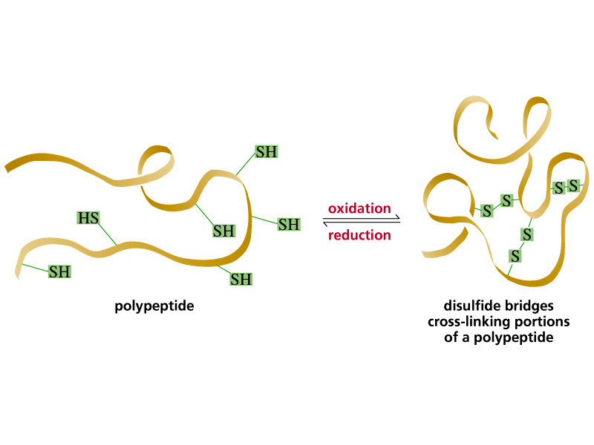
Amino acids with uncharged polar R groups
Disulfide bond is a covalent linkage formed from the sulfhydryl group (SH) of each of two cysteine residues to produce a cystine residues
Cysteine residues may be separated from each other by many amino acids in the primary sequence of a polypeptide (intramolecular) or may even be located on two different polypeptide chains (intermolecular). The folding of the polypeptide chain(s) brings the cysteine residues into proximity and permits covalent bonding of their side chains.

Slide 25
Amino Acids Abbreviations
3-letters
1-letter
Amino acid

Slide 26
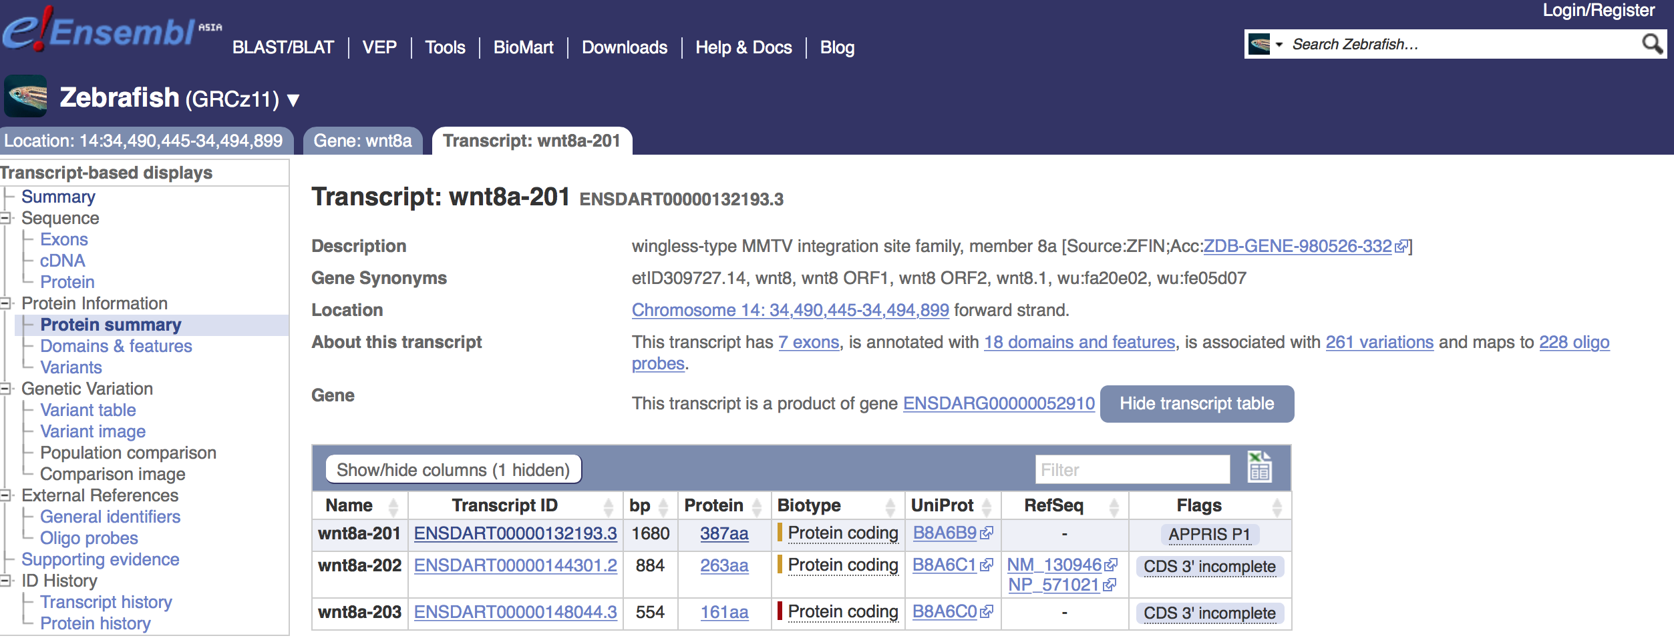
Ensembl (Genomic Browser )

Slide 27
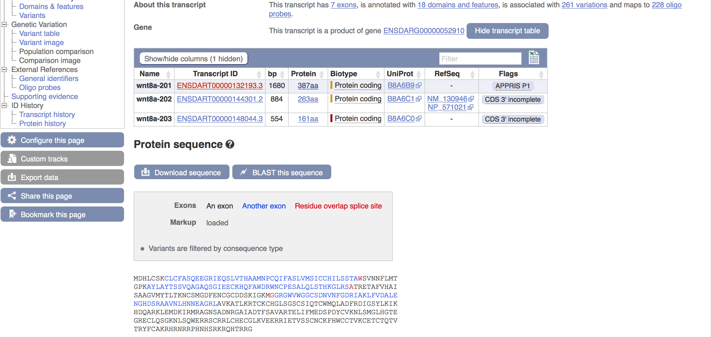
Ensembl (Genomic Browser )

