Slide 1
Head and Neck
Lecture 2
Mandible,Face, and scalp
Dr Omar Alrawashdeh

Slide 2
The mandible
The mandible is the largest and strongest bone of the face
It is composed of two parts; the body and the rami
The body has two surface (external and internal) and two borders (The superior border (alveolar) and inferior borders)

Slide 3
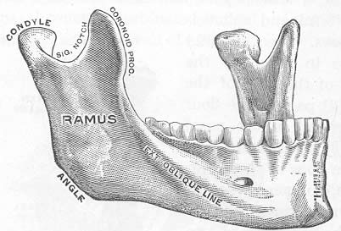

Slide 4
The external surface landmarks
The symphysis of the mandible (The median line anteriorly, indicating the line of fusion of the two sides)
The mental protuberance: at the lower end of the symphysis and has a depressed centre and elevated sides called mental tubercle.
The incisive fossa, is located above the mental tubercle
The mental foramen: located at the level of the premolar teeth on both sides for the passage of the mental nerve and vessels
The oblique lines: run from the mental tubercles posterior and superior to become continuous with the anterior border of the ramus

Slide 5
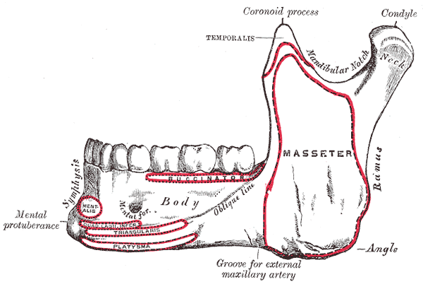

Slide 6
The internal surface landmarks
The mental spines: at the lower part of the symphysis from the inner side (attachment for tongue muscles).
Below the mental spines is the insertion of the digastric muscle.
Mylohyoid line extends upward and backward on the inner side (gives origin to the mylohyoideus)
Above the anterior third of the mylohyoid line is a fossa for the sublingual gland
Below the posterior two thirds of the line is a fossa for the submaxillary glands.

Slide 7
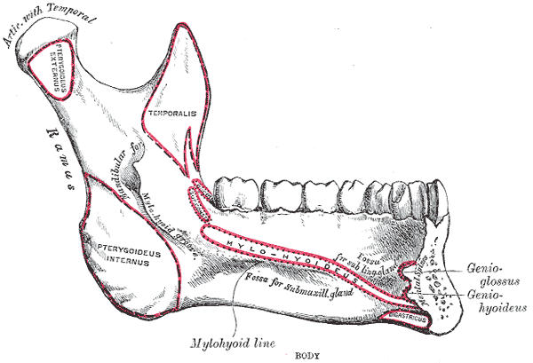

Slide 8
The mandibular ramus
The external surface gives attachment to the masseter muscle
The medial surface:
The mandibular foramen (at the centre of the medial surface (for the entrance of the inferior alveolar vessels and nerves)
Lingula, a ridge that serve as an attachment to a ligament
The myelohyoid groove run from the mandibular foramen margin downward and forward.
Behind the groove is a rough area for the insertion of the medial pterygoid muscle.
The mandibular canal run obliquely then horizontally from the mandibular foramen to the mental foramen.

Slide 10
The mandibular ramus
The lower border is continuous with the lower border of the body at the angle of the mandible
The anterior border is thin and continuous with the oblique line
The posterior border is thick, rounded, and smooth. It covered with the parotid gland.
The superior border (mandibular notch) lies between the coronoid and condyloid processes.

Slide 12
The mandibular ramus
The coronoid process is an ansertion of the temporalis and masseter muslces.
The condyloid process is the articulating portion for the temporomandibular joint (it has head and neck)
The neck of the condyloid process provides attachment to the lateral pterygoid muscle.

Slide 13
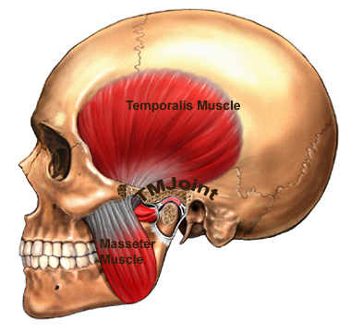

Slide 14
The TMJ
The TMJ is a synovial joint between the condyloid process of the mandible and the mandibular fossa of the temporal bone.
It is supported by the sphenomandibular, stylomandibular ligaments

Slide 15
The scalp
Formed of 5 layers:
Skin, thick with numerous sebaceous glands
Connective tissue: connects the skin to the underlying layer (aponeurosis). This layer is rich in blood vessels.
Aponeurosis of the occipitofrontlis muscle.
Loose areolar tissue, which loosely connects the above layer with the pericraneum. It contains emissary veins, which are valveless veins that anastomose with intracranial venous sinuses.
The pericranium: It is the periosteum that covers the skull bones.

Slide 16
Muscles of the scalp
*Occipitofrontalis
Occipital belly from the superior nuchal line to the aponeurosis (glia aponeurotica).
Frontal belly from the fascia above the eyes and nose to the aponeurosis.
Both bellies are supplied by the facial nerve via the temporal and posterior auricular branches.

Slide 17
Sensation from the scalp
Branches from the trigeminal nerve
The lesser occipital nerve, a branch of the cervical plexus (C2), supplies the scalp over the lateral part of the occipital region and the skin over the medial surface of the auricle.
The greater occipital nerve, a branch of the posterior ramus of the second cervical nerve, ascends over the back of the scalp and supplies the skin of that area.

Slide 18
Arterial supply of the scalp
The supratrochlear and the supraorbital arteries, branches of the ophthalmic artery
The superficial temporal artery, the smaller terminal branch of the external carotid artery.
The posterior auricular artery, a branch of the external carotid artery.
The occipital artery, a branch of the external carotid artery,

Slide 19
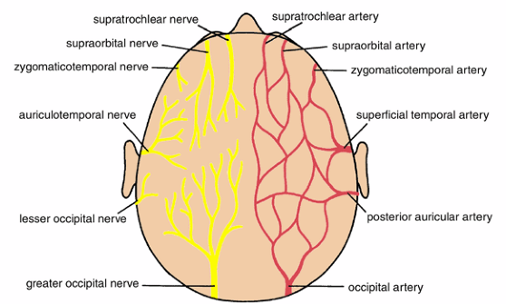

Slide 20
The face
The skin of the face is connected to the underlying bone by loose connective tissue, there is no deep fascia in the face
Muscles of facial expression insert into the skin and affect wrinkle lines.

Slide 21
Sensation from the face
The skin of the face is supplied by the three branches of the trigeminal nerve.
The trigeminal nerve also carried proprioception from the muscles of facial expression.
The area of the angle of the mandible is supplied by the great auricular nerve (C2-C3).

Slide 22
The ophthalmic nerve
The lacrimal nerve supplies the skin and conjunctiva of the lateral part of the upper eyelid
The supraorbital nerve supplies the skin and conjunctiva on the central part of the upper eyelid and the skin of the forehead.
The supratrochlear nerve supplies the skin and conjunctiva on the medial part of the upper eyelid and the skin over the lower part of the forehead, close to the median plane.
The infratrochlear nerve supplies the skin and conjunctiva on the medial part of the upper eyelid and the adjoining part of the side of the nose
The external nasal nerve supplies the skin on the side of the nose down as far as the tip

Slide 23
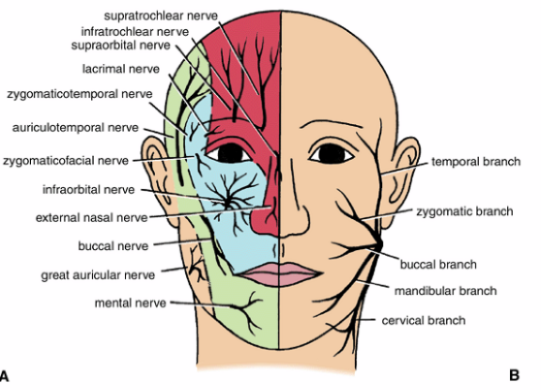

Slide 24
The maxillary nerve
The infraorbital nerve divides into numerous small branches to supply the skin of the lower eyelid and cheek, the side of the nose, and the upper lip.
The zygomaticofacial nerve supplies the skin over the prominence of the cheek.
The zygomaticotemporal nerve supplies the skin over the temple.

Slide 26
The mandibular nerve
The mental nerve supplies the skin of the lower lip and chin.
The buccal nerve supplies the skin over the cheek
The auriculotemporal nerve supplies the skin of the auricle, the external auditory meatus, the outer surface of the tympanic membrane, and the skin of the scalp above the auricle

Slide 28
Muscles of the face
All the muscles of the face are derived from the second pharyngeal arch
All of the facial muscles are supplied by the facial nerve.
Muscles of the face modify facial expression and control the face orifices, such as the mouth, the eyes and the nose.

Slide 29
Muscles of the eyelid
Orbicularis oculi: closes the eye
Levator palpebrae superioris: opens the eyes
Occipitofrontalis: assists in opening the eyes.
Corrugator supercilli: pulls the eyebrows toward the nose.

Slide 30
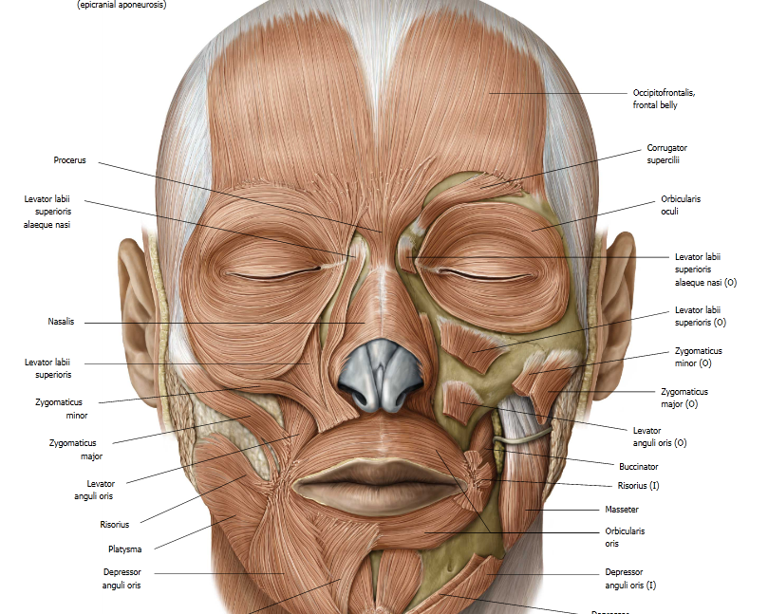

Slide 31
Muscles of the nostrils
The sphincter muscles is the compressor naris
The dilator muscle is the dilator naris

Slide 33
Muscles of the lips
Orbicularis oris is the sphincter muscle of the lip. It arises from the maxilla and the mandible.
Dilator muscles of the lips include Levator labii superioris, Zygomaticus minor, Zygomaticus major, Levator anguli oris (deep to the zygomatic muscles), Risorius, Depressor anguli oris, Depressor labii inferioris, Mentalis (no need to memorise them)

Slide 34
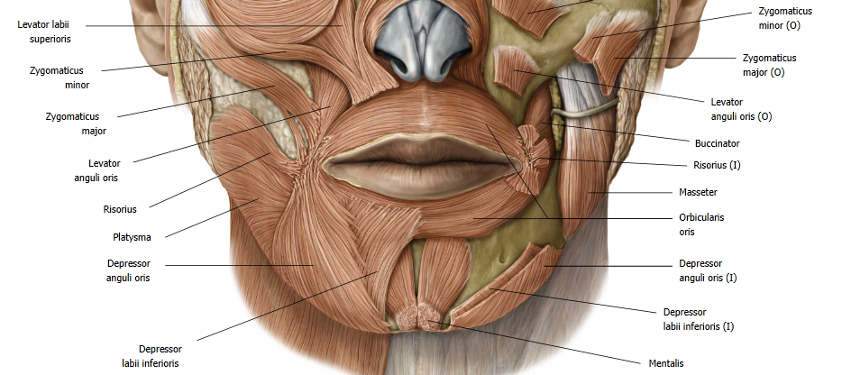

Slide 35
Muscles of the cheek
The buccinator originates from the alveolar process of the maxilla and the mandible at the level of the molar teeth and also have origin from the pterygomandibular ligament.
Fibers of the buccinator muscle pass forward and insert at the upper and lower lips.
The muscle compresses the cheeks and the lips against the teeth.

Slide 36
