Slide 1
Acyanotic heart disease

Slide 2
Incidence:
Incidence is 8/1000 live births (1%)
35,000 Patients born with CHD/year
11,000 Newborn Interventions/year
Risk of an infant with CHD increases with subsequent pregnancy (3%).
If the parent has CHD (10-15%)

Slide 3
Cardiac presentation:
Pre-Natal Diagnosis
Heart Murmur
Critical lesion
CHF
Arrythmia

Slide 4
Excessive Pulmonary Blood flow:
Clinical Findings
Tachypnea/Dyspnea
Failure to thrive
Murmur
Cardiac Chamber Enlargement
Frequent respiratory infections
Pulmonary Vascular Disease

Slide 5
Ductal dependant lesions
CoA/IAA
AS
TS/TA
TAPVR
Hyopplastic left heart
Presentation: Early presentation, tackycardia, tackypnea, poor perfusion, weak pulse an BP, Pulmonary edema, cardiomegaly, hepatomegaly

Slide 6
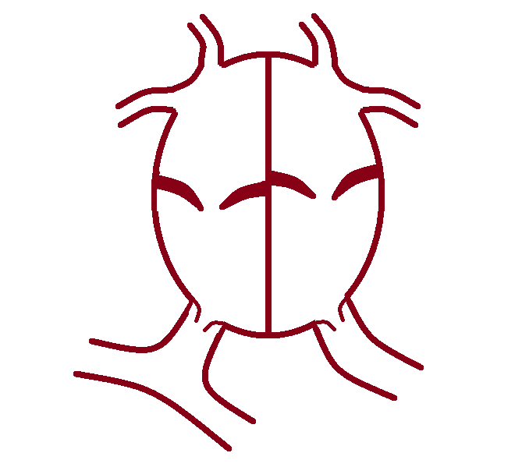
70%
100%
70%
70%
100%
RA
LA
RV
LV
100%
80%
80%
100%

Slide 7
Clinical findings of HFs:
Poor feeding
Growth failure
Sweating
Tachycardia
Cardiomegaly
Gallop rhythm

Slide 8
Pulmonary congestion (edema):
Tachypnea
Wheezing
Rales
Dyspnea
Cough
Cyanosis

Slide 9
Systemic venous congestion:
Hepatomegaly
Neck vein distension
Peripheral edema
Notes:
dependant

Slide 10
Cyanosis in the Newborn Cyanotic Congenital Heart Disease

Slide 11
Evaluation of CHD patients
History
Physical examination
ECG
CXR
Blood gases
Hyperoxia test
Echocardiogram
Cardiac catheterization
CT angiogram
MRI

Slide 12
Hyperoxia Test
Done when patient is cyanotic
R. Arterial PaO2 by ABG while patient is breathing room air
R. Arterial PaO2 by ABG after inhaling 100% O2 for 10 minutes
pO2 < 100; cyanotic CHD likely
pO2 100-250; cyanotic CHD possible
pO2 > 250; cyanotic CHD unlikely
A “failed” hyperoxia test is a neonatal emergency - urgent intervention.

Slide 13
Classifying CHD Lesions
Often classifieds as
Acyanotic lesions
Cyanotic lesions

Slide 14
Acyanotic Lesions
Ventricular Septal Defect (VSD)
Atrial Septal Defect (ASD)
Patent Ductus Arteriosus (PDA)
Atrioventricular Septal Defect (AVSD)
Aortic Stenosis (AS)
Coarctation of the Aorta

Slide 15
Cyanotic Lesions
Truncus Arteriosus
Transposition of the Great Arteries (TGA)
Tricuspid Atresia
Tetralogy of Fallot
Total Anomalous Pulmonary Venous Return (TAPVR)
Uncommon : pulmonary atresia, Ebstein’s anomaly, single ventricle, double outlet right ventricle

Slide 16
Classifying by blood flow physiology
Excessive Pulmonary Blood Flow:
VSD, ASD, PDA
Inadequate Pulmonary Blood Flow:
Tetralogy of Fallot
Inadequate or obstruction to systemic Blood flow:
HLH, Coarctation of Aorta
Abnormal Mixing:
TGA

Slide 17
Ventricular septal defect
It is the most common form of CHD 20%
Almost the same in males and females
Notes:
Same sex

Slide 18
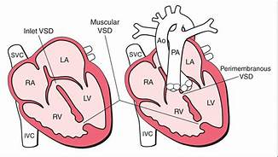
Perimemranous 80%: high rate of clousure
Muscular 15%: close spontaneously
Inlet with AV canal (5%)
Supracristal
Notes:
Embryo: fusion of bullous cordis and common ventricle then development of septum
Septum : muscular (from apex toward cushion leaving interventricular foramen) +
membranous( migration of n. crest from cushion to close foramen)

Slide 19
70%
100%
70%
70%
100%
RA
LA
3
6
RV
LV
6
3+3
100%
80%
3
85%
100%
6

Slide 20
VSD – pathophysiology:
Increase PBF
Pressure overload on LV
Volume overload on RV
Esinmenger
Notes:
RA not affected

Slide 25
Natural History
Murmur:
Soft low pitched: large defect
Loud high pitched: small defect
Heart failure at 1- 2 Months: poor feeding, rapid breathing, poor weight gain

Slide 26
Physical exam
Pansystolic murmur on LLSB
Loud S2: pulmonary HTN
If Qp:QA more 2:1 Diastolic rumble at mitral area

Slide 27
ECG and CXR
ECG: small VSD→ normal,
med VSD → LVH +/- LAE
large VSD→ BVH +/- LAE
LAD
Notes:
BVH = PpHN or PS

Slide 31
Prognosis
Muscular type closes alone in 80%
Perimembranous 35% before 4 year
Cath closure if:
2:1 Qp:QA
CHF
FTT
Esinmeger
Other types of VSD

Slide 32
ASD Acyanotic Lesion with increased pulm blood flow
10% of CHD
20% adult presentation
Female : male 3:1
Holt oram syndrome:
ASD
1st degree block
Absent radii

Slide 34
Types
Secondum (75%): located at fossa ovalis, may by associated with mitral valve prolapse, may close alone
Premium (15%): part of AV canal, associated with cleft anterior leaflet MV, doesn’t close alone
Sinus venosus (10%): upper part of septum, associated with PAPVR
Notes:
Secondum : high absorption of s.premium or def of septum secondum
Premium : VSD
Posteroinferior: absent coronary sinus+ lt svc to to LA

Slide 37
70%
100%
70%
80%
100%
RA
LA
6
3+3
3
RV
LV
3
3
100%
80%
3
85%
100%
6
Notes:
Volume overloads: dilataion right side
Low pressure lesion , so PA pressure rare
All affected except LV

Slide 38
Clinical
Normal growth in most cases
Prominent RV impulse
Fixed wide splitting of S2
ESM at left upper sternal border
Notes:
Fixed: continuous flow on pulmonary valve
Esm: pulmonay flow
Diastolic rumble: flow at TV
Adult: flutter, A fib
MR with premium

Slide 42
ECG
ECG:
small ASD→ normal
hemodynamically signify ASD →RAD
or RBBB
Notes:
LAD: premium

Slide 43
Treatment
Closure if:
Not secondum
Right side dilataion
QP:QS 2:1
Notes:
Complication: arrythmia, embllism,

Slide 46
PDA Acyanotic Lesion with increased pulm blood flow
Notes:
Functional closure at 10-15 hrs, anatomic at 3 wks
More with premature
RDS, inceased fluid, sepsis, prom
Decreasing : steroid, HTN mother
Pulmonary to descending aorta, ligamentum arteriosum
PG PGE2 by placenta and

Slide 47
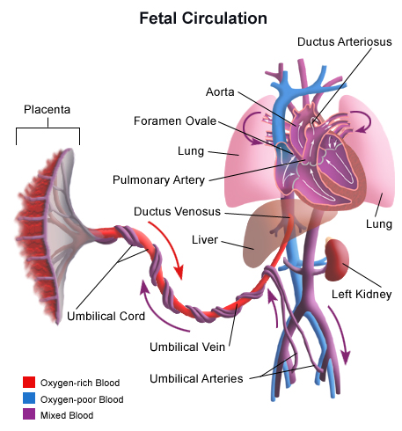

Slide 51
Notes:
Fetal : high sat in UV and venous nenosus 80%, IVC 26%,
SVC 40%,
,
All to RA, RV to PA whicj high prssure, so shunt to DA to descending aorta(60
At birth increased PVR, losss of placenta, raise aortic pressure, lower PA pressure,
Reversal of pressure

Slide 52
70%
100%
70%
70%
100%
RA
LA
RV
LV
100%
70%
80%
100%
Notes:
Worse than vsd, shunting all the cycle

Slide 53
PDA Acyanotic Lesion with increased pulm blood flow
Exam:
Bounding collapsing pulse
Wide pulse pressure
1-4 continuous “machinery-like” murmur loudest at LUSB
Congestive Heart failure
ECG:
Small to moderate PDA: Normal or LVH
Large PDA: BVH
CXR:
Possible cardiomegaly with increased pulmonary vascular markings
More common in premature infants
Notes:
Bounding collapsing pulse,
Wide pulse presuure
,achinary murmur LUSB, silent if large
+- mid diastolic murmur: mitrsl
Pulmonry: tackycardia and tackypnea, low sat
ECG: LVH, folllowed by RVH

Slide 54
Notes:
Tx: decrease fluid intske, peep, ؤ

Slide 55
Treatment
Decrease fluid input
Indomethacin
Inhibiting COX enyme, decreasing PG level
SE: oliguria, high creatinine, GI bleeding
Ibuprufen = same mechanism
Paracetalmol
Notes:
Revanin rescue if endo failed, high liver enymes
Surgical if > 5 mm, comp: vocal cord, diaphragmatic hernia, CLD, neuro

Slide 56
Complications
CHF
Pulmonary hmg
Oliguria, raising creatinine
FTT
Eisenmenger syndrome
Notes:
Inceases risk of IVH, pulm hmg, oliguria, high creatinine

Slide 57
AVSD Acyanotic Lesion with increased pulm blood flow
Exam:
Hyperactive precordium with systolic thrill at LLSB and loud S2
Possible holosystolic regurgitant murmur (MR)
Possible middiastolic rumble
ECG:
Superior QRS axis
possible RVH and LVH
CXR:
Cardiomegaly with increased pulmonary vascular markings
30-60% occur in Down Syndrome
Notes:
Most common in down
HF, PPHN, eisenmenger
S2 = high, PHTN,
Pulm systolic murmur, mid diastolic rumble = LLSB
+-MR
LAD, RBBB
CXR = biventricular megaly
Tx: HF, surgery at 6-12 m

Slide 59
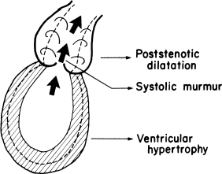
Obstruction to Ventricular Output
AS, and COA. These lesions produce the following three pathophysiologic changes:
1. Ejection systolic murmur
2. Hypertrophy of the LV
3. Poststenotic dilatation ( seen in CXR)

Slide 60
Aortic Stenosis

Slide 61
Aortic Stenosis PREVALENCE
3% to 6% of all patients with CHD,
male-female ratio of 4:1
Approximately 70% to 85% of stenotic valves are bicuspid.
Notes:
Decreased flow , increased pressure gradient across valce, LV concentric hypertrophy, decreased comp;ience
Increased ESV, then EDV decrease, SV decrease

Slide 62
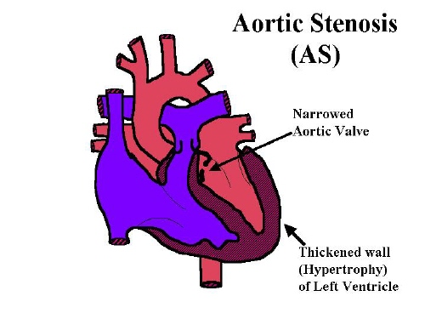
Stenosis may be at the
Valvular (71%)
Subvalvular (23%)
Supravalvular (6%) level
Notes:
Valvular: bicuspid, and rarely monocuspid (most severe)

Slide 63
Anatomic types of AS
Anatomic types of aortic stenosis. A, Normal. B, Valvular stenosis. C, Supravalvular stenosis. D, Discrete subaortic stenosis. E, Idiopathic hypertrophic subaortic stenosi
Notes:
Subvalvular: may have vsd, shone complex

Slide 64
Supravalvular AS
Annular constriction above the aortic valve
.
Occasionally, the ascending aorta is diffusely hypoplastic.
Associated with Williams syndrome.

Slide 65
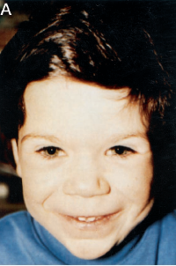
William’s Syndrome
Includes mental retardation, elfin facies, hypercalcemia and AS
Micro deletion of elastin gene on chromosome 7 q11.23
Notes:
Long upper lip , flat n. bridge
Broad forehead , Full face, round cheecks,
Stenosis of PA branch

Slide 66
CLINICAL MANIFESTATIONS
History
Most children with mild to moderate AS are asymptomatic. Occasionally, exercise intolerance may be present.
Exertional chest pain, easy fatigability, or syncope may occur with a severe degree of obstruction.
Infants with critical stenosis of the aortic valve may develop CHF within the first few weeks to months of life.
Infective endocarditis may be the presenting diagnosis in 4% of cases
Notes:
Endcarditis: bicuspid
Critical: born normally, sudden decrease in feeding, irritability sob, pallor, tacky, diminshed pulses, cold extremities, P.edema

Slide 67
Critical AS
Newborns with critical AS
may develop CHF triggered by ductal constriction.
The clinical picture may mimic overwhelming sepsis with low cardiac output.
the peripheral pulses are weak and thready.
The heart murmur becomes louder when CHF improves.

Slide 68
Physical Examination
Patients are acyanotic
Blood pressure is normal in most patients.
Narrow pulse pressure is present in severe AS
Small and slowly rising pulse
systolic thrill may be palpable at the upper right
sternal border, in the suprasternal notch, or over
the carotid arteries.
.
Notes:
Small rising pulse,
Thrill, palpable murmur in aortic area

Slide 69
Physical Examination
Soft S1-S2
The S2 splits a bit narrowly.
The S2 may split paradoxically in severe AS.
An ejection click may be heard with valvular AS
Ejection systolic murmur heard at the second right or left intercostal space, with transmission to the neck and apex.
Notes:
Soft S1 non complient LV
Soft s2 esp calcified
Severe murmur louder, peak later
Increased murmur with squatting, supine , vc

Slide 70
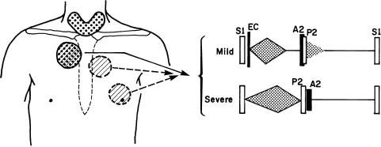
Cardiac findings of aortic valve stenosis. Abnormal sounds are indicated in black. Systolic thrill may be present in areas with dots.
EC, ejection click

Slide 71
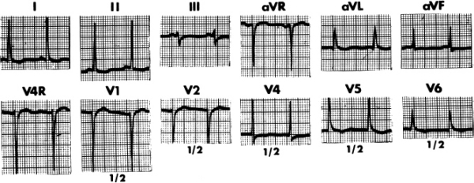
Electrocardiography.
In mild cases the ECG is normal.
LVH may be present in severe cases
Notes:
deep s v1, more 16 mm, r wave in v6 more24 mm
T inversion in left leads

Slide 72
X-ray Studies
1. dilated ascending aorta
2. Significant cardiomegaly does not develop unless CHF occurs later in life
3. Newborns with critical AS show generalized cardiomegaly
with pulmonary venous congestion
Notes:
Post stenotic dilataion

Slide 73
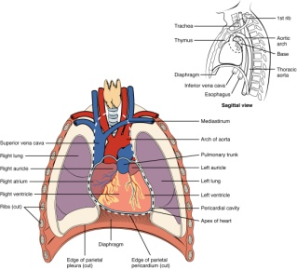
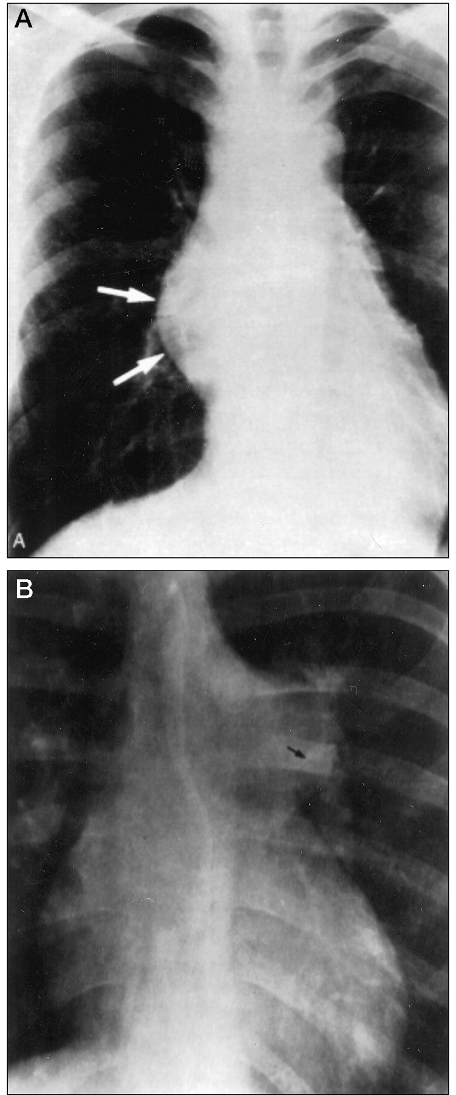
Poststenotic dilation of ascending aorta (A) and
Mack, G. et al. Pediatrics in Review 2000;21:79-85
Copyright ©2000 American Academy of Pediatrics

Slide 74
NATURAL HISTORY Summary
1. Chest pain, syncope, and even sudden
death (1% to 2% of cases) may occur in children with
severe AS.
2. Heart failure occurs with severe AS during the newborn
period or later in adult life.
4. The stenosis may worsen with aging as the result of calcification of the valve cusps.
5. SBE occurs in approximately 4% of patients with valvular AS.

Slide 75
MANAGEMENT Medical Management
Good oral hygiene and antibiotic prophylaxis against bacterial endocarditis.
Children with moderate to severe AS should not perform sustained, strenuous activities.
Valve replacement in severe cases
.
Notes:
Digoxin to increaseCO

Slide 76
MANAGEMENT For critically ill newborns with CHF
Rapidly acting inotropic agents (usually dopamine)
Diuretics should be started to treat the CHF
Prostaglandin E1 should be given to reopen the ductus.
Patients should be stabilized this way before surgery or balloon valvuloplasty.

Slide 77
Coarctation of Aorta

Slide 78
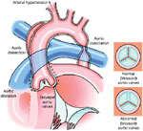
Coarctation of Aorta PREVALENCE
COA occurs in 8% to 10% of all cases of CHD
(male-female ratio of 2:1)
Among patients with Turner 's syndrome, 30% have COA
Notes:
70% bicusid AV

Slide 79
Definition
Coarctation is defined as a narrowing of the lumen of the aorta that obstructs flow.
Bicuspid aortic valve is frequently associated with coarctation of the aorta
Post obstructive dilataion
Collateral develops between proximal and distal vessels

Slide 80
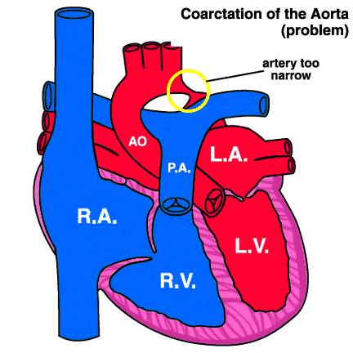
Mostly involving thoracic Aorta distal to subclavian artery, proximal to ductus

Slide 81
Blood pressure
Difference in systolic blood pressure between the upper and lower extremities
The classic findings are
hypertension in the upper extremities,
diminished or delayed femoral pulses,
low or unobtainable arterial blood pressure in the lower extremities.
The mechanical obstruction to flow is responsible for the elevation of blood pressure in the upper extremities.
Renal hypoperfusion may lead to enhanced renin secretion and subsequent volume expansion
Volume expansion produces a further elevation in blood pressure restoring renal perfusion and renin secretion toward normal.

Slide 82
Manifestations according to age Neonates with mild COA
Asymptomatic if PDA is patent or coarctation is not severe.
On examination, absent or delayed femoral pulse is diagnostic.
A murmur may be associated with other cardiac defects, such as PDA, AS, or VSD.
Differential cyanosis is seen in a neonate with severe coarctation of the aorta and a large PDA with a R-to-L shunt.

Slide 83
Manifestations according to age Neonates with sever COA
A neonate with may present with heart failure or shock when the ductal tissue constricts.
These children are
pale
irritable
diaphoretic
and dyspneic
with absent femoral pulses
they often have hepatomegaly
The pulses may be poor in all four extremities.
DDX of neonatal shock:
severe coarctation,
dilated cardiomyopathy,
sepsis, and metabolic abnormalities.

Slide 84
Manifestations according to age Older infants and children
Most remain asymptomatic, resulting in delayed diagnosis.
Symptoms are chest pain with exercise, cold extremities, and claudication.
Heart failure rarely occurs beyond the neonatal period.
Differential pressures between the upper and lower extremities or pulse delay in the lower extremities.
May present with hypertension, and/or murmurs resulting from collaterals or associated heart defects
Notes:
Murmur = lt subclavicular sys murmur + left inferioe scapular murmur

Slide 85
Manifestations according to age Adults
In previously undiagnosed adults, the classic presenting sign is hypertension.
Despite the variability in blood pressure in the upper and lower extremities, regional blood flow is generally maintained within normal limits by autoregulatory vasoconstriction in the hypertensive areas and vasodilation in the hypotensive areas
Most patients are asymptomatic unless severe hypertension is present leading to headache, epistaxis, heart failure, or aortic dissection. In addition, claudication occurs due to reduced flow to the lower extremities.

Slide 86
Cardiac examination
Ejection systolic click and a systolic ejection murmur from a bicuspid aortic valve, that is heard best at the apex.
A short midsystolic murmur at the left paravertebral interscapular area, due to flow across the narrow coarctation area.
Continuous murmurs may be caused by flow through large collateral vessels.

Slide 87
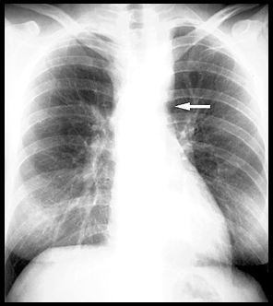
CXR
Absence of the proximal descending aortic arch shadow (arrow)
Another plain radiographic finding, not seen in this example, include notching of the posterior thoracic ribs.

Slide 88
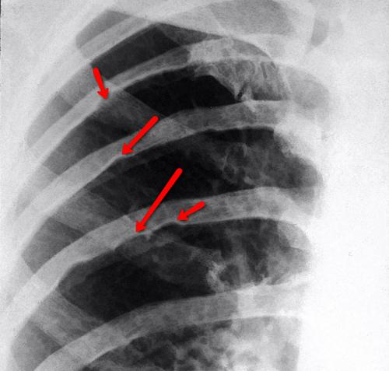

Slide 89
Management
Surgery = excision anastamosis
Balloon angioplasty

